Slide 1
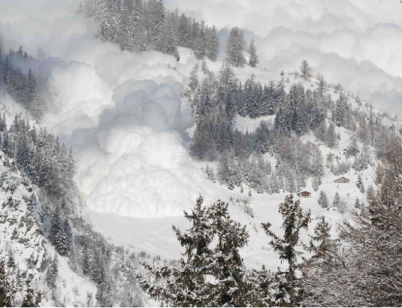
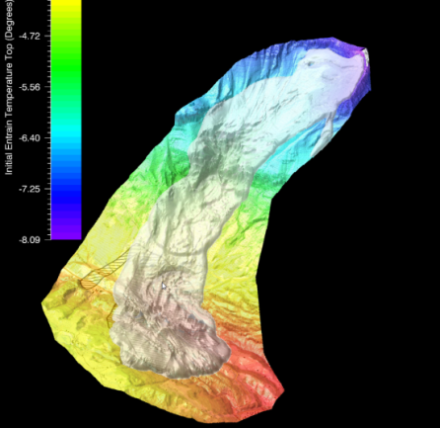
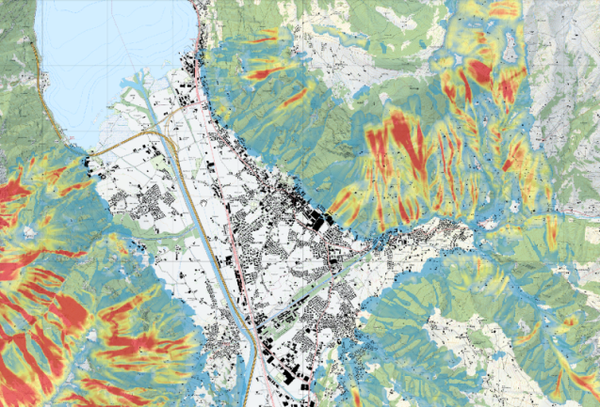
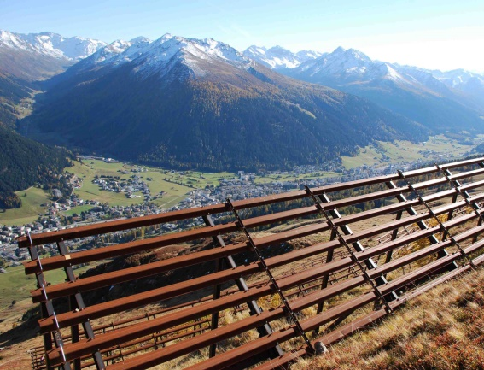
From Large Scale Hazard Mapping to Avalanche Risk Assessment
CLIMADA and RAMMS
Gregor Ortner^{1,2}, Michael Bruendl¹, David N. Bresch^{2,3}, and Yves Bühler¹
¹ WSL Institute for Snow and Avalanche Research SLF, Davos, Switzerland
² Institute for Environmental Decisions, ETH Zurich, Zurich, Switzerland
³ Federal Office of Meteorology and Climatology MeteoSwiss, Zurich, Switzerland

Slide 2
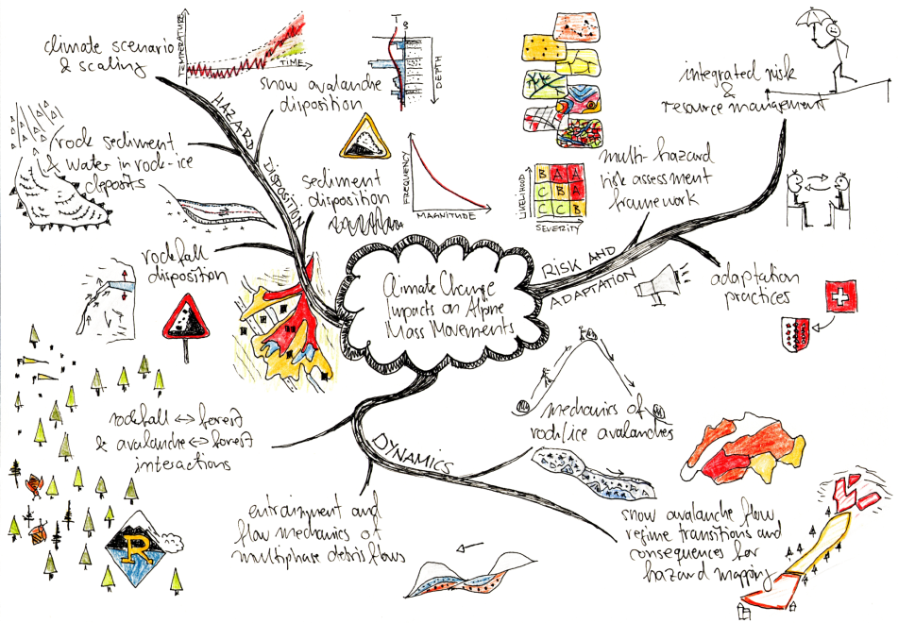
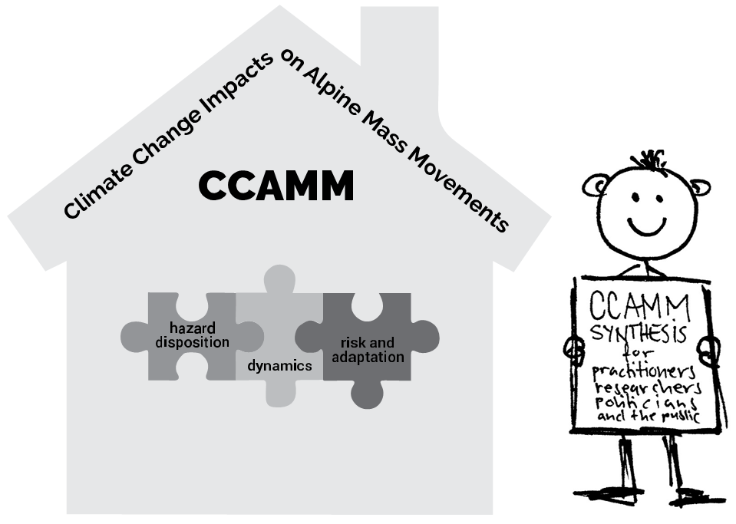



CCAMM - A WSL research program
WP III risk and adaptation
© Alexander Bast

Slide 3
Overall objective of the work
The development of a risk-based approach to illustrate the impact of climate change on multiple alpine hazards and the associated changes in risk on a large scale.

Slide 4
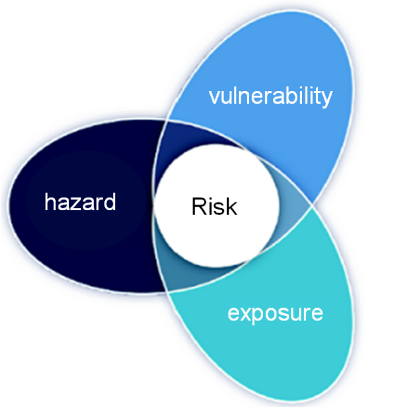
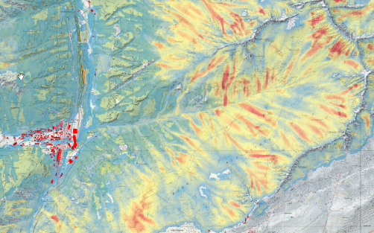
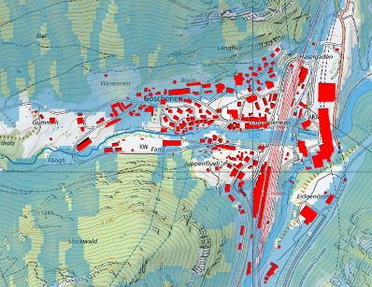
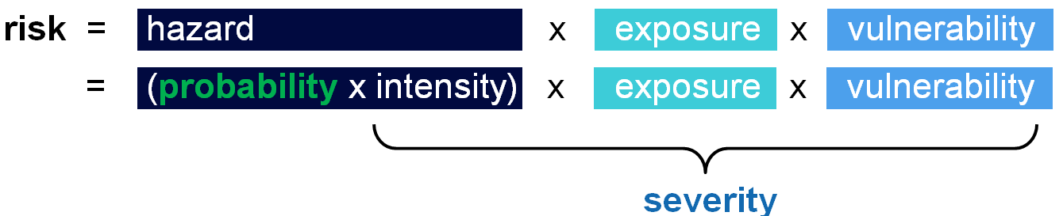
Introduction – Risk
risk = probability x severity
x
damage
x
intensity
Modified According to:
(Aznar-Siguan and Bresch, 2019) and (IPPCC 2014)

Slide 5
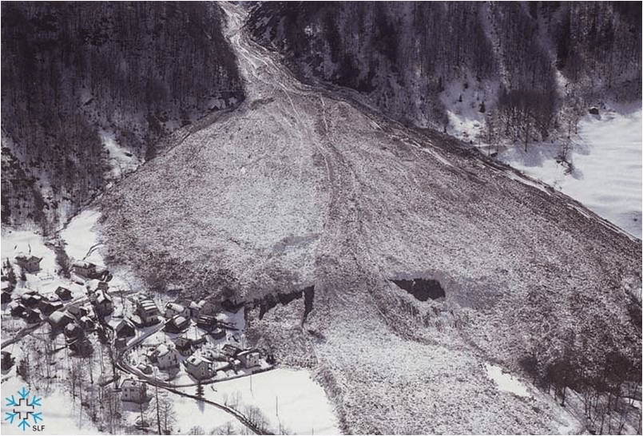
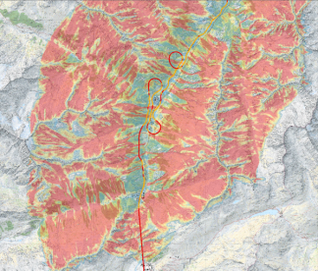
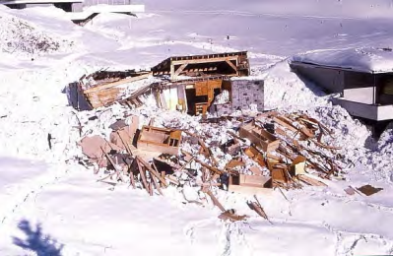
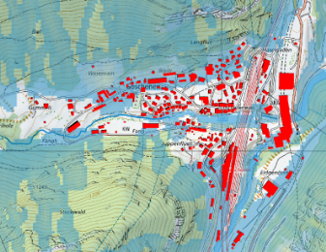

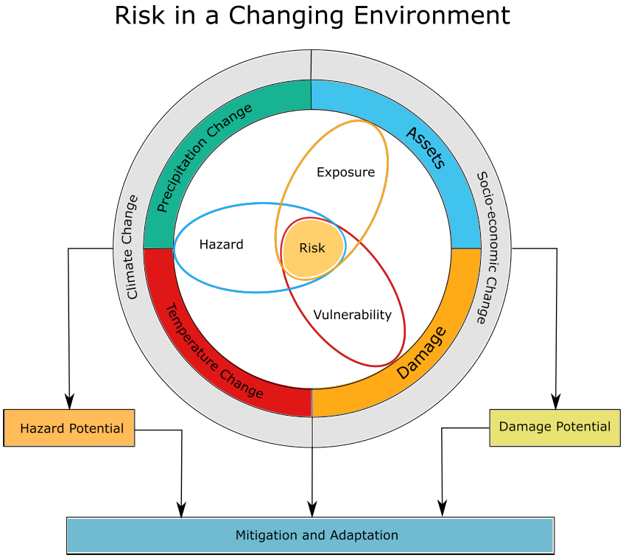
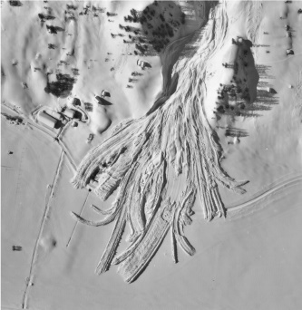
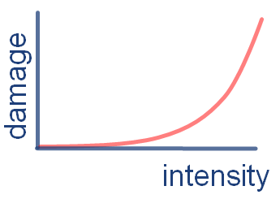
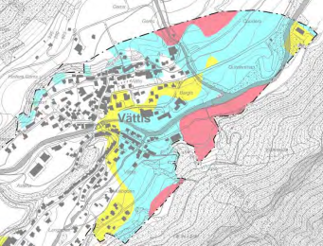

Introduction - Risk and climate change
Release volumes
Intensity
Impact
Exposure
Flow regimes
Vulnerability
Hazard Maps / Adaptation
Mitigation
Grafics Modified According to:
(Aznar-Siguan and Bresch, 2019) and (IPPCC 2014) Picture Origin: SLF

Slide 6
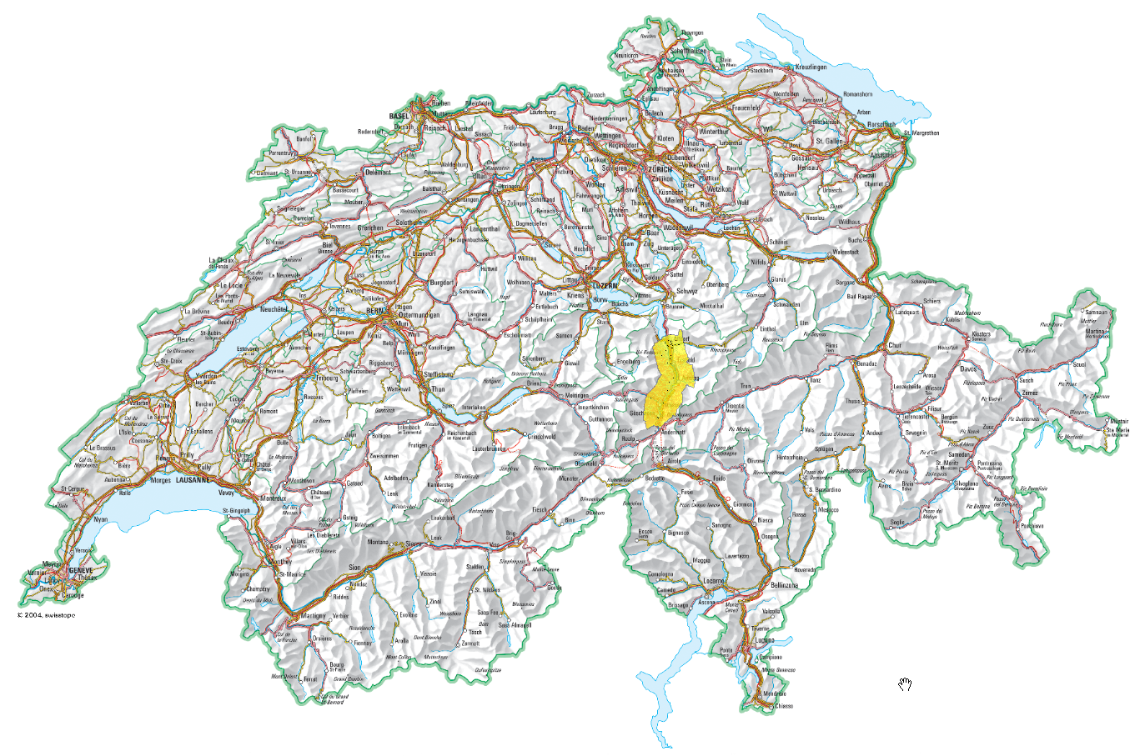
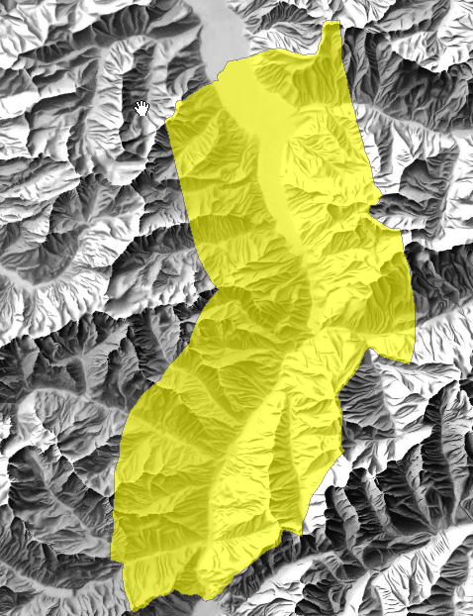
Testsite Altdorf – Göschenen
Altdorf
Göschenen
Swiss map with Test site perimeter (base layer: swisstopo, topomaps CH1mio str)

Slide 7
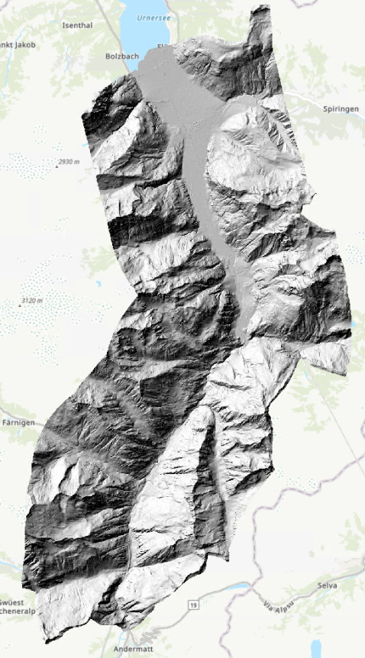
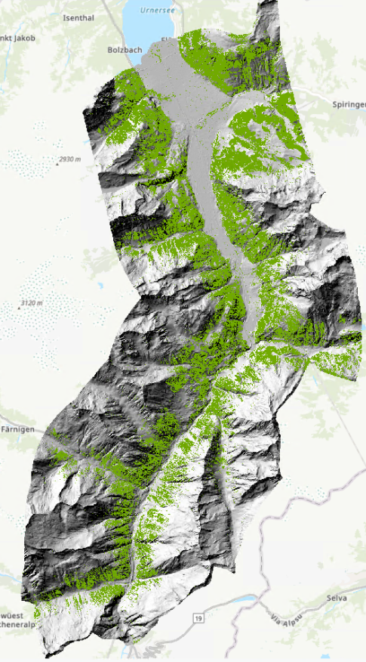
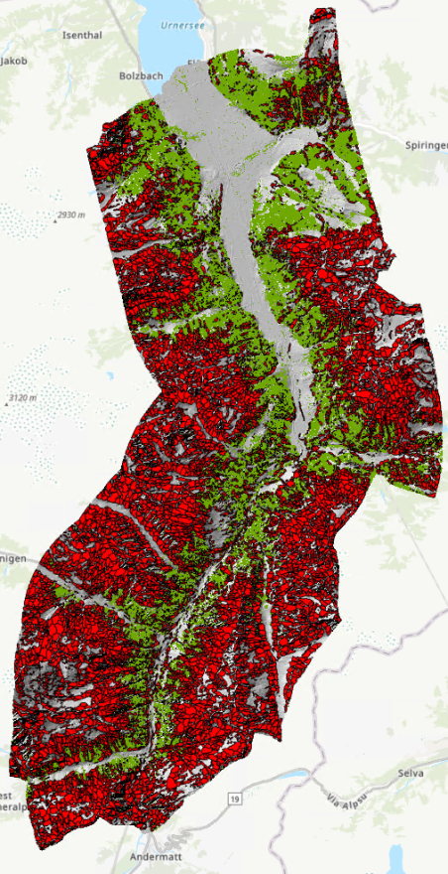
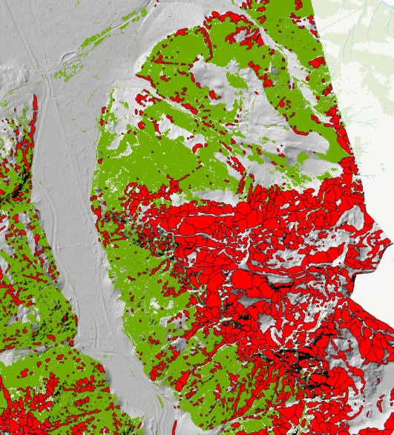
Production of potential release areas
Altdorf
Altdorf
Altdorf
Digital
Vegetation
Model
Digital Elevation Model
Potential Release Areas
Göschenen
Göschenen
Göschenen
PRA for four different anual scenarios were produced : 10y 30y 100y 300y
Bühler, Y. and von Rickenbach, D. Automated snow avalanche release area delineation – validation of existing algorithms and proposition of a new object-based approach for large-scale hazard indication mapping, Nat. Hazards Earth Syst. Sci., 18, 3235–3251, 2018

Slide 8
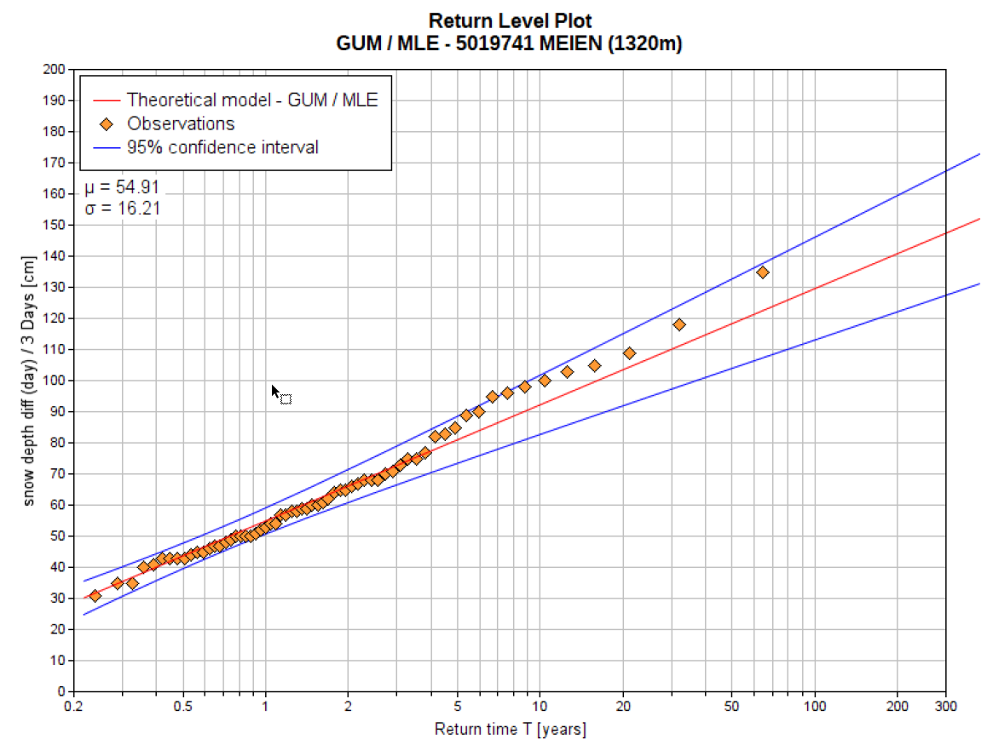
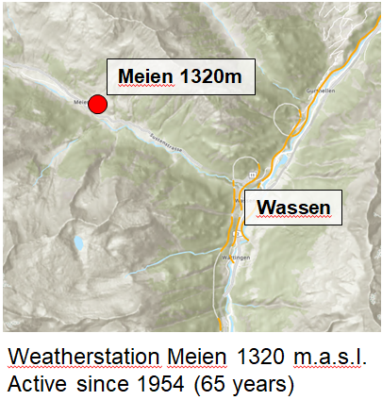
Snow precipitation - return periods
Avalanche volume - delta HS - 3 days
Annuality [y] | dHS3 [cm]
10 | 92.2
30 | 110.1
100 | 129.6
300 | 147.4
dHS3 Meien Origin: EVA+
GUM/MLE Plot Meien Origin: EVA+

Slide 9
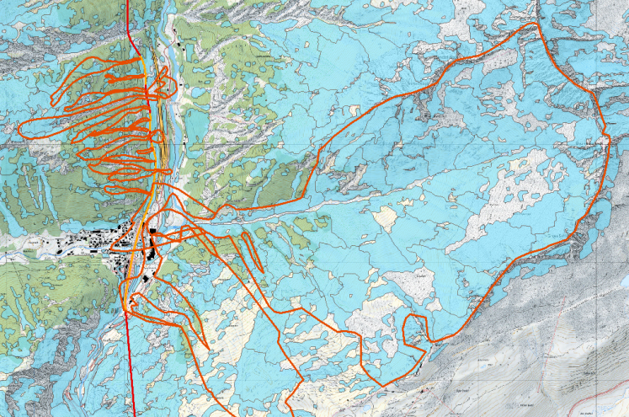
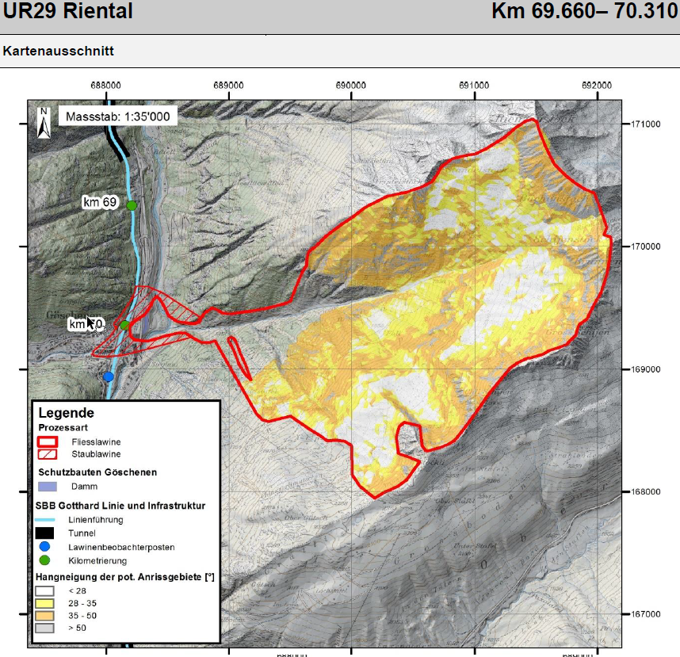


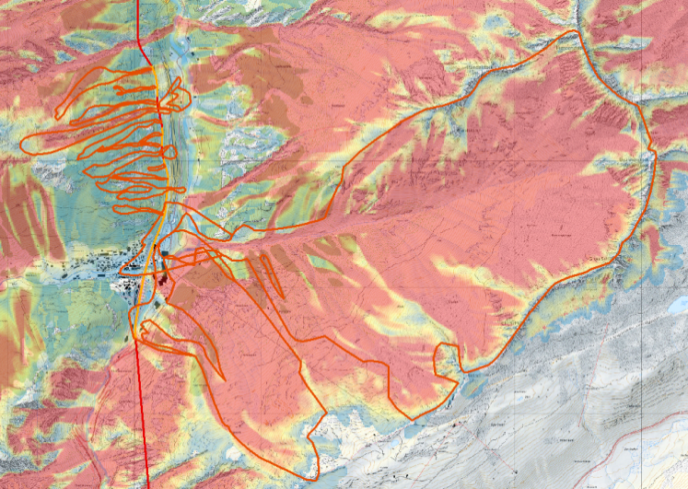
RAMMS - Large scale hazard mapping - comparison
Fig.19: PRA 300y Fig.18 RAMMS sim. 300y
Fig.20: «Factsheet Lawienenzüge SBB Riental»

Slide 10
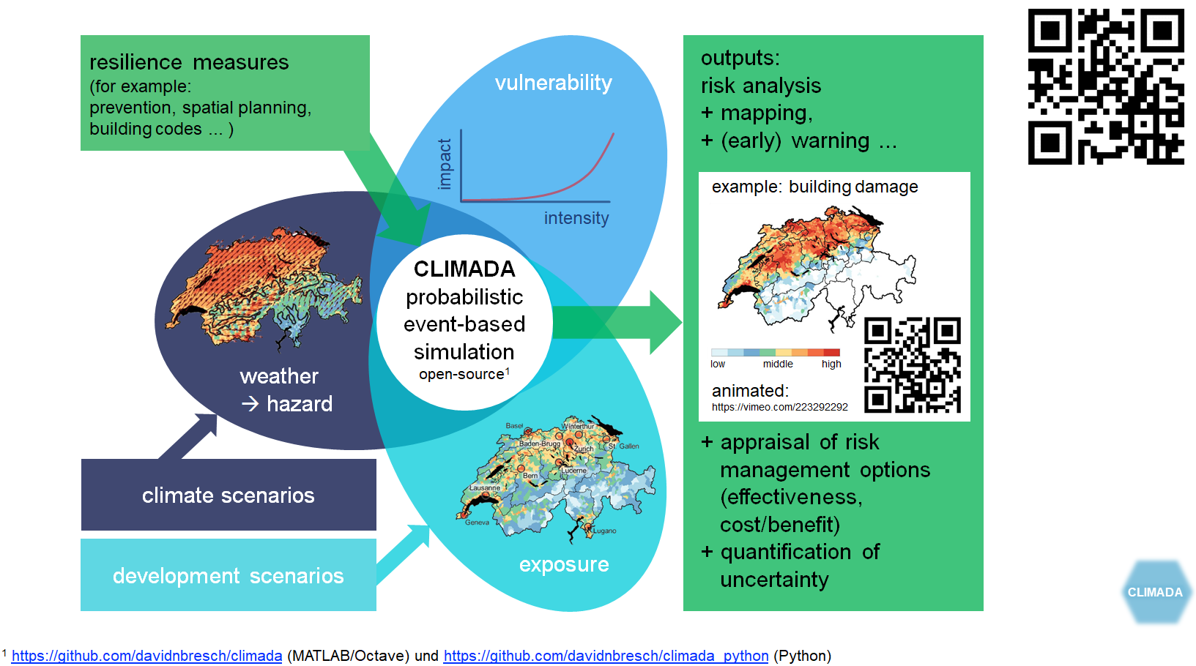
CLIMADA – Probabilistic Risk Tool
According to: Aznar-Siguan and Bresch, 2019

Slide 11

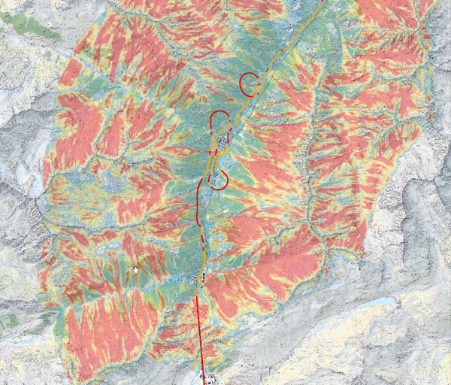

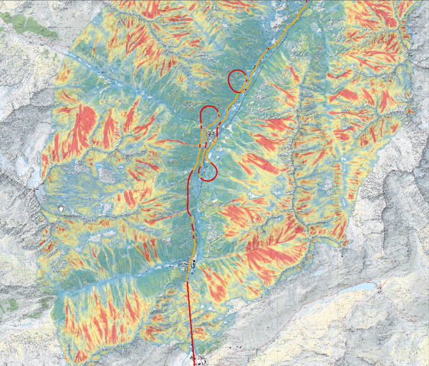
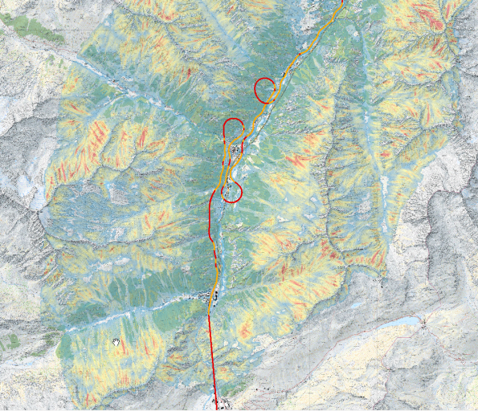


Modelling of four different annual scenarios for the current climate conditions
300 years
100 years
Extreme
30 years
10 years
Frequent

Slide 12
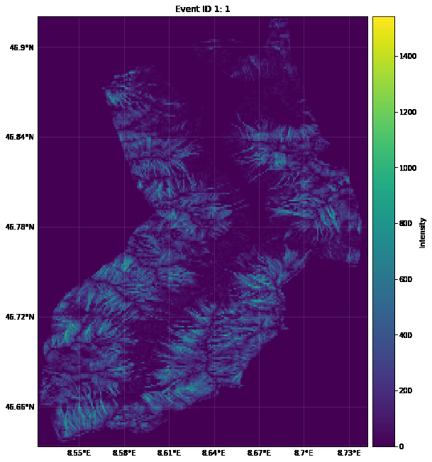
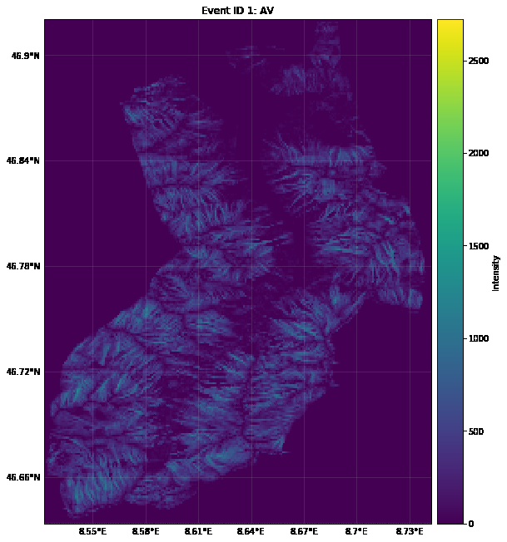
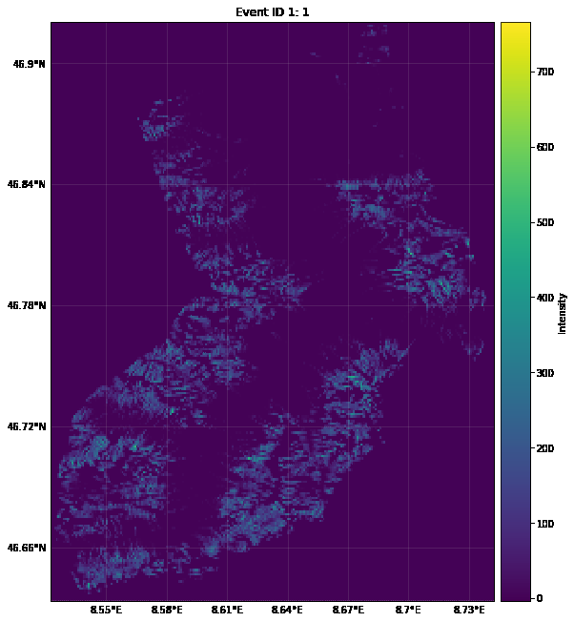
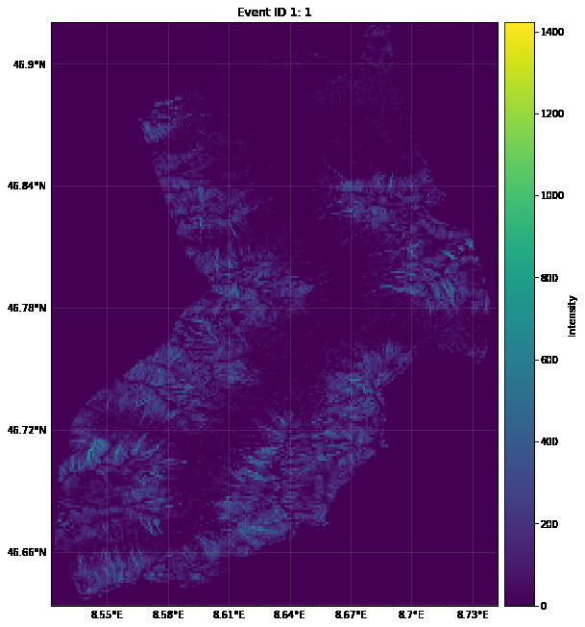
Intensity maps for all scenarios – CLIMADA
(Avalanche pressure kPa)
Extreme
Frequent
300 years
100 years
30 years
10 years

Slide 13
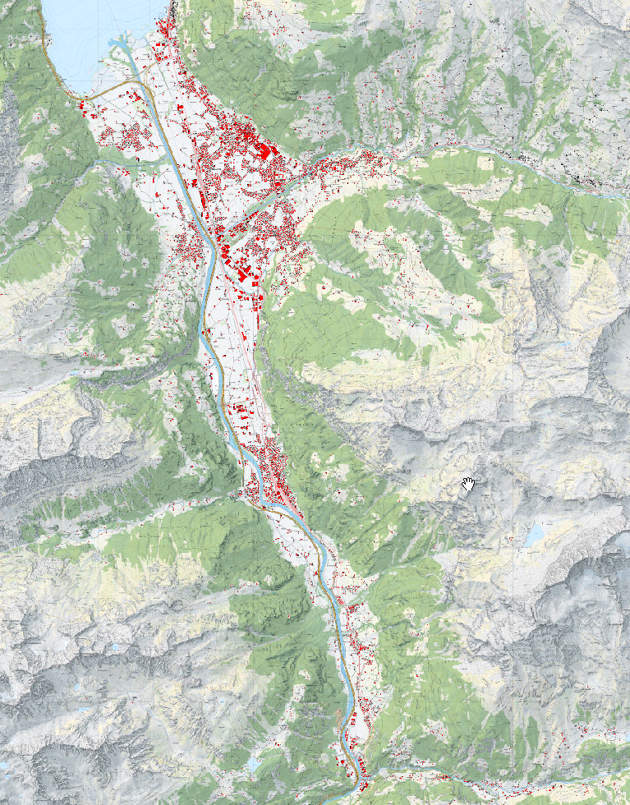
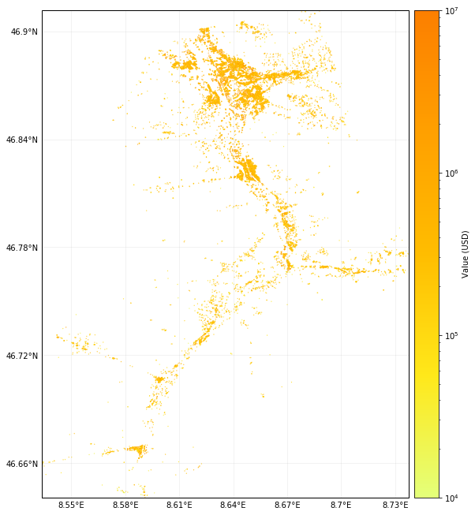
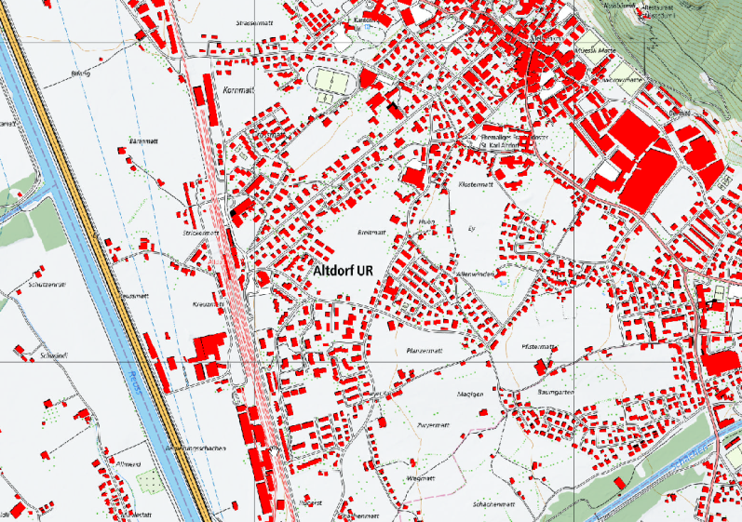
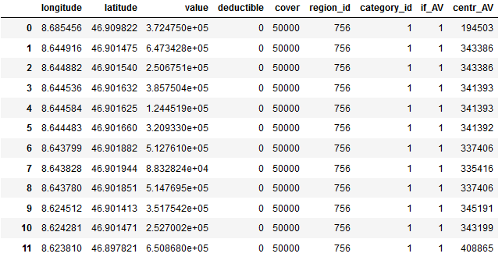
Entity – Buildings: based on central point per house
Source: swisstopo (swissBUILDINGS)

Slide 14
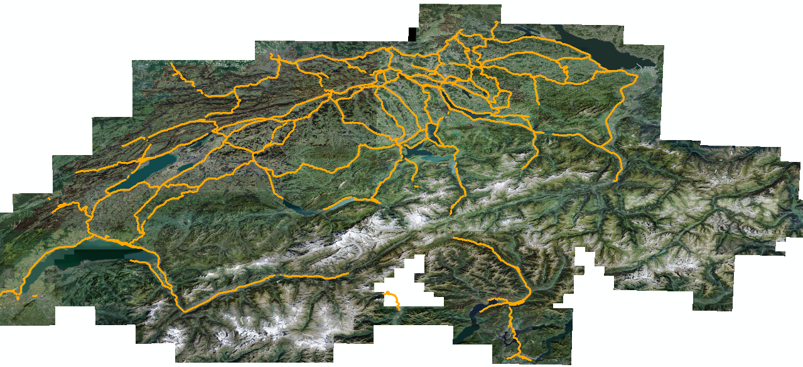
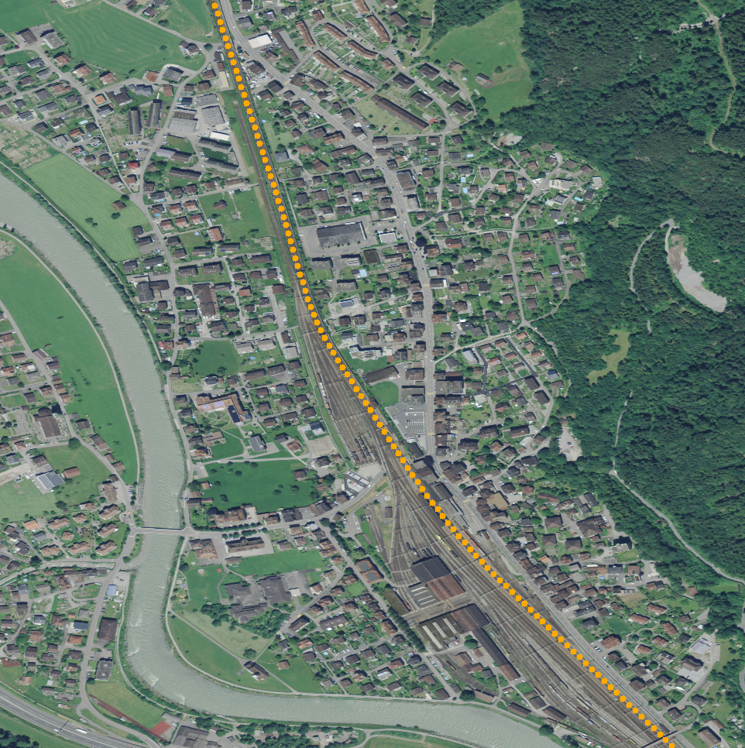
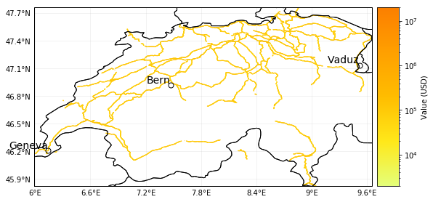
Exposure – Swiss Rail network as points

Slide 15
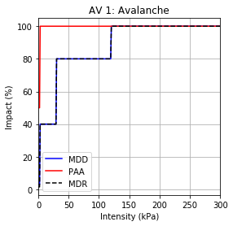
Impact function - Buildings
Mean Damage Degree (MDD)*
0 kPa – 3 kPa = 3% (windows)
3 kPa – 30 kPa = 40% (brick walls)
30 kPa – 120 kPa = 80% (concrete walls)
>120 kPa = 100% (fundations)
Percentage Affected Assets (PAA)
0 kPa – 3 kPa = 50%
>3 kPa – 30 kPa = 100% (due to very detailed assets locations)
*Based on “apartment house” within EconoMe :https://econome.ch/eco_work/temp/doku_Objekte_1566392229.pdf

Slide 16
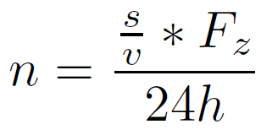
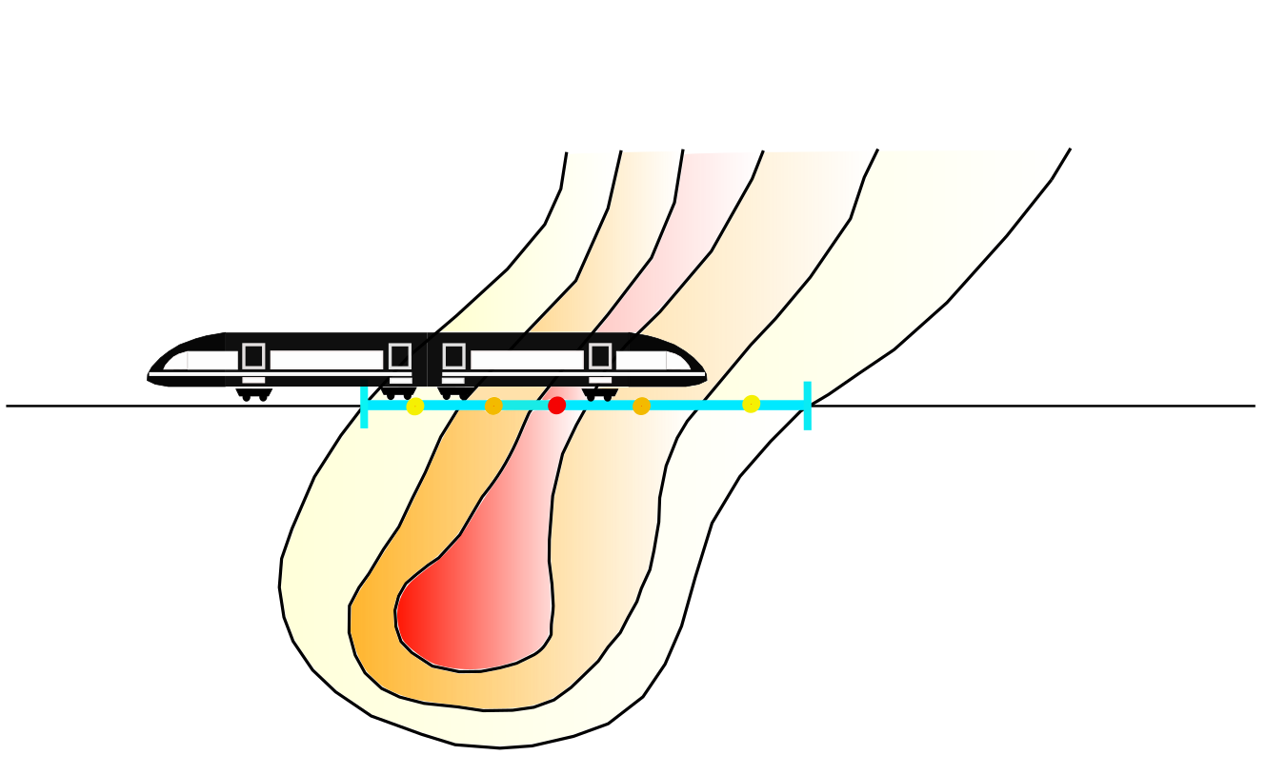
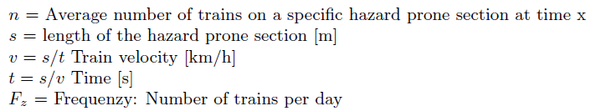
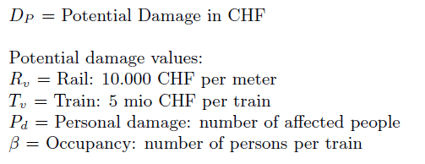
Impact – Rail network

Slide 17
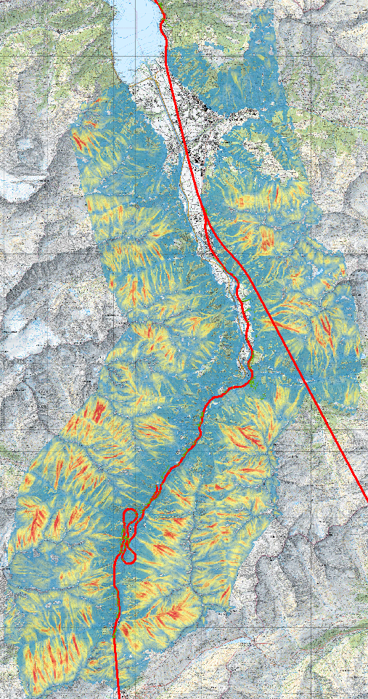


Hazard - RAMMS LSHM single avalanche

Slide 18








Calculated damage for chosen scenarios
Altdorf

Slide 19





Future outlook
How can the impact of climate change on snow avalanches be considered in hazard scenarios and integrated into risk assessment ?
+
=>
Δ Climate change input = Δ 3day snow hight for 2040 and 2080
RAMMS and RAMMS::Extended
Visualisation of changed risk in CLIMADA

Slide 20
Thank you for your attention

Slide 21
References
Aznar-Siguan, G. and Bresch, D. N. (2019). CLIMADA v1: a global weather and climate risk assessment platform. Geoscientic Model Development, 12(7):3085{3097.
Bartelt, P., Christen, M., Buhler, Y., C., and Buser, O. (2019). Simulation of Mixed Flowing/ Powder Avalanches with RAMMS::Extended. Internal Paper, WSL Institute for Snow and Avalanche Research, SLF Davos Dorf, Switzerland.
Buehler, Y., von Rickenbach, D., Stoel, A., Margreth, S., Stoel, L., and Christen, M. (2018). Automated snow avalanche release area delineation - validation of existing algorithms and proposition of a new object-based approach for large-scale hazard indication mapping. Natural Hazards and Earth System Sciences, 18(12):3235{3251.
CH (2018). CH2018 Climate Scenarios for Switzerland. Technical report, National Centre for Climate Services, Zurich, 271 pp.
EconoMe Consortium (2019). EconoMe 4, Wirtschaftlichkeit von Schutzmassnahmen gegen Naturgefahren. Brundl, M. Zaugg-Ettlin, L. Burkard, A. Oggier, N. Winkler, C. Dolf, F. Gauderon, A. Salz, M. Krummenacher, B. Gutwein, P. Hauser, M. Baumann. R. Loup, B. Nigg, U. Gertsch-Gautschi, E. Schertenleib, A. EconoMe Objektparameter Tabelle: https://econome.ch/eco work/temp/doku Objekte 1558890663.pdf last access: 7 August 2019.
Harvey, S., Schmudlach, G., Buhler, Y., Durr, L., Stoel, A., and & Christen, M., editors (2018). Avalanche terrain maps for backcountry skiing in Switzerland. ISSW, International snow science workshop.
IPCC (2014). Climate Change 2014: Impacts, Adaptation and Vulnerability. Part A: Global and Sectoral Aspects. Contribution of Working Group II to the Fifth Assessment Report of the Intergovernmental Panel on Climate Change, edited by: Field, C. B., Barros, V. R., Dokken, D. J., Mach, K. J., Mastrandrea, M. D., Bilir, T. E., Chatterjee, M., Ebi, K. L., Estrada, Y. O.,
Swisstopo (2019). Produktinformation swiss BUILDINGS3D 2.0. Technical report, Schweizerische Eidgenossenschaft, Bundesamt für Landestopogrie Swisstopo.
Veitinger, J., Purves, R. S., and Sovilla, B. (2016). Potential slab avalanche release area identi-cation from estimated winter terrain: a multi-scale, fuzzy logic approach. Natural Hazards and Earth System Sciences, 16(10):2211{2225.

