Slide 1

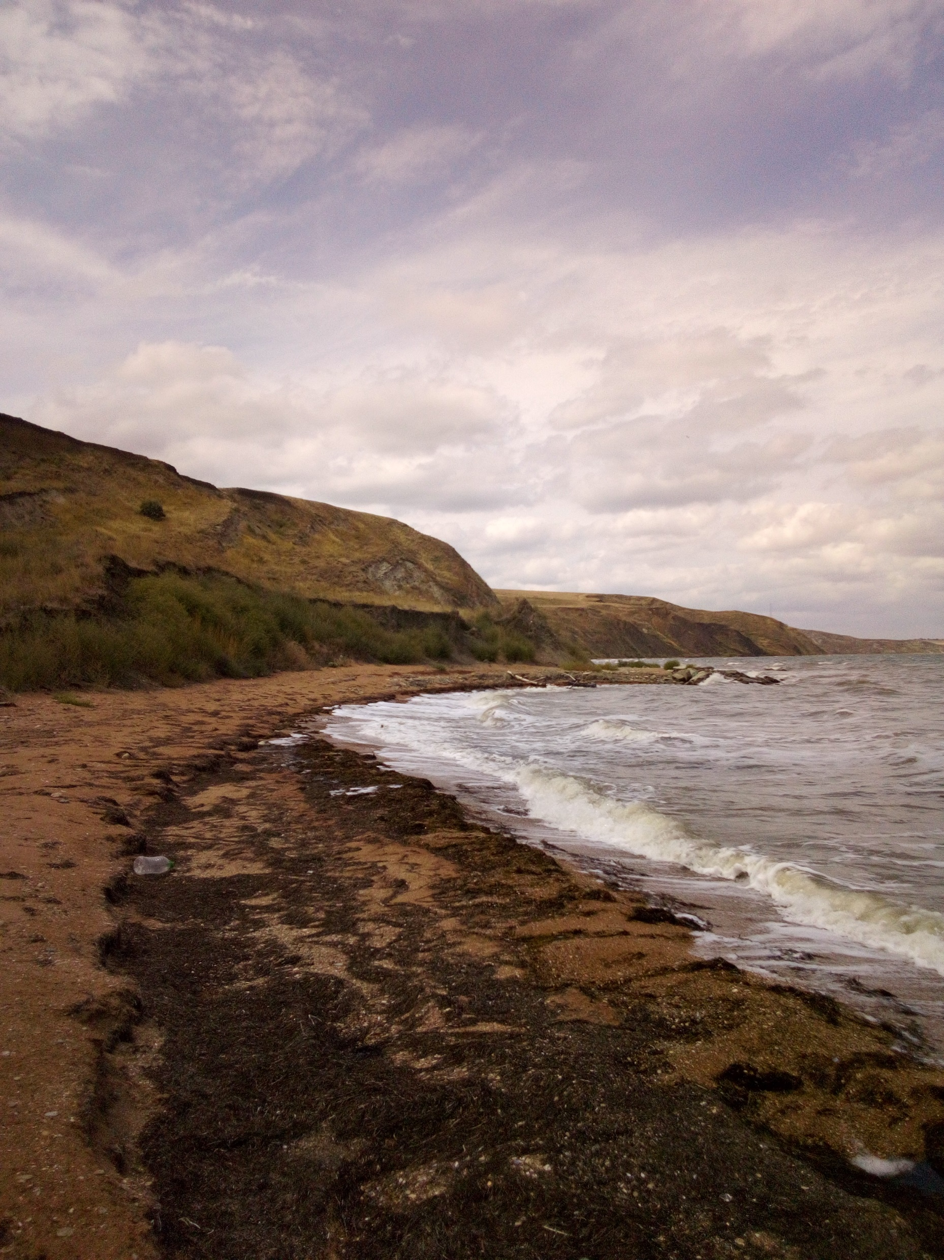



Paleomagnetic investigation of the Tarhanian deposits of Kop-Takyl section (Kerch peninsula, Crimea)
Olga Pilipenko^{1, 3},
Juliana Rostovtseva^{2, 3},
Eugeniya Filina³
(1) Schmidt Institute of Physics of the Earth RAS, Moscow
(2) Geological Department of the Lomonosov State University, Moscow;
(3) Geophysical Center RAS, Moscow
Online | 4–8 May 2020

Slide 2
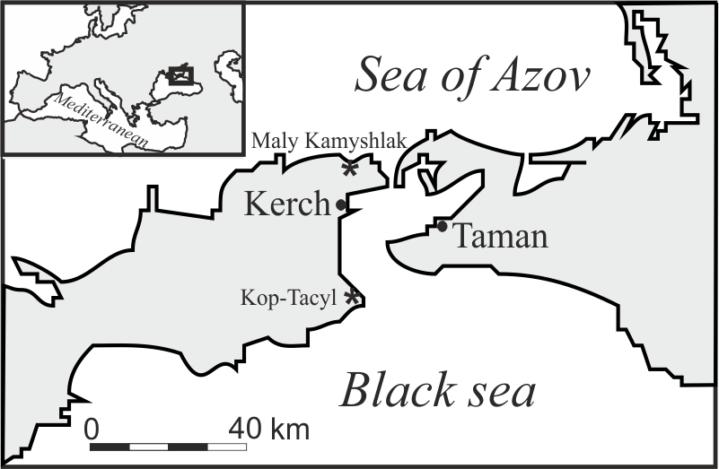
With the goal to provide the new magnetostratigraphic investigations of the Miocene marine deposits of the Black Sea Basin the forty-four oriented hand blocks of the Kop-Takyl section (45º10′N, 36º44′ °E, Kerch peninsula, Crimea) were collected during summer 2019 field work.

Slide 3
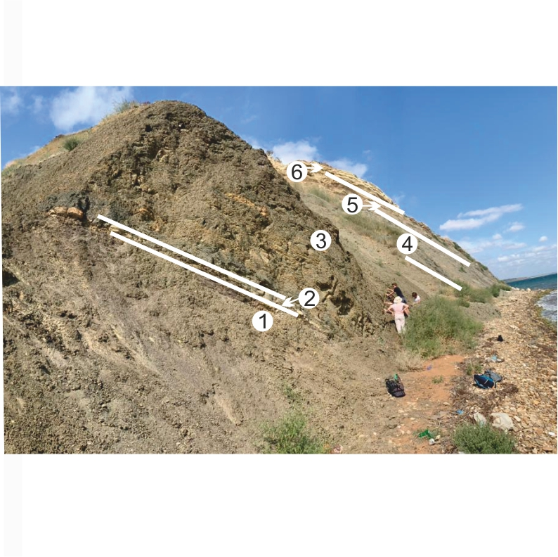
The section is composed mainly of clays, has a total thickness of ~ 53 -56 m and covered the Tarhanian stratigraphic interval
The studied sediments in the Kop-Takyl section are subdivided on next layers upwards:
1. Dark gray (up to black) clays, laminated, with jarosite, with a landslide at the base ~ 4 м.
2. Light grey carbonate layer (“Tarkhanian marlstone”), fine-grained, lenticular, with mollusk shells Lentipecten corneus denudatus ~ 0. 2 m.
3. Dark grey clays, laminated, with local pyritization, calcareous at the base (3-4 m), with rare mollusk shells, with thin sandy interlayers in the middle part, with separate carbonate nodules and layers in the top ~ 33-34 m.
4. Grey-green clays, laminated, with beds of carbonate rocks, in the upper part with an abundance of pteropod shells (spiratella) ~ 10-11 m.
5. Interbedding of grey-green laminated clays with carbonate rocks ~ 5-6 m.
6. Interbedding of carbonate rocks, carbonates with signs of local secondary dolomitization 1-1.2 m.
Коp-Такyl
(a)
1
2
3
4
5
6

Slide 4
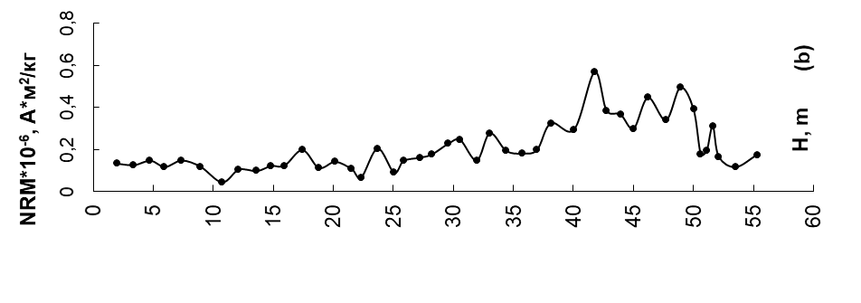
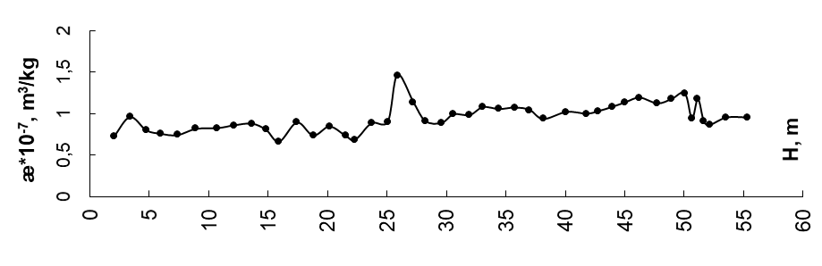
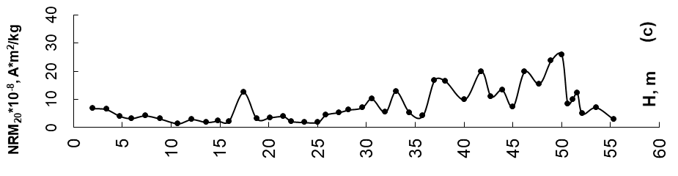
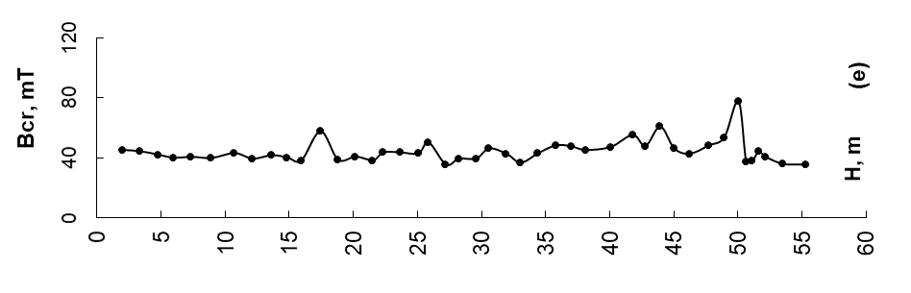
Standard paleomagnetic measurements have been performed to establish a new magnetostratigraphic record for the Kop-Takyl section
1 - clay
2 - calcareous clay
3 - clay with thin sandy layers
4 - carbonate nodules
5 - carbonate layers
6 - layer boundaries
1
2
3
4
5
6

Slide 5
The composition of the ferromagnetic fraction was examined using three methods of thermomagnetic analyzes: dependences of saturation magnetic moment on temperature. Bold line is the curve of the first heating, thin line is the curve of the second heating.

Slide 6
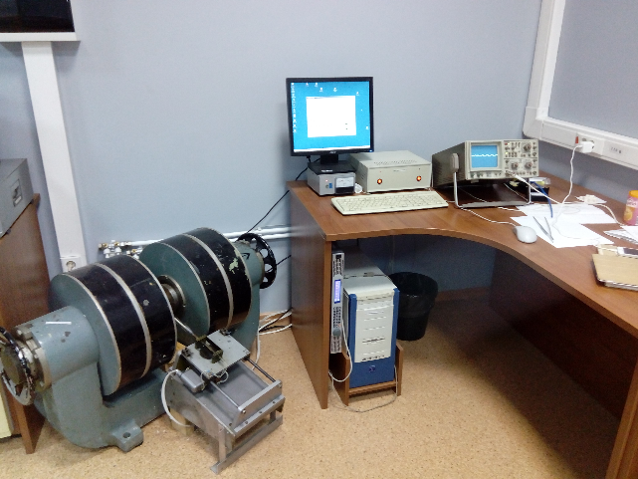
The thermomagnetic analysis of dependence of the saturation magnetic moment from the temperature and determination of the Curie points were carried out using Vibration Magnetometer ( Orion, Russia)

Slide 7
Dependences of saturation remanent magnetic moment on temperature. Thermo magnetic analyzes showed that the low concentration of magnetite and monoclinic pyrrhotite are the main carrier of the natural remanent magnetization NRM. The bold line – first heating, thin line- second heating.

Slide 8
Dependences of magnetic susceptibility on temperature

Slide 9
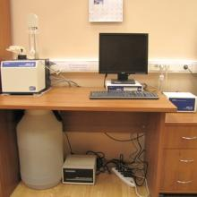
The thermomagnetic analysis of dependences of magnetic susceptibility on temperature and determination of the Curie points were carried out using Multi-Function Kappabridge MFK1-FA ( AGICO, Czech)

Slide 10
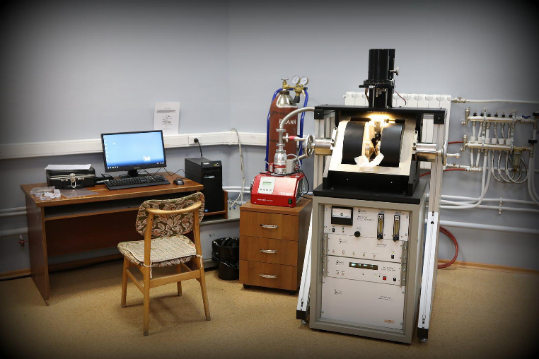
The domain structure of magnetite was determined using the Vibration Sample Magnetometer PMC Micro Mag 3900 ( Lake Shore, USA). The size of ferromagnetic grains of magnetite lies in a pseudo single domain and multi domain area.

Slide 11
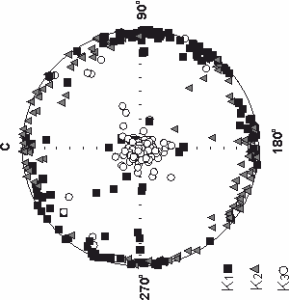
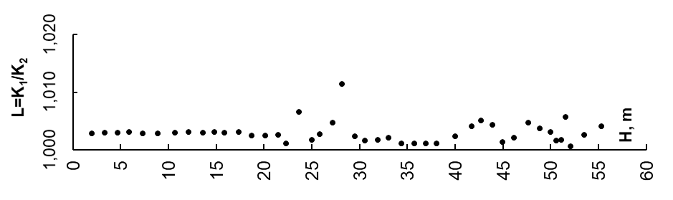
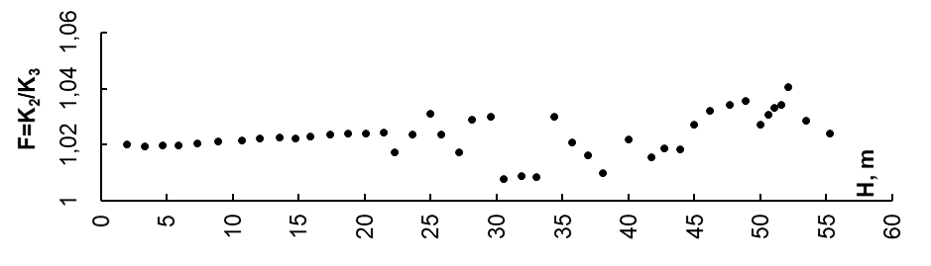
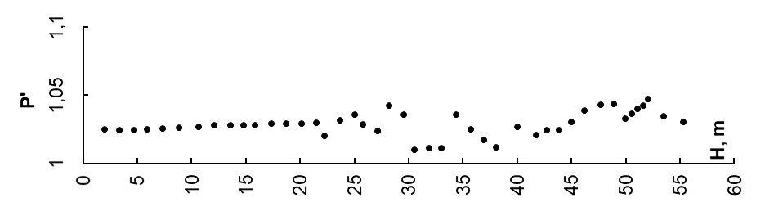
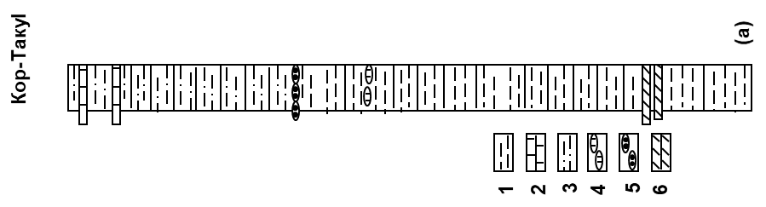
The magnetic susceptibility was measured in 15 directions. It gives the opportunity to estimate the magnetic anisotropy of the magnetic susceptibility. The rock samples have a low planar anisotropy (~ 3%), the shape of the magnetic particles is oblate, which is typical for natural sediments. . The obtained results indicate that the studied sedimentary rocks are characterized by an undisturbed natural structure.

Slide 12
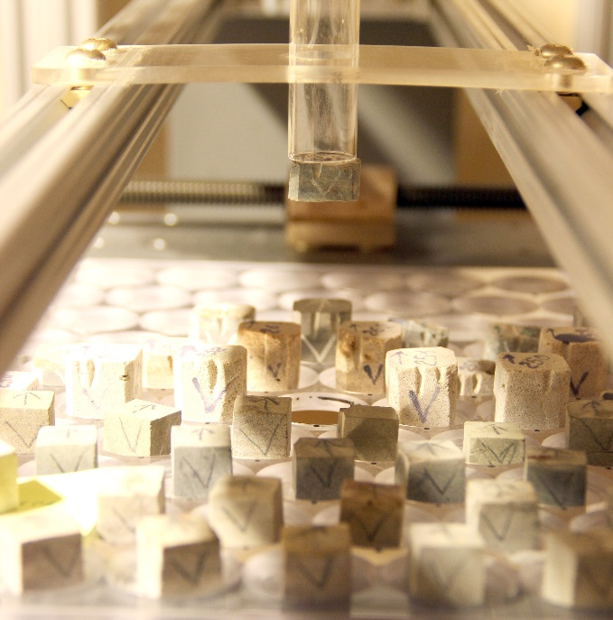
The alternating field demagnetization of the samples (three duplicates from each level) was fulfilled for obtaining NRM vector angle elements using SQUID Magnetometer (2G Enterprieses, USA)

Slide 13
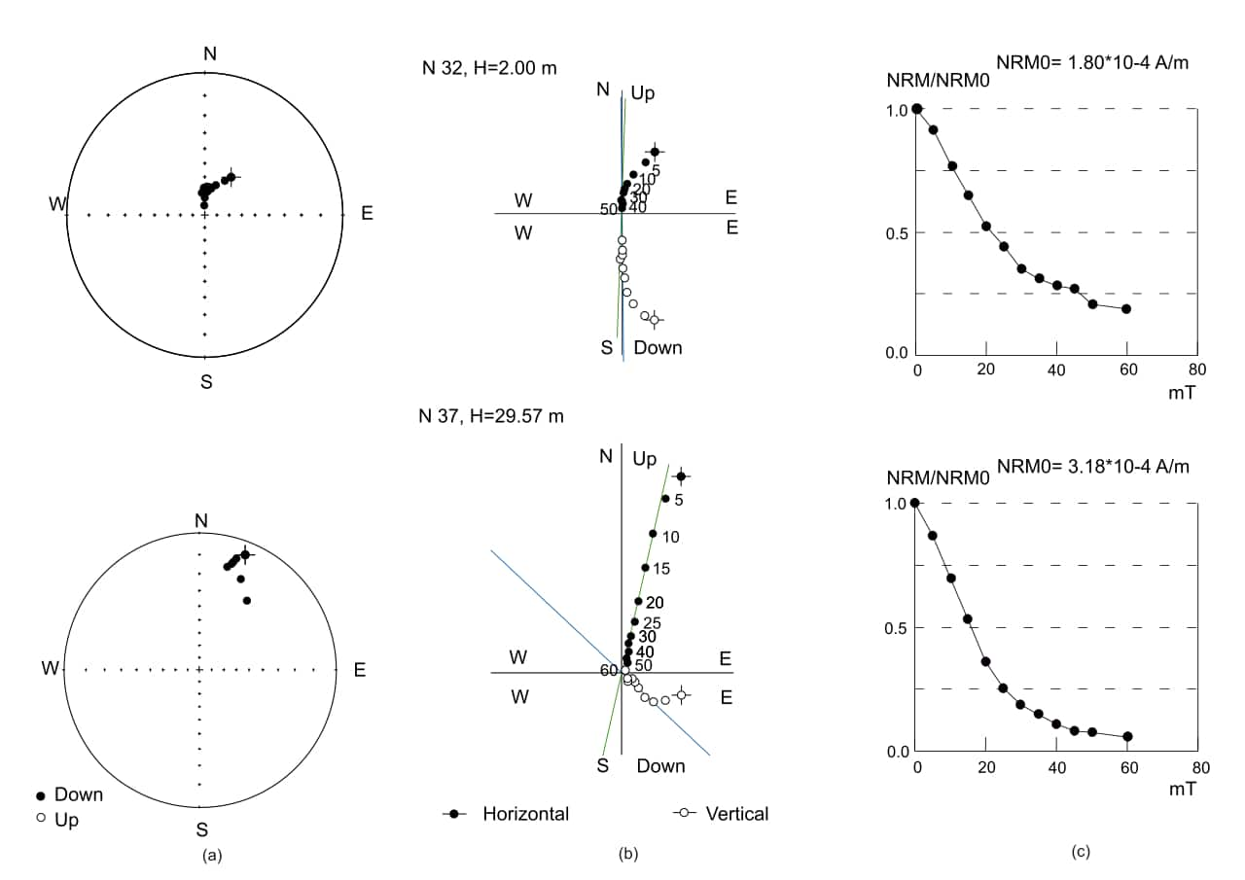
Demagnetization results were analyzed using orthogonal plots and stereographic projections. Polarity components were isolated in most samples between 15-60 mT.

Slide 14
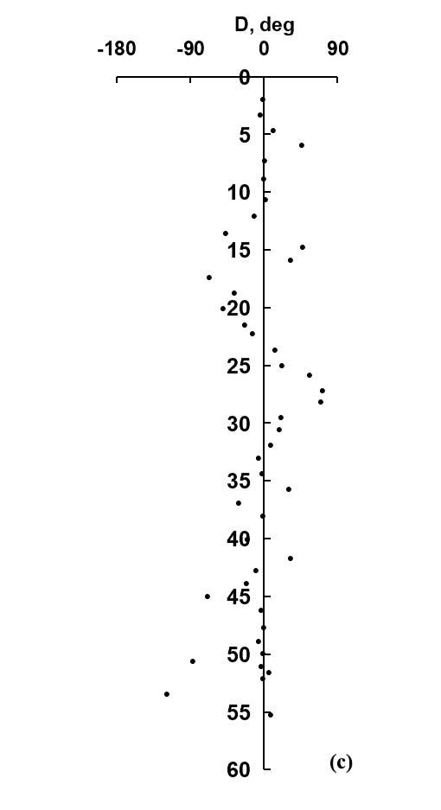
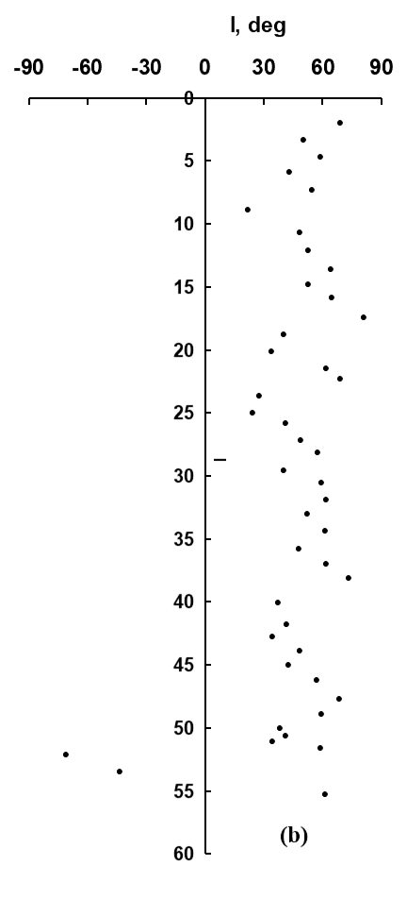
The values of the declination D and inclination I of the NRM satisfactory agree for all three duplicates from each level. This allows to average angle elements and construct curves of I and D variations over the thickness of the section. The lower part (Kuvinian and Terskian beds) of the Tarkhanian is related to the Lower Miocene, and the upper part (Argunian beds) - to the Middle Miocene (Nevesskaya et al., 2004).
Age
Beds
Kop-Takyl
180
270
Argunian
N
Tarkhanian
Terskian
Kuvinian
R

Slide 15
CONCLUSIONS
As a result of petromagnetic and paleomagnetic study of the Tarkhanian sediments of the Miocene of the Kop-Takyl section, it was found that the main carriers of magnetization in the rocks are monoclinic pyrrhotite and a low concentration of magnetite, which lead to low values ​​of natural remanent magnetization. The rocks have an undisturbed natural structure, which suggests the absence of significant secondary transformation of rocks.
It is established that the studied interval of the Kuvinian beds in the lower parts is composed of normal magnetized rocks. In its upper part, rocks have reverse polarity magnetization.
The rocks of the Terskian beds are distinguished by normal polarity magnetization.
If you do not take into account a single point of indeterminate polarity at the base of the Argunian beds, then the sediments of the Upper Tarkhanian are normal magnetized.
This conclusion is in a good agreement with the results obtained by D. Palcu (2019) for the Tarkhanian sediments in the sections of the Belaya and Psheha rivers of the Western Ciscaucasia.

Slide 16
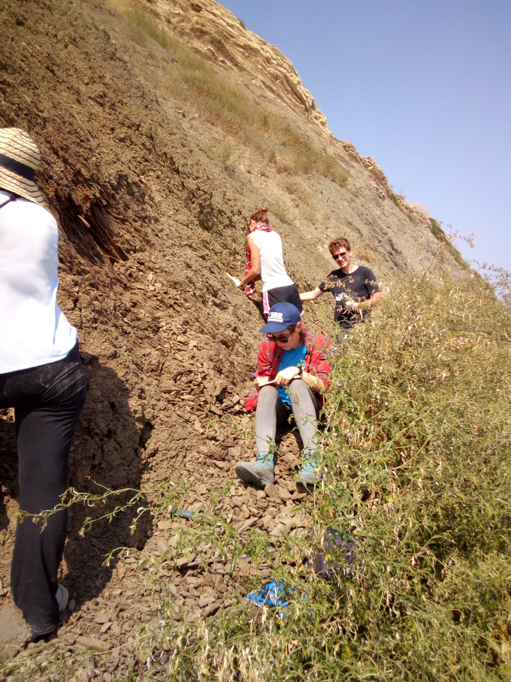
Thank you very much for your attention!
This work was supported by the Russian Science Foundation grant N 19-77-10075

