Slide 1
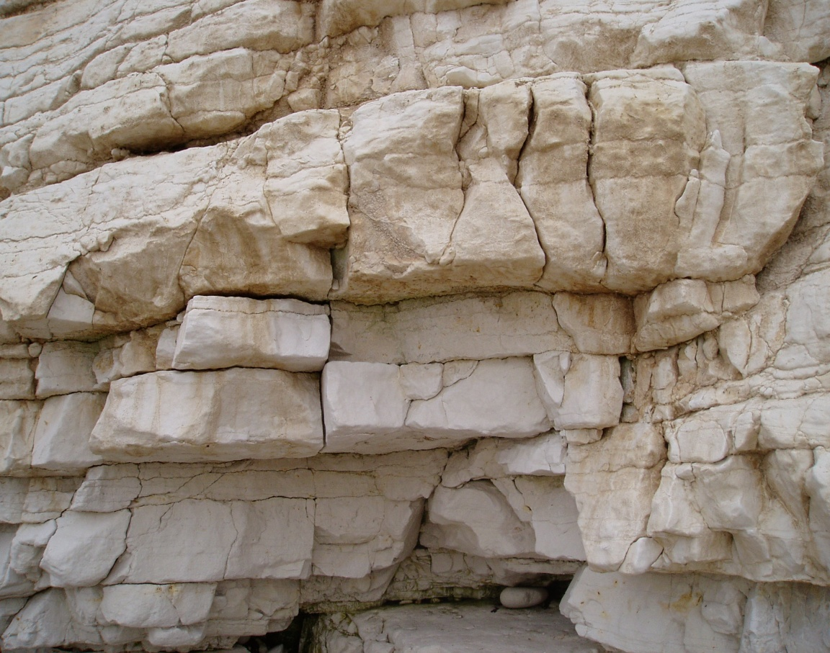
School of Earth and Environment
Characterizing solute transport properties for a fractured carbonate aquifer using open-well dilution tests
South Landing, Flamborough Head
20cm
L. Jared West, Prodeo Y. Agbotui, & Simon H. Bottrell
08 May, 2020

Slide 2
Content and objective
Objective: Demonstrate the use of single open-well dilution tests and a new workflow to characterise transport properties of the Chalk of England, UK.
1. Study area and results of earlier well-to-well tracer tests (Ward et. al., 1998)
2. Theory and implementation of the single-well hydrogeophysical method and new work flow
3. Results and model of dominant horizontal and vertical flow cases and the evaluation of single open-well dilution against other previous tests (well-to-well and flow logging results)

Slide 3
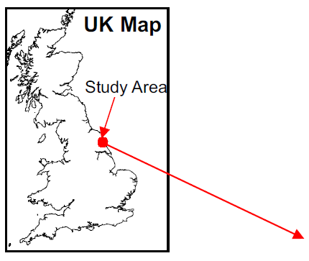
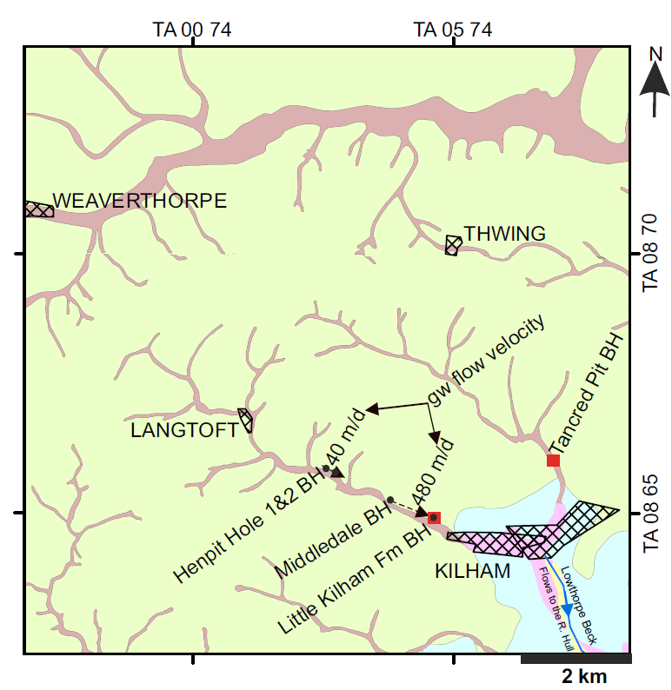
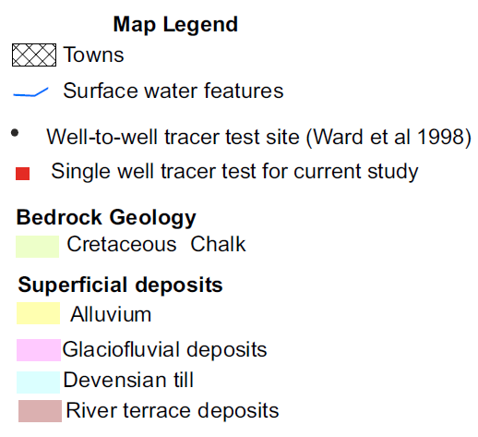
Tick marks on map border indicate 10km grid
Chalk aquifer of East Yorkshire, NE England, UK
©Crown Copyright and Database Right 2020. Ordnance Survey and Geology (Digimap License)

Slide 4
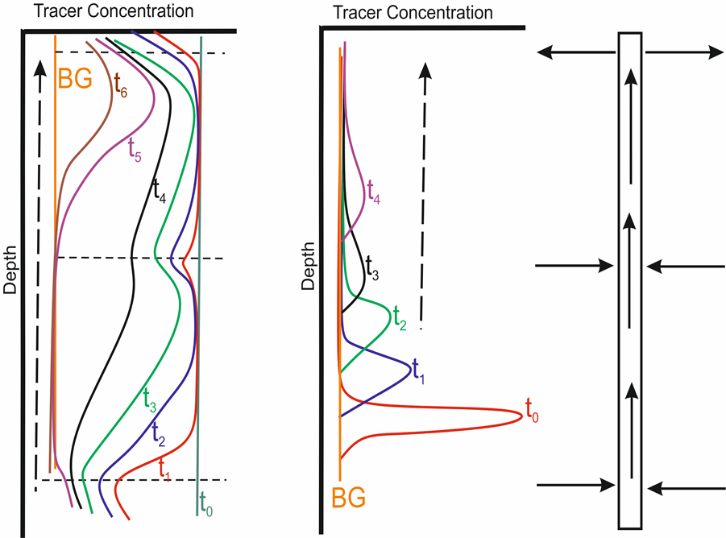
Injection profiles of single open-well dilution tests
$$q_{f}=\frac{q_{w}}{α}= \frac{mπr}{2α}$$
Uniform injection
Point injection
Conceptual model of flow in well

Slide 5
New work flow for conducting and analysing single open-well dilution tests
$$q_{f}=\frac{q_{w}}{α}= \frac{mπr}{2α}$$
Vertical flow dominated work flow route
Horizontal flow dominated work flow route

Slide 6
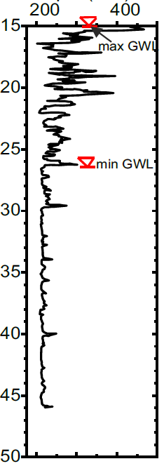
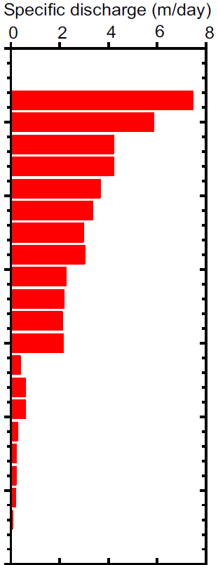
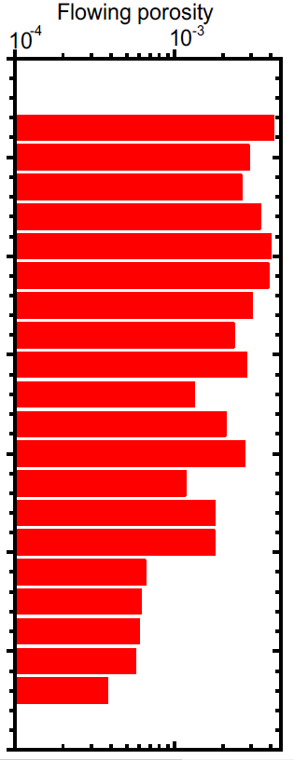
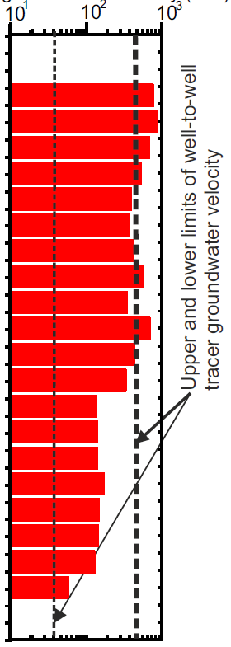
Horizontal flow case - Little Kilham Farm BH (depth 46 m)
Figure 2.1 Chalk outcrop in the United Kingdom and the location of study area.
Caliper log (mm)
[NaCl](g/L)
Specific discharge(m/d)
Flowing porosity
Avg gw velocity
Depth (m bgl)
Large diameter enlargements in zone of water table fluctuation
Specific discharge using Pitrak et al 2007 model
Flowing porosity using the Cubic Law
Evaluation of open-well dilution against well-to-well tracer tests
Uniform injection results

Slide 7
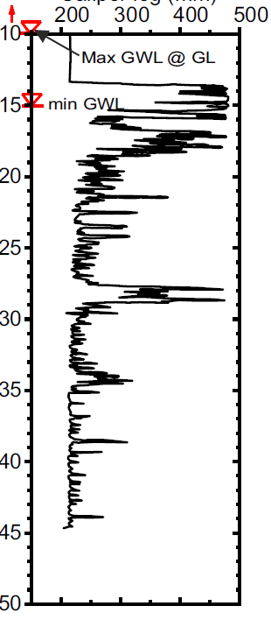
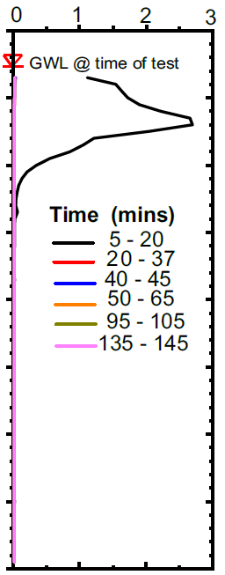
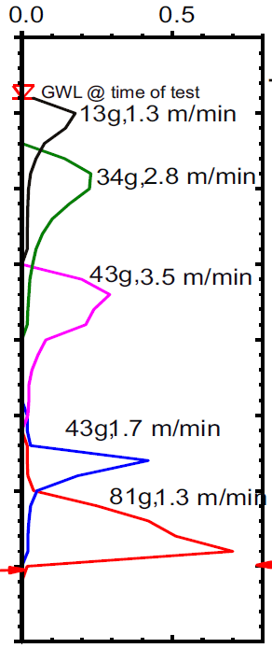
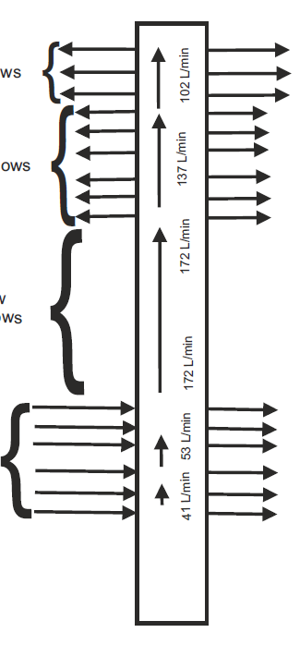
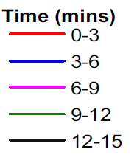
Vertical flow case – Tancred Pit BH (depth 50 m)
Figure 2.1 Chalk outcrop in the United Kingdom and the location of study area.
Caliper log (mm)
[NaCl](g/L)
[NaCl](g/L)
Vertical flow rates
Major Outflow zone
Minor Outflow zone
Depth (m bgl)
No ambient flow features
Crossflow + vertical flow zone
Well diameter enlargements
Uniform injection results
Vertical flow velocities and tracer masses from point injection test
Conceptual model of well agrees with flow logging from Parker et al (2019)

Slide 8
Conclusions
We used single-well dilution tests and the implementation of a new workflow to:
1. Determine presence and direction of vertical hydraulic gradients.
2. Determine the nature and depth distribution of flowing features.
3. Estimate porosity and permeability of flowing features with depth using pumping test transmissivity and geophysical logs.
4. Estimate groundwater velocities using local hydraulic head measurements in surrounding wells.
5. The good level of agreement of findings from current study with tracer tests and flow logging suggests the single-well dilution tests and the current workflow is robust and cheap method for the characterisation of carbonate aquifers.

Slide 9
Thank you for your attention
This work was made possible by: Scholarship Award No. GHCS – 2015- 147 from the joint sponsorship of the Commonwealth Scholarship Commission (CSC) UK and University of Leeds; Fieldwork Support Grant and data from the UK Environment Agency; field kit and guidance from Dr Louise Maurice of the British Geological Survey and field work support from Kirk Handley from the School of Earth and Environment, Leeds University.
Contact: Prodeo Agbotui, ee08pya@leeds.ac.uk /agbotuiprodeo@yahoo.com
Earth and Surface Science Institute
School of Earth and Environment
University of Leeds, U.K
References
Farrant, A.R., Woods, M.., Maurice, L., Haslam, R., Raines, M. and Kendall, R. 2016. Geology of the Kilham area and its influence on groundwater flow. British Geological Survey Commissioned Report CR/16/023.
Maurice, L.,Barker, J. A.,Atkinson, T. C.,Williams, A. T.,Smart, P. L., 2010. A Tracer Methodology for Identifying Ambient Flows in Boreholes. Ground Water, 49(2), pp.227– 238.
Parker, A.H., West, L.J. and Odling, N.E. 2019. Well flow and dilution measurements for characterization of vertical hydraulic conductivity structure of a carbonate aquifer. Quarterly Journal of Engineering Geology and Hydrogeology. [Online]. 52(1),pp.74–82. Available from: https://doi.org/10.1144/qjegh2016-145.
Pitrak, M., Mares, S. and Kobr, M. 2007. A simple borehole dilution technique in measuring horizontal ground water flow. Ground Water. 45(1).
Southern Science (1994). Geophysical Logging of Boreholes In Southern Yorkshire And the Dales. Report No 94/7/845. Prepared for the National Rivers Authority Northumbria & Yorkshire Area
Ward, R.S., Chadha, D.S., Aldrick, J. and Brewerton, L.J. 1998. A Tracer Investigation of Groundwater Protection Zones around Kilham PWS Well, East Yorkshire. British Geological Survey Report WE/98/19.
West, L.J. and Odling, N.E. 2007. Characterization of a multilayer aquifer using open well dilution tests. Ground Water. 45(1),pp.74–84.

