Slide 1

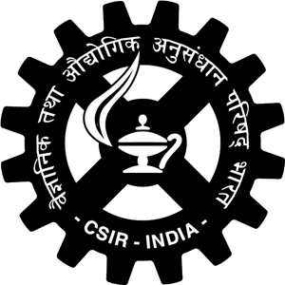


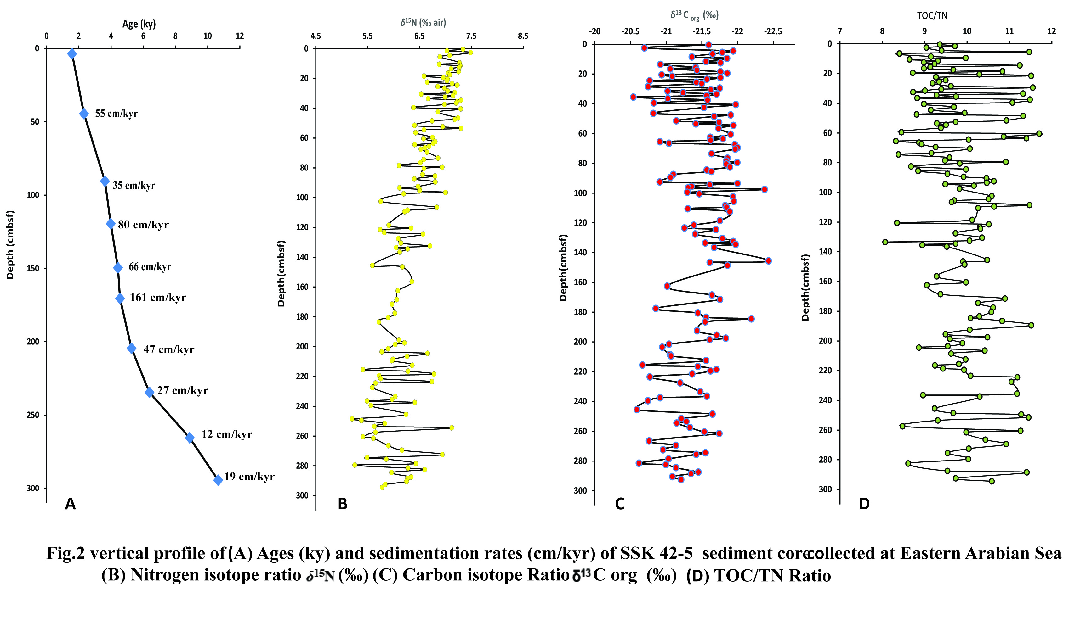
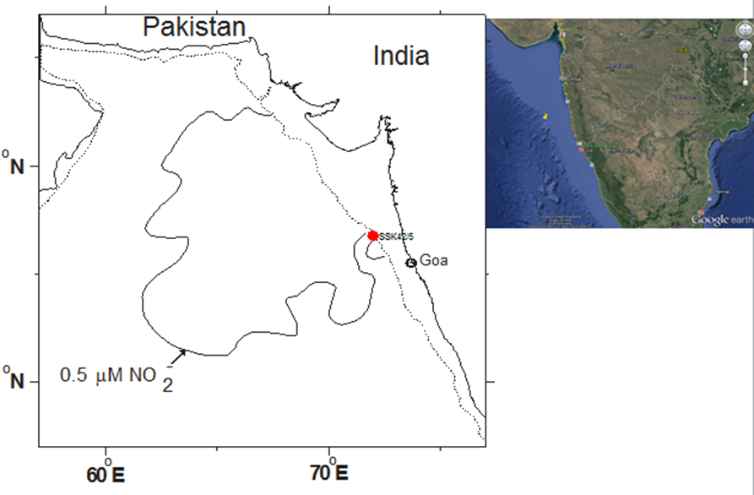
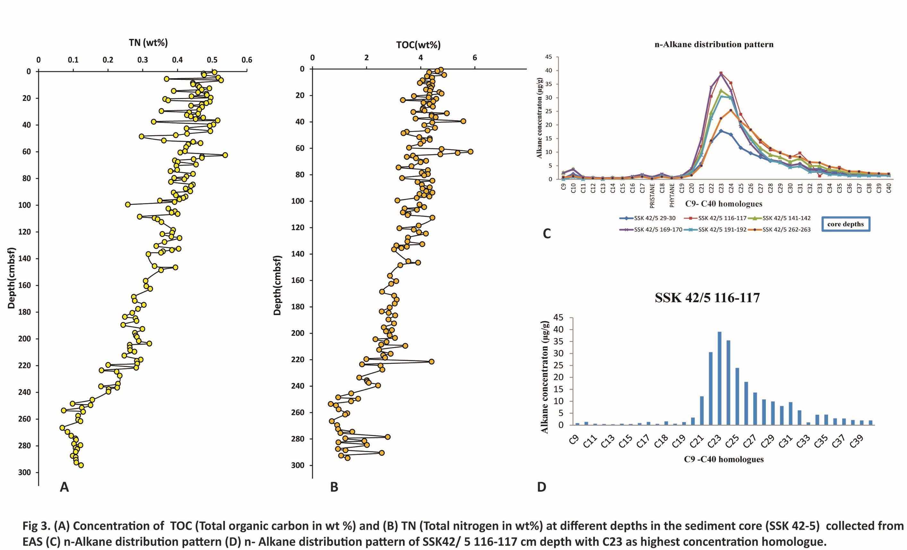
Last 12 ky record of various organic geochemical proxies in the eastern Arabian sea
Ayusmati S Manaskanya^{1,2}, Aninda Mazumdar² , Aditya Peketi² , Svetlana Fernandes², and Rheane D. A. Silva²
¹Academy of scientific and innovative research (AcSIR),Ghaziabad-201002, ² CSIR-National Institute of Oceanography , Dona Paula,Goa-403004,India
Contact information: asmanaskanya27@gmail.com
Introduction
Results
Nitrogen is a limiting nutrient in oceanic primary production, thus the nitrogen budget and its fractionation through oxic /anoxic condition is of particular interest. Organic nitrogen fractionates through many microbially mediated processes such as fixation ,nitrification and denitrification and oxygen minimum zones provide favorable ambiance for this elemental cycle. Nitrogen and carbon variability in the global biogeochemical cycle is vital to understand primary productivity in marine environments.
Work is being done to generate records of global biogeochemical cycle in the Eastern Arabian Sea (EAS) that comes under perennial Oxygen Minimum zone (OMZ) and thereby provides proper ambiance for intense denitrification.
Denitrification, a heterotrophic process, which is performed by respiratory reduction of nitrate or nitrite, and anaerobic ammonium oxidation (anammox), a autotrophic process that couples nitrite reduction and ammonium oxidation. Water column and sedimentary denitrification are the two major processes in marine realm , which believed to occur in suboxic environment of OMZs . Arabian sea (OMZ depth 150m to 1250m) is one of the three major water column denitrification sites in the world (Codispoti 1989; Naqvi et al., 2006) with denitrification rate of 10-30 Tg N /yr (Naqvi., 1992) covering total denitrification affected area of 1.37*10⁶ km² .
Significant low oxygen concentration (0.1≤ O₂ ≤0.2 mL L ⁻¹) within the Arabian Sea OMZ leads to intense denitrification. Particulate organic matter that settles down from the surface has δ¹⁵N values which represent the nitrate source and fractionation during partial utilization of nitrate by phytoplankton (Altabet and Francois, 1994). Denitrification replete the N¹⁵ content of the subsurface nitrate (Liu and Kaplan., 1989) and eventually upwelling causes enrichment of N¹⁵ in newly formed particulate nitrogen and hence sedimentary organic matter (Altabet et al., 1995).
.
Denitrification in Arabian Sea
Study area (core location)
SSK 42-5 is located along the Eastern Arabian Sea, along the western continental margin of India , which is a passive NNW-SSE margin ,a straight shelf edge breaking at 140-180 m depth (Fernandes and Mazumdar2019, and references there in, Mazumdar., 2009).The studied core sediments along outer shelf are mostly silts and clay.(Fernandes and Mazumdar., 2019)
Key findings:
Results contd..
The TOC and TN show parallel trends as the core is continuous and preserved properly.
The TOC/TN and δ¹³ C_{TOC} suggest typical marine organic matter source. This observation is also further supported by the n-alkane distribution pattern , where the dominance of nC₂₁ to nC₂₄ and the absence of odd alkane dominance over even suggest predominantly marine organic source.
The δ¹⁵N profile shows a steady increase from 5.7‰ at 203 cmbsf (5.5 ky BP) to 7.5‰ at 2 cmbsf (~1ky BP) suggesting gradual increase in denitrification possibly liked to reduced ventilation in the Arabian Sea, whereas, between 5.5 to 12 ky BP, the δ¹⁵N values show marked fluctuations (5.2 to 7.1‰) possibly indicating variable level of oxygenation which in turn controlled the extent of denitrification.
Possible influence of digenesis (microbial degradation of organic matter) on the δ¹⁵N value need to be investigated for a better understanding of the water column processes.
Perticular Source of Productivity in this area yet to be established in this core by further compound specific isotopic analysis.
Circulation pattern of the area
The eastern Arabian Sea experience a seasonal eastern-boundary-type upwelling environment (Naqvi et al.,2009). Seasonal hypoxia in western continental margin occurs during and shortly after SW monsoon and intimately linked to the seasonal reversal of surface circulation. (Naqvi et al., 2006). In winter (NE monsoon) ,the west India coastal current (WICC) flows pole ward causing downwelling off the west coast and in summer (SW monsoon) coastal upwelling prevails due to reversal of WICC (Agnihotri et al., 2008).Upwelling causes the oxygen-poor, nutrient rich subsurface water brought to the shelf, that turn anoxic by late summer due to exhaustion of oxygen and nitrate by heterotrophic microorganisms. This oxygen deficient system is world’s largest and intensified since three decades and the intensification clearly indicates increase in productivity since few decades as well (Naqvi et al., 2009).
REFERENCES:
Agnihotri, R., Kurian S., Fernandes M., Fernandes, Reshma K., DeSouza W., and Naqvi S. W. A., (2008) Variability of subsurface denitrification and surface productivity in the coastal eastern Arabian Sea over the past seven centuries, Holocene, 18, 755–764.
Codispoti, L. A. (1989), Phosphorus vs. Nitrogen Limitation of New and Export Production, in Productivity of the Ocean: Present and Past, edited by W. H. Berger et al., pp. 377–394, John Wiley, New York.
Devol, A. H., Uhlenhopp, A. G., Naqvi, S. W. A., and Brandes, J. A., : Denitrification rates and excess nitrogen gas concentrations in the Arabian Sea oxygen deficient zone, Deep-Sea Research. I, 53, 1533–547,2006a
Fernandes, S. Q., and Mazumdar , A. (2019), Pore water chemistry and sulfur iron carbon systematics in sediments underlying the oxygen minimum zone of the Arabian sea west coast of India. PhD thesis submitted to Goa University. URL: http://hdl.handle.net/10603/281644
Mazumdar, A., Dewangan, P., H. M. Joa ̈o, and Peketi A. et al., (2009), Evidence of paleo–cold seep activity from the Bay of Bengal, offshore India, Geochemistry Geophysics Geosystems, 10, 1–15.
Naqvi, S.W.A., Naik, H., Jayakumar, D.A., and Pratihary, A., Seasonal anoxia over the western Indian continental shelf. In: Indian Ocean: Biogeochemical Processes and Ecological Variability. Eds. Wiggert, J.D., Hood, R.R., Naqvi, S.W.A., Brink, K.H., Smith, S.L., Geophys. Monogr. Ser., AGU, Washington, D
Acknowledgements:
All the analyses were conducted in gas hydrate geochemistry laboratory of CSIR-NIO.
We Thank, Director ,NIO and Director, AcSIR for the support and encouragement. Our sincere thanks to Council of Scientific and industrial Research for lab facility and university grant commission for providing fellowship for carrying out this research work.

