Slide 1
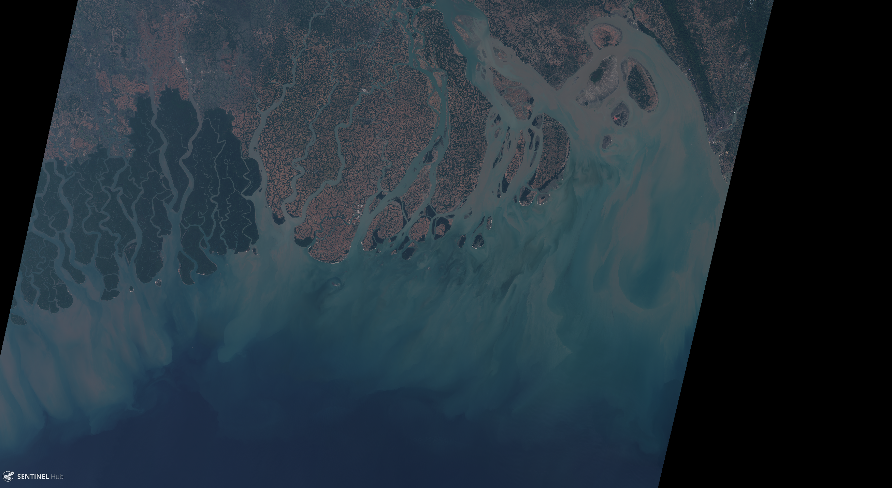
SPATIAL AND TEMPORAL SCALES OF VARIABILITY IN THE
Masuma Chowdhury
Irene Laiz Alonso, PhD
Isabel Caballero de Frutos, PhD
MEGHNA ESTUARY FROM OCEAN REMOTE SENSING
SENTINEL 2 MSI

Slide 2
EGU General Assembly 2020: Sharing Geoscience Online, 4-8 May 2020
Ganges-Brahmaputra-Meghna (GBM) River System
Geographic Features:
Empties to the Northern Bay of Bengal (BoB) through Meghna estuary
One of the widest coastal estuarine river systems
Shallow continental shelf followed by deeper basin
The self consists of mud and sandy mud
A huge submarine canyon: Swatch of No Ground (SNG) located west to the river mouth
Important morphologic features: erosion/accretion due to large water and sediment discharge (net natural land reclamation rate ~ 5.5-16.0 km²/year)
Fig. 1. Region of study (Press ‘Play’)
This estuary is in the first and third highest ranking in the world in terms of sediment and water discharge, respectively.

Slide 3
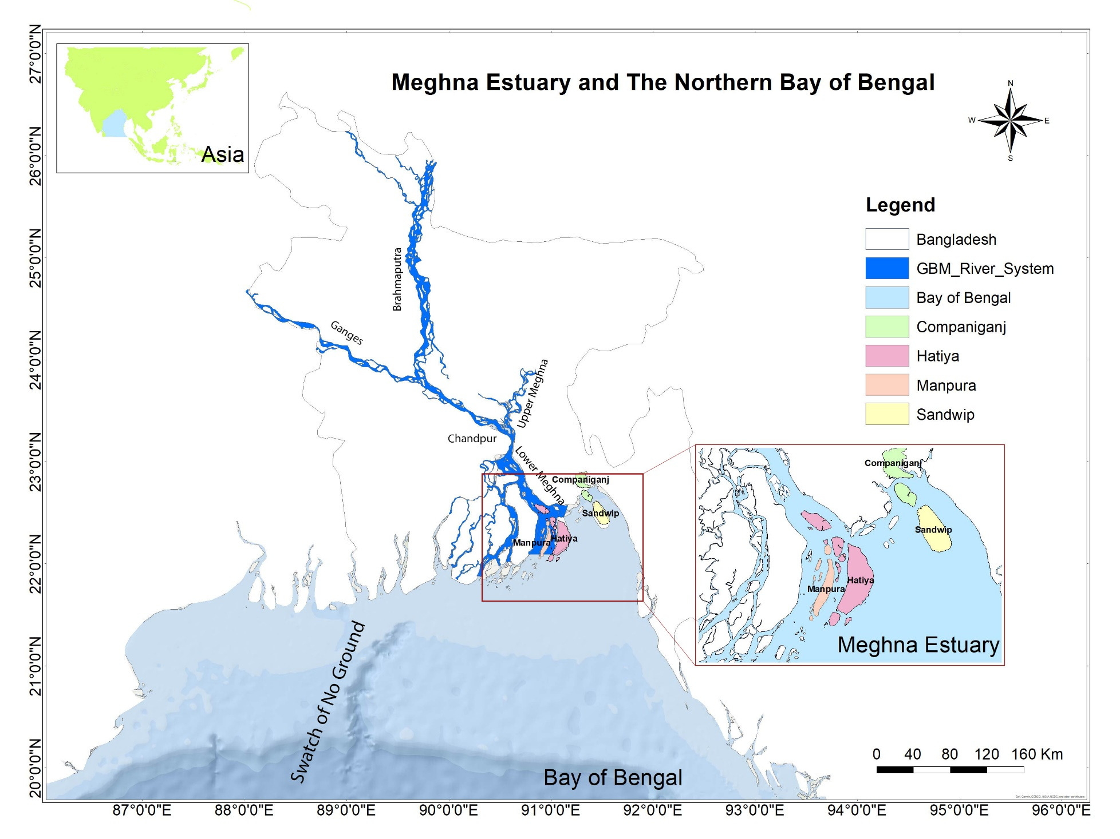
EGU General Assembly 2020: Sharing Geoscience Online, 4-8 May 2020
Ganges-Brahmaputra-Meghna (GBM) River System
Meteorological Features:
Annual rainfall of 3000 ~ 4900 mm in the upstream & 1500 ~ 2400 mm in the downstream of the river
Water discharge: 8000 ~100000 m³/s per year
Sediment discharge: 2 billion tons annually on average
Oceanographic Features:
Mostly meso-tidal, semidiurnal
Influenced by Indian ocean climatic conditions i.e., seasonal reversal of winds, surface ocean currents
Cyclonic and anticyclonic eddies
Fig. 2. Study area: GBM river system, Meghna estuary & Northern BoB

Slide 4
EGU General Assembly 2020: Sharing Geoscience Online, 4-8 May 2020
Data and Methods
Methods applied
Mean Spatial Distribution Analysis
Empirical Orthogonal Function (EOF) & Spectral Analysis to identify dominant modes of variabilty
Seasonal Cycle Analysis:
Premonsoon: Mar-Apr-May (MAM)
Monsoon: Jun-Jul-Aug(JJA)
Post monsoon: Sep-Oct-Nov (SON)
Winter: Dec-Jan-Feb (DJF)
Stepwise Linear Regression Analysis (dependent variable Chl-a; independent variables: SST, TSM, PAR & Rainfall)
Study period: 2003-2011
Satellite derived datasets
Chlorophyll-a (Chl-a) for Case 2 water (Neural network algorithm)
Total Suspended Matter (TSM)
Sea Surface Temperature (SST)
Photsynthetically Active Radiation (PAR)
Ancillary Data:
Rainfall (1948 – 2014)
Runoff data of Ganges and Brahmaputra Rivers (1988 – 2000)
Ocean Current

Slide 5
EGU General Assembly 2020: Sharing Geoscience Online, 4-8 May 2020
Findings
Meridional distribution of the observed optical parameters
Chl-a and TSM: Higher values around the northern coast, gradual offshore decreasing gradient.
SST and PAR: lower values around the northern coast, higher values offshore
Seasonal cycle is the most important signal in this region.
Large interannual variability is also observed
Maximum Chl-a concentration at the river mouth, peaking during monsoon but high spatial distribution during winter.
Maximum concentration of TSM at the river mouth during winter and premonsoon.
Fig. 3. Seasonal cycle (2003-2011) (Press ‘Play’)

Slide 6
EGU General Assembly 2020: Sharing Geoscience Online, 4-8 May 2020
Findings
The first EOFs mode was found relevant to this region representing 26.0%, 15.30%, 89.11%, and 85.11% of the Chl-a, TSM, SST, and PAR variability, respectively.
The northern coastal fringe behaves differently than the surrounding region, especially in terms of Chl-a and TSM.
Chl-a and TSM shows opposite variations in the Meghna estuary.
Maximum SST during monsoon and post monsoon.
The amount of PAR is high during premonsoon.
Fig. 4. Seasonal signal of the first EOF mode (Press ‘Play’)

Slide 7
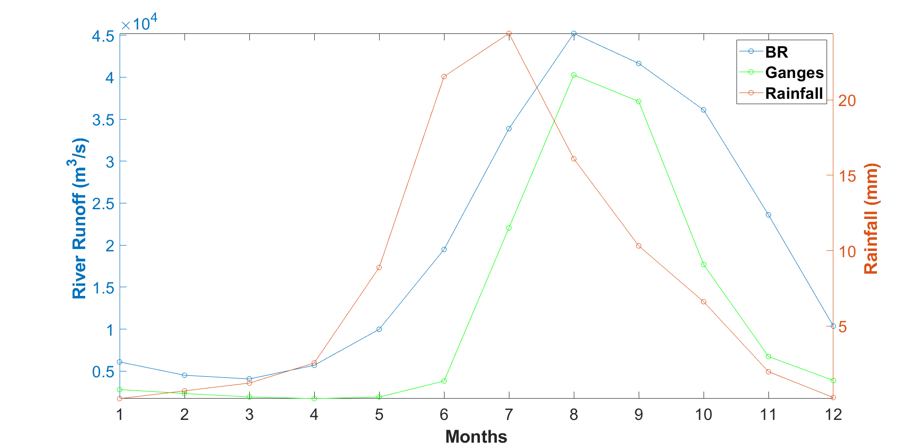
EGU General Assembly 2020: Sharing Geoscience Online, 4-8 May 2020
Findings
River runoff shows similar pattern (seasonal pattern) with rainfall (high correlation R>7.0, with 1-month delay). Hence rainfall is considered as a proxy of river runoff due to lack of data during the study period.
The step-wise linear regression showed that TSM explains the highest percentage of Chl-a variance (68%), followed by PAR, rainfall, and SST, respectively. Overall, the four variables accounted for 90% of the Chl-a variance.
Fig. 5. Climatology of river runoff and rainfall

Slide 8
EGU General Assembly 2020: Sharing Geoscience Online, 4-8 May 2020
Conclusions
Meghna Estuary discharges highest amount of water and sediments comparative to the other adjacent rivers in the study area.
During monsoon high river discharge flushed away the TSM out of the river mouth whereas, in winter, due to low river discharge, TSM accumulates at the river mouth. This behavior is also due to the mean currents during monsoon and winter (not showed in this work).
High temperature along with nutrients from the runoff promote phytoplankton growth during monsoon.
This study shows us how Meghna estuary is behaving differently at the basin scale BoB and demonstrates us the influence of this estuary. This study also suggested that seasonal cycle is the most important signal in this region.

Slide 9
EGU General Assembly 2020: Sharing Geoscience Online, 4-8 May 2020
Acknowledgement
I would like to thank Erasmus Mundus Joint Master Degree Scholarship Program on Water and Coastal Management (WACOMA) to give me such a nice opportunity to enhance my knowledge in a global scale. Besides, I would love to express my especial thanks of gratitude to Professor Irene Laiz Alonso, PhD and Isabel Caballero de Frutos, PhD for their cordial guidance and support.

