Slide 1
Impact of wave-induced sea ice fragmentation on sea ice dynamics in the MIZ
Guillaume Boutin¹, Timothy Williams¹, Pierre Rampal¹, Einar Ólason¹, Camille Lique²
Nansen Environmental and Remote Sensing Center, Bergen, Norway
Laboratoire d’Océanographie Physique et Spatiale (LOPS), Ifremer, Brest, France
CMEMS project: WIzARd
Session OS4.7 / EGU2020-8657
EGU – 08 May 2020

Slide 2
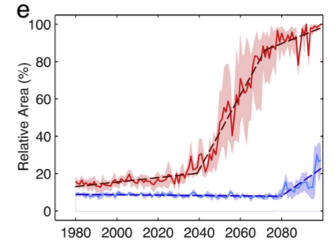
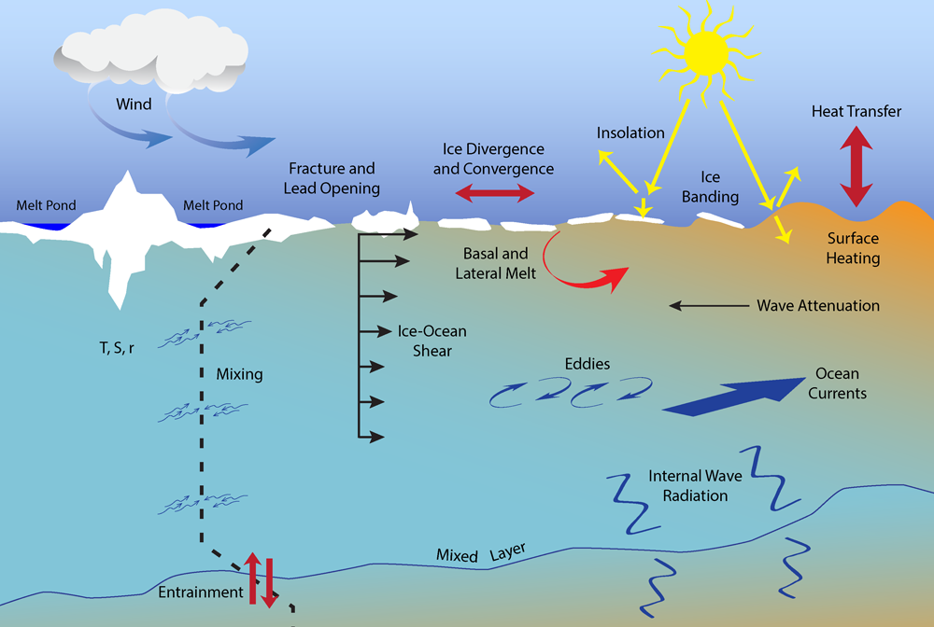
Introduction
The MIZ is a region with a great variety of interaction processes between the ocean, sea ice, and atmosphere.
Sea ice fragmentation by waves
Waves Radiative
Stress
Waves Radiative
Stress
Projected evolution of the MIZ area in winter (blue) and summer (red) (Aksenov et al. 2017)
Credits : APL, Univ. of Washington
Less sea ice, more open ocean for waves to grow and propagate -> greater impact on sea ice

Slide 3
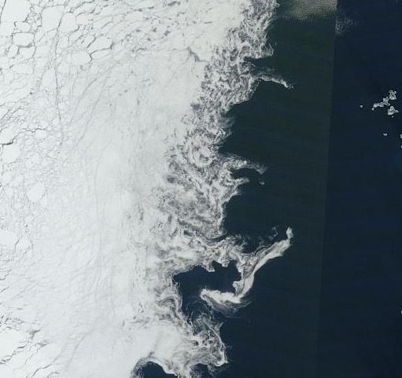
Introduction
Manucharyan and Thompson (2017):
Eddies -> export sea ice to the open ocean
IF the eddy-induced stress > ice resistance to deformation
Svalbard ->
Sea ice resistance to deformation is low for:
Low-concentration -> in models
Fragmented sea ice -> not in models (Why ?)
Why: Very few data to validate, no wave-sea ice interactions not included in models…
Aqua/MODIS corrected reflectance images. 15/09/2015, North of Svalbard (worldview.earthdata.nasa.gov)
Can we estimate the impact of waves on sea ice dynamics in the MIZ ?

Slide 4
Overview
Introduction
A new wave—sea-ice coupled framework
Results: case study in the Barents Sea
Conclusions

Slide 5
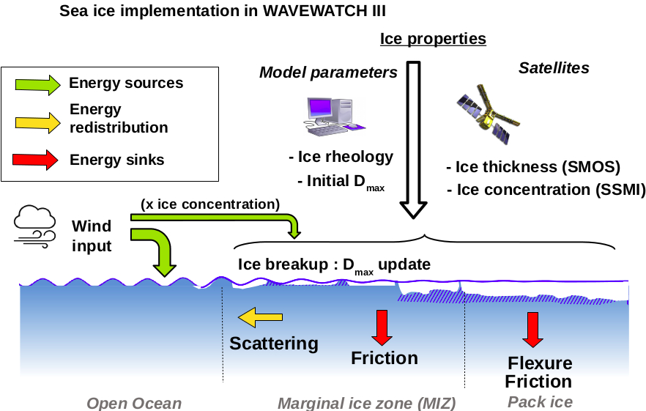
A new coupled framework
WAVEWATCH III
Wave attenuation depends on sea ice thickness, concentration and floe size
Sea ice break-up param. : feedbacks between floe size and wave attenuation
Boutin et al. (JGR, 2018)

Slide 6
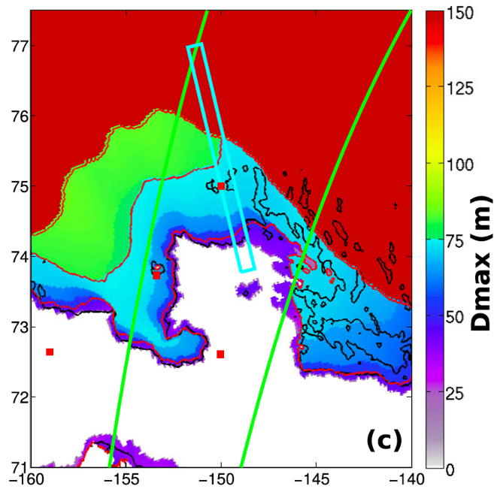
A new coupled framework
WAVEWATCH III
Good agreement for Hs with all buoys + SAR
Good agreement for broken sea ice extent with SAR
Wave attenuation depends on sea ice thickness, concentration and floe size
Sea ice break-up param. : feedbacks between floe size and wave attenuation
Evaluated in the Barents and Beaufort seas
Can be coupled to:
NEMO-LIM3 -> Waves affects the sea ice edge, which in turns affects SSS and SST in the MIZ Boutin et al. (The Cryosphere, 2020)
neXtSIM
Boutin et al. (The Cryosphere Discussion, 2020)
Distribution of the maximum floe size dmax from ww3. The green lines represent sentinel 1-a track used for evaluation in Ardhuin et al. (JGR,2018)

Slide 7
A new coupled framework
neXtSIM: A new Lagrangian sea-ice model
2 key features:
Maxwell-elasto-brittle rheology
Lagrangian moving mesh
High localization of deformation in linear kinematic features (LKF)
Uses a variable called “Damage” that keeps memory of previous deformation events
-> Highly deformed sea ice is damaged -> less resistant to further deformations
Rampal et al. 2016, Dansereau et al. 2016, Rampal et al. 2019

Slide 8
A new coupled framework
neXtSIM: What did we add ?
A floe size distribution (FSD) evolving with break-up and refreezing/healing. It distinguishes two definitions for the floe size:
Floes are separated by open water leads: relevant for thermodynamical processes, with a fast growth/healing of the floes as thin ice forms at the surface -> floe size D_{fast}
Floes are mechanically homogenous pieces of the ice cover: relevant for mechanical processes like wave attenuation, with a slow growth/healing as it takes time to regenerate solid joints between floes -> floe size D_{slow}
t=0, fragmentation just occurred
t=15-30days (healing)
t=1day (freezing)
D_{slow} = D_{fast}
D_{slow} < D_{fast}
D_{slow} = D_{fast}

Slide 9
A new coupled framework
neXtSIM: What did we add ?
2) A relationship between fragmentation and damage
If a fragmentation event occurs, sea ice damage of broken sea ice increases to the maximum value (d=1)
Why ?
Damage qualitatively represents the density of cracks/ridges, and wave-induced fragmentation creates a very large number of cracks on short timescales (minutes/hours).
What does it change for sea ice ?
Damaged sea ice has a low internal stress and is therefore almost in free drift. Ice strength is therefore not only function of sea ice thickness/concentration, but also of wave activity.
Discussion:
- Intuition supported by higher deformation rates observed in the MIZ (Oikkonen et al., 2017)
- We neglect the resistance to deformation that can arise from floe-floe interactions (but these are processes still largely misunderstood)
9

Slide 10
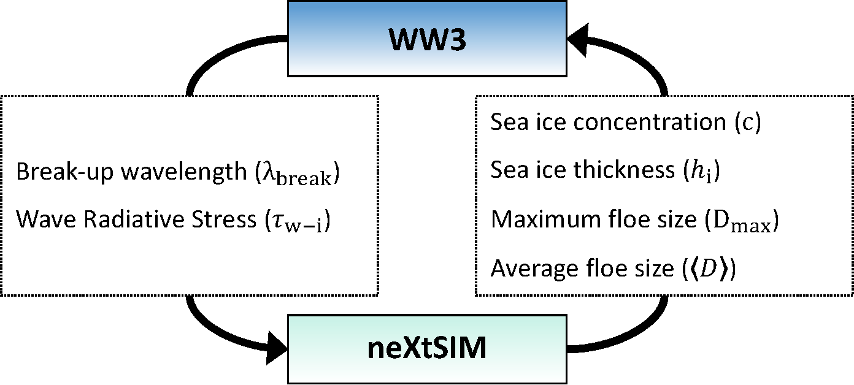
A new coupled framework
Information required to estimate wave attenuation
Fragmentation
Update of floe size +
impact on sea ice momentum equation
Evaluation strategy:
Evaluation with the Beaufort Sea case of Ardhuin et al. (2018) using a 1/4º grid
Wave attenuation ✓
Extent of broken sea ice ✓
10

Slide 11
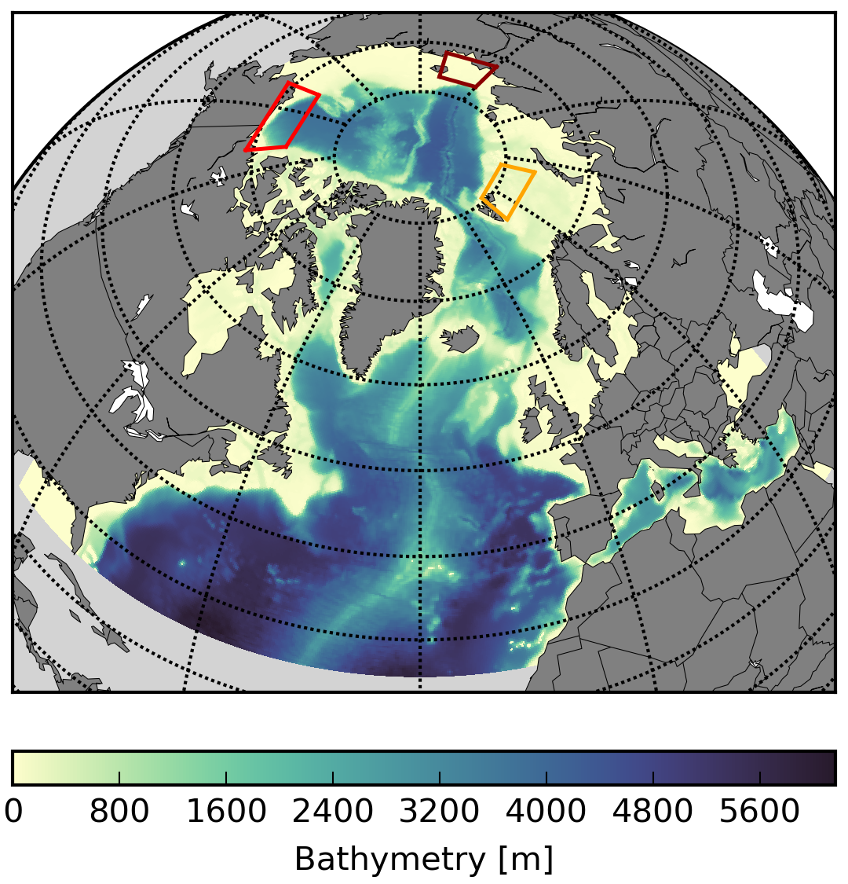
Barents Sea study case
Model setup:
Grid extracted from ORCA025: 12km everywhere in the Arctic (originally developed for NEMO)
neXtSIM uses a moving mesh initialized from this grid -> same resolution as WW3
Exchange between the models is done by the coupler OASIS, neXtSIM first interpolate exchanged quantities on the grid before sending them to the coupler.
Model domain:
Forcings:
Atm: CFSR reanalysis
Ocean: TOPAZ4
Timesteps:
- WW3 : 800s
neXtSIM 20s (to solve dynamics)
Coupling: 2400s
We look at a storm event in the Barents Sea

Slide 12
Barents Sea study case
Storm occurring in October 2015, in the Barents Sea, with large waves and ice break-up over a large area.
Significant Wave Height
Sea ice concentration
BEFORE
THE STORM
AFTER
THE STORM
The magenta line represents the extent of broken sea ice.
[-]
Full video here

Slide 13
Barents Sea study case
Maximum floe size
Damage
Sea ice drift
BEFORE
THE STORM
AFTER
THE STORM
The magenta line represents the extent of broken sea ice.
Ice drift velocity seems enhanced where sea ice is broken.
Full video here

Slide 14
Barents Sea study case
Impact on sea ice dynamics
21/10/2015 09:00 am
Investigation of the effects of fragmentation by comparing 2 simulations:
“DMG”: Coupled with link between frag. and damage
“WRS”: Coupled but NO LINK between frag. and damage
Snapshot of ice drift velocity difference between the DMG and WRS simulations after the storm.
The magenta line represents the extent of broken sea ice.
Ice drift speed is increased for broken AND thick/compact ice

Slide 15
Barents Sea study case
Impact on sea ice dynamics
Area of increased velocity coincide with thicker ice in the MIZ
21/10/2015 09:00 am
Investigation of the effects of fragmentation by comparing 2 simulations:
“DMG”: Coupled with link between frag. and damage
“WRS”: Coupled but NO LINK between frag. and damage
Snapshot of ice thickness in the DMG simulation, after the storm.
The black line represents the extent of broken sea ice.
Ice drift speed is increased for broken AND thick/compact ice

Slide 16
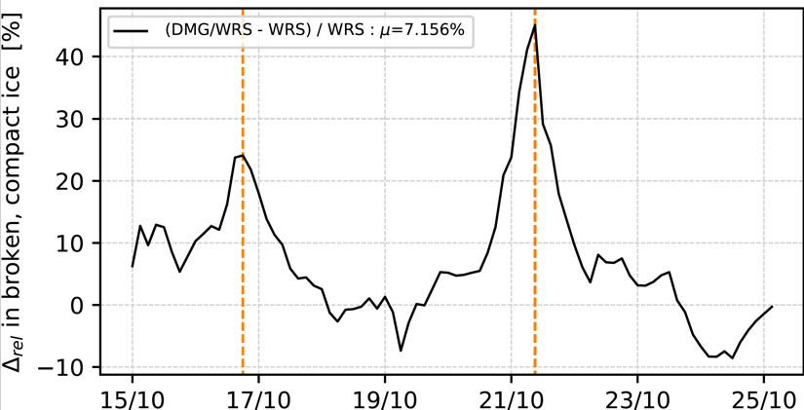
Barents Sea study case
Impact on sea ice dynamics
Relative difference of Ice drift speed between DMG and WRS for broken (Dmax<200m) and compact ice (sea ice concentration >0.8) averaged over the Barents Sea.
Maxima of wind/ice drift speed occur before the maxima in the difference between the simulations
Fragmentation increases the mobility of compact and broken sea ice after extreme events. Ice drift velocity can be enhanced by up to ~45% after storms.

Slide 17
CONCLUSION
neXtSIM and WW3 have been successfully coupled
The coupling development has raised new ideas for the representation of floe size evolution in sea ice models.
Waves can significantly increase the mobility of thick/compact sea ice, particularly in the wake of a storm.
Impact on sea ice drift close to the ice edge strongly stresses the need for considering waves in sea ice forecast platforms -> Upgrading the upcoming ice forecast with a wave component is a potentially interesting future development
Publication:
Boutin, G., Williams, T., Rampal, P., Olason, E., and Lique, C.: Wave–sea-ice interactions in a brittle rheological framework, The Cryosphere Discuss., https://doi.org/10.5194/tc-2020-19, in review, 2020.

