Slide 1
Föhn events at Cole Peninsula (Antarctica) in in-situ measurements and model simulations
Amélie Kirchgäßner, John King, Alan Gadian
contact: amelie.kirchgaessner@bas.ac.uk

Slide 2
Föhn events at Cole Peninsula (Antarctica) in in-situ measurements and model simulations
Amélie Kirchgäßner, John King, Alain Gadian
Background: Why Föhn, why here?
Location: Where are we?
Data and methods: How is Föhn identified?
Results: Observations vs Model
Results: The Role of Clouds
Results: Föhn vs no Föhn
Data and methods: What data is used?
Thank you and credentials!

Slide 3
Background:
Föhn:
The Antarctic Peninsula is one of the fastest warming regions in the world.
There are regional and seasonal differences, with winter winter warming strongest on the western side, and strong warming in summer and autumn on eastern side.
A mechanism to explain these seasonal and regional differences are Föhn winds.
A positive trend in the Southern Annular Mode (SAM) supports this. A stronger SAM index leads to stronger circumpolar westerly winds. Instead of being blocked by the mountain range, these stronger winds are more likely to overcome the barrier. This in turn leads to Föhn effect on the lee side of the Antarctic Peninsula.
Larsen Ice Shelves:
The dominant feature on the leeside of the Antarctic Peninsula is the Larsen Ice Shelf.
Its northern parts Larsen A and Larsen B have collapsed in 1998 and 2002 respectively.
Warm, dry Föhn winds are thought to have provided the atmospheric conditions that have led to the collapse through hydro-fracturing (Scambos et al., 2004).
Föhn winds are a major influence on the stability of the remaining Larsen C ice shelf.

Slide 4
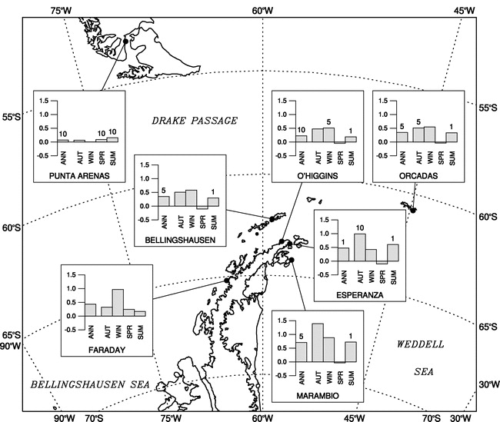
Antarctic Peninsula has warmed more rapidly than global average
regional and seasonal differences
winter warming strongest on the western side
strong warming in summer and autumn on eastern side
Marshall et al (2006),
Journal of Climate
Notes:
The mean annual near-surface temperature increased by 2.9°C during the period 1951–2004 (significant at a 1% level; Marshall et al. 2006), compared to the global average of 0.5°C (Hansen et al. 2001). The Faraday warming is largest in the winter season. In contrast, the warming on the eastern side of the AP is largest in summer and autumn. Between 1965 and 2004, the summer–autumn temperature increase at Esperanza
station was almost 3 times as large as at Faraday (2.7° and 1.0°C, respectively; Marshall et al. 2006). It is the summer warming that is most relevant in terms of the melting of snow and ice in the AP region and, as a consequence, in driving regional ecological change.

Slide 5
Three Föhn mechanisms:
Latent cooling and precipitation
Isentropic drawdown
Mechanical mixing
(Elvidge and Renfrew, 2016)
Föhn effect via latent cooling and precipitation

Slide 6
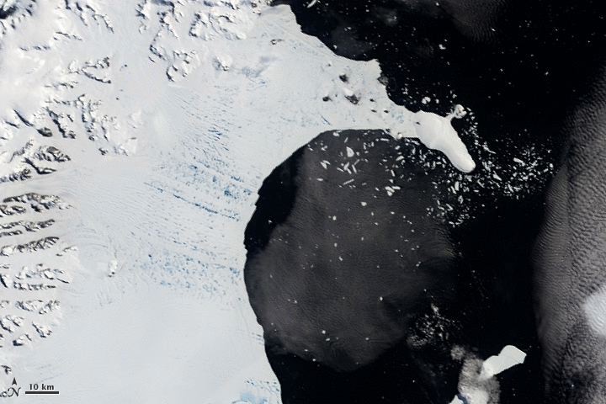
Animation of the collapse of Larsen B Ice Shelf collapse over the period from Jan 31st to April 13th 2002
It is widely accepted that hydrofracturing, the widening of crevasses due to the excess hydrostatic pressure exerted by meltwater which accumulates inside them, is the mechanism behind the break-up of the Larsen A and Larsen B ice shelves (e.g. Scambos et al, 2004).
Satellite images credit: NASA
Location

Slide 7
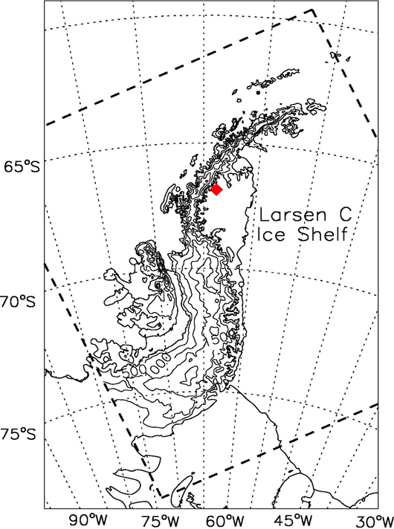
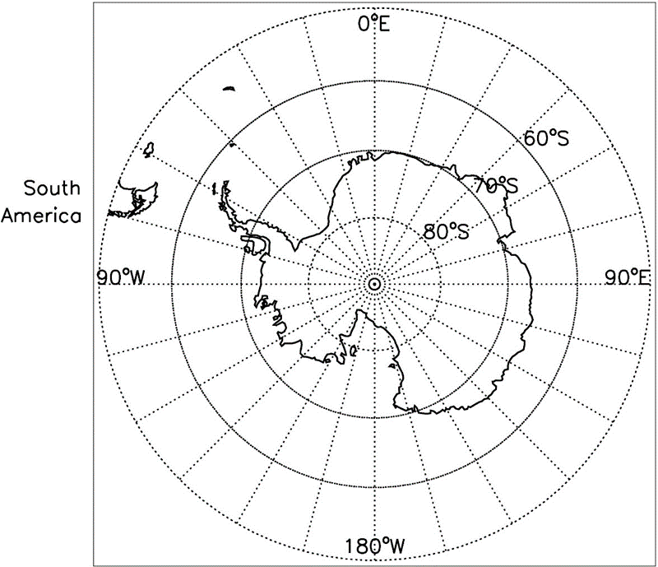
Map of the Antarctic Peninsula
Dashed lines mark the model domain of the Antarctic Mesoscale Prediction System.
The red diamond marks the location of Cole Peninsula AWS.

Slide 8
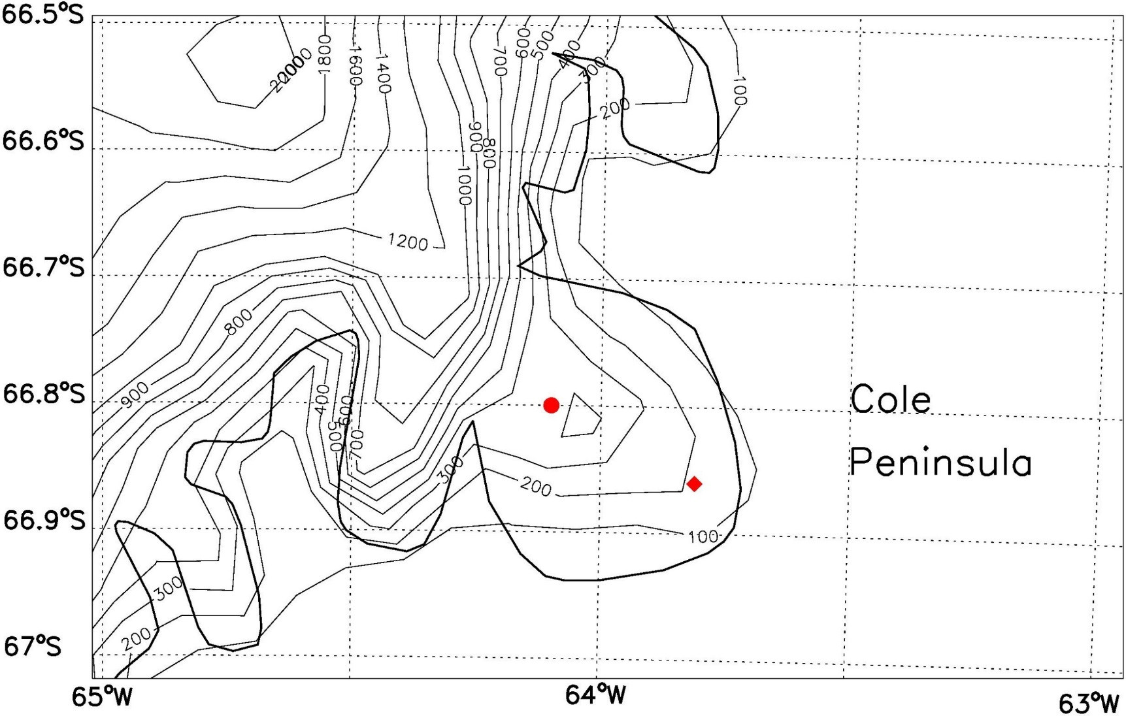
The model orography in the area of Cole Peninsula differs from reality.
The diamond marks the GPS location of the AWS projected onto model orography. The circle marks the location chosen for the comparison between measurements and model output, as it more closely resembles the AWS location in reality (424m asl).
Contours are at 100m intervals and at 200m intervals above 1000m.
The black line marks the mapped boundary between ice shelf and land.
location used for comparison
AWS location in model
Data sets

Slide 9
Observations
Automatic Weather Station at Cole Peninsula
Temperature & Relative Humidity
Wind speed and direction
Air pressure
Solar powered with battery back up
Data transmission via Iridium short burst messages
10 min measurements collated to six hour mean values
Model data
Antarctic Mesoscale Prediction System AMPS
Weather, Research and Forecasting model WRF
5km resolution
44 model levels
output of initialisations at 00UTC and 12UTC combined to 6 hourly artificial time series.
Data available at: https://catalogue.ceda.ac.uk/
(search for “AWS”, “Antarctic Peninsula”
Data available: www.earthsystemgrid.org

Slide 10
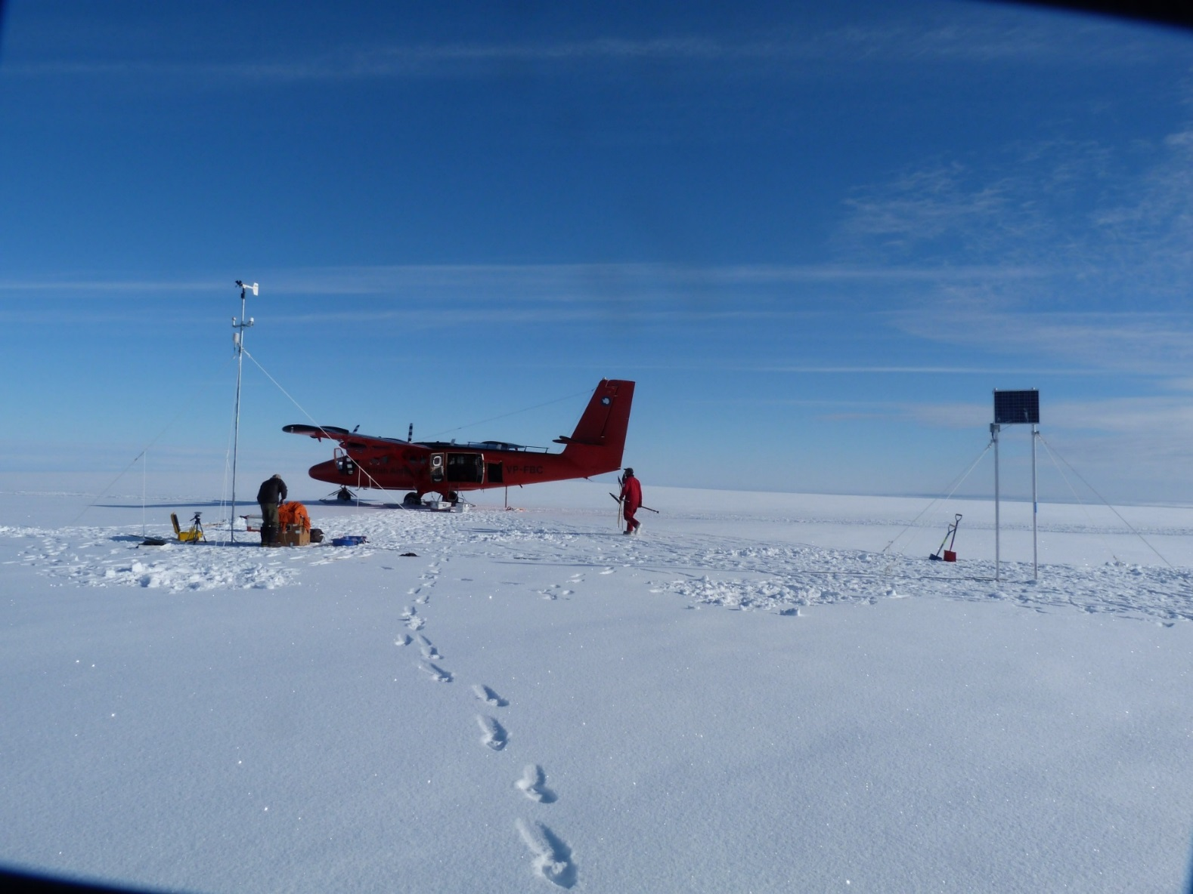
Automatic Weather Station at Cole Peninsula
Operational from Jan 21st 2011 – Jan 4th 2012
Location: 66°51'48''S, 63°48'39''W 424m above sea level
Photo credit: Andy Elvidge

Slide 11
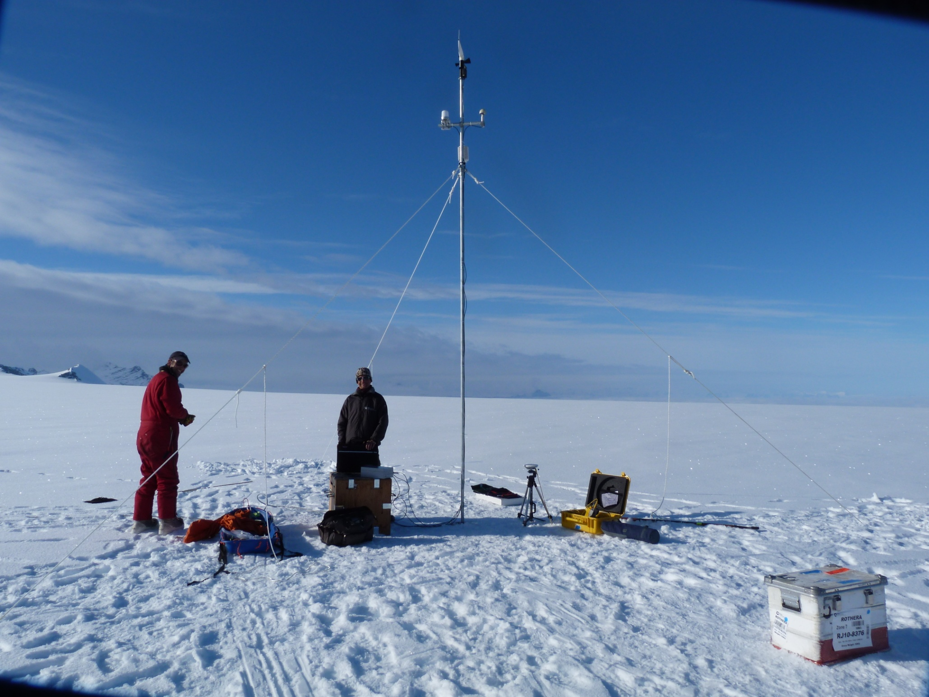
Automatic Weather Station at Cole Peninsula
RM Young prop vane (4m above surface)
GPS and Iridium antenna at 3.5m
Humicap HMP45D at 3m
Pressure sensor buried with logger box at the foot of the AWS.
Photo credit: Andrew Elvidge

Slide 12
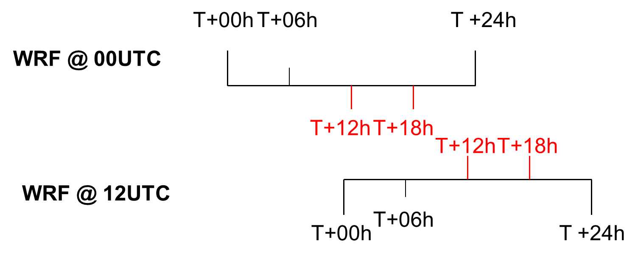
Schematic of how the two daily initialisations of the model runs were combined into a 6 hourly time series. E.g. Seefeldt and Cassano (2008) have shown that up to 12 hours are needed for the model to adjust to topography.
Föhn identification

Slide 13
How do we identify Föhn cases?
In the observations:
We use thresholds empirically obtained from measurements during an intensive aircraft field campaign.
either RH < 65%
or RH < 70% and 3K temperature increase or decrease over 12 hours.
In the model simulations:
We extract the potential temperature at 70°W and 66.8°S (to match the latitude of the AWS) at 2000m height.
The point at 70°W is about one Rossby radius upwind of the AP, and therefore can be considered representative of the undisturbed upwind flow under westerly conditions.
Then the minimum height of this potential temperature value on the lee side of the mountains along 66.8°S was determined in the section between 64°W and 66°W.
If this minimum height was lower than 1500m (signifying a drawdown of at least 500m), this data point was classified as Föhn.
For the comparison only data points are considered that are identified as Föhn in observations and simulations.

Slide 14
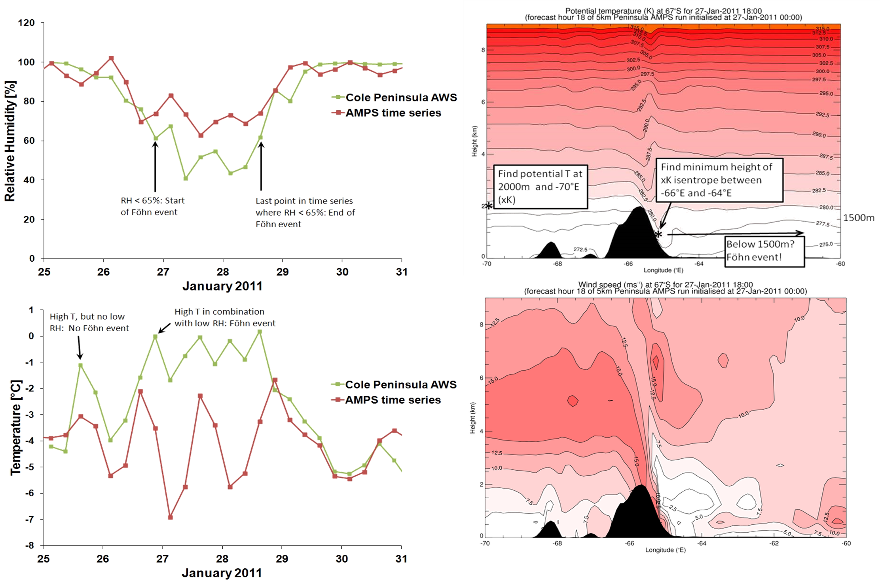
Obs vs Sim

Slide 15
Observations vs simulations
AMPS overestimates the near surface Temperature
AMPS underestimates near surface Relative Humidity
Wind speed and direction do not agree that well. In such complex terrain this is not unexpected.
Generally the model does a good job simulating meteorological conditions at Cole Peninsula
n = 1352 | T [° C] | p [hPa] | RH [%] | u [m/s] | v [m/s] | ff [m/s]
AWS | -12.3 ±10.3 | 942.7 ±11.9 | 84 ±23 | 1.5 ±4.2 | -1.8 ±1.7 | 3.9 ±3.3
AMPS | -11.8 ±8.6 | 942.5 ±12.2 | 81 ±19 | 3.8 ±4.5 | 1.2 ±4.9 | 6.6 ±4.7
Mean bias | 0.5 | -0.2 | -2 | 2.3 | 3.0 | 2.7
Correlation | 0.93 | 0.99 | 0.76 | 0.28 | -0.07 | 0.49
RMSE | 3.88 | 1.59 | 15.6 | 5.68 | 6.07 | 5.05

Slide 16
Temperature
generally model and observations agree well
for „no Föhn“ data points the model overestimates temperature
for „Föhn“ data points the model underestimates the temperature

Slide 17
Relative humidity
generally good agreement, less so in winter
for „no Föhn“ data points the model underestimates RH
for „Föhn“ data points the model overestimates RH
Föhn vs no Föhn
Notes:
During "no Föhn" conditions the bias is largest in August, when the atmosphere can be expected to be driest due to the low temperature. Hence a small error in the moisture content of the air can make a big difference in relative terms, especially as the temperature is overestimated in the model, thus increasing the saturation value to which the actual moisture content is related to.

Slide 18
Föhn versus no Föhn
Significantly higher T during Föhn than no Föhn in both data sets
Significantly lower RH during Föhn than no Föhn in both data sets
AMPS underestimates T during Föhn
AMPS overestimates RH during Föhn
 | T [° C] | p [hPa] | RH [%] | a [g/m^3] | u [m/s] | v [m/s] | ff [m/s]
no Föhn (AWS): | -16.9± 8.8 | 942.9±11.8 | 97 ± 5 | 2.9±0.8 | 2.3 ± 4.0 | -1.7 ± 1.5 | 3.8 ± 3.4
Föhn (AWS) | -0.4 ± 4.9 | 943.4 ±11.4 | 46 ± 13 | 2.2±0.6 | -0.9 ± 2.6 | -2.2 ± 2.6 | 3.4 ± 2.7
Difference (AWS) | 16.5K | 0.5 | -51 | -0.7 | -3.2 | -0.5 | -0.4
no Föhn (AMPS): | -15.3 ±7.9 | 942.6 ±12.0 | 91 ± 13 | 1.5±1.0 | 2.7 ± 2.7 | 3.0 ± 3.7 | 5.4 ± 3.0
Föhn (AMPS): | -3.2 ± 4.6 | 942.7 ±11.8 | 60 ± 13 | 2.3±0.9 | 7.6 ± 7.2 | -4.4 ± 4.5 | 10.4 ± 7.4
Difference (AMPS) | 12.1K | 0.1 | -31 | 0.8 | 4.9 | -7.4 | 5.0

Slide 19
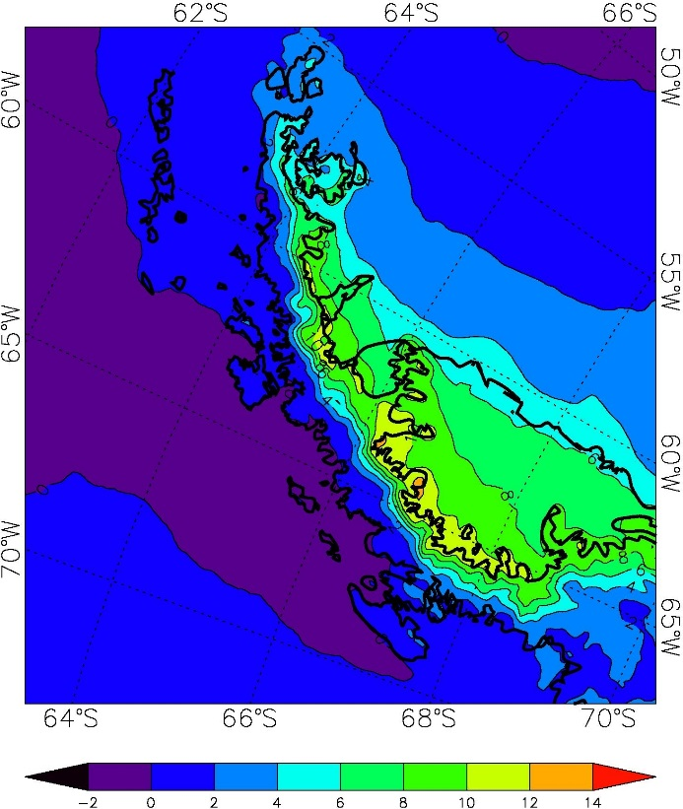
Up to 12K difference in surface near air temperature are shown in model output between Föhn and no Föhn conditions.
The largest difference occurs at the foot of the Antarctic Peninsula mountains.
Difference in modelled 1.5 m temperature (K) between composites for Föhn and no Föhn conditions.

Slide 20
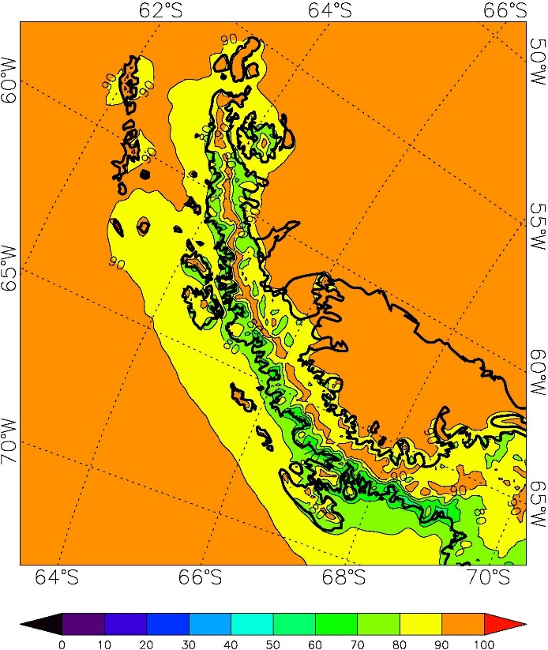
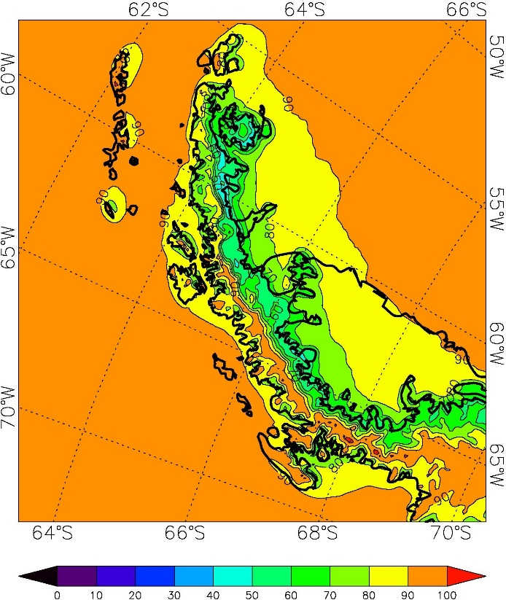
a)
b)
Simulated RH shows a stark contrast between Föhn and no Föhn conditions.
Largest differences are found in the direct lee of the spine of the Antarctic Peninsula mountains.
Composite plots of relative humidity with respect to ice for non-Föhn (a) and Föhn (b) conditions based on AMPS data (lowest model level, ~16m).

Slide 21
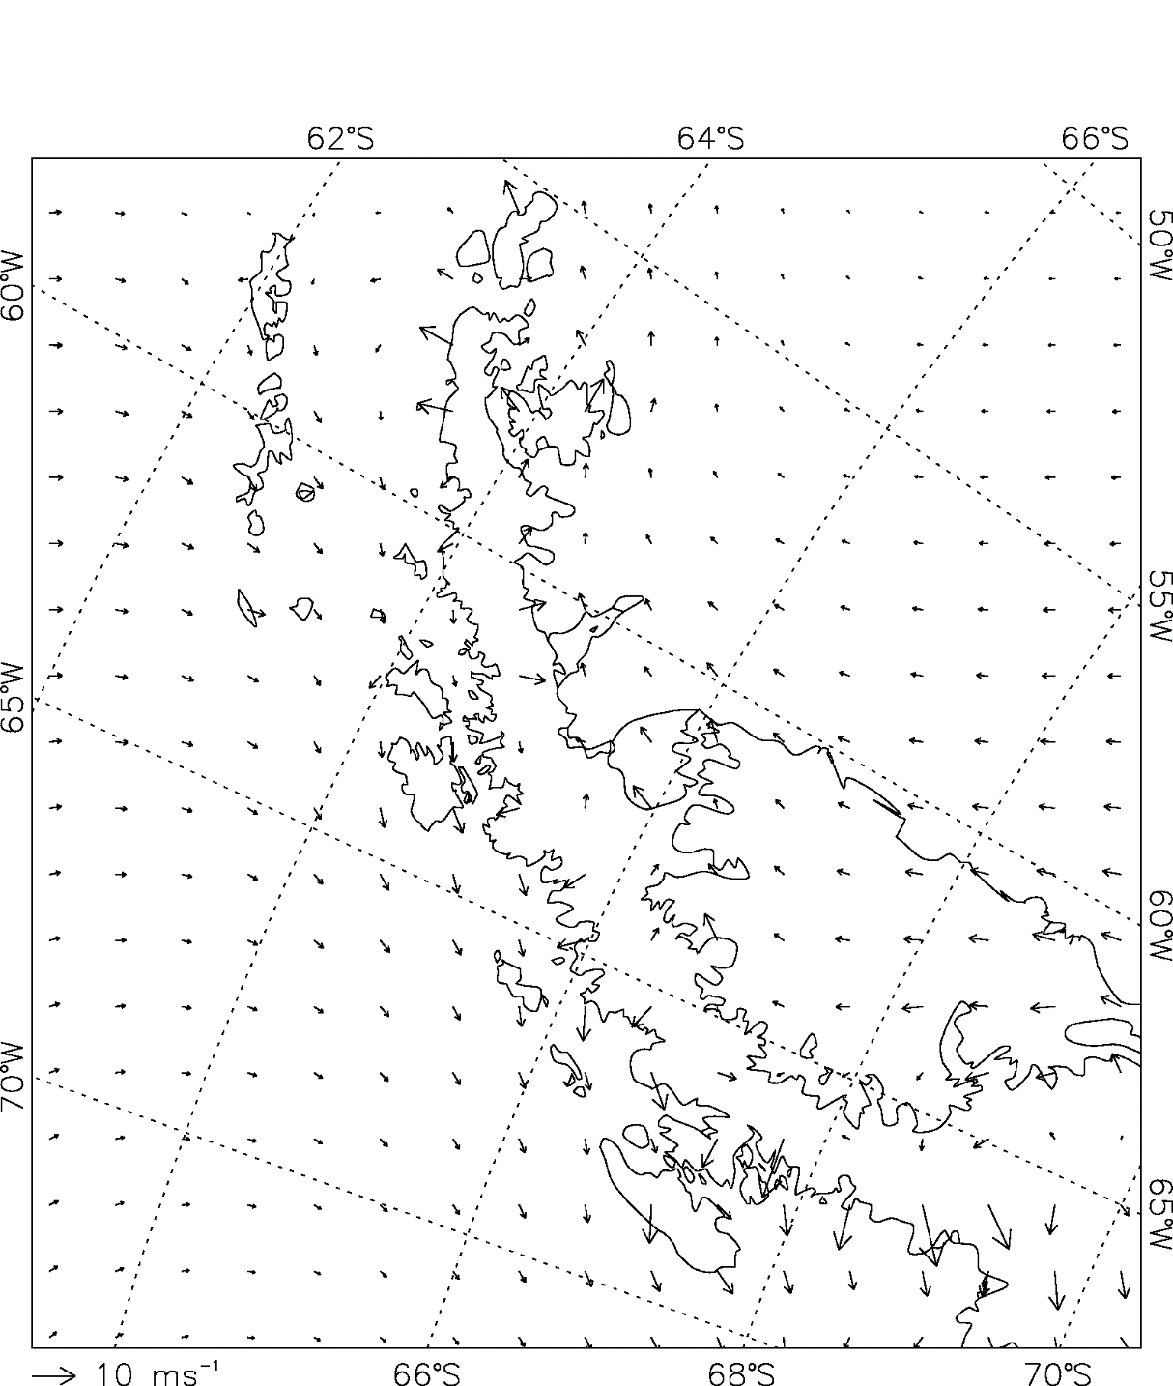
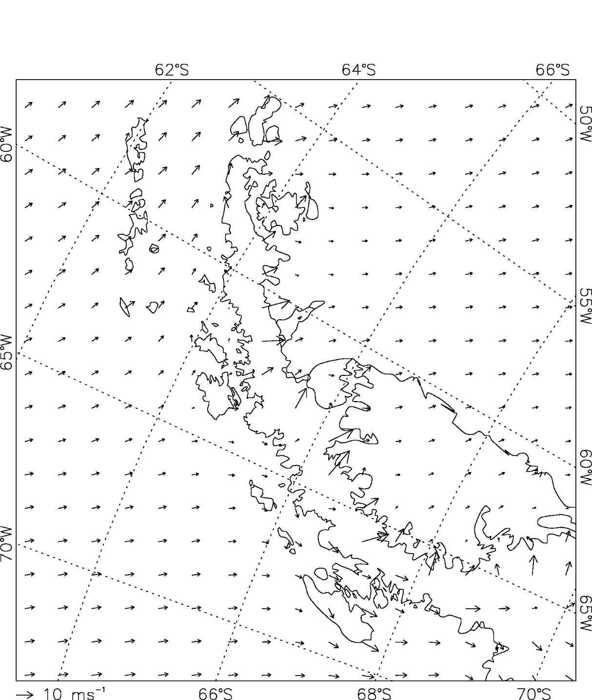
The blocking effect of the mountain range during normal conditions is clearly visible (left).
Strong cross barrier winds from NW to W dominate during Föhn conditions (right).
Composite plots of the wind speed and direction at 10m height for non-Föhn (left) and Föhn (right) conditions during 2011, based on AMPS data.
Clouds

Slide 22
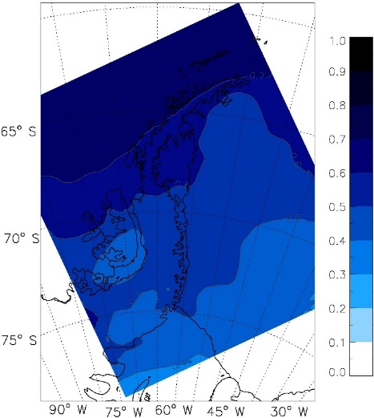
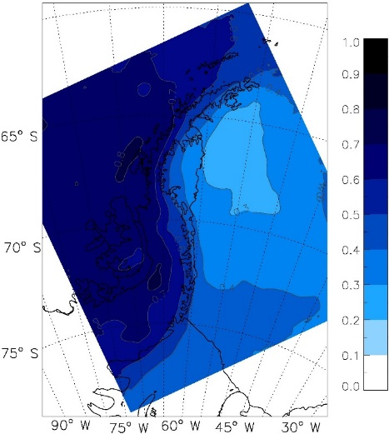
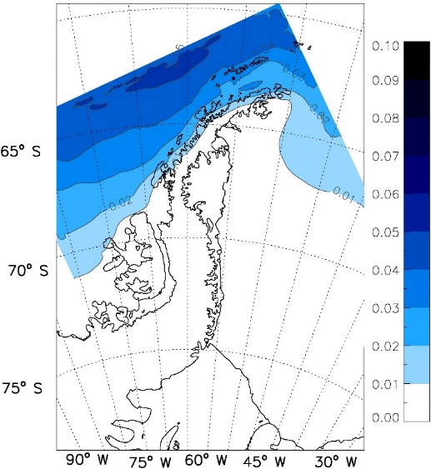
The Role of Clouds
Surface energy balance comparison by King et al. (2015) indicate WRF simulates
low level clouds that are optically too thin.
Experiments by C. Listowski show that independent of cloud scheme, the model
underestimates the fraction of low level cloud, on the windward side. Hence the
cloud clearing effect of Föhn is likely smaller, and thus
the effect on T and RH is also reduced.
Possible reason is the absence of any liquid water in clouds in the area in the simulations.
Studies by Grosvenor et al. (2012) and Lachlan-Cope et al. (2016) have shown that, in reality, a significant amount of liquid water is present in clouds on both sides of the Antarctic Peninsula.
No Föhn Cloud fraction Föhn
Liquid cloud water (all data points)

Slide 23
This comparison of simulated cloud fraction between no Föhn and Föhn shows that the model generally reproduces a cloud clearing effect through Föhn in the lee of the mountain range.
Composite plots of cloud fraction for non-Föhn (left) and Föhn (right) in AMPS in 2011.

Slide 24
The model though does not simulate any liquid cloud or rain water south west of a line from 70°S and 75°W to 65°S and ~62°W.
According to the model all clouds over our study area are ice clouds, which are optically thinner than liquid water or mixed-phase clouds with the same water content.
Studies by Grosvenor et al. (2012) and Lachlan-Cope et al. (2016) have shown that, in reality, a significant amount of liquid water is present in clouds on both sides of the Antarctic Peninsula.

Slide 25
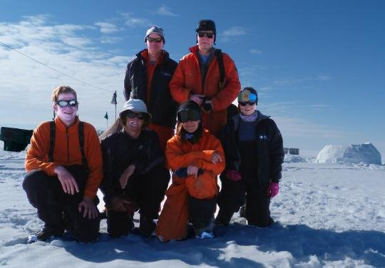
Many thanks for your interest!
The work presented here was supported by the UK Natural Environment Research Council (NERC) under grant NE/G014124/1 “Orographic Flows and the Climate of the Antarctic Peninsula” and by the Netherlands Organisation for Scientific Research under grant 818.01.016. Thanks also go to the Mesoscale and Microscale Meteorology Division at NCAR for giving us access to the AMPS forecast archive, and BAS staff at Rothera Research Station for supporting the field measurement programme.
This work has been published under
Kirchgaessner, Amelie , King, John, Gadian, Alan. (2020) The representation of Föhn events to the east of the Antarctic Peninsula in simulations by the Antarctic Mesoscale Prediction System (AMPS). Journal of Geophysical Research: Atmospheres, 124. 17 pp. 10.1029/2019JD030637

