Slide 1
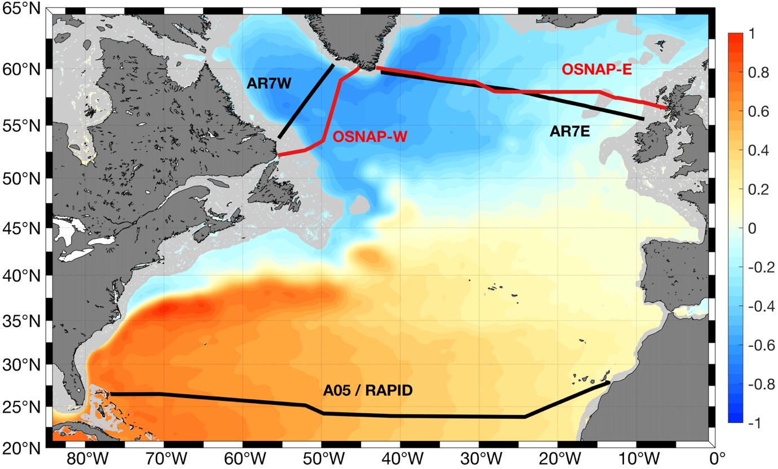
A stable Atlantic Meridional Overturning Circulation in a changing North Atlantic Ocean
EGU2020 | May 05, 2020
Yao Fu^{[1]}, Feili Li^{[2]}, Johannes Karstensen^{[3]}, Chunzai Wang^{[1]},
Hydrographic sections:
Labrador section:
AR7W / OSNAP-West lines
repeated nearly each year
Eastern SPNA section:
AR7E / OSNAP-East lines
repeated about every 2-4 years
Subtropical section:
A05 line
6 repeats available since the 1990s
^{[1]} South China Sea Institute of Oceanology, Chinese Academy of Sciences, Guangzhou, China
^{[2]} Georgia Institute of Technology, Atlanta, GA, USA
^{[3]} GEOMAR Helmholtz Centre for Ocean Research Kiel, Kiel, Germany

Slide 2
Dramatic subpolar hydrographic changes between the decades
Decadal Salinity differences in the SPNA compared to the 1990s
Dramatic upper layer waters changes in the eastern SPNA
  due to NAO-induced convection and circulation changes
  (e.g. Holliday et al., 2020)
Dense LSW more saline in the 2010s
  indicating weaker convection
Overflow waters salter in the 2010s
  maybe due to excessive salt transport in the 2000s
What is the state of the AMOC over the past decades alongside the dramatic hydrographic changes?

Slide 3
AMOC strength from array-observations, GECCO2, and Hydrography
AMOC from hydrography determined using the box inverse method
The inverse model constrained using annual mean Ekman transport, Florida Current transport, and AVISO velocity for the subpolar sections.
GECCO2 :
agrees well with RAPID and OSNAP-East
overestimate in the Labrador Sea
Hydrography-based estimates:
consistent with array-based observations at all sections attributed to annual mean AVISO velocity
the AMOC in the 2010s not distinctly different from that in the 1990s
Eastern SPNA dominates the overturning on decadal timescales

Slide 4
Conclusions
Dramatic subpolar hydrographic changes over the past three decades
in contrast
Stable AMOC in terms of overturning strength and east-west partition of the SPNA over the same period
AMOC changes and interior property changes are decoupled to a higher degree than expected

Slide 5
Appendix
Additional materials

Slide 6
Dramatic subpolar hydrographic changes between the decades
Decadal potential temperature and Oxygen differences in the SPNA compared to the 1990s

Slide 7
Validation of the inverse method: Mean velocity sections from hydrography
SPNA mean velocity section
Very robust mean circulation features
Key circulation elements well reproduced
IC
NAC
LC
WGC
EGC
LC: Labrador Current
WGC: West Greenland Current
EGC: East Greenland Current
IC: Irminger Current
NAC: North Atlantic Current

Slide 8
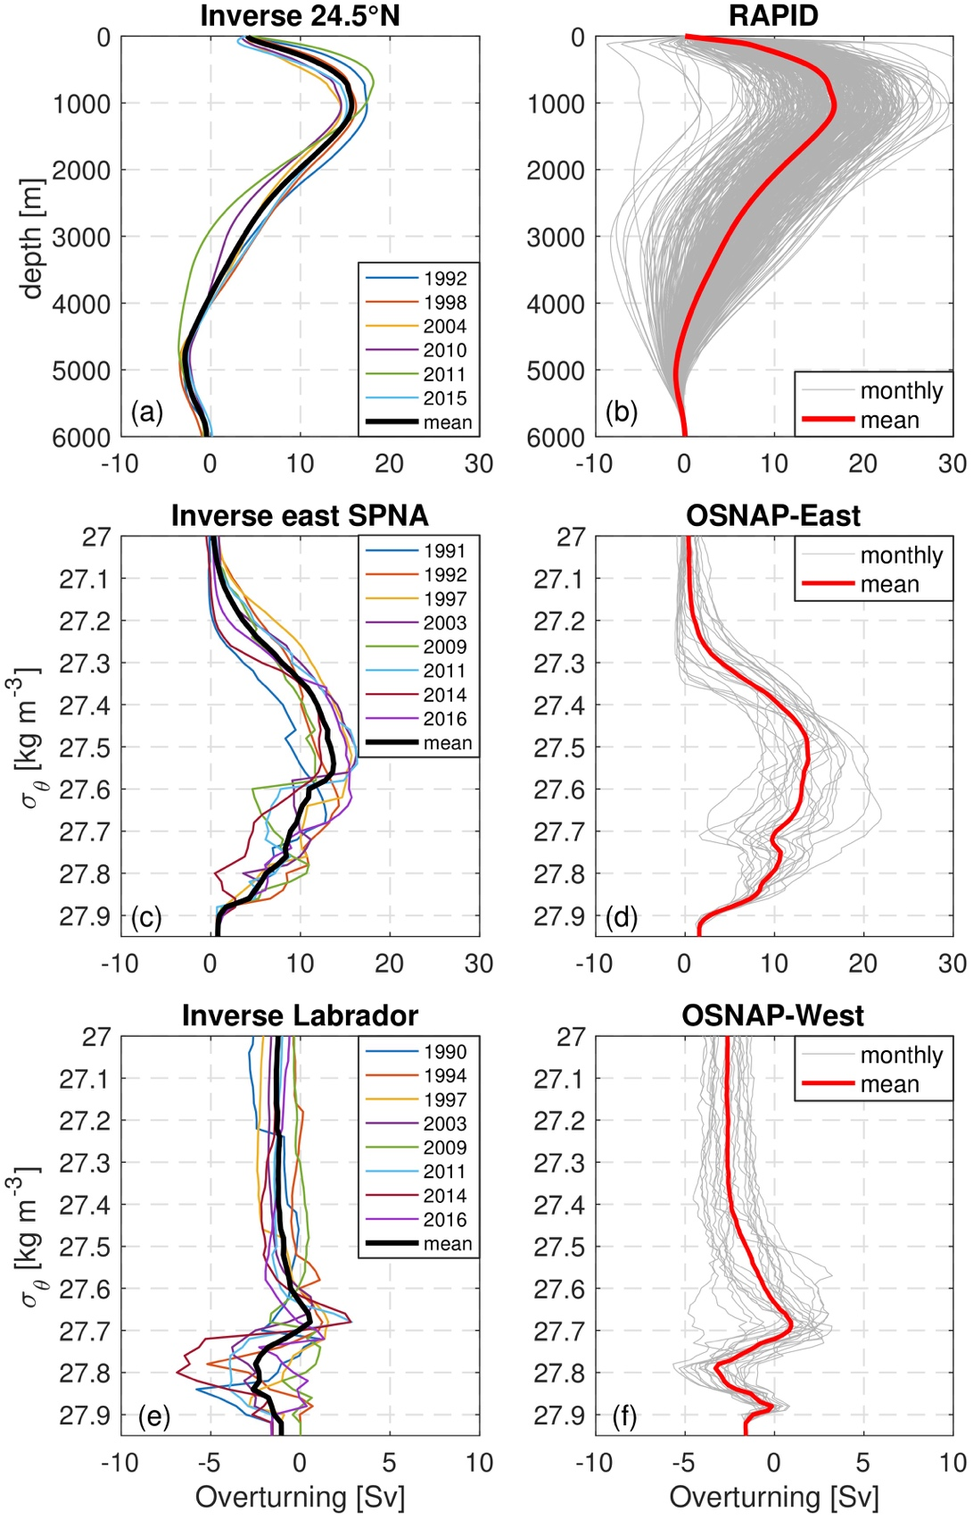
Validation of the inverse method: Overturning streamfunction
Very consistent overturning structure with array observations
Mean AMOC strength [Sv]:
Sections | Inverse | Array
Subtropics | 16.4±1.2 | 17.6±3.8
East SPAN | 14.4±1.9 | 15.6±0.8
Labrador | 1.6±0.8 | 2.1±0.3
Definition: maximum of the overturning streamfunction

Slide 9
Combination of the sections for the inverse model
Inverse box number | Subtropical section | Eastern SPNA section | Labrador section
1 | A05-1992 | AR7E-1991 | AR7W-1990
2 | A05-1992 | AR7E-1992 | AR7W-1994
3 | A05-1998 | AR7E-1997 | AR7W-1997
4 | A05-2004 | AR7E-2003 | AR7W-2003
5 | A05-2010 | AR7E-2009 | AR7W-2009
6 | A05-2011 | AR7E-2011 | AR7W-2011
7 | A05-2015 | OSE-2014 | OSW-2014
8 | A05-2015 | OSE-2016 | OSW-2016
For any box, only repeats occupied in nearby years are used
A05-1992 and A05-2015 are used twice to increase the number of estimates in the SPNA.

