Slide 1
Investigation of spatial and temporal salinity distribution in river deltas through idealized numerical modelling
Constantinos Matsoukis, Laurent O. Amoudry, Lucy Bricheno, Nicoletta Leonardi
06/05/2020
Open session on coastal and shelf seas

Slide 2
River deltas
Highly fertile regions – accommodating rural and agricultural activities
Half a billion people dependant on deltaic ecosystems
Threatened by sea level rise, variations in riverine flow, changes in land-use practices
Increased salinity in deltaic regions can be detrimental for anthropogenic activities (irrigation, agriculture, drinking water etc.) and the environment (wildlife, plant succession, fisheries dynamics etc.)

Slide 3
Questions
METHODS
Numerical modelling to simulate hydrodynamics and salinity field for a river dominated delta
Investigation for the existence of any correlations between salinity and delta’s features
Qualitative comparison with the appropriate field data
Can we describe spatiotemporal salinity distribution in deltas based on estuarine physics theory?
Can we derive simple correlations between salinity and delta’s features?

Slide 4
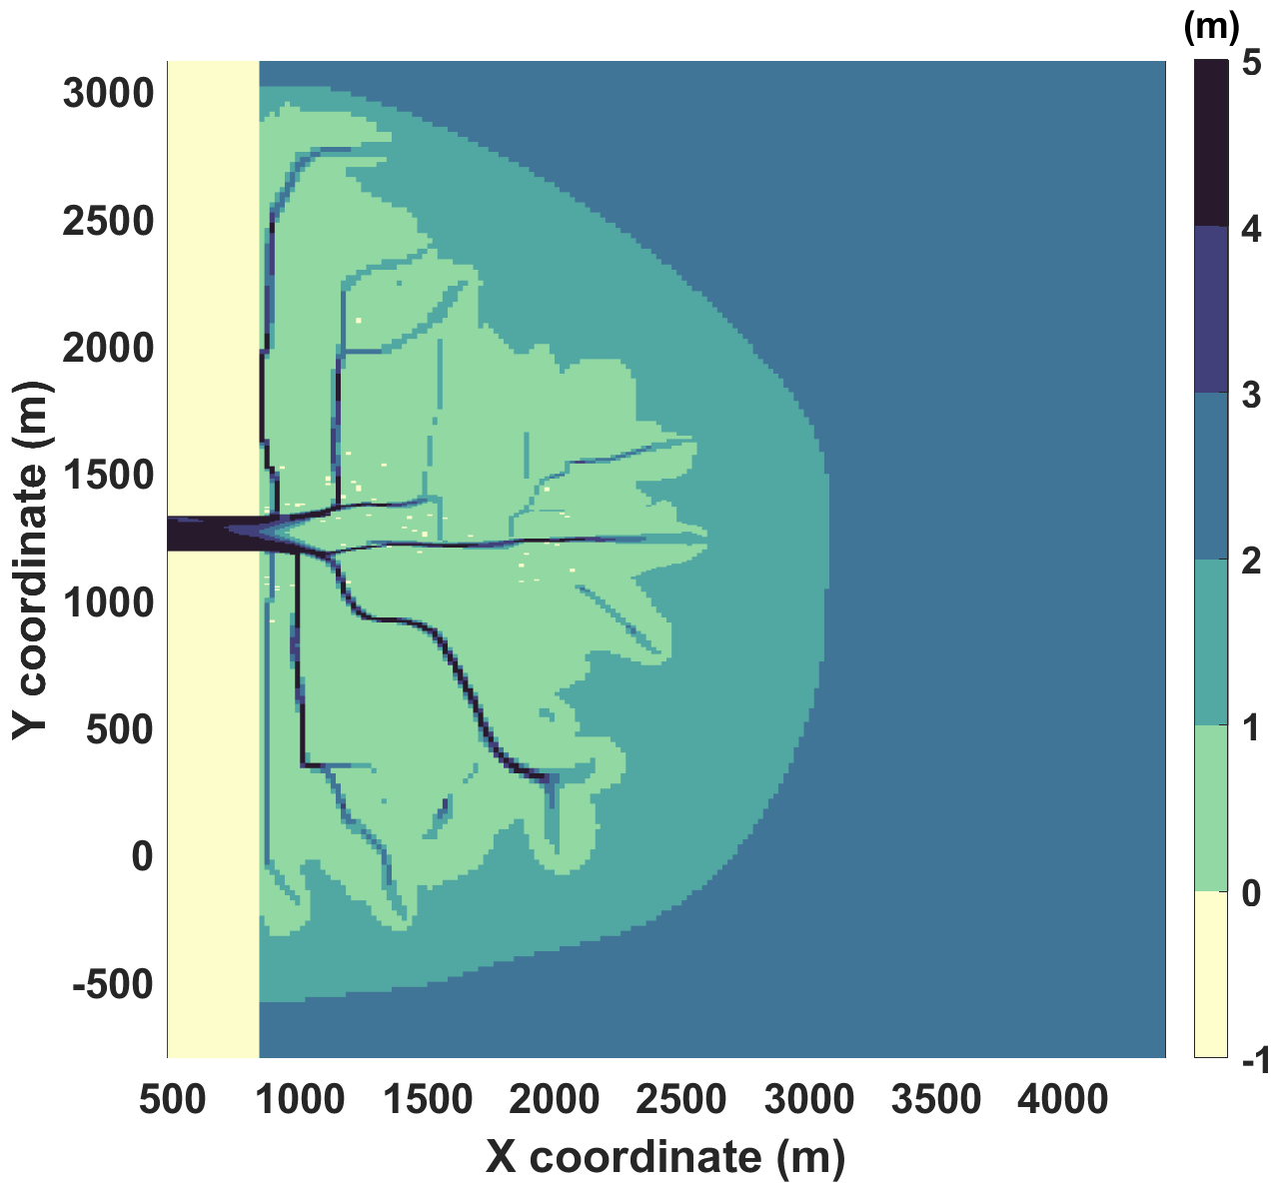
IDEALIZED MODEL FOR A RIVER DOMINATED DELTA
An idealized delta model is built in DELFT3D (Deltares)
A delta bathymetry is produced by a high and constant river flow carrying sediments that enters from a rectangular inlet (400m*200m) in a water basin, eroding the bed and depositing sediments aside.
Input bathymetry for salinity simulations
No coupling between salinity and sediment transport (frozen bathymetry for salinity simulations)

Slide 5
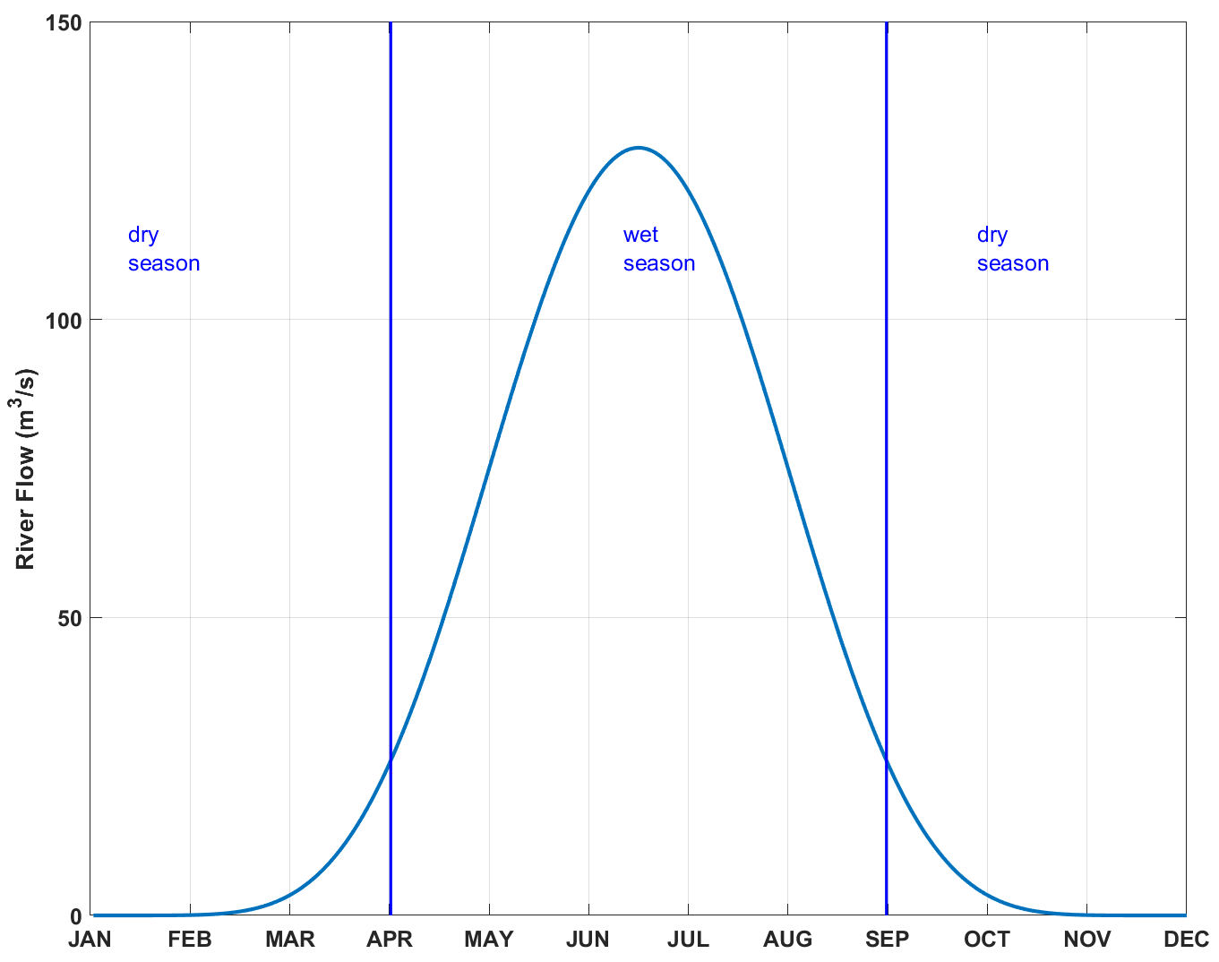
MODEL SETUP
Simulation period : 1 year
Time step : 0.5 minutes
Four (4) σ layers in the vertical
River boundary
Fresh water flow, an annual hydrograph with a Gaussian distribution
Fresh water salinity (0 PSU)
Offshore boundary conditions:
Zero water level, constant in time
Constant salinity equal to 30 psu
Lateral Boundary conditions
Riemann condition (weakly reflective boundary)
Free salt transport (the model is allowed to calculate its own values at the boundaries)

Slide 6
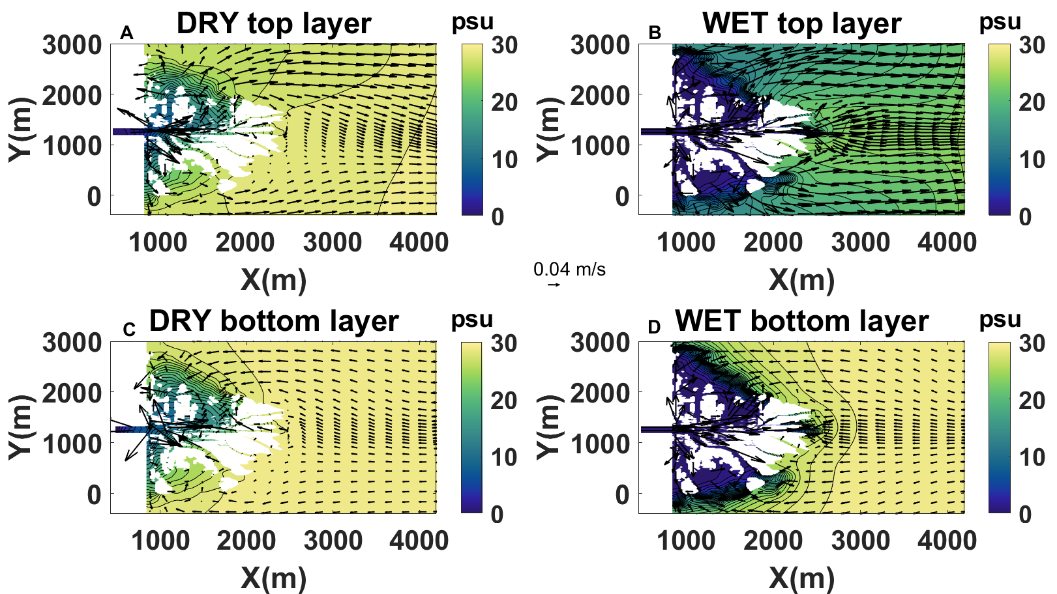
MODELLING RESULTS
Monthly averaged salinity isohalines and flow vectors at the driest and wettest months for top and bottom layers

Slide 7
MODELLING RESULTS
Monitoring the development and evolution of a freshwater area defined as the areas inside the delta where salinity is below 2 PSU during dry and wet season
DRY SEASON
Narrow freshwater area restricted around the river inlet.
Salt intrusion in the inlet during periods of lowest flows
WET SEASON
Formation of an offshore buoyant plume
Top layer salinities are reduced throughout most of the domain while bottom layer salinities still show a sharp gradient around the delta limit

Slide 8
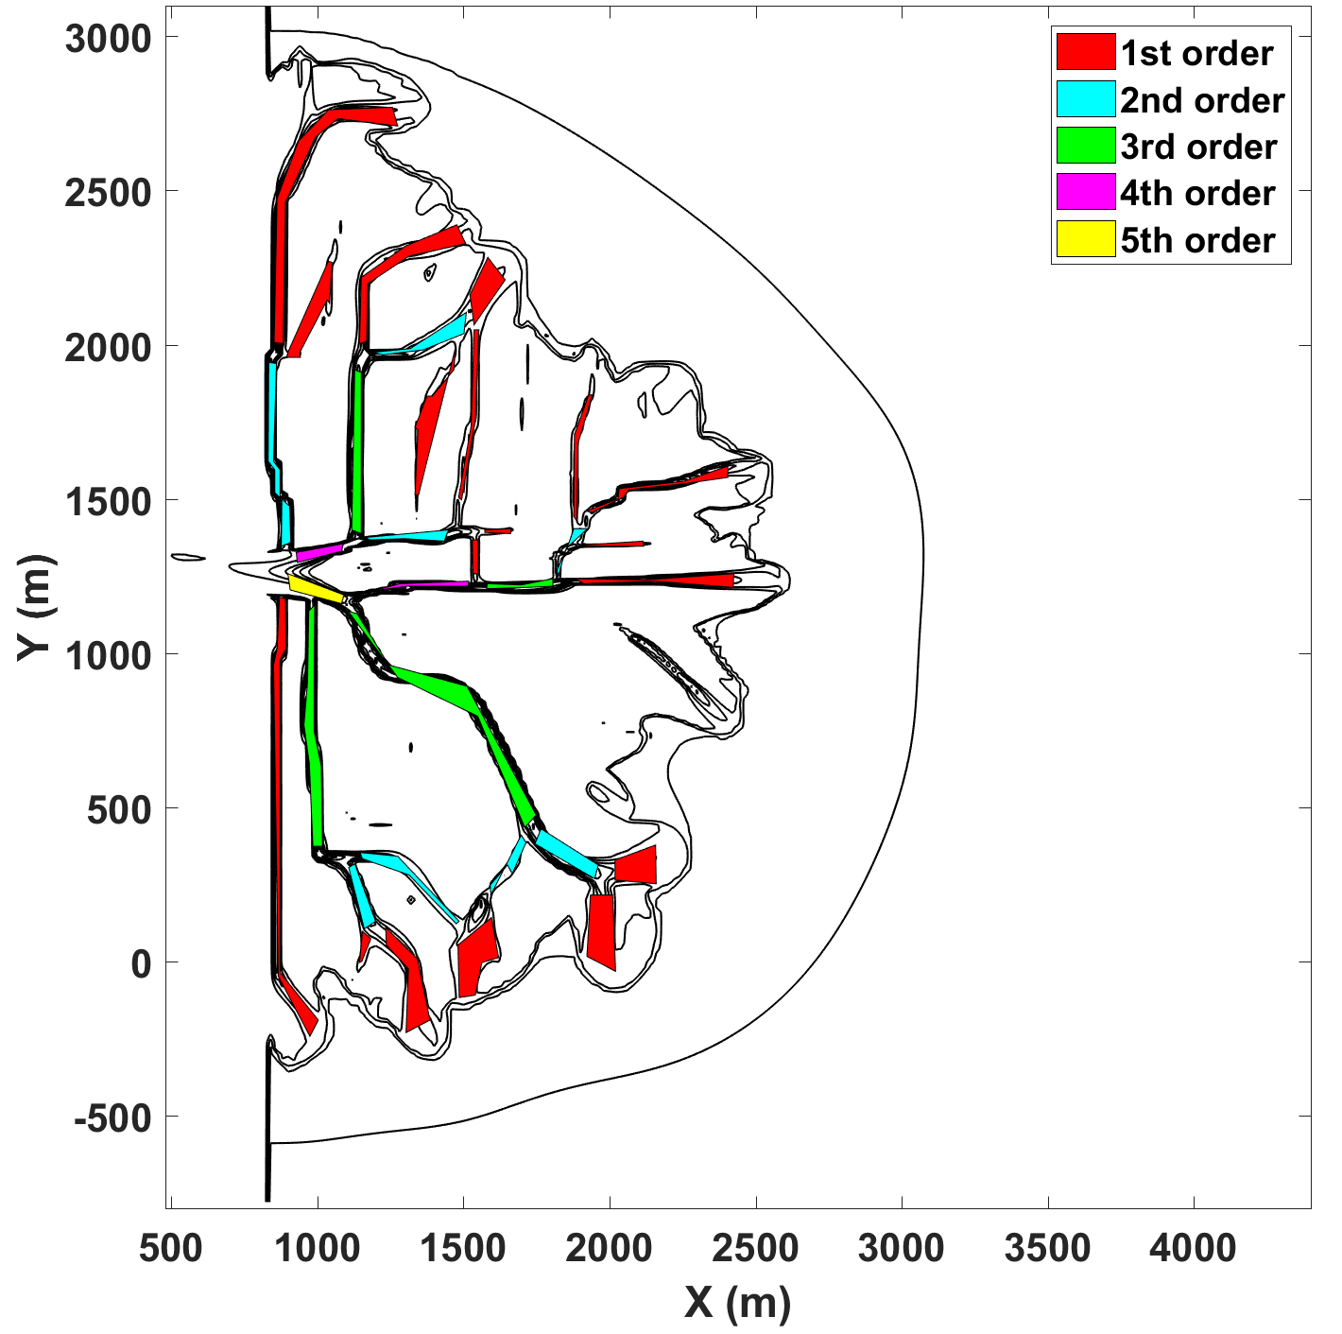
CLASSIFICATION OF DELTA CHANNELS
Every delta channel is assigned a stream order number based on the Strahler-Horton method (1952)
Channels with no junctions are 1st stream order channels
Second stream order channels begin at the confluence of two first stream order channels
Stream order increases by one if a channel receives channels of the same stream order
When a stream of a given order receives a channel of lowest order, its own order does not change
The idealized delta has a 5th order bifurcation

Slide 9
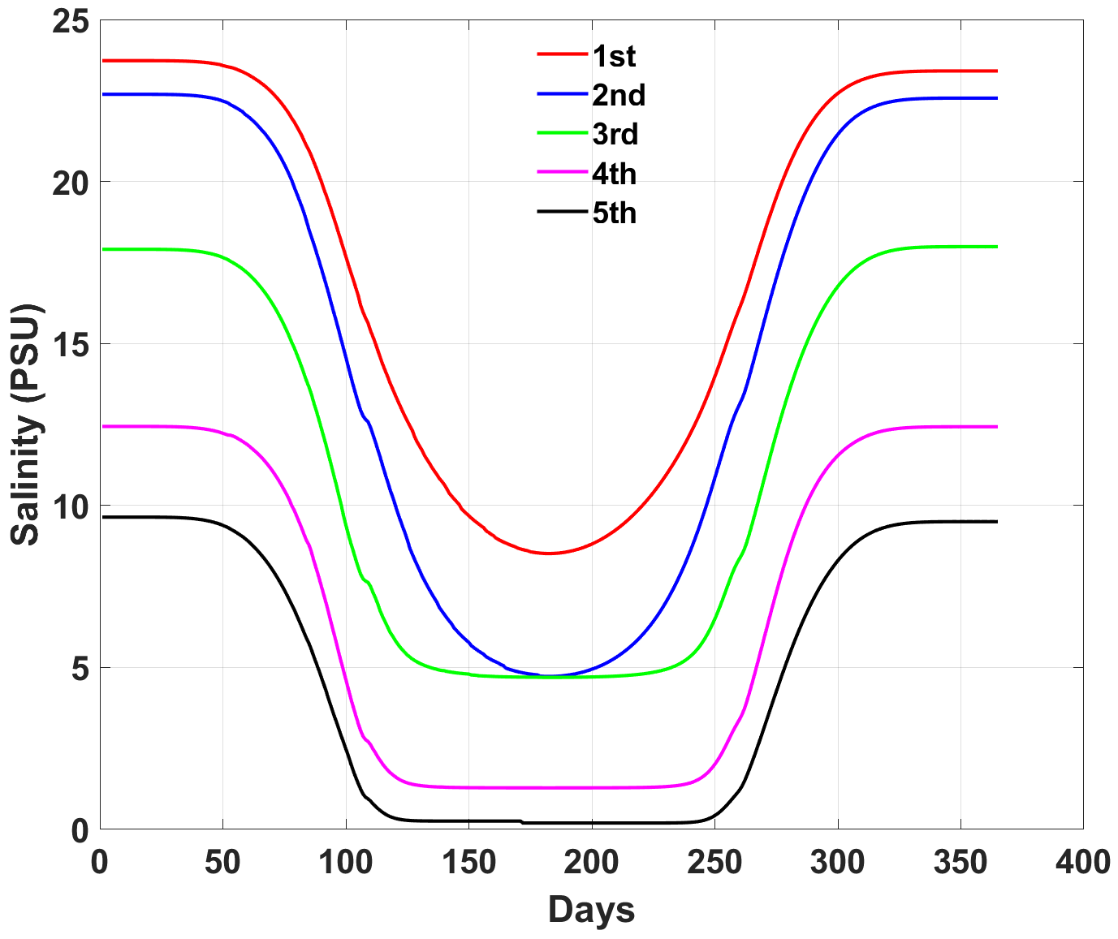
Correlations with channel bifurcation order
Temporal evolution of the depth-averaged salinity averaged within channels of the same stream order
Salinity and channel stream order are inversely proportional
Maximum salinities at low order channels (most distant)
Minimum salinity at high order channels (most proximal to the river)

Slide 10
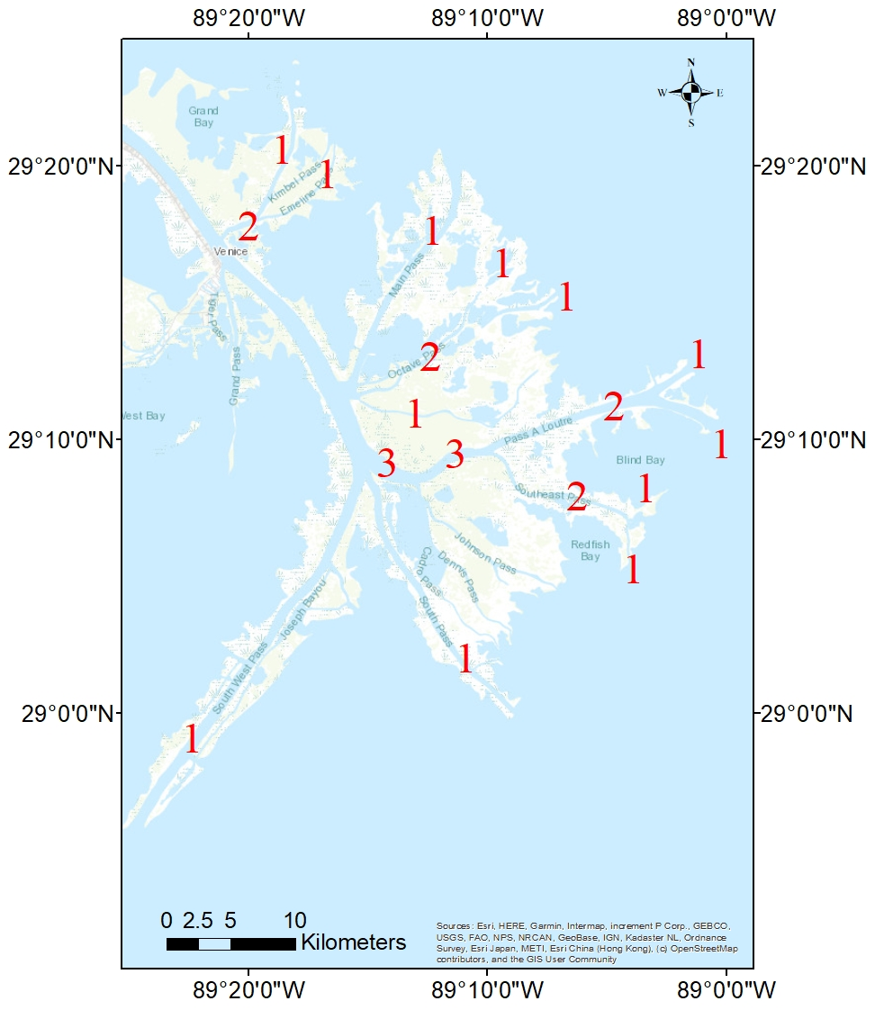
COMPARISON WITH A REAL DELTA
The Mississippi River Delta is also a river dominated delta
Channels of 1st, 2nd and 3rd order were identified
Monthly averages of salinity observations from Mississippi Delta (www.saveourlake.org) and river flow measurements (usgs.gov) are available
The same methods are implemented in the real data for comparison

Slide 11
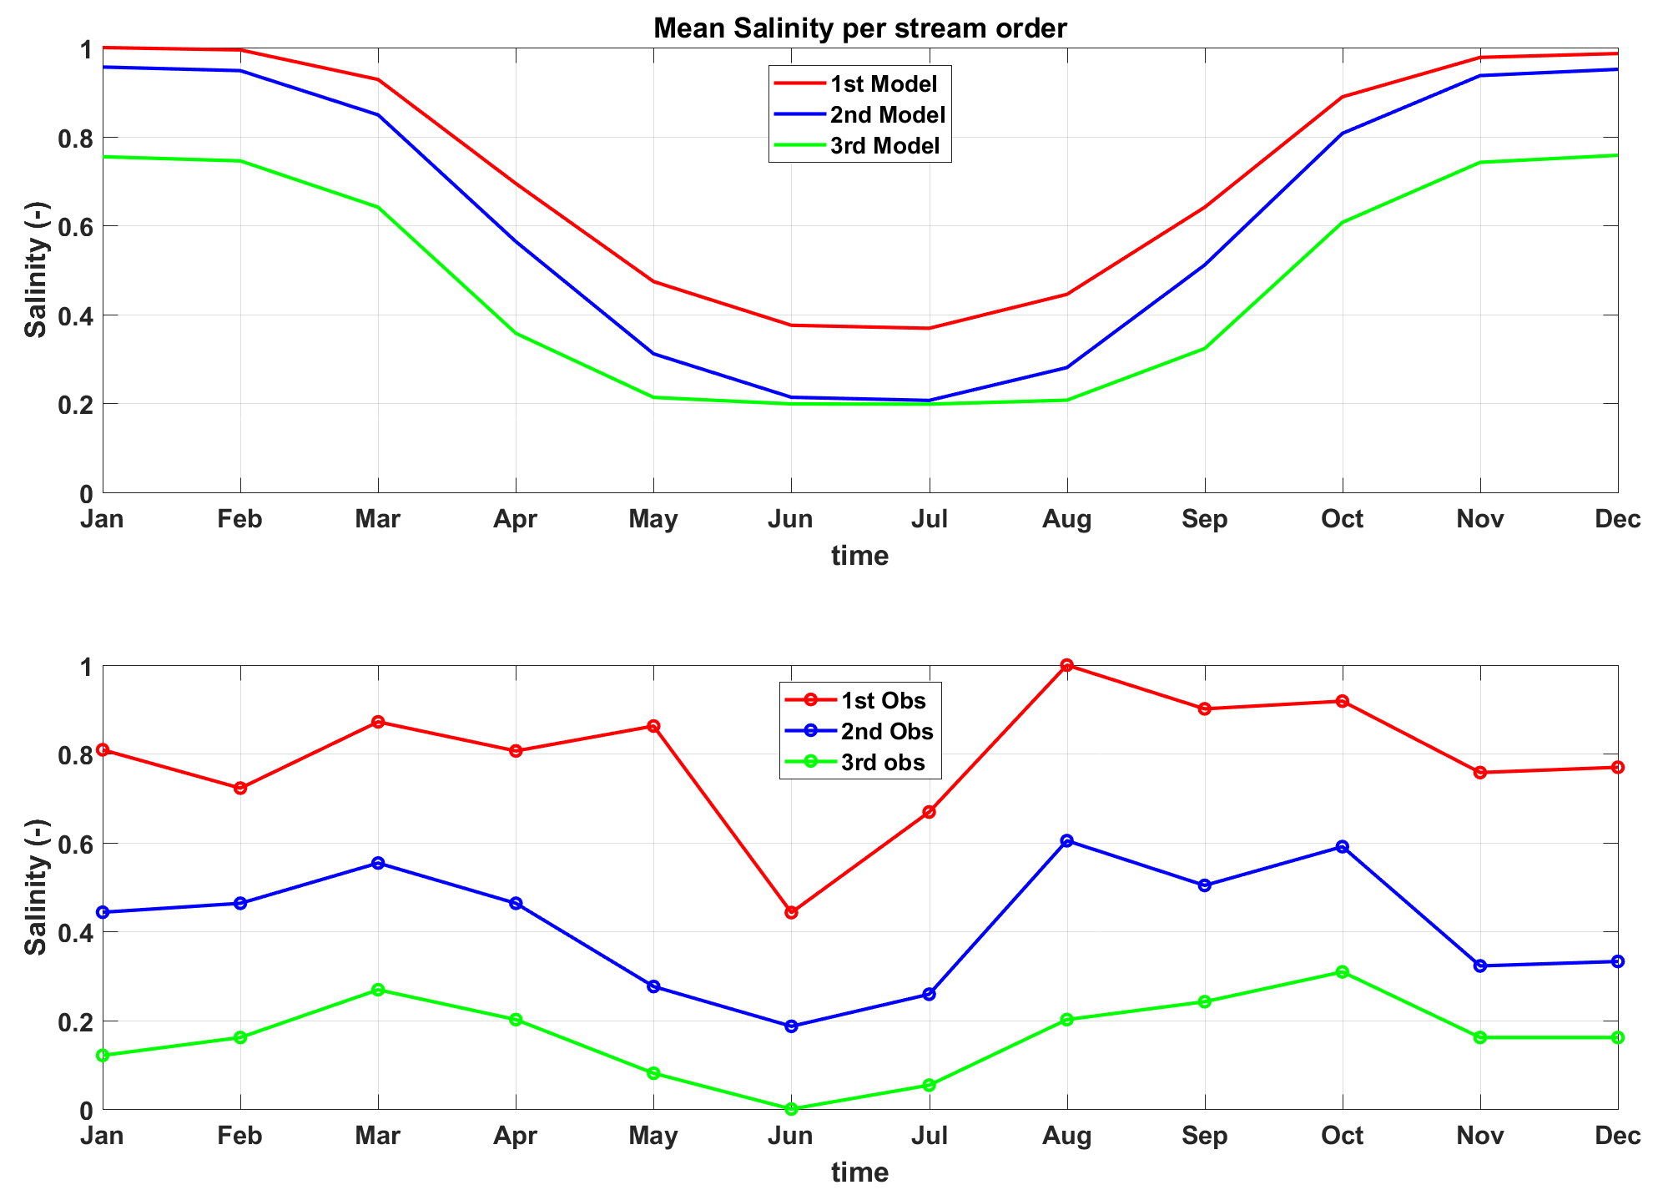
MODEL –OBSERVATIONS COMPARISON
Monthly averages of salinity averaged over channels of the same stream order (normalized by their maximum results)
The correlation between salinity and bifurcation order is also present in the Mississippi Delta
Salinity and stream order number are inversely proportional

Slide 12
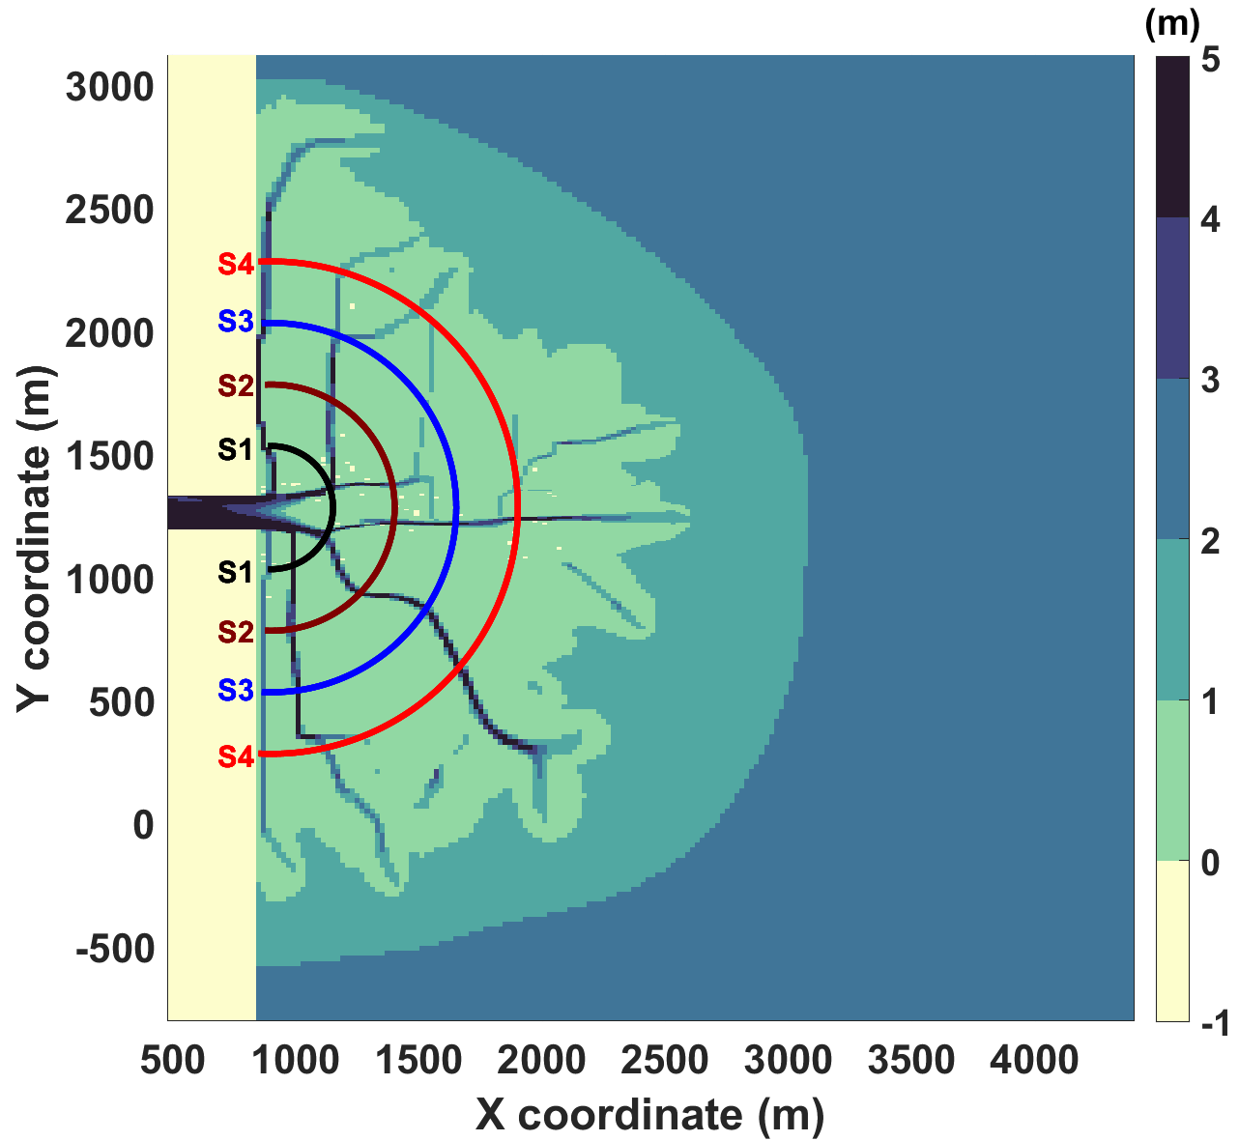
DERIVATION OF AN ANALYTICAL EXPRESSION
A polar coordinate system is imposed at the idealized delta with its centre at the exit of the river inlet
The position of any point inside the delta can be expressed by a radius r denoting the distance from the river and an angle φ with the horizontal along the delta (ro )
Salinity is averaged then along four (randomly selected) semicircles with distances 250m (S1),500m (S2),750m (S3) and 1km (S4) from the river exit
r
r
φ
o

Slide 13
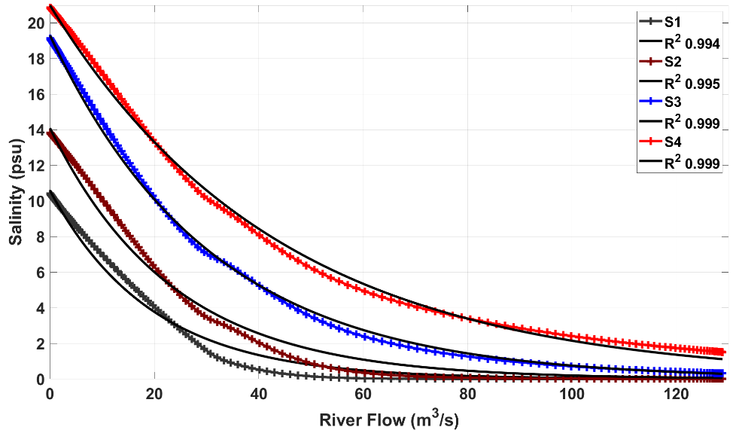
DERIVATION OF AN ANALYTICAL EXPRESSION
The averaged along the semicircles daily salinity (S) is plotted against the daily river flow (Q)
The two magnitudes (S,Q) are negatively and exponentially correlated

Slide 14
DERIVATION OF AN ANALYTICAL EXPRESSION
$$〈\overline{S(r,t)}〉= 〈\overline{S_{ini}\left(r\right) }〉∗\exp^{−β\left(r\right)Q\left(t\right)}$$
Brackets denote depth averaged and overbars radially averaged values
$S_{ini}$ is the salinity at time $t$=0
The exponent coefficient β is a function of distance (r) that decreases seaward
Exponential correlations between salinity and river flow have been found in estuarine systems (Zimmerman 1988;Denton and Sullivan 1993;Peterson et al.1996)

Slide 15
SIGNIFICANCE OF THE ANALYTICAL EXPRESSION
Salinity (S) in some distance $r$ from the river and at a specific time moment $t$can be predicted for a known flow hydrograph Q($t$)
It successfully approximates the problem despite the non-uniform bathymetry and unsteady conditions
Dimensionality is reduced by depth and radial averaging
The solution holds for both low flow periods (buoyancy dominated) and high flow periods (inertia dominated)

Slide 16
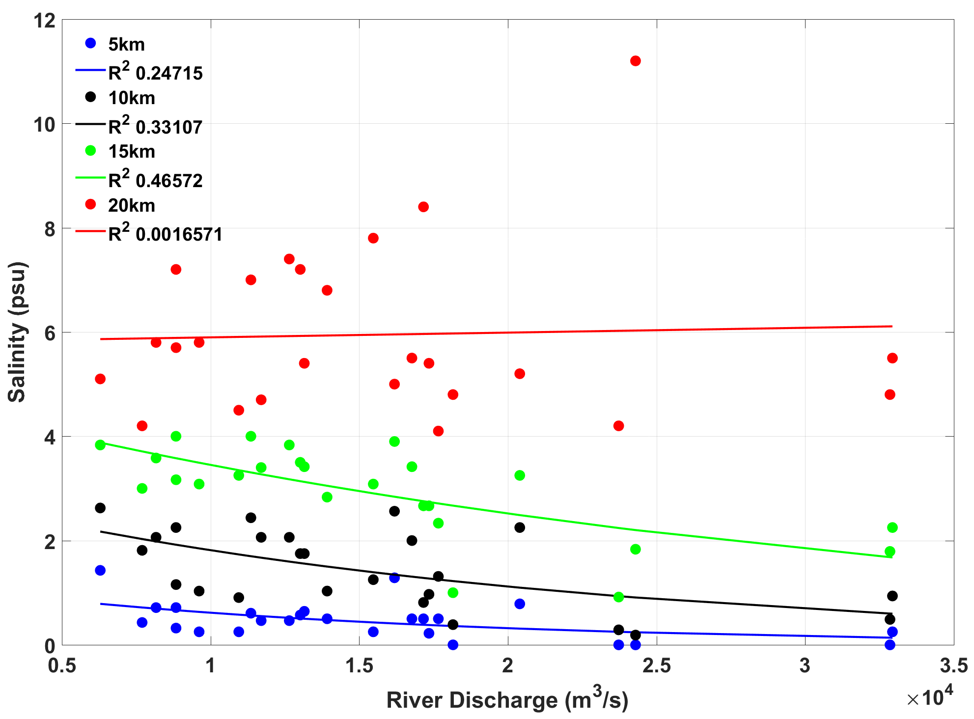
IMPLEMENTATION OF THE SAME METHOD IN THE MISSISSIPPI RIVER DELTA
Investigation of an exponential correlation between salinity and river flow in the Mississippi Delta
Salinity is averaged within points in distance of 5km,10km,15km and 20km from the main river branch
Salinity and flow averages every fortnight are compared
Exponential fitting is weaker than in the model
Data is much more scattered in long distances

Slide 17
LIMITATIONS OF THE ANALYTICAL EXPRESSION
It assumes steady state conditions, constant channel cross section and diffusion coefficient
It refers to a non-rotating case and it does not include tides or wind/waves driven mixing
External forcing (other than river flow) would have an impact on the vertical structure, the thickness and the shape of the freshwater area weakening or even altering the exponential correlation between salinity and river flow
The above could justify the weaker exponential fitting of the Mississippi Delta data

Slide 18
CONCLUSIONS
Model results indicate the existence of a negative and exponential correlation between salinity and river flow that can be summarized in an 1D analytical expression
It is possible (under certain limitations) to predict salinity at a certain location and time if the flow hydrograph is known
We can detect delta areas that are most likely exposed to high salinity based on a channels classification scheme by stream orders
Salinity and stream order number are inversely proportional

