Slide 1
Order out of Chaos: Shifting paradigm of convective turbulence
Sergej Zilitinkevich^{1,2}
with contributions from:
Irina Repina³ and Evgeny Kadantsev¹
¹ Institute of Atmospheric & Earth System Research, Univ. Helsinki ² Finnish Meteorological Institute, Helsinki
³ A. Obukhov Institute of Atmospheric Physics, Moscow, Russia
__________________________________________________________________________________________________________
EGU 2020

Slide 2
CONTENT / MOTIVATION
The conventional paradigm of turbulence declares only direct cascade of turbulent kinetic energy (TKE) towards viscous dissipation and only downgradient turbulent fluxes quantified via turbulent exchange coefficients
The paradigm is attributed to Kolmogorov (K-1941-1942), but he limited to the neutrally stratified homogeneous turbulence!
In unstable stratification this means that buoyancy-generated plumes are not distinguished from shear-generated eddies
The concept of the only direct cascade does not explain the energy supply of self-organisation structures, such as rolls and cells in convective boundary layers (CBLs)

Slide 3
Conventional vision of turbulence
Two types of moton: regular mean flow + chaotic turbulence making direct cascade
The energetics is quantified by single Turbulent Kinetic Energy (TKE) budget equation
Turbulent fluxes = gradients multiplied by exchange coefficients (eddy viscosity, conductivity or diffusivity)
Chaos our of order
(Richardson, 1920 → Kolmogorov, 1941)

Slide 4
Convective turbulence in atmosphere
Buoyancy-generated plumes are very
different from shear-generated eddies!

Slide 5
CONVECTIVE (ANARCHY) TURBULENCE in the Procrustean bad of conventional theory
Buoyant plumes do not break down but merge to form larger plumes →
Inverse energy cascade towards self-organised flow patterns cells / rolls → Order out of chaos!
Notes:
http://www.muk.uni-hannover.de/~maronga/animations.html#cbl

Slide 6
New paradigm: the two opposite cascades
Budget of TKE splits
into separate budgets:
of mechanical TKE
and convctive TKE
Shear yields eddies: direct cascade
-
Buoyancy yield plumes: inverse cascade
Divergence of vertical flux of TKE
quantifies the rate of conversion
of TKE into KE of organised motions
.

Slide 7
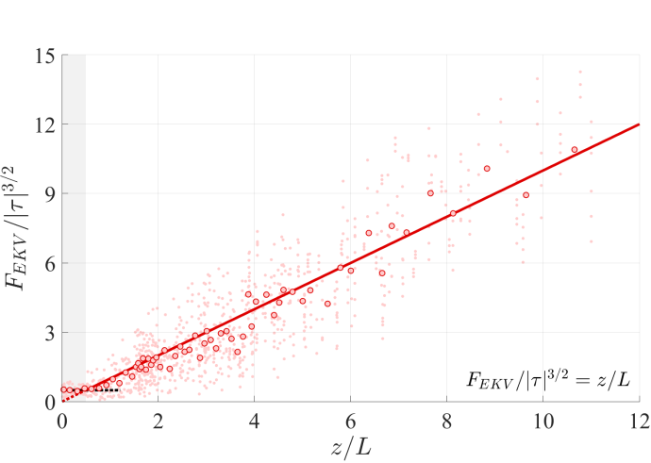
Vertical flux of vertical (convective) TKE
is the Obukhov
Turbulent length
scale trans
The flux is positive and defines . So, TKE is transported upward, counter the gradient!
Its divergence quantifies the rate of conversion of TKE into kinetic energy of self-organised structures.
Experimental data prove separate budget of convective TKE

Slide 8
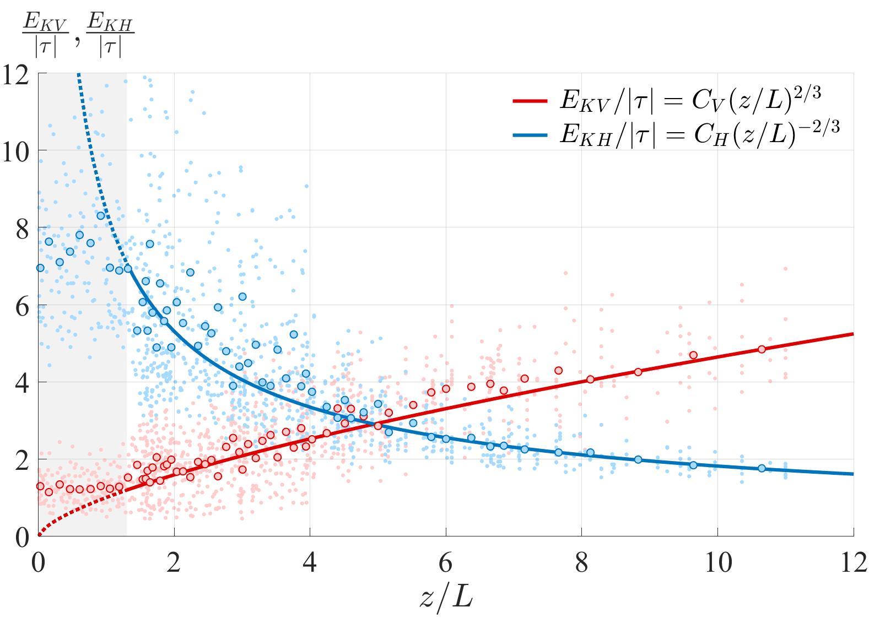
Convective TKE budget yields familiar
(red line and data) while mechanical TKE budget yields heretical (blue line and data)

Slide 9
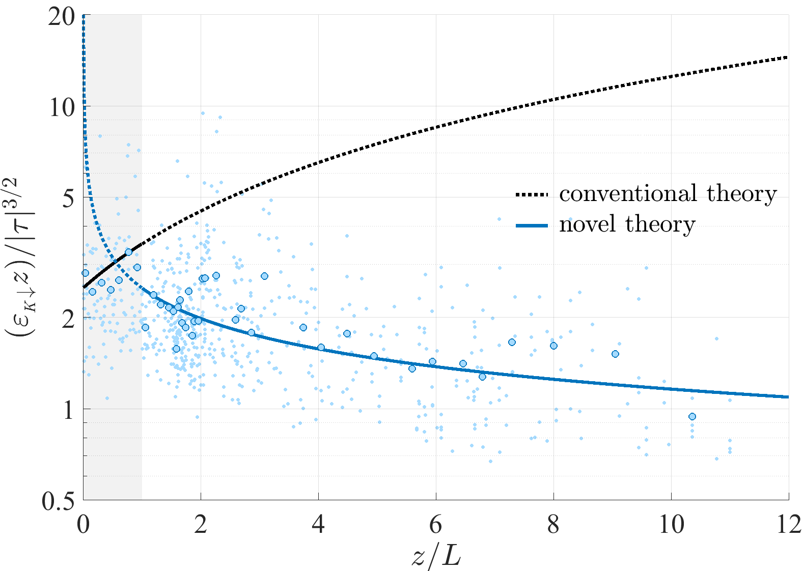
Novel (blue) and conventional (black) vision of the TKE dissipation rate. Experimental data show that only mechanical TKE is subjected to the viscous dissipation

Slide 10
Ratio of horizontal to vertical heat flux vs z/L
K:1941 & MO:1954 valid in the shear-domnated layer
z₀ < z < 0.1L but
fail in the anarchy turbulence layer
0.1L > z > 10L
Conventional view: direct cascade of the presumably
breaking plumes: u´~w´~ (βF_{z}z)^{-1/3} → E_{x,y} /E_{z} = const.
Real picture: u´~ τ/(βF_{z}z)^{-1/3} → E_{x,y}/E_{z} ~ (z/L)^{-4/3}
Data: Kader & Yaglom (1990)

Slide 11
Conclusions
Current theories of unstably stratified turbulence wrongly identify convective turbulence (inverse cascade feeding self-organised structures) with mechanical turbulence (direct cascade) feeding viscous dissipation
Conventional turbulence-closure and similarity theories are principally erroneous but for lucky chance correctly define vertical TKE and vertical turbulent exchange coefficients
Chaos out of order Richardson-1920 → Kolmogorov-1941 → conventional paradigm coexist with
Order out of chaos Prigogine-1982 → New paradigm
The new paradigm provides agenda for comprehensive revision of the theory of unstably stratified turbulence in GEOPHYSICAL and ASTROPHYSICAL fluid flows!
THANKS MUCH FOR YOUR ATTENTION!
http://www.jpgmag.com/photos/1006154

