Slide 1
Experimental imaging of focused fluid flow through a viscous porous rock-analogue.
Reinier van Noort,* Hongliang Wang, Viktoriya Yarushina
IFE, Reservoir Technology, Kjeller, Norway
*) Reinier@ife.no

Slide 2
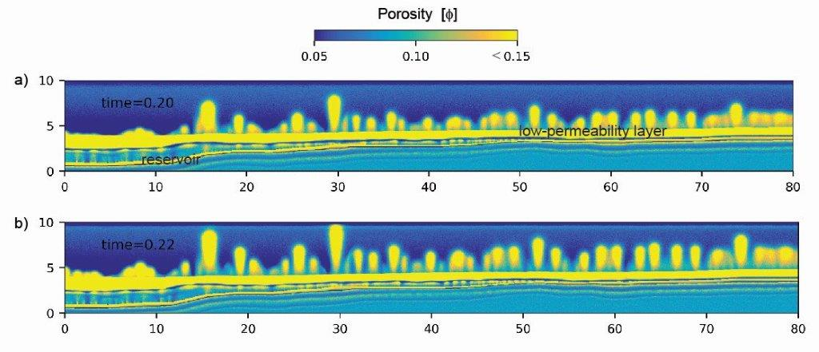
Introduction
Seismic chimneys have been observed in sediments overlying reservoirs containing different fluids, such as water, hydrocarbons, or CO₂. Furthermore, such chimneys have been linked to pockmarks and gas seepages on the seafloor, and may thus provide important leakage mechanisms for fluids stored in reservoirs, such as CO₂.¹
The formation of such chimneys as a result of focused fluid flow through viscous, porous materials has been shown by visco-plastic models.² However, the mechanisms that cause fluid flow to focus along such relatively narrow pathways with transiently elevated permeability have not been investigated thoroughly in experiments. One way to exhibit these mechanisms experimentally, is to perform experiments on analogue materials that allow these mechanisms to occur at timescales, dimensions, and PT-conditions that are easily accessible in the laboratory. Then, these processes, and the conditions under which they do or do not occur, can be studied.
We present analogue experiments carried out in a transparent Hele-Shaw cell, in which a fluid is injected into an aggregate of viscous grains to create transient, focused fluid flow, to be recorded using a digital camera. Then, our preliminary observations are compared to models describing chimney formation.
¹) Chadwick RA, Noy DJ (2010) History-matching flow simulations and time-lapse seismic data from the Sleipner CO₂ plume, Geological Society, London, Petroleum Geology Conference series 7, 1171-1182.
²) E.g., Räss L, Yarushina VM, Simon NSC, Podladchikov YY (2014) Chimneys, channels, pathway flow or water conducting features—an explanation from numerical modelling and implications for CO₂ storage. Energy Procedia 63, 3761–3774.
Simulation results showing the formation of several major chimneys and several smaller fluid flow features, originating from a fluid-filled reservoir.

Slide 3
Method
Using a pump, water with a dye is injected into a transparent, Hele-Shaw type cell with a working volume of (15 x 11 x 0.6 cm³), containing a wet aggregate of viscous grains of selected grain size.
The cell has two exit ports at the top; one open, and one through a steel micropore filter.

Slide 4
Preliminary experimental results
Injecting water into an aggregate of fine viscous grains (~1 mm grain size).
Outflow through port with micropore filter only.
3 pulses of fluid flow up to top level of wet aggregate of viscous grains, and breaking through (creating a mound of grains plus fluid).
Video digitally enhanced to increase contrast; Flickering in video due to use of fluorescent light source. Video playback speed increased 10x.
Observed flow behaviour may be impacted by constricted flow through the exit port.

Slide 5
Preliminary experimental results
Injecting undyed water into a reddish dyed aggregate of fine viscous grains (~1 mm grain size).
Outflow through open port.
Pulsed fluid flow feeding a slowly rising fluid plume (one pulse from 0:17 onwards).
Video playback speed increased 10x. Video otherwise not enhanced.

Slide 6
Numerical models imitating experiments
Governing equations:
Assumption
Incompressible fluids and solid
Viscous compaction
Decompaction weakening
Bulk viscosity is reduced during decompaction
Mass balance
Force balance
Model setup
Compaction length: 1
Model domain: 10*20 unit
Initial condition: background porosity of 0.1
Boundary condition:
Zero flux at the sides
Constant effective pressure at top and bottom
Solid density: 1.1
Fluid density: 1
Darcy flow
Permeability
$$k=k0 {(\frac{ϕ}{ϕ_{0}})}^{3}$$
Bulk viscosity
$$η_{φ}=f(Pe, ϕ, τ)$$
Yarushina & Podladchikov. 2015
Flux injection: 2,5,10 unit

Slide 7
Numerical models imitating experiments
Slow flux injection
Fast flux injection

Slide 8
Conclusion
The experiments show similar pulsed flow as predicted by the models. However, in some tests, flow may have been controlled by other factors than the mechanical behavior of the grain aggregate. Furthermore, due to low density contrasts between aggregate and fluids, flow behavior in our system is very sensitive to flow rate. At too low flow rates, flow through the pore network leads to the formation of a simple fluid plume. At too high flow rates, an open channel is formed, that may be either transient (pulsed) or constant.
Future experiments, now ongoing, focus on pinpointing conditions; excluding other factors controlling fluid flow; and improving imaging.

Slide 9
Questions?
Reinier van Noort
Researcher, IFE Reservoir Technology
reinier@ife.no

