Slide 1




Seasonally fitted probability functions changing weights for combining vegetation indices forecasting models
EGU General Assembly
Vienna, Austria
3–8 May 2020
MAIN MENU
INTRODUCTION
THE PROBLEM
REMOTE SENSING
DATA
STUDY AREA
METHODOLOGY
VI Forecasting
Seasonally varying weights
RESULTS
Decomposition
VI Forecasting
Seasonally varying weights
CONCLUSIONS
CONCLUSIONS
Oumayma Bounouh
Houcine Essid
Imed Riadh Farah
Vienna, May 2020

Slide 2


EGU General Assembly
Vienna, Austria
3–8 May 2020
Seasonally fitted probability functions changing weights for combining vegetation indices forecasting models
Oumayma Bounouh
Houcine Essid
Imed Riadh Farah
Vienna, 7 May 2020

Slide 3
EGU General Assembly
Vienna, Austria
3–8 May 2020
THE PROBLEM
Seasonally fitted probability functions changing weights for combining vegetation indices forecasting models
COMBINING LOCAL SCALING AND GLOBAL METHODS TO DETECT SOIL PORE SPACE

Slide 4

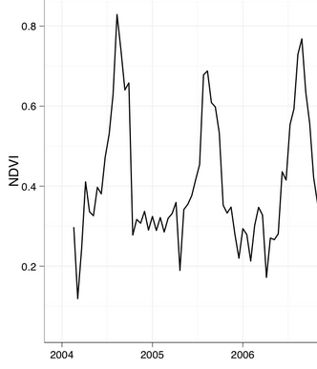
INTRODUCTION
BACK TO MAIN MENU
THE PROBLEM
Vegetation cover plays very important role in several fields: economic, touristic, biodiversity, climate change, food scarcity.
Meanwhile, remote sensing provides an important source of data for land cover changes monitoring.
Several vegetation indices are proposed by the scientific community. Particularly, NDVI is the most widely used in vegetation cover studies.
Forecasting vegetation indices time series covers various applications such as production, plant health, drought, phenology an so on.
Good forecasting model has to take into account the statistical singularities within the data.

Slide 5
INTRODUCTION
BACK TO MAIN MENU
THE OBJECTIVE
To study the statistical properties of NDVI time series.
To evaluate the use of combination models on the forecasting accuracy enhancement.
To determine whether the migration from the normal distribution to an other well-fitted probability function could enhance the forecasting model performance.
Based on the results, to propose a more suitable combining model.

Slide 6
EGU General Assembly
Vienna, Austria
3–8 May 2020
REMOTE SENSING DATA
NDVI AND NSMI CORRELATIONS DURING A CYCLE
COMBINING LOCAL SCALING AND GLOBAL METHODS TO DETECT SOIL PORE SPACE

Slide 7

INTRODUCTION – REMOTE SENSING DATA
BACK TO MAIN MENU
MODIS DATA
Bi-Monthly MODIS MOD13Q1 images, from February 2000 till September 2019, were processed to extract NDVI, with a resolution of 250mx250m.
Specified NDVI pixels were selected based on field survey.
Selected NDVI time series describe cereal land cover.
Quality layers are used for the preprocessing step to avoid data quality loss.
https://earthexplorer.usgs.gov/

Slide 8
INTRODUCTION – REMOTE SENSING DATA
BACK TO MAIN MENU
NDVI & data quality time series
Pixel reliability
Pixel Quality
Example of original NDVI

Slide 9
EGU General Assembly
Vienna, Austria
3–8 May 2020
STUDY AREA
Seasonally fitted probability functions changing weights for combining vegetation indices forecasting models
COMBINING LOCAL SCALING AND GLOBAL METHODS TO DETECT SOIL PORE SPACE

Slide 10
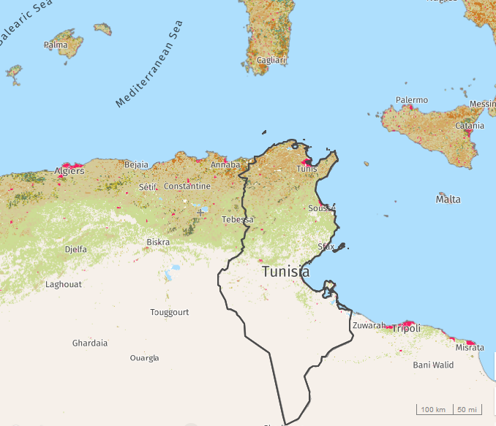
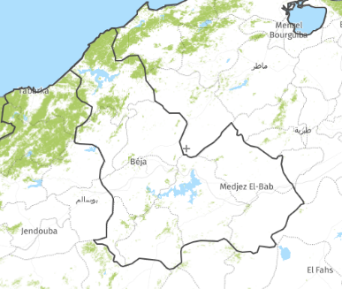
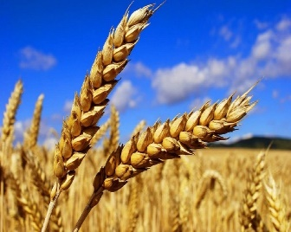
INTRODUCTION - THE STUDY AREA
BACK TO MAIN MENU
CEREAL IN THE COMMUNITY OF BEJA, TUNISIA

Slide 11
INTRODUCTION - THE STUDY AREA
BACK TO MAIN MENU
CEREAL IN THE COMMUNITY OF BEJA, TUNISIA
Bèja is a northwestern Tunisian region. It is a sub-humid area. The cereal culture occupies, there, over than 143 000 ha. This region represents the main production area in Tunisia.

Slide 12
EGU General Assembly
Vienna, Austria
3–8 May 2020
METHODOLOGY
Seasonally fitted probability functions changing weights for combining vegetation indices forecasting models
COMBINING LOCAL SCALING AND GLOBAL METHODS TO DETECT SOIL PORE SPACE

Slide 13
BACK TO MAIN MENU
Methodology
1
Preprocessing
3
Forecasting
Decomposition based on wavelet transform
Seasonnaly varying weights
2

Slide 14
METHODOLOGY - COMBINING WEIGHTS
BACK TO MAIN MENU
METHODOLOGY
Seasonaly varying weights:
3
Linear combination
Forecasts observations portioning
PDF for each season
1
2

Slide 15
EGU General Assembly
Vienna, Austria
3–8 May 2020
RESULTS
Seasonally fitted probability functions changing weights for combining vegetation indices forecasting models
COMBINING LOCAL SCALING AND GLOBAL METHODS TO DETECT SOIL PORE SPACE

Slide 16
EGU General Assembly
Vienna, Austria
3–8 May 2020
DECOMPOSITION
Seasonally fitted probability functions changing weights for combining vegetation indices forecasting models
COMBINING LOCAL SCALING AND GLOBAL METHODS TO DETECT SOIL PORE SPACE

Slide 17
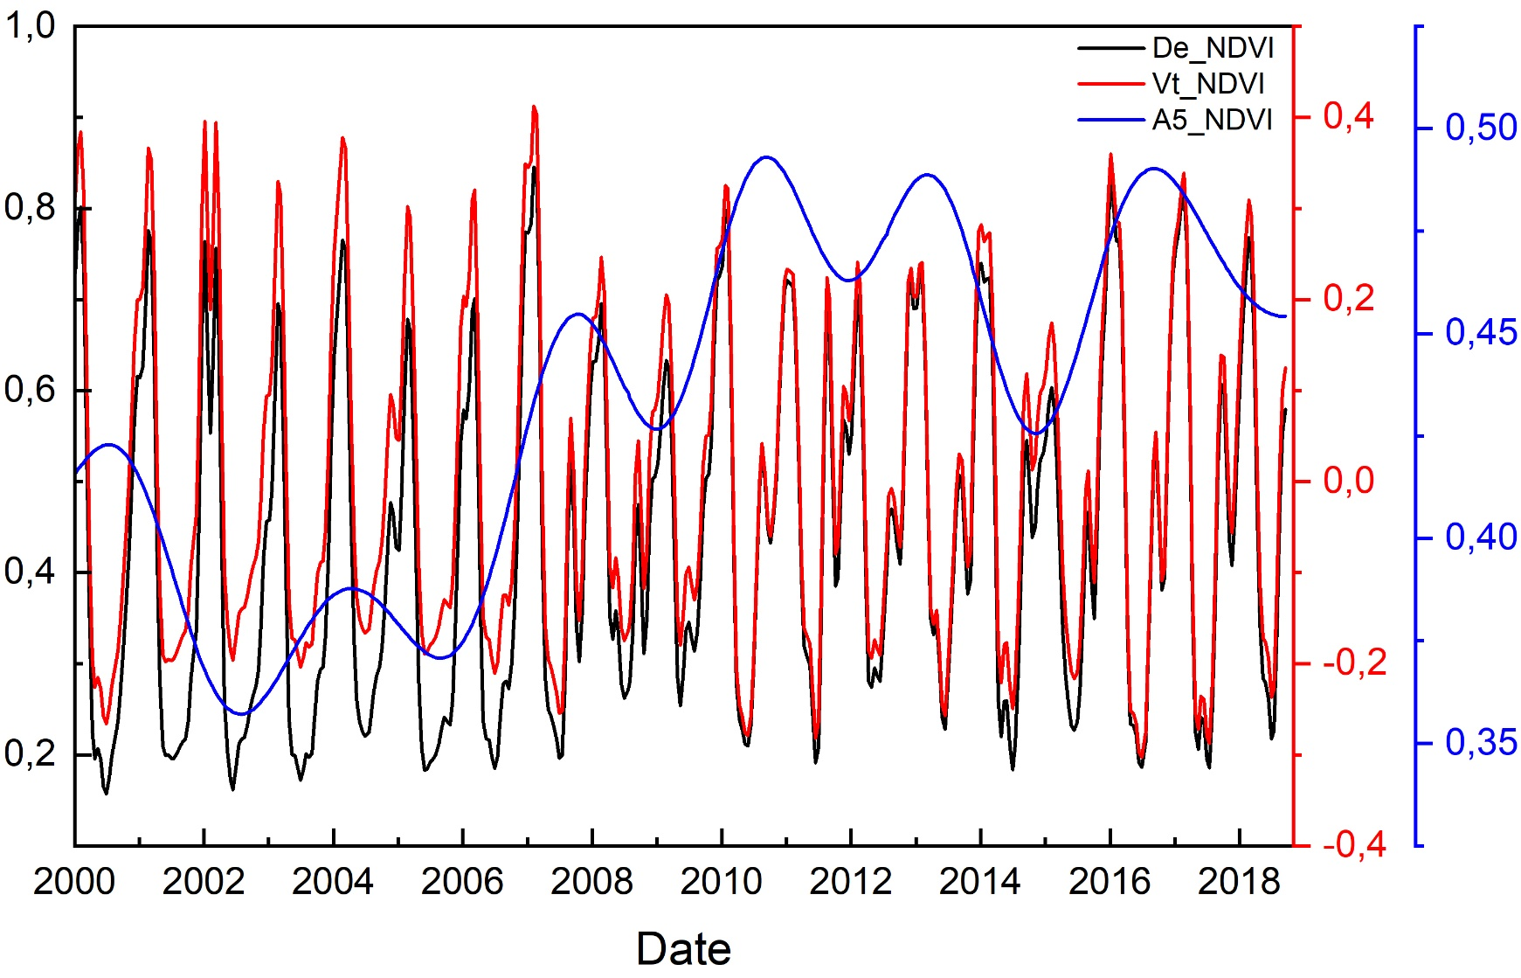
RESULTS –
BACK TO MAIN MENU
CEREALS NDVI TIME SERIES DECOMPOSITION
De_NDVI: Denoised NDVI, Vt_NDVI: Total variability of NDVI or said Seasonal component, A5_NDVI: 5th Approximation or said the trend component.

Slide 18
EGU General Assembly
Vienna, Austria
3–8 May 2020
VI Forecasting
Seasonally fitted probability functions changing weights for combining vegetation indices forecasting models
COMBINING LOCAL SCALING AND GLOBAL METHODS TO DETECT SOIL PORE SPACE

Slide 19
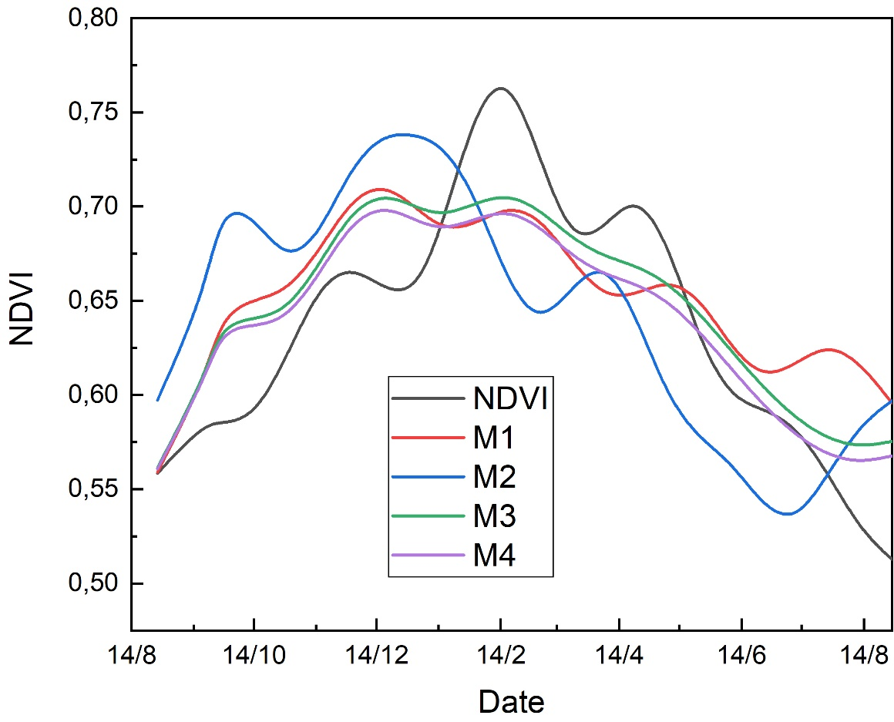
RESULTS – UPSCALING CORRELATIONS
BACK TO MAIN MENU
4 Models Forecasts
M1: NAR
M2: SARIMA
M3: ARIMA-NAR
M4: NAR-NAR
Cover Type |  | RMSE |  |  |  | sMAPE
 |  | M1 | M2 | M3 | M4 | M1 | M2 | M3 | M4
Cereals | NDVI | 0,1619 | 0,1544 | 0,1058 | 0,0919 | 20,75 | 28,37 | 14,21 | 14,54

Slide 20
EGU General Assembly
Vienna, Austria
3–8 May 2020
SEASONALLY VARYING WEIGHTS
Seasonally fitted probability functions changing weights for combining vegetation indices forecasting models
COMBINING LOCAL SCALING AND GLOBAL METHODS TO DETECT SOIL PORE SPACE

Slide 21
RESULTS – UPSCALING CORRELATIONS
BACK TO MAIN MENU
4 Models Forecasts
Distribution: Generalized Extreme Value S4
Log likelihood: 890.663
Domain: -Inf < y < Inf
Mean: Inf
Variance: Inf
Parameter Estimate Std. Err.
k 3.78277 0.0154636+0i
sigma 0.00245525 6.8432e-05+0i
mu 0.000647554 0+1.2543e-06i
Distribution: Gamma | S1
Log likelihood: 123.9
Domain: 0 < y < Inf
Mean: 0.577506
Variance: 0.0022566
Parameter Estimate Std. Err.
a 147.795 23.9485
b 0.00390749 0.000634237
Distribution: Beta |  | S2
Log likelihood: 100.332
Domain: 0 < y < 1
Mean: 0.653902
Variance: 0.00420193
Parameter Estimate Std. Err.
a 34.565 8.24143
b 18.2946 4.38158
Estimated covariance of parameter estimates:
a b
a 67.9212 35.7686
b 35.7686 19.1982
Distribution: Weibull S3
Log likelihood: 327.658
Domain: 0 < y < Inf
Mean: 0.704377
Variance: 0.00265745
Parameter Estimate Std. Err.
A 0.726891 0.00318835
B 16.8369 0.882944
Estimated covariance of parameter estimates:
A B
A 1.01655e-05 0.000875841
B 0.000875841 0.77959

Slide 22
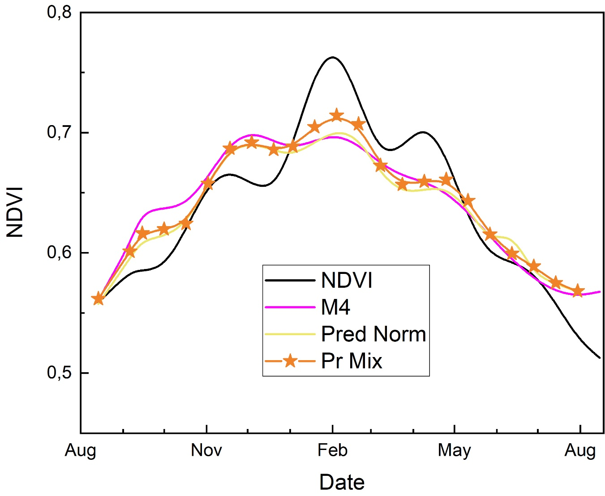
RESULTS – UPSCALING CORRELATIONS
BACK TO MAIN MENU
SEGMENTED NDVI PER 16x16 PIXELS
Classical combining models are tested and they generated worst results.
M4 | 0,091
Normal PDF | 0,030646
Mixed PDF | 0,003433

Slide 23
EGU General Assembly
Vienna, Austria
3–8 May 2020
CONCLUSIONS & FUTUR WORK
Seasonally fitted probability functions changing weights for combining vegetation indices forecasting models
COMBINING LOCAL SCALING AND GLOBAL METHODS TO DETECT SOIL PORE SPACE

Slide 24
CONCLUSIONS
BACK TO MAIN MENU
CONCLUSIONS & FUTUR WORK
Forecasting models combination provides better accuracies.
Time series singularities may be better reflected in segments of data than in the whole time series.
Taking into account the statistical properties enhance the model performance.
Combination model based on the evidence theory is the next step.

Slide 25

EGU General Assembly
Vienna, Austria
3–8 May 2020
THANK YOU FOR YOUR ATTENTION
Acknowledgements
Seasonally fitted probability functions changing weights for combining vegetation indices forecasting models
COMBINING LOCAL SCALING AND GLOBAL METHODS TO DETECT SOIL PORE SPACE

