Slide 1
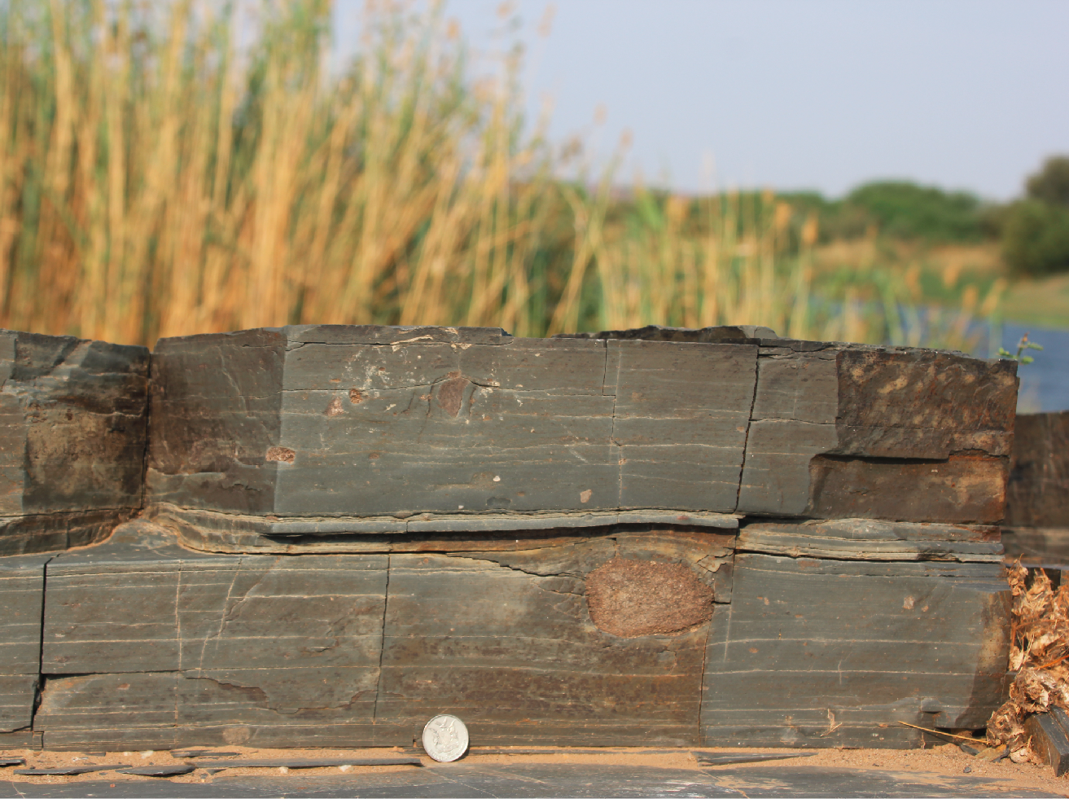



Complex development of a 300-million-year old subglacial unconformity in southern Namibia
Daniel Paul Le Heron¹, Christoph Kettler¹, Neil Griffis², Pierre Dietrich³, and Isabel Montañez²
¹Institute for Geology, Althanstraße 14, Universität Wien, 1190 Vienna, Austria (daniel.le-heron@univie.ac.at)
²Earth and Physical Sciences, 2119 One Shields Avenue, University of California Davis, Davis, CA 95616, USA.
³Géosciences Rennes, UMR6118, Université de Rennes 1, 263 Avenue du Général Leclerc, Bâtiment 15, Campus de Beaulieu, 35042 Rennes Cedex, France.
See also sister presentation by Dietrich et al:
https://doi.org/10.5194/egusphere-egu2020-14059

Slide 2
Complex development of a 300-million-year old subglacial unconformity in southern Namibia
Daniel Paul Le Heron¹, Christoph Kettler¹, Neil Griffis², Pierre Dietrich³, and Isabel Montañez²
¹Institute for Geology, Althanstraße 14, Universität Wien, 1190 Vienna, Austria (daniel.le-heron@univie.ac.at)
²Earth and Physical Sciences, 2119 One Shields Avenue, University of California Davis, Davis, CA 95616, USA.
³Géosciences Rennes, UMR6118, Université de Rennes 1, 263 Avenue du Général Leclerc, Bâtiment 15, Campus de Beaulieu, 35042 Rennes Cedex, France.
The expansion of ice masses across southern Africa during the Late Palaeozoic Ice Age (LPIA) at about 300 Ma has been recognised in the literature for over a century, including the distribution of upland areas in controlling the configuration of ice masses (Davis, 1908). In Namibia, increasing attention has focussed on long and deep palaeovalley networks in the north, but comparatively little work has been attempted in the topographically subdued plains of the south. The desert terrain of the Mariental area exposes diamictites of the Dwyka Formation discontinuously over about 300 km, extending further south to the Noordoewer area at the Namibian-South African border along the Orange River. Whilst examined at a stratigraphic level, the nature of the contact between the Dwyka glacial rocks and underlying lithologies has not been systematically investigated. This paper presents some preliminary results from fieldwork in austral winter 2019, in which we describe a highly varying basal contact that records the processes of growth, flow and expansion of ice masses across this part of Gondwana. Subglacially-produced unconformities may exhibit classic glacially-striated pavements at basin margins, which substitute for soft-sediment striated surfaces in comparatively more “basinal” areas. Where these features are absent, additional criteria may be sought. In Mariental, spectacular soft-sediment shear zones exhibit a combination of brittle and ductile end products are recognised, overprinted by shear bands. This type of subglacial unconformity developed over well differentiated, unconsolidated, siliciclastic materials. Where ice advanced over more poorly sorted material or cannibalised pre-existing diamictites, “boulder-pavements” formed in which in single clast-thick boulder-dominated intervals were facetted and striated in situ by overriding ice. By integrating measurements of striation orientations, fold vergence and palaeocurrent information, former ice flow pathways can potentially be reconstructed over a wide area, which is suspected to have been dominated by Piedmont glaciers.
[manuscript in prep- all materials new for EGU2020]

Slide 3
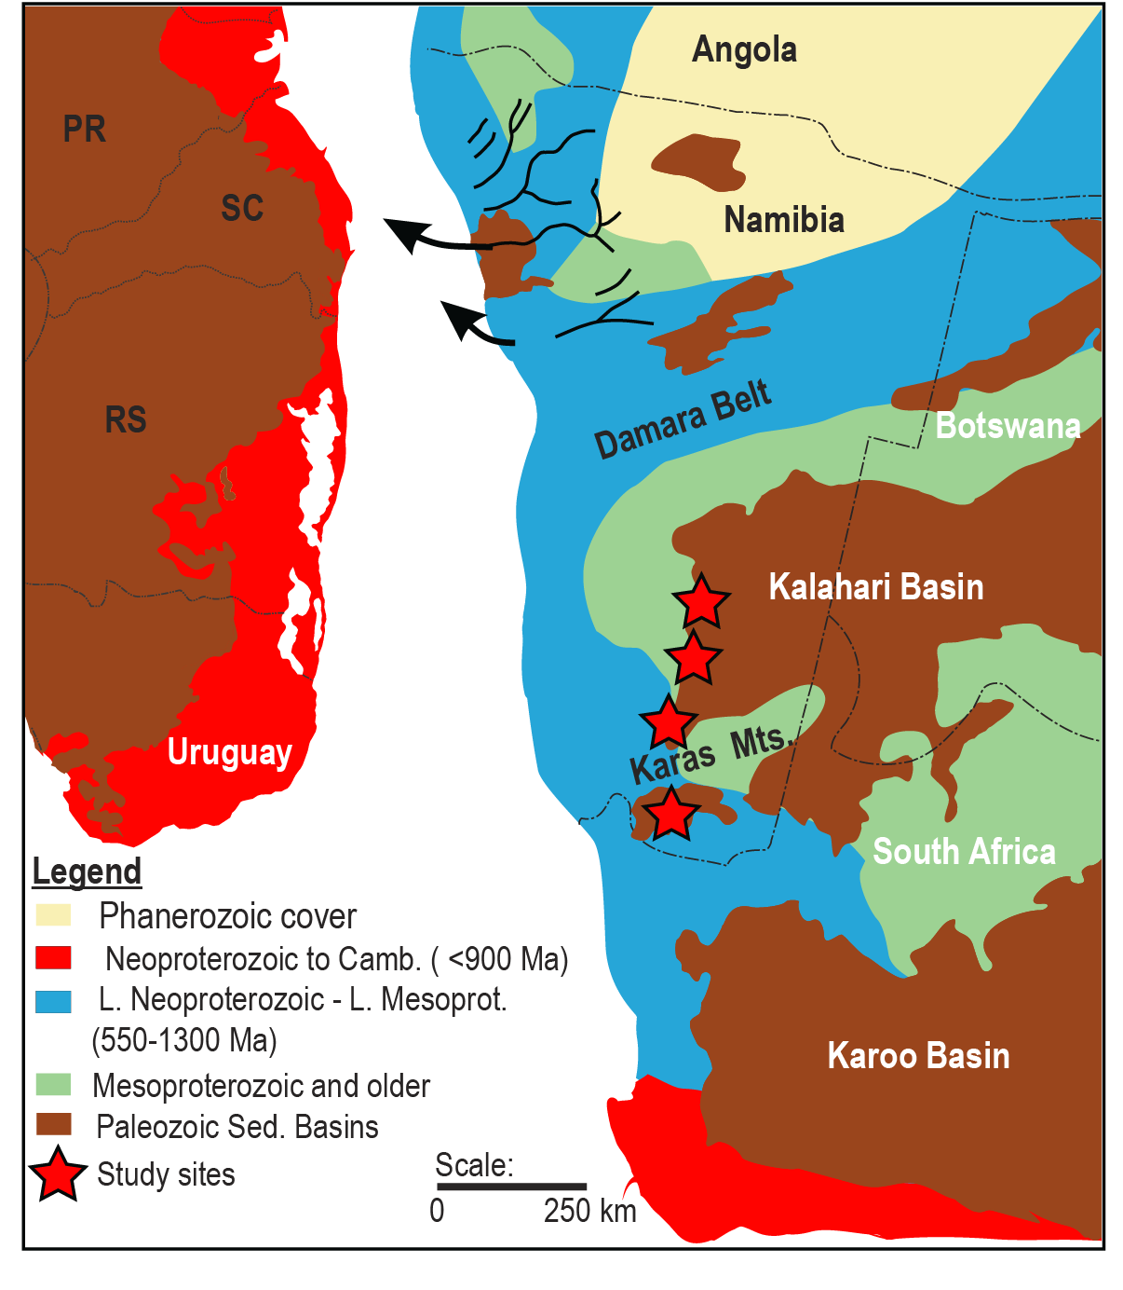
Palaeogeographic map- setting the scene
Northern Namibia: extensive network of deeply incised palaeovalleys: see Dietrich et al. EGU 2020 abstract: https://doi.org/10.5194/egusphere-egu2020-14059
Central Namibia (Damara): Mega-scale glacial lineations and palaeo-ice stream topography (Andrews et al., 2018)
Southern Namibia (W Kalahari Basin)- since Stratten (1977) and Visser (1983), only mapping scale work and unpublished theses

Slide 4
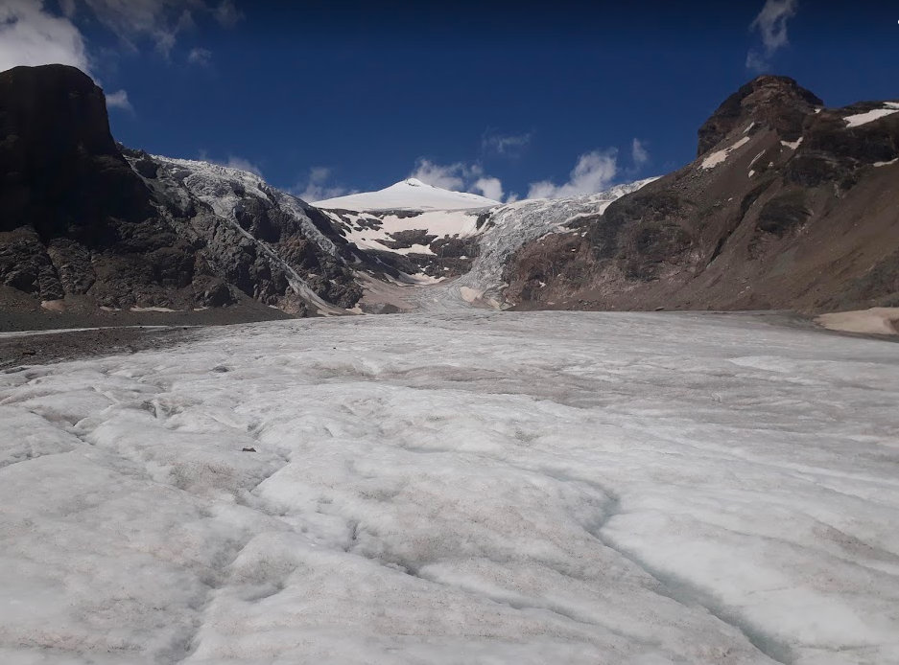
Our motivation: We know that this part of Africa was glaciated during the LPIA, but precisely how? Valley glaciers? Ice streams? Piedmont glaciers?
Our methods:
Sedimentary facies analysis coupled with interdisciplinary approach to measuring any rock fabric that can help us reconstruct a 300 Ma ice mass.
For example: (i) striation measurements of stones embedded in diamictites, (ii) cross-bed orientations, (iii) clast orientations, (iii) lineations on aerial photos (full use of drone- data not possible to process owing to COVID-19 office restrictions), (iv) striated pavements, (v) measurements of soft-sediment folds, etc.
Background image: Pasterze Glacier, Austria, July 2018. Photo: D.P. Le Heron.

Slide 5
If you are want to know why we use drone imagery to investigate LPIA glacial unconformities, check out the Open Access Paper in Geology from 2019 (link below). Presented at EGU 2019, it explains the vital and cryptic information preserved on these surfaces (photo below from Oorlogskloof, South Africa)
https://pubs.geoscienceworld.org/gsa/geology/article/47/11/1034/573666/Scratching-the-surface-Footprint-of-a-late

Slide 6
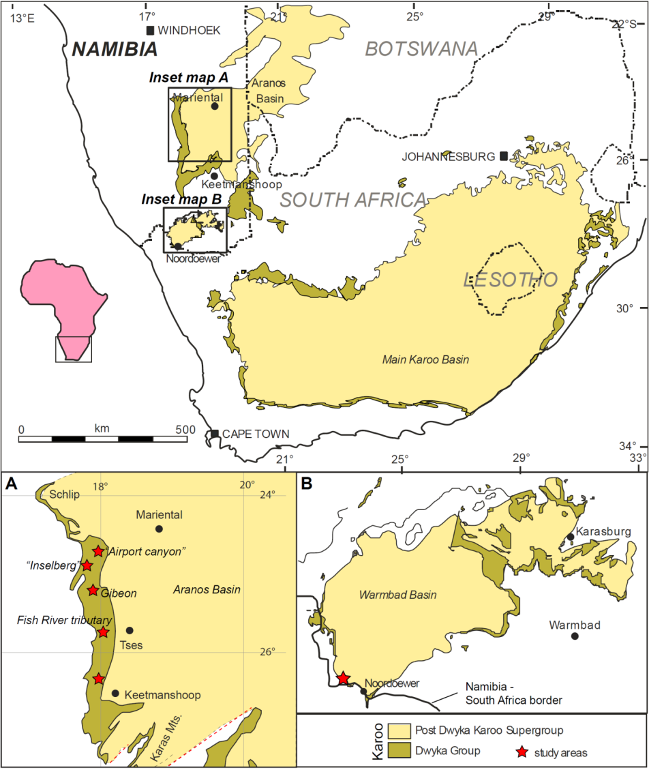
Outcrops in this presentation
Maps showing the study areas of the Dwyka Group in southern Namibia. Compiled from Martin (1981), Visser (1983), Bangert et al. (1988), and Geiger (1999).
Throughout the presentation, data from outcrops are presented from the so-called ”Airport canyon” working progressively south through the localities in inset map A, before presenting detailed analysis of the Noordoewer outcrop in inset map B.

Slide 7
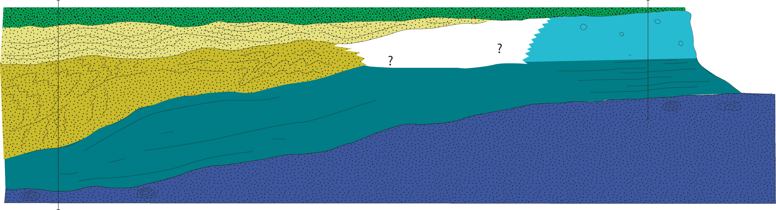
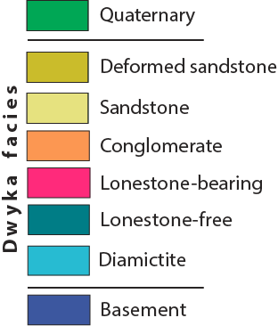
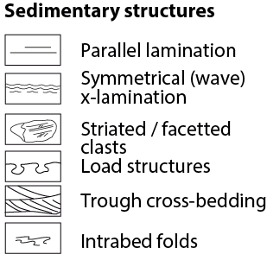
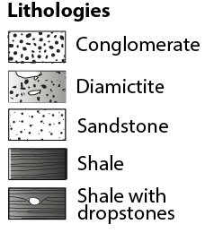
Mariental Airport canyon
24°39'42.90"S
17°55'51.30"E
a.
ca. 250 m
b.
The two profiles a. and b. are shown overleaf. The legend for this profile, together with all of the symbols shown on sedimentary logs throughout this contribution, are shown below.

Slide 8
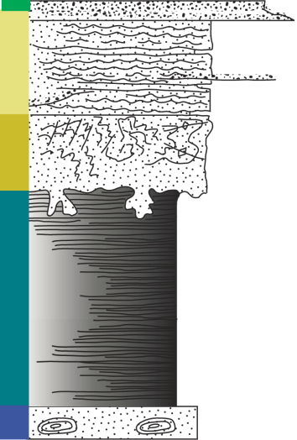

Mariental Airport canyon
a.
ca. 250 m
b.
Profile a. exhibits a spectacular suites of soft sediment deformation (imaged overleaf). These include convolute bedding, deformation bands in wave rippled sandstone, complex thrust geometries and recumbent folds. Profile b. lacks all these facies, but a pebbly diamictite is present. The profiles are bracketed by presumed Lower Palaeozoic sandstone with nodules beneath and young (presumed Pleistocene-Recent) river terrace gravels on top. The assemblage of deformation structures compares closely to subglacial facies described elsewhere (Melvin 2019).
1 m
1 m

Slide 9
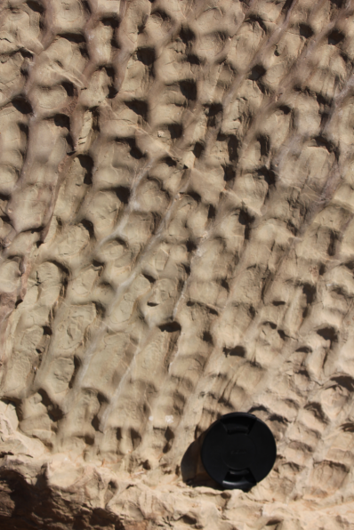
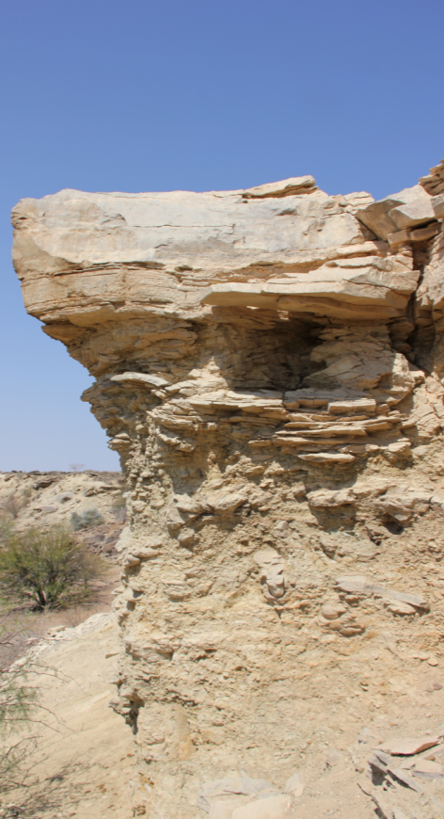
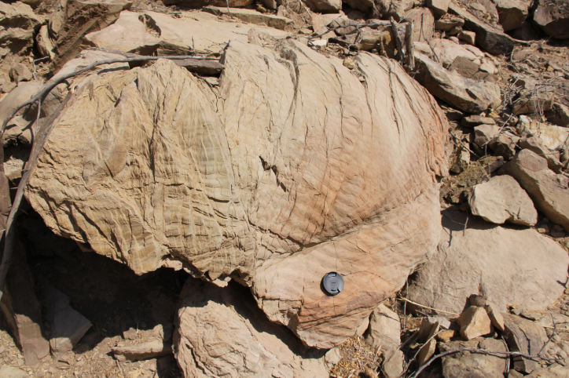
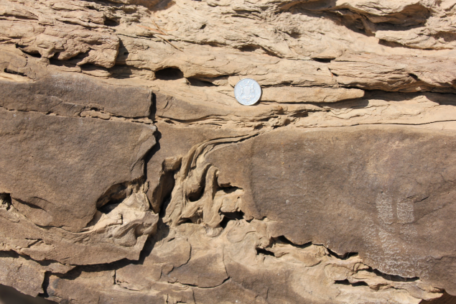
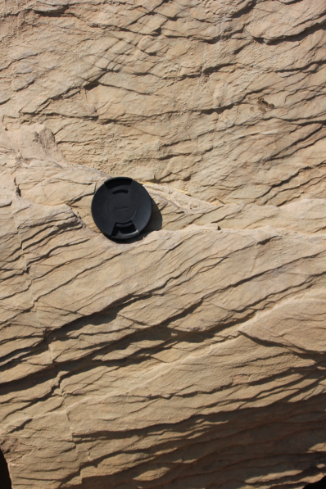
Mariental Airport canyon [profile a]
iii
i
ii
iv
v
(i) Overall profile view. (ii) Recumbently folded wave rippled sandstones, traversed by deformation bands. (iii) Ladderback ripples. (iv) Soft-sediment injection structure. (v) Deformation bands.
Collectively, the deformation structures are interpreted to record strain within a subglacial substrate.

Slide 10
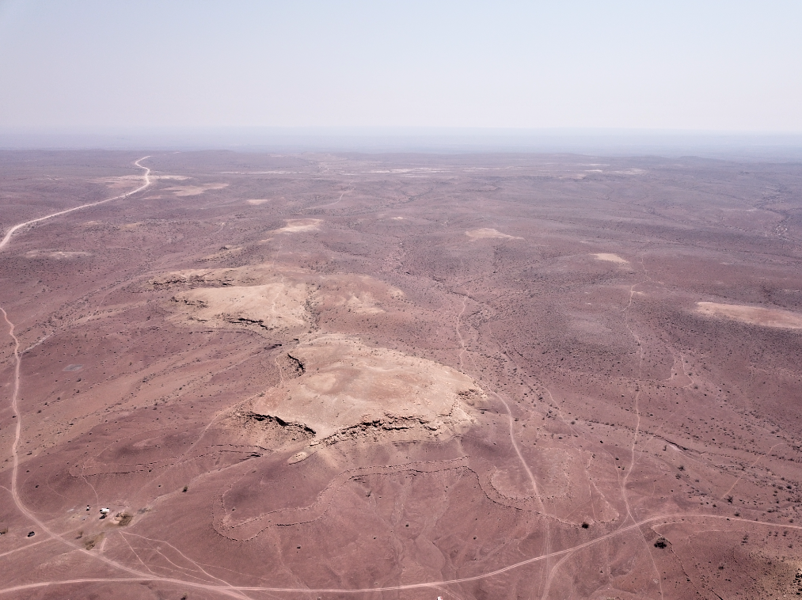
Mariental “Inselberg” aerial view
25° 4'49.20"S
17°44'13.40"E
Interpreted channel body: small pre (and pro) glacial fluvial valley?
Dwyka
Profile
Cambrian
Aerial images allow the relationships between pebbly sandstone inselbergs of the basal Dwyka to be revealed. These are interpreted to represent the initial downcutting and incision into the surface shortly prior to glacial advance.

Slide 11
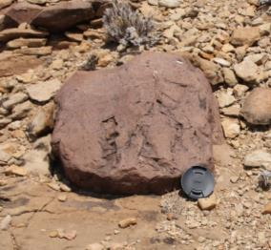
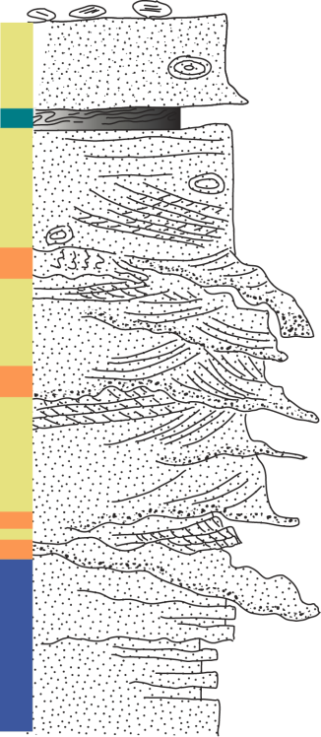
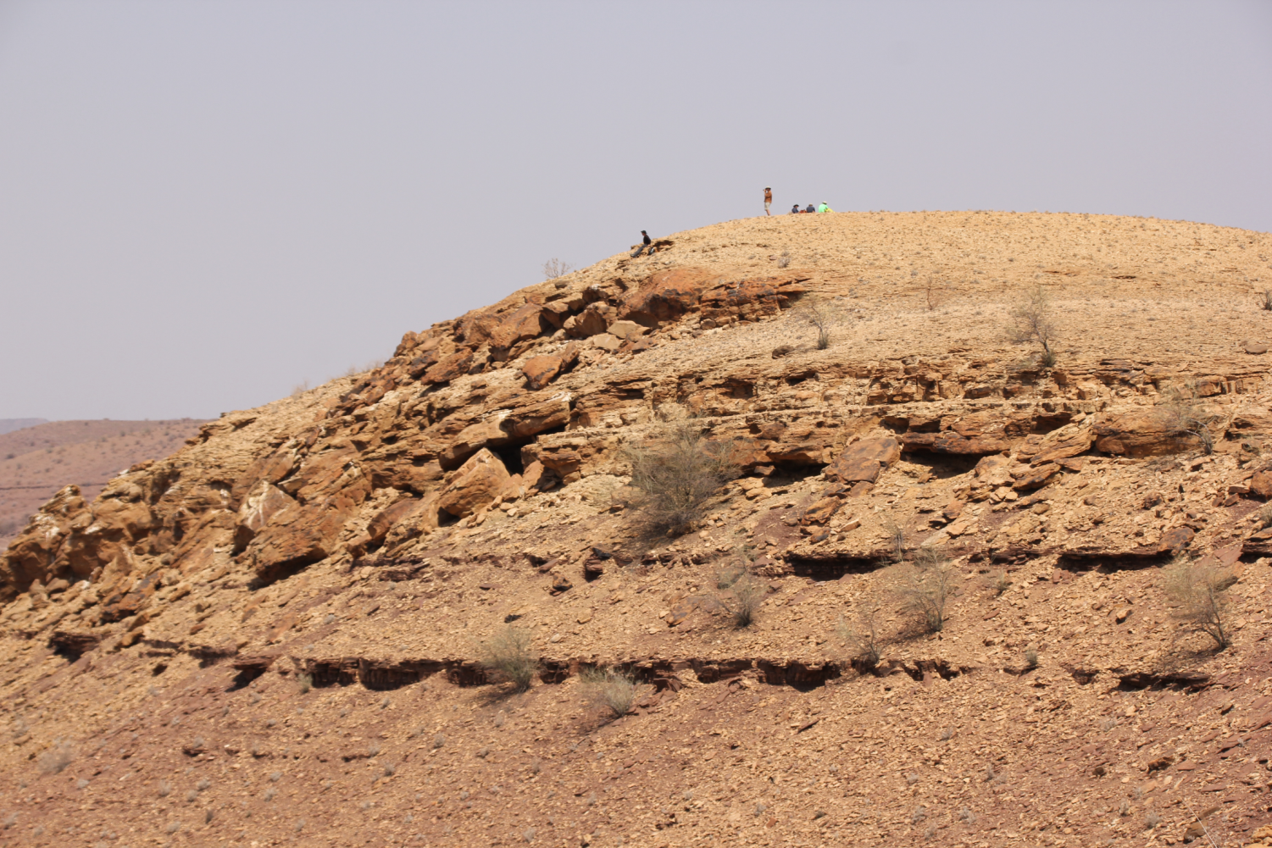
Mariental “Inselberg”
25° 4'49.20"S
17°44'13.40"E
2 m
Facetted & striated boulders weather out
Trough cross-beds (N = 24)
Dwyka
Cambrian
Dwyka Formation represented by stacked pebbly trough cross-bedded sandstone
Interpreted as a fluvial channel system cut into basement

Slide 12
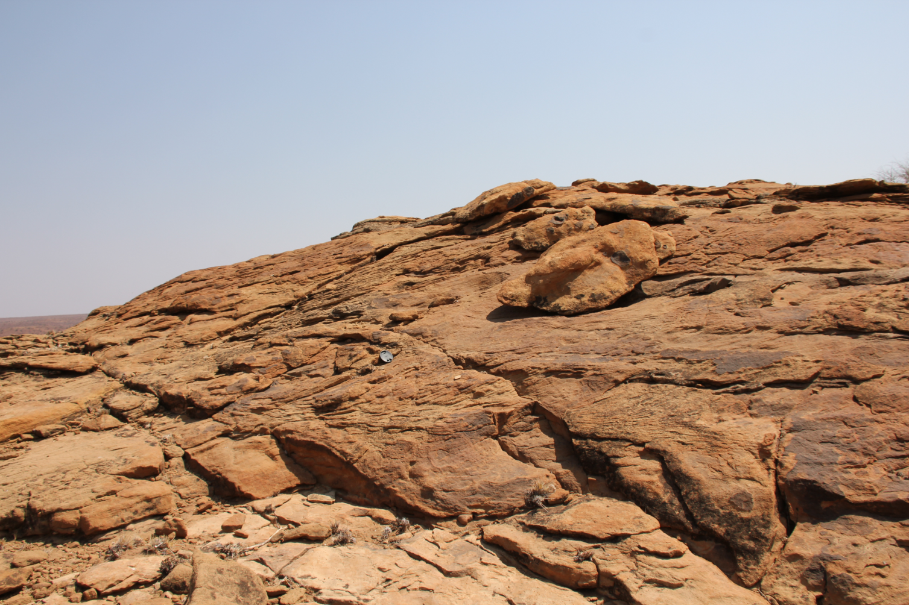
Mariental ”Inselberg”
25° 4'49.20"S
17°44'13.40"E
Large pebbly cross strata interpreted as a complex network of bar forms

Slide 13
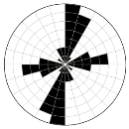
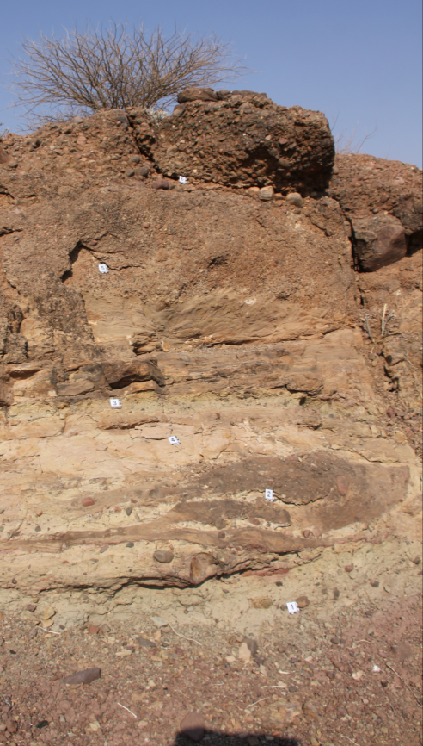
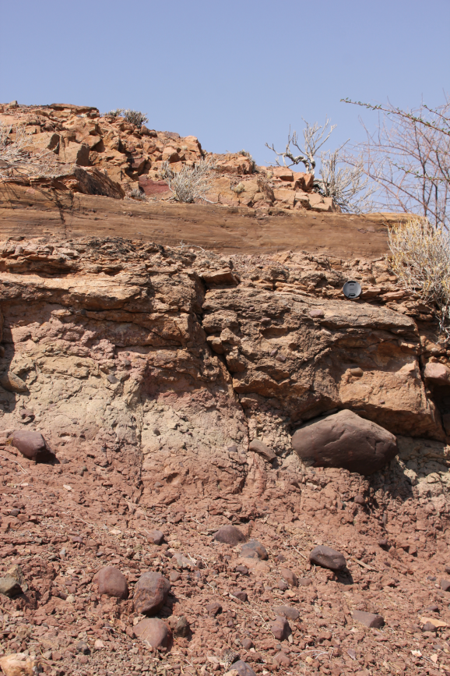
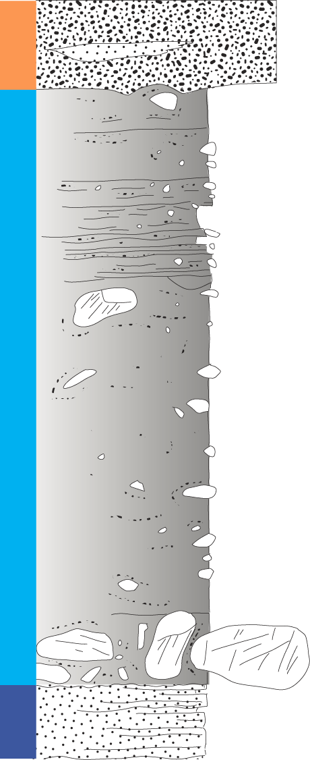
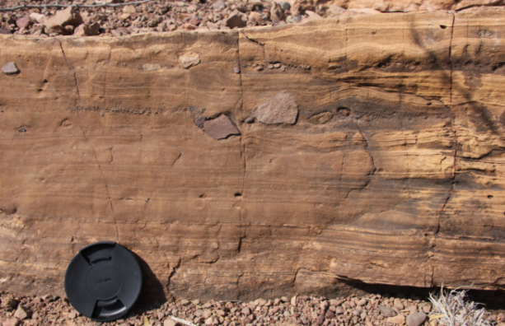
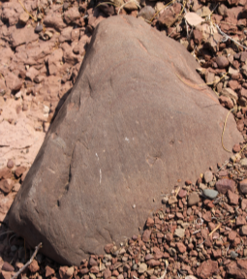
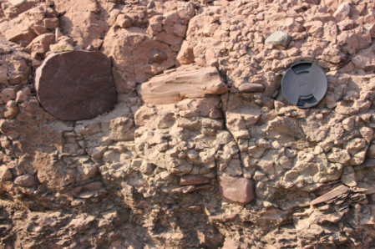
Gibeon
i
ii
Striation orientations from embedded clasts (N = 30)
6
6
v
5
5
iv
4
ii
3
4
3
2
2
1
1 m
1
iii
iii
iv
v
25° 7'56.07"S
17°45'39.20"E

Slide 14
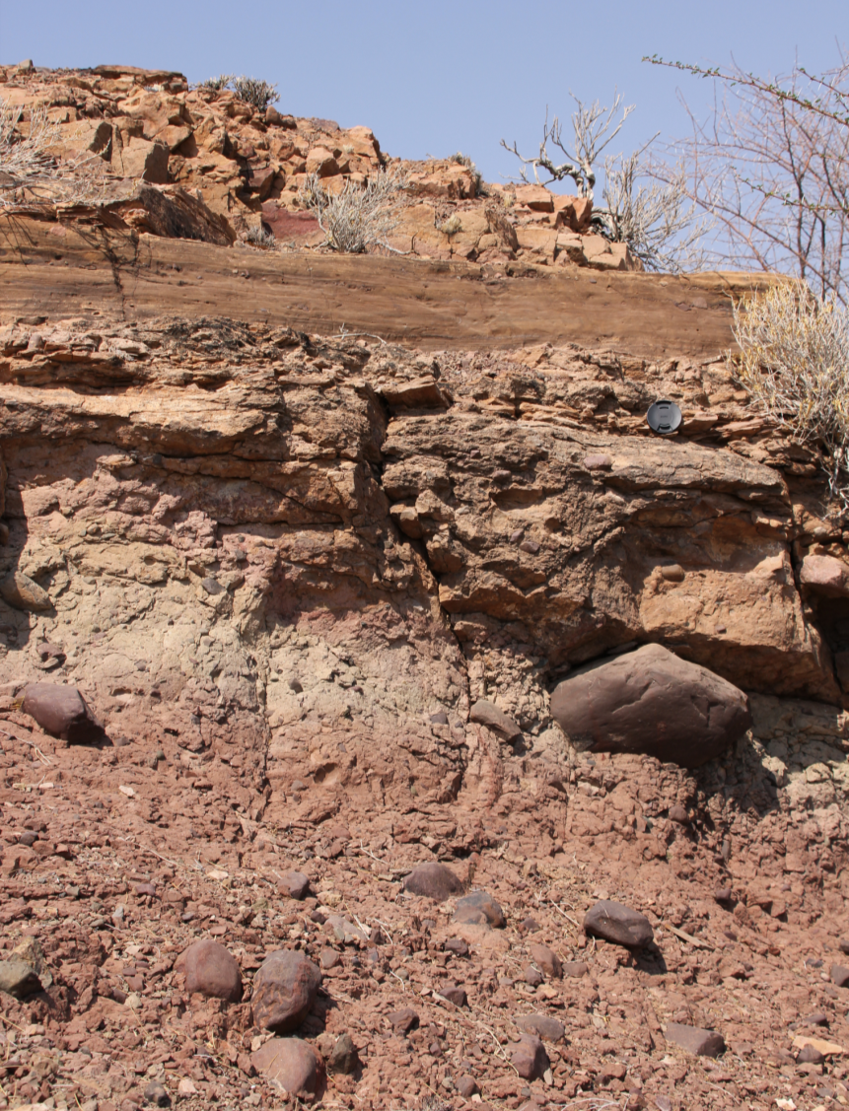
Gibeon
Striation orientations from embedded clasts (N = 30)
1 m
The Gibeon diamictites are interpreted as subglacial tillites. Striation orientations indicate strong fabric development. Note that a strong N-S and a secondary E-W fabric is preserved.

Slide 15
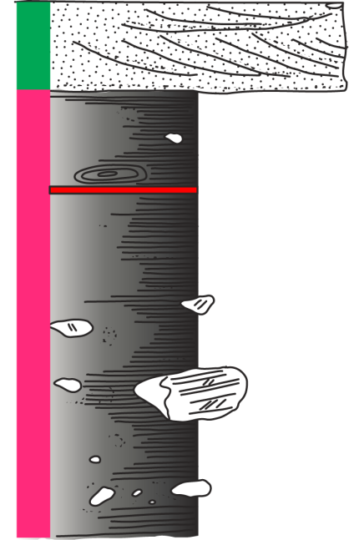
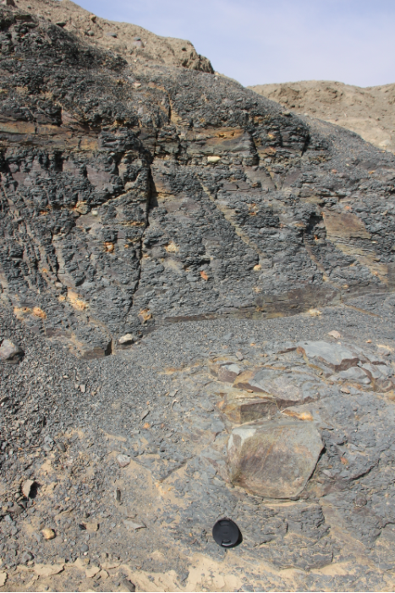
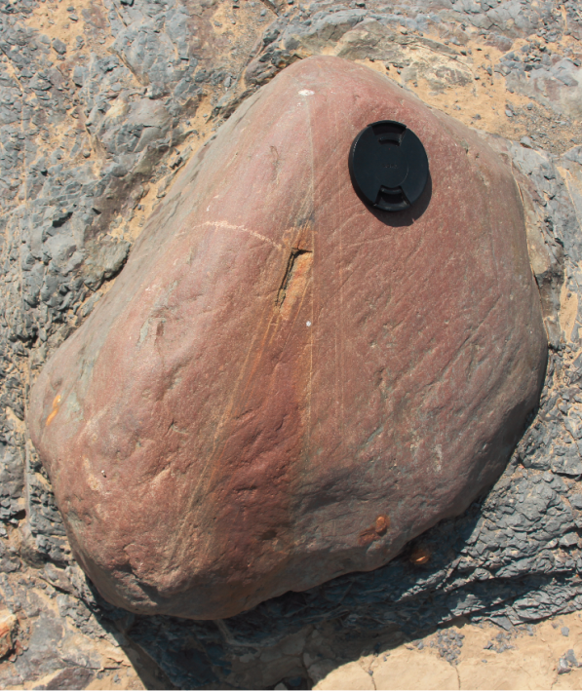
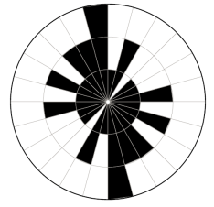
Fish River tributary 1
i
ii
25°53'36.30"S
18° 0'38.40"E
1 m
This diamictite is stratified (photo i). Striations (photo ii) were measured along the clast long axes, and show a weak N-S trend (rose diagram, left). Collectively, these characteristics allow us to interpret the Fish River tributary 1 diamictite as subglacial.
(N = 36)

Slide 16
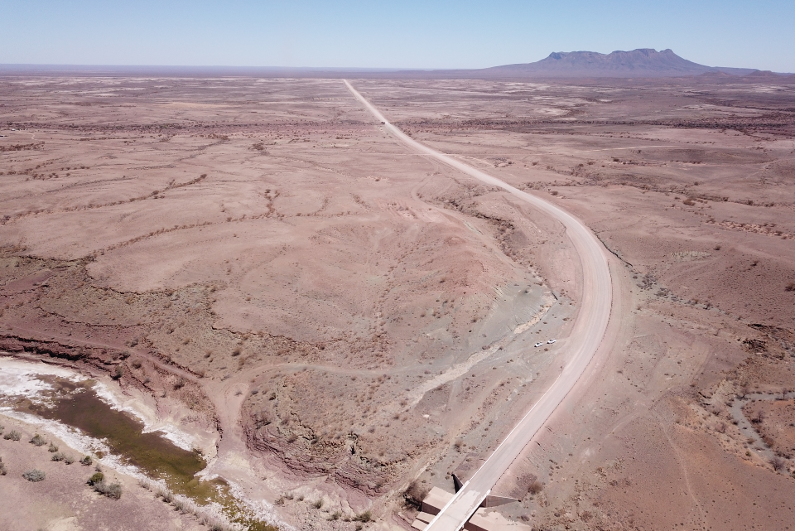
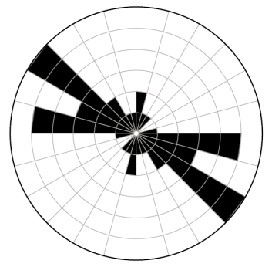
Fish River tributary 2
This locality (N = 23)
Bukkaros Volcano
Dwyka
Cambrian
The Fish River tributary 2 diamictite shows the same characteristics as “tributary 1” and can be followed 5 km along strike. Embedded clasts show striations in a NW-SE orientation in this interpreted subglacial deposit. Comparing and contrasting the orientations highlights the risks of inherent bias in terms of interpreting a consistent ice flow orientation in the lowermost Dwyka diamictite in southern Namibia.

Slide 17
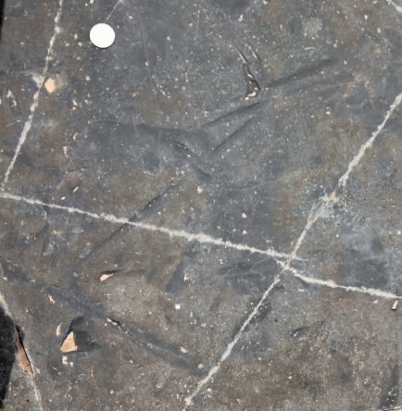
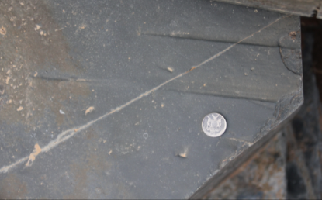
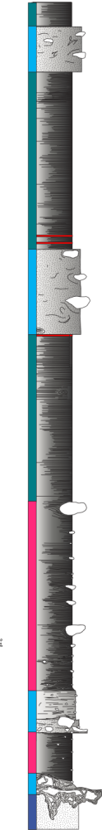
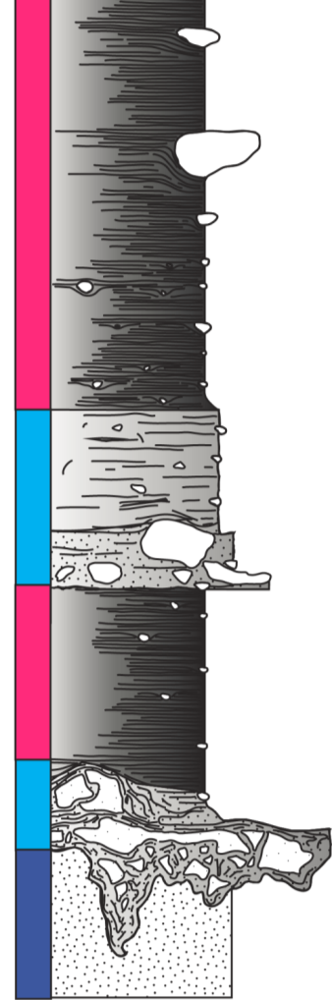
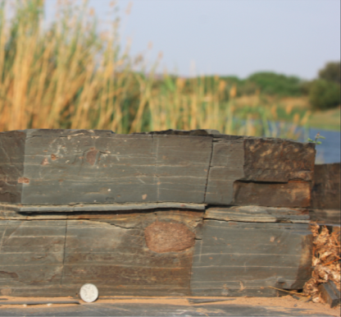
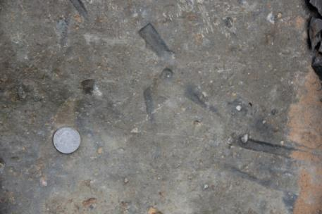
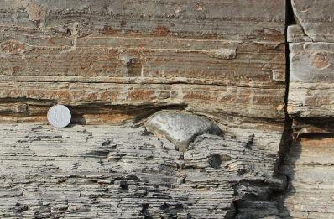
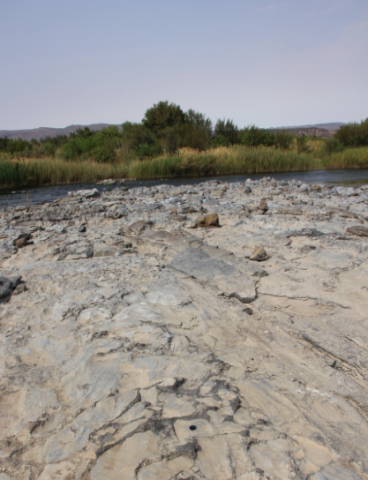
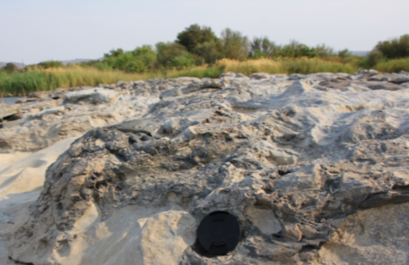
Noordoewer
vi
vii
1 m
iv
v
Scour marks on the top of bedding planes. Very abrupt terminations, very sharp. Interpreted to have formed through scouring of the sea floor by sea ice.
v, vi, vii
iv
iii
Dropstones in stratified
diamictite
ii
iii
Dropstones in shale
i
i, ii
Diamictite injected
into Cambrian basement
The long axes of large
boulders were measured

Slide 18
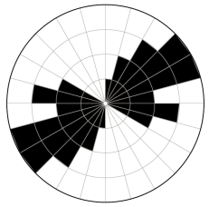
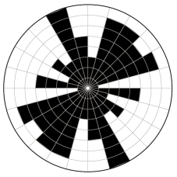
Noordoewer
1 m
“Sea ice” scour marks (N = 22)
Boulder long axes, basal diamictite (N = 56)
“Sea ice” scours
Directional data: The orientation of the structures interpreted as sea ice scour marks, together with the orientation of the long (A) axis of boulders > 1m size in the basal diamictite were measured. Based on the relatively small dataset, the sea ice scour marks show a preferred NE-SW trend. The boulder data are more complex with a broad NE-SW dominant trend and a NW-SE secondary trend.
Boulder long axes
[Fun fact: Injection of diamictite into basement in the Warmrad Basin outcrops was documented long ago by the legendary Visser (1983)]

Slide 19
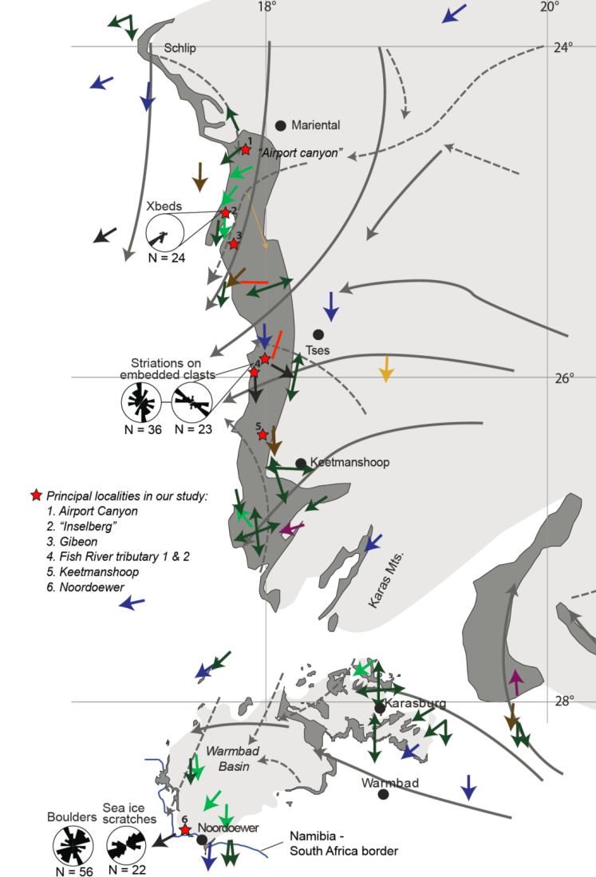
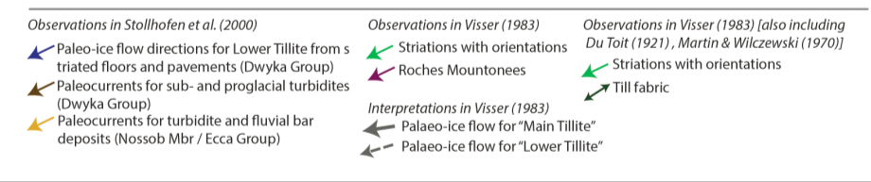
Discussion
Synthesis of previous data leads to a consensus that a N-S flow of ice preceded an NE-SW flow event (Stollhofen et al., 2008), and that these flow orientations were represented by a basal and “main” diamictite respectively (Visser, 1983).
We question this consensus by presenting multiple orientation trends from the basal diamictite at Gibeon, Fish River tributary 1 & 2, and Noordoewer. Independently, these trends could traditionally have been explained by the two separate ice masses (see previous slide).
We tentatively reinterpret these trends as recording evolving subglacial conditions, and concomitant change in ice flow direction, during a single glacial cycle.
Considering the Inselberg sections south of Mariental, at least in this area an immediately pre-glaciated landscape consisted of SW-directed drainage event.

Slide 20



Reflections, thoughts and questions
Can sensible flow orientations be deduced by splicing new data with historical observations?
How can diamictite fabrics better be interrogated to extract full 3 D information in these ancient rocks?
When do we know we are looking at regional vs local flow patterns in such a complex dataset?
Which weighting do we put on the different data (i.e. striae, tillite fabrics, cross strata)?
We are very grateful to the National Research Foundation of South Africa and to the Österreichischer Austauschdienst for funding our 2019 field season.

Slide 21
References
Andrews, G. D., McGrady, A. T., Brown, S. R., & Maynard, S. M. (2019). First description of subglacial megalineations from the late Paleozoic ice age in southern Africa. PLOS ONE, 14(1), e0210673. https://doi.org/10.1371/journal.pone.0210673
Bangert, B., Stollhofen, H., Lorenz, V., and Armstrong, R.L., 1999, The geochronology and significance of ash-fall tuffs in the glaciogenic
Carboniferous-Permian Dwyka Group of Namibia and South Africa: Journal of African Earth Sciences, v. 29, p. 33–49, doi: 10.1016/S0899-
5362(99)00078-0
Geiger (1999). An Explanation of the Geological Map 1:10 000 of the Namibian borderland along the Orange River at Zwartbas - Warmbad District - Karas Region – Namibia. Diplomkartierung, Bayerische Julius-Maximilians-Universität Würzburg.
Grill, H., 1997, The Permo-Carboniferous glacial to marine Karoo record in southern Namibia: Sedimentary facies and sequence stratigraphy: Beringeria, v. 19, p. 1–98.
Le Heron, D. P., Dietrich, P., Busfield, M. E., Kettler, C., Bermanschläger, S., & Grasemann, B. (2019). Scratching the surface: Footprint of a late Carboniferous ice sheet. Geology, 47(11), 1034–1038. https://doi.org/10.1130/g46590.1
Martin, H., 1981, The Late Paleozoic Dwyka Group of the South Kalahari Basin in Namibia and Botswana and the subglacial valleys of the
Kaokoveld in Namibia, in Hambrey, M.J., and Harland, W.B., eds., Earth’s Pre-Pleistocene Glacial Record: New York, Cambridge University Press, p. 61–66.
Melvin, J. (2019). Zarqa megafacies: Widespread subglacial deformation in the Sarah formation of Saudi Arabia and implications for the sequence stratigraphy of the hirnantian glaciation. In Geological Society Special Publication (Vol. 475, Issue 1, pp. 53–80). Geological Society of London. https://doi.org/10.1144/SP475.6
Stollhofen, H., Werner, M., Stanistreet, I.G., and Armstrong, R.A., 2008, Single-zircon U-Pb dating of Carboniferous-Permian tuffs, Namibia, and the intercontinental deglaciation cycle framework, in Fielding, C.R., Frank, T.D., and Isbell, J.L., eds., Resolving the Late Paleozoic Ice Age in Time and Space: Geological Society of America Special Paper 441, p. 83–96, doi: 10.1130/2008.2441(06).
Stratten, T. 1977. Conflicting directions of Dwyka ice flow in the western Cape Province and southern South West Africa. South African Journal of Geology, Volume 80, Issue 2, p. 79 – 86.
Visser, J. N. J. (1983). An analysis of the Permo-Carboniferous glaciation in the marine Kalahari Basin, Southern Africa. Palaeogeography, Palaeoclimatology, Palaeoecology, 44(3–4), 295–315. https://doi.org/10.1016/0031-0182(83)90108-6

