Slide 1
Water Problems Institute, Moscow, Russia
Lomonosov Moscow State University, Moscow, Russia
Pacific Geographical Institute, Vladivostok, Russia
Flash flood simulation using unit hydrograph and hydrodynamic models
(case study of Western Caucasus, Russia)
Pelagiya Belyakova, Ekaterina Vasil'eva, Andrey Aleksyuk, Vitaly Belikov,
Boris Gartsman and Andrey Bugayets
E-mail: hydropolya@gmail.com

Slide 2
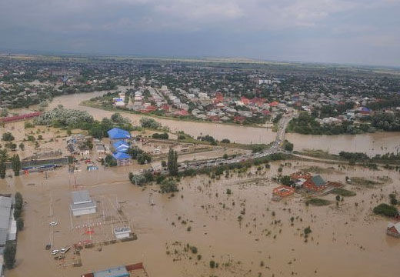
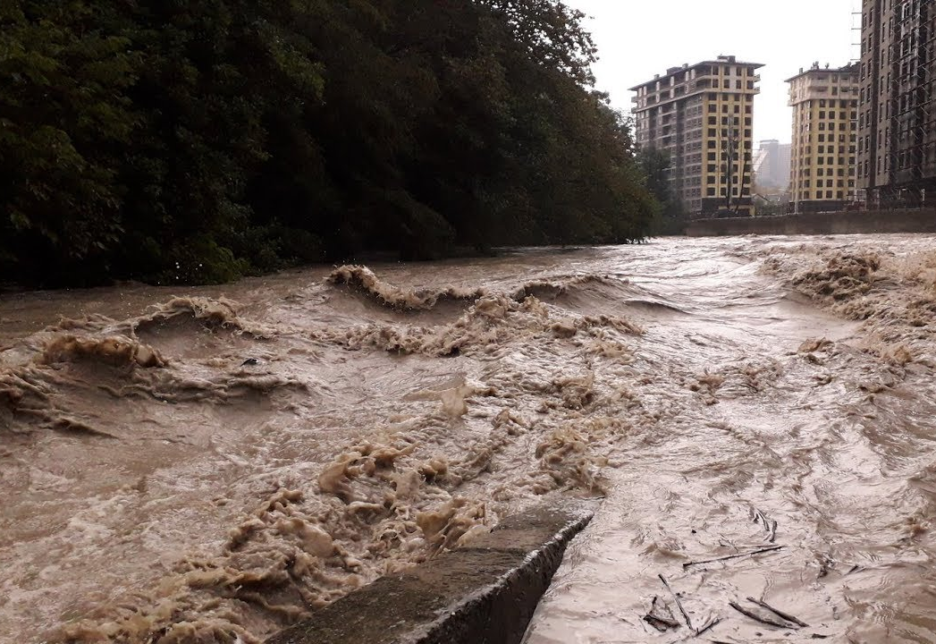
Introduction
In the Russian part of Western Caucasus heavy rainfall episodes frequently occur, leading to flash floods that cause fatalities and severe damage. One of the most destructive floods took place in the town of Krymsk at the Adagum river (Kuban river basin) on 6-7 July 2012 (153 deaths, damage 0.5 billion Euro).
On the Black Sea coast of Caucasus flash floods are regular events due to orographically enhanced precipitation. Flash floods occur almost every year in one or several small river basins (50-350 km²). The coast is the most important recreational area of Russia and hence densely populated. The floods and their causes on the Black Sea coast of Russia are studied by (Alexeevsky et al., 2016).
In this research we applied 2 different models (KW-GIUH and STREAM 2D CUDA) for 2 river basins in Western Caucasus in order to assess benefits of each model and possibilities for flash flood forecasting.
the Adagum river, Krymsk, 6-7 of July 2012
the Zapadny Dagomys river,
23-25 October 2018

Slide 3
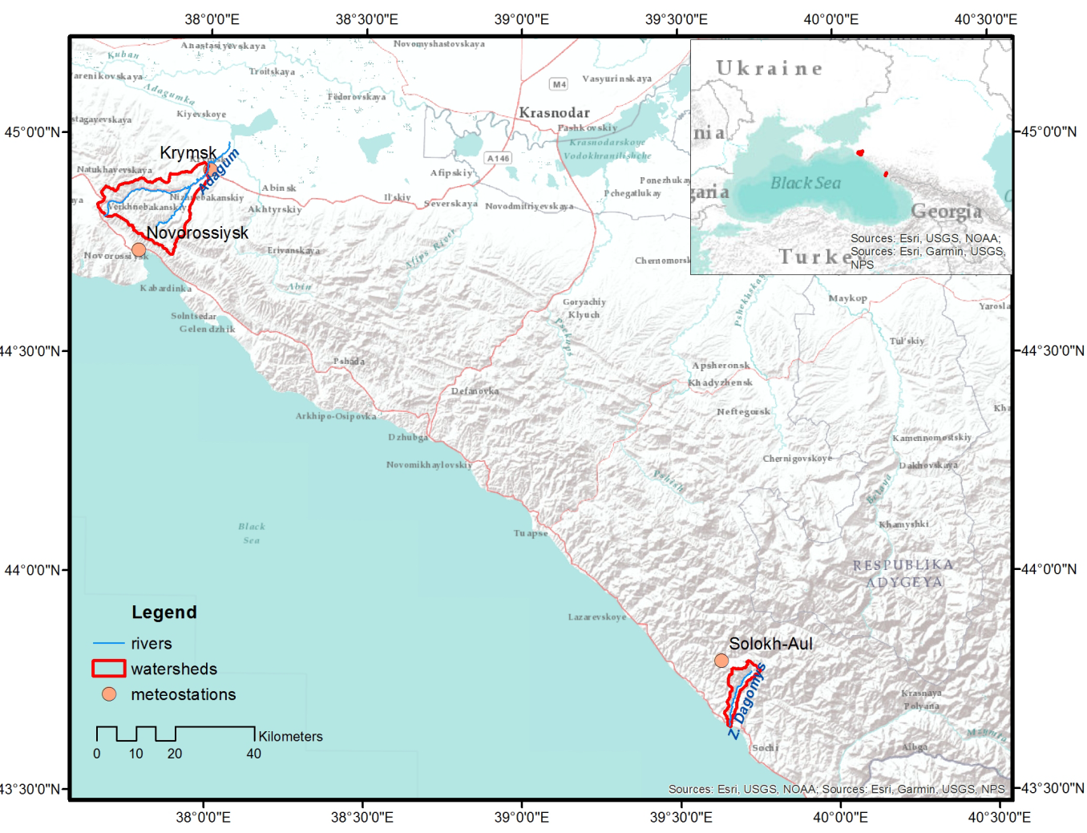
Study area

Slide 4
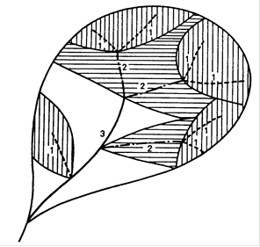
KW-GIUH model
Kinematic-Wave-Based Geomorphologic Instantaneous Unit Hydrograph
Rainfall-runoff event model
Conception of watershed geomorphologic IUH (Rodriguez-Iturbe & Valdes, 1979)
Travel time for ith-order channel and overland flow is computed using kinematic-wave approximation (Lee & Yen, 1997; Lee et al., 2009)
INPUT DATA
watershed geomorphologic features estimated on HYDROSHEDS DEM (res. 3 arcsec)
event rainfall data (here hourly measurements from 1 or 2 AMS). Distributed version
for radar precipitation is also available (Gonchukov et al., 2019)
ratio of partial contributing area to the total watershed area
MODEL CALIBRATION
Storm event record (rainfall & runoff data)
Main parameters – roughness coefficients of channels and slopes
OUTPUT
Discharge hydrograph
COMPUTATION TIME: < 1 minute
Q
t

Slide 5
STREAM 2D CUDA model
STREAM 2D CUDA is based on numerical solution of shallow water equations in a two-dimensional formulation
Original algorithm uses the exact solution of the Riemann problem (Aleksyuk & Belikov, 2017) due to which the calculation is performed for the entire catchment without special allocation of the channel network
INPUT DATA
DEM HYDROSHEDS (resol. 3 arcsec)
Rainfall data
OUTPUT
Discharge hydrograph
Water levels in river channels
COMPUTATION TIME: about 1 hour
Area 49.0 km²
Elevation, m

Slide 6
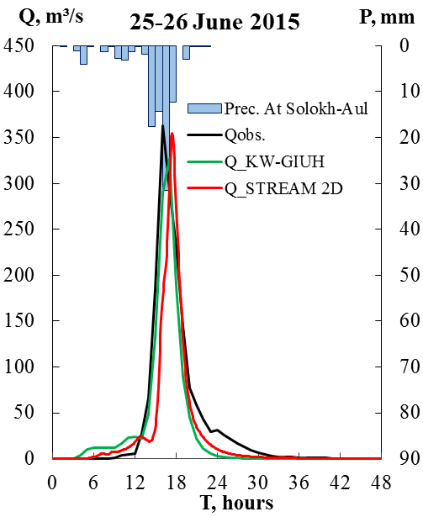
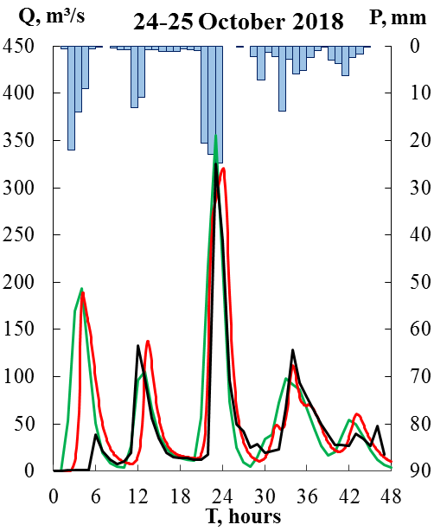
Results. The Zapadny Dagomys river
On 25 June 2015 the most severe flash flood occurred in Sochi surroundings (>1500 damaged houses, 178 people evacuated), especially at the Zapadny Dagomys river
95.5 mm precipitation at Solokh-Aul (75.8 mm during 4 hours, max intensity 31.5 mm/h)
On 24-25 October 2018 the most destructive flood occurred in Tuapse (6 deaths, 300 people evacuated) . At the Z. Dagomys riv. flood levels didn’t reach dangerous levels as in 2015.
208.9 mm precipitation in 2 days.
Models calibration was the most successful with roughness coefficients
n channel = 0.03; n overland flow = 0.1 for both models and both events
KW-GIUH is better at peak timing then STREAM 2D.
Peak values are satisfactory represented by both models.

Slide 7
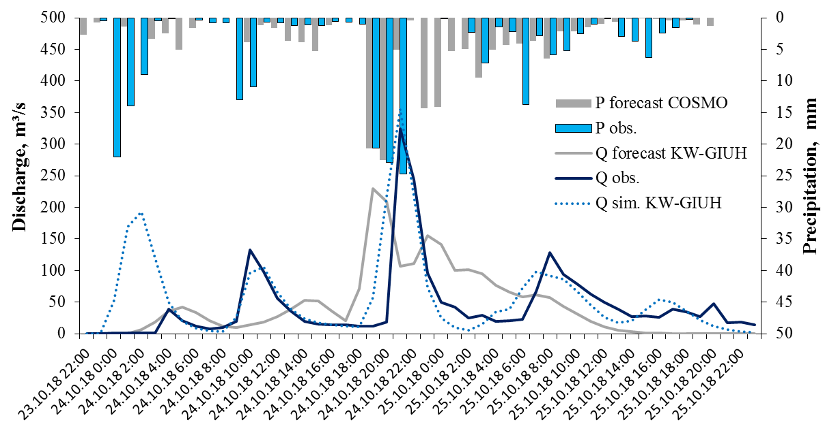
Results
For the 24-25 October 2018 precipitation forecast by COSMO-Ru7 model was used in order to estimate flood hydrograph and maximum discharge. By that time only KW-GIUH was calibrated.
Precipitation forecast interpolated to AMS coordinates showed 169 mm in 2 days which was close to observed values (208.9 mm). Pluviograph was quite similar to observed but intensive precipitation (>20 mm/h) lasted in forecast only 2 hours versus 3 hours in reality. That led to underestimation of peak discharge (1.5 times) though the difference in peak timing was only 2 hours.

Slide 8
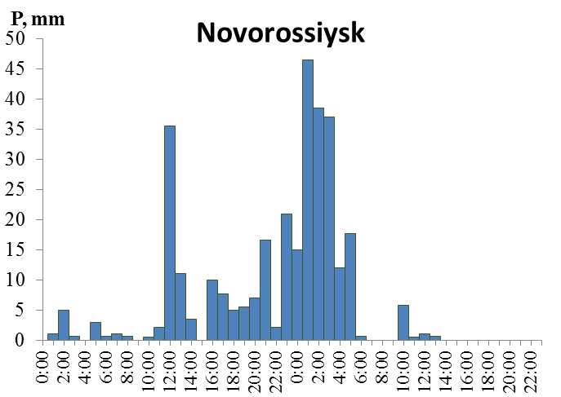
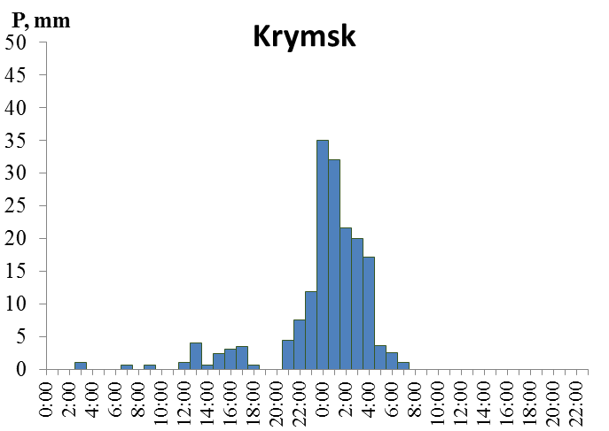
Results. The Adagum river
On 6-7 July 2012 extremely heavy rainfall as a consequence of deep convection in a cyclone led to flash floods on the rivers, mainly the Adagum river.
Precipitation:
In Novorossiysk 275 mm / 24 h
In Krymsk 156 mm/24 h
Because of the night time of the event and almost no warning 153 people died.
The urban inundation was simulated using STREAM 2D model (Alekseevskiy et al., 2014)
Here we aimed to simulate runoff from the Adagum river basin.
Area 326 km²
Elevation, m
Elevation,m

Slide 9
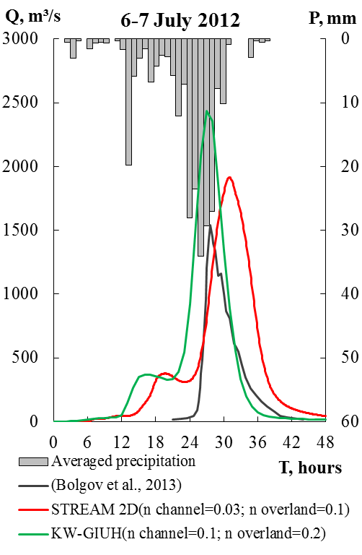
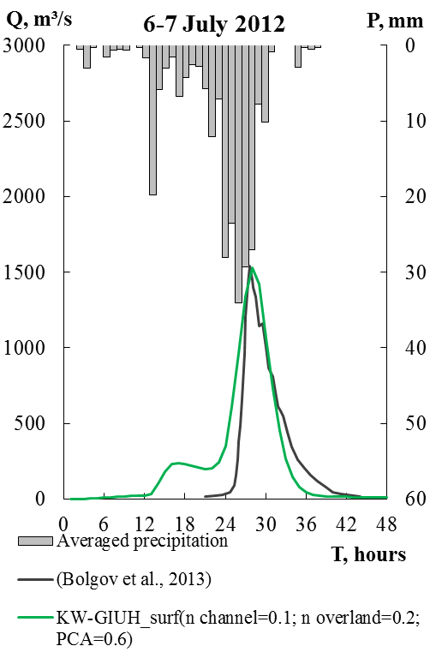
Results. The Adagum river
By this stage of research precipitation was taken average between 2 meteostations: Novorossiysk and Krymsk
Runoff coefficient was taken 1 (a) which leads to overestimation of flood volume (212 mm) and peak discharge as well. Flood volume was estimated 91–122 mm by hydrometric investigations and with SWMM (Bolgov et al., 2013)
For KW-GIUH also ratio of partial contributing area (PCA) was taken 0.6 (runoff coefficient 0.52) which showed good agreement with SWMM and observed hydrograph
Optimal roughness coefficients used in the models KW-GIUH and STREAM 2D became slightly different.
Peak timing (4-5 hours AM) was well simulated by Bolgov et al. (2013) with SWMM model,
KW-GIUH peak is later by 1 h, STREAM 2D – by 3h.
STREAM 2D took into account influence of railway dams restricting river channel just at the river inflow to the town.

Slide 10
Conclusions
For two mountain watersheds numerical modeling of flash floods was performed using the KW-GIUH (unit hydrograph) model and the STREAM 2D CUDA model based on the numerical solution of two-dimensional shallow water equations. A good agreement was obtained between the simulated hydrographs themselves and with observed data.
KW-GIUH is less sensible to input DEM data than STREAM 2D CUDA and more quick in computation. KW-GIUH is better in predicting peak timing.
STREAM 2D CUDA is able to provide water level data along the river channel and is good at peak discharge simulation. Scenario calculations with changing hydraulic conditions at the catchment can be simulated using the STREAM 2D CUDA model.
The results of the rainfall-runoff simulation using KW-GIUH and STREAM 2D CUDA models could be used for flash flood forecasting for the chosen rivers.

Slide 11
References
Alekseevskiy, N.I., Krylenko, I.N., Belikov, V.V., Kochetkov, V.V., Norin, S.V. 2014. Numerical Hydrodynamic Modeling of Inundation in Krymsk on 6 – 7 July 2012. Power Technology and Engineering. 48(3), 179-186. doi: 10.1007/s10749-014-0505-y
Aleksyuk, A.I., Belikov, V.V. 2017. Simulation of shallow water flows with shoaling areas and
bottom discontinuities, Computational Mathematics and Mathematical Physics, 57(2), 318–339. doi:10.1134/S0965542517020026
Alexeevsky, N.I., Magritsky, D.V., Koltermann, K.P., Krylenko, I.N., Toropov, P.A. 2016. Causes and systematics of inundations of the Krasnodar territory on the Russian Black Sea coast. Natural Hazards and Earth System Sciences, 16, 1289–1308. doi:10.5194/nhess-16-1289-2016
Bolgov, M.V., Korobkina, E.A. 2013. Reconstruction of Rain Flood at the Adagum River on the Basis of Mathematical Models for Discharge Formation. Water management in Russia, 2013, 3. 87–102 (in Russian)
Gonchukov, L.V., Bugaets, A. N., Gartsman, B.I., Lee, K.T. 2019. Weather Radar Data for Hydrological Modelling: An Application for South of Primorye Region, Russia. Water Resources, 46 (S2), S25–S30. doi:10.1134/S0097807819080098
Lee, K.T., Cheng, N.K., Gartsman, B.I., Bugayets, A.N. 2009. A current version of the model of a unit hydrograph and its use in Taiwan and Russia, Geography and Natural Resources, 30 (1), 79–85. doi:10.1016/j.gnr.2009.03.015
Lee, K.T. and Yen, B.C. 1997. Geomorphology and kinematic-wave based hydrograph
derivation. J. Hydraulic Engrg., ASCE, 123(1), 73-80.

Slide 12
Acknowledgements
This research was funded by
Russian Science Foundation, research project 17-77-30006 (processing of river discharge data, flash flood simulation);
Russian Foundation for Basic Research, research project 19-45-233007 (data processing from an Automated Flood Monitoring System of the Krasnodar Territory).

