Slide 1
Abrupt Climate Change in the North Atlantic: a glacial vantage
Adrienne Foreman¹,
Gordon Bromley^{1,2}, Brenda Hall²
¹Geography, NUI Galway, Ireland
²Climate Change Institute, University of Maine, USA
Abrupt climate change is a prominent feature of the North Atlantic region and, more broadly, the Northern Hemisphere. Establishing the causes and mechanisms of abrupt change is central not only to understanding past events, such as Heinrich Stadial 1 (HS1) and the Younger Dryas (YD), but also to accurately project future shifts in mean climate state that might result from anthropogenic global warming.
The traditional view of HS1 and the YD holds both as periods of severe year-round cooling that interrupted the last glacial termination, with each accompanied by cryospheric expansion. Yet, key proxies used to establish this paradigm are potentially weighted toward winter temperatures (i.e., ice core δ¹⁸O [1]) or confined to marine environments (i.e., foraminifera abundance). In contrast, several terrestrial proxies have been used recently to infer circum North Atlantic warming during HS1 and the YD, including the behaviour of mountain glaciers [2], terrestrial meltwater fluxes [3], and plant macrofossil data [4]. This raises the question of whether anomalous cold is the sole expression of abrupt climate change or if this phenomenon is instead characterized in the circum North Atlantic by extreme seasonality (cold winters but warm summers). As terrestrial indicators of summer temperature [5], glaciers provide a unique vantage into the seasonality of past abrupt climate shifts via the geologic record of glaciation. We employ cosmogenic ¹⁰Be surface-exposure dating of relict glacial deposits in Connemara, Western Ireland, where climate is dominated by the North Atlantic, making this a unique location for assessing potential differences between terrestrial and marine climate responses. Our overarching goal is to construct a high-resolution record of cryospheric change during HS1 and the YD as a proxy for summer temperature.

Slide 2
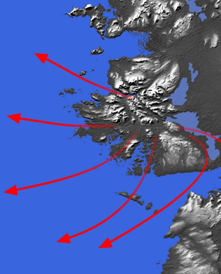
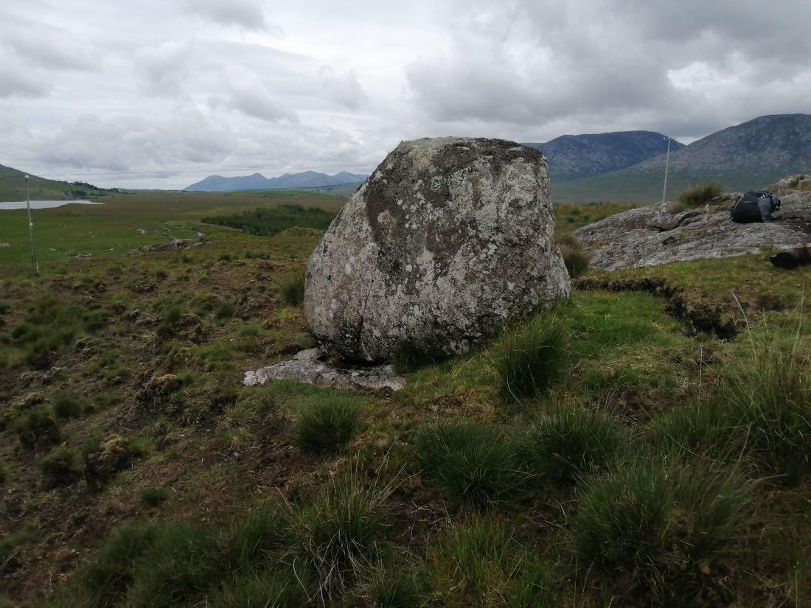
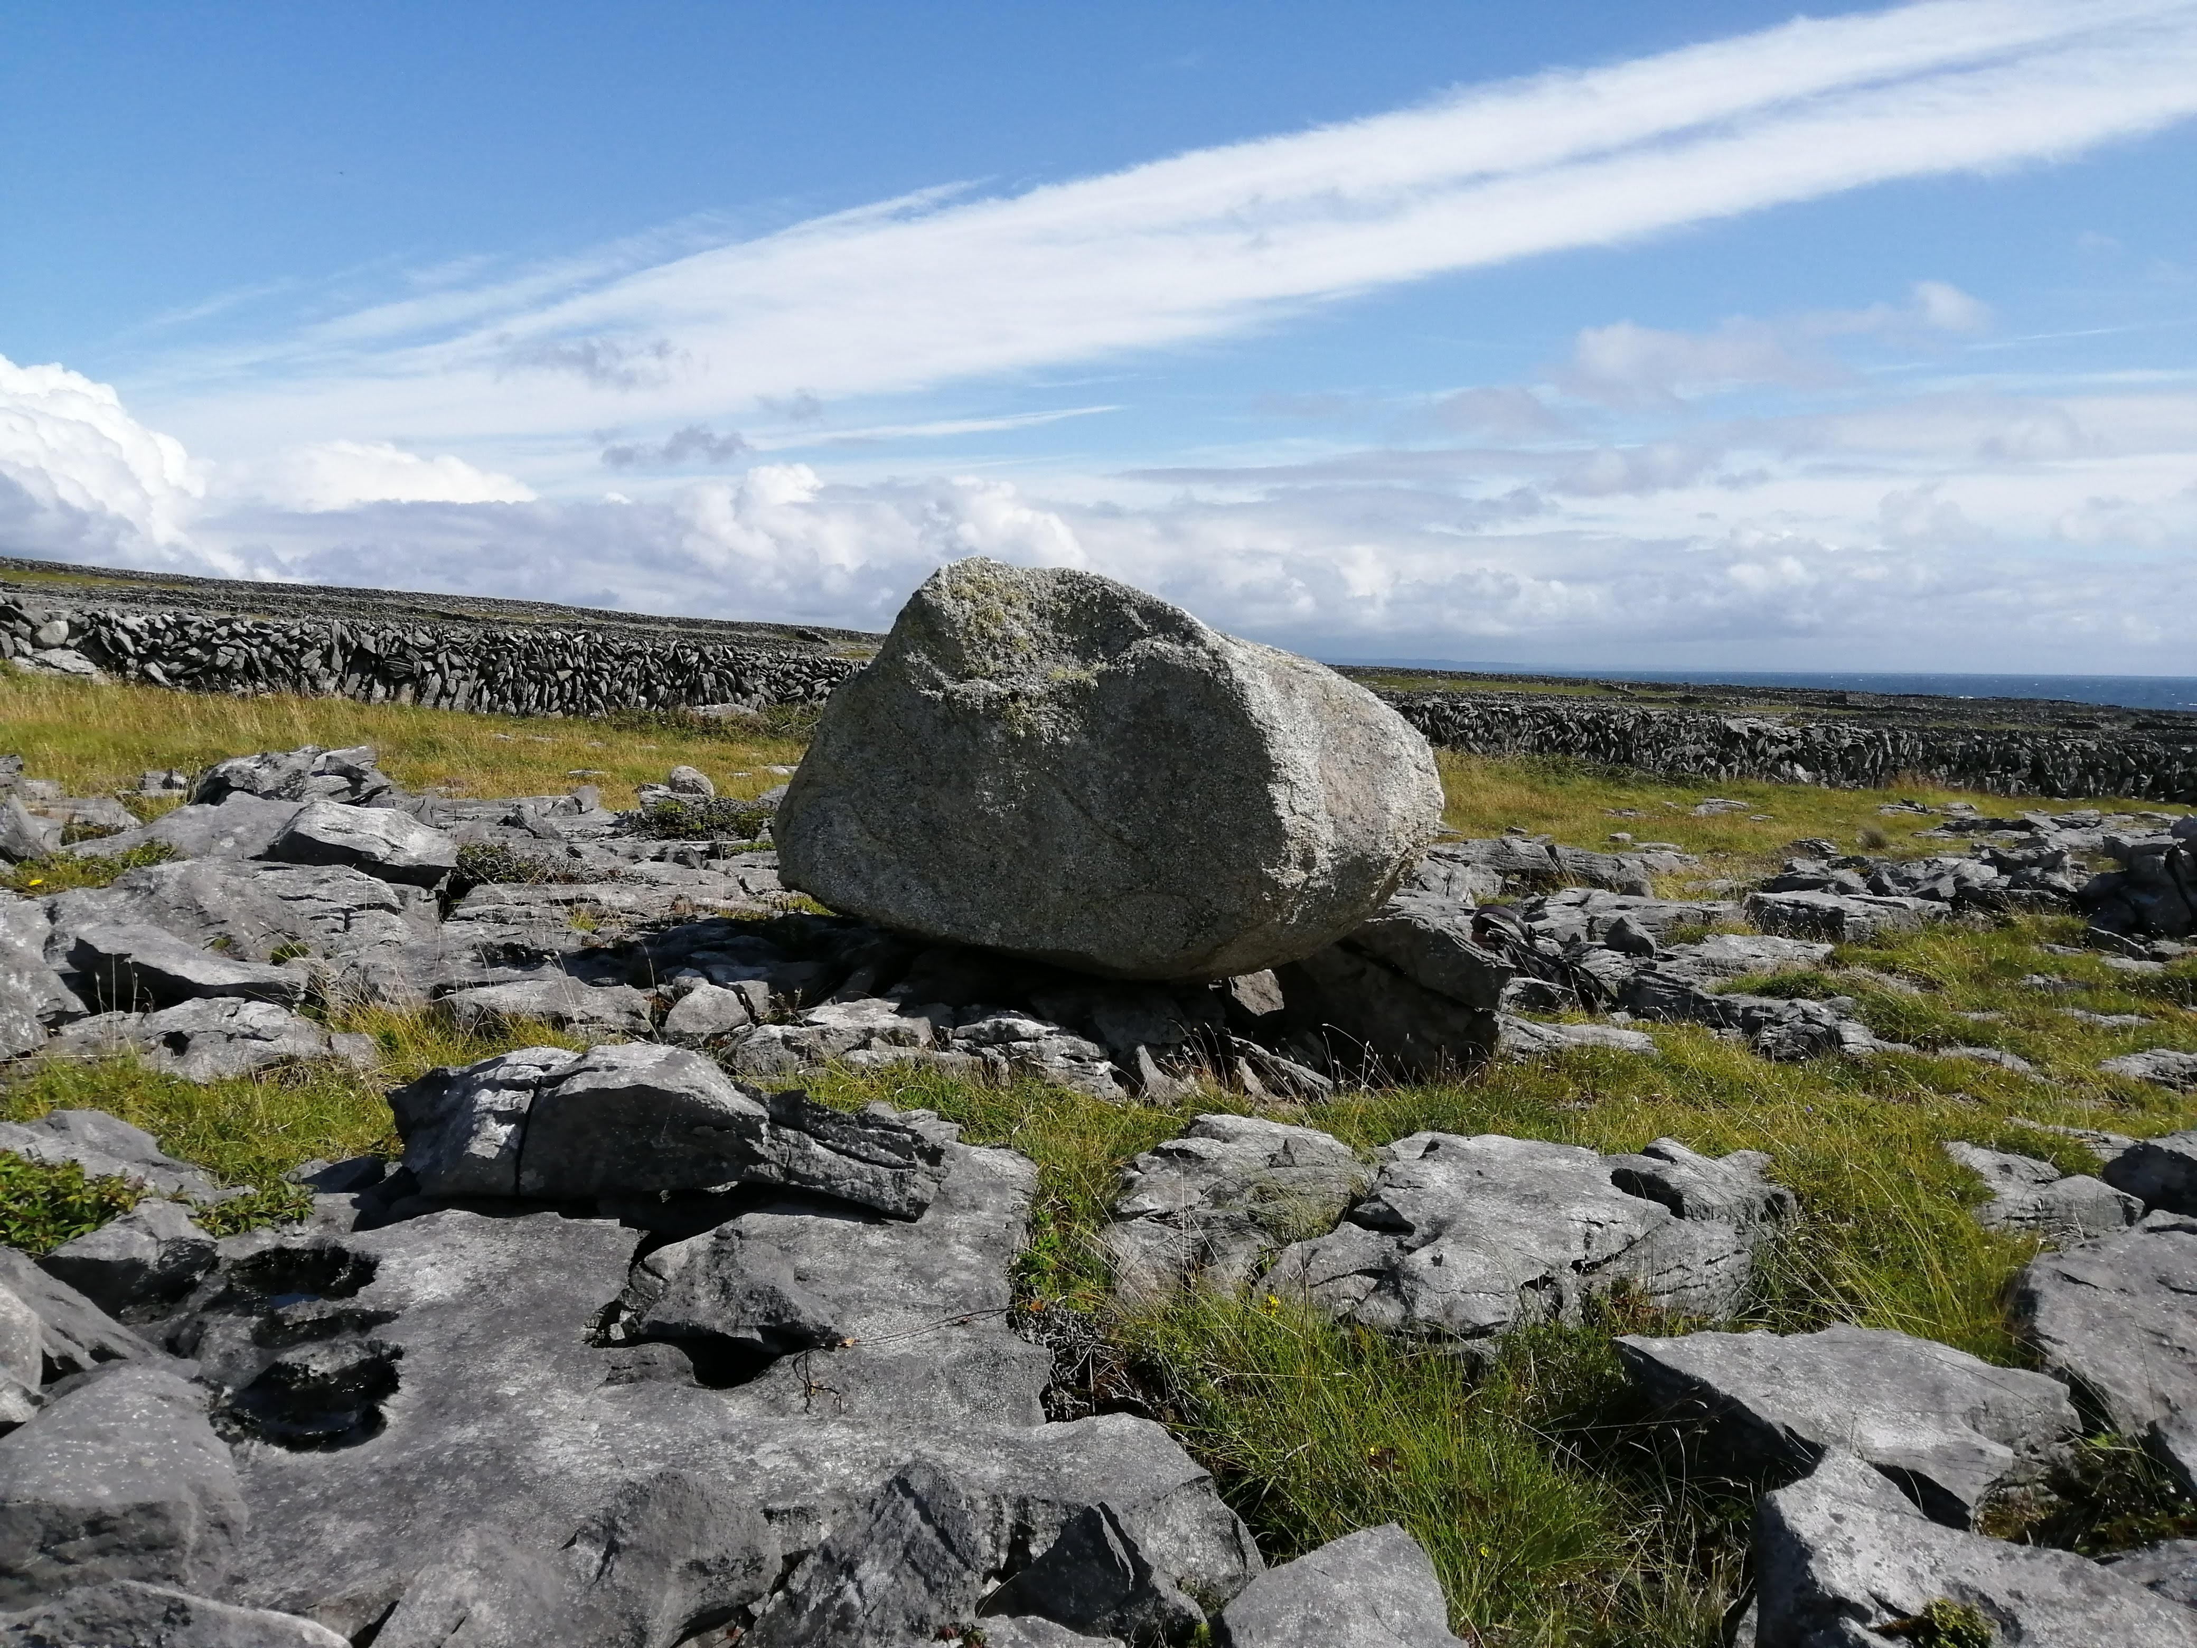
Reconstructing the Connemara dome of the Irish Ice Sheet: Results to Date
Two sites were initially selected at opposite ends of a ~40 km transect. The first, the Aran Islands, are a Carboniferous Limestone formation at the entrance to Galway Bay. Previously undated granitic erratics perched on bedrock on Inis Mór lie along a former flowline of the Connemara ice dome (flowlines denoted by red arrows, above [6]) and form the southern, seaward end of our deglacial transect. Our second site, Maam Cross, lies at the northern end of the transect at the former centre of the Connemara ice dome. At this site, granitic erratics are perched on metamorphic bedrock of the Dalradian Supergroup. Cosmogenic ¹⁰Be surface-exposure ages from both sites give tight, internally consistent distributions: the Maam Cross population gives a mean age of 17.3 ± 0.6 ka (1σ), while the Inis Mór samples give a mean age of 17.4 ± 0.3 ka. The two populations are statistically indistinguishable, indicating rapid deglaciation early during HS1. As glacier mass balance is dominated by summer air temperature, we interpret this pattern as reflecting strong summertime warming in Western Ireland during HS1.
Notes:
Dates within statistical errors of each other, Essentially instantaneous, Interpretation atm: Glacier melt during HS1

Slide 3
Reconstructing the Connemara dome of the Irish Ice Sheet: Going forward
Together, our initial evidence for rapid deglaciation during HS1 and the abundance of landforms shaped by meltwater suggest that deglaciation was driven by melting. At face value, this scenario conflicts with the paradigm of HS1 as a period of anomalous cold in the North Atlantic. To explore this pattern further, we are continuing to develop the Connemara deglacial record, which will comprise three separate flowlines of the former ice dome (red arrows in above panel) and constraint of ice sheet thickness via vertical transects. Sites of ongoing sample collection and geomorphic mapping are shown in blue. Ultimately, we will compare the terrestrial record of summertime temperature from Connemara with existing marine and ice core data to assess the role of seasonality in stadial climate.
[1] Buizert et al., 2014. Science 345, 1177-1180.
[2] Bromley et al., 2014. PNAS 111, 6215-6219.
[3] Toucanne et al., 2015. 113-133.
[4] Schenk et al., 2020. Quat. Sci. Rev. 233, 106243.
[5] Oerlemans, 2005. Science 308, 675-677.
[6] Charlesworth, 1929. Proc. Royal Irish Acad. B, 39, 95-106
Notes:
Dates within statistical errors of each other, Essentially instantaneous, Interpretation atm: Glacier melt during HS1

