Slide 1

Cold Atom Interferometer activities for measuring the Earth’s gravity field
Olivier Carraz
07/05/2020

Slide 2
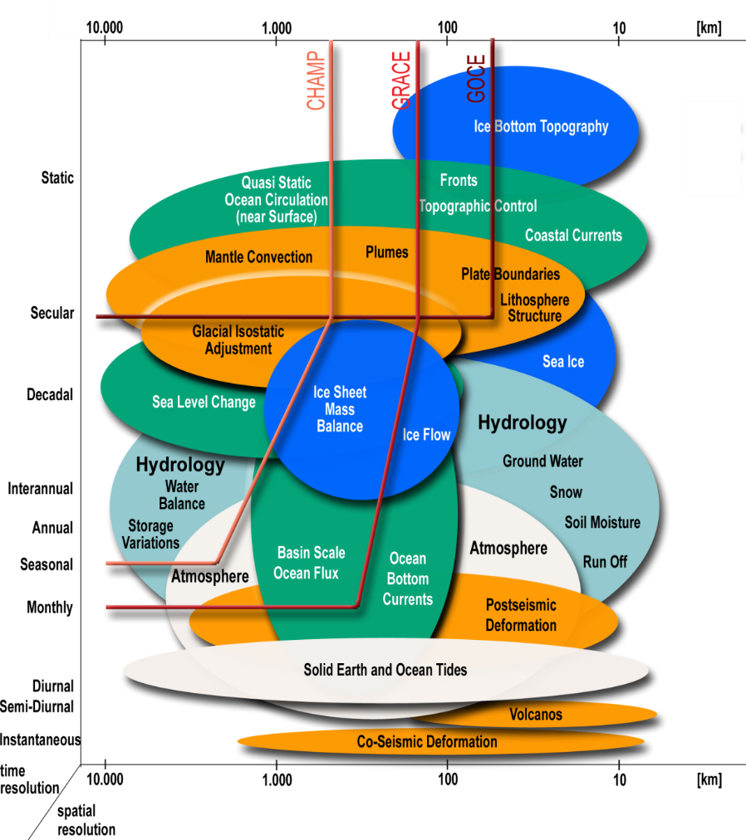
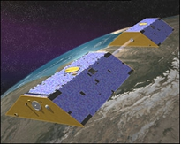
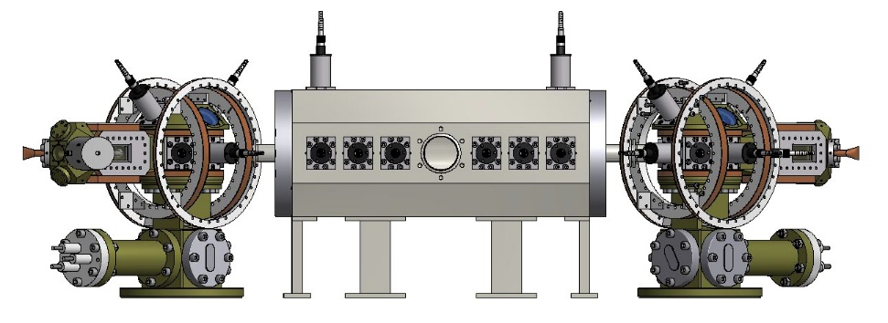
Earth Observation Future needs
GRACE FO
Future Concepts?
NGGM
CAI

Slide 3
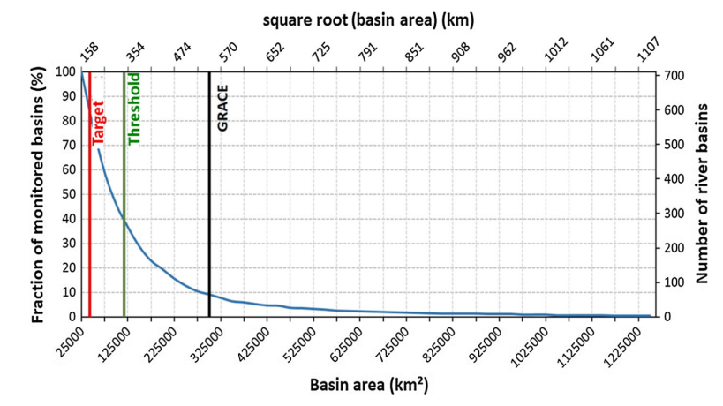
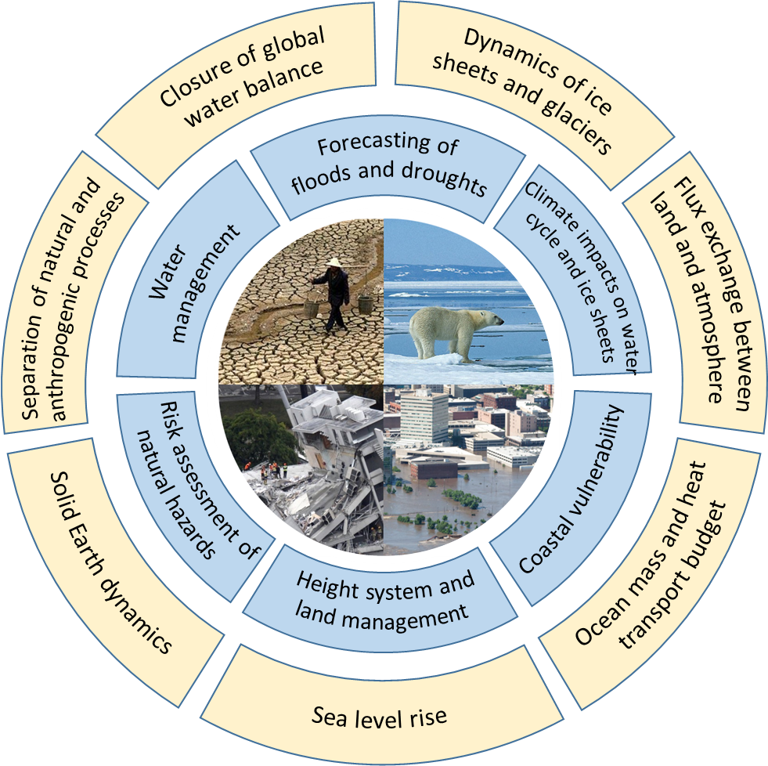
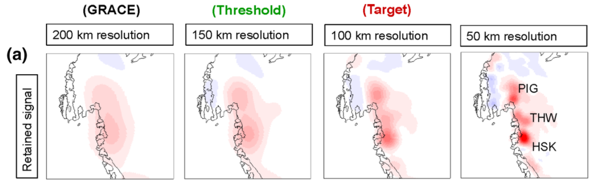
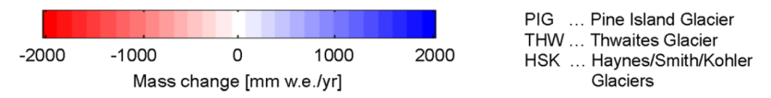
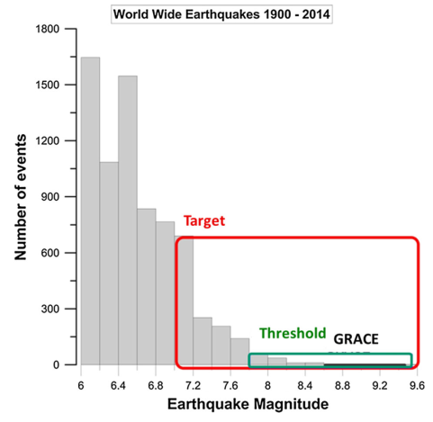
Potential of a future mass transport space constellation with the Next Generation Gravity Mission (NGGM) Concept
Enhanced and new observations at short and long time scales
water cycle: river basins & groundwater
ice sheets: mass change and sea level
Solid Earth dynamics
Enhanced and new applications

Slide 4
Principle of a Cold Atom Interferometer (CAI) Gravimeter
Credit: LP2N

Slide 5
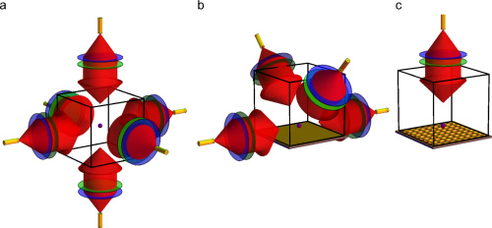
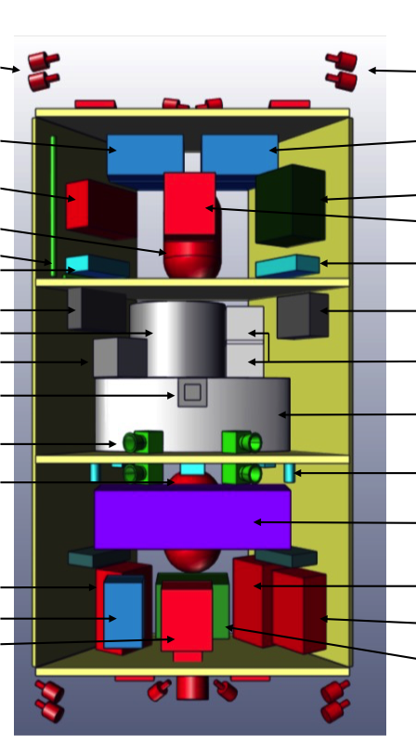
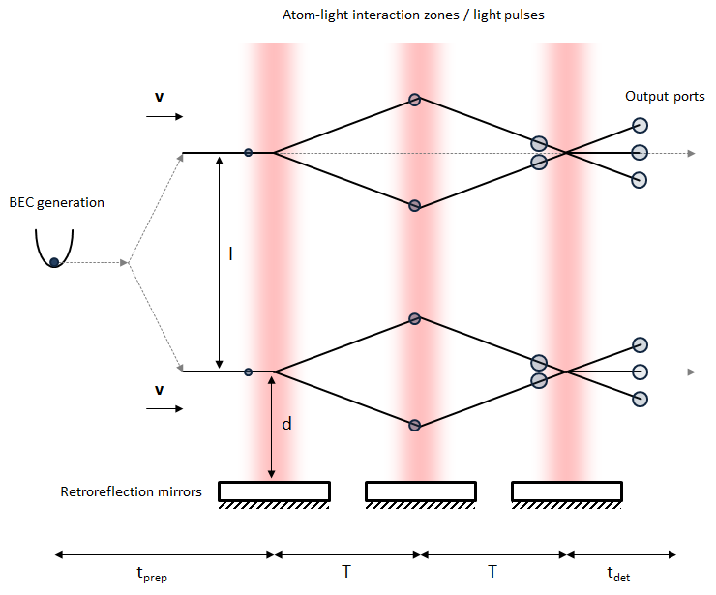
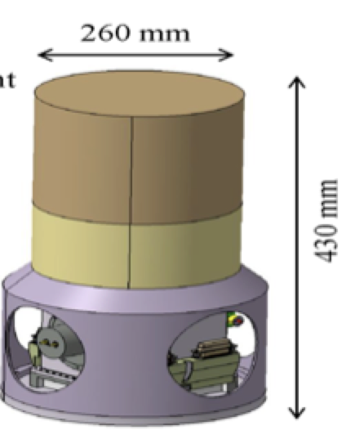
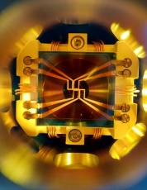
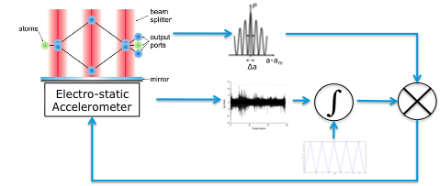
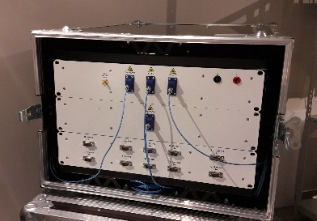
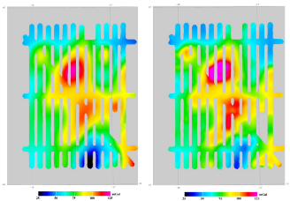
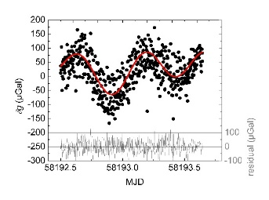
Matter-Wave Interferometer (MWI) for EOP
Concepts for Earth Geodesy
1. MWI interleaved gravity gradiometer
Hardware development
1. Grating Magneto Optical Trap (MOT)
Results
1. Mission and instrument concepts validated
TAS (It)
Strathclyde (UK)
SYRTE (Fr)
2. Compact Vacuum Chamber for BEC
RAL-Space (UK)
2. Hybridization classical accelerometers/MWI
ONERA (Fr)
ONERA (Fr)
3. Agile and compact laser system for MWI
2. On-ground validation
MWI
Classical
Laser System
Muquans (Fr)
Airborne campaign

Slide 6
Technology Roadmap: Need for a Space Demonstrator
QT SPACE (EU)
Short-term goals (5 years)
  Push TRL level of all subcomponents to >6 and test performance of interferometry in relevant environment (ground-based μg facilities).
  Study and choose to most efficient mission concept.
Medium-term goals (10 years)
  Develop a payload QGG EM and plan a mission of type Earth venture. C-COOL Consortium
Long-term goals (> 10 years)
  Have a geodesy mission using one or multiple satellites quantum sensors.
National Agency
CNES: Phase 0 study: GRICE (2016-2018) ; Techno demonstrator: CARIOQA (2019-2020) for a launch opportunity by 2025
UK: Phase 0 study: CAGE (2018-2020) ; Techno demonstrator: CASPA, MCLAREN
ASI: Phase 0 study: MOCASS (2016-2018), MOCAST+ (2020-)
ESA
Techno development at subsystem components (2012-2022)
Phase 0 study for instrument concept, mission concept and techno demonstrator concept (2015-2020)
QT inertial sensor demonstrator launch opportunity: 2023+

Slide 7
Beyond GOCE, GRACE-FO and NGGM
Beyond GRACE and GOCE and NGGM… NGGM evolution:
  CAI/EA hybridization
  CAI Gradiometry
CAI gradiometry needs at least one order magnitude improvement (C-COOL Consortium)
  Relaxing drag control needs by improving phase reading scheme
  Improving sensitivity of the instrument by using quantum correlation techniques
Technology development for quantum sensors for space applications starts now. Market in expansion to anticipate any Space Missions after 2030.
Demonstrator with a Science Case should be envisaged to enable a long-term mission.

