Slide 1
Changes in soil nutrient content, biological activity and CO₂ emission rate as a result of low-dose municipal sewage sludge compost application
Andrea Farsang*^{1,3}, Katalin Perei^{2,3}, Attila Bodor^{2,3}, Zsuzsanna Ladányi^{1,} , Katalin Tímea Csányi¹, Katalin Gombos^{1,3}, Izabella Babcsányi¹, Károly Barta¹
¹ Department of Physical Geography and Geoinformatics, University of Szeged, H-6722 Szeged, Egyetem utca 2-6, Hungary
² Department of Biotechnology, University of Szeged, H-6726 Szeged, Közép fasor, Hungary
³ Institute of Environmental Science and Technology, University of Szeged, H-6720 Szeged, Tisza L. krt 132, Hungary
*Correspongding author:
E-mail address: farsang@geo.u-szeged.hu
Farsang et al./ EGU 2020, Vienna, Austria

Slide 2
1. Introduction
Land application of sewage sludge is an increasingly popular means of the reuse of sewage sludge as it allows for recycling of valuable components, such as organic matter, N, P and other nutrients.
Indeed, sewage sludge amendment to the soil modifies the soil’s physico-chemical properties, such as plant-available macro/micro nutrient contents, organic matter content. Additionally, sewage sludge applications can significantly increase the amount of microbial biomass in the soil and can also increase the soil enzyme activities.
The aim of the present study is to investigate the impact of low-dose municipal sewage sludge compost amendment on the nutrient status and the biological activity in Chernozem soils.
Farsang et al./ EGU 2020, Vienna, Austria

Slide 3
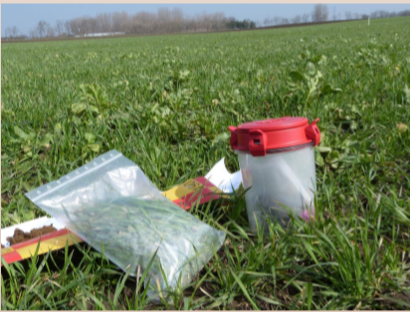
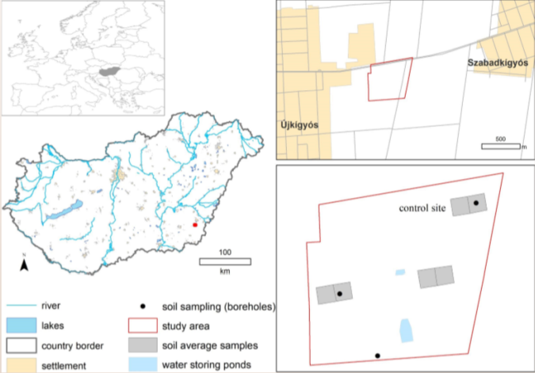
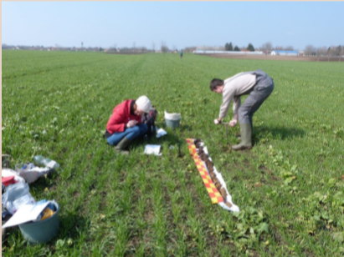
2. Study area
The study area, located near Újkígyós (SE Hungary), is a 5.6 ha arable land, where 2.5 m³/ha/year municipal sewage compost has been regularly disposed since 2013.
Farsang et al./ EGU 2020, Vienna, Austria

Slide 4
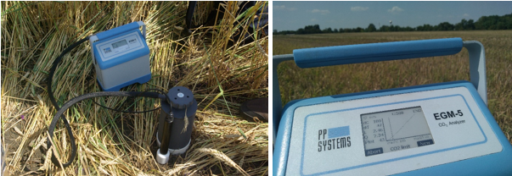
3. Methods
The pH (in H₂O) and humus content of soils were measured according to standard procedures. The macronutrients P₂O₅ and K₂O were extracted using ammonium-lactate, while the nitrogen forms (NO₂⁻ + NO₃⁻ -N) were extracted with KCl-solution. The nutrient content was then determined by a flow injection analysis photometer.
In order to determine the bacterial composition and enzyme activity of the soil samples, the number of living cells (CFUs), the catalase enzyme activity (CAT) and the dehydrogenase activity (DHA) were determined. The CO₂ emission was measured by an EGM-5 Portable High Precision CO₂ Meter in the field.
Application of the EGM-5 under winter wheat
Farsang et al./ EGU 2020, Vienna, Austria

Slide 5
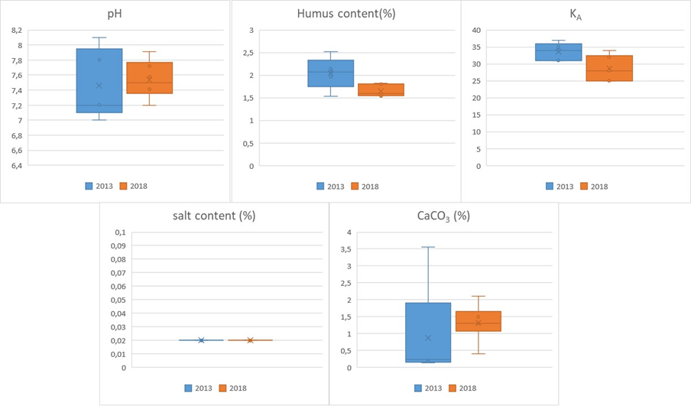
4. Result and discussion
Basic soil parameters between 2013 and 2018 (before the compost treatments and afterwards) in the topsoils of the study area near Újkígyós (Hungary)
Farsang et al./ EGU 2020, Vienna, Austria

Slide 6
4. Result and discussion
The Pb, Cr and Ni concentrations in the sewage compost treated soils and soils before treatment
Farsang et al./ EGU 2020, Vienna, Austria

Slide 7
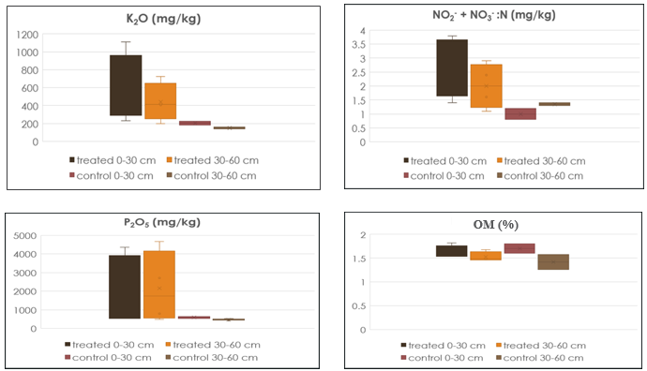
4. Result and discussion
The extractable nutrient (K₂O, NO₂ + NO₃--N, P₂O₅ ) and humus contents in the sewage-treated and the control soils
Farsang et al./ EGU 2020, Vienna, Austria

Slide 8
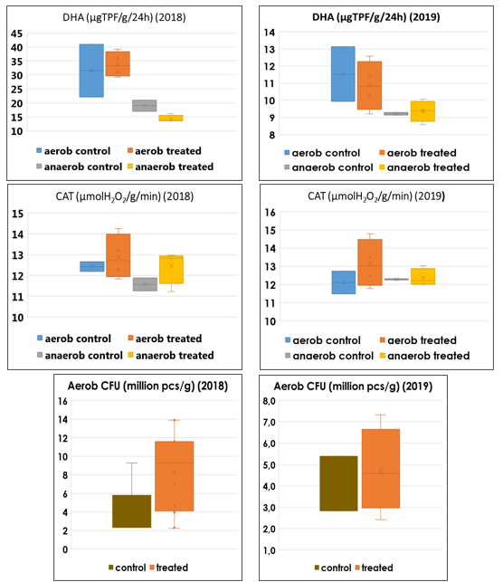
4. Result and discussion
Results of the bacteriological tests
Farsang et al./ EGU 2020, Vienna, Austria

Slide 9
5. Conclusion
The sewage sludge compost applied to Chernozem soils improved soil properties by adding slowly decomposing organic matter, abundant in plant macronutrients (N, K, P).
Moreover, the sewage sludge compost spreading on field seemingly causes some heavy metal enrichment.
The anaerobic microorganisms and the DHA enzyme activity in the anaerobic soil layers did not increase in the compost-amended soils.
The aerobic microorganisms (CFUs) and CAT activity tended to be higher in treated soils compared to the non-amended (control) site, however not significantly. These results suggest that the soil biological activity is only moderately affected by the low-dose municipal sewage sludge compost applications.
According to our field CO₂ emission measurements, the yearly application of the sewage sludge compost in a low-dose seemingly did not affect the soil respiration rates, compared to a local control site.
Farsang et al./ EGU 2020, Vienna, Austria

Slide 10
The research was funded by the ‘Thematic Network for the Sustainable Use of Re-sources – RING2017’ project (program code: EFOP-3.6.2-16-201700010).
Farsang et al./ EGU 2020, Vienna, Austria

