Slide 1
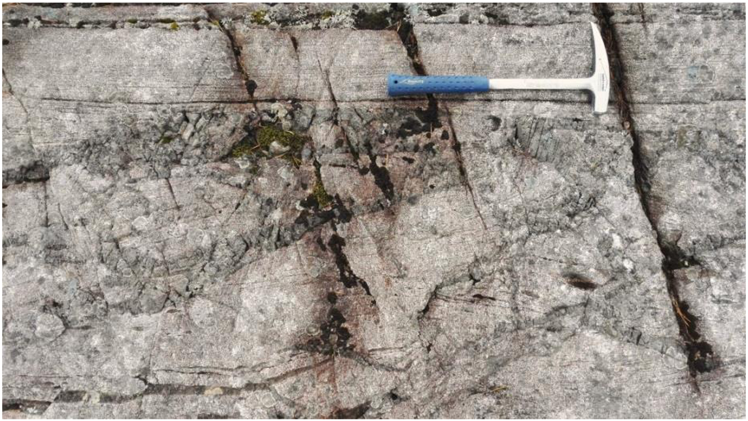
Direct observations of a dynamic earthquake rupture in the lower crust
Arianne Petley-Ragan^{1,*}, Ben-Zion, Y.², Austrheim, H.¹, Ildefonse, B.³, Renard, F.^{1,4} and Jamtveit, B.¹
¹Physics of Geological Processes, The Njord Centre, University of Oslo, Oslo, Norway
²Department of Earth Sciences, University of Southern California, California, USA
³Geosciences Montpellier, CNRS, University of Montpellier, Universite des Antilles, Montpellier, France
⁴University Grenoble Alpes, ISTerre, Grenoble, France
Science Advances (2019) 5: eaaw0913
Display Contents:
pg. 2. Geological Setting and Field Map
pg. 3. Fault Description
pg. 4. Fault Microstructures: Damage Zone
pg. 5. Fault Microstructures: Cataclasites
pg. 6. Dynamic Rupture Model
Through rapid brittle deformation, fluid infiltration and metamorphism, lower crustal earthquakes have a profound effect on dry portions of the lower continental crust. However, their triggering mechanism and sequence of events are still debated. This display presents observations from Petley-Ragan et al. (2019) that piece together the temporal evolution of a lower crustal earthquake fault from the Bergen Arcs, Western Norway. Our results provide evidence for purely brittle deformation processes acting prior to frictional melting and subsequent fluid-driven metamorphism caused by the earthquake, and fits a scenario in which a dynamic rupture has propagated within the lower crust.

Slide 2
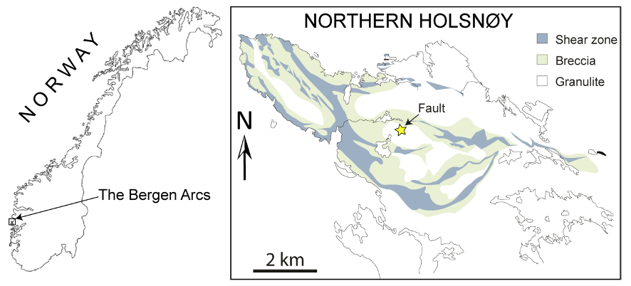
Page 2. Geological Setting and Field Map
a.
A pseudotachylyte-bearing fault cuts through granulite facies anorthosite (930 Ma) and is spatially associated with fluid-driven amphibolite facies metamorphism (420-430 Ma).
Conditions of metamorphism are 0.9-1.0 GPa and 550-625℃ based on local equilibrium in the pseudotachylyte.
An apparent displacement of 1.7 m was measured from an offset garnet-pyroxene seam in the wall rock.
Wall rock damage and injection veins are locally evident on only the northern side of the fault (pg. 3).
b.
pg.3(b)
pg.3(a)
pg. 3(c)

Slide 3
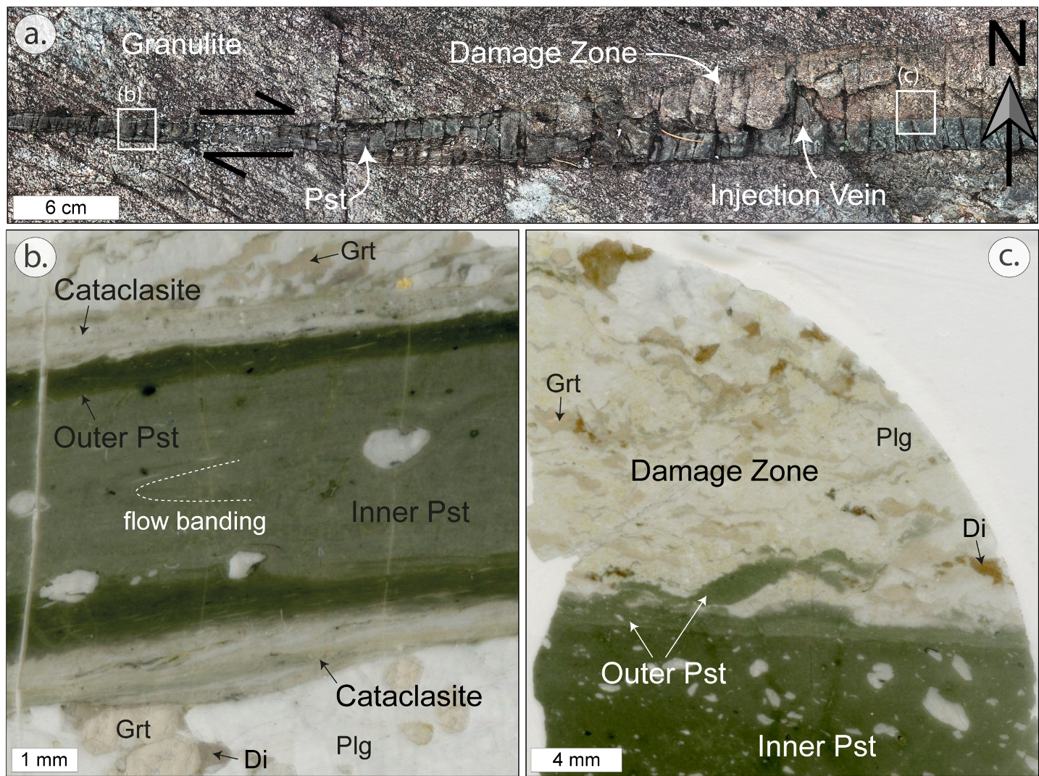
Page 3. Fault Description
The fault is defined by a zoned pseudotachylyte (pst), injection veins, an asymmetrical damage zone (pg. 4) and symmetric cataclasites (pg. 5).
A light-colored damage zone is present in only the northern wall rock adjacent to the fault.
Cataclasites (pg. 5) symmetrically bound either side of the fault.
pg.4(a)
pg.4(b)
Garnet, plagioclase and diopside are fragmented in the damage zone (pg. 4).
pg.5(a)
A zoned pseudotachylyte with floating plagioclase clasts makes up the core of the fault.
Clasts of cataclasite are present in the outer pst, suggesting that cataclasis predates melting.
pg.5(b)
Pst veins inject into the damaged wall rock, suggesting that wall rock deformation predates melting.
The southern wall rock remains intact.

Slide 4
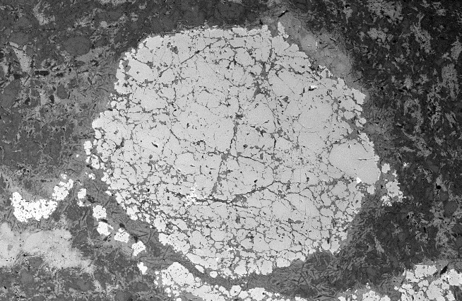
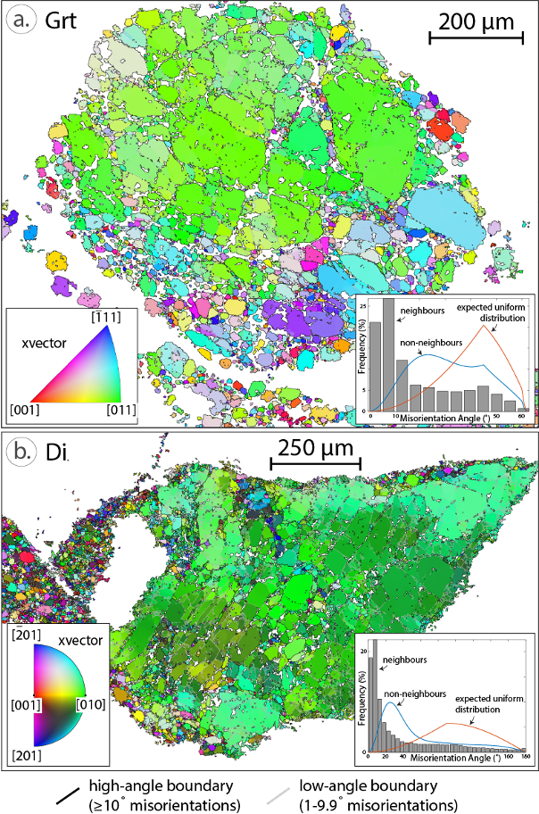
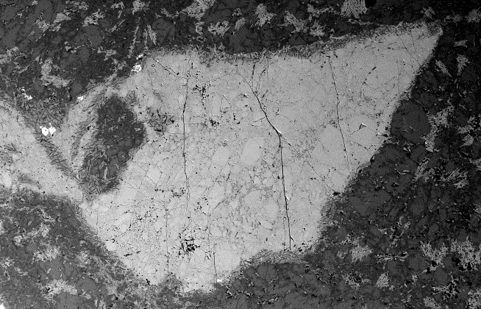
Page 4. Fault Microstructures: Damage Zone
Crystallographic orientation and misorientation between grains
Grain Size Distributions
Brittle deformation with lack of shear strain
a.
a.
a.
-1.40
Cpx+Ky+Kfs
Garnet
-2.09
500 µm
Area Normalized
b.
b.
Plg
b.
-2.03
Diopside
Hbl+Ky+Kfs
500 µm
Area Normalized
The asymmetrical damage zone displays wall rock deformation that lacks a significant amount of shear strain. Once-intact grains are now pulverized but preserve their original grain shape. The new grains have a strong crystallographic preferred orientation and abundant low-angle misorientations between grains. Grain size distributions have power law relations with exponents near -2 which has previously been attributed to fragmentation involving rapid volumetric expansion and contraction known as pulverization (Rockwell et al., 2009; Muto et al., 2015).

Slide 5
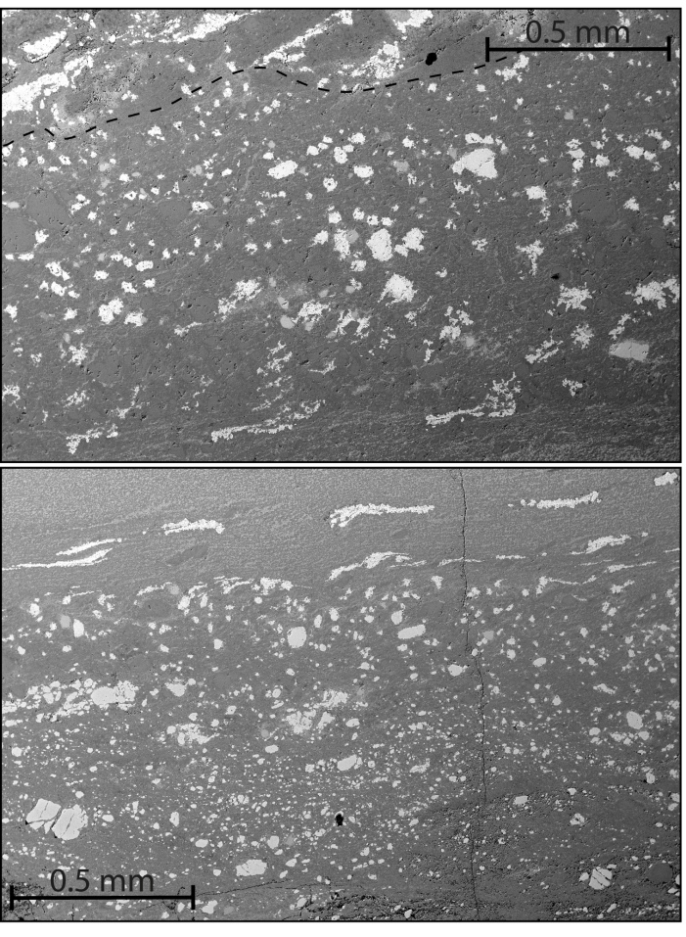
Page 5. Fault Microstructures: Cataclasites
Brittle deformation with shear strain
Grain Size Distributions
a.
a.
-1.46
b.
-1.78
Northern Cataclasite
Plg
-2.62
-2.21
Grt
Di
Pst
b.
Pst
Area Normalized
Area Normalized
Crystallographic orientation and misorientation between grains
Grt
Southern Cataclasite
Plg
The cataclasites are made up of garnet, plagioclase and diopside clasts in a fine-grained plagioclase-rich matrix. At the contact with the pseudotachylyte, elongated aggregates of garnet grains display the high shear strain within this domain. The garnet grains have a random crystallographic orientation and abundant high-angle misorientations between grains. Grain size distributions have power law relations with exponents near -1.5 and -1.8, and cross-over to steeper slopes for the largest clasts. These grain size distributions are attributed to a brittle shear comminution process (Monzawa and Otsuki, 2003; Sammis and King, 2007).

Slide 6
Page 6. Dynamic Rupture Model
Based on our microstructural observations, we propose the following temporal evolution for the fault:
(i)
Propagation of a dynamic shear rupture with symmetric fracturing at the rupture tip created a process zone.
(ii)
(iii)
(iv)
(v)
(ii)
Opposing tensile and compressive stresses formed in the wall rock behind the process zone. The damage zone is produced on the tensile side, since rocks are weaker under tension, cracking the wall rock with minimal shear strain.
(iii)
Shear motion behind the process zone causes cataclasis and comminution in what we refer to as the slipping zone.
(v)
Fluid is now able to infiltrate the damage wall rock adjacent to the fault, driving metamorphic reactions in the pseudotachylyte, cataclasites and damage zone.
(iv)
As frictional heating increases in the slipping zone, the cataclasites begin to melt and pseudotachylyte is produced.
References:
Monzawa, N. & Otsuki, K. Comminution and fluidization of granular fault materials: Implications for fault slip behaviour. Tectonophysics 367, 127-143. (2003).
Muto, J., Nakatani, T., Nishikawa, O. & Nagahama, H. Fractal particle size distribution of pulverized fault rocks as a function of distance from the fault core. Geophys. Res. Lett. 42, 3811-3819. (2015).
Rockwell, T. et al. Chemical and physical characteristics of pulverized Tejon Lookout granite adjacent to the San Andreas and Garlock faults: Implications for earthquake physics. Pure Appl. Geophys. 166, 1725-1746. (2009).
Sammis, C. G. & King, G. C. P. Mechanical origin of power law scaling in fault zone rocks. Geophys. Res. Lett. 34, 2-5. (2007).

