Slide 1
Evolution of topography, sediment yield and efficiency of erosion in intra-continental rift settings: A perspective from numerical modelling using coupled surface processes and tectonic models
Lorenz Michel, Ritske Huismans, Sebastian Wolf
Department of Earth Science, University of Bergen (Norway)

Slide 2
Scientific questions
Main aim:
Investigate and explore a possible coupling and feedbacks between tectonic and earth surface processes during continental breakup and rifting.
We especially want to address the following questions during different stages of rifting:
Formation and evolution of structures and basins?
Evolution of topography?
Evolution of the sedimentary flux?
Using:
A thermo-mechanical model coupled with a landscape evolution model

Slide 3
Outline of the contents in the presentation
With this presentation we give a brief overview about our current model work. We focus on explaining our general modelling strategy and ideas, and show results for one model as an example. On the next slides we address the following points:
Model setup: We describe the models used and the model dimensions. We also explain our modeling strategy with a conceptual model.
Parameter space: We briefly outline all the parameters that are varied between the different model runs and the strategy behind this.
Example model M1: We show an example animation for one parameter combination and explain possible types of analyses and observations.

Slide 4
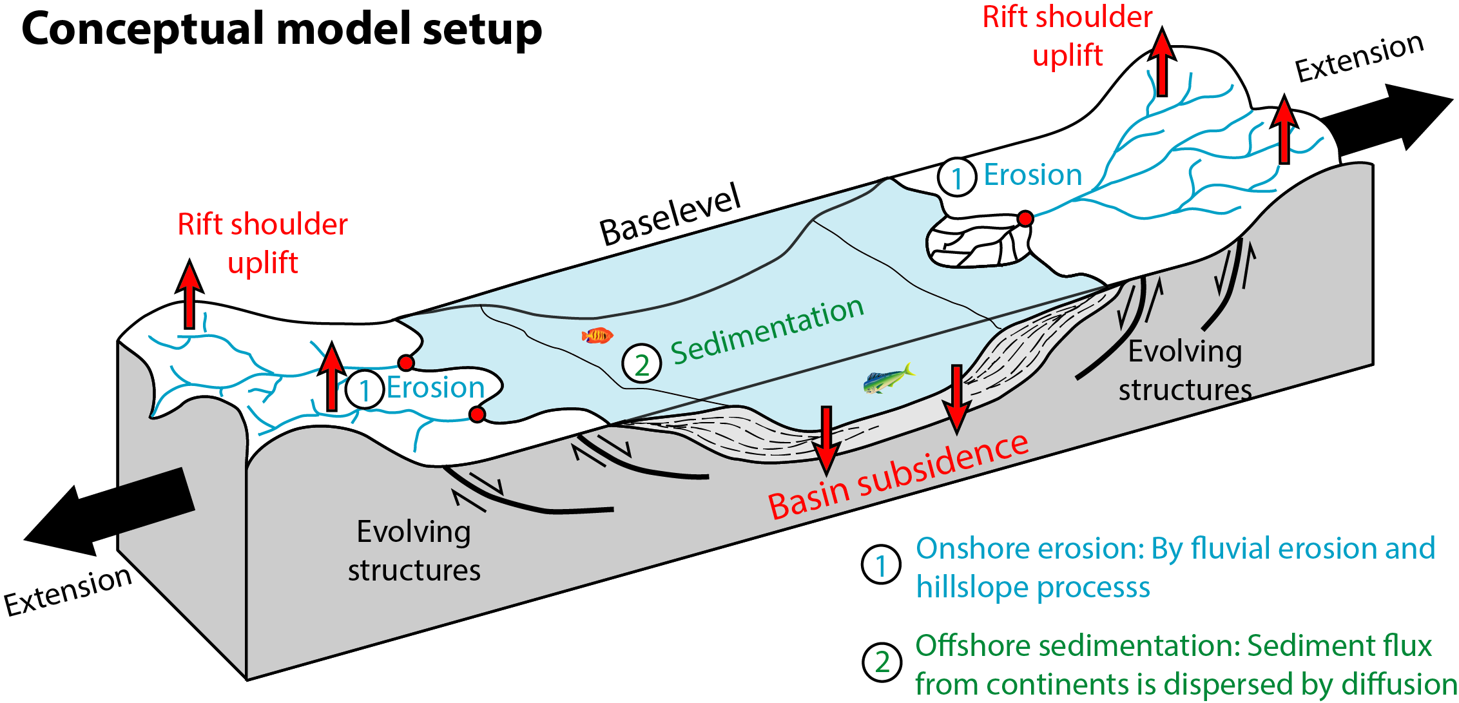
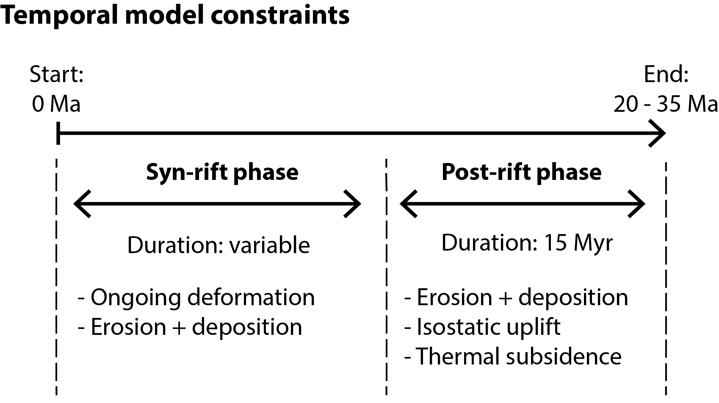
Coupled model: General model setup
Model components:
We use a 2D thermo-mechanical model (Fantom) coupled with a 3D landscape evolution model (FastScape).
The model domain is extended with a constant extension rate (1 cm/yr) and a rift develops subsequently. Erosion occurs onshore and sediment is deposited offshore below baselevel.
The models have the following dimensions:
Fantom: z = 600 km, x = 1200 km
Fastscape: x = 1200 km, y = 400 km
Main purpose:
Use the models in order to investigate possible feedbacks between tectonic and earth surface processes, by:
Systematically varying parameters between models
Evaluating rift structure + topography + sediment flux

Slide 5
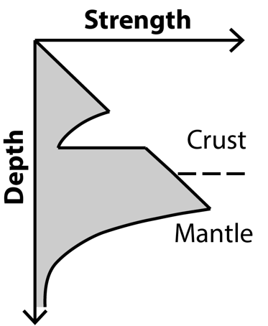
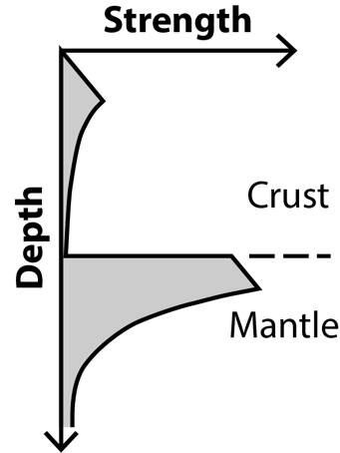
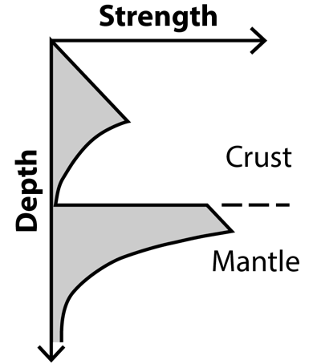
Which parameters are investigated?
-500 m
-1000 m
Our purpose with chosing and varying the displayed parameters is as follows:
Kf: Used to vary the erosive potential between the models (along with baselevel)
Baselevel: Include the effect of pre-existing topography at rift initiation
Rheology: Explore the role of different crustal strengths between the models
Inheritance: Explore the effect of inherited structures
Duration: Compare rifts during different evolutional stages
2.5 x 10⁻⁵ m^{0.2}/yr
0.5 x 10⁻⁵ m^{0.2}/yr
Baselevel
Simple
(seed model)
Kf-values
Strain inheritance
0.1 x 10⁻⁵ m^{0.2}/yr
Distributed (Noise model)
Parameters
20 Myr
Rheology
Strong crust
Weak crust
15 Myr
Intermediate crust
Duration of extension
“Tectonic” parameters
Parameter combination for the displayed model
5 Myr
10 Myr
“Earth surface” parameters

Slide 6
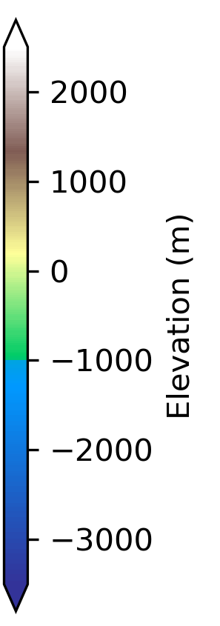
Example animation M1: Results for one combination of parameters
Displayed are the evolution of the topography and structures.
Model parameters:
Observations:
Asymmetric rift
Low-topography rift shoulders
Several active structures
Intermediate sediment yield
River capture events (starting at 18 Myr)
Strength: | Intermediate
Inheritance: | Noise
Baselevel: | -1000 m
Kf-value: | 0.5 x 10⁻⁵ m^{0.2}/yr
Extension: | 10 Myr
Top view of Fastscape topography
Crosssection of Fantom structures
Prerift sediments
Middle Crust
Lithospheric mantle
Synrift sediments
Upper Crust
Lower Crust
Asthenospheric mantle

Slide 7
Analysis of sediment flux and maximum topography for M1
Here we show analysis of the model output. Displayed are the temporal evolution of the sediment flux (normalized by total amount of sediment flux) and the maximum elevation in the model domain
Synrift Phase
Postrift Phase
Extension stops at 10 Ma
Sediment flux
Sediment delivered by erosion of rift shoulders
Evolution of sediment flux:
Synrift: Erosion of uplifting rift shoulders controls the sediment flux
Postrift: Importance of river capture events
Sediment delivered by river capture events
Extension stops at 10 Ma
Maximum elevation
Deformation shifts from rift shoulders to the rift center
Evolution of maximum elevation:
Synrift: Uplift and erosion of rift shoulders controls elevation
Postrift: Steady erosion, isostatic response to river capture
Initial uplift of rift shoulders
Isostatic response to erosional unloading of river capture events

Slide 8
Preliminary conclusion: Coming back to the scientific questions
The initial questions:
Investigate a possible coupling and feedbacks between tectonic and earth surface processes during continental breakup and rifting.
Formation and evolution of structures and basins?
Fault activity shifts from rift shoulders to the rift center
Evolution of topography?
Uplift of rift shoulders during early synrift phase, subsequent erosion
Importance of river capture events in the late postrift phase
Evolution of the sedimentary flux?
Sediment flux depends both on tectonic (rift shoulder uplift) and earth surface processes (river capture)

