Slide 1
Evaluating Validity of Bouchet-Morton Complementary Relationship at Regional Scale through Terrestrial Evapotranspiration derived using Remote Sensing Platform and Land Surface Models
Swapan Kumar Masanta and V V Srinivas
Indian Institute of Science, Bangalore
swapanm@iisc.ac.in; vvs@iisc.ac.in

Slide 2
Introduction
Introduction > Evaporation Paradox > Validity of CR > ET_{a} estimation
Decrease in potential/reference evapotranspiration (ET_{p}), despite significant increase in near-surface air temperature is reported at many locations across the world
This counter-intuitive phenomenon known as evaporation-paradox, could be attributed to
decrease in net solar radiation and/or wind speed and/or
increase in terrestrial evapotranspiration (ET_{a}), which effect ET_{p} through Bouchet–Morton complementary relationship (CR) between ET_{a} and ET_{p}

Slide 3
Introduction Contd.
Introduction > Evaporation Paradox > Validity of CR > ET_{a} estimation
Bouchet–Morton complementary relationship (CR) hypothesizes that at regional scale there exists a feedback mechanism between ET_{a} and ET_{p} for homogeneous surfaces having low advection of heat and moisture.
It postulates that increase in regional ET_{a} consumes energy, thereby reduce regional ET_{p} through cooling and humidifying the overpassing air.
Recent improvements in remote sensing technology provide scope to quantify ET_{a} and use it for evaluating validity of CR at regional scale to discern the possible cause for evaporation-paradox.
Further, if the CR is valid for a region, models could be developed to estimate regional ET_{a} using ET_{p} estimated from its predictor hydro-climate variables.

Slide 4
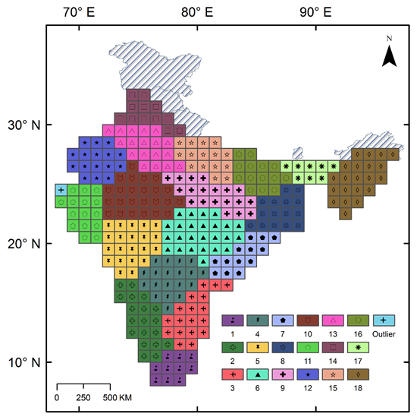
Do Evaporation Paradox exist in India?
Introduction > Evaporation Paradox > Validity of CR > ET_{a} estimation
MK trend (5% sig) & Sen slope
ET_{p}= -1.58* cm/ decade
T_{max}= 0.07* °C d⁻¹/ decade
T_{min}= 0.07* °C d⁻¹/ decade
W= -0.07* ms⁻¹d⁻¹/ decade
RH= 0.29 % d⁻¹/ decade
Rad= 0.70* watt d⁻¹/ decade
MK trend (5% sig) & Sen slope
ET_{p}= -4.30* cm/ decade
T_{max}= 0.07* °C d⁻¹/ decade
T_{min}= 0.03 °C d⁻¹/ decade
W= -0.09* ms⁻¹d⁻¹/ decade
RH= 0.81* % d⁻¹/ decade
Rad= -2.99* watt d⁻¹/ decade
Eighteen homogeneous ET_{p} regions formed in India using fuzzy dynamic clustering approach with climate variables as predictors (Masanta and Srinivas, 2019).
MK trend (5% sig) & Sen slope
ET_{p}= -2.32* cm/ decade
T_{max}= 0.15* °C d⁻¹/ decade
T_{min}= 0.07 °C d⁻¹/ decade
W= -0.09* ms⁻¹d⁻¹/ decade
RH= 0.09* % d⁻¹/ decade
Rad= 0.47* watt d⁻¹/ decade
MK trend (5% sig) & Sen slope
ET_{p}= -1.74* cm/ decade
T_{max}= 0.10* °C d⁻¹/ decade
T_{min}= 0.05* °C d⁻¹/ decade
W= -0.05* ms⁻¹d⁻¹/ decade
RH= 0.69* % d⁻¹/ decade
Rad= -0.96* watt d⁻¹/ decade
It is investigated whether evaporation paradox exists in any of eighteen homogeneous ET_{p} regions and discern possible cause for the same.
Evaporation paradox was evident at annual scale in four regions located in north-west and north-eastern parts of India, which is attributed to factors such as global dimming, increase in relative humidity and/or global stilling.

Slide 5
Evaluating the validity of CR
Introduction > Evaporation Paradox > Validity of CR > ET_{a} estimation
Validity of CR is verified at different spatial scales
regional scale
river basin scale
catchment scale

Slide 6
Details of datasets
Introduction > Evaporation Paradox > Validity of CR > ET_{a} estimation
Database | Data Type | Temporal resolution | Spatial resolution | Period | Spatial Extend | Details | Reference
GLEAM v3a | AET & PET | Daily | 0.25° × 0.25° | 1980 to 2014 | 90°N–90°S | PET estimated by Priestley-Taylor (P-T) expression. AET estimated from PET using a multiplicative stress factor depending on land cover and soil moisture. The GLEAM v3a uses a combination of reanalysis and remotely sensed data. GLEAM v3b uses only remotely sensed data. | Martens et al. (2016)
GLEAM v3b | AET & PET | Daily | 0.25° × 0.25° | 2003 to 2015 | 50°N–50°S
MOD16A | AET & PET | Monthly | 0.5° × 0.5° | 2000 to 2014 | 80°N–60°S | PET estimated by Priestley-Taylor (P-T) expression. AET estimated from wet canopy, soil, and plant transpiration using Penman–Monteith (P-M) equation using GMAO meteorological data and other MODIS products. | Mu et al. (2011)
Zhang dataset | AET | Monthly | 0.073°×0.073° | 1983 to 2006 | 90°N–90°S | AET dataset was prepared using an algorithm driven by inputs from combination of reanalysis and remotely sensed data. | Zhang et al. (2009)
CRU reanalysis | PET & precipitation | Daily | 0.5° × 0.5° | 1901 to now | 90°N–90°S | PET estimated by Penman–Monteith formula | Harris et al. (2013)
IMD | Precipitation | Daily | 0.25° × 0.25° | 1901 to now | India | Interpolation of station data | Pai et al. (2014)
PET estimate | PET | Daily | 1° × 1° | 1951 to 2013 | India | PET estimated by Penman–Monteith formula considering inputs from NCEP reanalysis and IMD observed data | Masanta and Srinivas (2019)
Estimation of AET (ET_{a}) or PET (ET_{p}) rely on different expressions, and have diverse forcing data. Therefore, their estimate can differ substantially with each other.

Slide 7
Validity of CR at regional scale in India
Introduction > Evaporation Paradox > Validity of CR > ET_{a} estimation
C
D
B
C
A
D
ref: under review, Masanta and Srinivas, 2020 International Journal of Climatology, Manuscript Id JOC-20- 0042
A
B

Slide 8
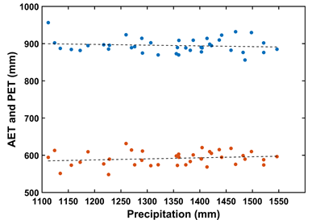
Validity of CR at 405 river basins across the world
Introduction > Evaporation Paradox > Validity of CR > ET_{a} estimation
Brahmaputra
Cauvery
Ganges
Godavari
AET: GLEAM v3a
PET: CRU
PRE: CRU
Period: 1980 to 2014
Narmada
Tapti
Krishna
Mahanadi

Slide 9
Validity of CR at 405 river basins across the world contd.
Introduction > Evaporation Paradox > Validity of CR > ET_{a} estimation
Cauvery
Brahmaputra
Ganges
Godavari
AET: GLEAM v3b
PET: CRU
PRE: CRU
Period: 2003 to 2015
Narmada
Tapti
Krishna
Mahanadi

Slide 10
Validity of CR at 405 river basins across the world contd.
Introduction > Evaporation Paradox > Validity of CR > ET_{a} estimation
×10 ³
×10 ³
Brahmaputra
Cauvery
×10 ³
×10 ³
×10 ³
Ganges
Godavari
AET: MOD16A
PET: MOD16A
PRE: CRU
Period: 2000 to 2014
×10 ³
×10 ³
×10 ³
×10 ³
Narmada
Tapti
Krishna
Mahanadi

Slide 11
Validity of CR at 405 river basins across the world contd.
Introduction > Evaporation Paradox > Validity of CR > ET_{a} estimation
Brahmaputra
Cauvery
Ganges
Godavari
AET: Zhang dataset
PET: CRU
PRE: CRU
Period: 1983 to 2006
Narmada
Tapti
Krishna
Mahanadi

Slide 12
Quality of ET_{a} estimates | 71 minimum regulated catchments from peninsula India
Introduction > Evaporation Paradox > Validity of CR > ET_{a} estimation
R² between annual ET_{a} estimated from different datasets
Correlation between annual ET_{a} estimated from different datasets
71 Gauged minimum regulated catchments are selected from peninsula India.
Annual ET_{a} is estimated from water balance of the catchments
ET_{a} = Precipitation-runoff

Slide 13
Quality of ET_{a} estimates | 71 minimum regulated catchments from peninsula India
Introduction > Evaporation Paradox > Validity of CR > ET_{a} estimation
RMSE (mm) between annual ET_{a} estimated from different datasets
R-RMSE (%) between annual ET_{a} estimated from different datasets
NSC between annual ET_{a} estimated from different datasets
Lower triangle values of the matrix is estimated with respect to the dataset mentioned in y-axis

Slide 14
Quality of ET_{a} estimates | 71 minimum regulated catchments from peninsula India
Introduction > Evaporation Paradox > Validity of CR > ET_{a} estimation
AR-bias (%) between annual ET_{a} estimated from different datasets
MAE (mm) between annual ET_{a} estimated from different datasets
Lower triangle values of the matrix is estimated with respect to the dataset mentioned in y-axis

Slide 15
Conclusion
Introduction > Evaporation Paradox > Validity of CR > ET_{a} estimation
Complementary relationship between ET_{p} and ET_{a} plays important role beside trend of climate variables in influencing the trend of ET_{p} (and therefore, evaporation paradox) through changes occurring in air temperature and relative humidity.
There is disagreement among datasets about validity of CR in different parts of the world. However, validity of CR is confirmed in India.
There is considerable difference in ET_{a} estimates obtained based on different datasets (except GLEAM-a and GLEAM-b) and none of them is consistent with that ET_{a} estimated from observed precipitation and runoff data in India.

Slide 16
Reference
Introduction > Evaporation Paradox > Validity of CR > ET_{a} estimation
Martens B, Miralles DG, Lievens H, Van derSchalie R, DeJeu RA. Férnandez-Prieto MD, Beck HE, Dorigo WA, and Verhoest NEC (2016), GLEAM v3: Satellite-based land evaporation and root-zone soil moisture, Geosci. Model Dev. Discuss., 2016, 1–36. https://doi.org/10.5194/gmd-2016-162
Masanta SK, Srinivas VV. (2019), Regionalization of evapotranspiration using fuzzy dynamic clustering approach. Part 1: Formation of regions in India. International Journal of Climatology. 2019;1–17. https://doi.org/10.1002/joc.6411
Masanta SK, Srinivas VV. (2020), Regionalization of evapotranspiration using fuzzy dynamic clustering approach. Part 2: Applicati`on of regions. International Journal of Climatology. 2020; Manuscript Id JOC-20-0042 (under review)
Harris I, Jones PD, Osborn TJ, Lister DH (2013), Updated high-resolution grids of monthly climatic observations – the CRU TS3.10 Dataset. International Journal of Climatology. 2020, https://doi.org/10.1002/joc.3711
Mu, Q., M. Zhao, and S. W. Running (2011), Improvements to a MODIS global terrestrial evapotranspiration algorithm, Remote Sens. Environ., 115(8), 1781–1800. https://doi.org/10.1016/j.rse.2011.02.019
Pai, D. S., Sridhar, L., Rajeevan, M., Sreejith, O. P., Satbhai, N. S., and Mukhopadhyay, 787 B. (2014), Development of a new high spatial resolution (0.25× 0.25) long period 788 (1901–2010) daily gridded rainfall data set over India and its comparison with existing 789 data sets over the region. Mausam, 65(1), 1-18.
Zhang, K., Kimball, J.S., Mu, Q., Jones, L.A., Goetz, S.J. and Running, S.W. (2009), Satellite based analysis of northern ET trends and associated changes in the regional water balance from 1983 to 2005. Journal of Hydrology, 379(1–2), 92–110. https://doi.org/10.1016/j.jhydrol.2009.09.047

Slide 17
Thank You
swapanm@iisc.ac.in vvs@iisc.ac.in

