Slide 1
The penetration of Labrador Sea Slope Water to Cape Hatteras and its role in Gulf Stream Dynamics
Adrian New¹, David Smeed¹, Arnaud Czaja², Adam Blaker¹ and Jenny Mecking¹
National Oceanography Centre, Southampton, UK
Imperial College, London, UK

Slide 2
Conclusions – 4 more slides below if interested in more details
EN4 shows a well defined Labrador Sea Slope Water (LSSW) core all the way to the Mid-Atlantic Bight near Cape Hatteras, associated with a salinity minimum between 400-800m.
Analysis (in EN4) of periods when the AMOC is high (2005-2008) and low (2009-2015) in the RAPID array (at 26°N) shows a clear difference with fresher LSSW penetrating to Cape Hatteras, and uplifting of isopycnals near the slope, which have an associated transport increase of 3Sv.
Analysis of Line W occupations near 70°W also shows that LSSW is present in the Mid-Atlantic Bight with core densities near 27.5, and salinities below 35.0.
It is renewed episodically with fresher LSSW which causes density surfaces near the slope to rise (since it is also thicker). It also spreads to fill the Slope Sea between the slope and the Gulf Stream core.
The fresher LSSW is present only in the AMOC high period and is associated with a transport increase (deduced from Line W, station 7) of 2-3 Sv.
The LSSW could play a role in the decadal timescale variability in the North Atlantic.

Slide 3
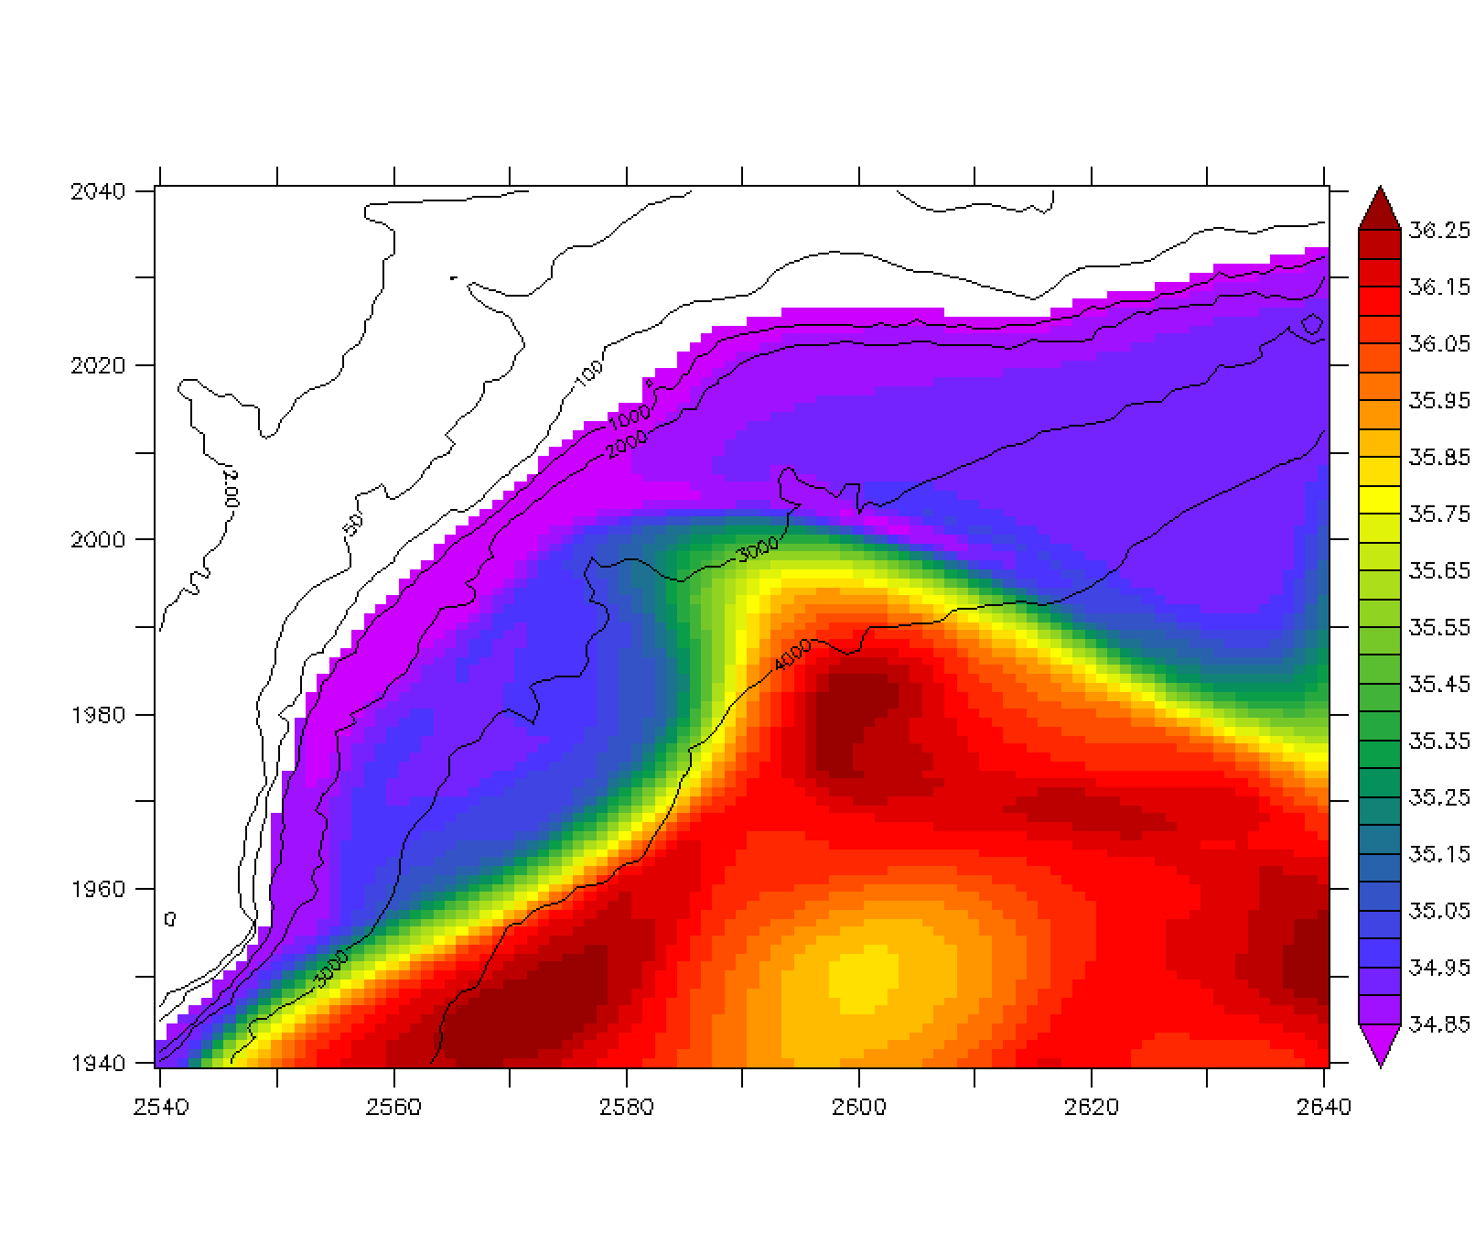
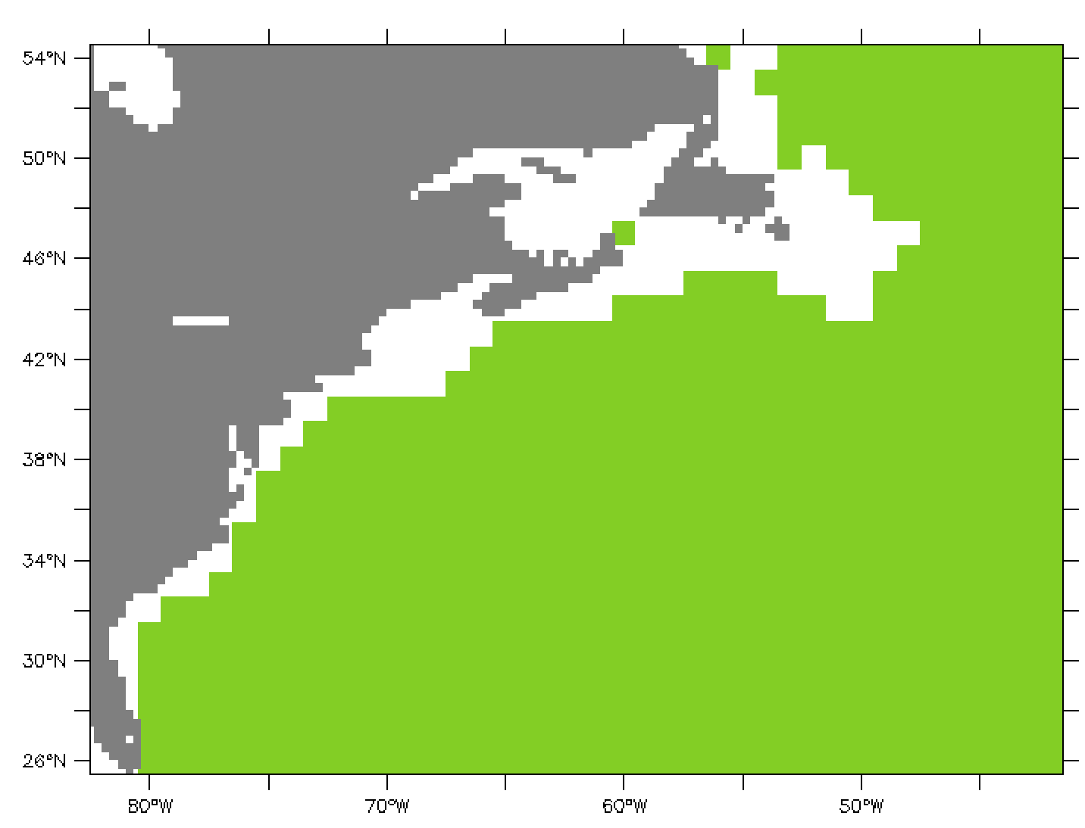
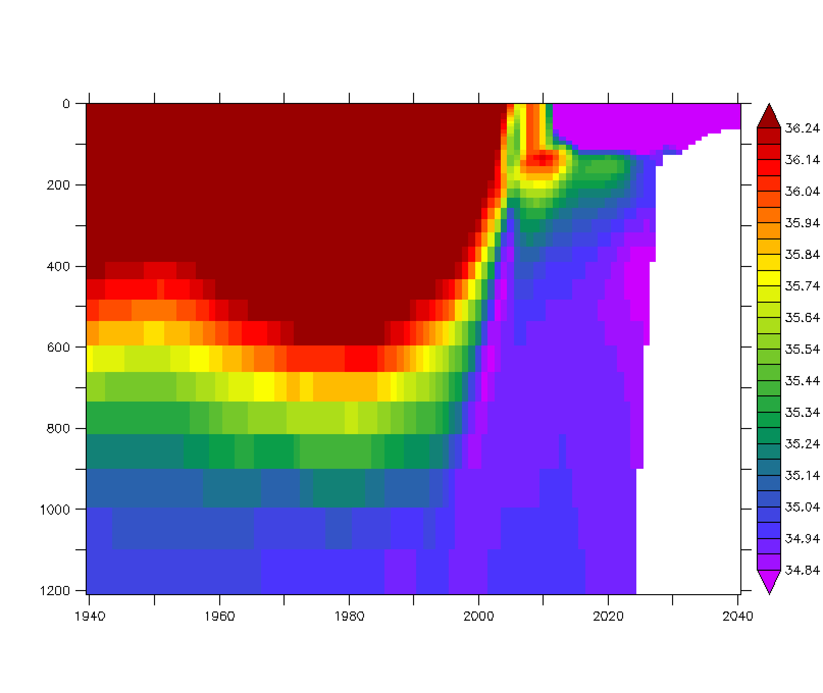
Introduction and Motivation
NEMO Salinity at 565 m, 23 Jan 1979
Upper layer circulation (shading shows 540m depth contour)
LC
LSSW
SBJ
Gulf Stream
Line W
NEMO Salinity at x=2600, 23 Jan 1979
Labrador Sea Slope Water (LSSW) is a fresh water mass in the Slope Sea, deriving from the Labrador Current (LC), at depths of 300-700m, thought to penetrate to about 65W. The Shelf Break Jet (SBJ) is a shelf edge current in the upper 200m. Also note the position of Line W (hydrographic repeats).
However, a high resolution (NEMO, 1/12°) ocean model shows the LSSW reaching to Cape Hatteras, with ejection events into the Gulf Stream (GS) system in the Mid Atlantic Bight.

Slide 4
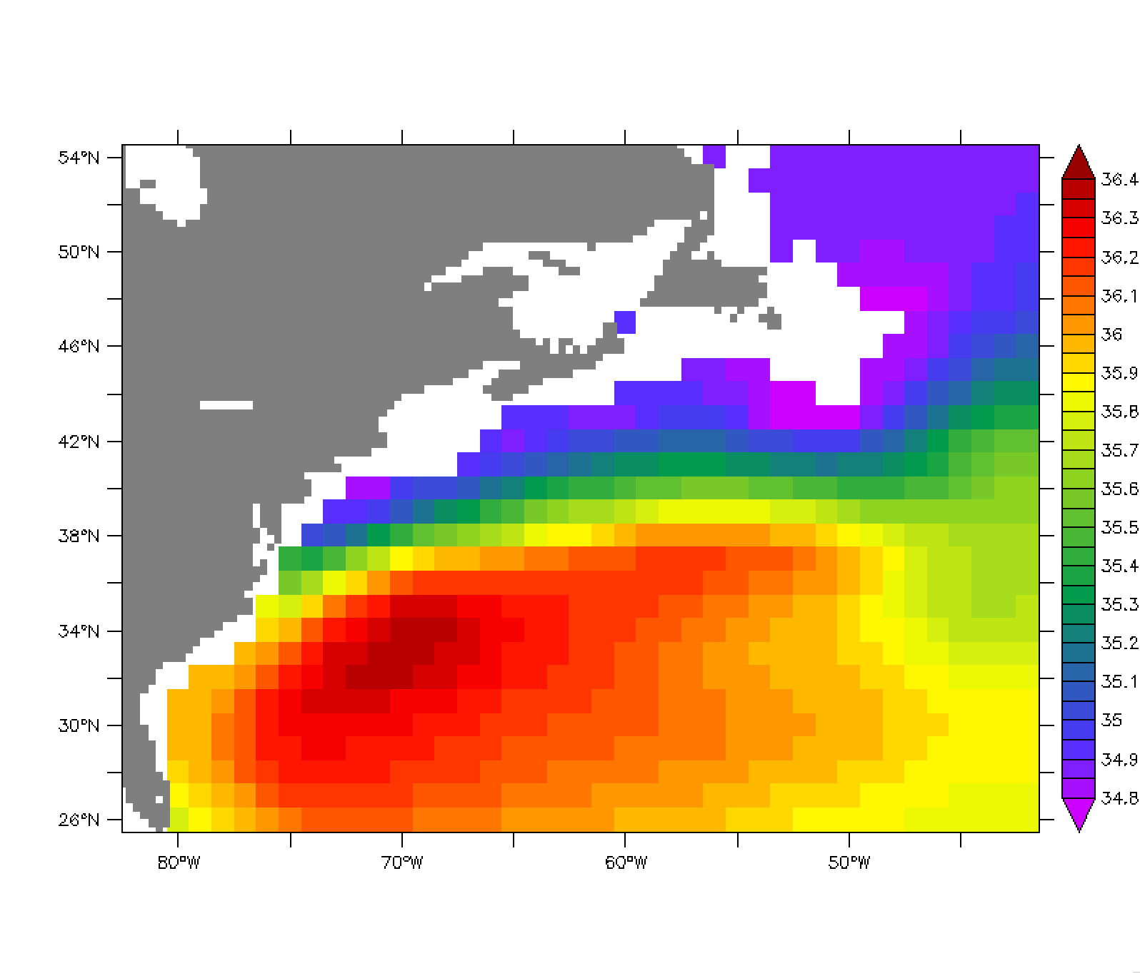
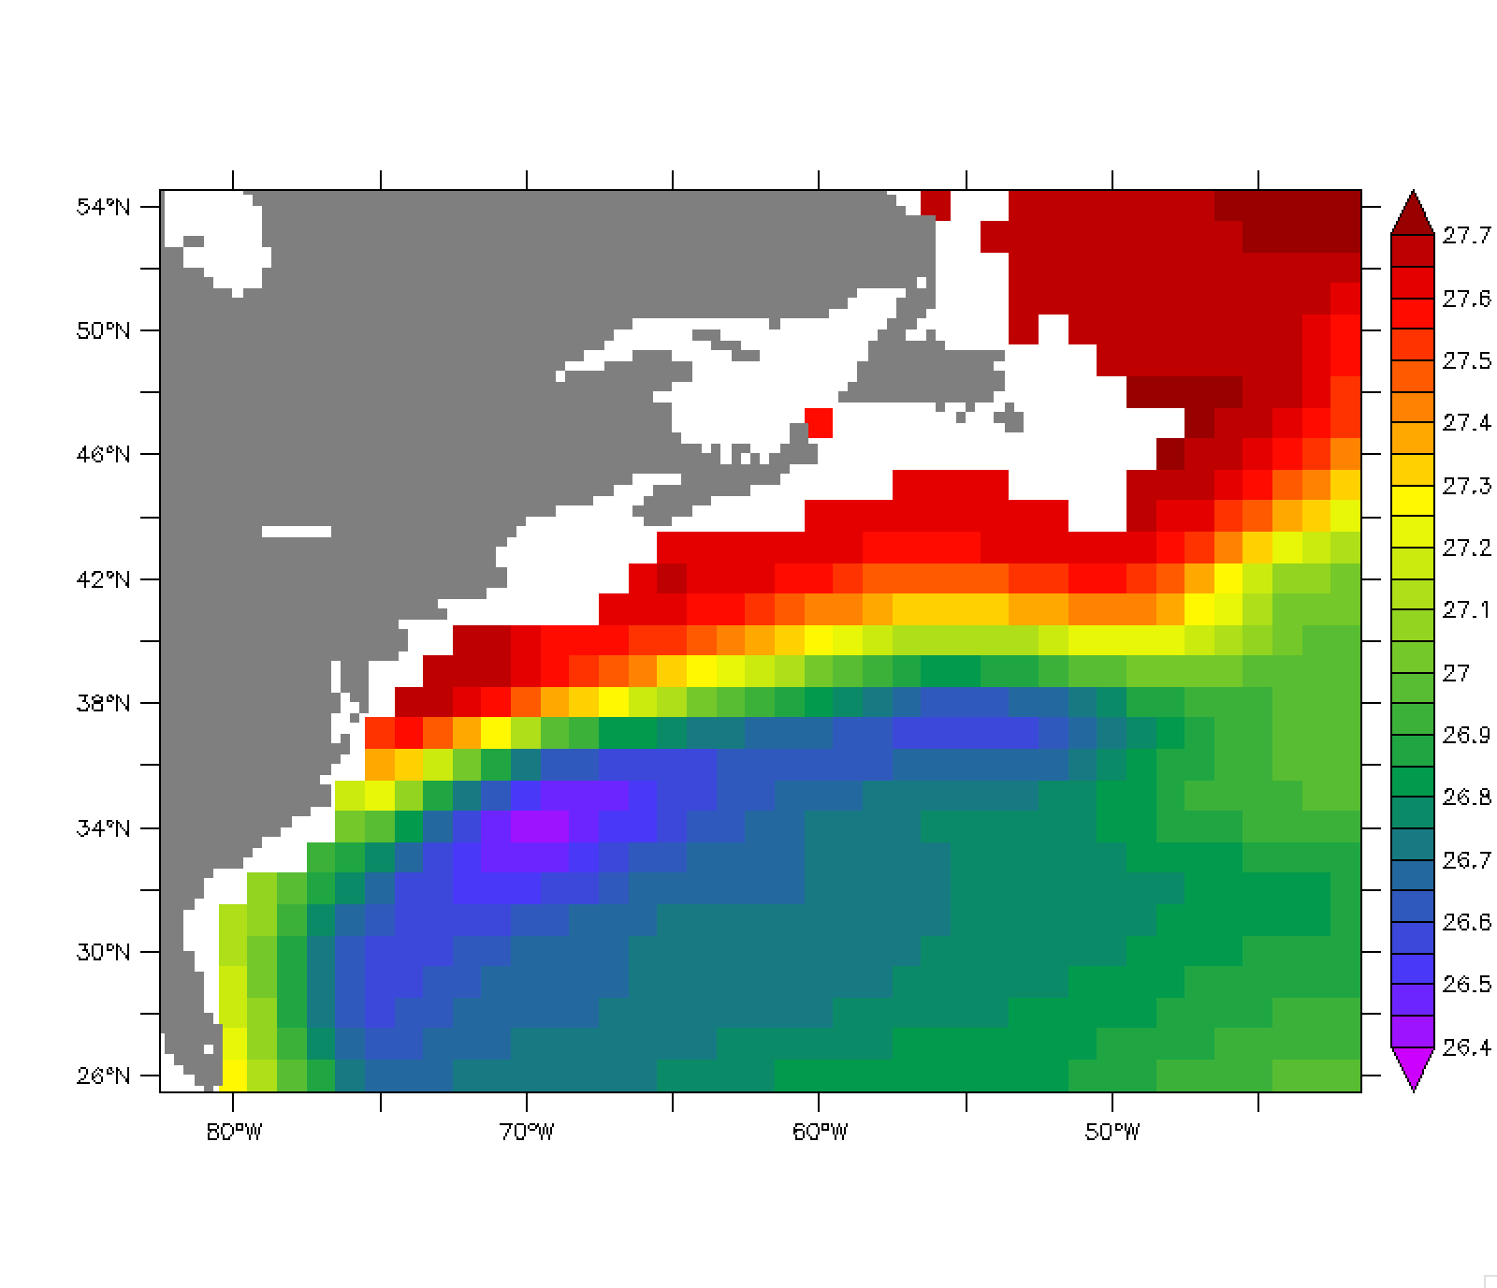
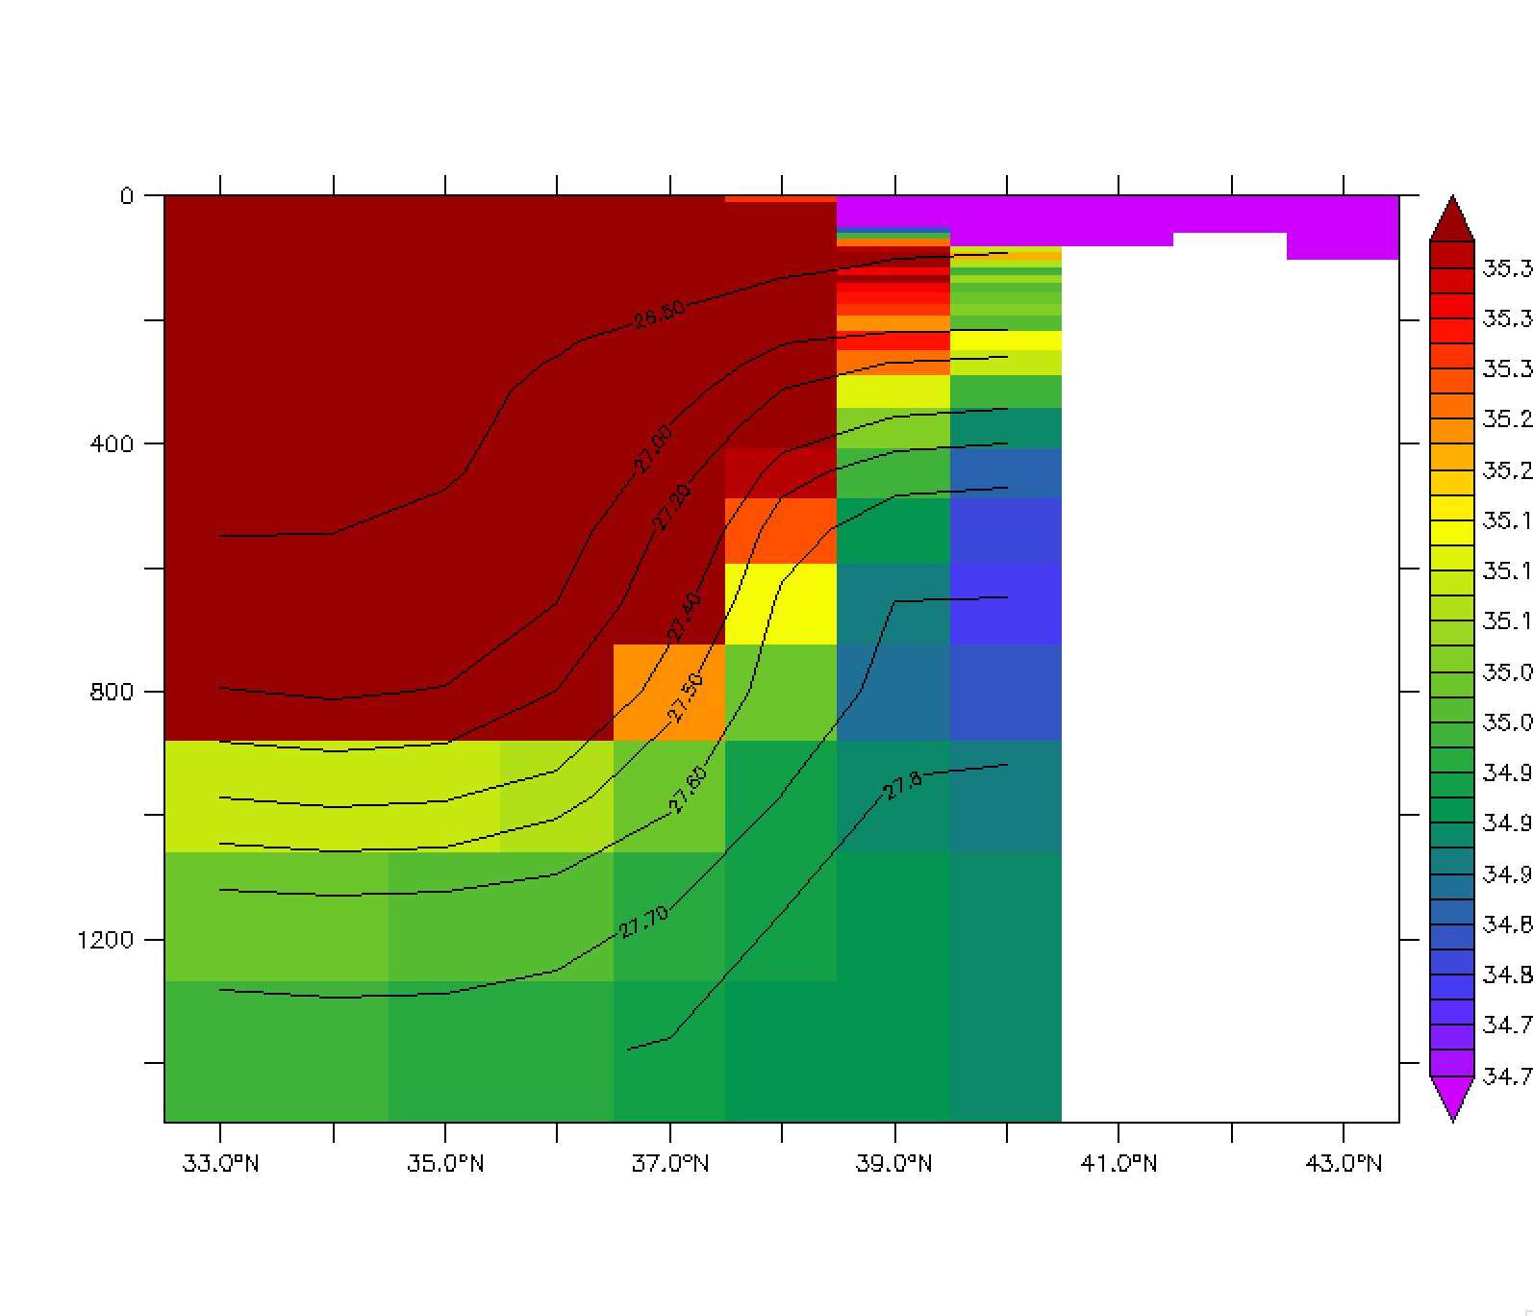
Mean Structure in EN4 (2005-2015 average)
Density at 540m
Salinity at 540m
LSSW penetrates into the Mid Atlantic Bight near Cape Hatteras as a fresh boundary current between depths of 400-800m, with salinity below 35.0 at 540m, and densities 27.4-27.7
Salinity (and Density) at 71°W

Slide 5
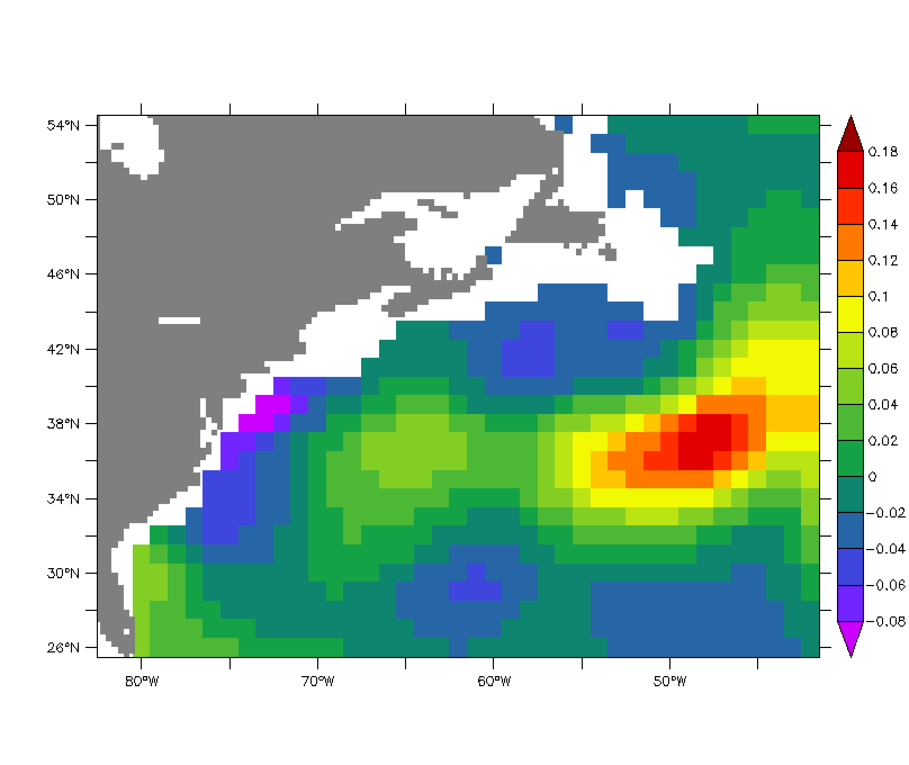
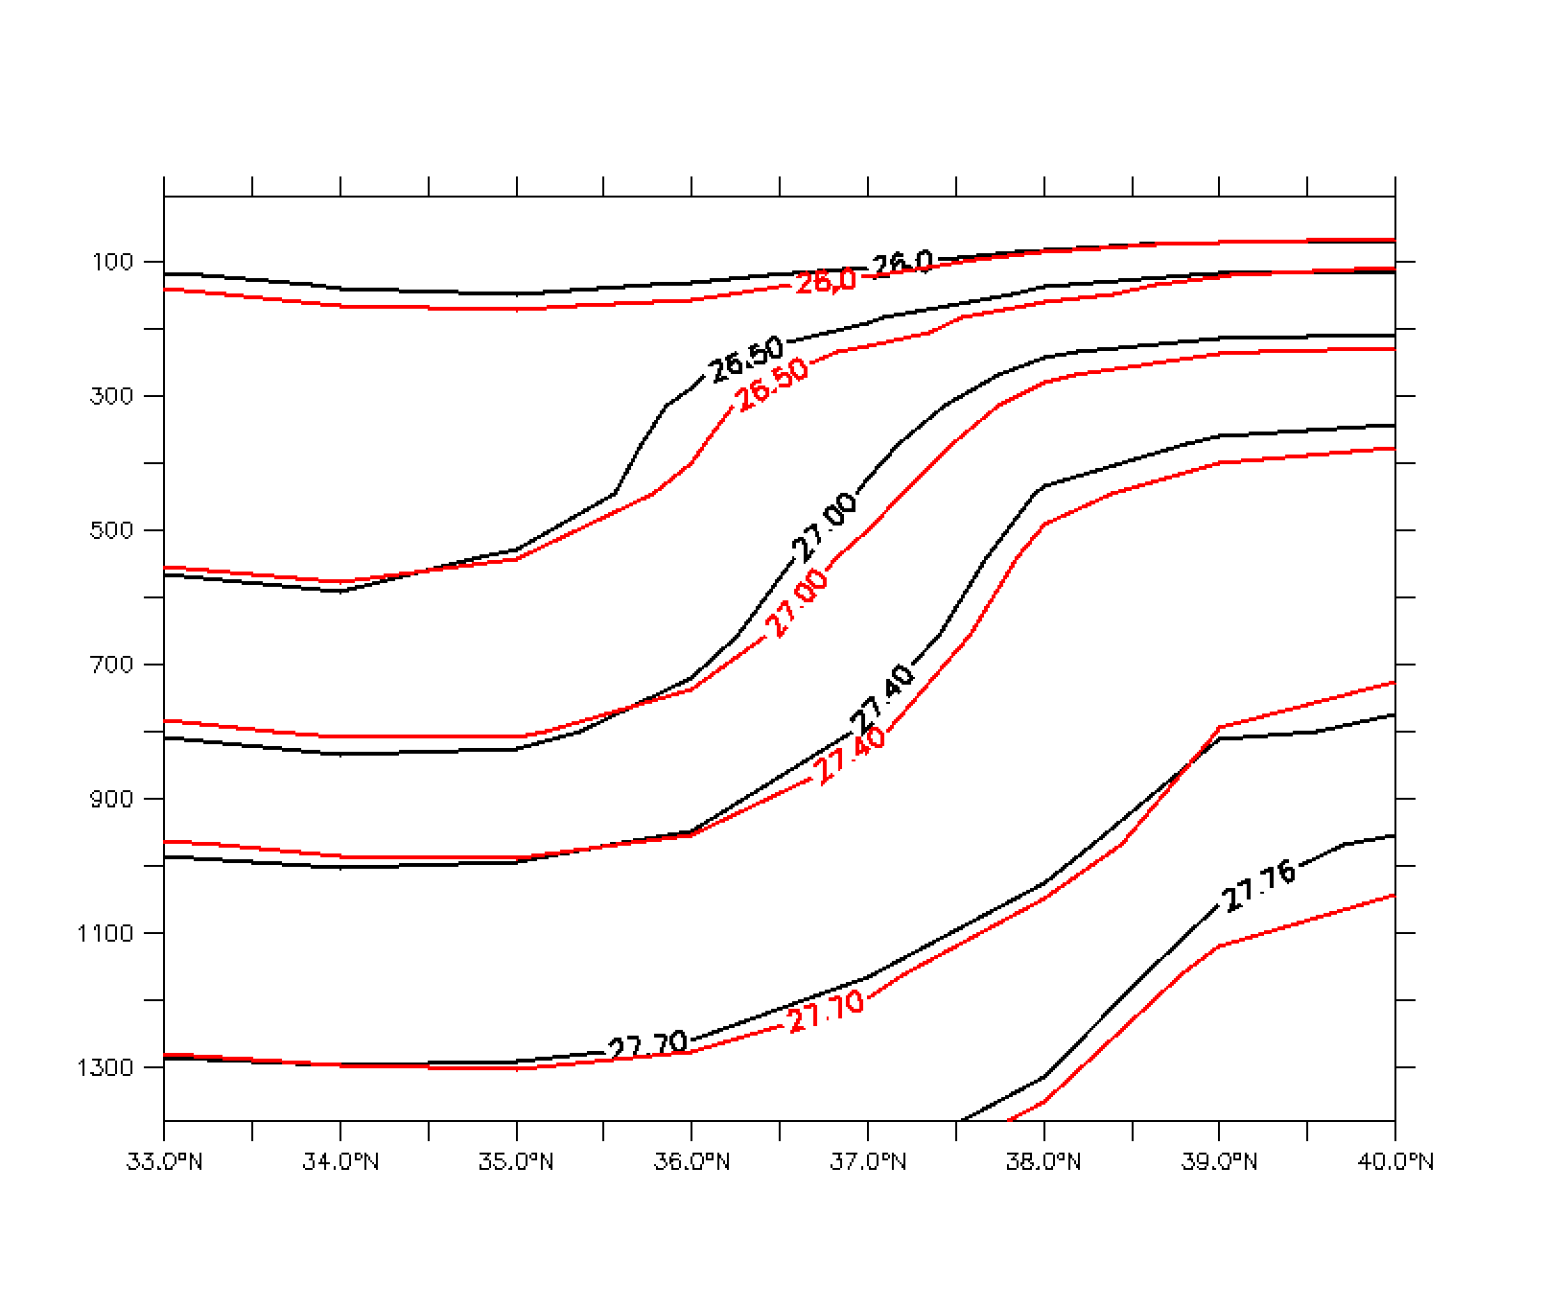
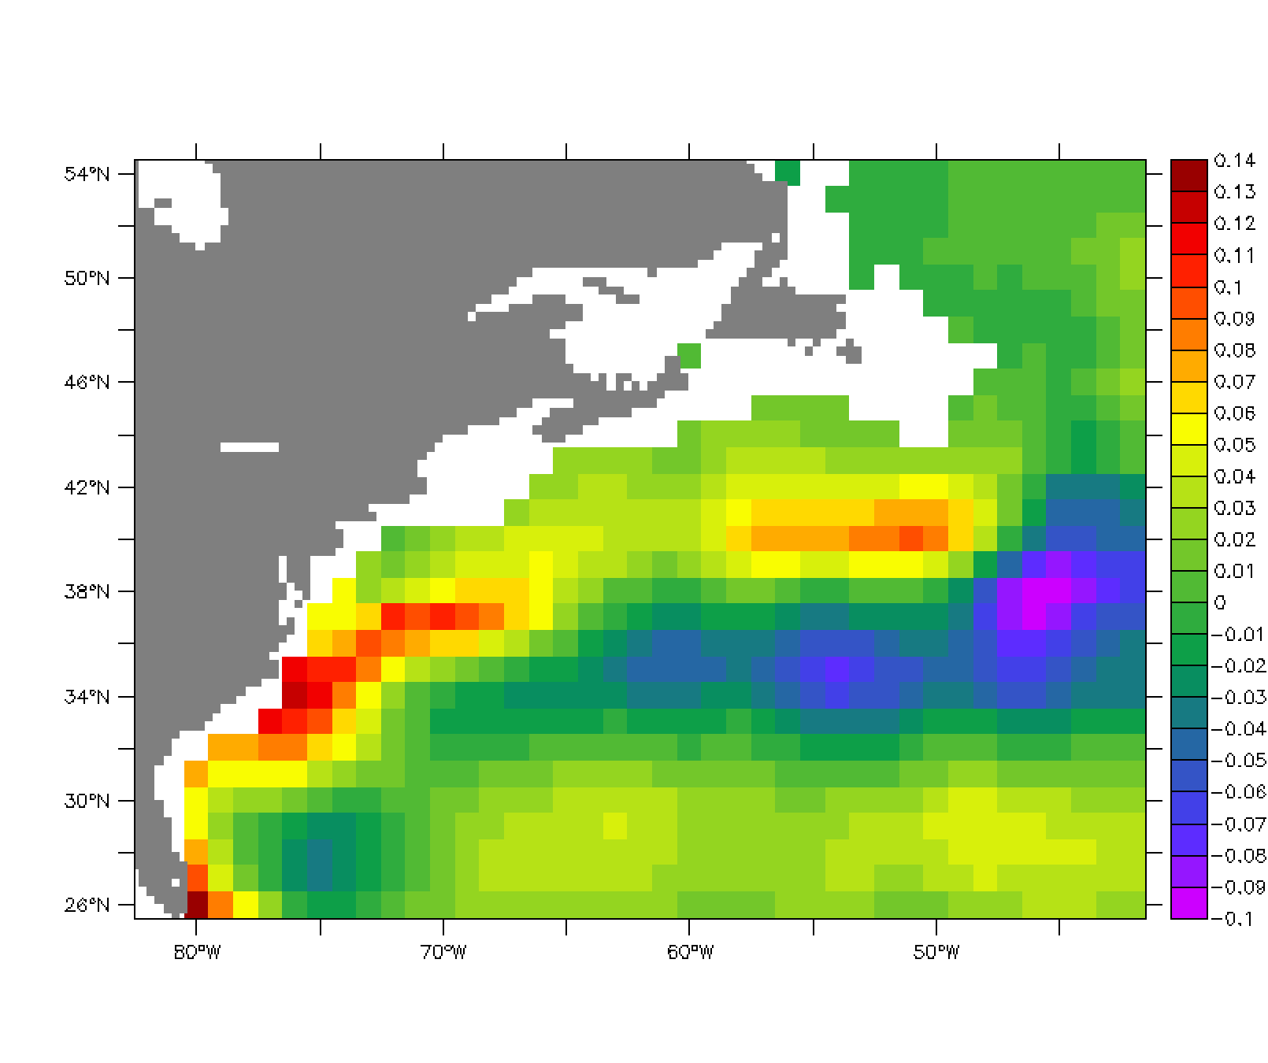
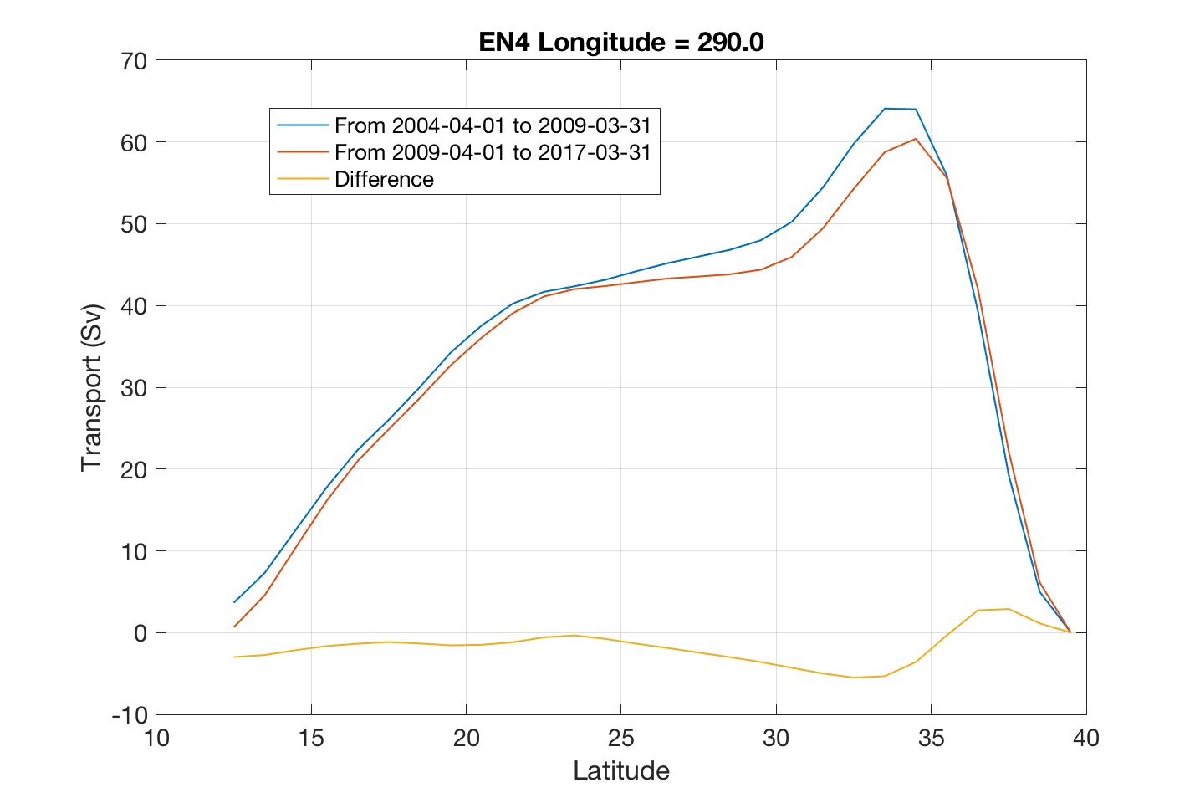
EN4 changes between 2005-08 and 2009-15
These are periods when the AMOC at 26°N is high and low respectively (Smeed et al, 2018)
(a) Salinity change at 540m (high-low)
(c) Density change at 70°W (black: AMOC high-red: AMOC low)
At AMOC high: at 540m (a) the LSSW at 540m is fresher near Cape Hatteras, (b) the density increases along the Gulf Stream, and at 70°W: (c) the thickness of 27.4-27.7 (LSSW) increases near the slope (40°N) and (d) geostrophic transport increases by some 3Sv. (b), (c) and (d) also show the Gulf Stream is further south at AMOC high
(b) Density change at 540m (high-low)
(d) Geostrophic transport above 1500m & change at 70°W

Slide 6
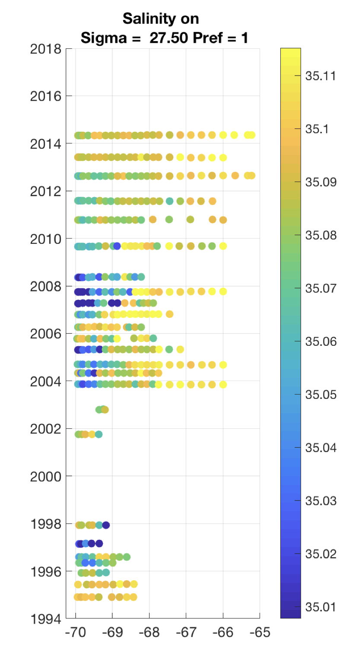
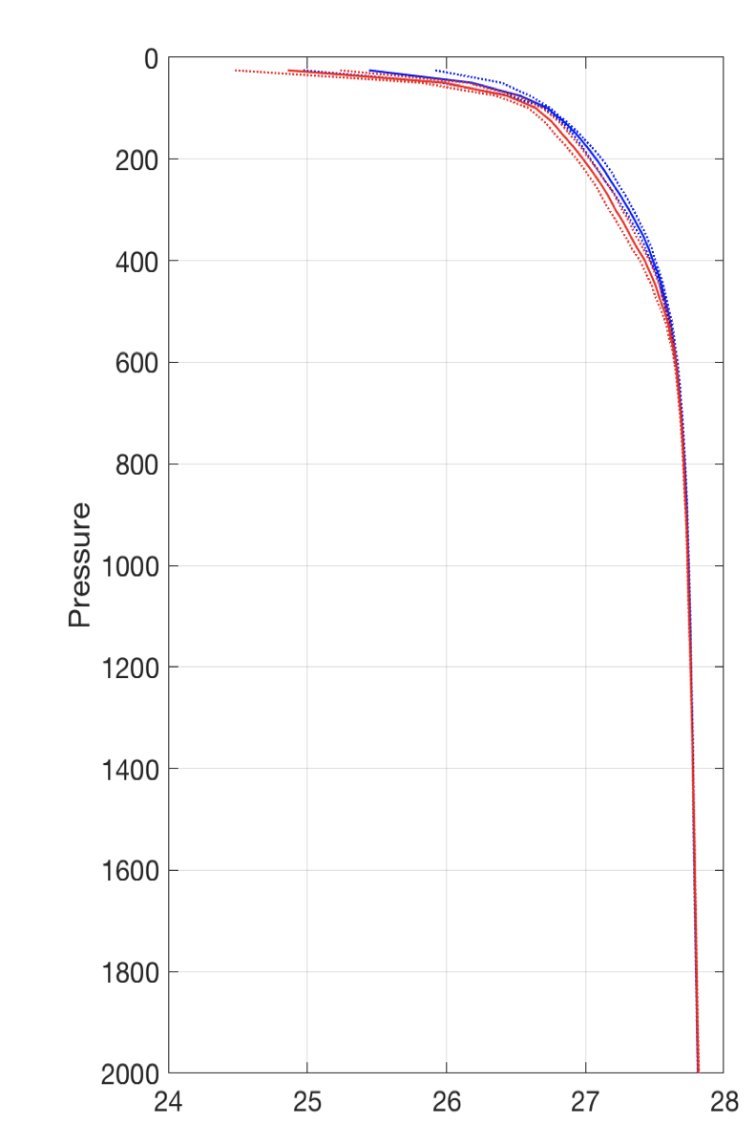
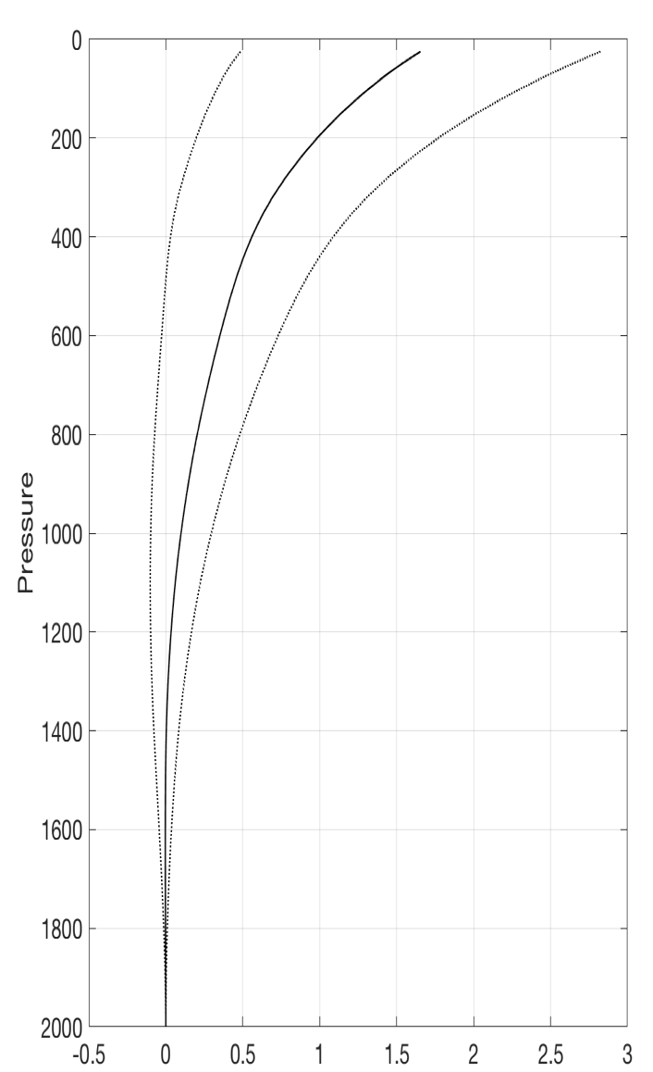
Line W analysis
(a) Salinity on sigma0 = 27.5
(b) Density profiles from station 7 in
2004-2008 (blue) and 2009-2014 (red)
(c) Geostrophic transport change
(relative to 2000m)
Potential Density Transport Change (Sv)
(a) Shows episodic renewal of fresh LSSW (2 episodes between 2004-2008) with gradual reduction thereafter (to 2014), and that the LSSW extends to to 69-68W (39-37.5N, GS core). (b) shows that the density surfaces at Station 7 (69.8°N) above 600m are lifted upwards (by thickening of the LSSW) and (c) shows the implied transport increase.

