Slide 1




Microbial metabolic activity measurements in clouds and precipitation at the Puy-de-Dôme station (Central France)
Florent Rossi¹, Raphaëlle Péguilhan¹, Maxence Brissy¹, Laurent Deguillaume², Anne-Marie Delort¹ and Pierre Amato¹
¹ Université Clermont Auvergne, CNRS, SIGMA Clermont, ICCF, F-63000 CLERMONT-FERRAND, FRANCE
² Université Clermont Auvergne, CNRS, OPGC, F-63000 CLERMONT-FERRAND, FRANCE
Notes:
Changer auteurs pour ceux de l’article?

Slide 2

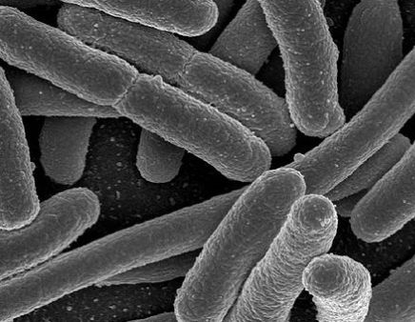
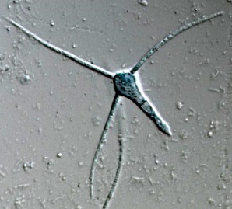



Introduction
Clouds
10³-10⁴ cell/m³ of water
10⁴-10⁵ cell/m³ of water
10³ cell/m³ of air
Precipitation
Air
Outdoor atmosphere, clouds and precipitation harbors a complex microbial assemblages including bacteria
These microorganisms are aerosolized from surfaces by mechanical disturbances mostly, such as wind or raindrop impacts
© Authors

Slide 3
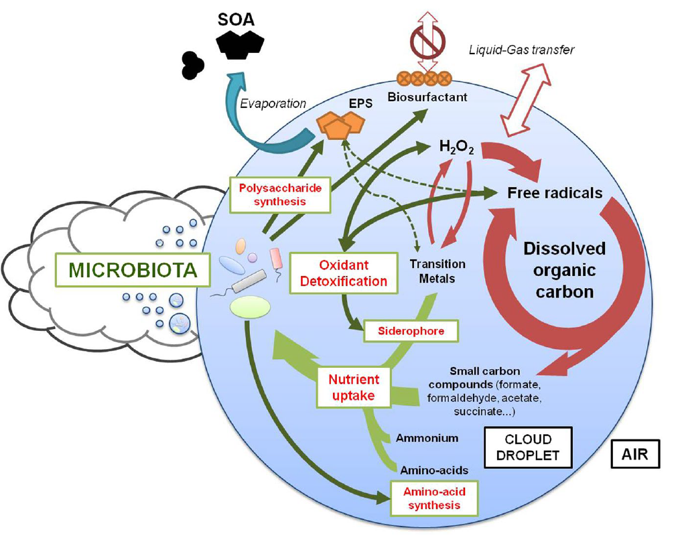
Metabolic activity in clouds
Despite the harsh environmental constraints (U.V., low temperature, osmotic variations) and low microbial biomass, these microorganisms can remain active, as shown by Amato et al. (2019)
The main function identified involve:
Polysaccharide synthesis
Amino-acid synthesis
Oxidant detoxification
Nutrient uptake
Impact on Cloud chemistry?
However…
Only few studies involving few cloud samples were analysed so far
Only qualitative images of the whole microbial functioning were performed so far
© Authors

Slide 4
Objectives of the study
The objectives of this study are:
To assess microbial activity in the different compartments of the atmosphere (clouds, precipitation) at a larger spatial and temporal scale
To link microbial activity and biodiversity
To investigate the environmental factors (physical and chemical characteristics) that influence such activity
© Authors

Slide 5
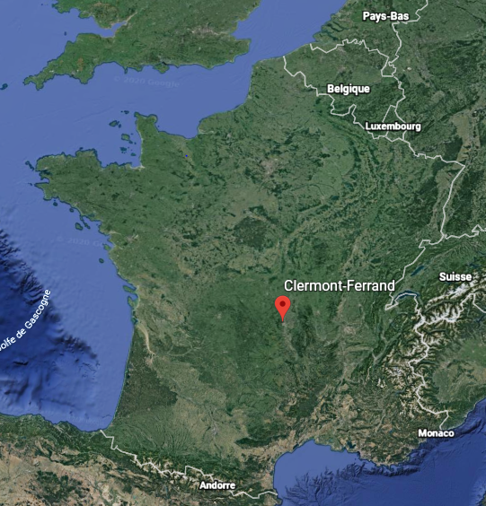
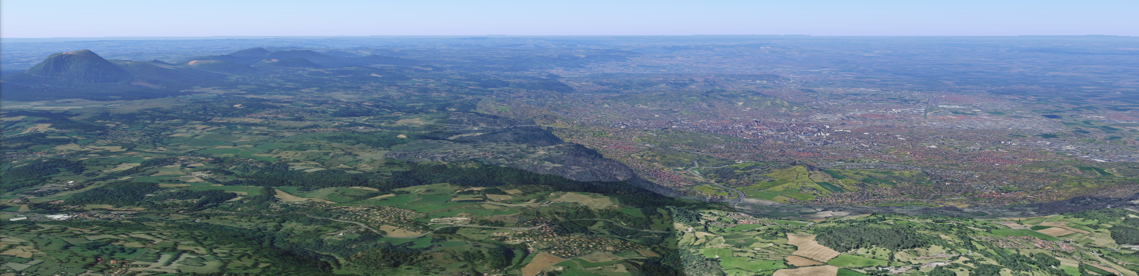
Sampling sites
The study was performed in Clermont-Ferrand (central France)
2 study sites:
Puy-de-Dôme station for clouds (1465m a.s.l)
Opme station for precipitation (680m a.s.l)
Puy-de-Dôme
Clermont-Ferrand
12.40 Km apart
Opme
© Authors

Slide 6
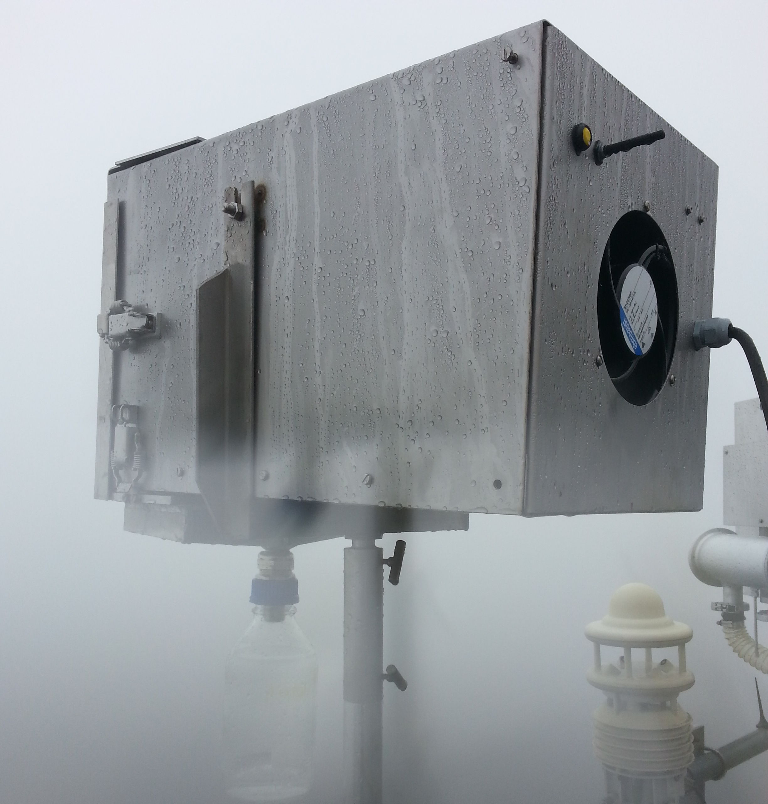
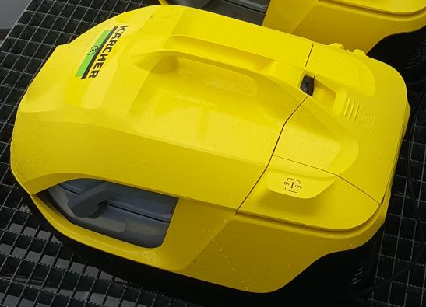
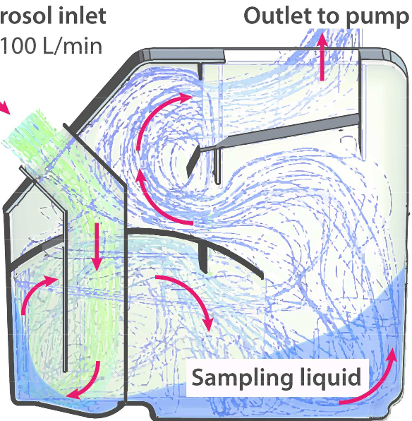
Sampling of clouds
Cloud droplet impactor
Flow rate: 108 m³of air/h
Chemical measurements
Sample harvested in sterile glass bottle
Bacterial counts
Sampling for 4 hours
High flow rate impinger (Kärcher DS6)
Filled with RNA later solution (DNA/RNA fixator)
Flow rate: 2 m³of air/min
DNA/RNA
Sampling for 4 hours
Sample is then filtered (MCE 0.2 µm) for DNA/RNA extraction
(Temkiv et al., 2017)
© Authors

Slide 7
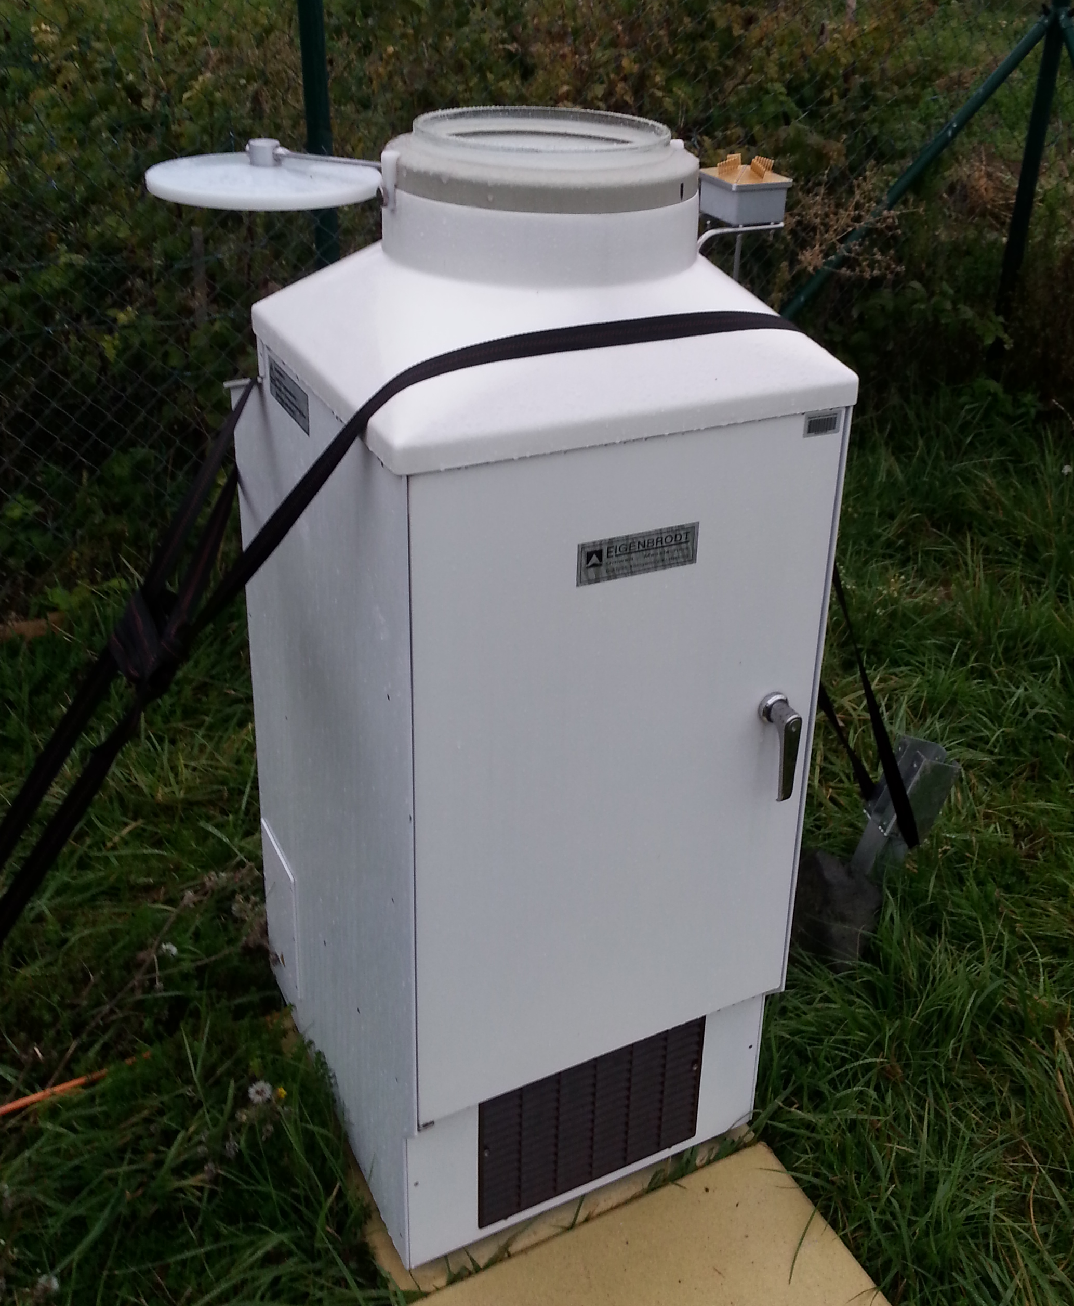
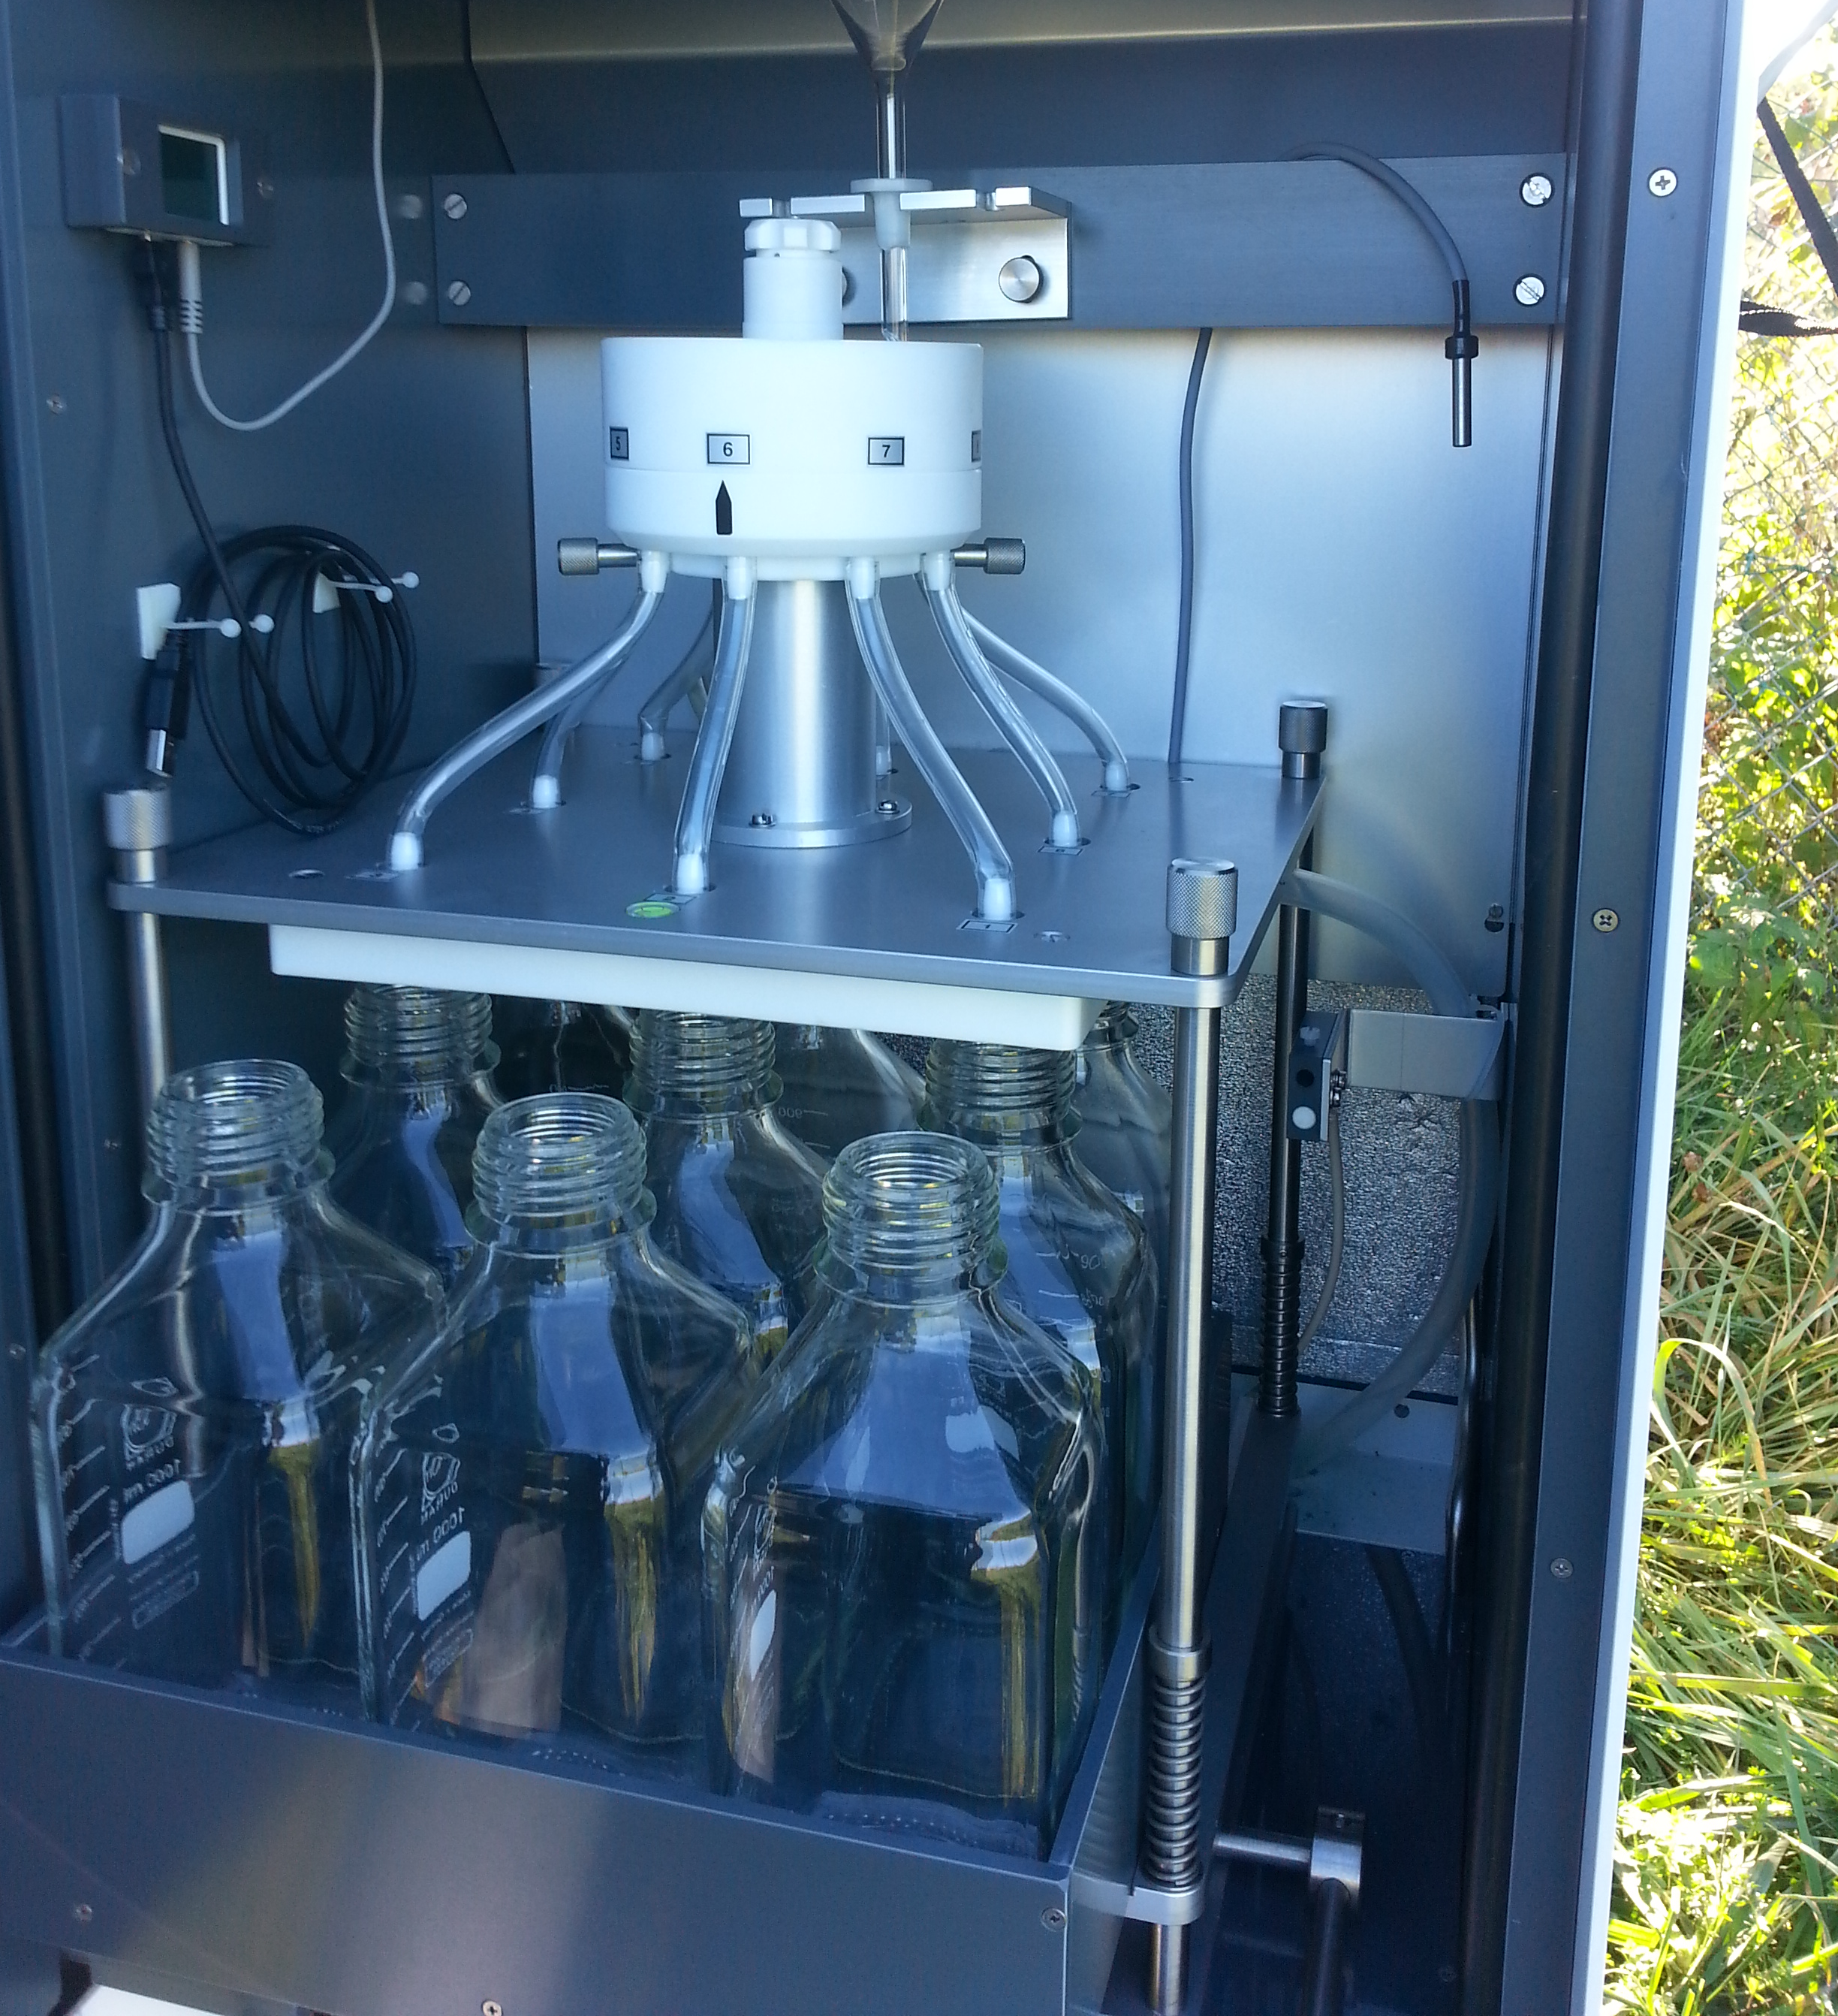
Sampling of precipitations
Eigenbrodt NSA 181 / KHS Precipitation Collector
Equipped with an automated teflon lid that opens with precipitation detector
Precipitation are harvested in sterile glass bottle (8 bottles in total)
Samples are maintained at 4°C
Samples were recovered within 24h for further analyses
DNA/RNA
Bacterial counts
Chemical measurements
© Authors

Slide 8
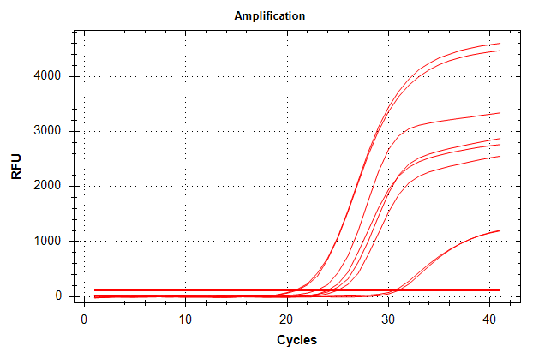
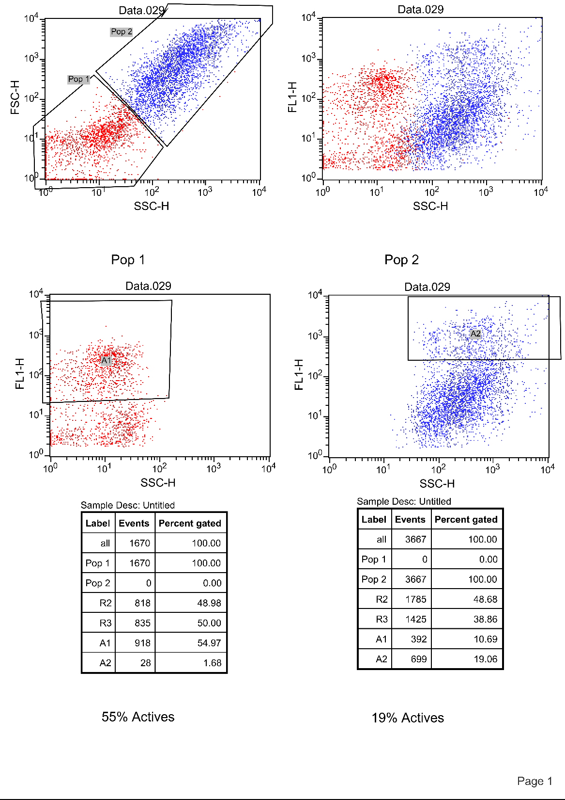
Metabolic activity assessments
Bio-molecular approaches vs cellular approaches
Quantitative PCR
Flow Cytometry
Ratio of the 16S rRNA/16S rDNA gene in bacteria
Esterase enzymes activity (FDA)
© Authors

Slide 9
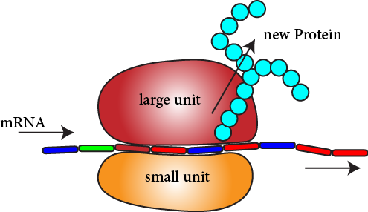
Determination of metabolic activity by qPCR
16S gene (V4 region)
ribosomal RNA transcription
Ribosome units contains
Proteins
RNA
Active cell
Cell in dormancy
Nucleoid (DNA)
rRNA > rDNA
Ribosomes
rRNA < rDNA
A rRNA/rDNA ratio > 1 highlight a recent metabolic activity in the community
© Authors

Slide 10
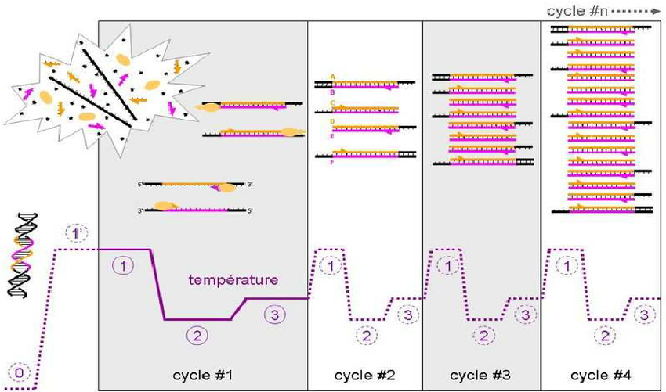
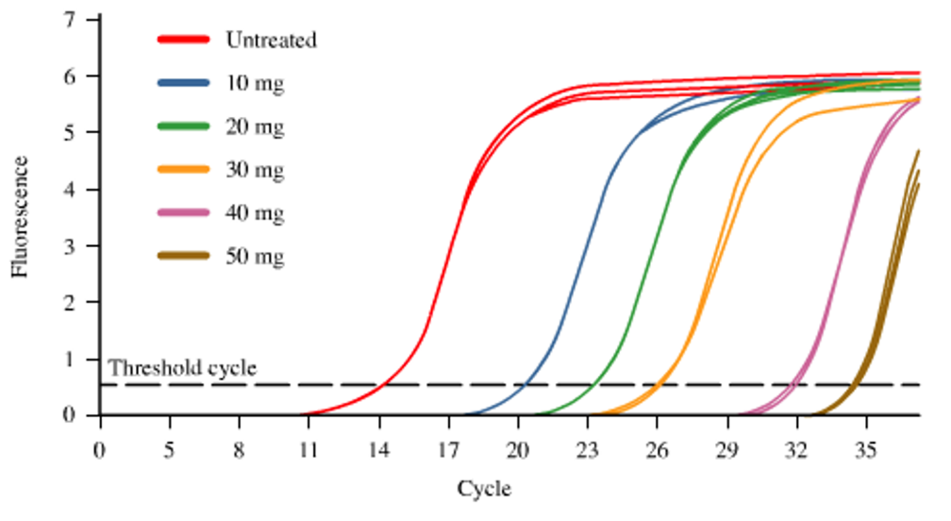
Principle of qPCR
Identical to Polymerase Chain Reaction (PCR): amplification of a DNA fragment (70-200pb)
Also contains a fluorophore (SYBR green) that binds to the DNA
Quantification of DNA at each cycle
Amplification curves
After 35-40 cycles
1
Denaturation
2
Annealing
3
Elongation
Q_{DNAn} = 2 x Q_{DNA n-1}
Determination of a Ct value (threshold cycle) = number of cycles to detect a signal above the threshold line
Proportional to the DNA or RNA at the start
Important: the lowest the Ct value, the more DNA or RNA
© Authors

Slide 11
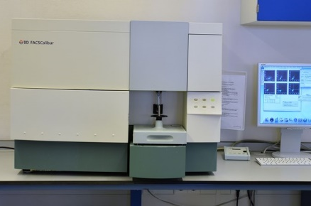
Principle of Flow cytometry
Capillary
Bacterial cells
FL3 (670LP)
Red wavelength
FL4 (661/61)
Orange wavelength
FL2 (585/42)
Yellow wavelength
Side Scatter - SSC (488/10)
Particle granulometry
Fluorescence channel 1 – FL1 (530/30)
Green wavelength
Laser beams
Forward Scatter - FSC (diiode)
Particle size
Flow
Allow to identify and count particles according to their size and staining
© Authors

Slide 12
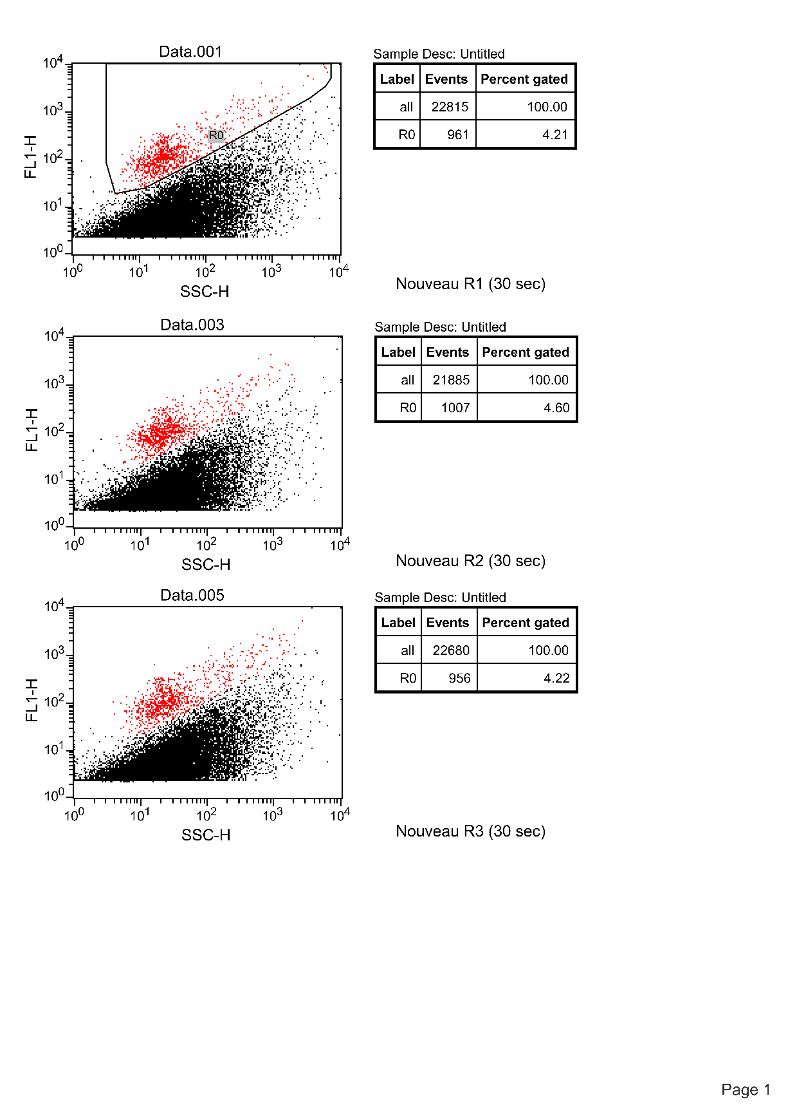
Principle of Flux cytometry: example
Cloud sample stained with SYBR green (intercalating agent of DNA)
fluoresces in green (FL1)
Bacterial population
Fluorescence
Background fluorescence
Cells granulometry
Because DNA within bacterial cells is stained with SYBR green, the bacterial population emit a higher signal on FL1 axis and stands out from the background
Total bacterial number measurement
For metabolic activity measurement, SYBR is replaced by fluorescein diacetate (FDA, non-fluorescent), which is cleaved by esterase enzymes into fluorescein (fluoresces in green (FL1))
© Authors

Slide 13
Results
Cloud and precipitation events of the 22/10/2019
© Authors

Slide 14
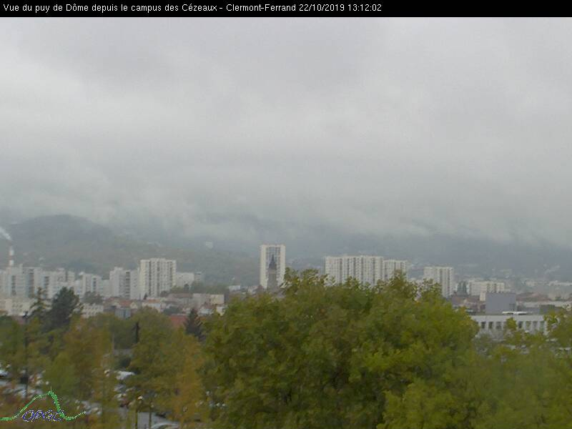
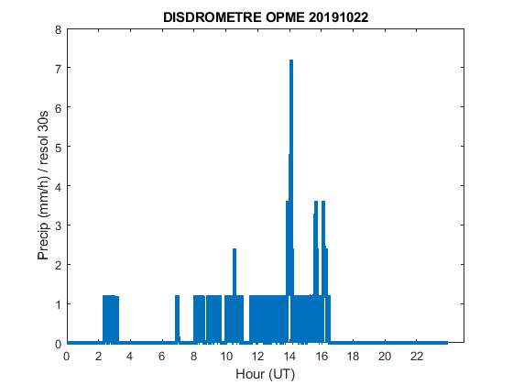
Results: Cloud and precipitation at the sites
Cloud at the summit of the Puy-de-Dôme station (PDD)
Total precipitation at Opme
PDD
1465 m
Puy-de-Dôme
Opme
680 m
Boundary layer (719 m)
Clermont-Ferrand
12.40 Km apart
Opme
© Authors

Slide 15


Results: qPCR on cloud sample
Control +
cDNA (=RNA)
Ct _{RNA} = 23.48
DNA
Ct _{DNA} = 24.69
Control -
Ct
the lowest the Ct value, the more DNA or RNA
Ratio $\frac{Ct RNA}{Ct DNA}$ ≈ 0.95
Recent Metabolic Activity?
rRNA quantity > rDNA quantity
© Authors

Slide 16
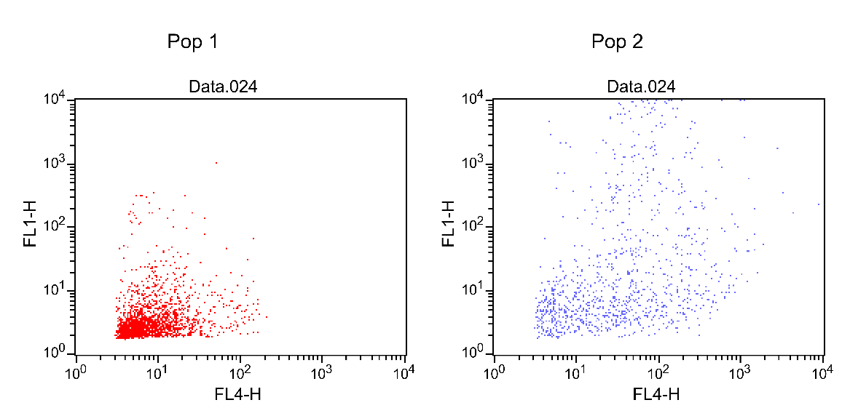
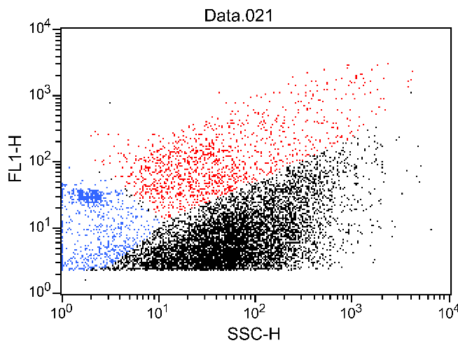
Results: Flow cytometry
Cloud
Precipitation
Total bacteria (SYBR)
Active bacteria (FDA)
Total bacteria (SYBR)
Active bacteria (FDA)
More bacteria in precipitation
Below-cloud scavenging?
Bacteria more active in precipitation
33%
Microbial multiplication in fresh precipitation?
12%
© Authors

Slide 17
Conclusions
Higher bacterial density and microbial activity in precipitation than in the associated cloud:
The more favorable conditions in precipitation allowed for bacteria to quickly multiply?
The difference between cloud and precipitation comes from the scavenging of aerosols?
e.g. If we consider a total scavenging, aerosols compartment contributes to 80% and 92% of the total and active bacterial cells respectively found in precipitation
Aerosols may represent a huge reservoir of total and active bacterial cells
Raindrop impacts on the ground aerosolized active microorganisms surrounding the sampler?
Bacteria had time to grow in the glass bottle before sample recovery?
Both qPCR and cytometry allowed to highlight metabolic activity in cloud, although different information can be extracted
qPCR provide the activity of the whole microbial community (bacteria and archaea), but is highly dependent on DNA/RNA quality and quantity
Flow cytometry provide a general activity (esterase) but more accurately
© Authors

Slide 18
Perspectives
The results presented here concern only one cloud event and the associated precipitation
More sampling events are needed to strengthen the interpretations
Considering the potential contribution of aerosols into precipitation, microbial activity and bacterial density in the air compartment should be assessed as well
The data need to be supplemented with microbial diversity and chemical/physical parameters to identify the main factors affecting microbial activity
The high activity observed in precipitation highlights the potential strong impact of airborne microorganisms (precipitation and aerosols) on receptacle ecosystems
Need to assess the effect of precipitation on microbial diversity on receiving ecosystems
Thank you for your attention!
EGU congress, 5th May 2020
© Authors

