Slide 1
The NeXtSIM-F sea ice forecasting system
Sea ice modeling group, NERSC
Guillaume Boutin
Anton Korosov
Einar Olason
Pierre Rampal
Timothy Williams
Acknowledgements
Arne Melsom, met.no
Sylvain Bouillon, Veronique Dansereau, Philipp Griewank

Slide 2
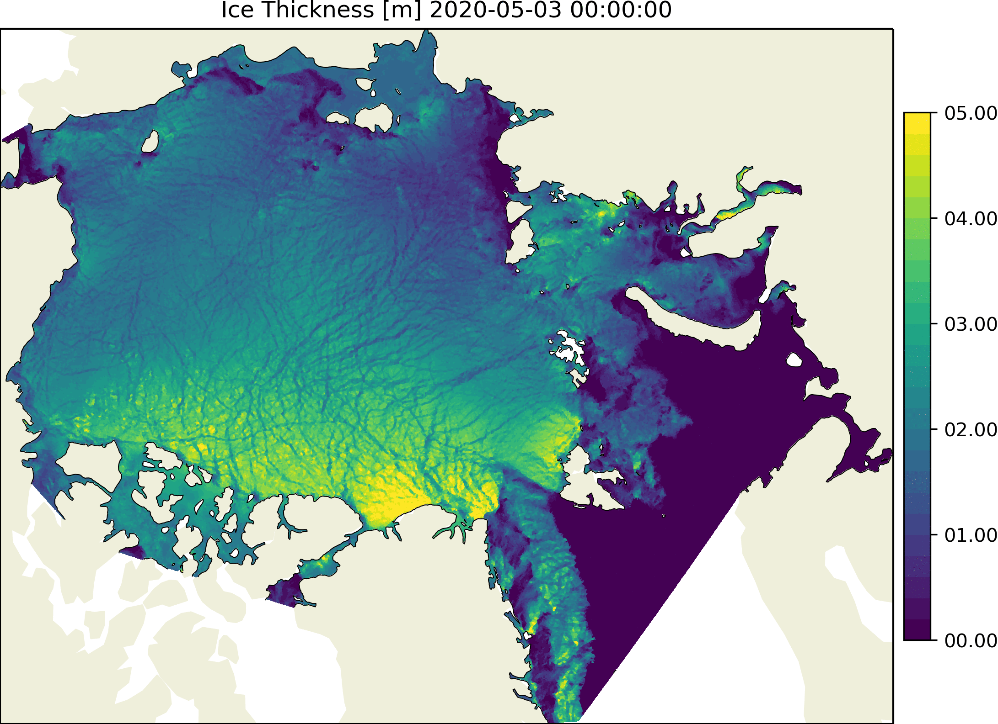
Outline
neXtSIM-F forecast platform
Running operationally
Will be included as part of CMEMS ARC-MFC portfolio in July 2020
Evaluation for 2018-11 - 2020-03
Drift for 2018-2019 winter agrees well with observations
Drift for 2019-2020 winter deteriorated slightly
RMSE up by ~1km/day
Thickness too high off NE Greenland and north of Svalbard
Concentration underestimated in Fram Strait
Recent forecast of sea ice thickness
run on 2020-05-04

Slide 3
neXtSIM-F forecast platform
First forecast system using the neXtSIM sea ice model
One of few models that doesn’t use the EVP rheology
Maxwell-Elasto-Brittle rheology
Relatively recent upgrade
Good sea ice drift and deformation
Needs further modifications to prevent excessive thickness growth
Recent forecast of sea ice thickness
run on 2020-05-04

Slide 4
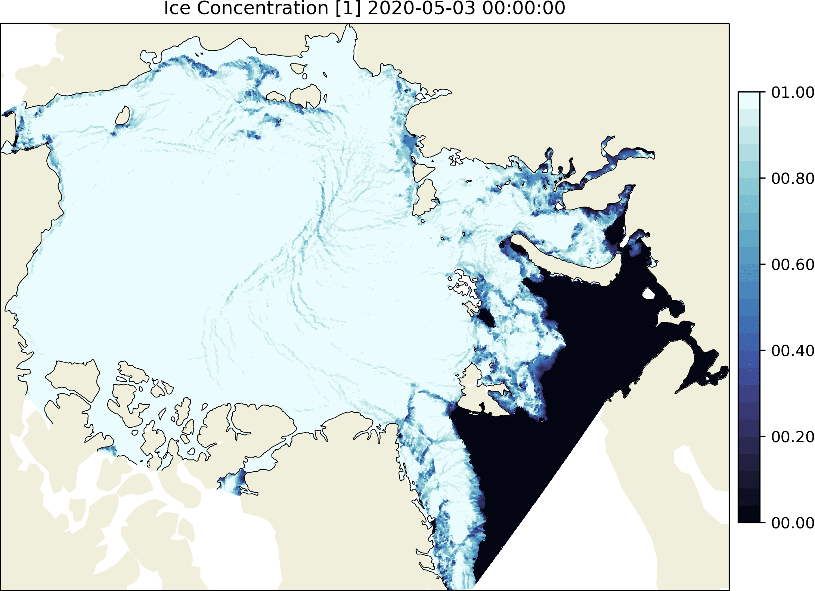
neXtSIM-F forecast platform
Currently running a 10-km Arctic domain
Daily:
1-day hindcast
7-day forecast
Stand-alone model, forced by TOPAZ4 (ocean) and ECMWF IFS (atmosphere)
Takes 2.5h with 16 CPU on a local server
To be improved by solving the ice dynamics explicitly
Currently they are solved implicitly (~ Picard solution)
Recent forecast of sea ice concentration
run on 2020-05-04

Slide 5
neXtSIM-F forecast platform
Assimilation
Blend of OSISAF SSMI and AMSR2 concentration
Use AMSR2 to give sharper ice edge
Only change concentration if ice masks disagree
Changing ice conc led to terrible drift/thickness fields
Compensating heat flux if ice removed
To stop regrowth
SST lowered to freezing point if ice added
To stop melting
Recent forecast of sea ice concentration
run on 2020-05-04

Slide 6
neXtSIM-F forecast platform
Correction to concentration - more a correction of extent
Thin ice concentration
prior to assimilation
Thin ice concentration
after assimilation
Thin ice concentration
innovation
From forecast run on 2020-05-4

Slide 7
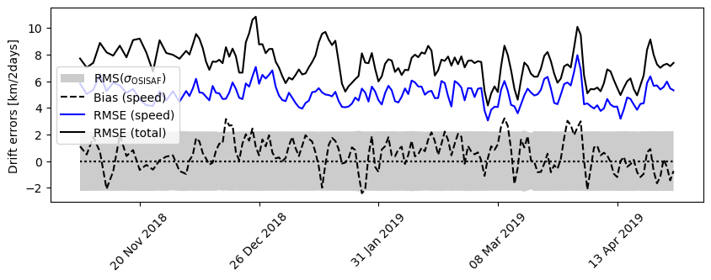
Evaluation: Ice drift
Comparison of analysis to OSI SAF drift (48h, 60km product). Winter 2018-2019.

Slide 8
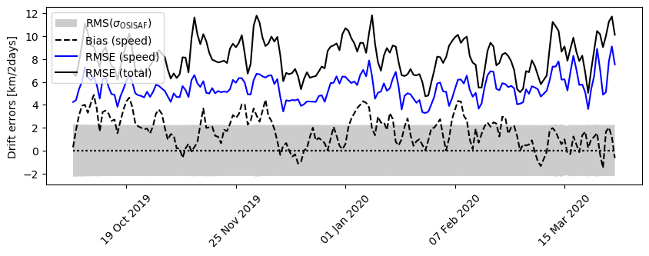
Evaluation: Ice drift
Comparison of analysis to OSI SAF drift (48h, 60km product). Winter 2019-2020. RMSE has increased since first winter.

Slide 9
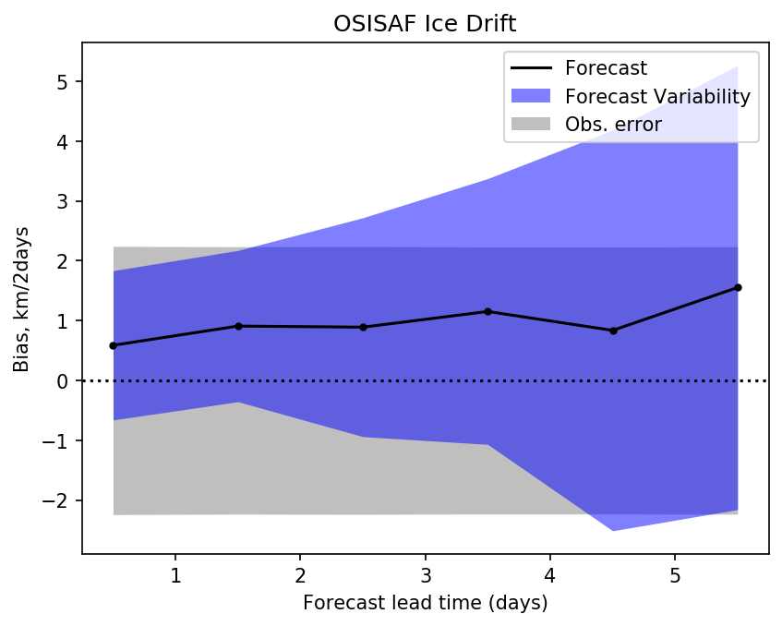
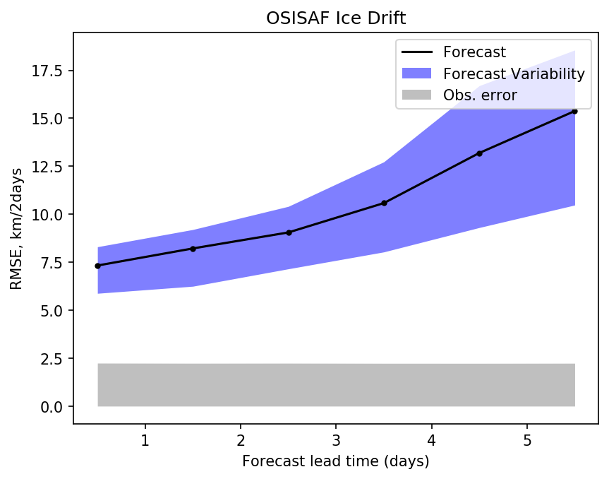
Evaluation: Ice drift
Comparison of forecasts to OSI SAF drift (48h, 60km product). Both winters.

Slide 10
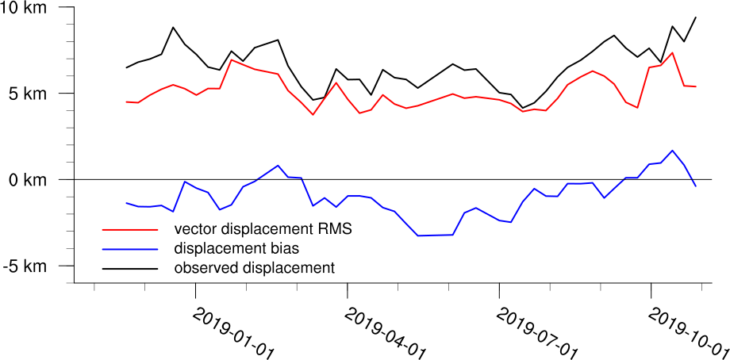
Evaluation: Ice drift
Comparison of day 6 forecast to OSI SAF drift (24h high-resolution product, derived from SAR). Similar to 48h results.
Arne Melsom, CMEMS Quality Information Document (to be released).

Slide 11
Evaluation: Ice thickness
Comparison of analysis to CS2-SMOS thickness. Winter 2018-2019.

Slide 12
Evaluation: Ice thickness
Comparison of analysis to CS2-SMOS thickness. Winter 2019-2020. Growing positive bias.

Slide 13
Evaluation: Ice thickness
Comparison analysis to CS2-SMOS thickness. April 2019 average.
Large overestimation of ice thickness north of Svalbard
Underestimation in Fram Strait
Caused by too-thick ice allowing an arch to form

Slide 14
Evaluation: Ice thickness
Comparison analysis to CS2-SMOS thickness. February 2020 average.
Large overestimation of ice thickness north of Svalbard
Large overestimation in Fram Strait
Overestimation in central pack also

Slide 15
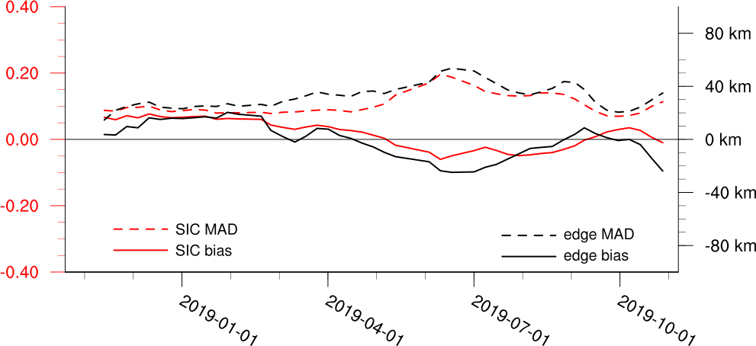
Evaluation: Ice concentration & extent
Comparison of day 6 forecasts to OSI SAF ice concentration (SSMI).
MAD: Mean absolute difference
Arne Melsom, CMEMS Quality Information Document (to be released).

Slide 16
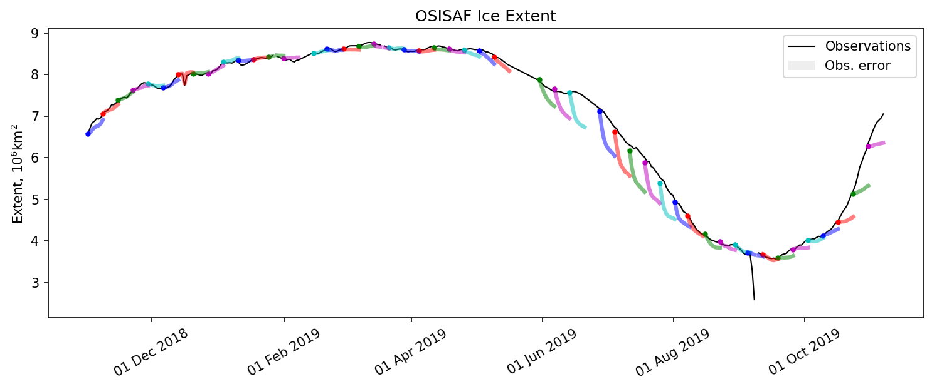
Evaluation: Ice concentration & extent
Extent from forecasts compared to OSI SAF ice concentration (SSMI).
Correction of concentration not persisting in summer.

Slide 17
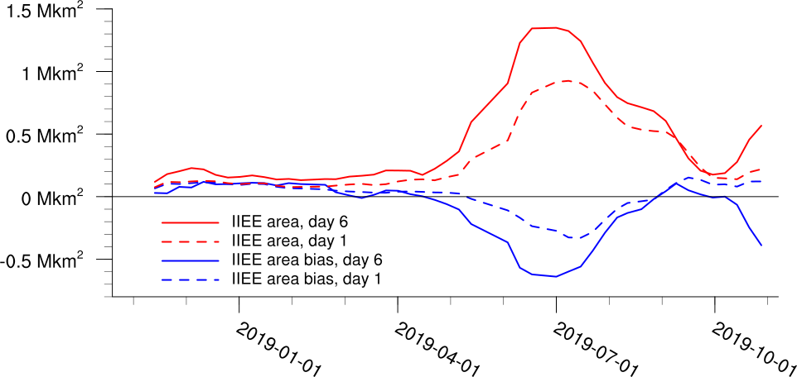
Evaluation: Integrated ice edge error
Large error in Fram Strait in summer
Comparison of day 1, 6 forecasts to OSI SAF ice concentration (SSMI).
Arne Melsom, CMEMS Quality Information Document (to be released).

Slide 18
Evaluation: Ice concentration & extent
Comparison analysis to OSI SAF ice concentration (SSMI). June 2019 average.
Large underestimation of ice extent in summer in the Fram Strait
Caused by too-thick ice north of Svalbard allowing an arch to form

Slide 19
Evaluation: Ice concentration & extent
Comparison analysis to OSI SAF ice concentration (SSMI). July 2019 average.
Large underestimation of ice extent in summer in the Fram Strait
Caused by too-thick ice north of Svalbard allowing an arch to form

Slide 20
Conclusion
Drift generally agrees well with observations
Very good in first winter while thickness is more realistic
Still reasonable in second winter, but less good.
Accumulation of ice by North Greenland and North Svalbard causes some problems
Arching blocks export through Fram Strait
Affects drift
Recent forecast of sea ice concentration
run on 2020-05-04

Slide 21
Future Plans
Priorities:
Dynamic parameterisations
To address thickness issues
Explicit solver (speed)
Assimilation of:
CS2-SMOS thickness
SAR deformation
Other ideas (finer tuning)
Assimilation of SMOS thickness
Another compensating heat flux for when ice is added
Longer term
Ensemble Kalman Filter (EnKF)
Recent forecast of sea ice concentration
run on 2020-05-04

