Slide 1
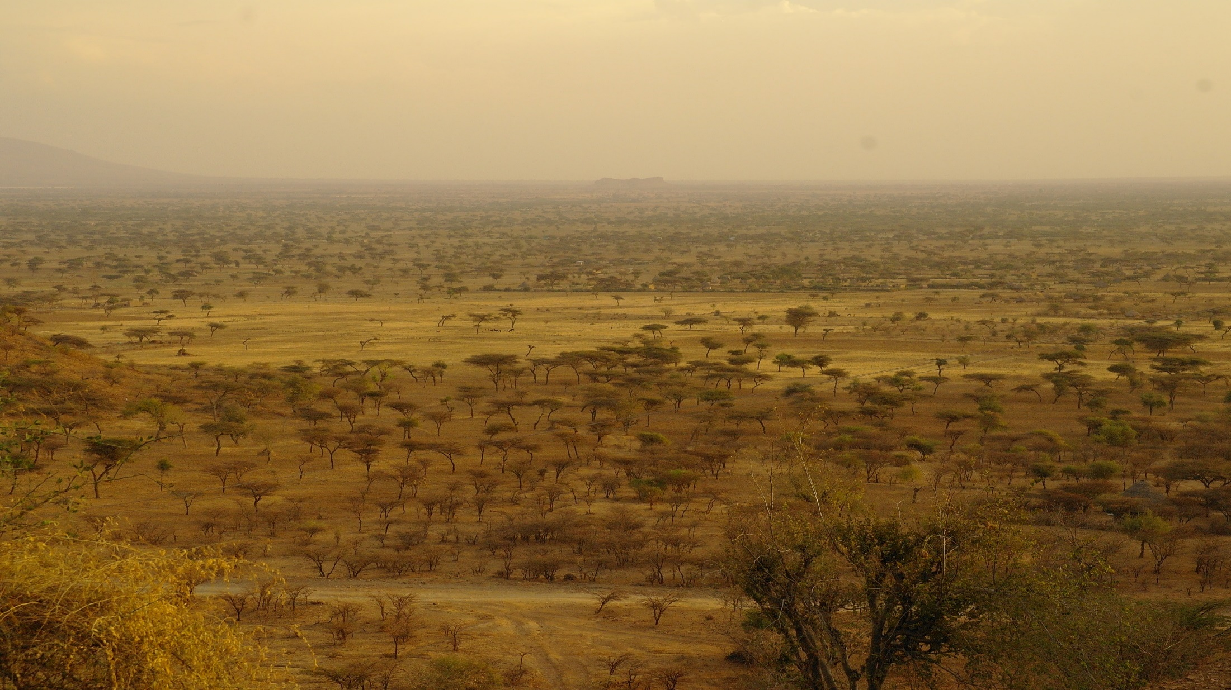
Imaging magma storage in the Main Ethiopian Rift with 3-D Magnetotellurics Juliane Hübert^{1,2}, Kathy Whaler¹, Shimeles Fisseha³, Fiona Iddon⁴, Colin Hogg⁵ ¹School of Geosciences, University of Edinburgh, Edinburgh, U.K. ²now at British Geological Survey, Edinburgh, UK ³ Institute of Geophysics, Space Science and Astronomy, Addis Ababa University, Ethiopia ⁴Department of Earth Sciences, University of Cambridge, UK ⁵Dublin Institute for Advanced Studies, Dublin, Ireland

Slide 2
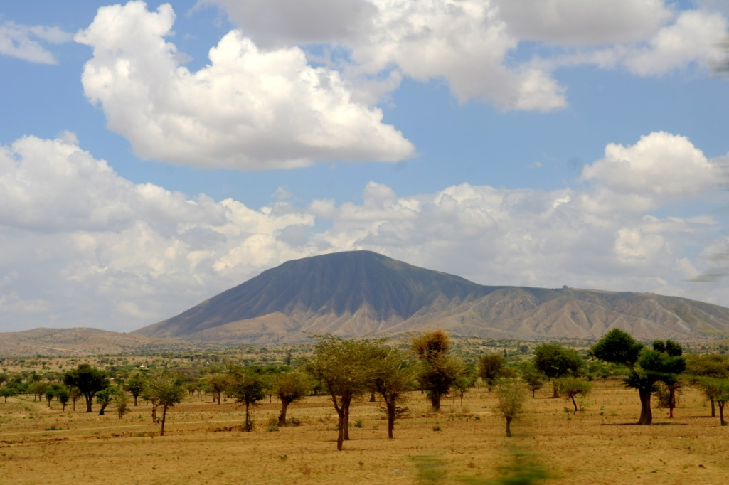
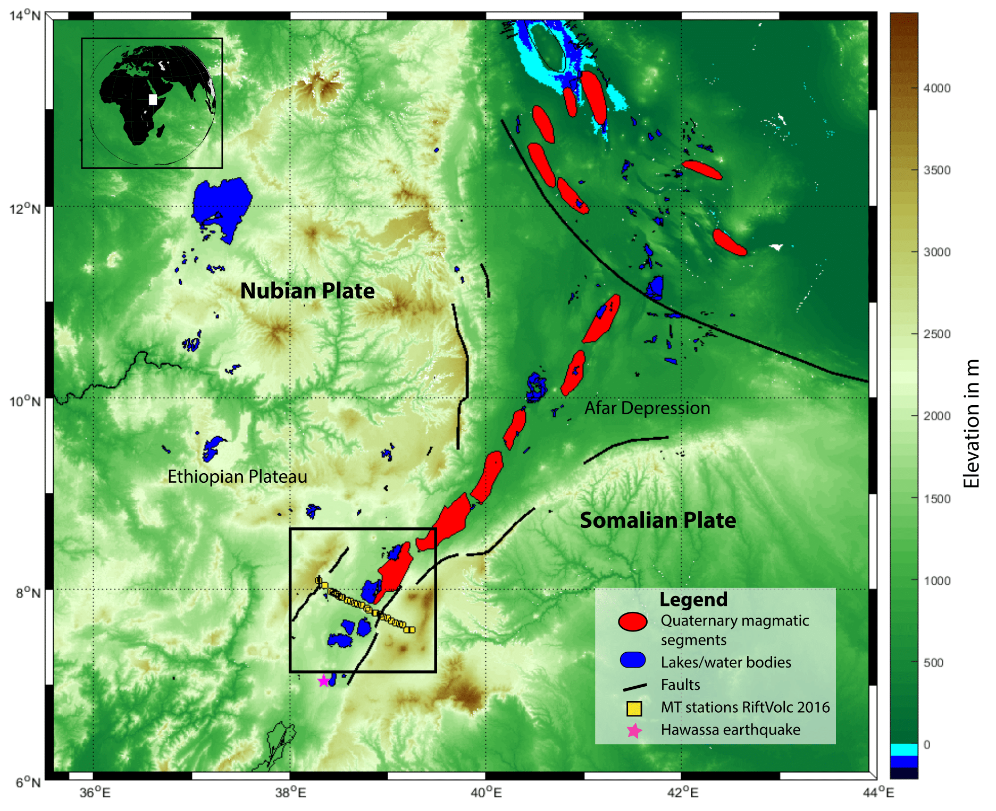
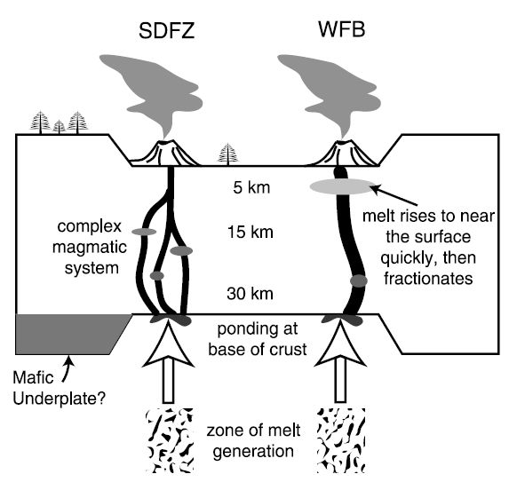
Main Ethiopian Rift (MER)
Number of active volcanoes – geothermal energy is of great interest, but also large hazard for population
Volcanism is greatly variable: silicic calderas, basaltic monogenetic vents etc. (Fontijn et al. 2018)
Magma storage and supply is debated
MER is located at transition between continental rifting and seafloor spreading in Afar
Rooney et al. (2007)

Slide 3
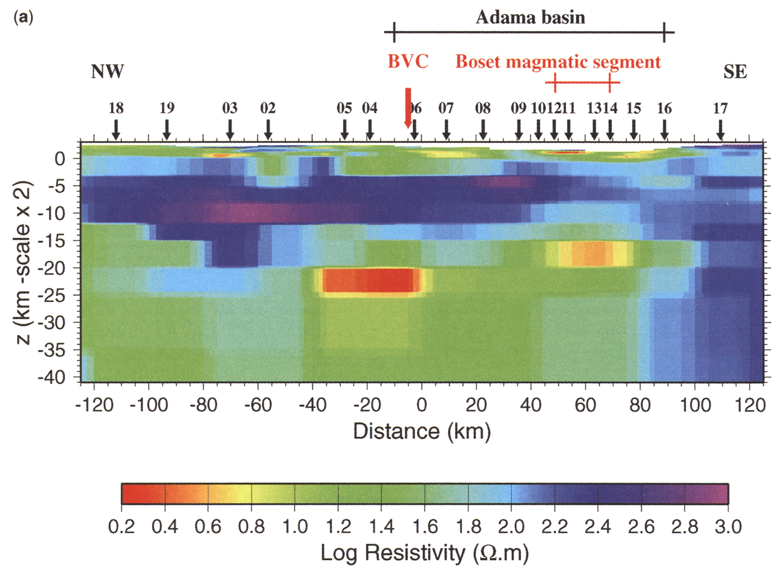
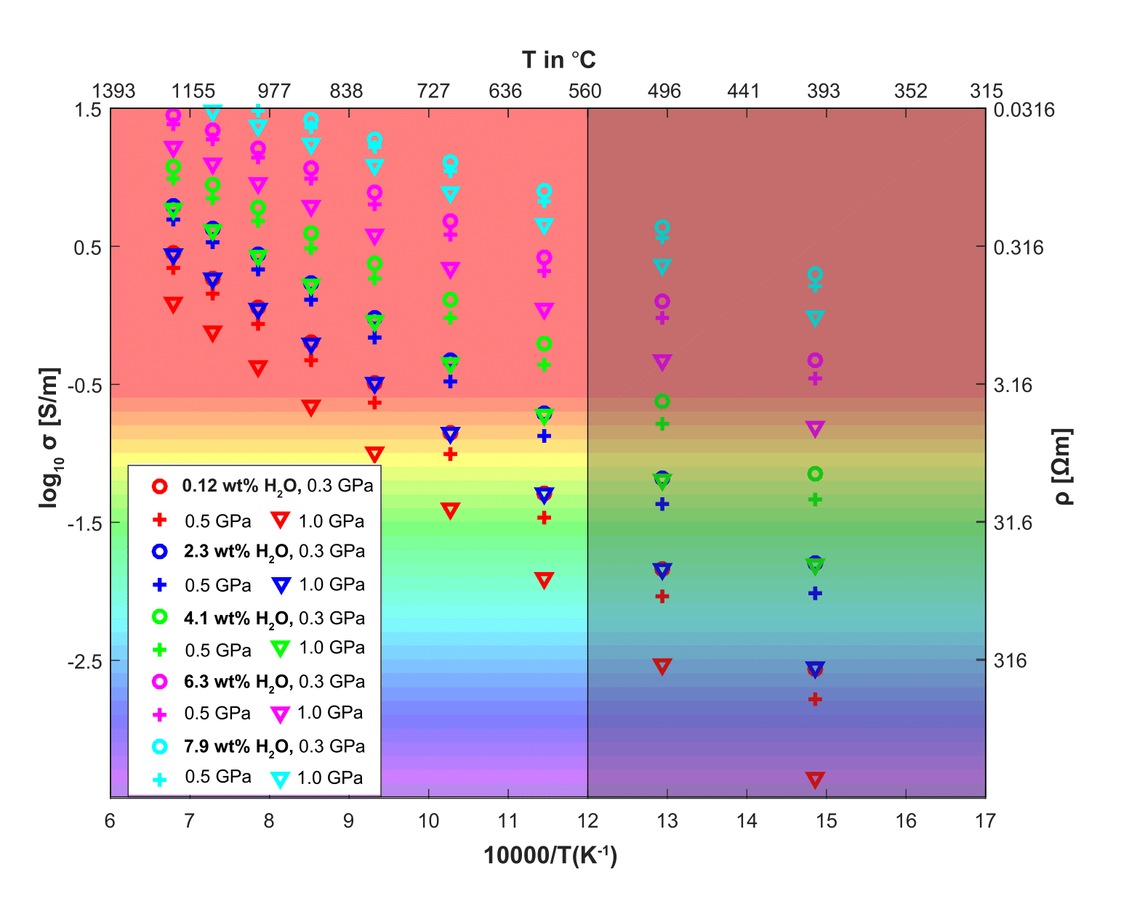
Imaging magmatic processes with magnetotellurics (MT)
MT images the bulk electrical conductivity/resistivity of the Earth
-> highly sensitive to presence of magma/fluid
Electrical conductivity can be interpreted in terms of temperature, pressure, water and melt content using petrological models and lab experiments
Whaler&Hautot (2006) EAGLE profile in the northern main Ethiopian rift, deeper conductor related to magmatic segment
After Guo et al. (2016)

Slide 4
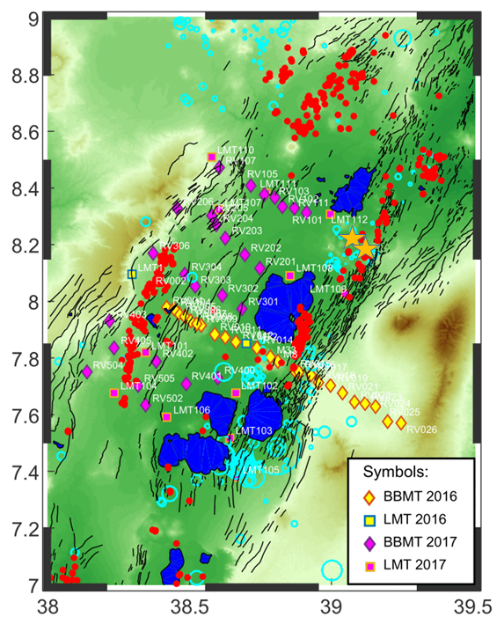
MT data collected within RiftVolc:
14 Long period MT + Broadband stations, 45 Broadband stations in array in Western part of MER, mixed data quality (high population density)
+ 2 Sites from Reykjavik Geothermal’s Tulu Moye prospect
-> roughly 6 parallel profiles
Crossing Central volcano Aluto (silicic caldera with active hydrothermal system), focus of many more detailed studies

Slide 5
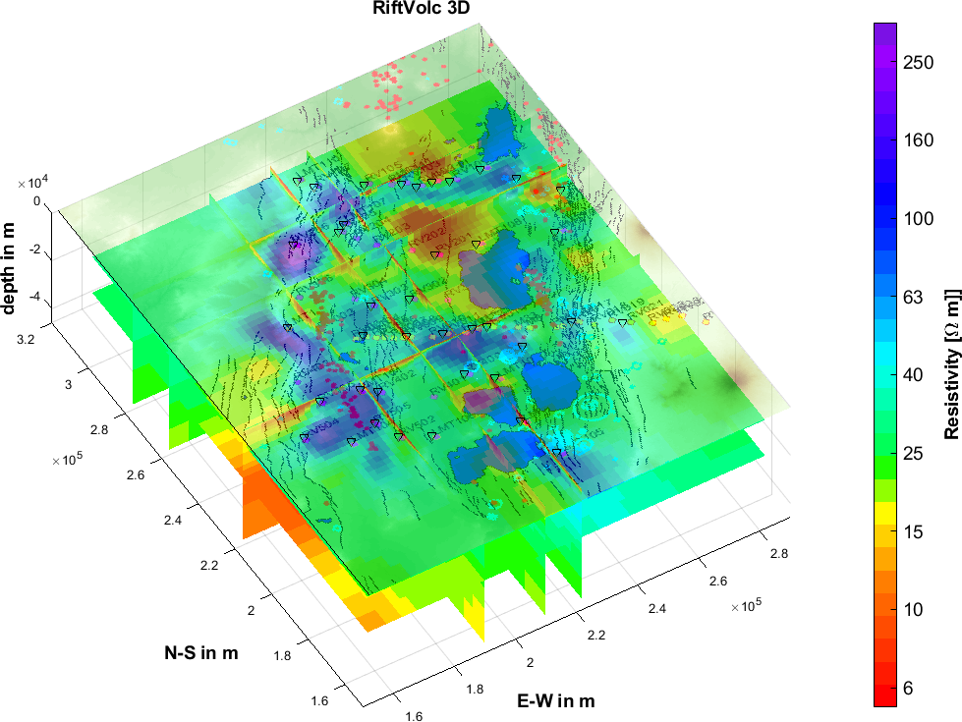
A new full 3-D inversion model of electrical resistivity in the MER
Inversion parameters and details:
ModEM (Egbert&Kelbert 2012)
Starting model is homogeneous half space with 25 Ωm (average of all apparent resistivity curves)
Covariance set to 0.4 (after testing)
start with full impedance data (>1s), then all impedance data plus LMT tipper (BB tipper is very small and noisy)
RMS of preferred model is 2.7

Slide 6
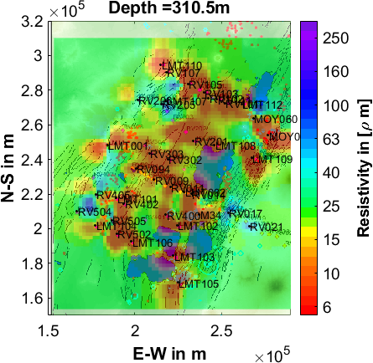
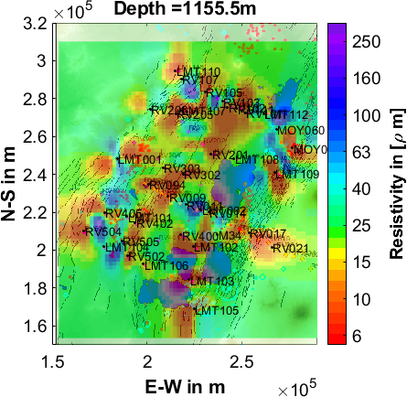
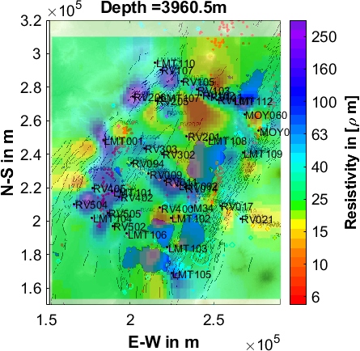
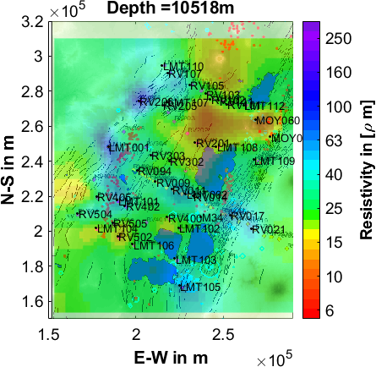
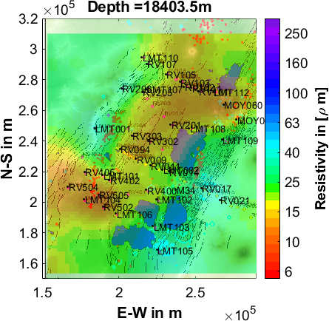
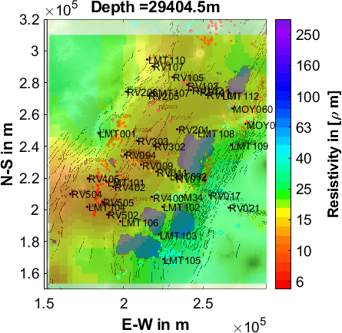
3-D inversion model of CMER

Slide 7
3-D inversion model of CMER – some details
No big conductor at 5km under central volcano
Large deeper conductor in the northern part with connection to Tulu Moye hydrothermal prospect deep reservoir at ~5km)
Large zone of higher conductivity in the lower crust in the Western part of the rift
Asymmetric shoulders

Slide 8
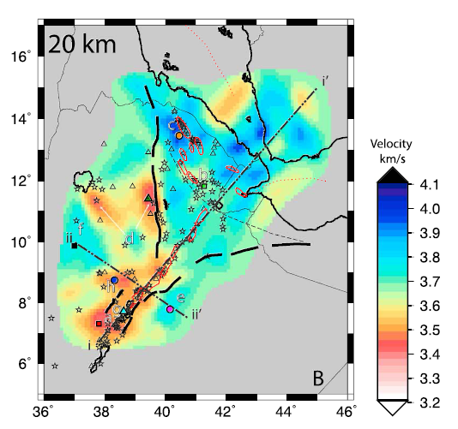
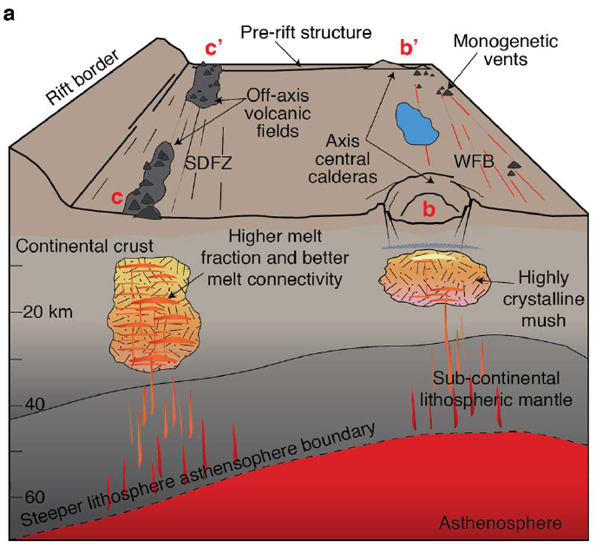
Structural interpretation of melt storage in the MER supported by MT model
Chambers et al. (2019), 3-D slow shear wave velocity anomaly roughly 200‐km by 100‐km wide positioned 20km beneath the MER axis
Iddon (2019), model of melt storage in the MER

Slide 9
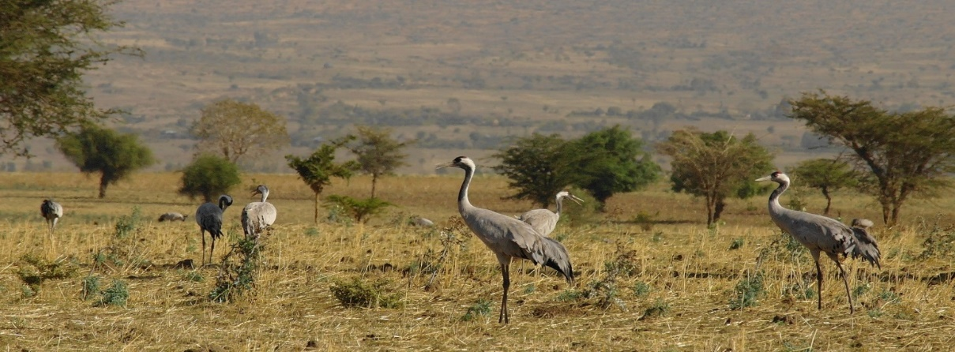
Summary
Broadband and long period MT data from an array in the CMER yield new 3-D model of electrical conductivity of the crust (<40km)
Electrical conductivity observed/modelled can constraint water and partial melt content of current storage conditions
Magma is stored below the rift centre and off-axis
Zone of higher conductivity in the lower crust coincides with low shear-wave velocity
Acknowledgements:
RiftVolc is a NERC funded project that aims to research past and current volcanism and volcanic hazards in the central Main Ethiopian Rift. The five year long project includes BGS, the Universities of Edinburgh, Bristol, Oxford, Cambridge, Southampton and Leeds as well as Addis Ababa University and the Geological Survey of Ethiopia.
Special thanks go to the staff at IGGSA, drivers and field crews and Dublin Institute of Advanced Studies for the instrument loan. Reykjavik Geothermal kindly provided MT data from two stations of the Tulu Moye prospect.

