Slide 1
Deformation history of the Marmara Granitoid and implications for
a dextral shear zone in NW Anatolia
by
Salim Birkan Bayrak¹, Işıl Nur Güraslan¹, Alp Ünal¹, Ömer Kamacı¹, Şafak Altunkaynak¹, and Erdinç Yiğitbaş²
¹Istanbul Technical University, Faculty of Mines, Geological Engineering Department, Istanbul, Turkey
²Çanakkale Onsekiz Mart University, Engineering Faculty, Geological Engineering Department, Çanakkale, Turkey
#shareEGU2020, EGU General Assembly 2020

Slide 2
Outline of Presentation
Introduction
Geology of study area
Solid-state deformation
Shear kinematics
Results

Slide 3
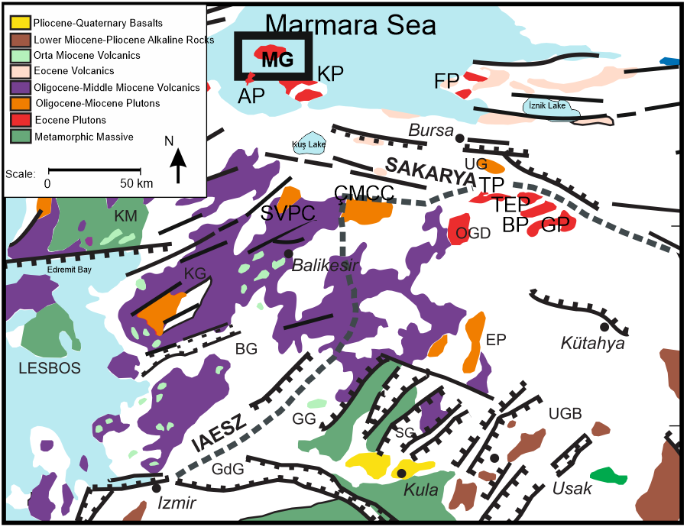
Introduction
Marmara Island is located in Western Anatolia which comprises different tectonic units.
Fig 1. Location of Marmara Island in Western Anatolia (modified from Altunkaynak and Dilek, 2006).

Slide 4
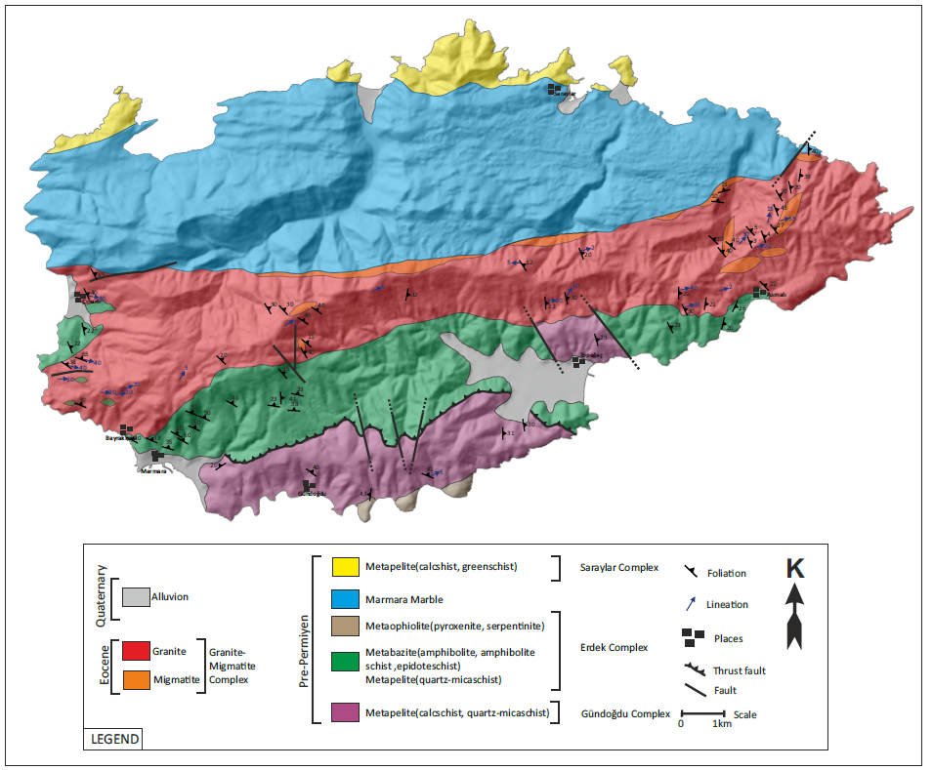
Geology of study area
Gündoğdu complex, which forms the basement of the study area, is represented by metapelites and recrystallized limestones that have undergone regional metamorphism in amphibolite facies.
Erdek complex which contains metabasites, metaophiolyticis, metapelites and marbles have undergone metamorphism in epidot-amphibolite facies.
Marmara marble is a banded marble which was affected by a greenschist facies regional metamorphism.
Saraylar complex includes metavolcanites, metatuffs and marble blocks that have undergone regional metamorphism in greenschist facies.
Fig 2. Geological map of Marmara Island.

Slide 5
Geology of study area
Marmara granitoid (47 Ma: Ustaömer et al., 2009) is a representative example of the Eocene post-collisional magmatism which produced several granitic plutons in NW Anatolia, Turkey.
It is a W-E trending sill-like magmatic body which was concordantly emplaced into the metamorphic basement rocks of Erdek Complex and Saraylar Marble.
Mineral composition of Marmara granitoid is granodiorite. It’s mineral paragenesis is plagioclase + quartz + alkali feldspar + biotite + hornblende +epidote +muscovite.
The granitoid is represented by deformed granodiorite which displays well-developed lineation and foliation in meso-scale defined by elongation of mica and feldspar crystals and recrystallization of quartz however, in some places, magmatic textures are preserved.
Deformed granodiorite is broadly cut by aplitic and pegmatitic dikes and contains mafic enclaves which display the same deformation indicators with main granitoid.

Slide 6
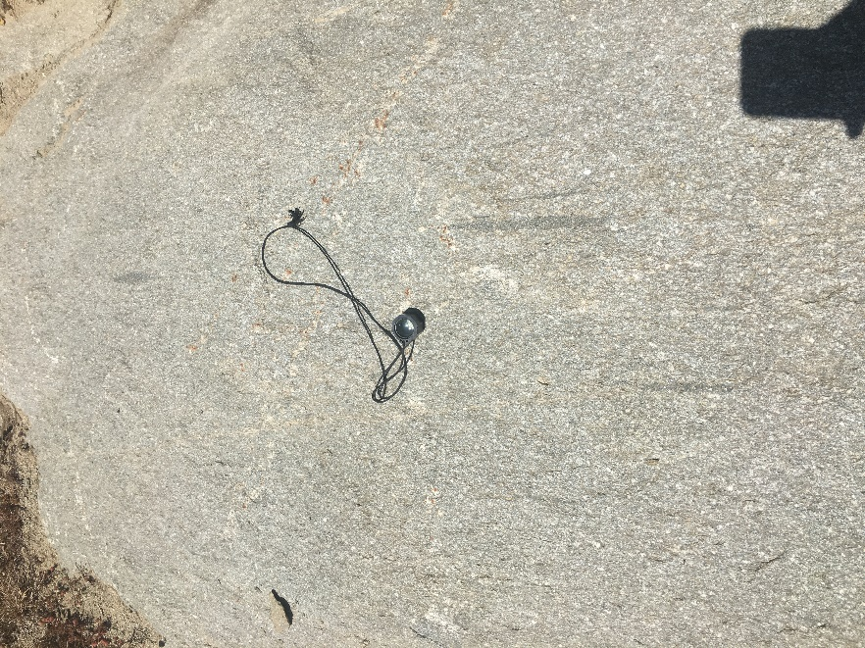
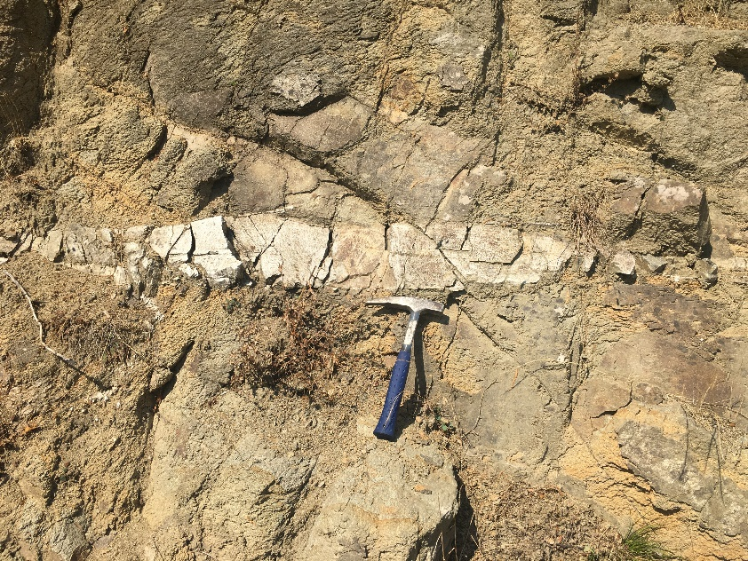
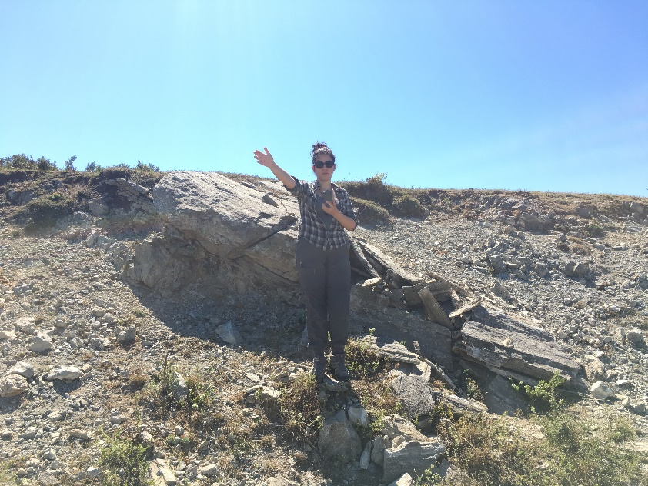
Geology of study area
(a)
(b)
(b)
(c)
(d)
Fig 3. Field photographs showing elogated mafic enclaves (a), elongated mafic minerals (b), aplite dyke (c), and foliated Marmara granitoid (d).

Slide 7
Geology of study area
qtz
(b)
ept
(a)
bt
bt
plg
ept
qtz
4x
2.5x
Fig 4. General thin section views of granodiorite (a,b) (ept: epidote, bt: biotite, plg: plagioclase, qtz: quartz).

Slide 8
Solid-State Deformation
Solid-state deformation of granodiorite is represented by ductile deformation with high temperatures and ductile-to-brittle deformation with relatively lower temperatures.
Evidence for the ductile deformation of the granitoid is represented by chessboard extinction of quartz, grain boundary migration (GBM) and subgrain rotation recrystallisation (SGR) which exhibits that the deformation temperature changed from 600 ºC to 400 ºC (Passchier and Trouw, 1996).
Bulging recrystallization (BLG), grain size reduction of amphibole, biotite and plagioclases and microcracks on plagioclases were considered as overlying ductile-to-brittle deformation signatures which develop between <250 ºC temperatures (Passchier and Trouw, 2005).

Slide 9
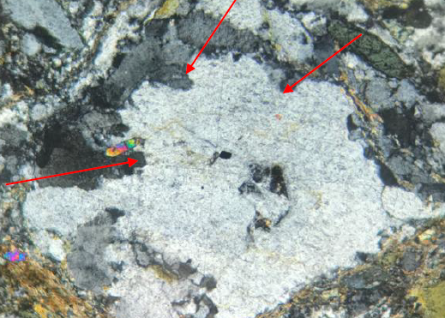
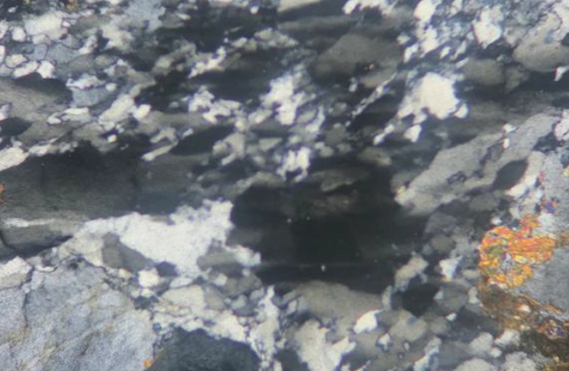
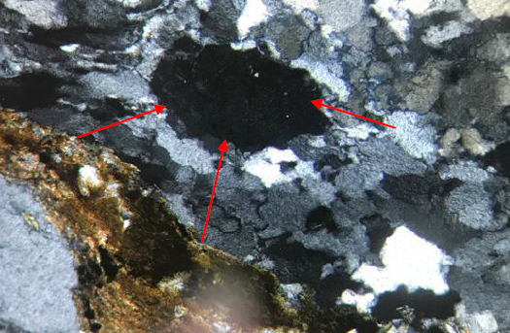
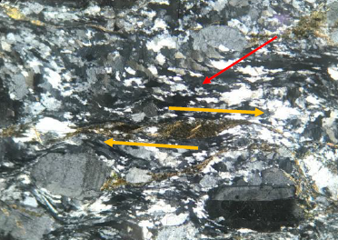
Solid-State Deformation
(a)
(b)
BLG
BLG
BLG
Qtz
Chessboard
Qtz
4x
10x
(c)
(d)
SGR
GBR
Bt
4x
4x
Fig 5. Thin section photograpgs showing bulging recrystallization (BGR)(a), chessboard extinction (b), graind boundary migration (c), subgrain rotation recrystallization (SGR)(c,d) and micafish structure (d).

Slide 10
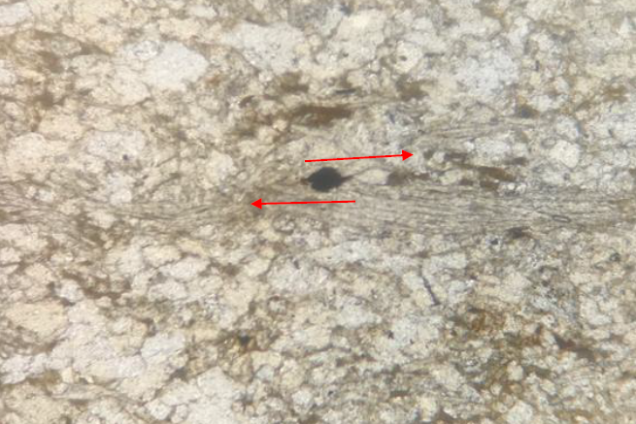
Shear Kinematics
(a)
(b)
SGR
δ type
Bt
4x
4x
Fig 6. Optical photographs of shear sense indicators such as δ type mantled porphyroclast (a) and micafish structure (b).

Slide 11
Results
All of these field and micro-structural data collectively suggest that the shear sense indicators such as micafish structures and δ type mantled porphyroclasts displayed stair-steppings pointing out to a right lateral movement,
Indicating that the structural evolution and deformation history of Marmara granitoid was controlled by a dextral shear zone.

Slide 12
References
Ustaömer, P. A., Ustaömer, T., Collins, A. S., & Reischpeitsch, J. (2009). Lutetian arc-type magmatism along the southern Eurasian margin: new U-Pb LA-ICPMS and whole-rock geochemical data from Marmara Island, NW Turkey. Mineralogy and Petrology, 96(3-4), 177-196.
Passchier, C. W., & Williams, P. R., 1996, Conflicting shear sense indicators in shear zones; the problem of non-ideal sections. Journal of Structural Geology, 18(10), 1281-1284.
Passchier, C. W., & Trouw, R. A., 2005, Microtectonics. Springer Science & Business Media.
Altunkaynak, S., & Dilek, Y. (2006). Timing and nature of postcollisional volcanism in western Anatolia and geodynamic implications. SPECIAL PAPERS-GEOLOGICAL SOCIETY OF AMERICA, 409, 321.

