Slide 1
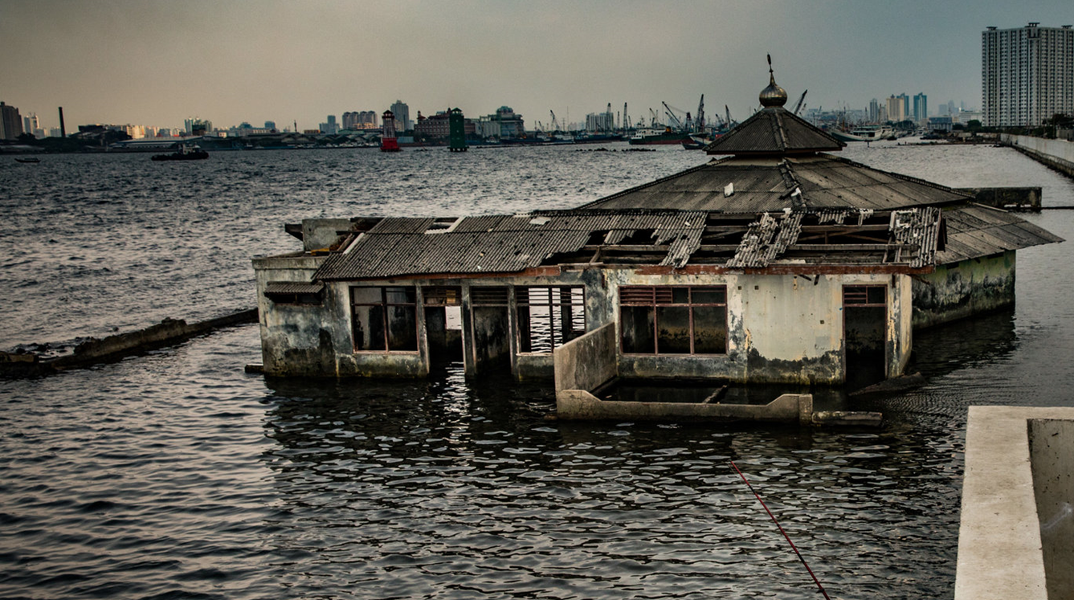
Identifying correlations between rainfall and flood loss across 3 cities in Java
Dr Avi Baruch
Matthew Farnham, Dr. Vivian Camacho-Suarez, Prof. Alistair Milne, Dr. John Hillier, Prof. Dapeng Yu, Prof. Louise Slater, Laura Whyte
Funded by NERC. Work undertaken by Previsico and Loughborough University

Slide 2
Background: FINJAVA Project
Insurance penetration rate in Indonesia is ~2.8%
Indonesia amongst the worst affected countries by flooding
Limited understanding of the multitude of risks from natural hazards the Indonesian market faces
The FINJAVA project aims to produce an initial exploratory analysis of catastrophe modelling in a data sparse context

Slide 3
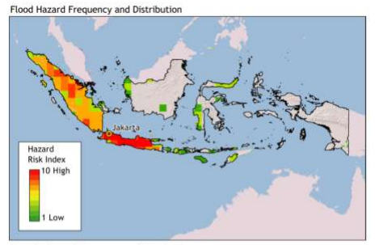
Java the worst affected region
Indonesia Flood Hazard Frequency (World Bank, 2018)

Slide 4
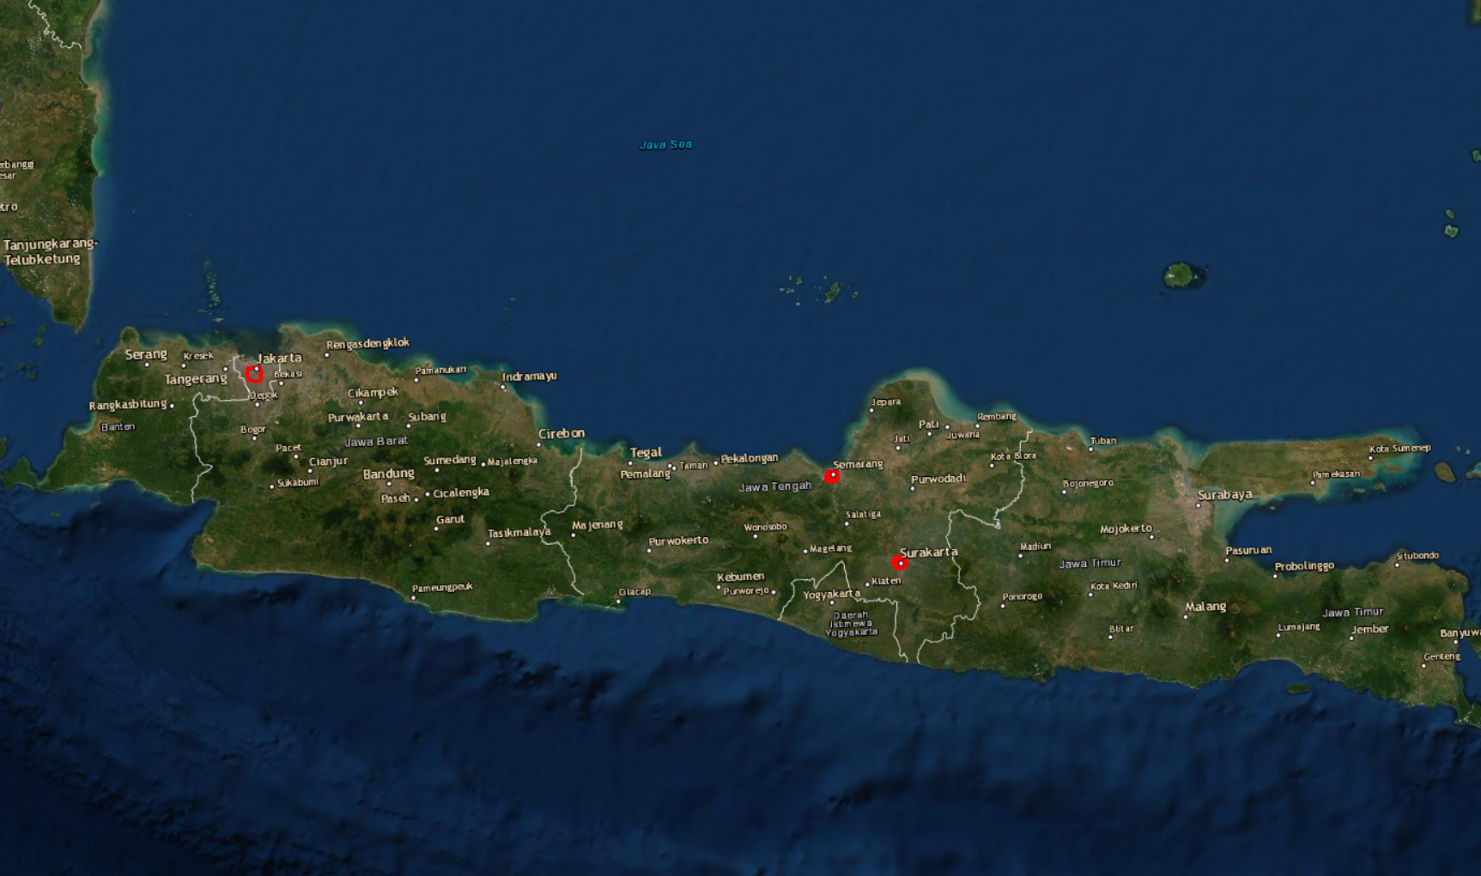
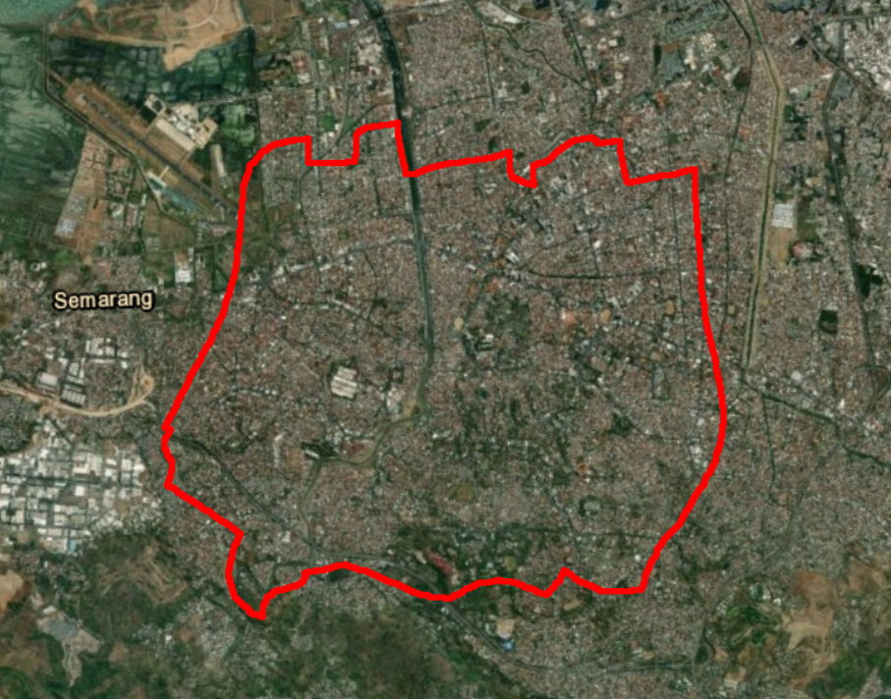
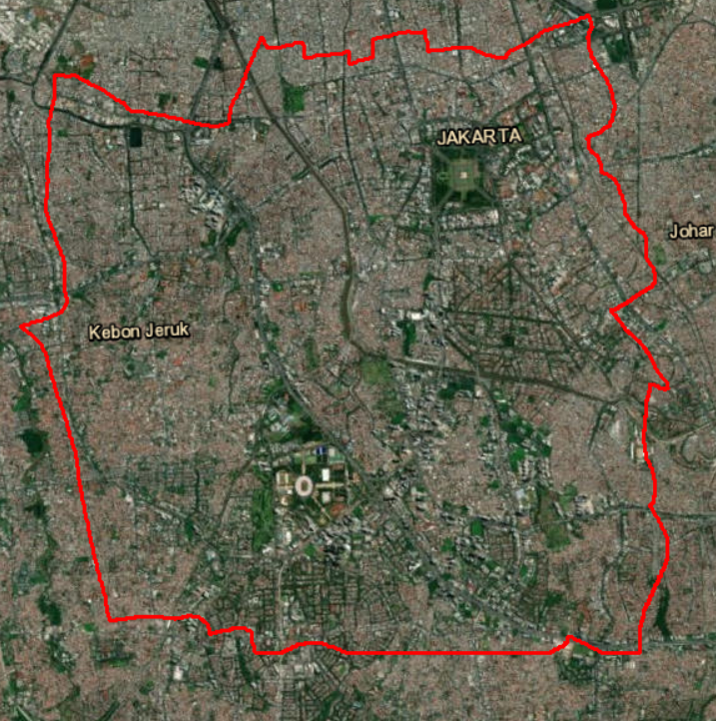
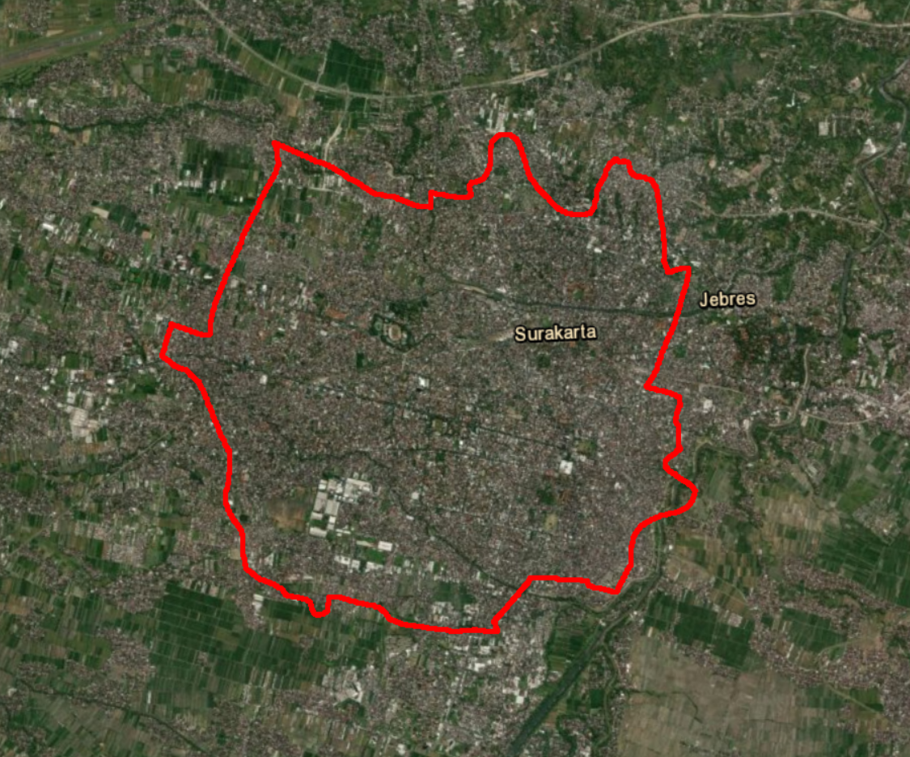
Jakarta
Study sites
Semarang
Solo
76km
471km
Chosen Areas
Notes:
Distance between Jakarta and Semarang – 400km
Distance between Jakarta and Solo – 500km
Distance between Solo and Semarang – 75km

Slide 5
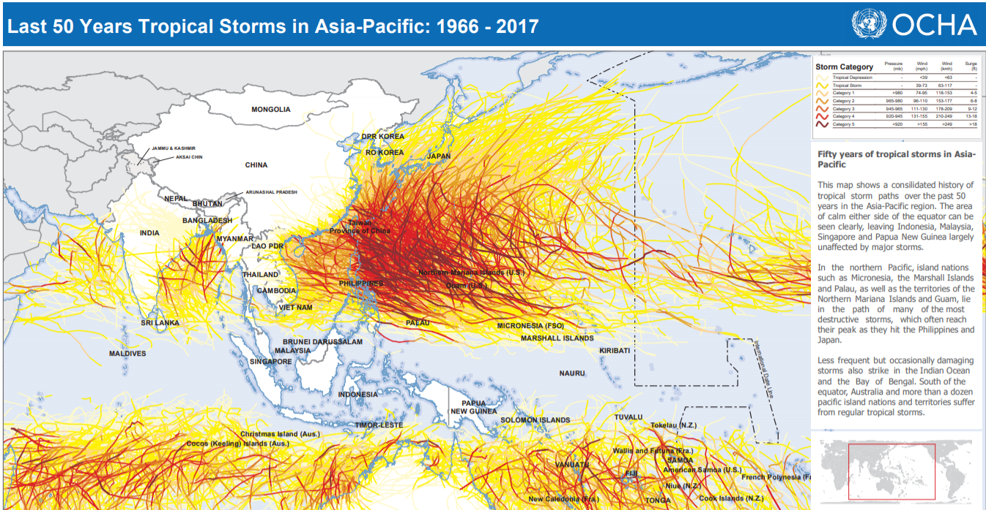
Background
More tropical storms in Semarang and Solo than Jakarta
Based on tropical cyclone paths, Solo and Semarang were expected to have a higher correlation.

Slide 6
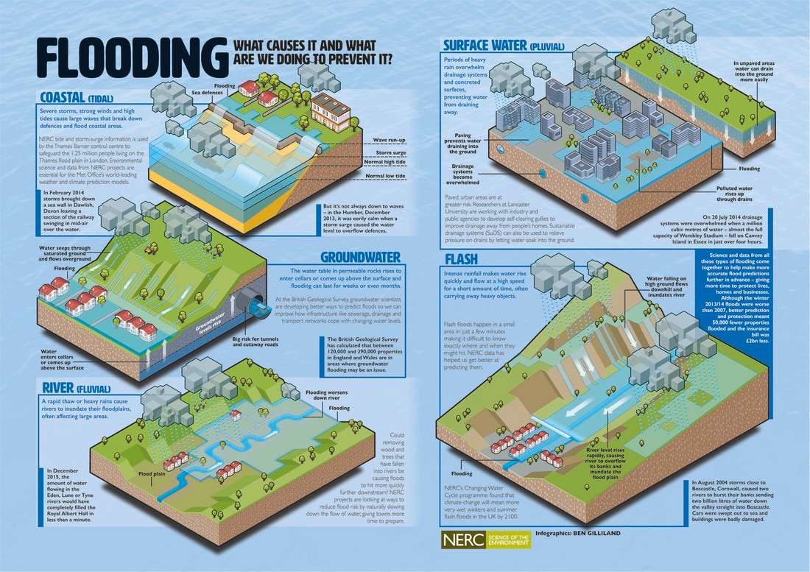

Slide 7
Objectives
Model surface water flooding for top rainfall events in each city
Estimate losses of each event using simulated floods and building data
Assess relationships between cities

Slide 8
Methods
Inspect performance
6
Extraction of top rainfall events
Model set-up
Run simulations
Calculate damages
Model
calibration

Slide 9
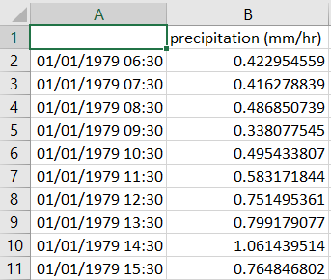
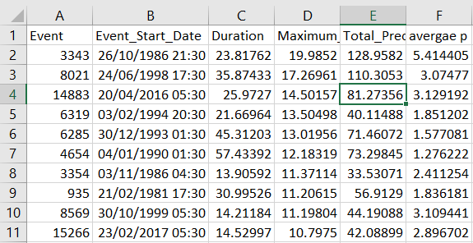
Step 1: Extracting rainfall for top events
Extraction of heavy precipitation (flood) events Jakarta Raw Data (1979-2018)
Top 10 events for identified for each city
Rainfall for these events were extracted for each of the other cities

Slide 10
Step 2: Model set up
We used FloodMap our own proprietary 1D river flow model and 2D floodplain flow model
10m DSM
Geology
Land cover
ERA-5 hourly Precipitation Data

Slide 11
Step 3: Run simulations

Slide 12
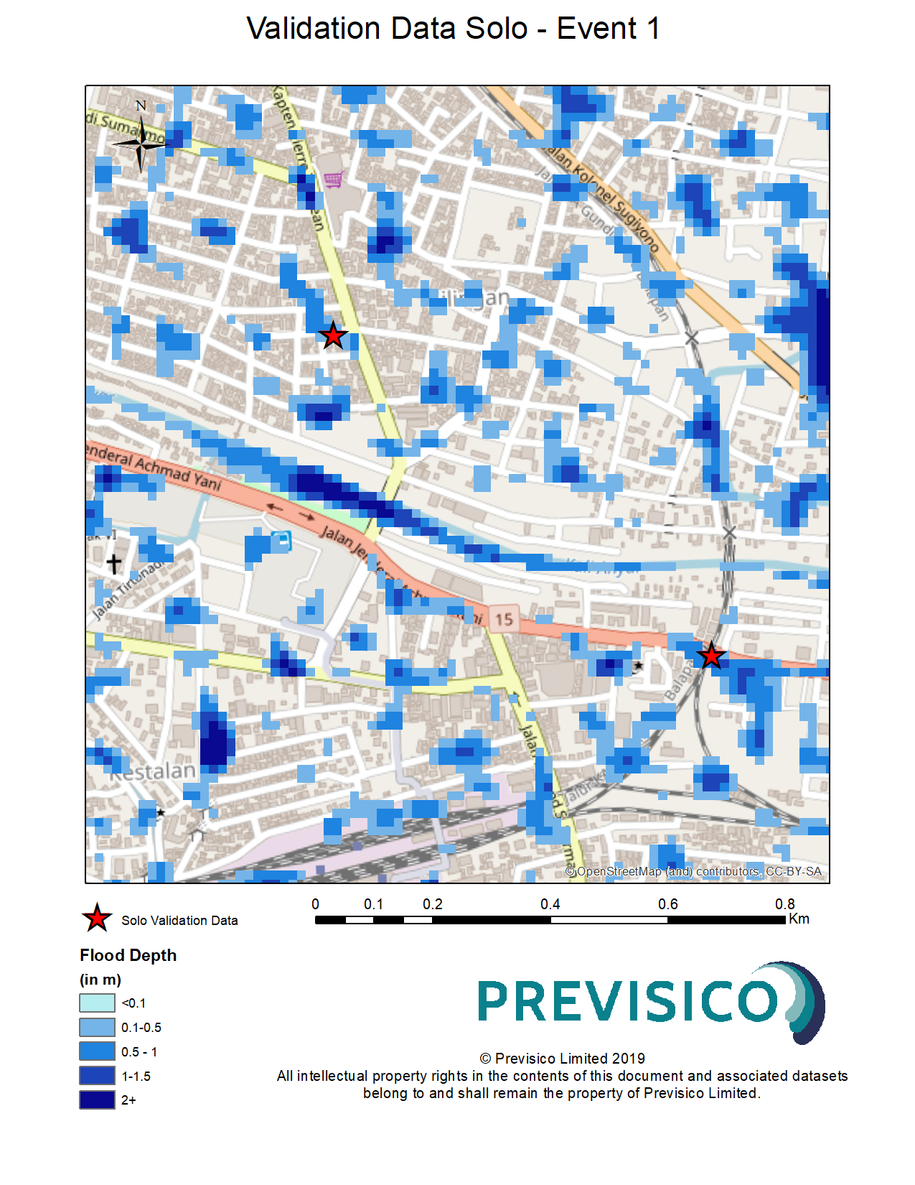
Step 4: Inspect model results

Slide 13
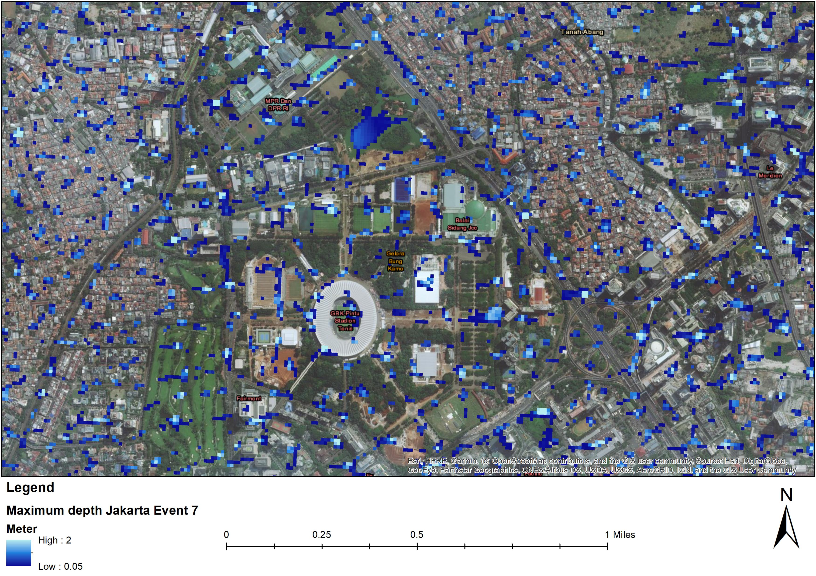
Step 5: Model Calibration

Slide 14
Step 6: Estimating damages
98% of buildings of unknown type
Damage estimated using number of buildings flooded

Slide 15
Rainfall thresholds for flooding

Slide 16
Results: Concurrence of top 10 flood events
Top 10 events
 | Jakarta | Semarang | Solo
Jakarta | x | 0 | 5
Semarang | 4 | x | 9
Solo | 2 | 6 | x
Concurrence with other cities

Slide 17
Concurrence for 4th Jan, 1990 (event 7)
Number of buildings flooded

Slide 18
Correlations between flooded buildings

Slide 19
Conclusions
Losses typically caused from rainfall of 40-50mm over 54 hours
Higher concurrence between Semarang and Solo rainfall than Jakarta for flood events
Strong correlation between cities on number of buildings affected for the top storms
Further studies are required to develop pragmatic approaches to complement catastrophe modelling that integrate the spatial correlation between flood damages in cities.

Slide 20
Thanks for listening!
avinoam.baruch@previsico.com
@Previsico
@Previsico

