Slide 1
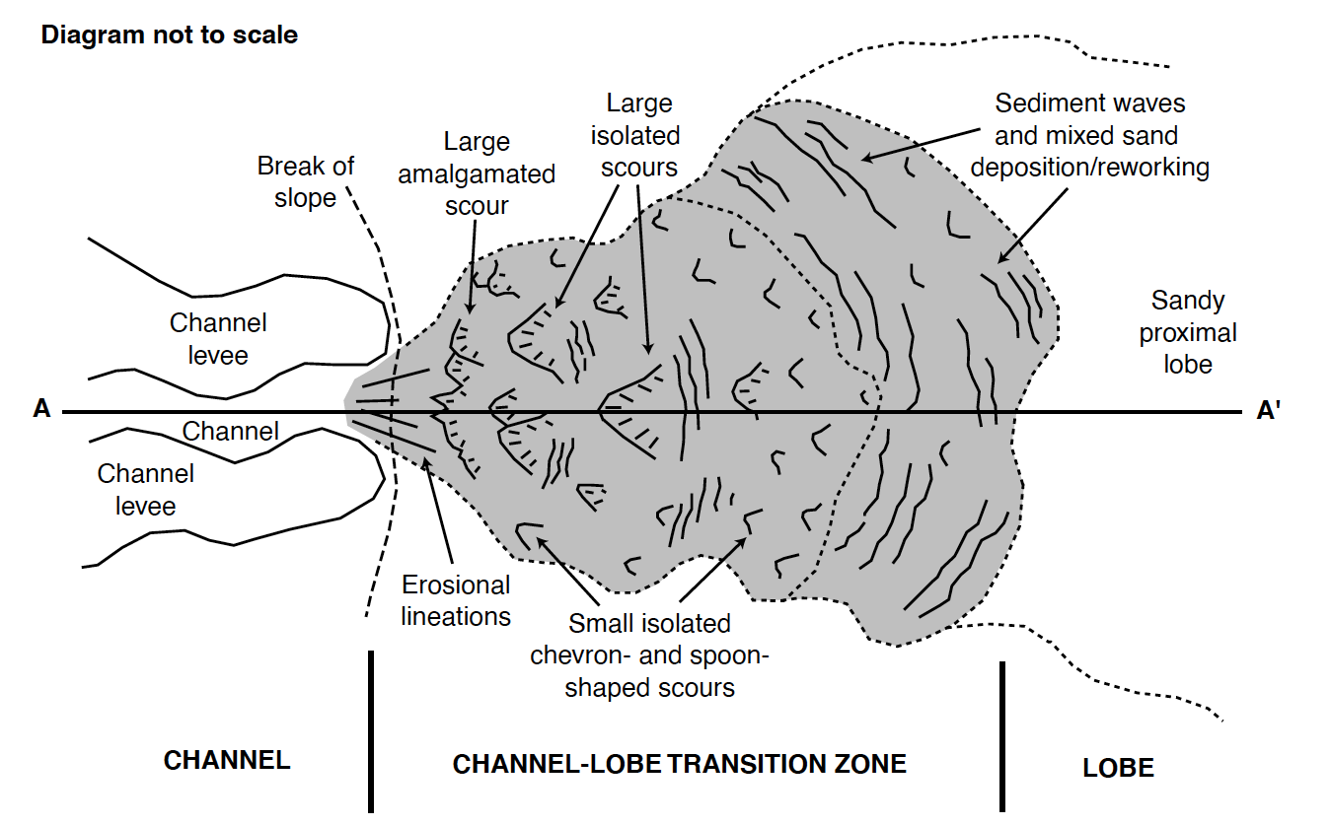

NEW INSIGHTS INTO THE INTERNAL STRUCTURE OF TURBIDITE DEPOSITS FROM PHYSICAL MODELLING OF RELEVANT EROSIONAL AND DEPOSITIONAL PROCESSES
SSP 3.5 PICO
How does system topography control the evolution of base of slope systems, their flow process, and resulting sedimentation patterns?
Jonathan Wilkin (University of Dundee); A. Cuthbertson (University of Dundee); S. Dawson (University of Dundee); D. Stow (Heriot-Watt University); K. Stephen (Heriot-Watt University); U. Nicholson (Heriot-Watt University); N. Penna (University of Calabria); B. Cullen (Cairn Energy)
Processes within CLTZ’s
Loss of Confinement
Base of Slope
Not every system has a ‘clear CLTZ connecting well-developed channels to well developed lobes’ (Mutti and Normark, 1979).
Systems vary as a result of upslope activity, slope break severity, and loss of confinement style.
This presentation has an attached audio
Wynn et al., 2002
Notes:
Hi everyone, thanks for downloading this e-version of my PICO presentation.
If you have any questions, please contact me on jzwilkin@dundee.ac.uk

Slide 2
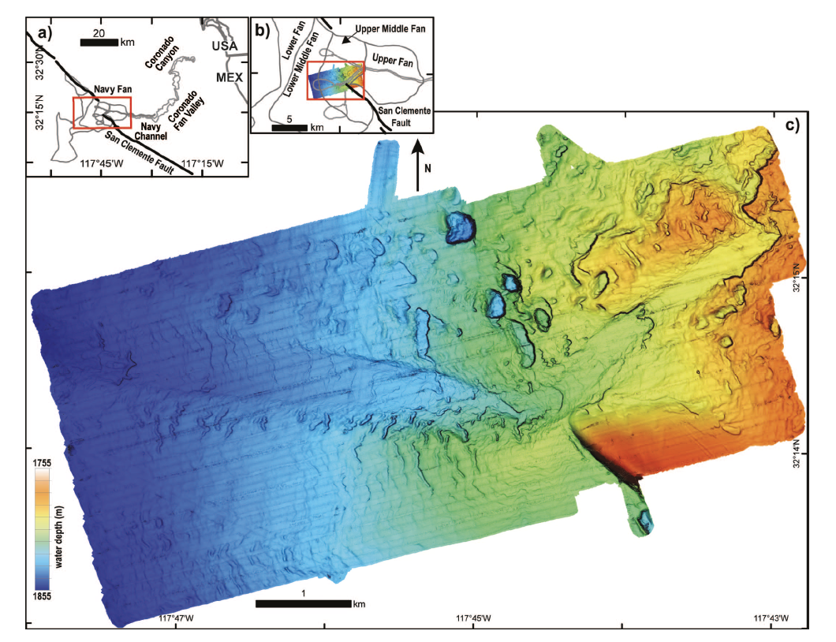
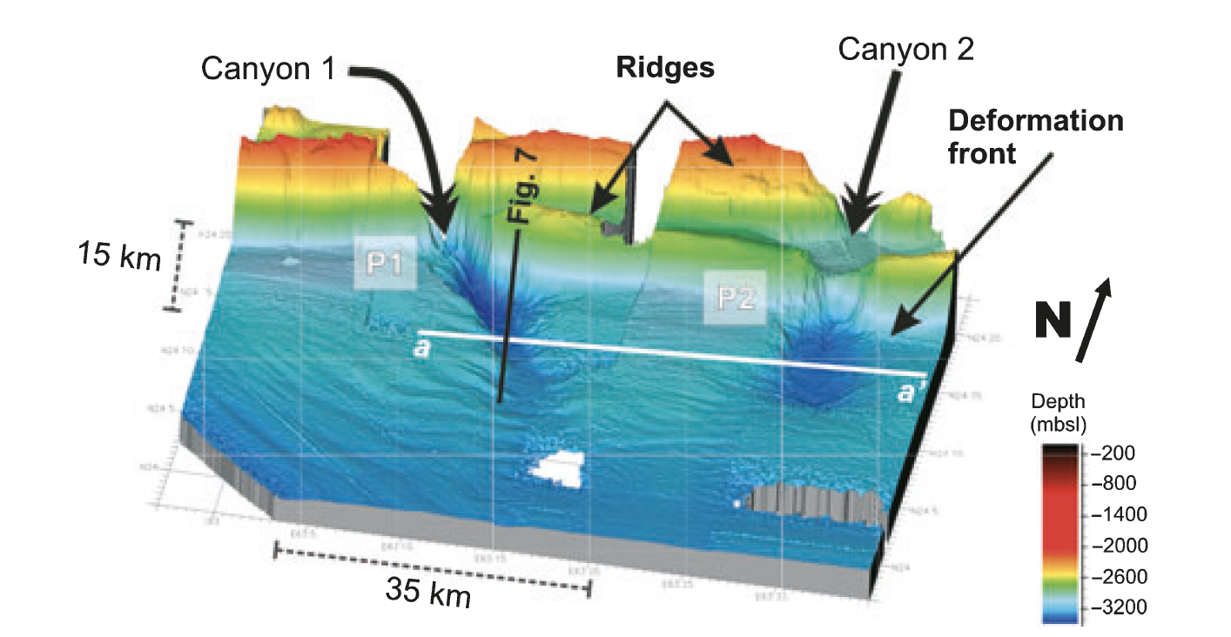
End-Member Systems
Gradual (Navy Fan) Carvajal et al., 2017
Abrupt (Makran Margin) Bourget et al., 2010
Vs

Slide 3
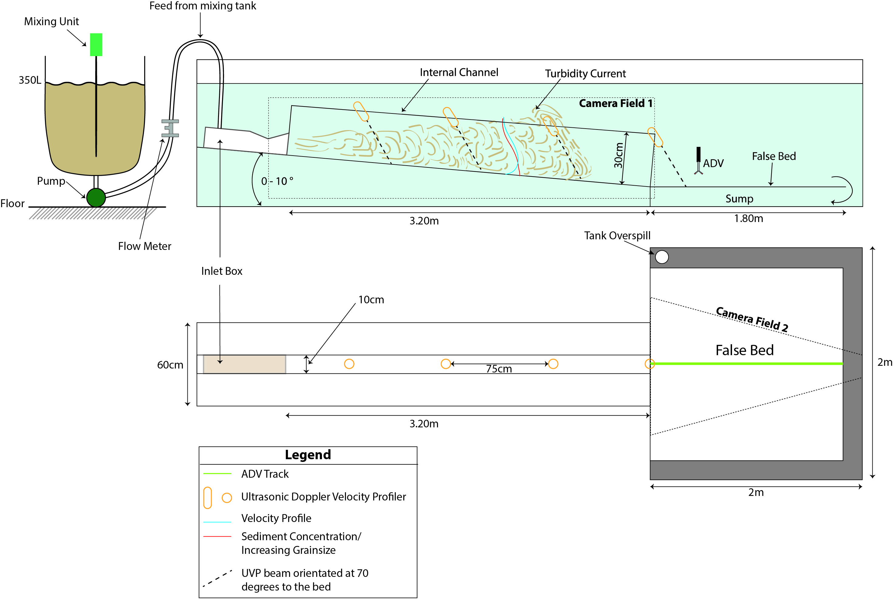
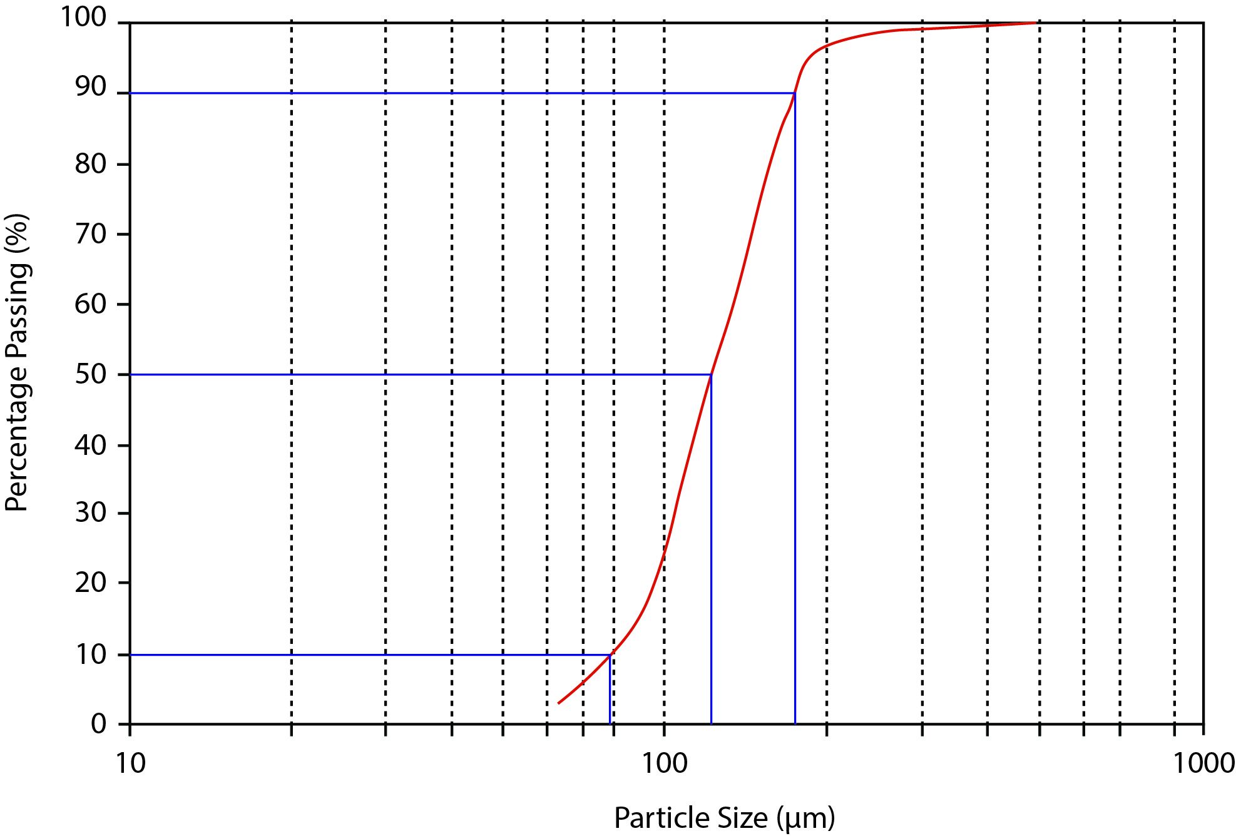
NEW INSIGHTS INTO THE INTERNAL STRUCTURE OF TURBIDITE DEPOSITS FROM PHYSICAL MODELLING OF RELEVANT EROSIONAL AND DEPOSITIONAL PROCESSES
SSP 3.5 PICO

Slide 4
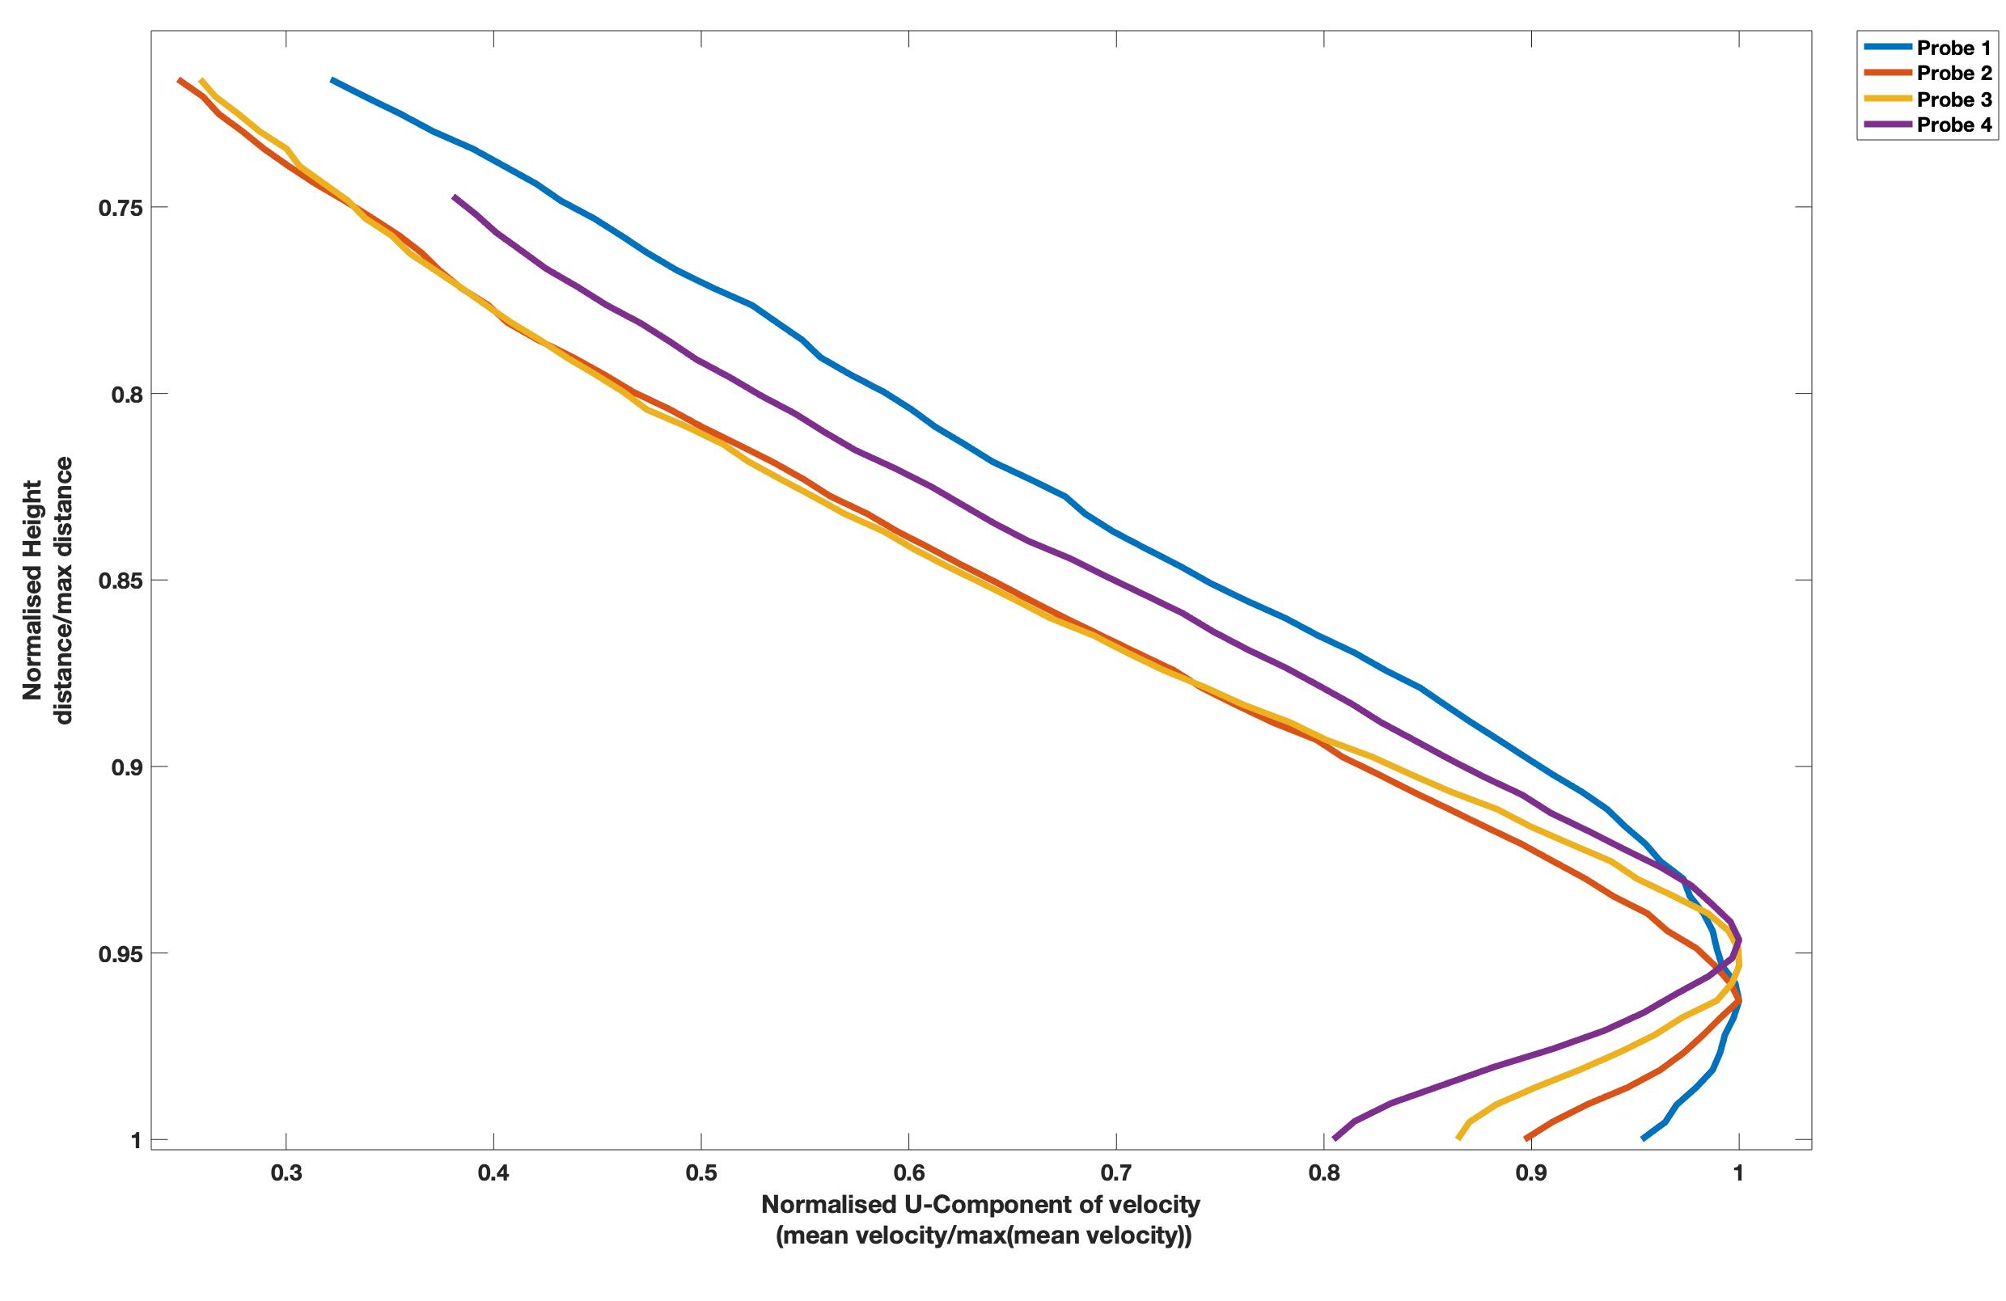
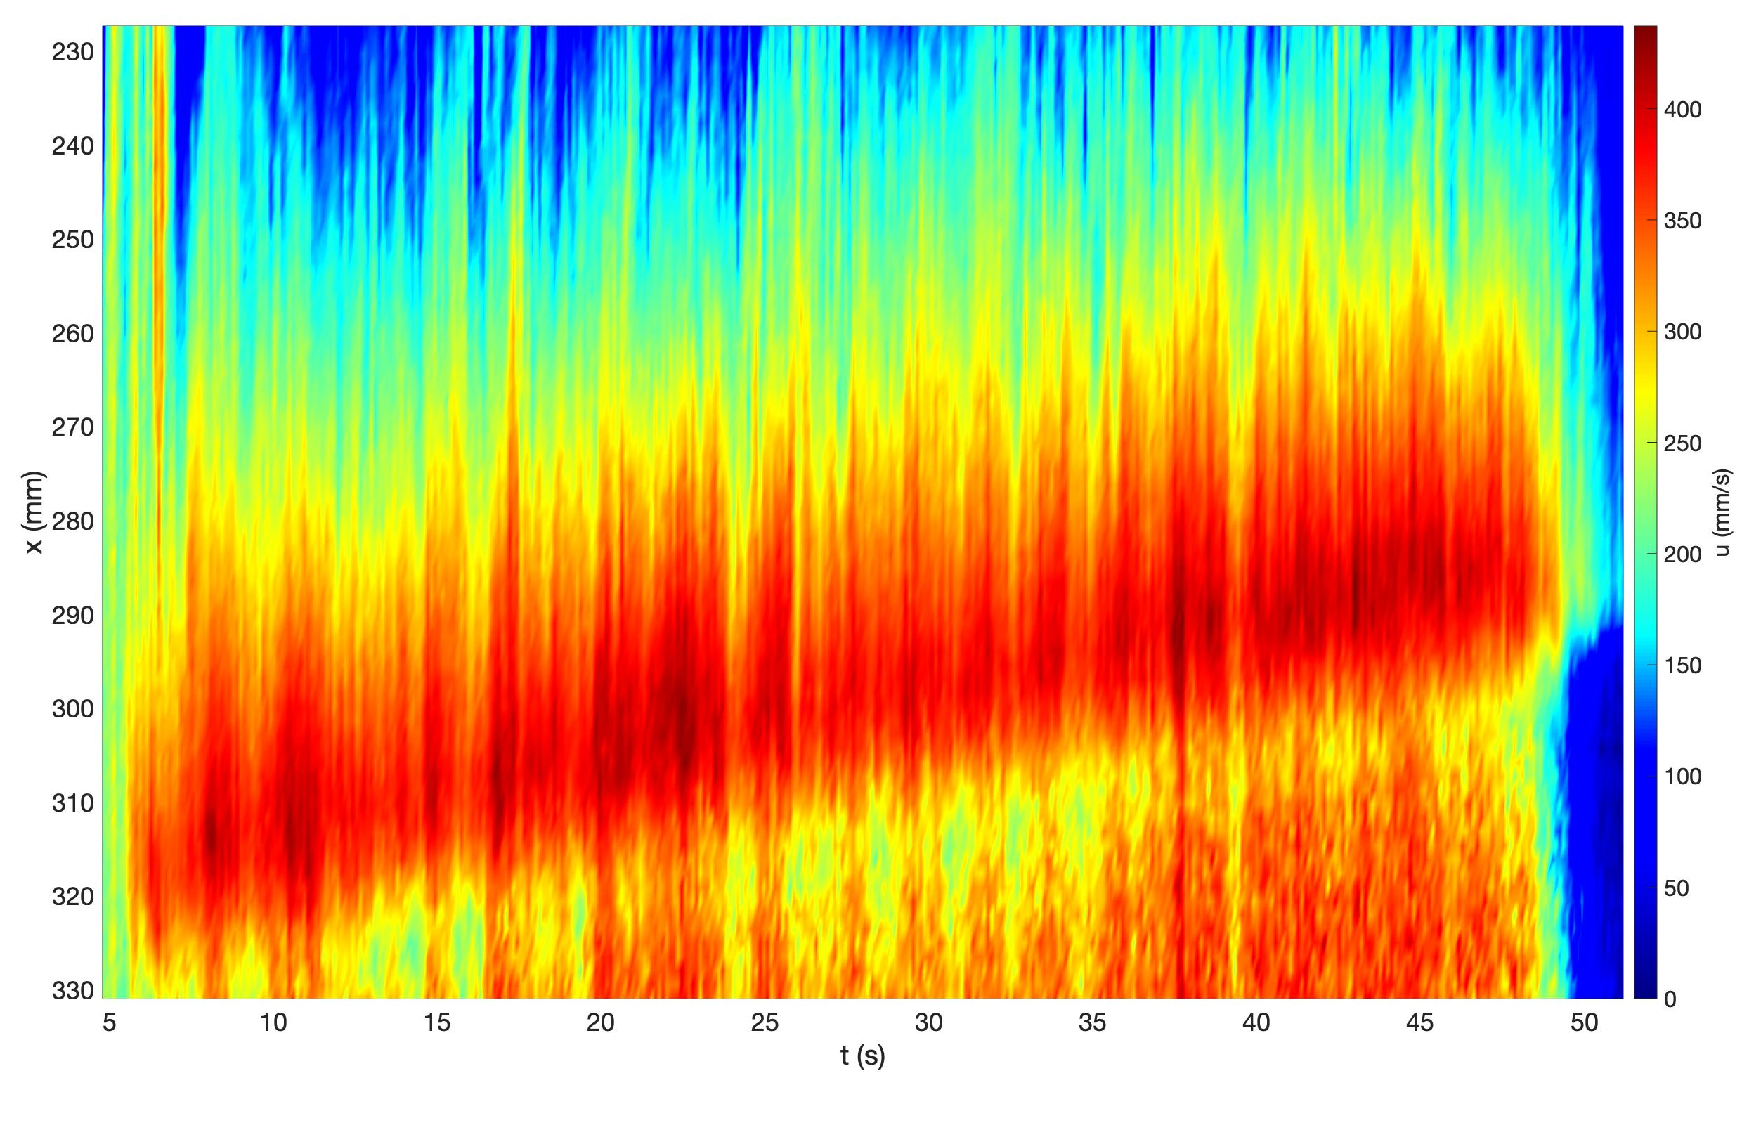
NEW INSIGHTS INTO THE INTERNAL STRUCTURE OF TURBIDITE DEPOSITS FROM PHYSICAL MODELLING OF RELEVANT EROSIONAL AND DEPOSITIONAL PROCESSES
SSP 3.5 PICO

Slide 5
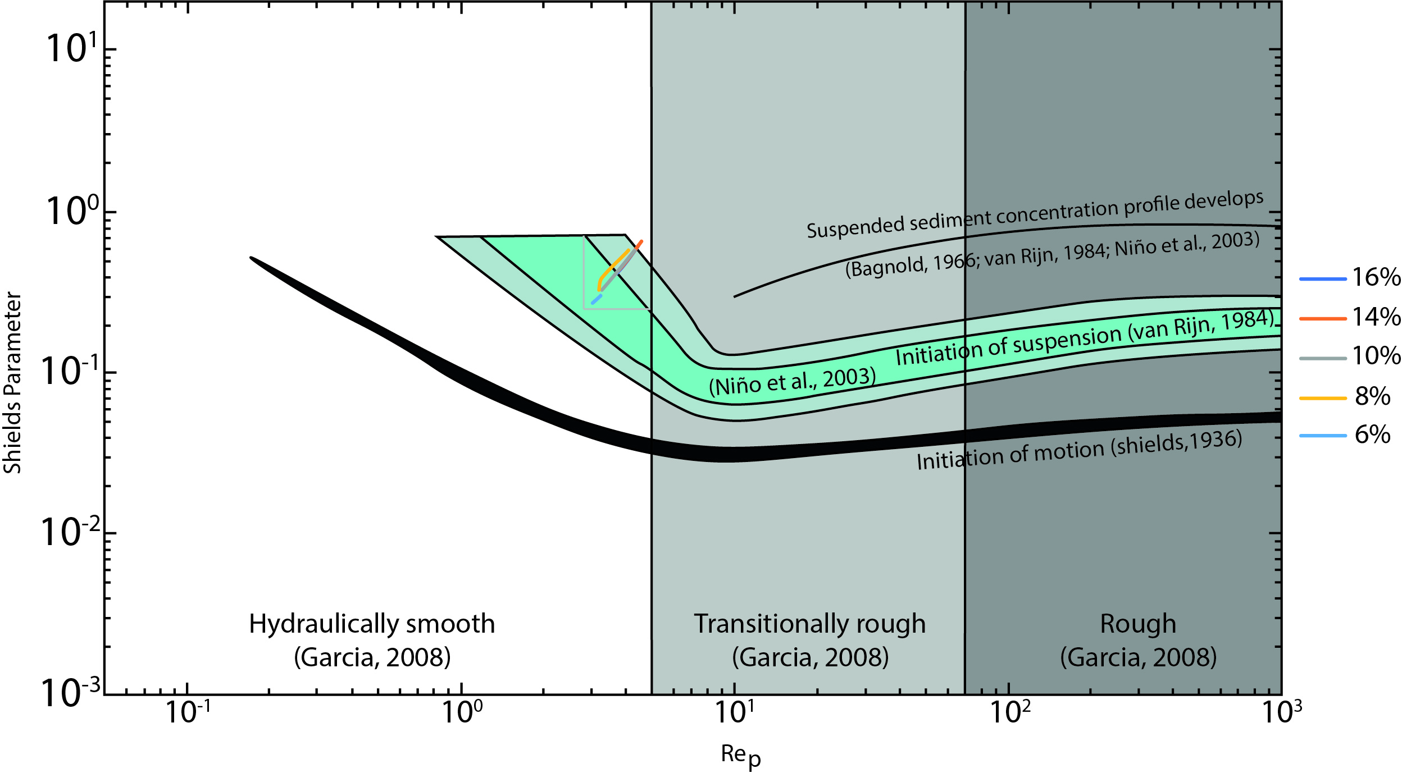
NEW INSIGHTS INTO THE INTERNAL STRUCTURE OF TURBIDITE DEPOSITS FROM PHYSICAL MODELLING OF RELEVANT EROSIONAL AND DEPOSITIONAL PROCESSES
SSP 3.5 PICO
All flows are supercritical as they leave confinement, however, all flows where net depositional whilst confined to the channel.
It is expected that the shear values increased dramatically upon leaving confinement, as the flows structure collapses.

Slide 6
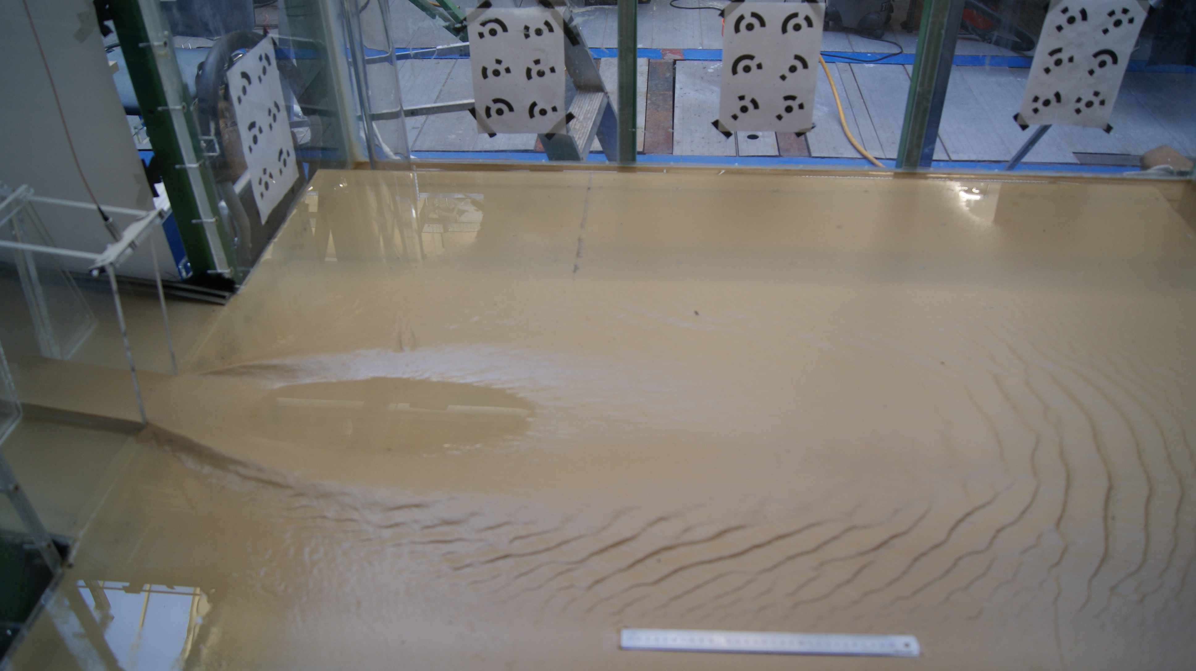


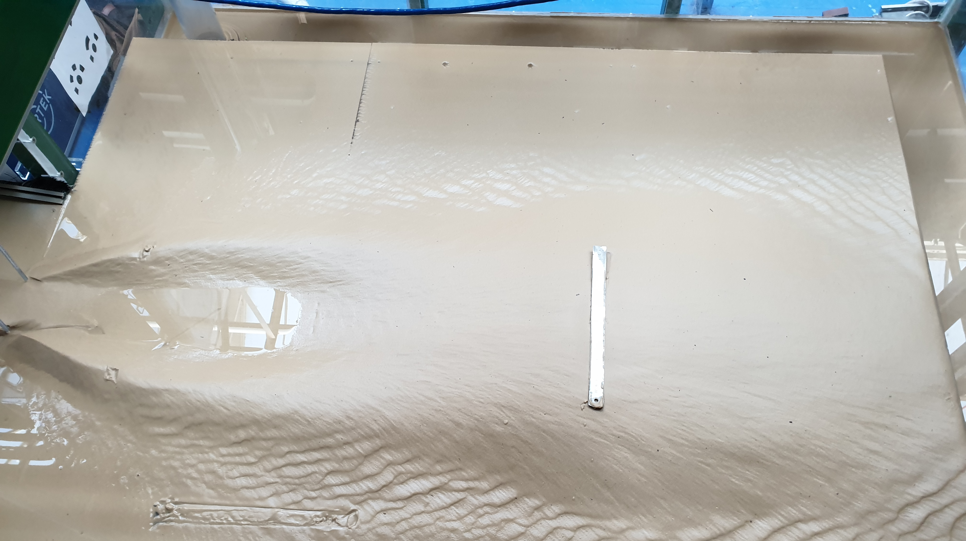
NEW INSIGHTS INTO THE INTERNAL STRUCTURE OF TURBIDITE DEPOSITS FROM PHYSICAL MODELLING OF RELEVANT EROSIONAL AND DEPOSITIONAL PROCESSES
SSP 3.5 PICO
6%
Lobe elements
Scours
16%

Slide 7
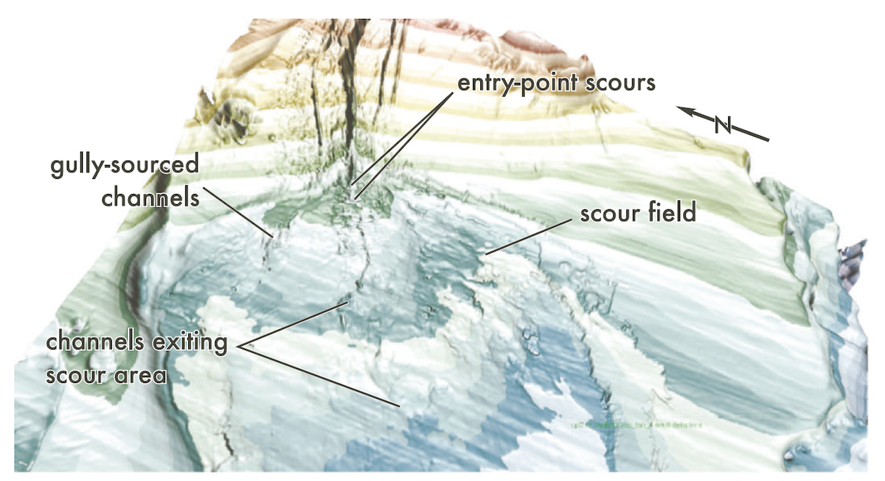
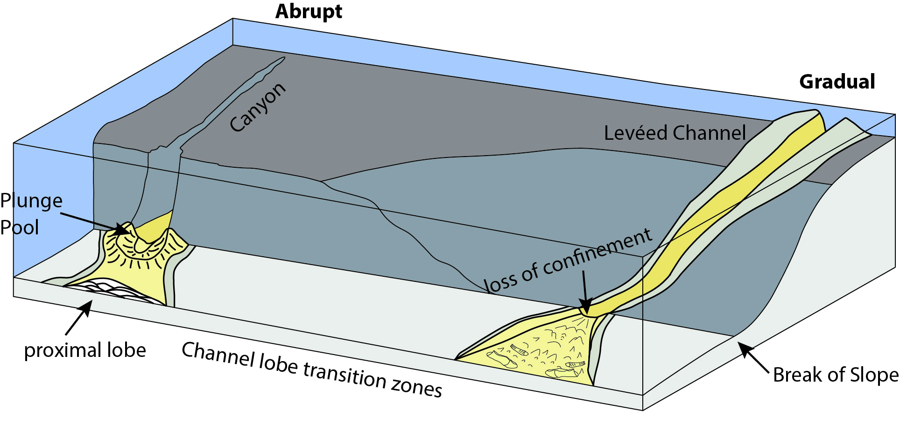
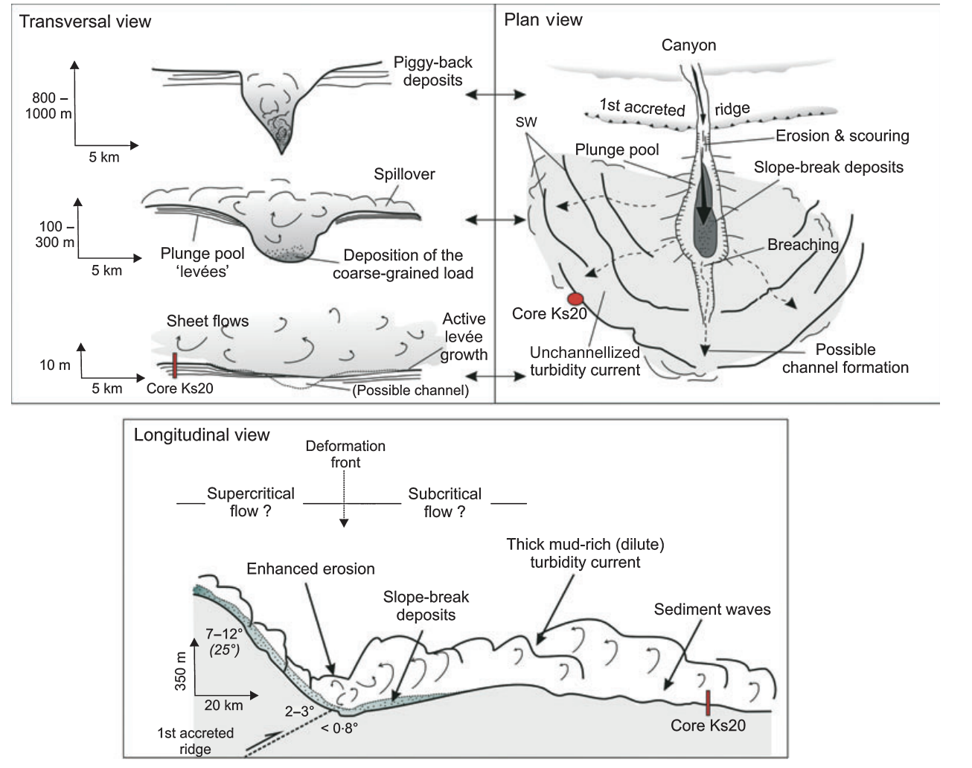
NEW INSIGHTS INTO THE INTERNAL STRUCTURE OF TURBIDITE DEPOSITS FROM PHYSICAL MODELLING OF RELEVANT EROSIONAL AND DEPOSITIONAL PROCESSES
SSP 3.5 PICO
Conclusions
Prather et al., 2012
Next stages of this work:
DEM models of the sedimentation patterns produced by SGF’s over an initially erodible bed.
How do flow processes in these environment vary to those of gradual systems.
Bourget et al., 2010

