Slide 1
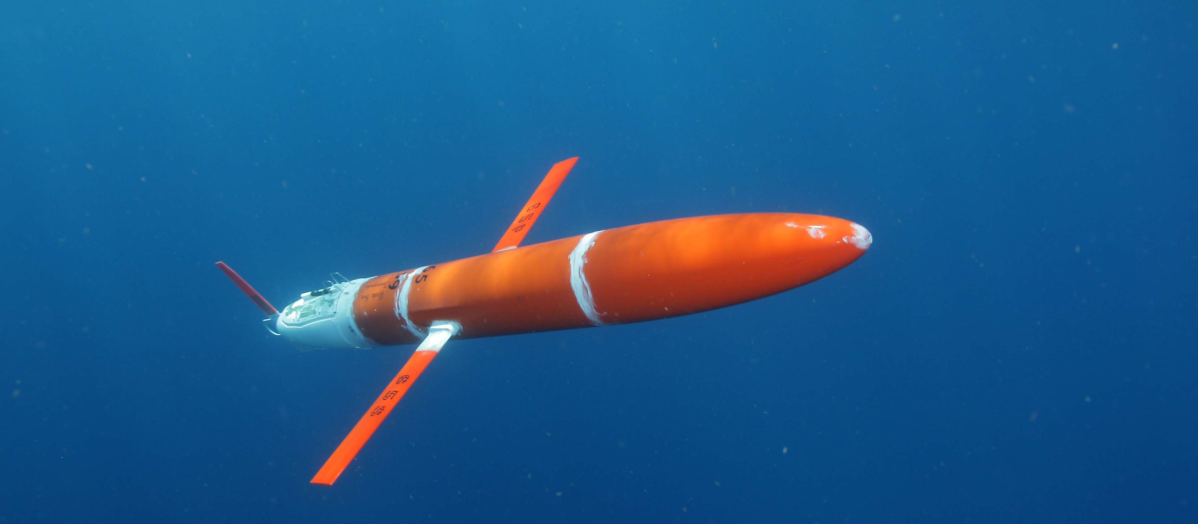

Along-stream evolution of Gulf Stream volume transport and water properties from underwater glider observations
Joleen Heiderich^{1,2}
Robert E. Todd¹
¹ Woods Hole Oceanographic Institution
² Massachusetts Institute of Technology
Notes:
AMOC projected to change due to global warming
=> need to understand Gulf Stream dynamics in the present climate

Slide 2
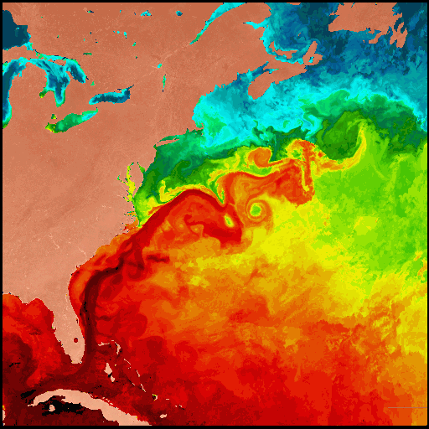
The Gulf Stream Contributes to Poleward Heat and Volume Transport
Circulation at depth:
Deep Western Boundary Current
Intermediate water masses
in the Gulf Stream:
Upper Labrador Sea Water
is carried southward in the Deep Western Boundary Current and encounters the Gulf Stream at Cape Hatteras
Antarctic Intermediate Water enters the Gulf Stream through the Florida Strait
Cape Hatteras
Circulation at the surface: warm, salty
Gulf Stream
Florida Strait
[https://marine.coastal.edu/gulfstream/gs6.gif ]
Notes:
Remotely formed intermediate waters (e.g., Antarctic Intermediate Water, upper Labrador Sea Water) get entrained in the Gulf Stream

Slide 3
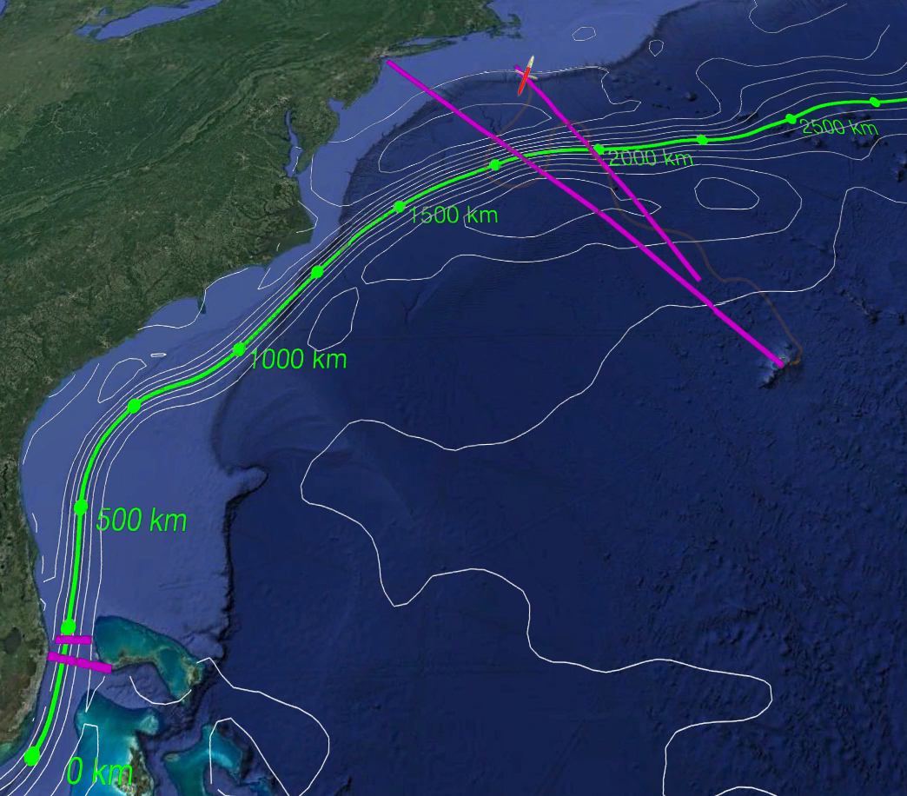
Gliders Fill Gap in Long-Term Subsurface Gulf Stream Observations
See Robert Todd’s presentation (#3745) for Gulf Stream MKE and EKE from gliders
Statistics:
2004 – present
28 complete missions
195 crossings
(177 with AD2CP)
~ 17,000 profiles
> 2,100 glider-days
> 81,000 km over ground
Line W
(2004 - 2014)
M/V Oleander
(1992 - present)
What about the
1500 km in between?
Western Boundary
Time Series
(1982 - present)
Notes:
CTD and ADCP!
Charleston Bump

Slide 4
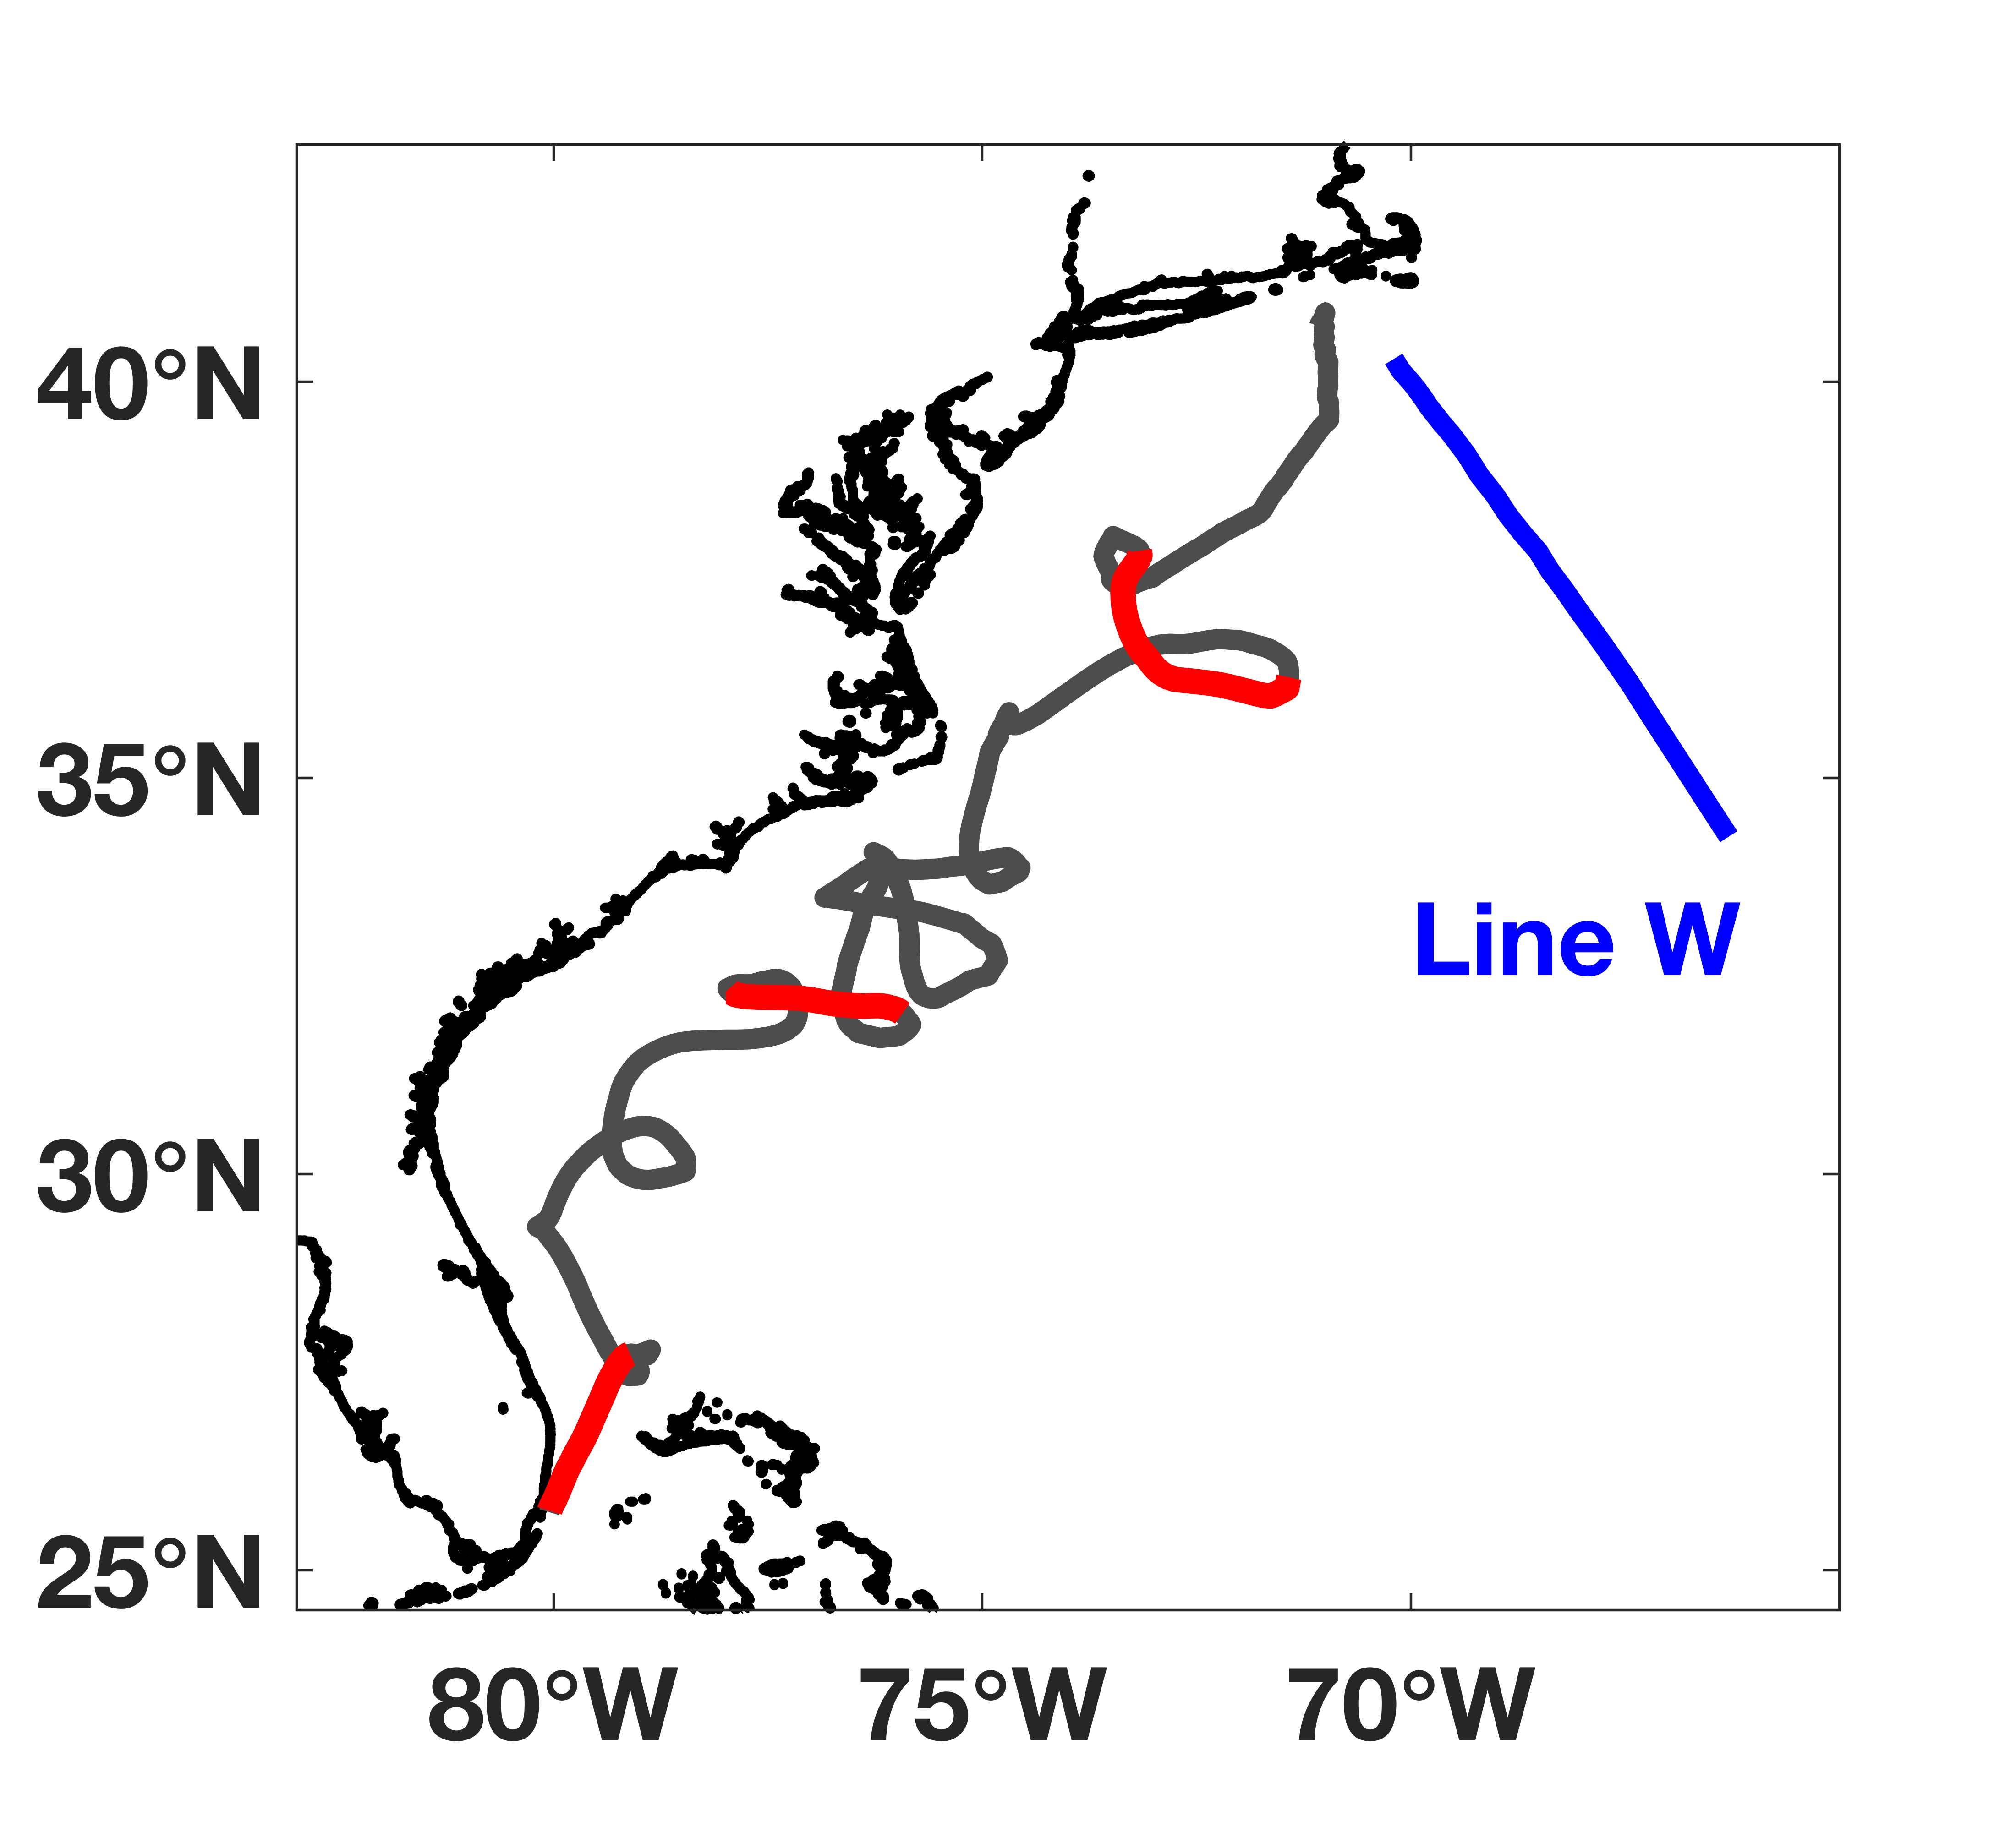
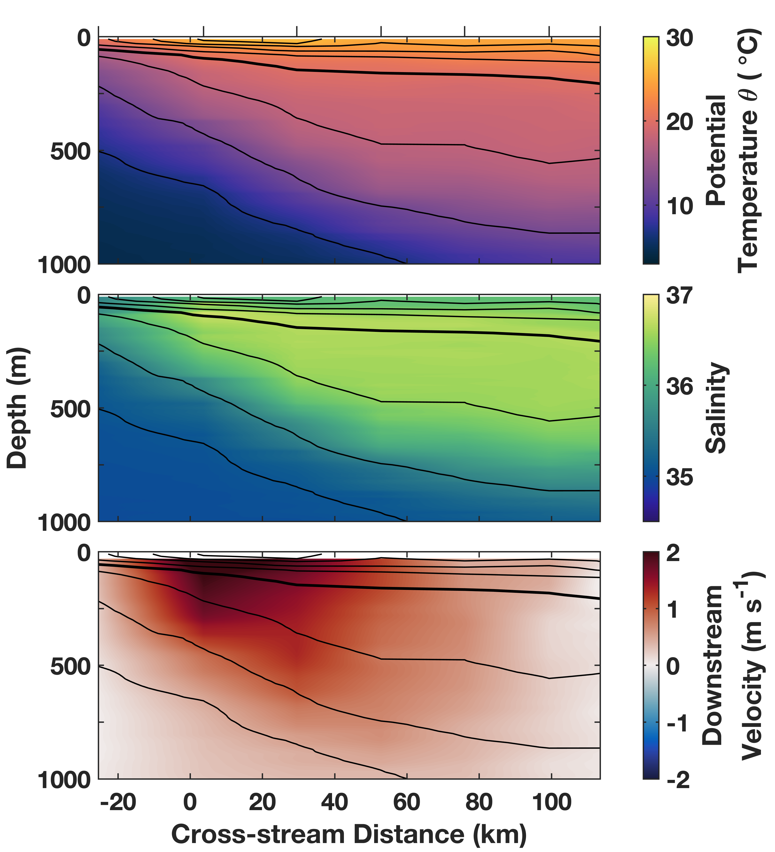
Observations: Example Cross-Gulf Stream Transects
Gliders
Line W
Notes:
Transects with cross-stream distance as horizontal coordinate
Transects are from missions:
Glider: 19306601 (March – June 2019)
Line W: May 2013

Slide 5
Along-stream Increase of Volume Transports
[Meinen et al.,
2010, DSR]
[Andres et al.,
2020, DSR]

Slide 6
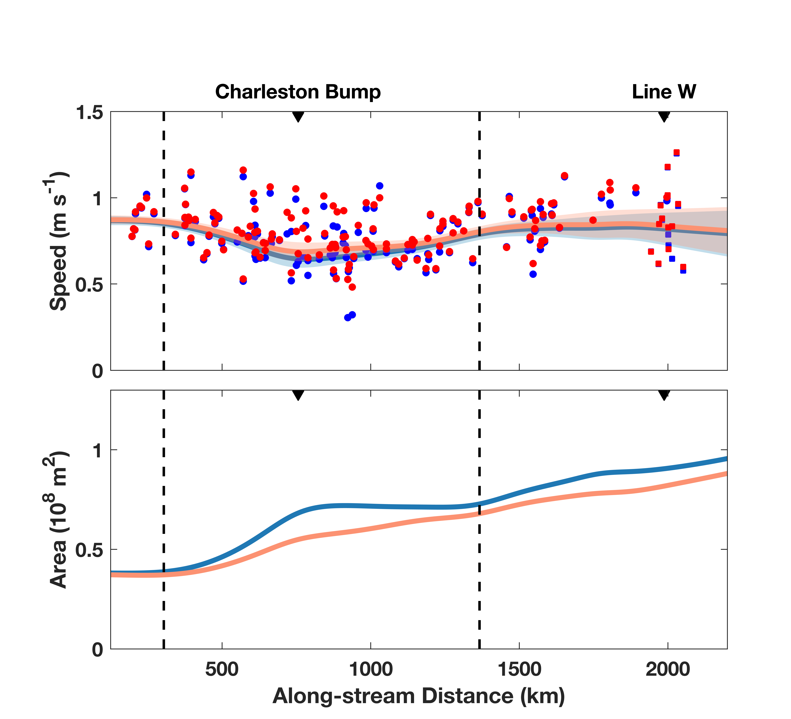
Increase of Volume Transports: Due to Increase in Speed or Area?
Speed does not change much
Transport increase mostly due
to increase in Gulf Stream area

Slide 7
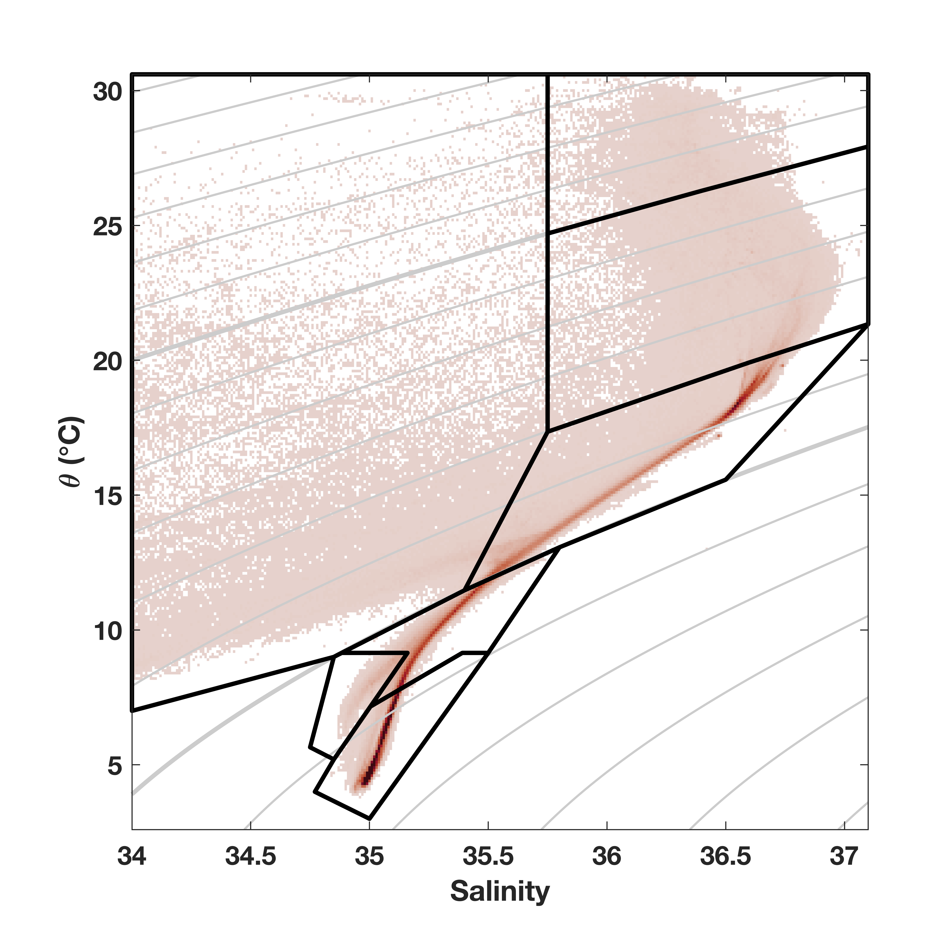
Which Waters Contribute to the Transport Increase?
Surface Waters (SW)
Mid Atlantic Bight Waters (MABW)
Thermocline Waters (TW)
Eighteen Degree Water (EDW)
Intermediate Water (IW)
Antarctic Intermediate Water (AAIW)
Upper Labrador Sea Water (uLSW)

Slide 8
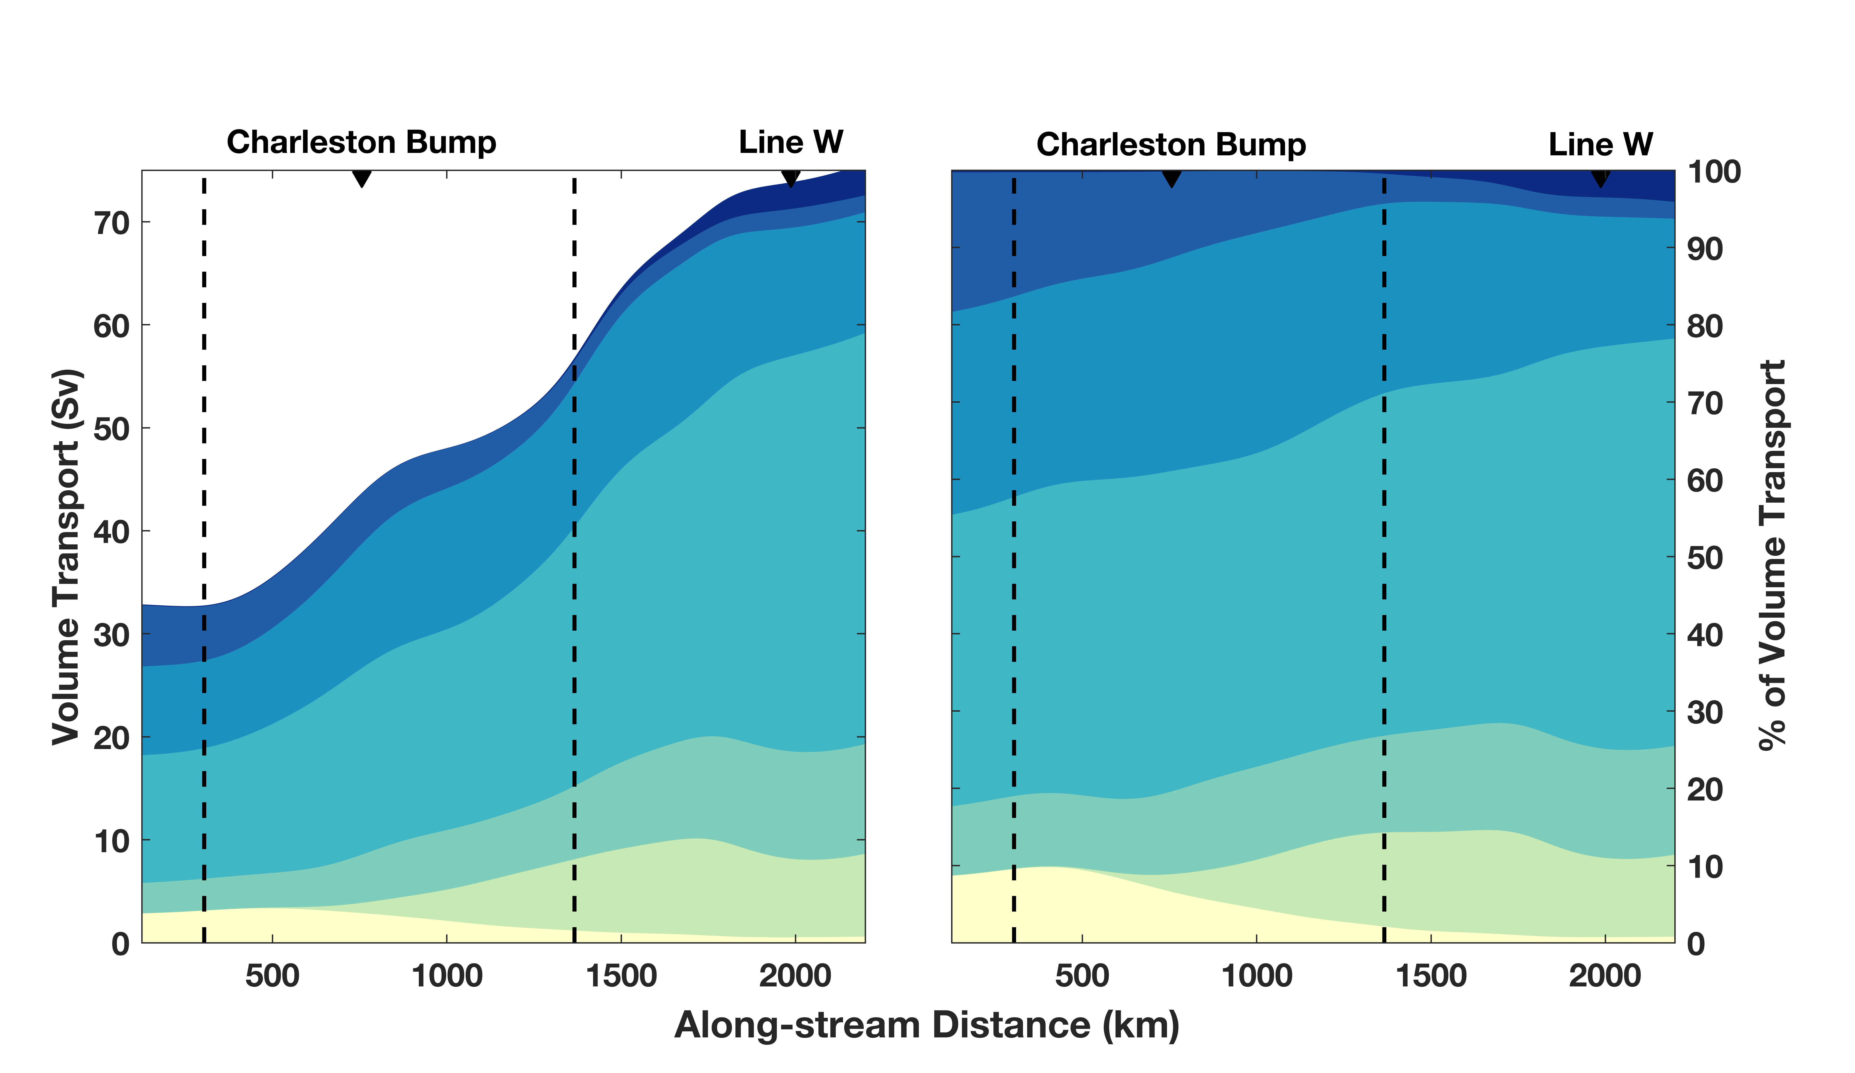
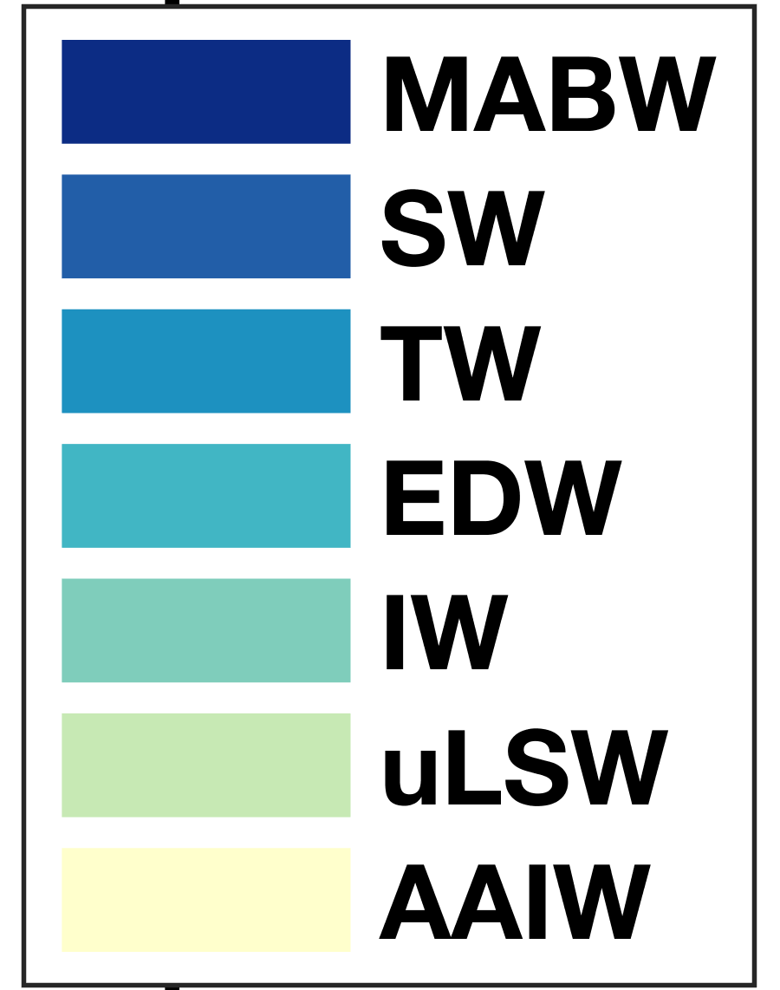
Volume Transport by Water Class
Volume transport increases due to entrainment of sub-thermocline waters

Slide 9
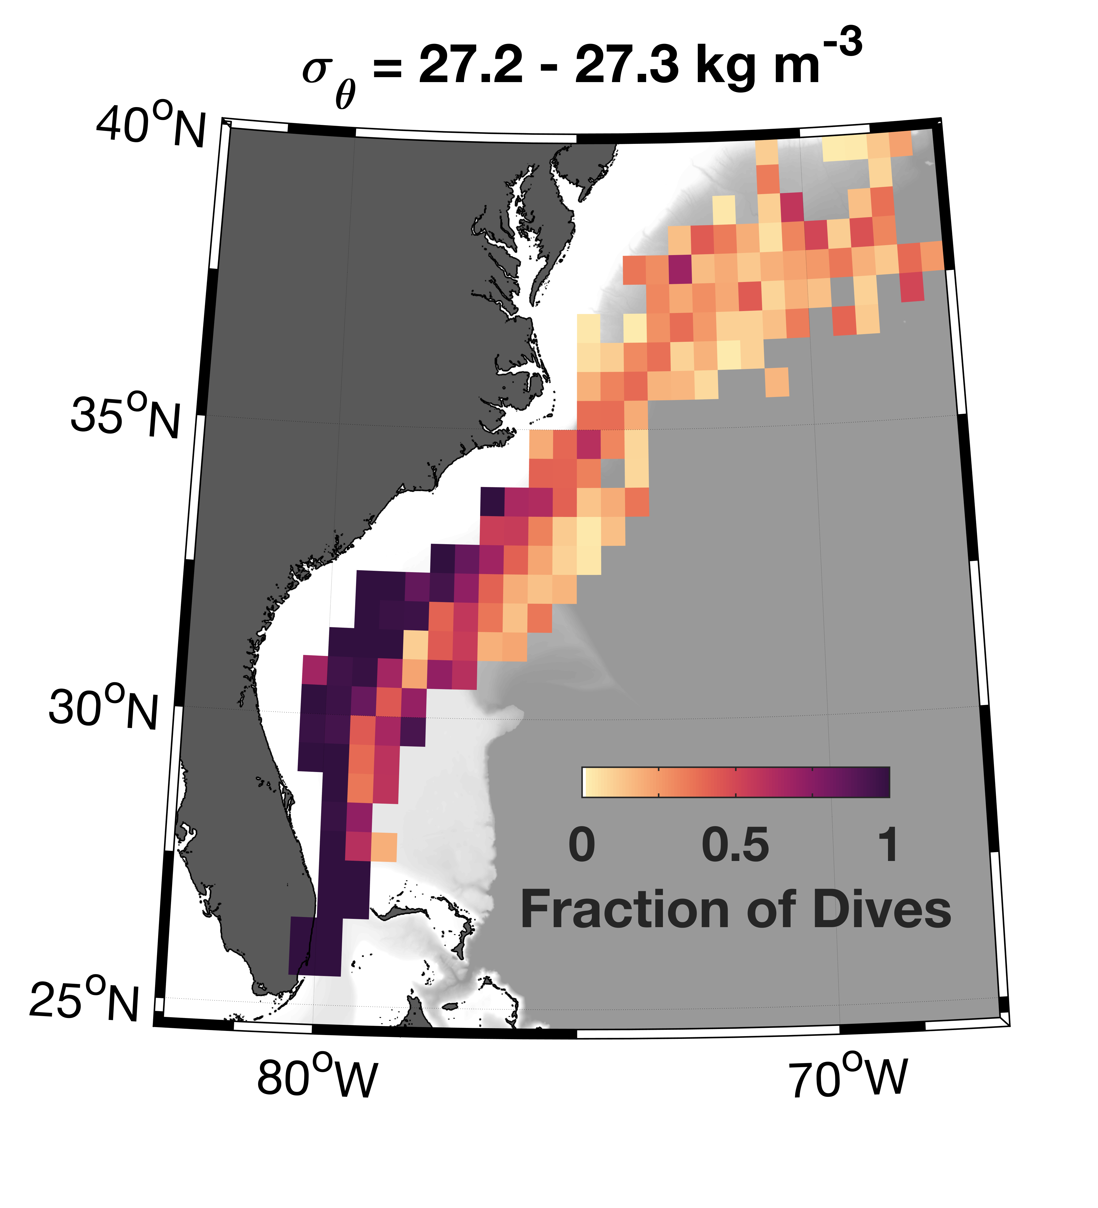
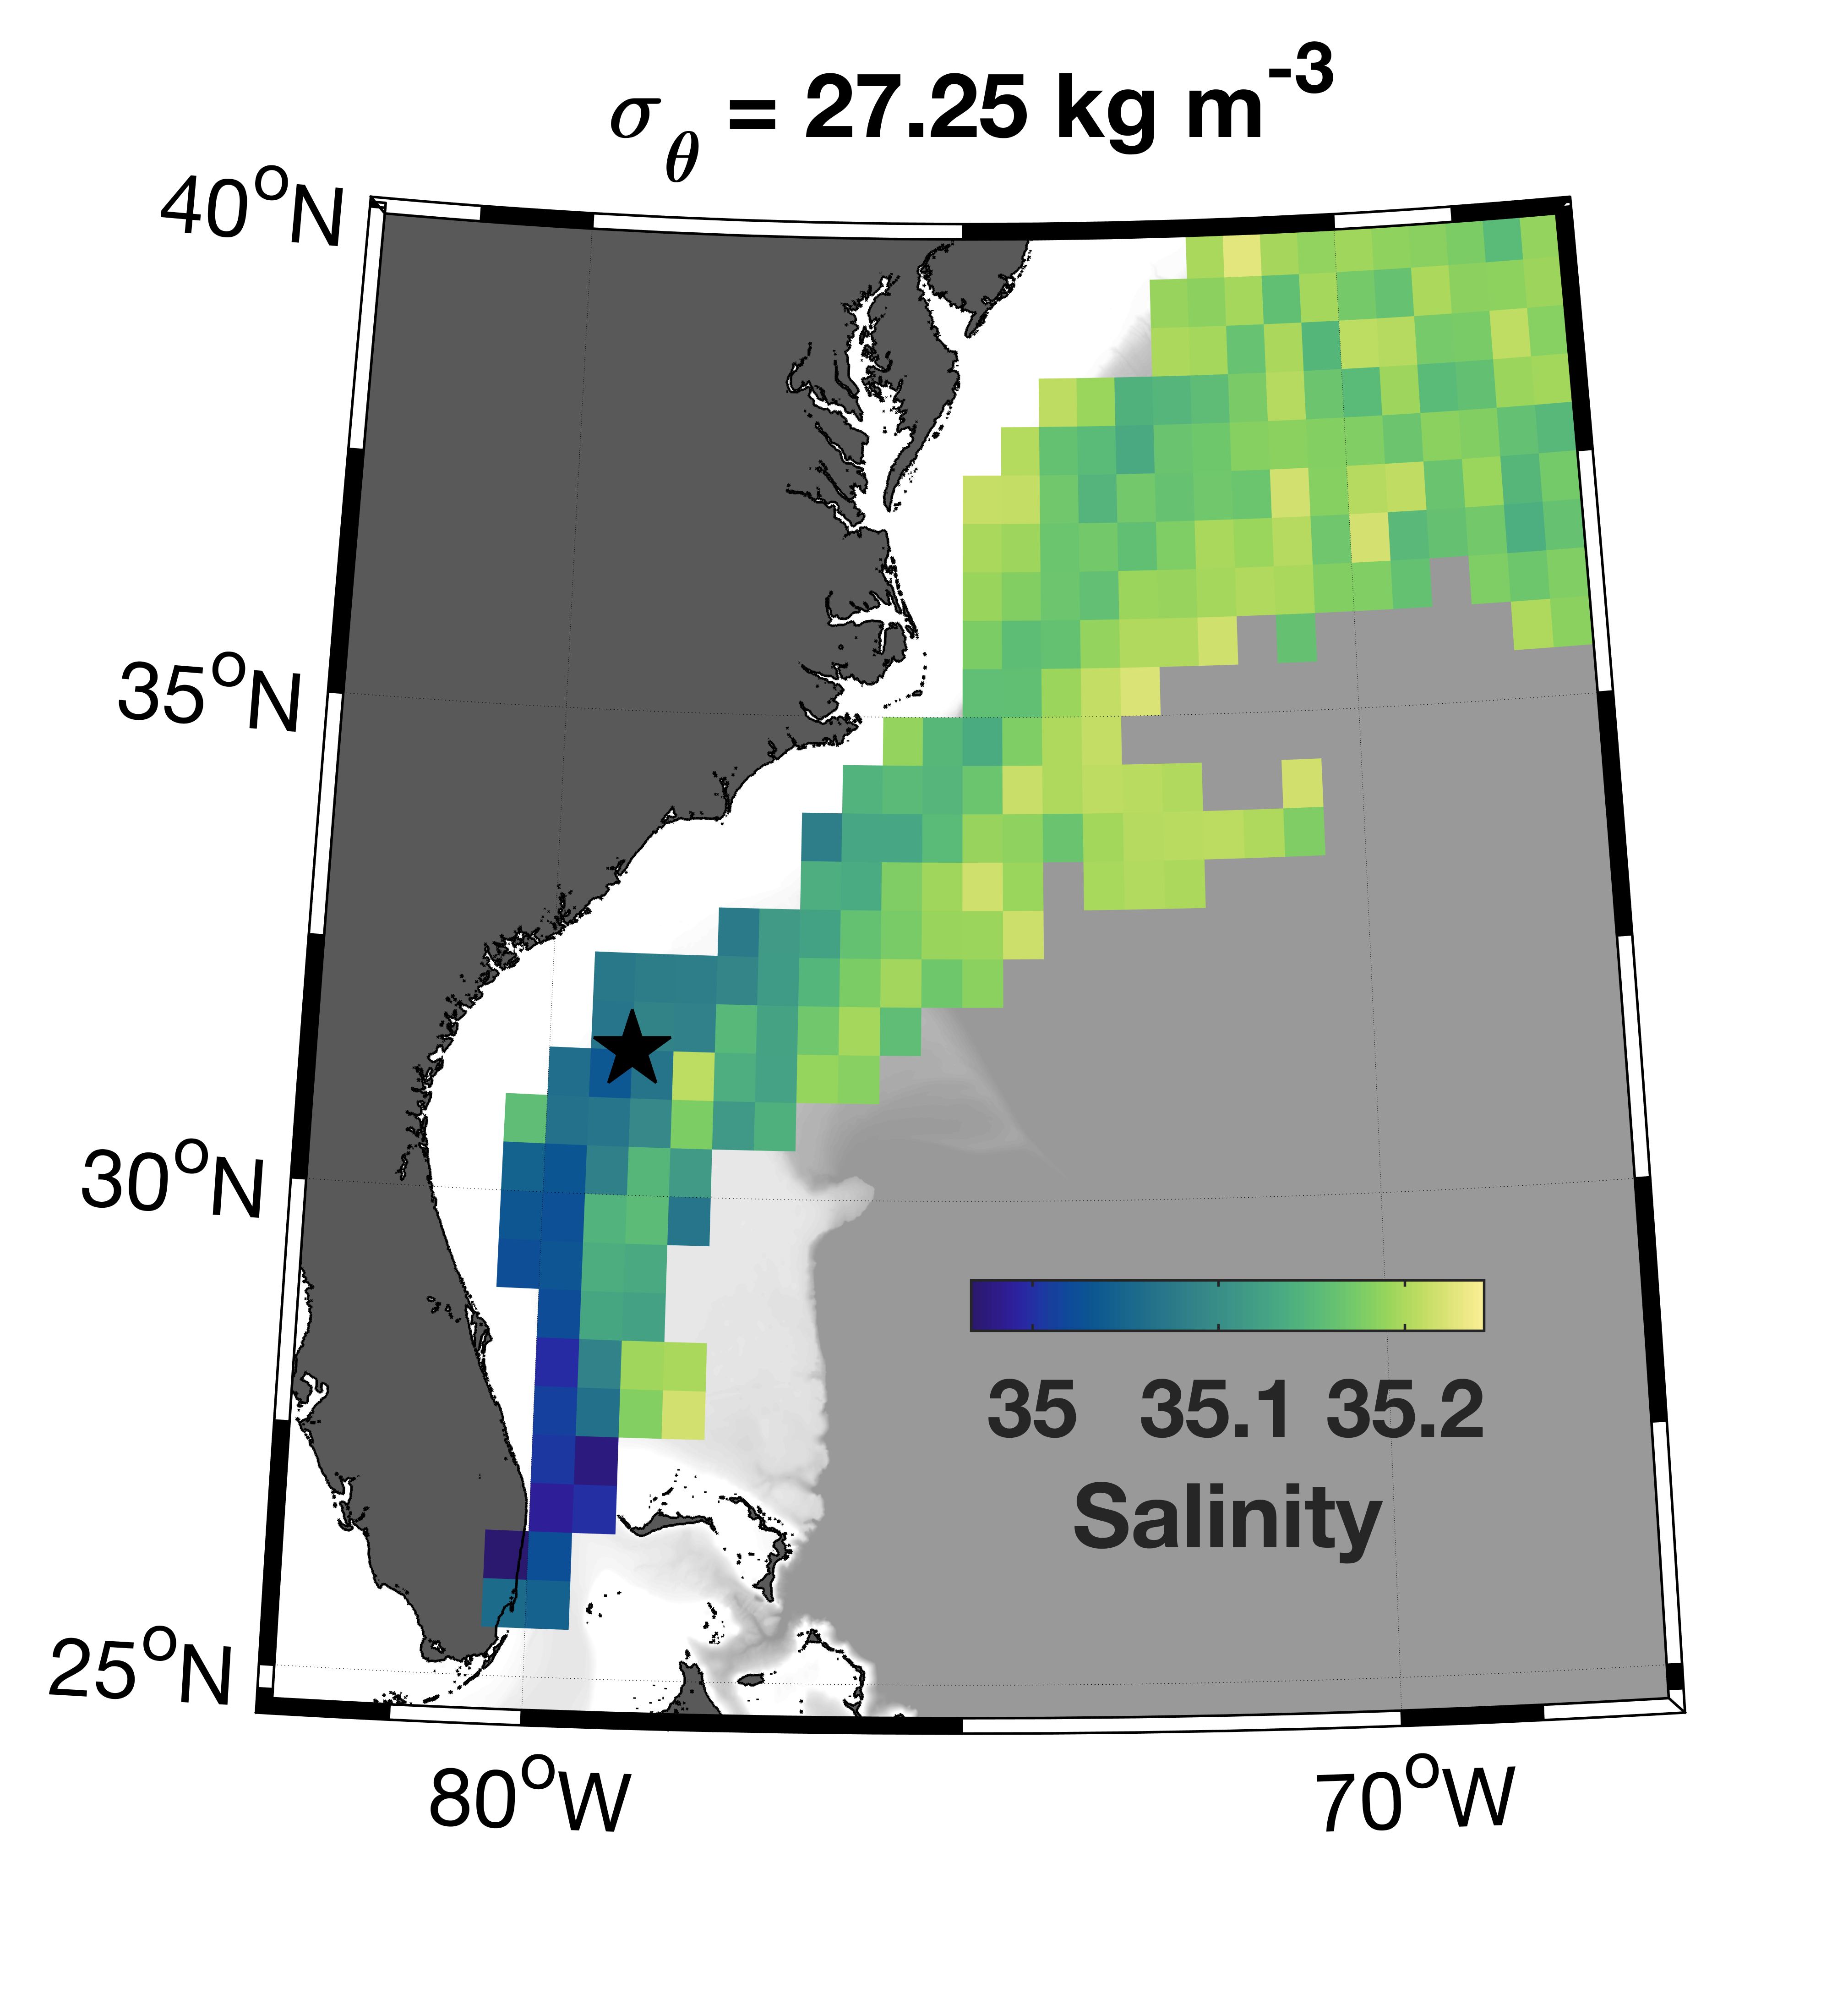
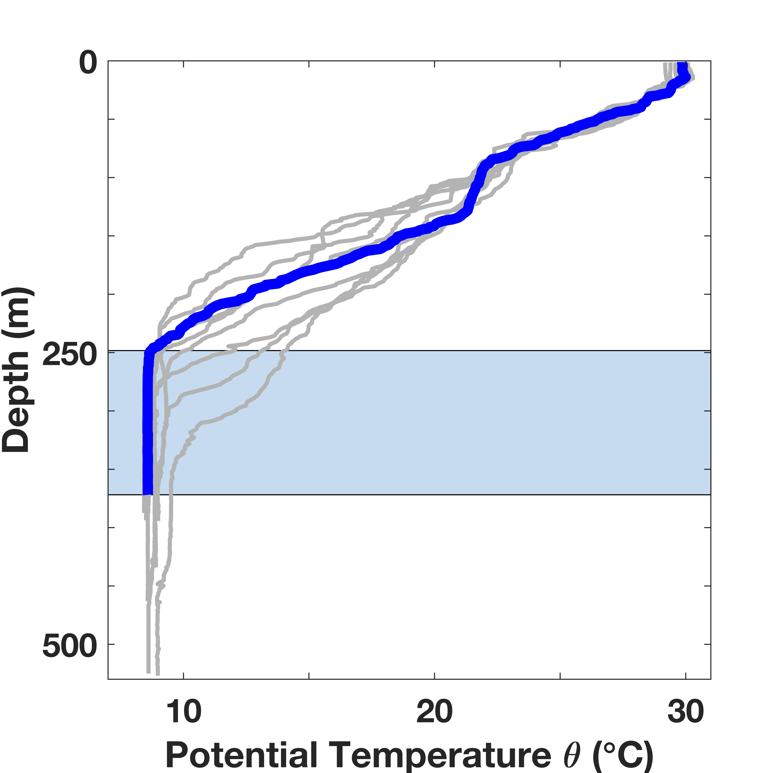
Antarctic Intermediate Water (AAIW) likely Eroded Away due to Bottom Mixing
[Todd, 2017, GRL]
Thick bottom
mixed layer
Charleston Bump
with AAIW
AAIW enters the Gulf Stream through the Florida Strait
Indication of bottom mixing
near the Charleston Bump
Notes:
Benthic front erosion

Slide 10
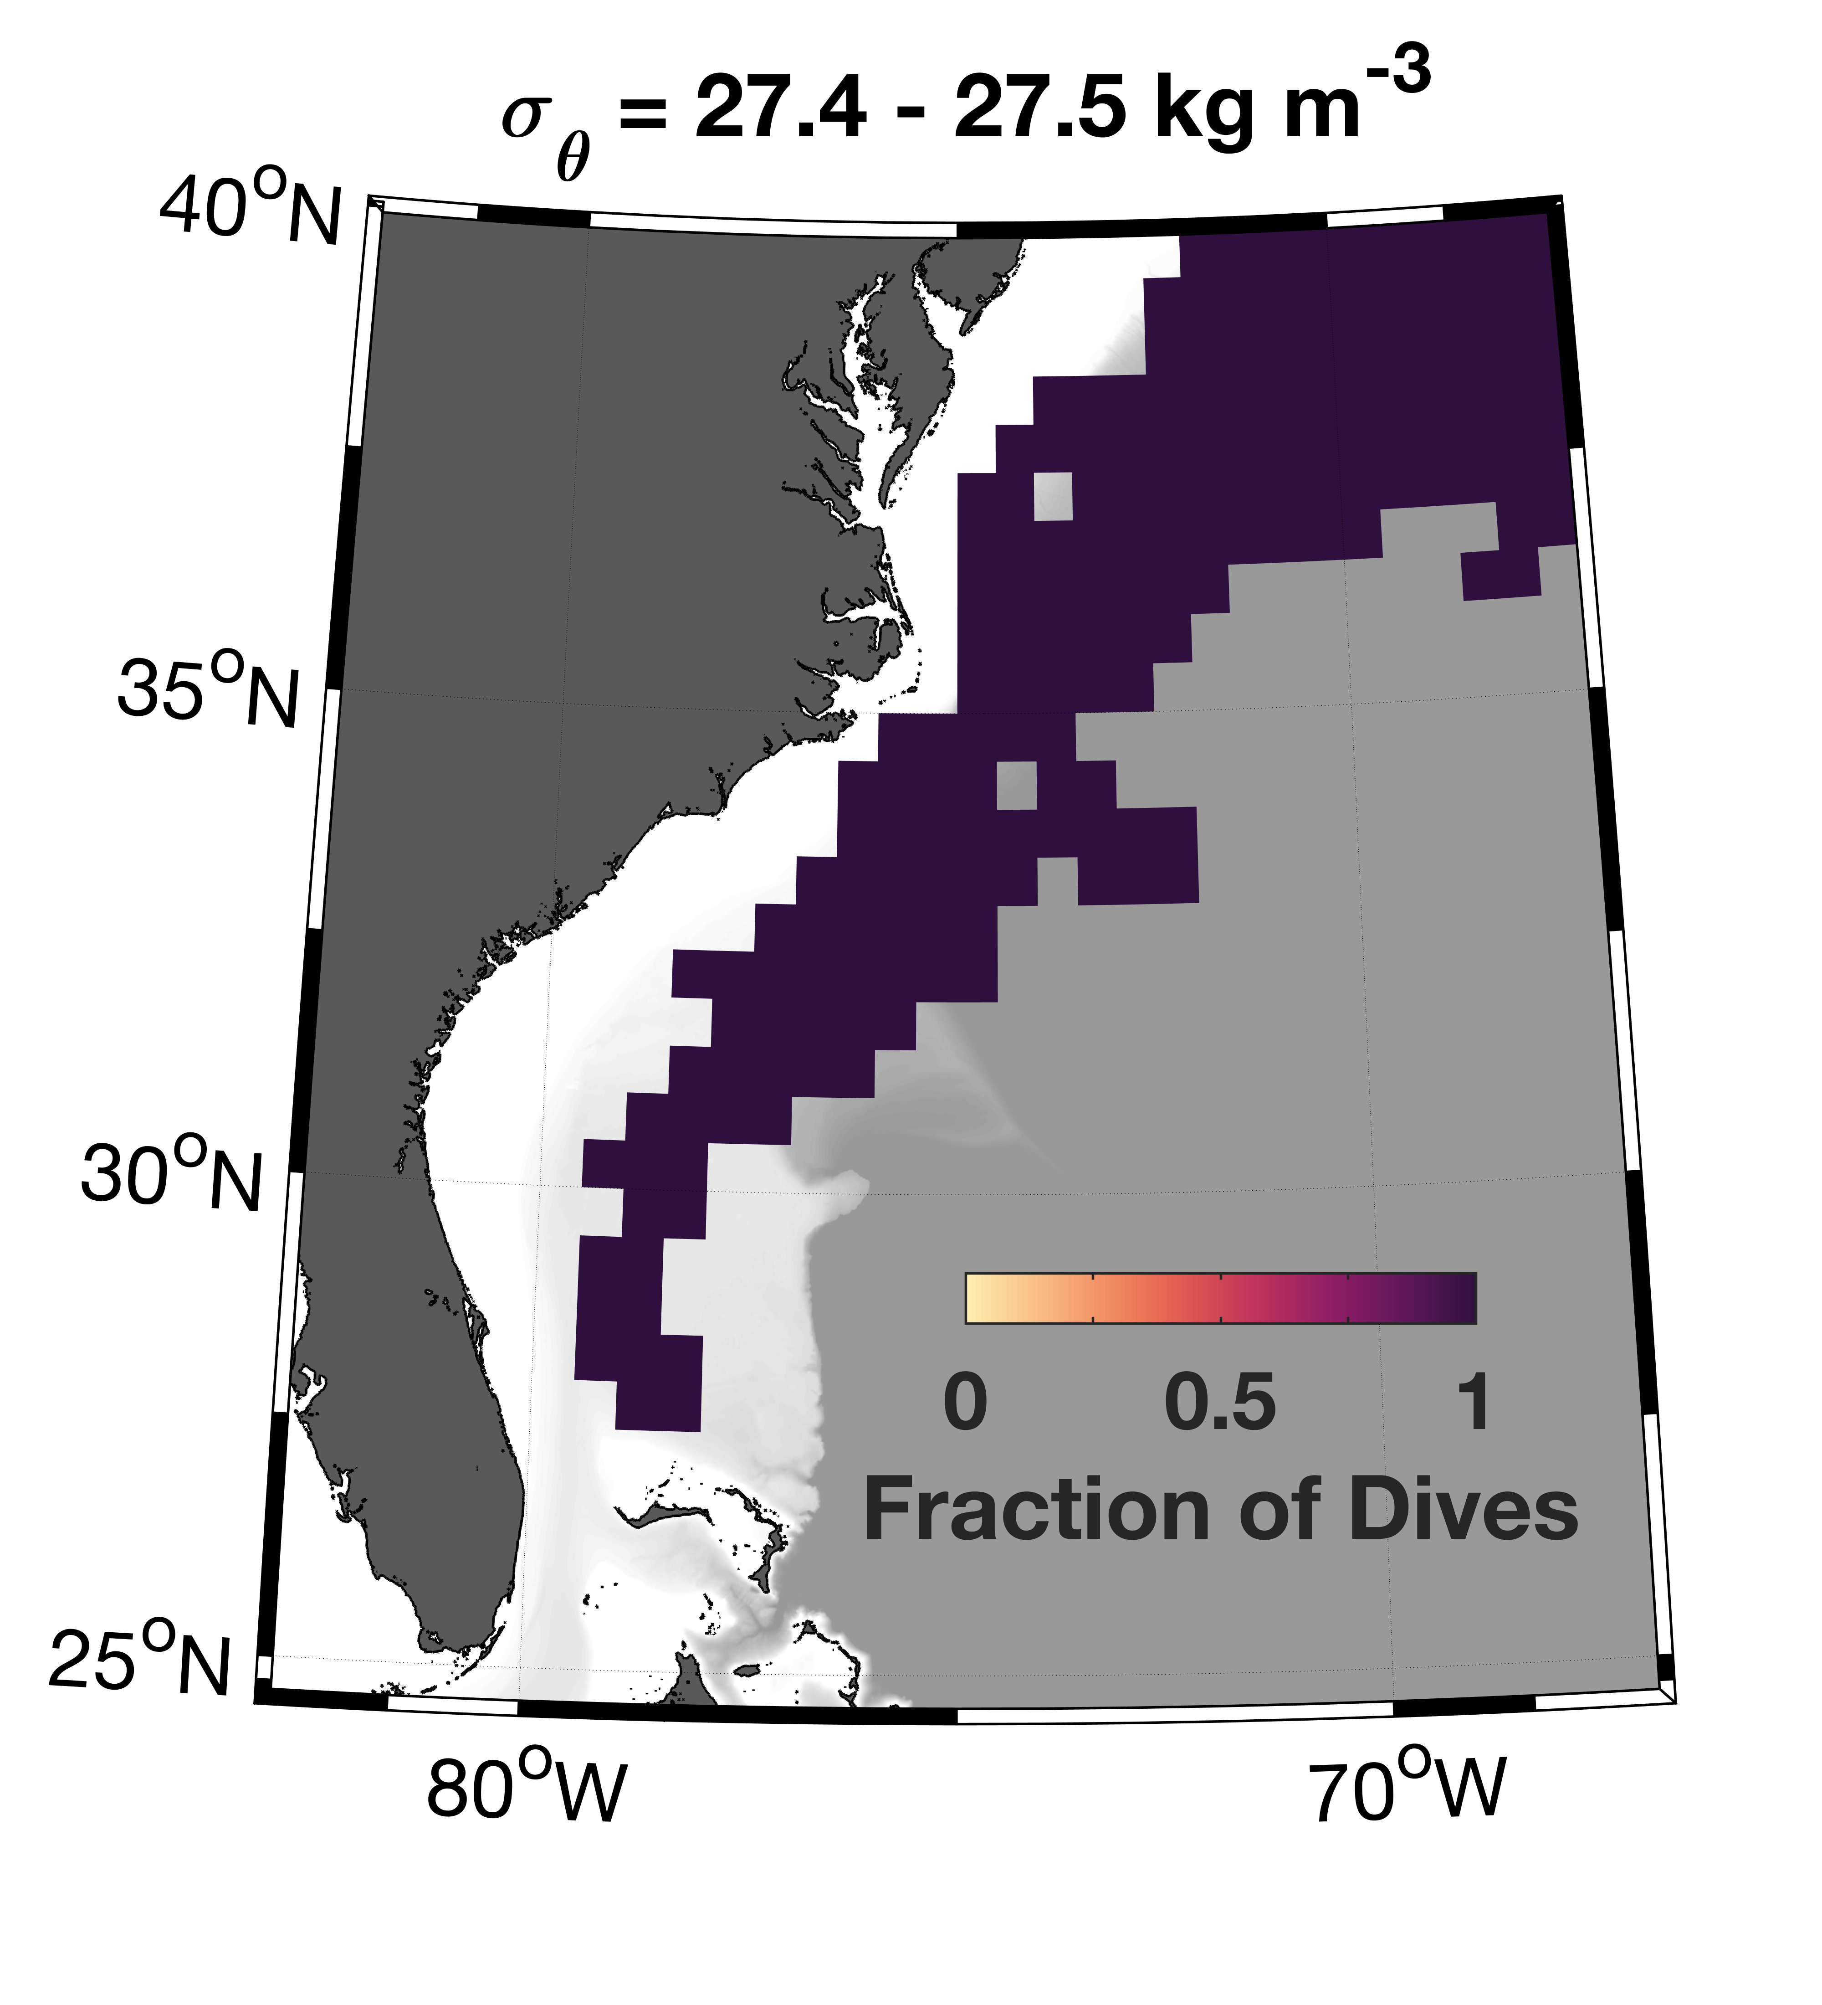
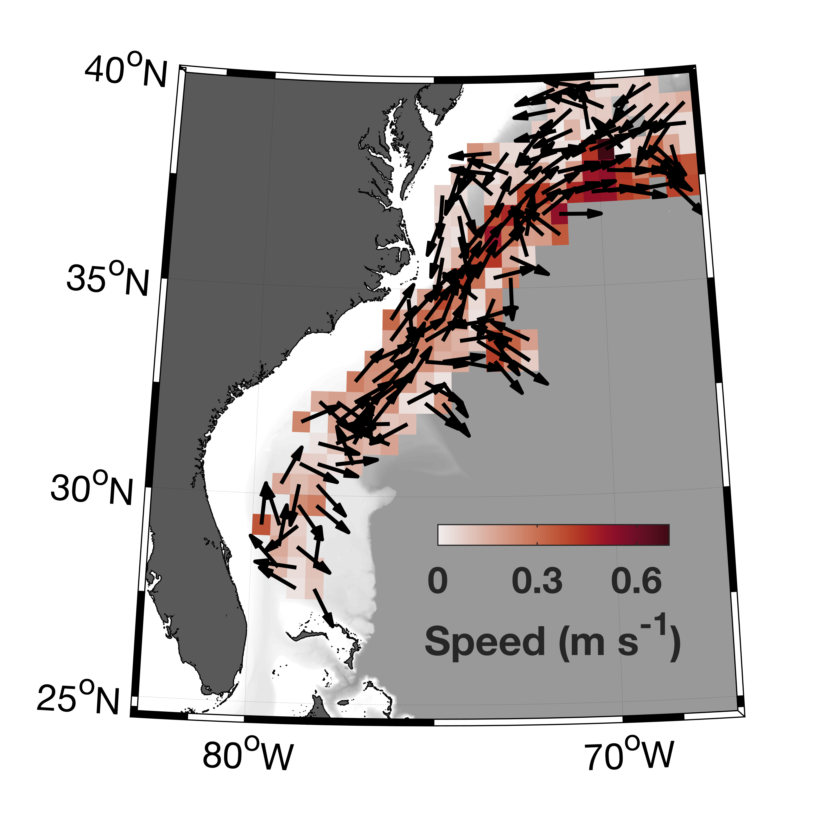
Evidence of a Cross-isobath Pathway for Upper Labrador Sea Water (uLSW)
with uLSW
uLSW is detected throughout
the entire sampling domain
Possible entrainment of uLSW
north of the Bahamas?

Slide 11
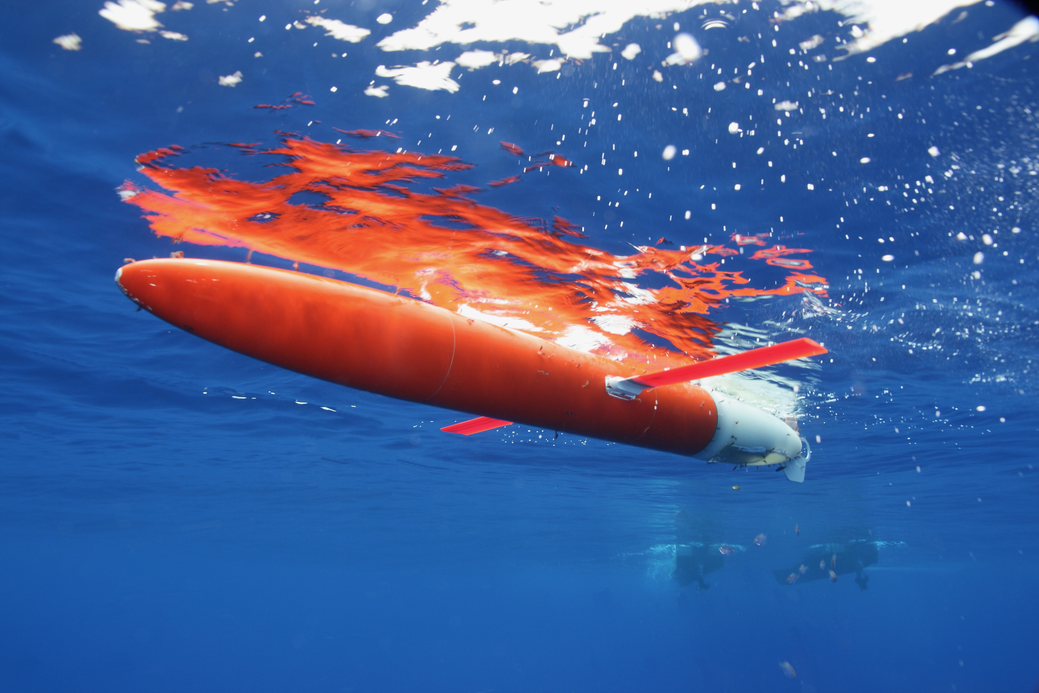



Summary
Gliders provide multi-year, high-resolution observations to
fill a gap in sustained subsurface Gulf Stream monitoring
Observations resolve details of the along-stream increase
in Gulf Stream volume transport along the US East Coast
Entrainment of sub-thermocline waters (e.g., upper
Labrador Sea Water, Eighteen Degree Water, Intermediate
Water) is the primary source of the transport increase
Antarctic Intermediate Water enters through the Florida Strait, but is eroded away through bottom mixing near the Charleston Bump
Evidence of a cross-isobath pathway for Upper Labrador Sea Water to reach the Gulf Stream over the Blake Plateau
Joleen Heiderich
joleenh@mit.edu
Thanks to our collaborators at:
WHOI, Instrument Development Group at Scripps,
NOAA AOML, UNC CSI, UNC IMS, NCSU CMAST
Notes:
Thanks:
- WHOI: Breck Owens, Larry George, Patrick Deane, Ben Hodges, Carol Anne Clayson, Ray Graham
- Scripps: Dan Rudnick, Jeff Sherman, Ben Reineman, Kyle Grindley,Evan Randall-Goodwin, Gui Castelao, Instrument Development Group
- NOAA AOML: Gustavo Goni, Molly Baringer, Francis Bringas
- UNC Coastal Studies Institute, UNC Institute for Marine Sciences, NCSU Center for Marine Sciences and Technology, Discovery Diving Co.

