Slide 1
Data driven methods for real time flood, drought and water quality monitoring: applications for Internet of Water (iow)
Brianna R. Pagán¹, Nele Desmet¹, Piet Seuntjens¹, Erik Bollen², and Bart Kuijpers²
¹Environmental Modelling Unit, Flemish Institute for Technological Research (VITO); ²Computer Science Department, University of Hasselt

Slide 2
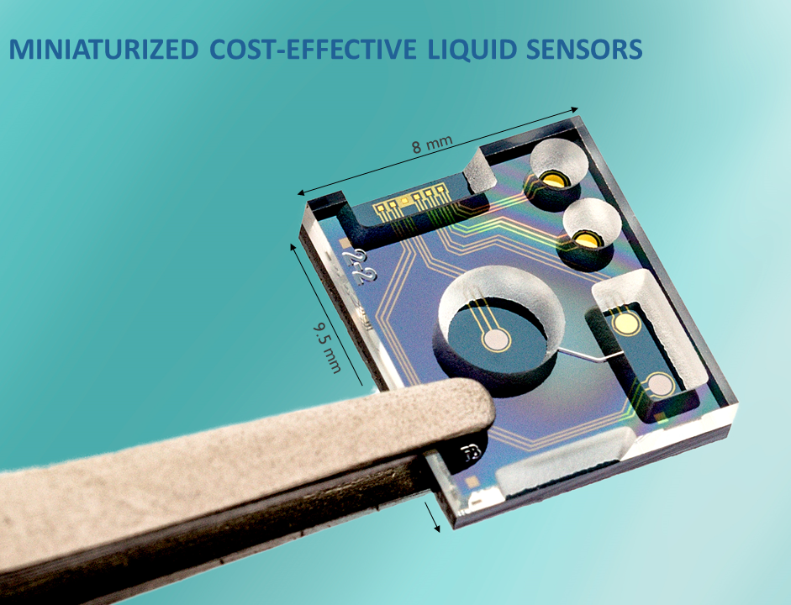
Internet of water
The Internet of Water (IoW) is a large-scale permanent sensor network with 2500 small, energy-efficient wireless water quality sensors spread across Flanders, Belgium.
This intelligent water management system will permanently monitor water quality and quantity in real time.
https://www.internetofwater.be/

Slide 3
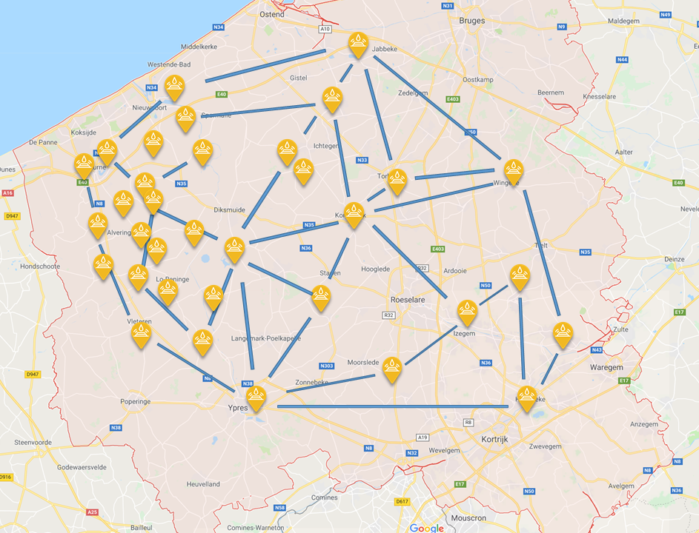
Motivation
Such a dense network of sensors with high temporal resolution (sub-hourly) will provide unprecedented volumes of data for drought, flood and pollution management, prediction and decisions.
While traditional physical hydrological models are obvious choices for utilizing such a dataset, computational costs or limitations must be considered when working in real time decision making.
Here we present data mining and machine learning initiatives which support the IoW.

Slide 4
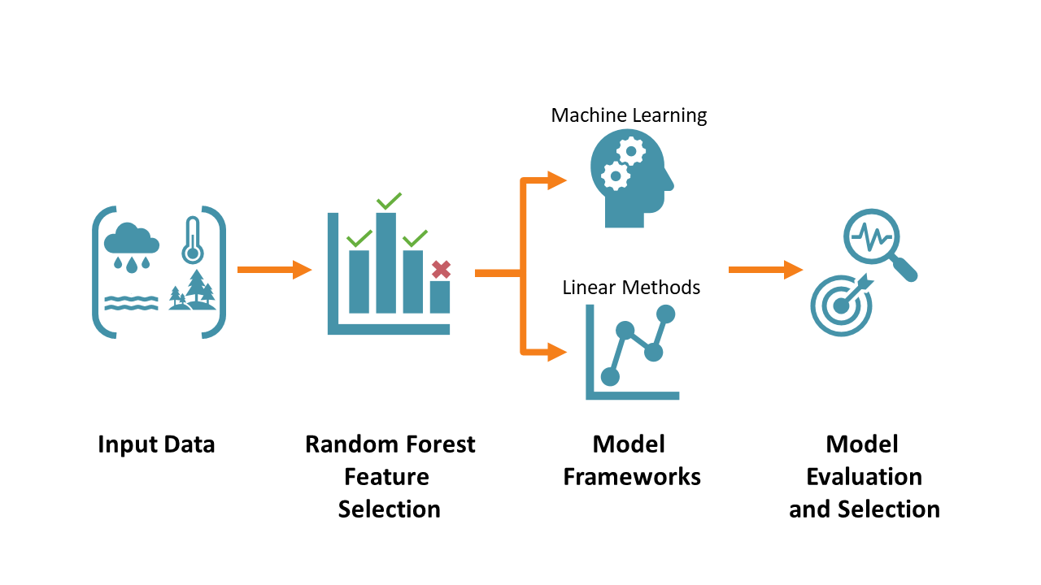
Methods

Slide 5
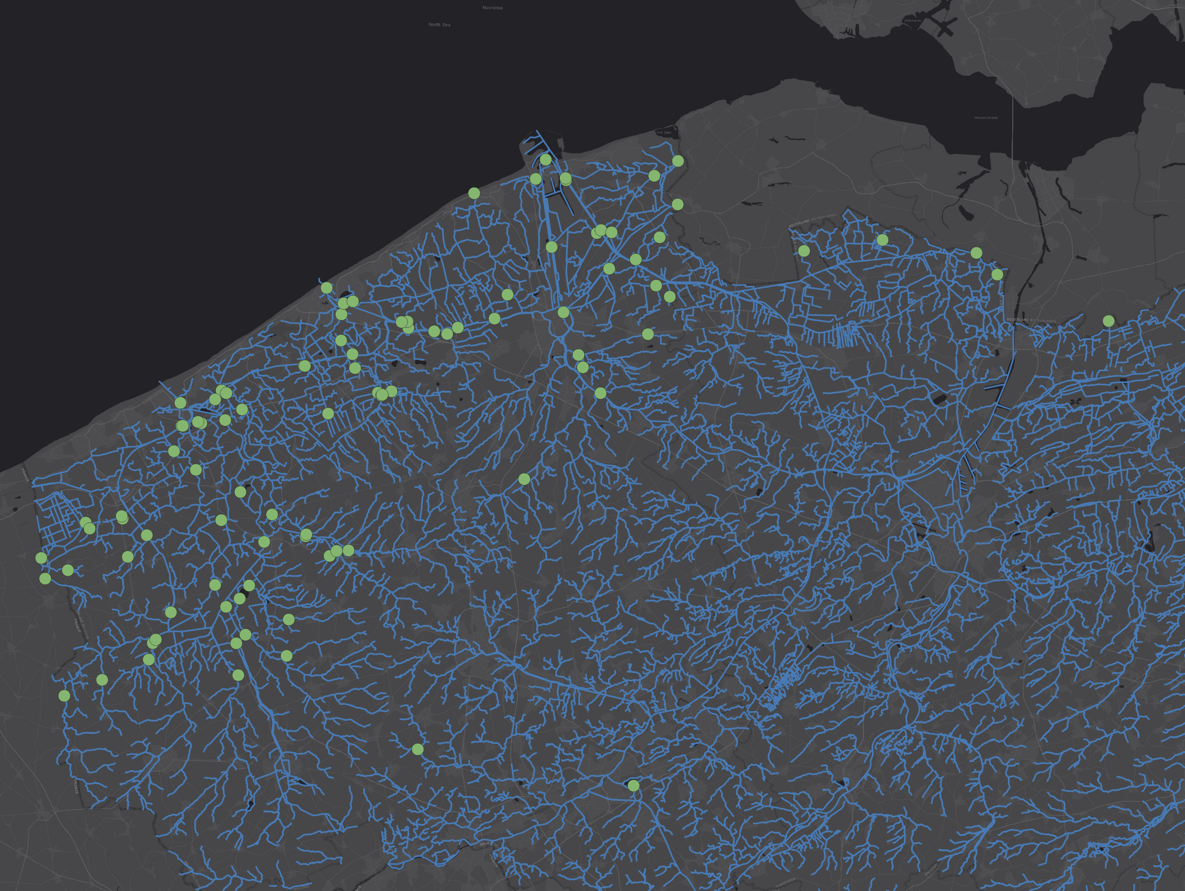
Application 1: extrapolating point measurements to stream segments
Objective: Provide more detailed information on electrical conductivity (EC; a proxy for salinity) distribution, to better monitor seawater intrusion along the coast
Task: Create a machine learning approach to extrapolate the point grab samples along the stream segments
90 locations, grab samples measuring EC taken 1-2 per month.
Test year: 2019, ~1000 data points
EC point measurement locations.

Slide 6
Application 1: extrapolating point measurements to stream segments
Data: Several land use characteristics (shown to the right) and historical EC measurements
Model Set-Up: Feed forward neural network, classifying EC measurements at the streams into categories: very low, low, mid, high, very high
organic matter content
pH
month
fraction of sand
fraction of silt
fraction of clay
distance to ocean

Slide 7
Application 1: extrapolating point measurements to stream segments
Results:
Model captures the expected monthly dynamics across the streams, based on the gauges and land use data

Slide 8
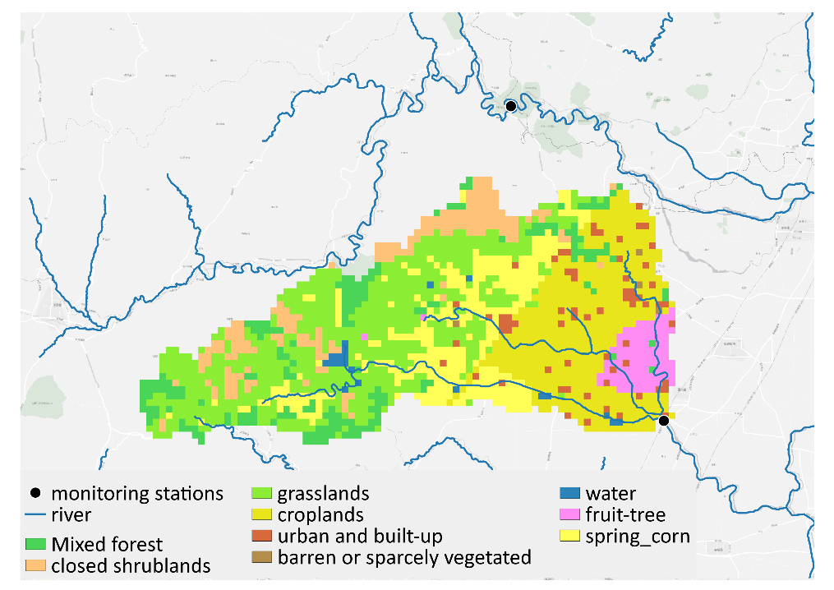
Application 2: provide water quality forecasting
Objective: Forecast water quality for a number of parameters (dissolved oxygen, petroleum etc.) for a given watershed.
Task: Create a machine learning model which uses historical water quality data, river conditions and weather forecasts to predict water quality parameters
Land use data which is coupled with gridded meteorological observations and forecast data

Slide 9
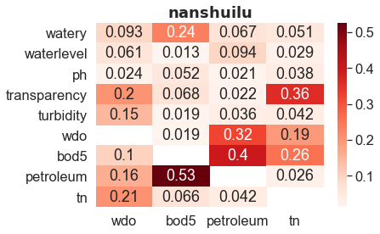
Application 2: provide water quality forecasting
Data: Distributed observational and forecast metrological data, aggregated by land use type, historical water quality and river conditions
Model Set-Up: Random forest for feature selection, feeding into a Long Short Term Memory (LSTM) neural network, given historical, observational and forecast data, predicts water quality +1-7 days
Random forest feature selection results for selected water quality parameters (x-axis)

Slide 10
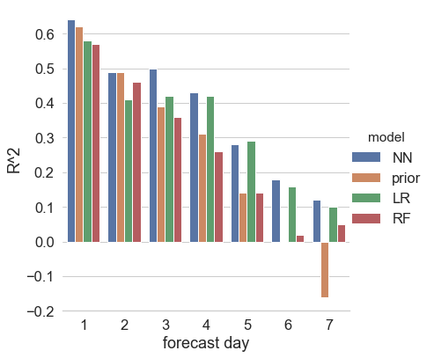
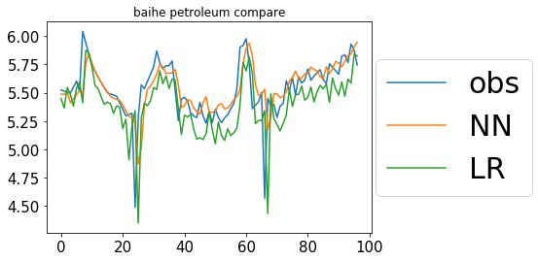
Application 2: provide water quality forecasting
Results:
LSTM neural network (NN), shows adequate performance over benchmark models i.e. taking the previous time step (prior) or linear regression (LR) and a random forest (RF).
Notes:
Use gridded meteorological data and distributed amongst land use classifications. Here you would have precipitation totals for mixed forest, crops etc., rather than one precip value representative of the entire basin.

Slide 11
Questions?
Brianna R. Pagán
Hydroinformatics
VITO NV
brianna.pagan@vito.be

