Slide 1
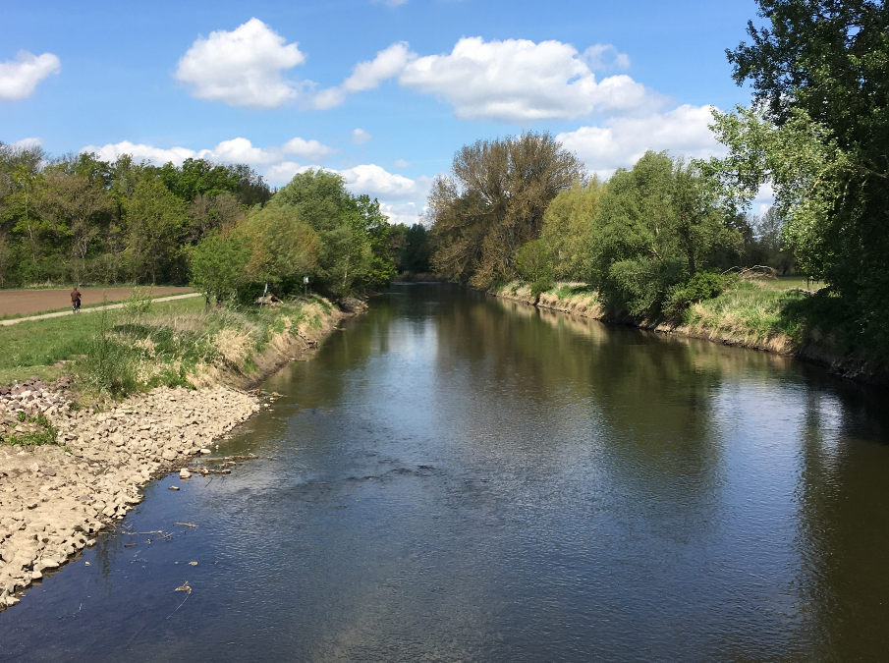
River water quality modeling using continuous high frequency data allows disentangling whole-stream nitrogen uptake and release pathways
#shareEGU
Jingshui Huang & Michael Rode
Helmholtz Centre for Environmental Research - UFZ, Department of Aquatic Ecosystem Analysis, Magdeburg, Germany (jingshui.huang@ufz.de)

Slide 2
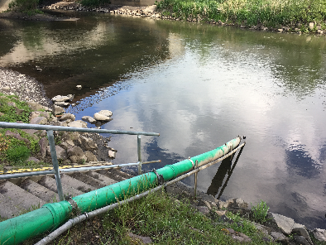
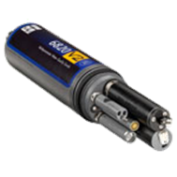
Research Questions
Q1：How can the combination of emerging high frequency monitoring techniques and water quality modeling support continuous quantification of instream N uptake pathways?
Q2：What are instream N uptake efficiency and pathways over the 5 years and their inter-annual comparison?
Q3：What are their seasonal patterns?
Q4： What are their characteristics at the extreme low flow in summer 2018?
？

Slide 3
Method
Model Name: WASP7.5.2 Advanced Eutrophication Module
Model Domain: 27.4-km 5th river
Time Range: 5 years
Time Step: < 0.01 d
Model Setup:
Flow Boundary
Upper: 15-min interval Q at GGL
Lateral: calculated daily discharge
Water Quality Boundary
Upper: 15-min interval data for DO, NO3, Chl-a at GGL, monthly data for other variables
Lateral: calculated daily NO3, bi-monthly data at routine WQ stations for other variables
Model Calibration:
Data: 15-min interval simulations vs measurements at STF
Step 1: Q
Step 2: Phytoplankton Chl-a & periphyton biomass carbon
Step 3: Diurnal DO—>GPP (for assimilatory uptake)
Step 4: NO3 (for denitrification)
N Uptake Calculation: At daily, seasonal, annual & 5-y scales.
Fig. 1 Site description of Lower Bode

Slide 4
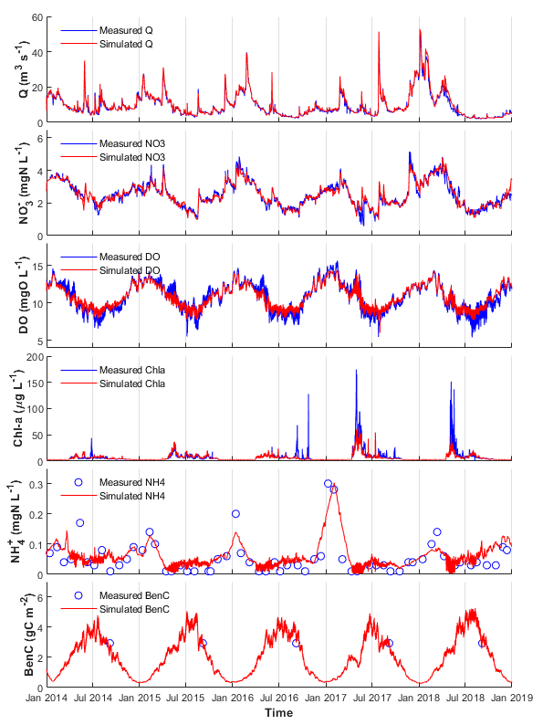
Simulation vs Measurement (Q1)
Fig. 2 State variable comparison
R: 0.99
PBias: 3.00%
Not only compare state variables, but also process fluxes!
In this case, GPP from measurement is the hidden process information in high frequency data to support quantification of assimilatory N uptake.
In spring, GPP by Phytoplankton is dominant. In summer, GPP by Periphyton is dominant.
R: 0.96
PBias: 0.53%
R: 0.97
PBias: -0.02%
R: 0.66
PBias: 0.36%
R: 0.48
PBias: 1.53%
Fig. 3 Simulated and observed GPP comparison
Notes:
Spring: GPP by Phytoplankton is dominant.
Summer: GPP by Periphyton is dominant.

Slide 5
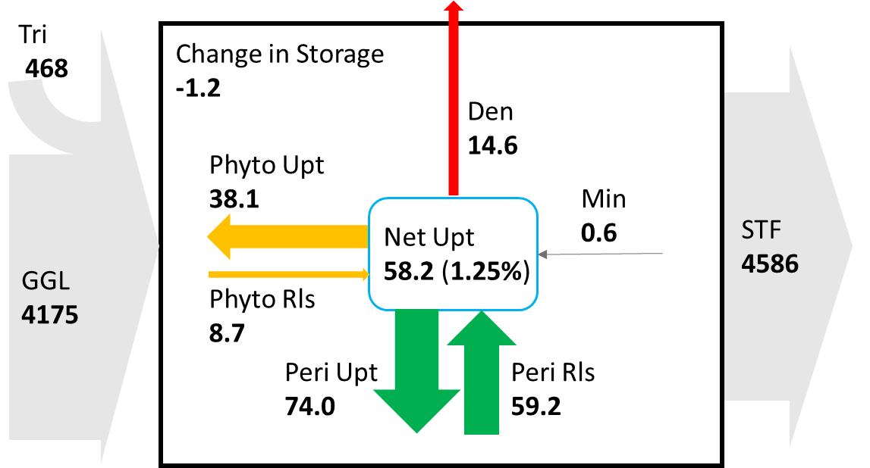
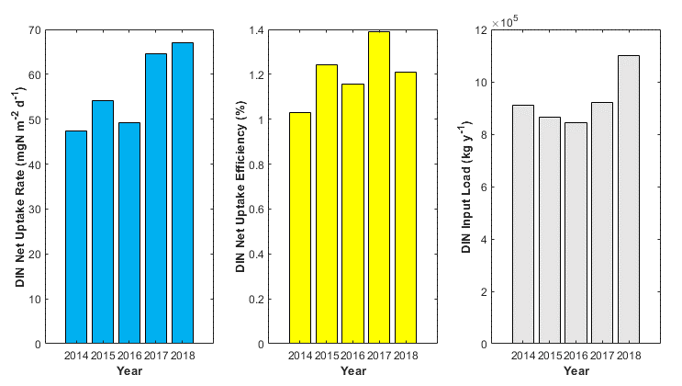
Instream DIN Uptake on 5-Year and Annual Scales (Q2)
5-Year
Annual
Annual mean DIN uptake rate varied from 47.37 (2015) to 67.09 (2018) mgN m⁻²d⁻¹
The DIN uptake efficiency of 2018 was not the highest because of the maximum input load.
Fig. 4 Total DIN budget in Lower Bode from 2014 to 2018
The black box represents the lower Bode.
The line thickness is proportional to the DIN fluxes in the unit of MgN (=10⁶ gN).
Net DIN uptake efficiency in the 5th-order agricultural river amounted to 1.25%.
Total uptake amount ranking via pathways: Periphyton Uptake > Phytoplankton Uptake > Denitrification
Fig. 5 Annual DIN uptake rate, uptake amount of the total load & total input DIN Load.

Slide 6
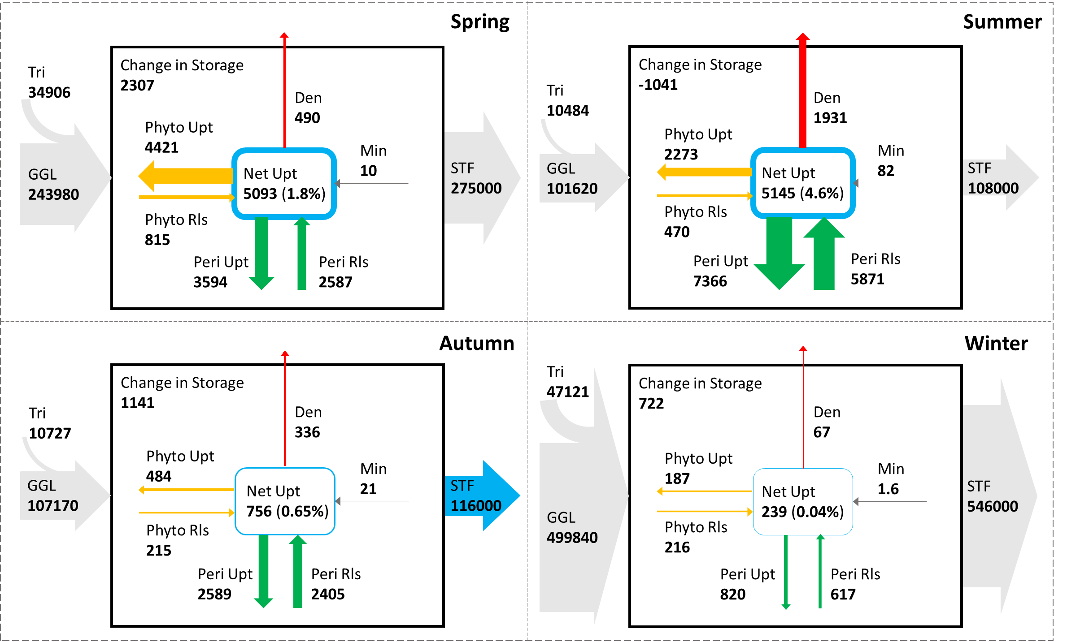
Seasonal Patterns (Q3)
Seasonal
DIN Uptake Amount Seasonal Ranking: Summer > Spring > Autumn > Winter
Efficiency Seasonal Ranking : Summer (4.6%) > Spring (1.8%) > Autumn (0.65%) > Winter (0.04%)
Spring + Summer: The sum of net DIN uptake amounts accounted for 91% of total uptake amount of the year.
Spring: Phytoplankton uptake is dominant (52%).
Summer: Periphyton uptake is dominant (63%).
Fig. 6 Seasonal DIN budget in Lower Bode (average results from 2014 to 2018, in kgN)
The beginning of the seasons is set at: Spring - 1st Mar, summer - 1st Jun; autumn - 1st September and winter - 1st December.

Slide 7
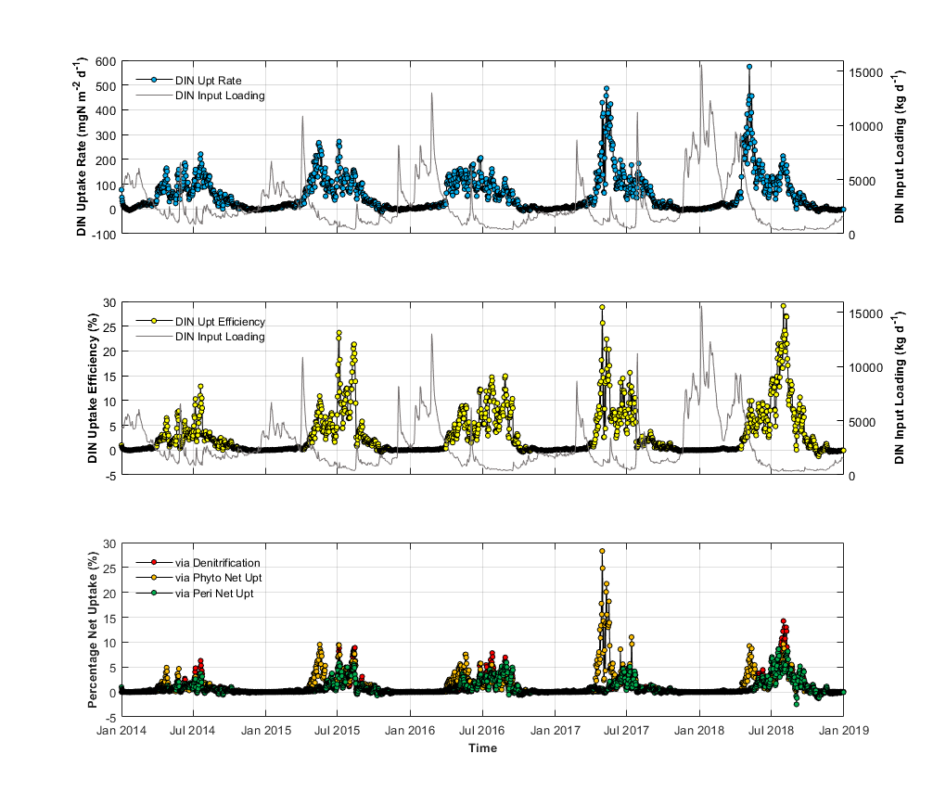
At Extreme Low Flow (Q4)
Fig. 7a DIN Net Uptake rate on a daily scale
The DIN Uptake rates at extreme low flow in 2018 was not especially higher than those over the same period in the previous years. They were lower than those during the spring of 2017 and 2018 when phytoplankton bloomed.
However, the DIN uptake efficiency during this period was significantly higher than usual over the 5 years, with the highest value of ~30%.
Denitrification contributed half of the net uptake (~15%) when the uptake efficiency was highest at this stage.
Fig. 7b Net DIN uptake efficiency on a daily scale
Fig. 7c Net DIN uptake efficiency via different processes

