Slide 1
Combining Experiments and Modelling to Understand the Role of Potential Sputtering by Solar Wind Ions
Paul Stefan Szabo
Institute of Applied Physics, TU Wien, Vienna, Austria
Highlights:
Sputtering yields under He²⁺ irradiation are found to be significantly higher than for He⁺.
This can be modeled by assuming an additional potential sputtering of O atoms.
For a realistic solar wind scenario, a significant O depletion at the surface and sputtering yield increases of about 40% can be expected.
EGU 2020, May 8th, 2020

Slide 2
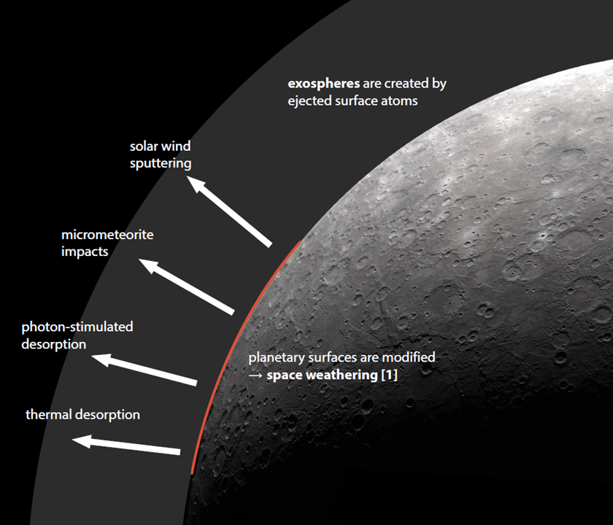
Motivation
Solar wind sputtering is an important factor in space weathering and exosphere formation on Moon and Mercury [1,2].
We want to investigate effects that are not described by established simulations (e.g. SRIM).
We focus on potential sputtering by multiply charged solar wind ions [3].
© NASA
[1] B. Hapke, J. Geophys. Res.: Planets, 106 (2001), 10039
[2] P. Wurz, et al., Icarus, 191 (2007), 486
1
[3] F. Aumayr, HP. Winter, Philos. Trans. R. Soc. A, 362 (2004), 77

Slide 3
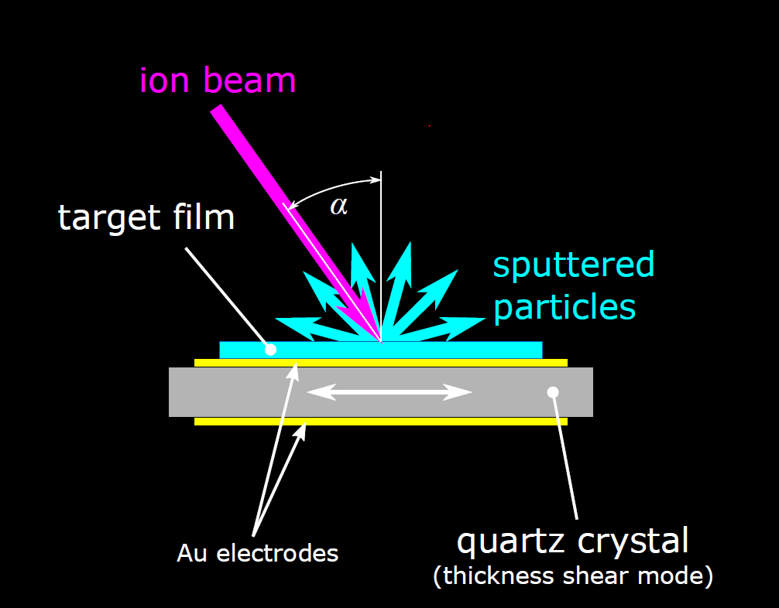
Experimental Methods
Wollastonite (CaSiO₃) is used as an analog for pyroxenes on Moon and Mercury.
Thin films were deposited on a Quartz Crystal Microbalance (QCM) with Pulsed Laser Deposition (PLD).
→ Mass changes due to ion irradiation cause changes of the quartz‘s resonance frequeny [1,2]. This enables precise real-time sputtering measurements in ultrahigh vacuum.
[1] G. Sauerbrey, Zeitschrift für Physik, 155 (1959), 206
[2] G. Hayderer, et al., Rev. Sci. Instrum., 70 (1999), 3696

Slide 4
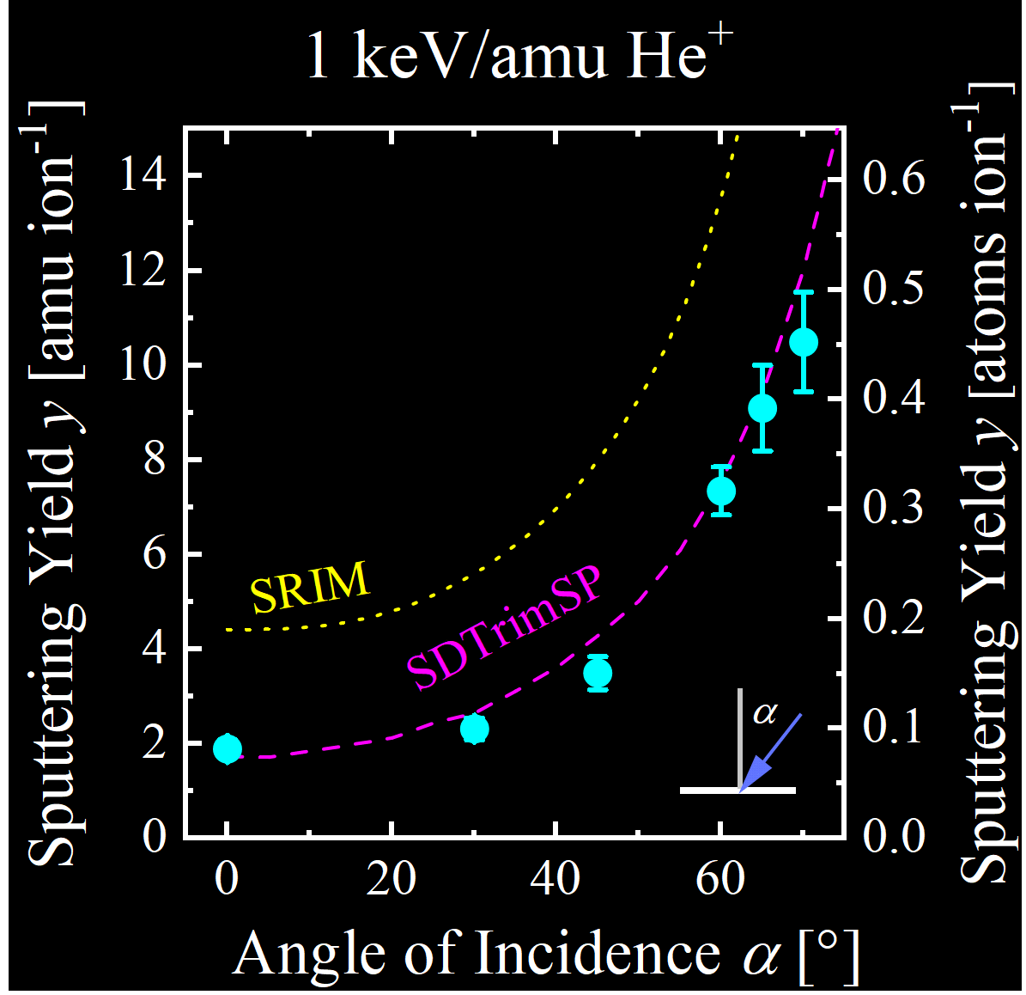
Kinetic Sputtering by Singly Charged Ions
Figure: Example of He⁺ at solar wind energy [1], experimental values for CaSiO₃ are compared to simulations with the programs SRIM [2] and SDTrimSP [3].
SRIM overestimates measured sputtering yields.
SDTrimSP with adapted surface binding energies (dashed lines) consistently describes experiments well.
© AAS, The Astrophysical Journal
[1] P.S. Szabo, et al., Astrophys. J, 891 (2020), 100
[2] J.F. Ziegler, M.D. Ziegler, J.P. Biersack, Nucl. Instrum. Methods Phys. Res. B, 268 (2010), 1818
[3] A. Mutzke, et al., IPP-Report, (2019)

Slide 5
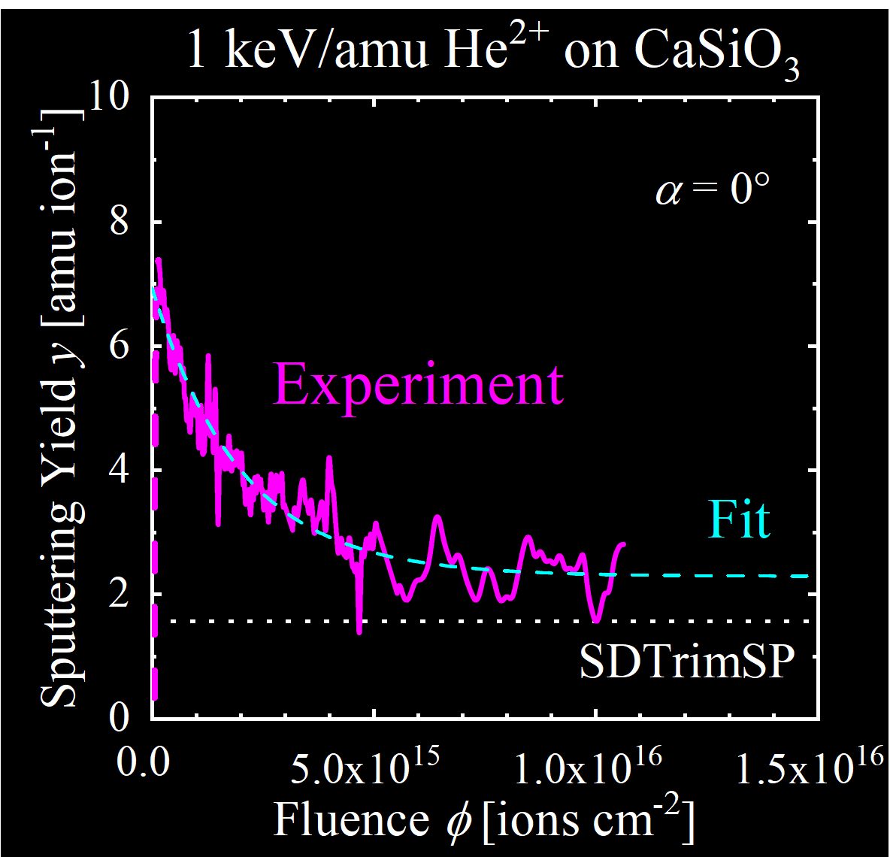
Potential Sputtering by He²⁺
Figure: He²⁺ sputtering yields of CaSiO₃ were measured under continuous irradiation [1].
Initial sputtering yields are much higher than the He⁺ yield (dotted white line).
A steady state is reached after sputtering a few monolayers. Steady state sputtering yields are still higher than for He⁺.
The sputtering yield decreases exponentially.
© AAS, The Astrophysical Journal
→ Test measurements with Ar^{q+} (q = 2-8) show that the increase of the initial sputtering yield is proportional to the ion‘s potential energy [1].
[1] P.S. Szabo, et al., Astrophys. J, 891 (2020), 100

Slide 6
Potential Sputtering: Calculation
Previous measurements with oxides showed that only O atoms are desorbed by potential sputtering [1]. We want to test if O sputtering and subsequent O depletion of the surface is sufficient to describe our measurements. We use a model that has been similarly applied before (e.g. [2]).
→ Coupled differential equations (one for each target element, example for O) to describe the change of the surface composition due to sputtering [3]:
C_{i} ... Surface concentration of element i
ϕ ... Fluence
n_{A} ... Number of atoms in a monolayer
Y_{i} ... Sputtering yield of element i
C_{i}^{b} ... Bulk concentration of element i
© AAS, The Astrophysical Journal
Surface concentration
Surface concentration decrease by sputtering
Surface concentration increase from bulk atoms reaching the surface
→ Kinetic sputtering yields are taken from SDTrimSP simulations, an additional potential sputtering term is included for the sputtering yield of O:
Monolayer density
Bulk concentration
Fluence
Sputtering yield
γ … scaling factor
E_{pot} ... Ion potential energy
E_{B} ... Band gap of the target material
© AAS, The Astrophysical Journal
Scaling factor is taken from measurements
[1] M. Sporn, et al., Phys. Rev. Lett., 79 (1997), 945
[2] A.F. Barghouty, et al., Nucl. Instrum. Methods Phys. Res. B, 269 (2011), 1310
[3] P.S. Szabo, et al., Astrophys. J, 891 (2020), 100

Slide 7
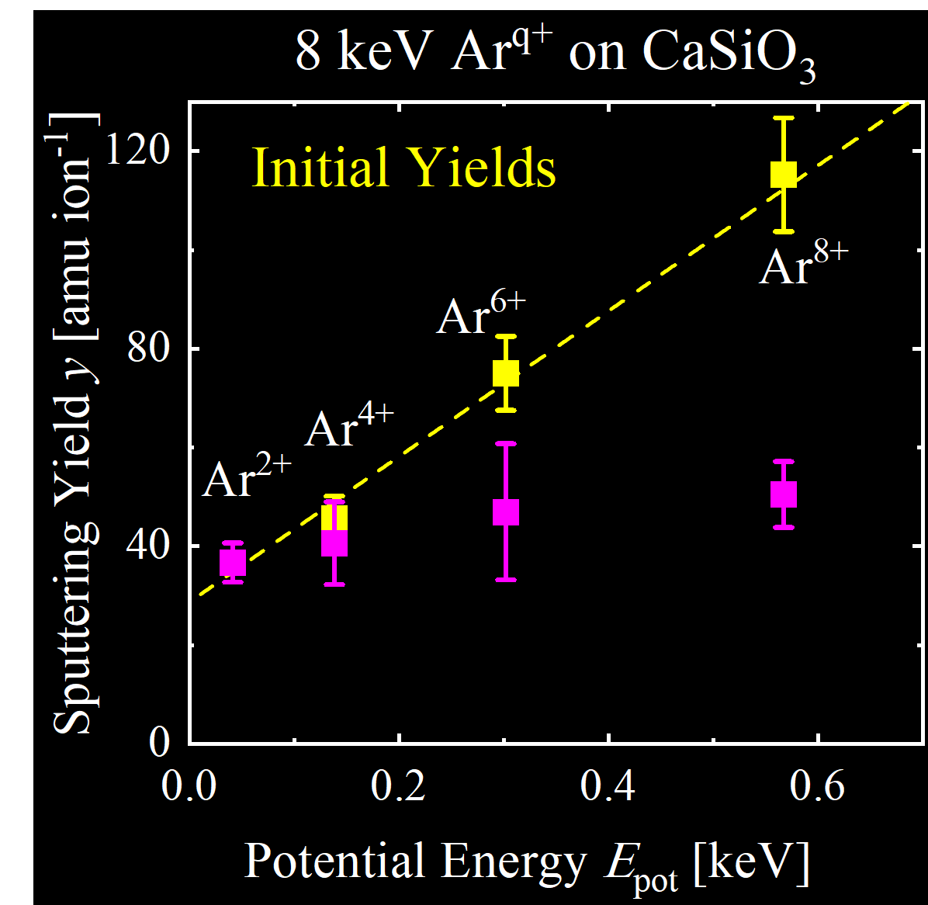
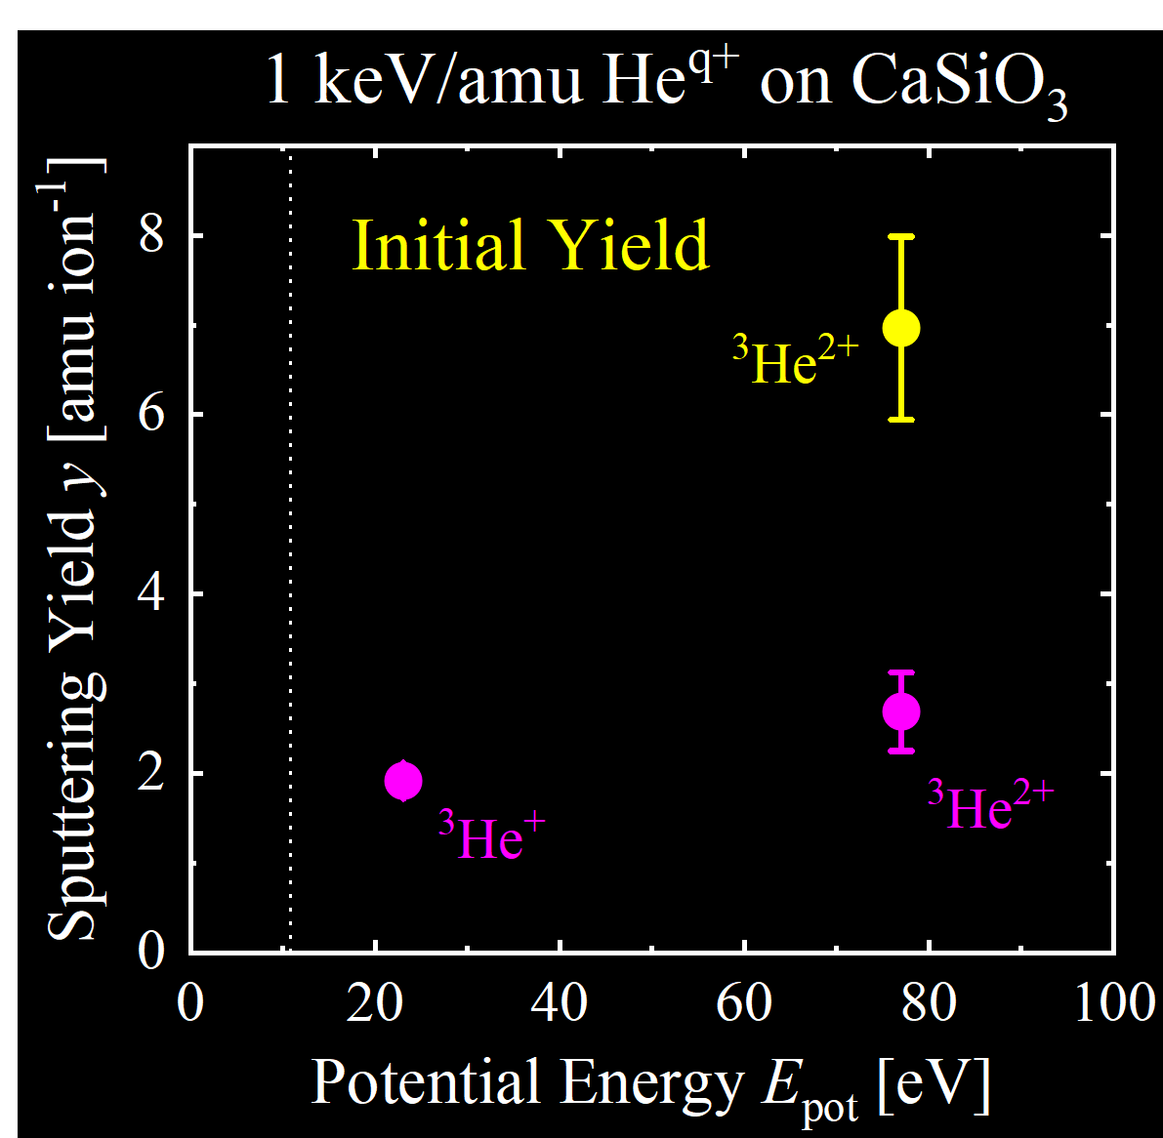
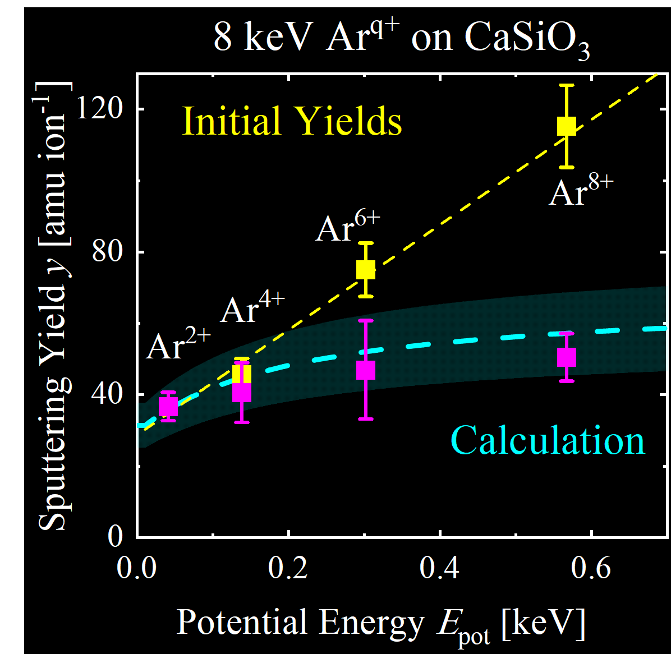
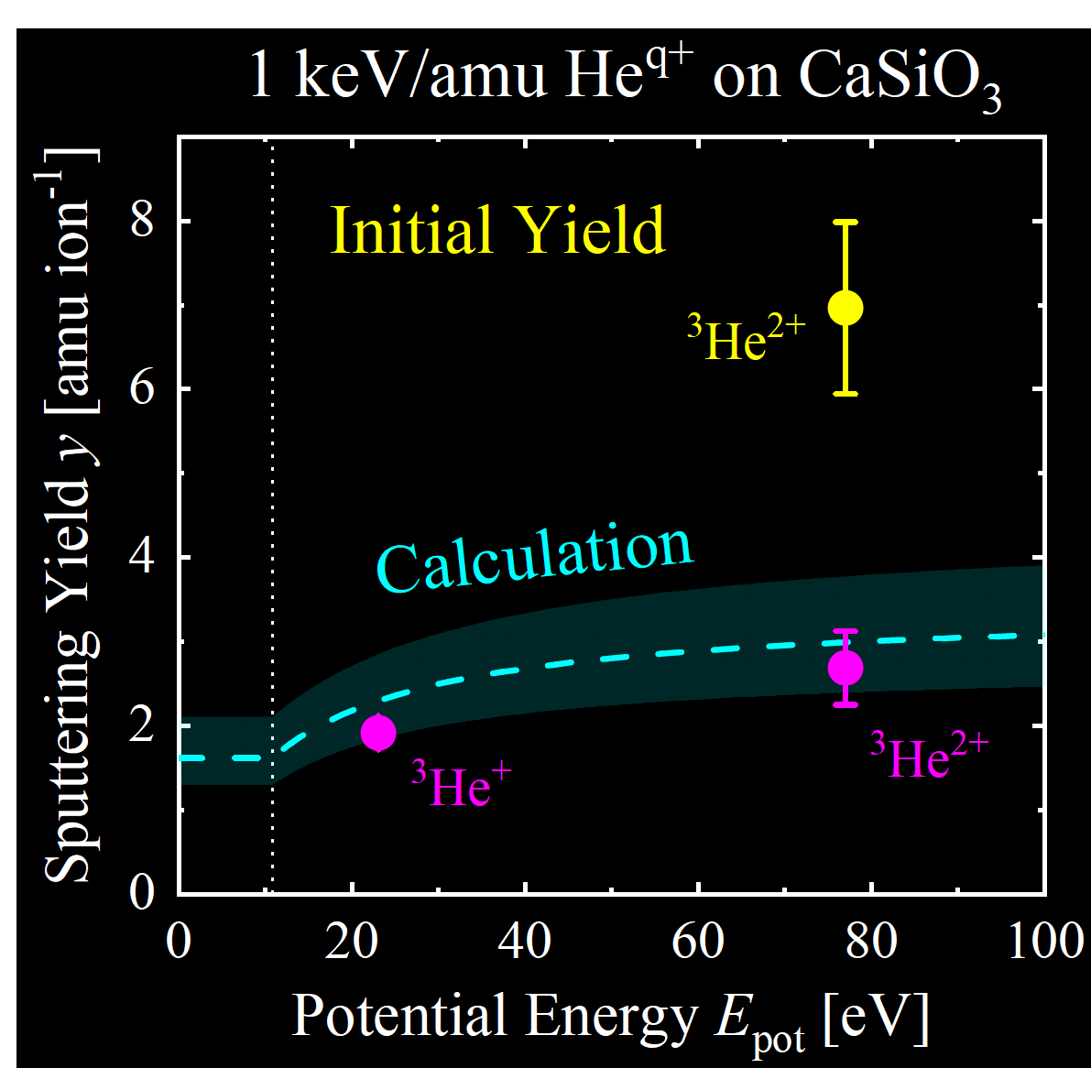
Comparison between Experiment and Model
→ The model is used to calculate the steady state sputtering yields from measured initial yields at the start of the irradiation [1,2].
© AAS, The Astrophysical Journal
© AAS, The Astrophysical Journal
→ All measured steady state yields are predicted very well. Therefore, potential sputtering of CaSiO₃ can also be described by a preferential sputtering of O atoms.
[1] P.S. Szabo, et al., Astrophys. J, 891 (2020), 100
[2] P.S. Szabo, et al., Icarus, 314 (2018), 98

Slide 8
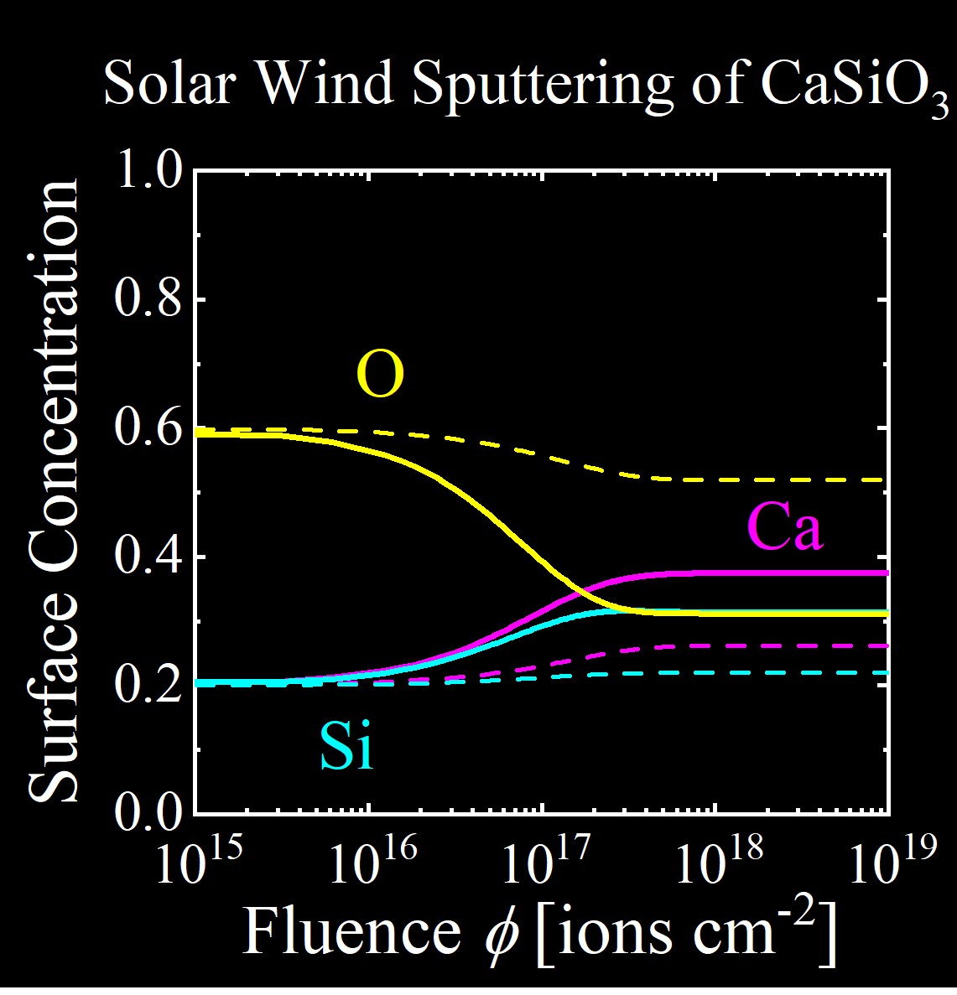
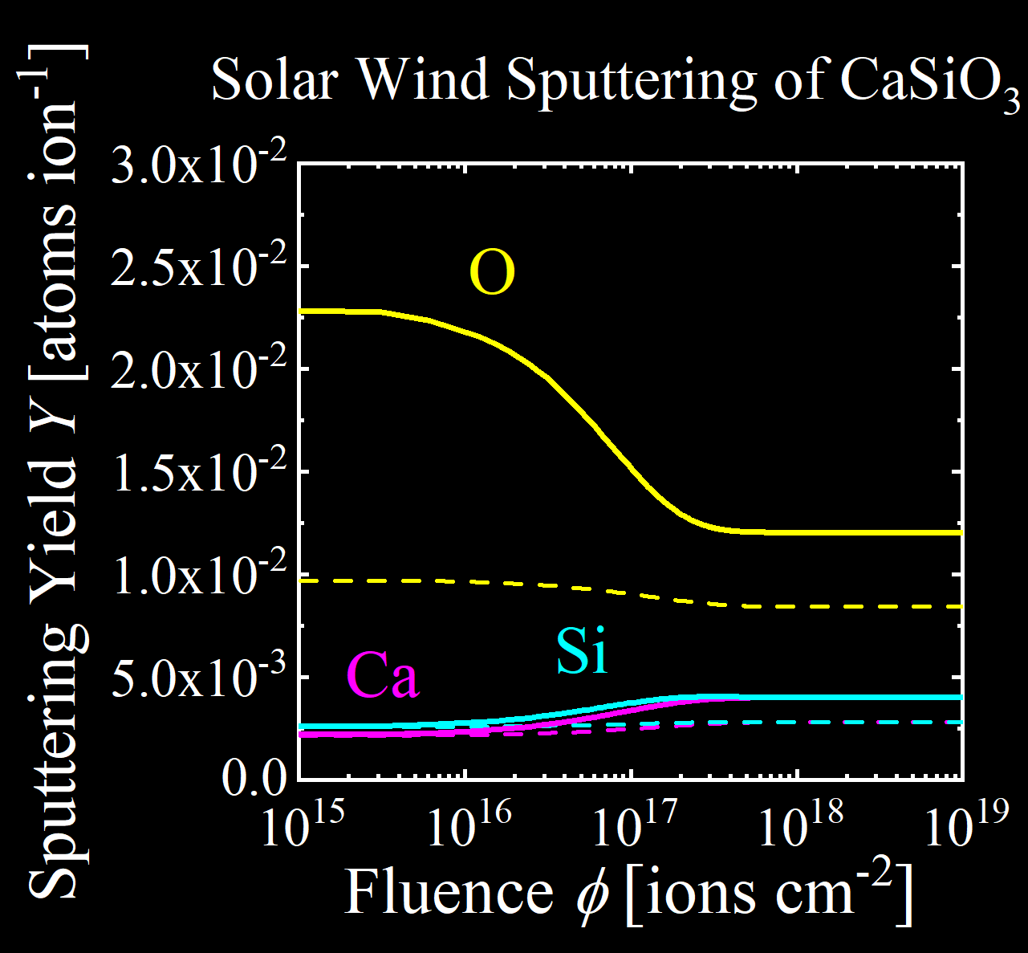
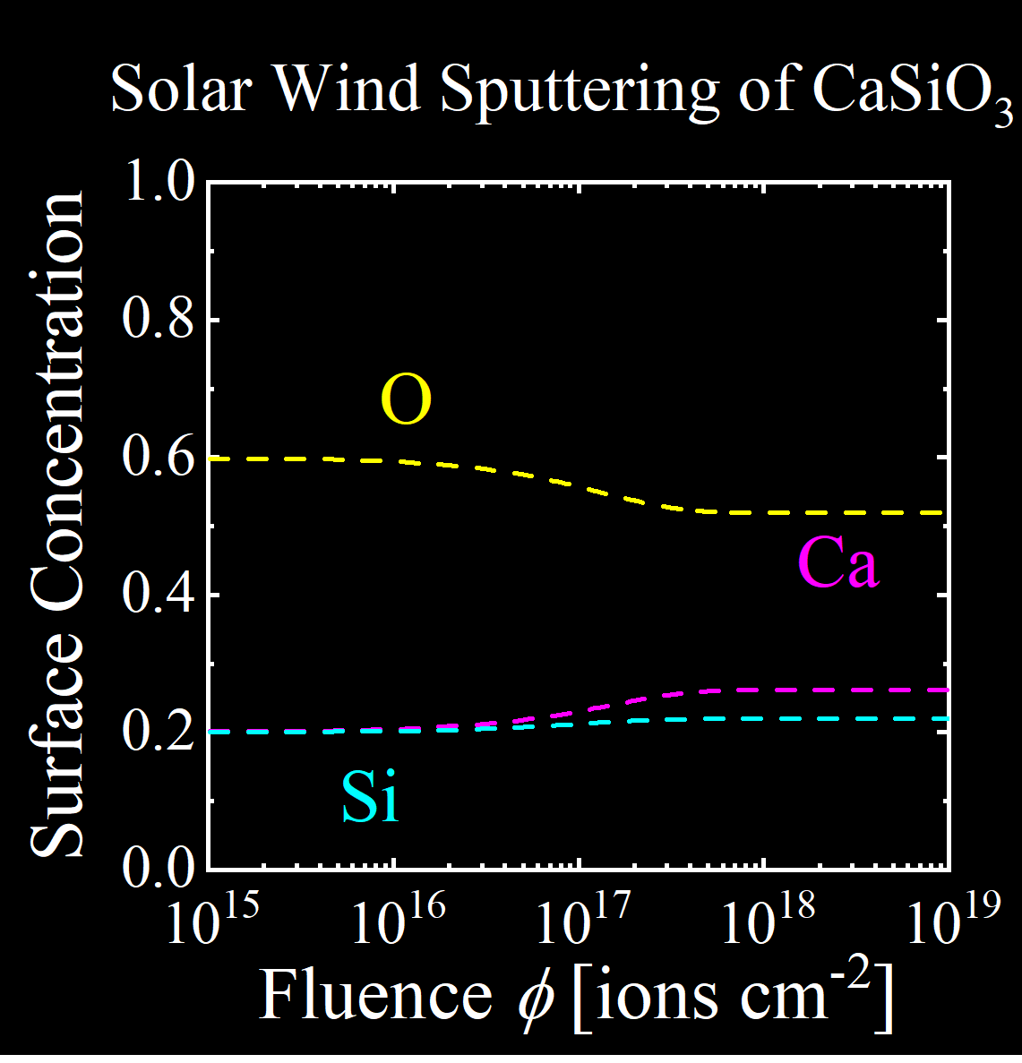
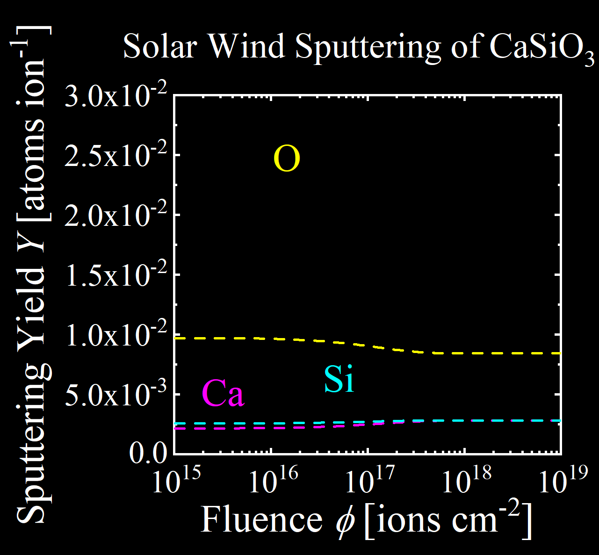
Consequences for Solar Wind Sputtering
→ The total solar wind sputtering is calculated for a solar wind composition of 96% H⁺ and 4% He²⁺. Results where only kinetic sputtering is taken into account (dashed lines) are compared to calcultions with included potential sputtering (full lines) [1].
A steady state is reached after several 100 years.
In the steady state, all sputtering yields are increased by 43%.
© AAS, The Astrophysical Journal
© AAS, The Astrophysical Journal
Significant O depletion at the surface can be expected.
[1] P.S. Szabo, et al., Astrophys. J, 891 (2020), 100

Slide 9
Summary
Sputtering yields for He⁺ and He²⁺ were measured at 1 keV/amu. A significant increase by potential sputtering was found for He²⁺, as well as an exponential decrease with fluence.
The measured steady state sputtering yields could very be well reproduced with a model assuming potential sputtering of O atoms and subsequent O depletion.
Calculations for solar wind sputtering then show that just 4% He²⁺ will already reduce the O content of the surface significantly. Sputtering yields in the steady state are predicted to be about 40% higher than without potential sputtering.
Further Information and Outlook:
Significant implantation of He has been observed in our experiments (see H. Biber‘s display EGU2020-9895 in the same session PS1.4/ST4.7).
Experiments with more realistic mineral samples are planned (see N. Jäggi‘s display EGU2020-3303 in session PS4.4/GD11.2/GI6.10/ST1.11).

Slide 10
Acknowledgements
H. Biber, M. Brenner, D. Weichselbaum, M. Wappl, A. Niggas, R. Stadlmayr, A. Nenning, M. Sauer, J. Fleig, A. Foelske-Schmitz, F. Aumayr
N. Jäggi, A. Galli, P. Wurz, K. Mezger
Financial support has been provided by the Austrian Science
Fund FWF (Project No. I 4101-N36) and by KKKÖ (Commission
for the Coordination of Fusion research in Austria at the Austrian
Academy of Sciences—ÖAW) as well as the Swiss National
Science Foundation Fund (200021L_182771/1). Support by
VR-RFI (contracts #821-2012-5144, #2017-00646_9 & 2018-
04834) and the Swedish Foundation for Strategic Research (SSF,
contract RIF14-0053) supporting operation of the accelerator at
Uppsala University is gratefully acknowledged.
The computational results presented have been achieved
using the Vienna Scientific Cluster (VSC).
M.V. Moro, D. Primetzhofer
M.V. Moro, D. Primetzhofer
A. Mutzke
H. Lammer

