Slide 1




Effect of the interplay between ultra-slow spreading ridge and transform faults on seafloor morphology
S. J. Beaussier, A. Plaza Faverola, T. Gerya, S. Buenz

Slide 2
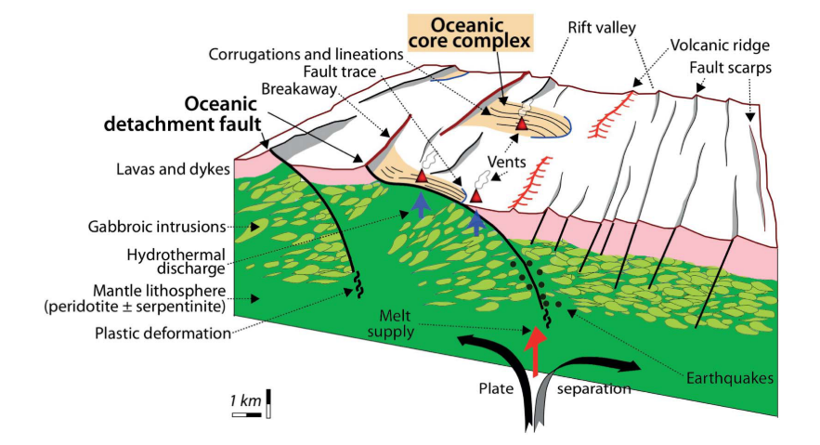
Introduction
Slow and ultra-slow spreading systems give way to complexes seafloor morphologies (e.g. North Atlantic, Central Atlantic, NW Indian Ocean).
This morphology is a consequence of different modes of tectono-magmatic activity at the ridge:
  Crust accretion by episodic magma supply.
  Low-angle brittle/ductile normal faulting.
  High-angle normal faults leading to the formation of oceanic core complexes (OCC).
Maffione et al. 2013

Slide 3
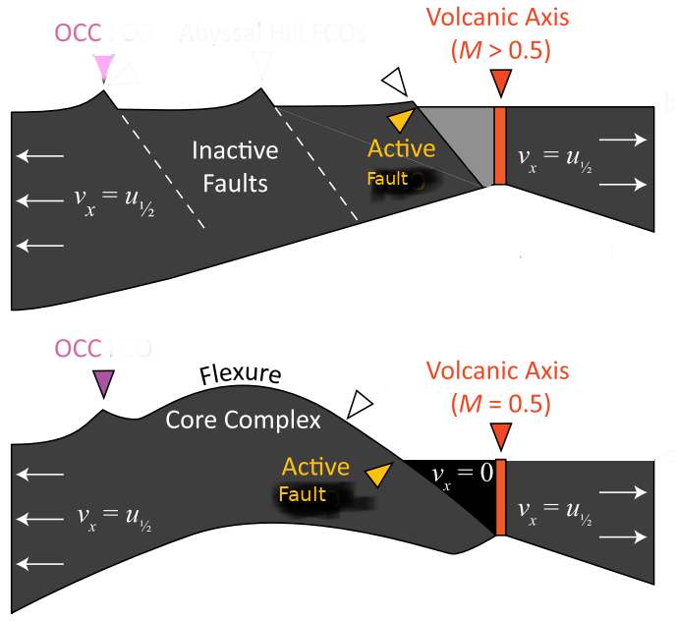
Introduction
The tectonic regime in slow and ultra-slow spreading ridges has been well studied.
Tectono-magmatic regime is primarily controlled by the magmatic supply (Buck et al., 2005).
Brittle properties of the oceanic lithosphere and faults healing rate significantly affect this first order behaviour (Gulcher et al., 2019).
Although the 3D behaviour of slow spreading ridge systems have been studied (e.g. Howel et al., 2019; Choi et al., 2008). Several intrinsically 3D properties of those systems remains poorly understood. In particular how ridge obliquity and its interplay with transform faults affects the tectono-magmatic regime and seafloor morphology.
In this study we will be using high resolution numerical modelling to investigate the 3D properties of ultra slow spreading ridge systems. Results will be tested against the spreading in the Fram Strait in the past 10 Myr.
OCC : oceanic core complex forming fault
M : Magmatic supply
Modified from Howell et al., 2019

Slide 4
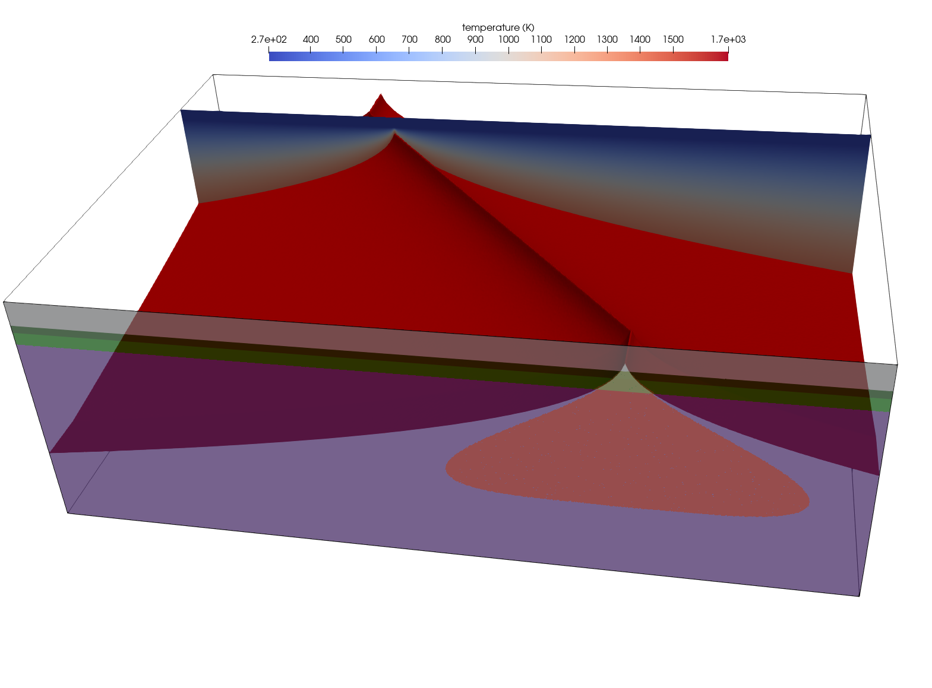
Initial configuration of numerical model
Model parameters (additional information in notes):
Dimension – 298x98x202 km.
Resolution – 500 m.
Boundary conditions:
  Divergence is imposed on left and right boundaries (black arrows), with a half-rate of 7 mm/yr.
  Free surface is defined using a sticky-air layer.
The setup is that of an homogeneous ultra-slow spreading ridge with and oblique ridge. Red surface mark the 1100ᵒC isotherm. In the back a cross-section of the model show temperature distribution with depth and in the front a cross-section show material distribution.
Θ is the obliquity of the ridge.
202 km
θ
98 km
298 km
Oceanic crust
Oceanic crust
Mantle
Partial molten zone
Notes:
The figure show the initial configuration of the numerical experiments. The setup correspond to an oceanic lithosphere with an homogenous 8 km thick continental crust. The thermal structure of the lithosphere correspond to the half-space model for ocean, with continuous divergence half-rate of 7 mm/yr. The obliquity of the ridge is the angle between the divergence direction and the ridge axis (i.e. Orthogonal ridge has an obliquity of 90ᵒ). It is defined by the thermal structure of the oceanic lithosphere than can be see in red on the figure.
A free surface boundary condition on top of the model is implemented using 10 km a sticky-air layer (Schmeling et al., 2008). Upper and lower velocity boundary conditions are defined to preserve mass balance in the sticky-air and material domains of the model respectively.
A very high resolution of 500m is used to adequately model fault formation in ultra-slow spreading systems (Gulcher et al. , 2019).
We use the grain-damage rheology to model ridge transform systems in 3D.
The melting and accretion is controlled by a temperature and pressure dependent thermodynamic database. Melt extraction and percolation is implemented in a simplified manner assuming instantaneous movement to the top of the shallowed part of the partial molten region (see Puthe et al., 2014 for details).

Slide 5
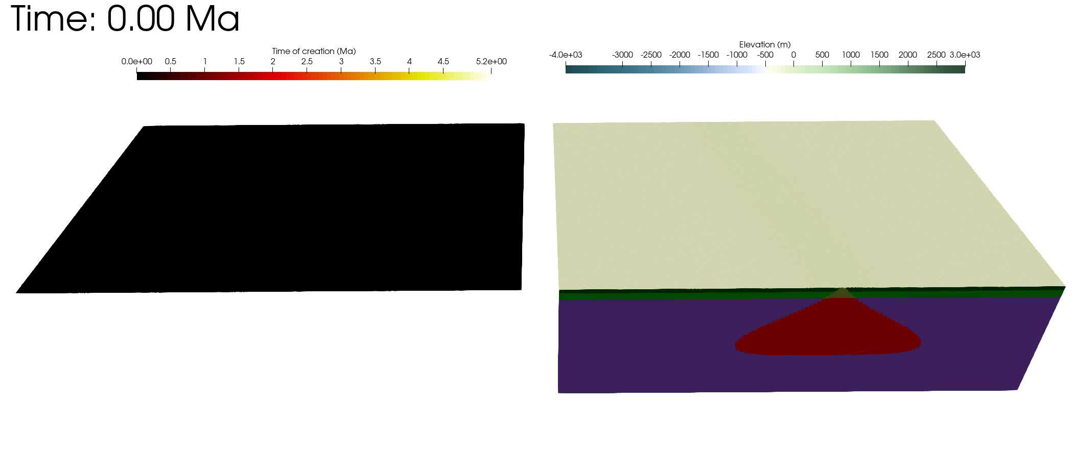
Coupled effect of obliquity and melt supply on ultra-slow spreading systems
Animation of numerical experiments with an oblique ridge (80ᵒ). On the right side is the time of creation of elements at the surface (elements that were created at model initiation have a time of creation of 0 Ma). On the left you have the bathymetry in the model on top of a material distribution block.
Notes:
Model sshad.

Slide 6

Coupled effect of obliquity and melt supply on ultra-slow spreading systems
Animation of numerical experiments showing how obliquity interplay with a reduced magmatic supply. This numerical experiment has an obliquity of 80ᵒ and a reduced magma supply (mantle depletion 0.2, see next slide for details). Legend is the same a in previous slide.
Notes:
Model sshae

Slide 7
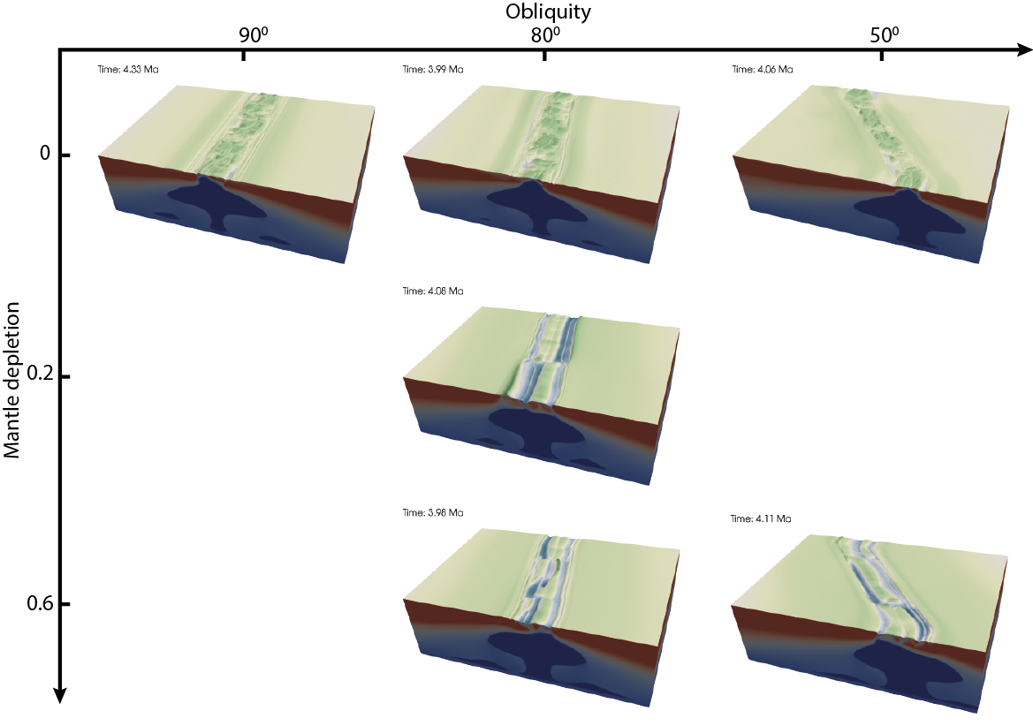
Coupled effect of obliquity and melt supply on ultra-slow spreading systems
Click on elements of the figure to zoom
The following figure summarizes how obliquity and magmatic supply interplay to affect the seafloor morphology (see notes for more explanations).
In accordance with previous studies the results show that the magmatic supply is the main control on tectonic regimes. Low magmatic supply favours the formation of oceanic core complexes over crustal accretion and low angle detachment.
Obliquity of the ridge plays a second order role. Higher obliquity favours longer ridge segments.
Notes:
As ridge position/activity is not controlled in this numerical model magma supply cannot be varied as in previous studies (e.g. Buck et al., 2005; Howel et al., 2019). For these reasons We use the mantle rock depletion level as a proxy for magma supply. By increasing the depletion level in mantle rocks this artificially reduce the melting capacity of these rocks and reduce the magma supply at the ridge. The melting and accretion is controlled by a temperature and pressure dependent thermodynamic database (see Puthe et al., 2014 for details). Melt extraction and percolation is implemented in

Slide 8
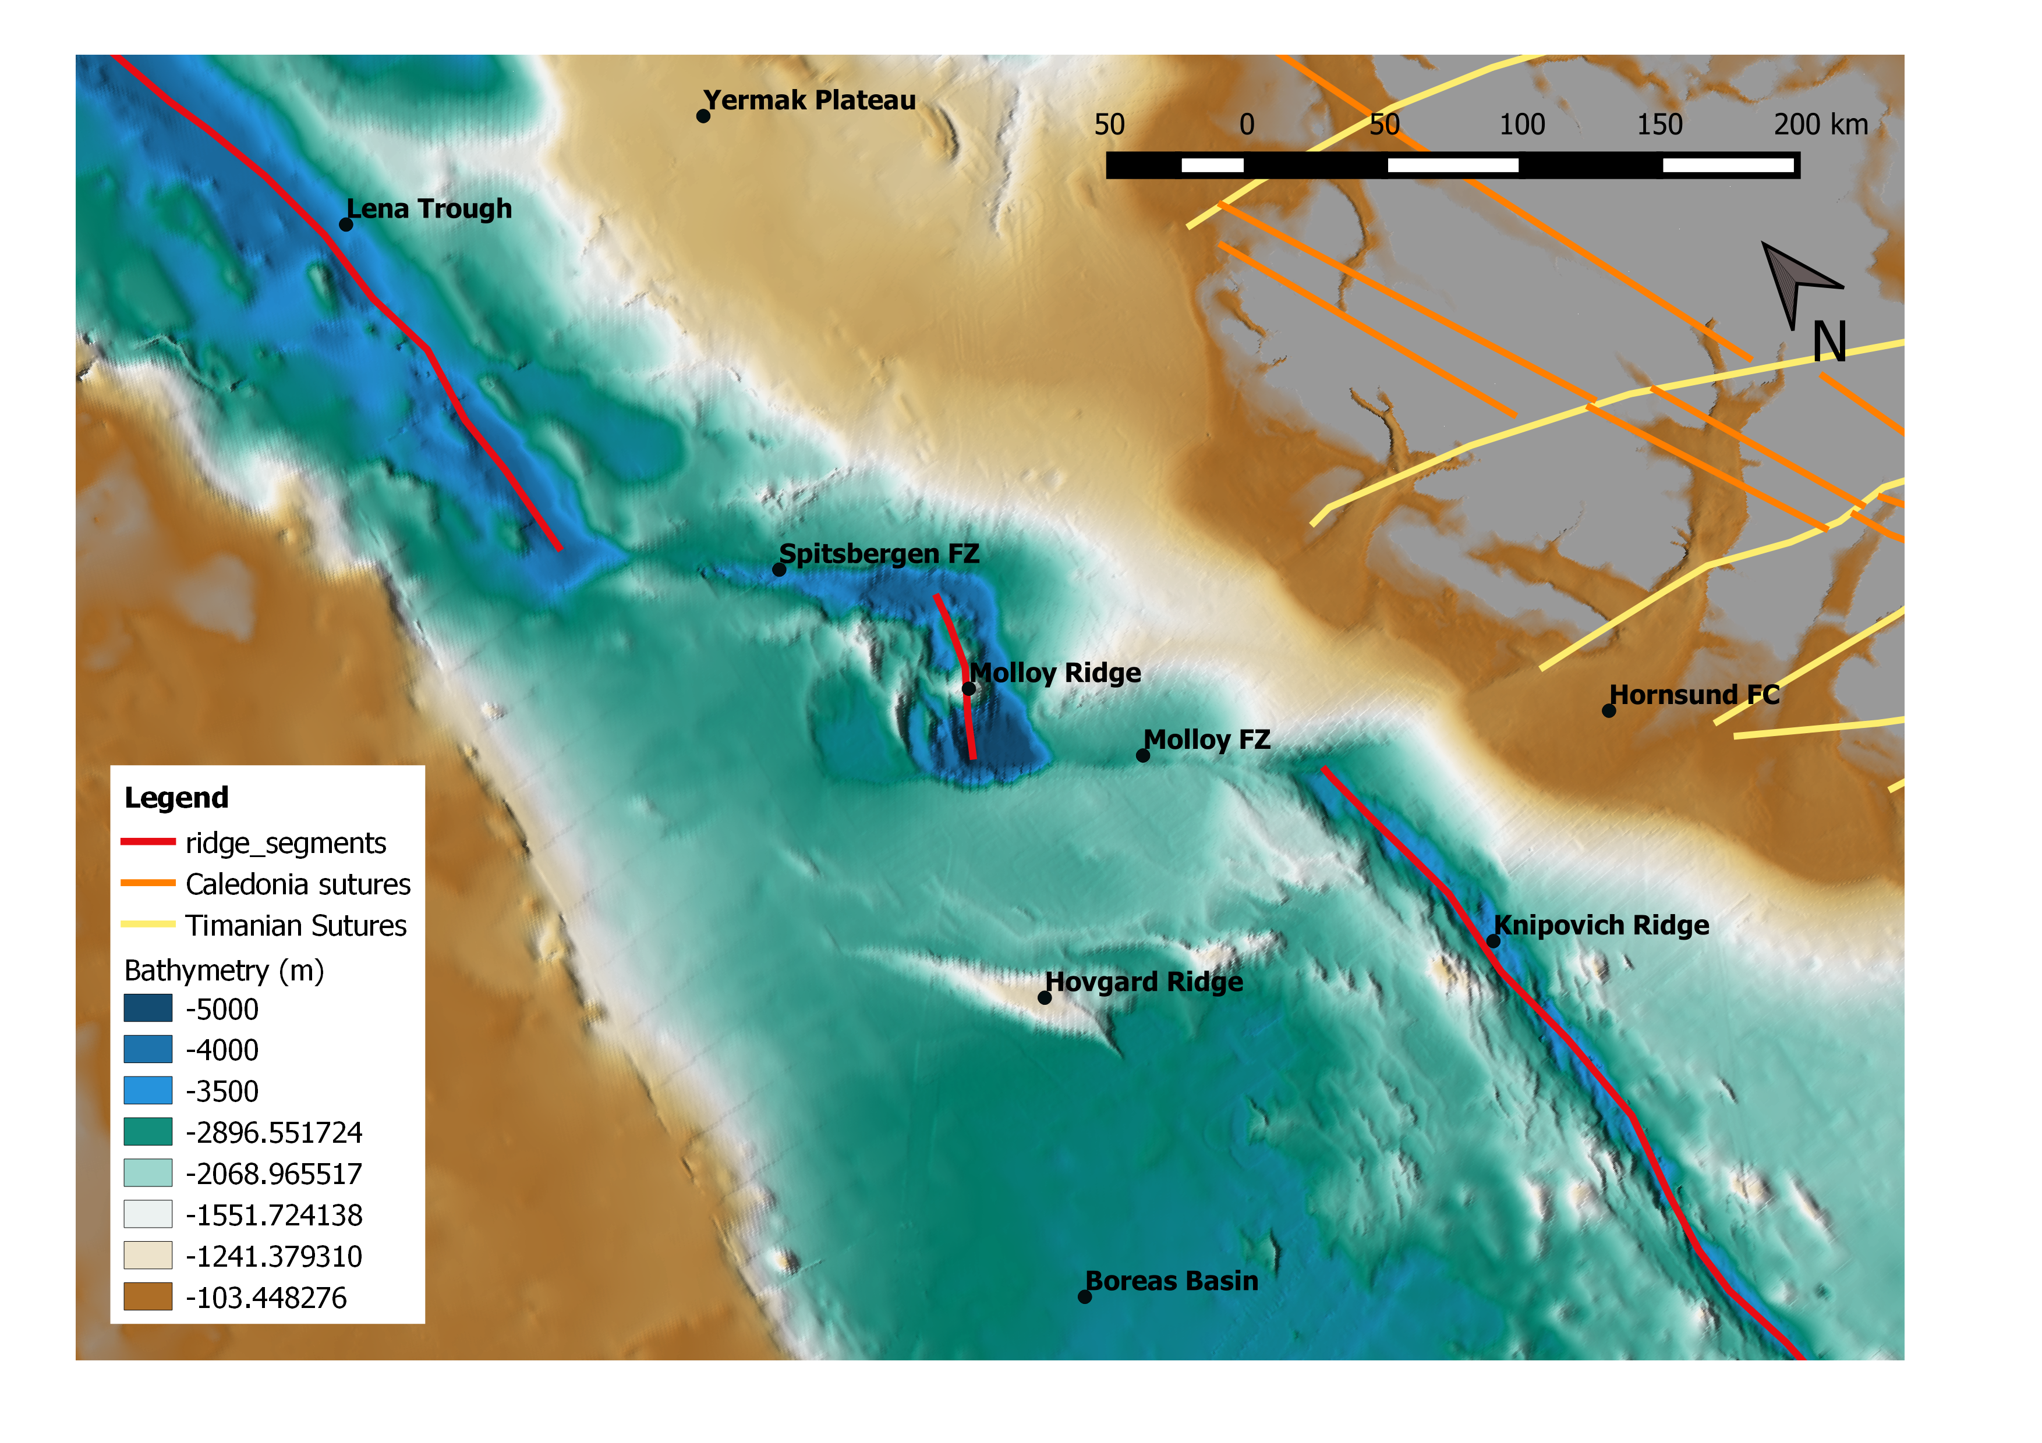
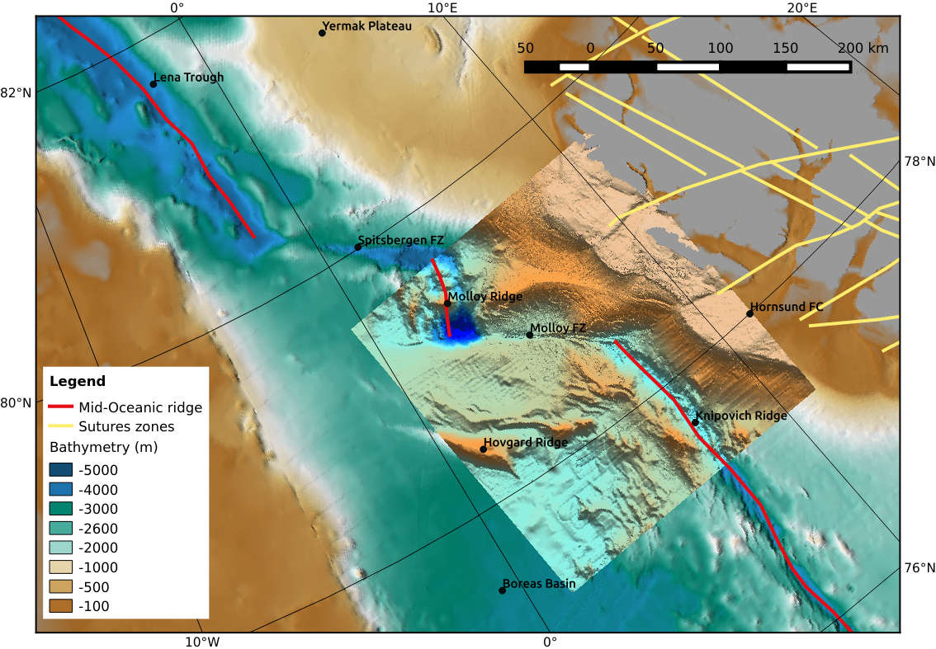
Case study: The Fram Strait
The Fram strait is an example of the complex interaction between ridge and transform systems.
The two largest transform faults – the Spitzbergen and Molloy Fault zone – are likely inherited from prior lithospheric-scale shear-zones in the continental margin.
We apply the modelling approach to study the morphology of the Fram Strait Seafloor.
Sutures mapping on the Svalbard continental shelf is a curtesy of J.-B. Koehl

Slide 9
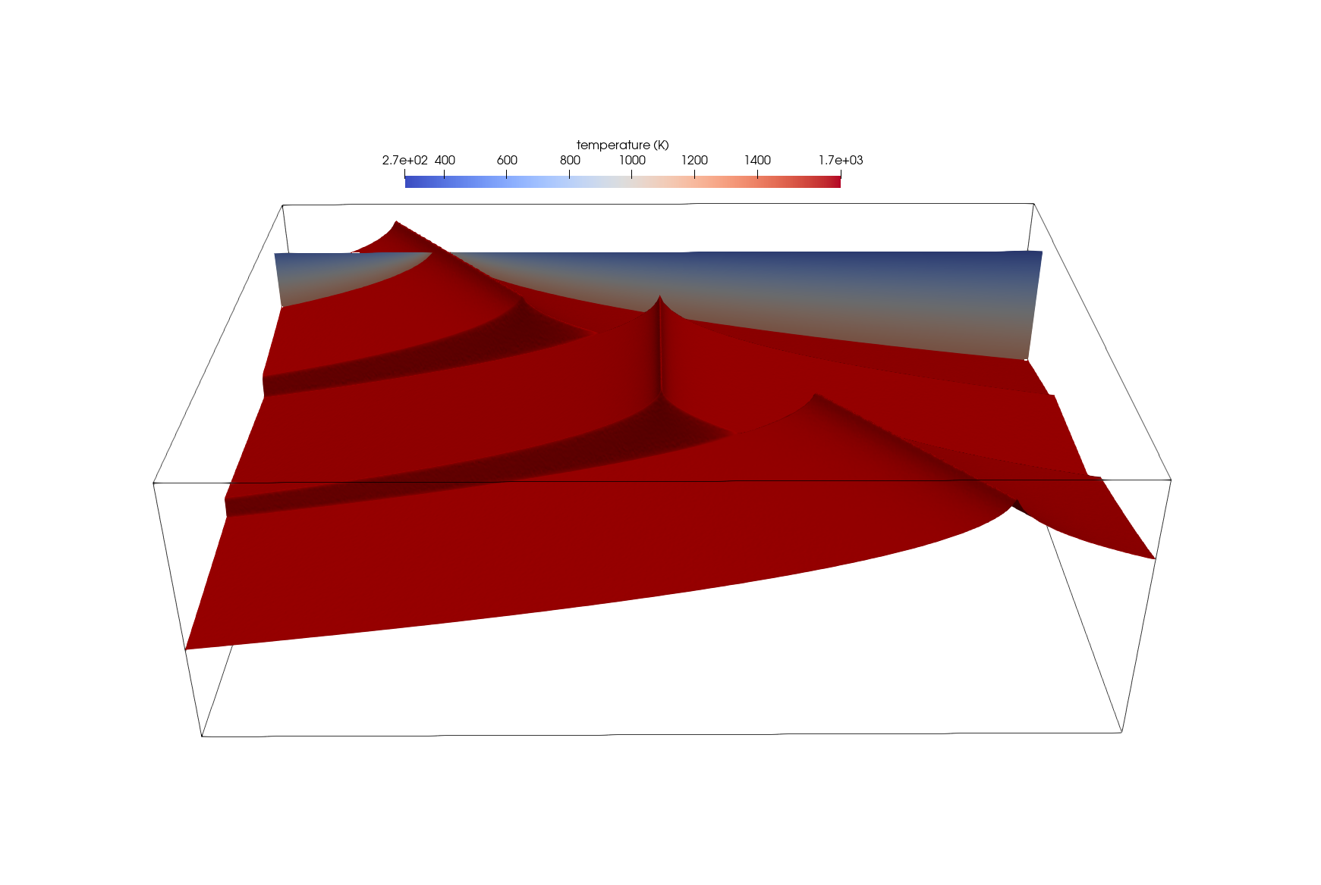
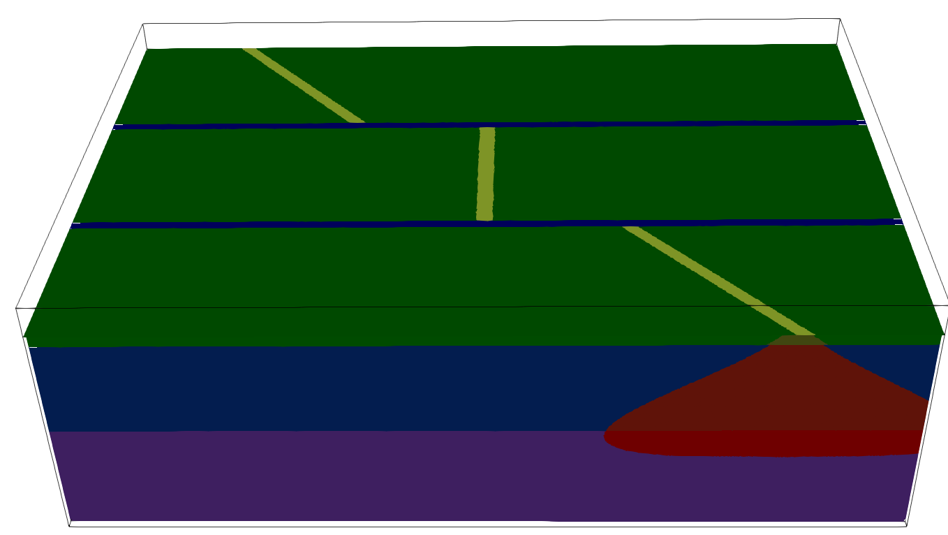
Initial configuration of numerical model
Model parameters:
Dimension – 298x98x202 km
Resolution – 500 m
Boundary conditions:
  Divergence is imposed on left and right boundaries (black arrows), with a half-rate of 7 mm/yr.
  Free surface with a sticky-air layer.
The setup is of three ridge segments corresponding to the Lena Trough, Molloy Ridge and Knipovich Ridge, respectively (light green). They are separated by two transform faults (blue). The Red surface mark the 1100ᵒC isotherm.
Two ridge segments are oblique (50ᵒ) while the central one is orthogonal.
202 km
98 km
298 km
Oceanic crust
Oceanic crust
Lithosphere
Asthenosphere
Partial molten zone
Notes:
The figure show the initial configuration of the numerical experiments. The setup correspond to an oceanic lithosphere with an homogenous 8 km thick continental crust. The thermal structure of the lithosphere correspond to the half-space model for ocean, with continuous divergence half-rate of 7 mm/yr. The obliquity of the ridge is the angle between the divergence direction and the ridge axis (i.e. Orthogonal ridge has an obliquity of 90ᵒ). It is defined by the thermal structure of the oceanic lithosphere than can be see in red on the figure.
A free surface boundary condition on top of the model is implemented using 10 km a sticky-air layer (Schmeling et al., 2008). Upper and lower velocity boundary conditions are defined to preserve mass balance in the sticky-air and material domains of the model respectively.
Melting and ridge accretion is implemented using a thermodynamic database and a melt migration algorithm that has been successfully applied to the study of accretion at ridges in previous studies (Gerya et al., 2013).
A very high resolution of 500m is used to adequately model fault formation in ultra-slow spreading systems (Gulcher et al. , 2019).
We use the grain-damage rheology to model ridge transform systems in 3D.

Slide 10
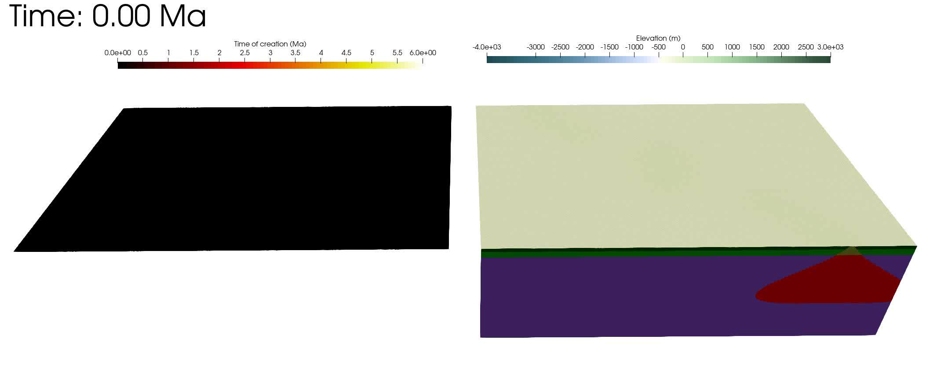
Modellins seafloor spreading at the Fram Strait
Animation of numerical experiments representing seafloor spreading in the Fram Strait. On the right side is the time of creation of elements at the surface (elements that were created at model initiation have a time of creation of 0 Ma). On the left you have the bathymetry in the model on top of a material distribution block.
Notes:
Model sshad.

Slide 11
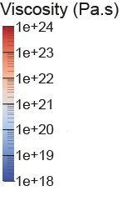
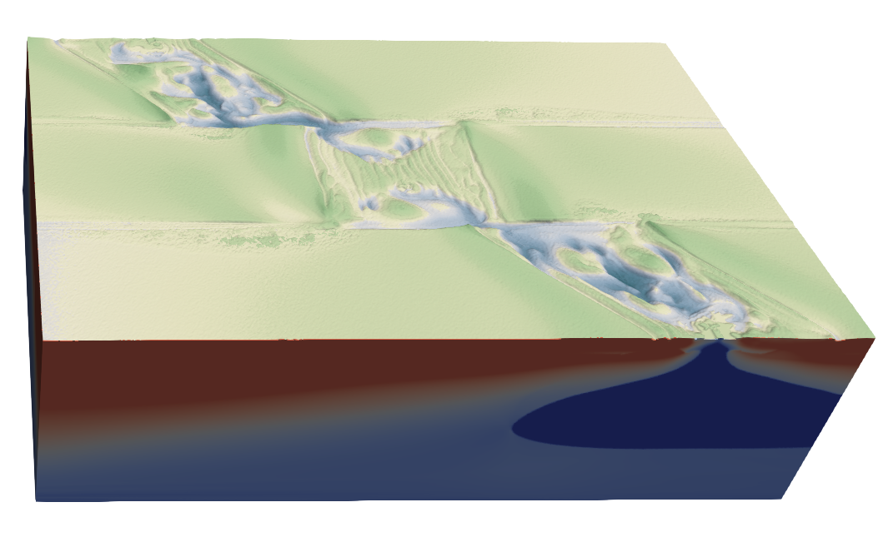
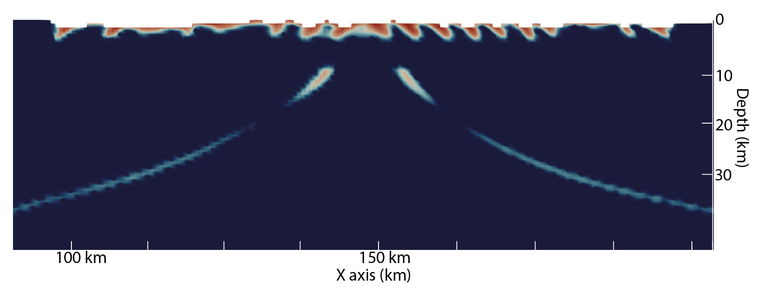
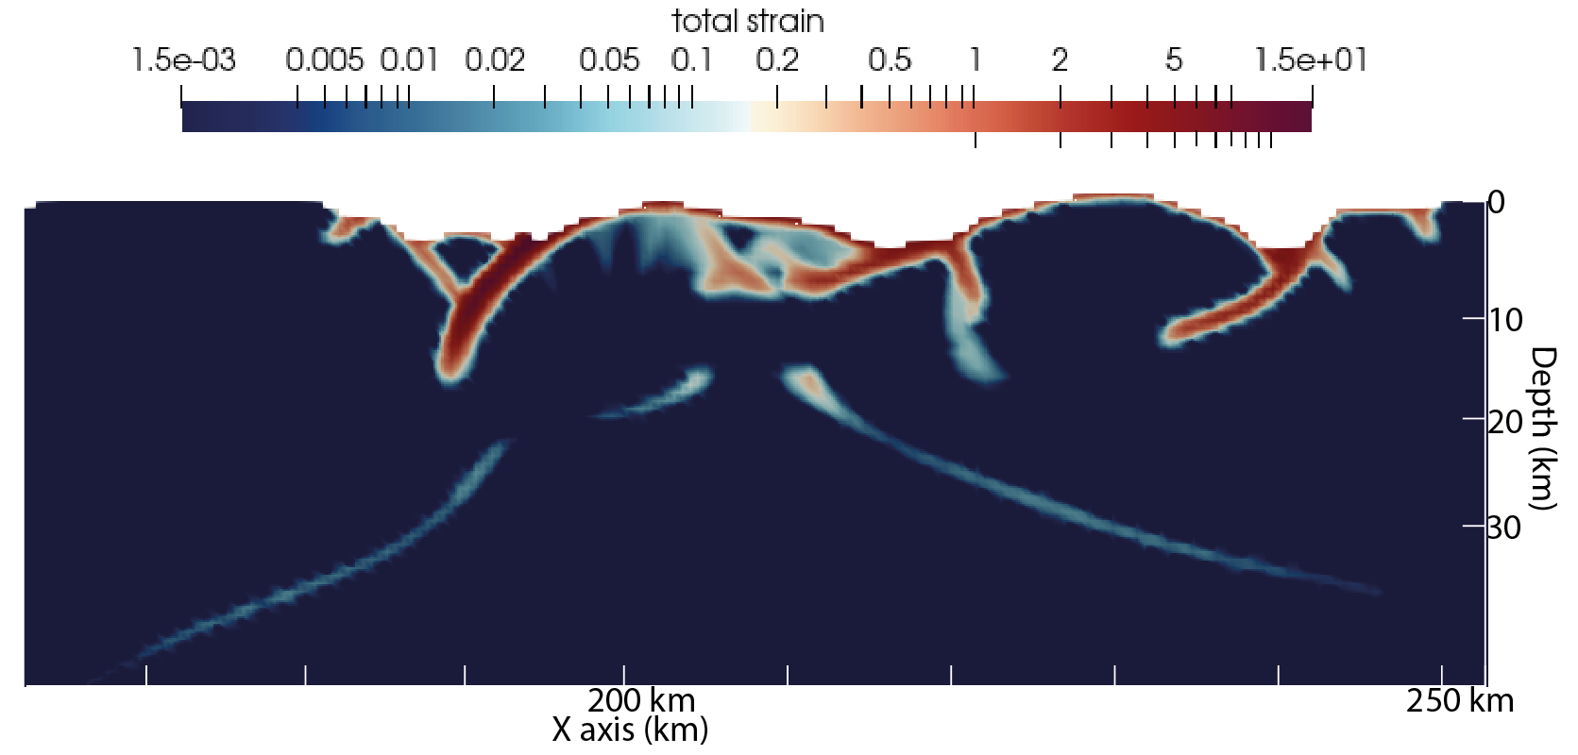
Fram Strait: interplay between ridge and transform systems
5.16 Ma
Oceanic crust accretion and low-angle faults
The difference in ridge obliquity strongly affect the system. In the orthogonal segments oceanic crust accretion and low-angle detachment faults are dominant while in the oblique segments OCC formation is dominant with high-angle detachment faults.
Oceanic core complex and high-angle faults

Slide 12
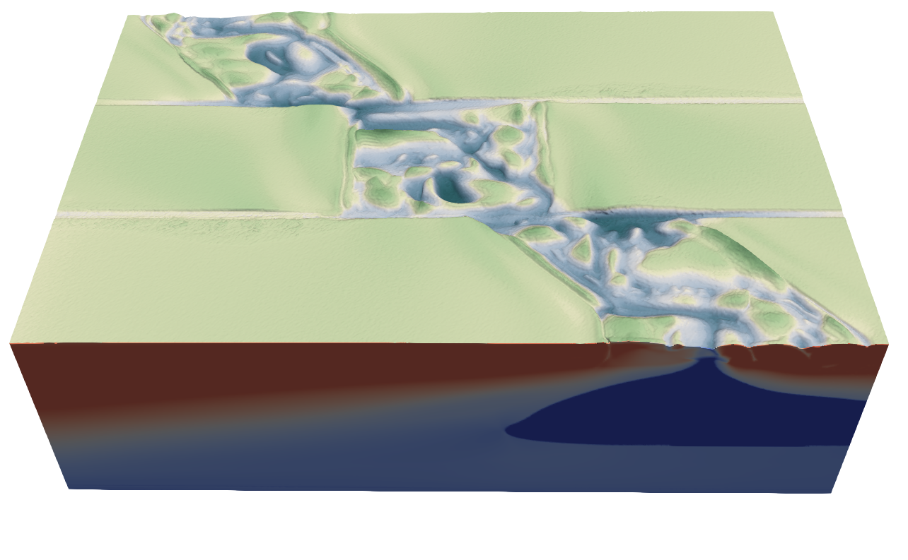
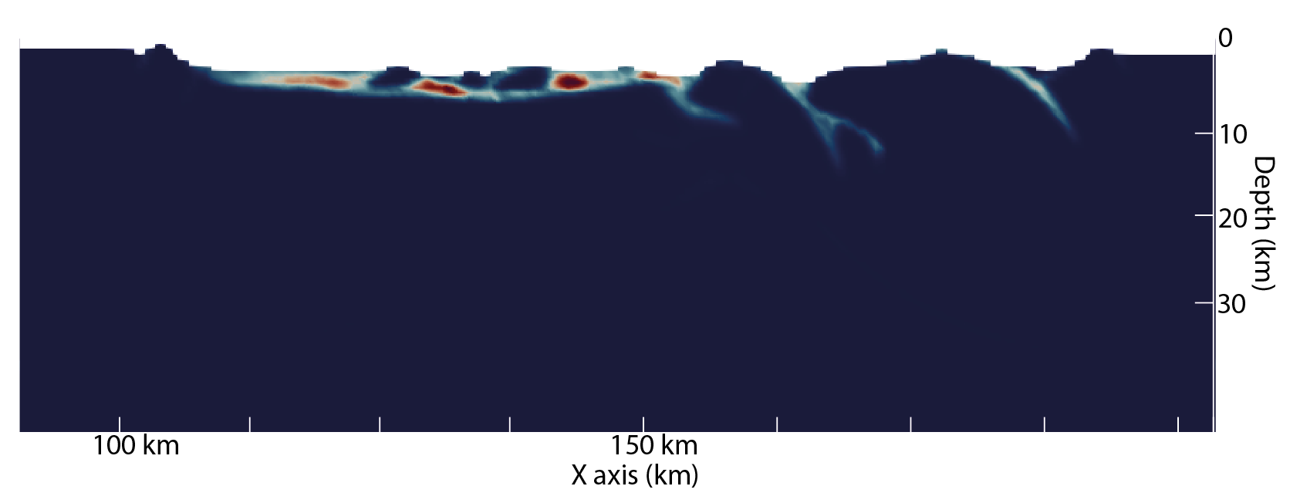
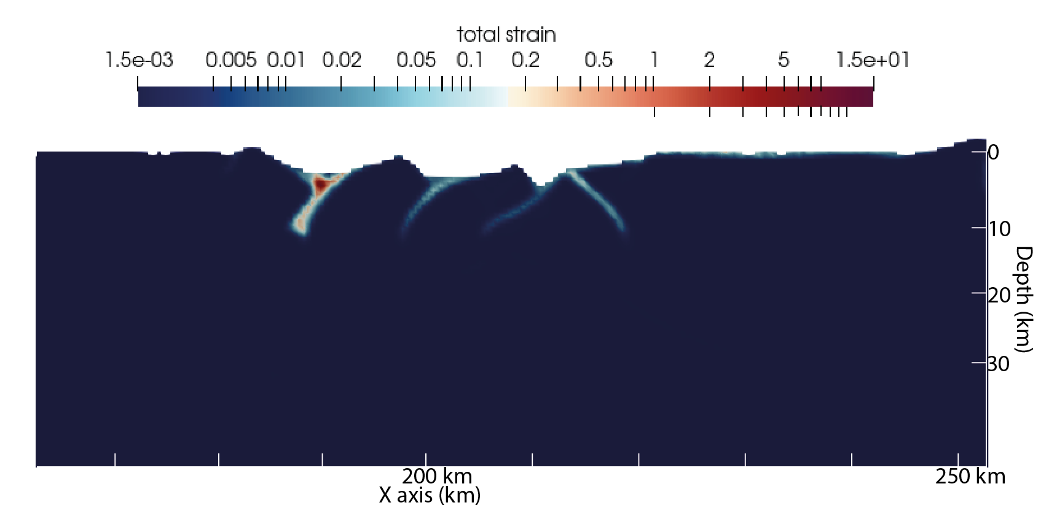
Fram Strait: interplay between ridge and transform systems
6.12 Ma
By reducing melt input at the ridge. OCC are formed in the orthogonal region.

Slide 13
Conclusion
This study has provided an additional perspective on the dynamics of ultra-slow spreading ridge.
  Using an advanced model for partial melting and accretion. Numerical experiments are in accordance with previous studies that has shown that the main control of tectonic regime is the magma supply at the ridge.
  Furthermore it shows that ridge obliquity can play an important role in controlling the seafloor morphology by affecting the tectono-magmatic regime and the segmentation of mid-oceanic ridge systems.
  There seem to be an interplay between tectonic activity at transform faults and ridge obliquity but understanding it would require further studies.
  This last point is likely to play a major role in understanding the morphology of seafloor in the Fram Strait.

Slide 14
Thank you for reading this online presentation
Simulation presented where performed on the SAGA cluster of the Norwegian e-infrastructure for research and education (project nn9707k).
This study is part of the Seamstress project and was financed by grants A31680 from the Tromsø Research Foundation.

Slide 15
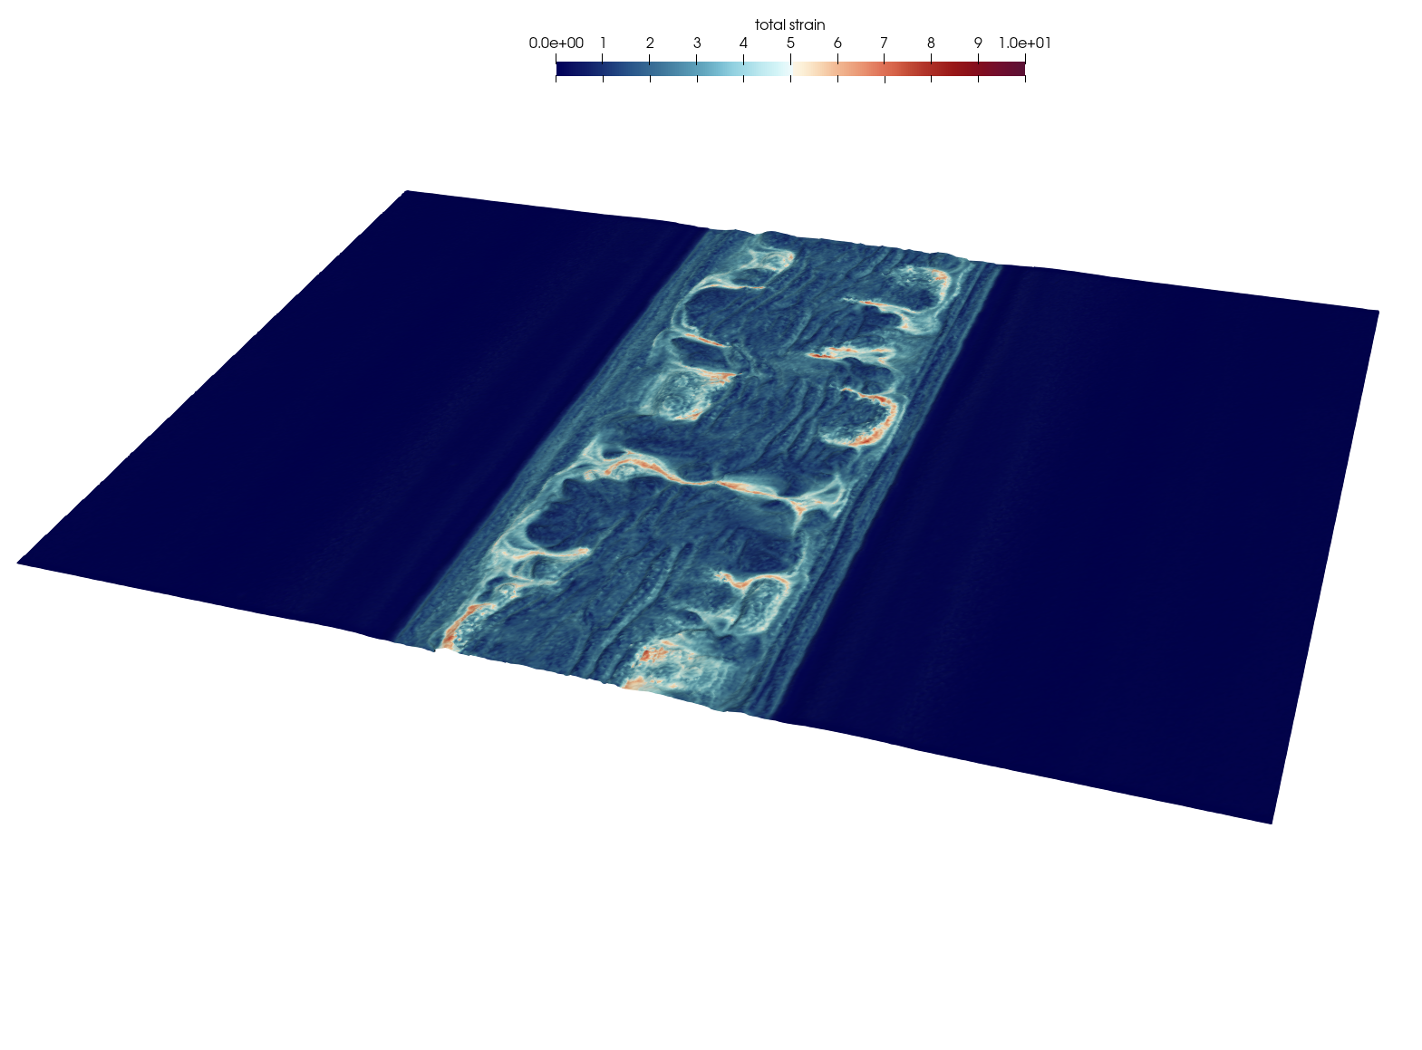
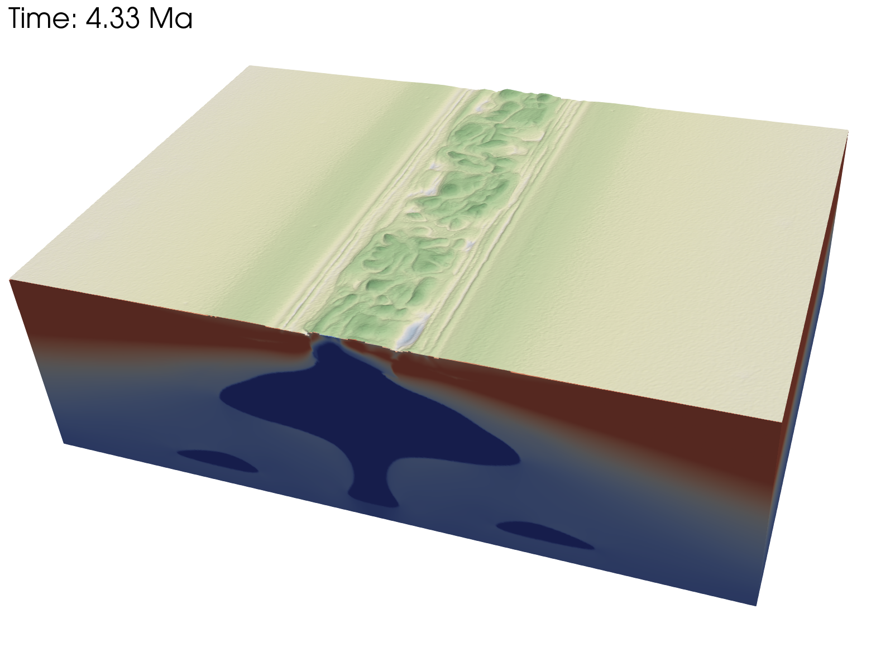
Obliquity 90ᵒ - mantle depletion – 0.0
Go Back

Slide 16
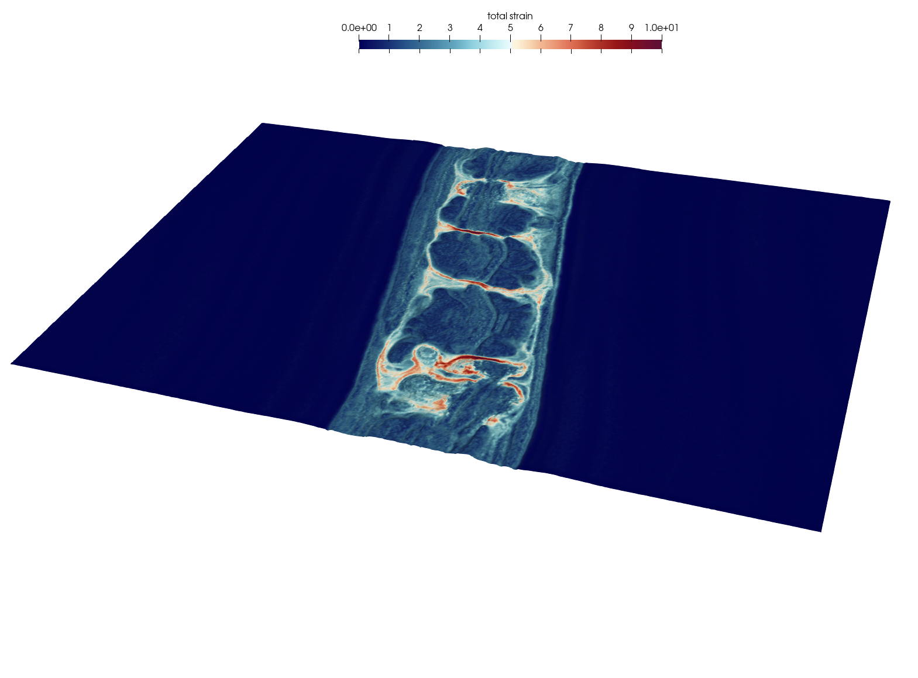
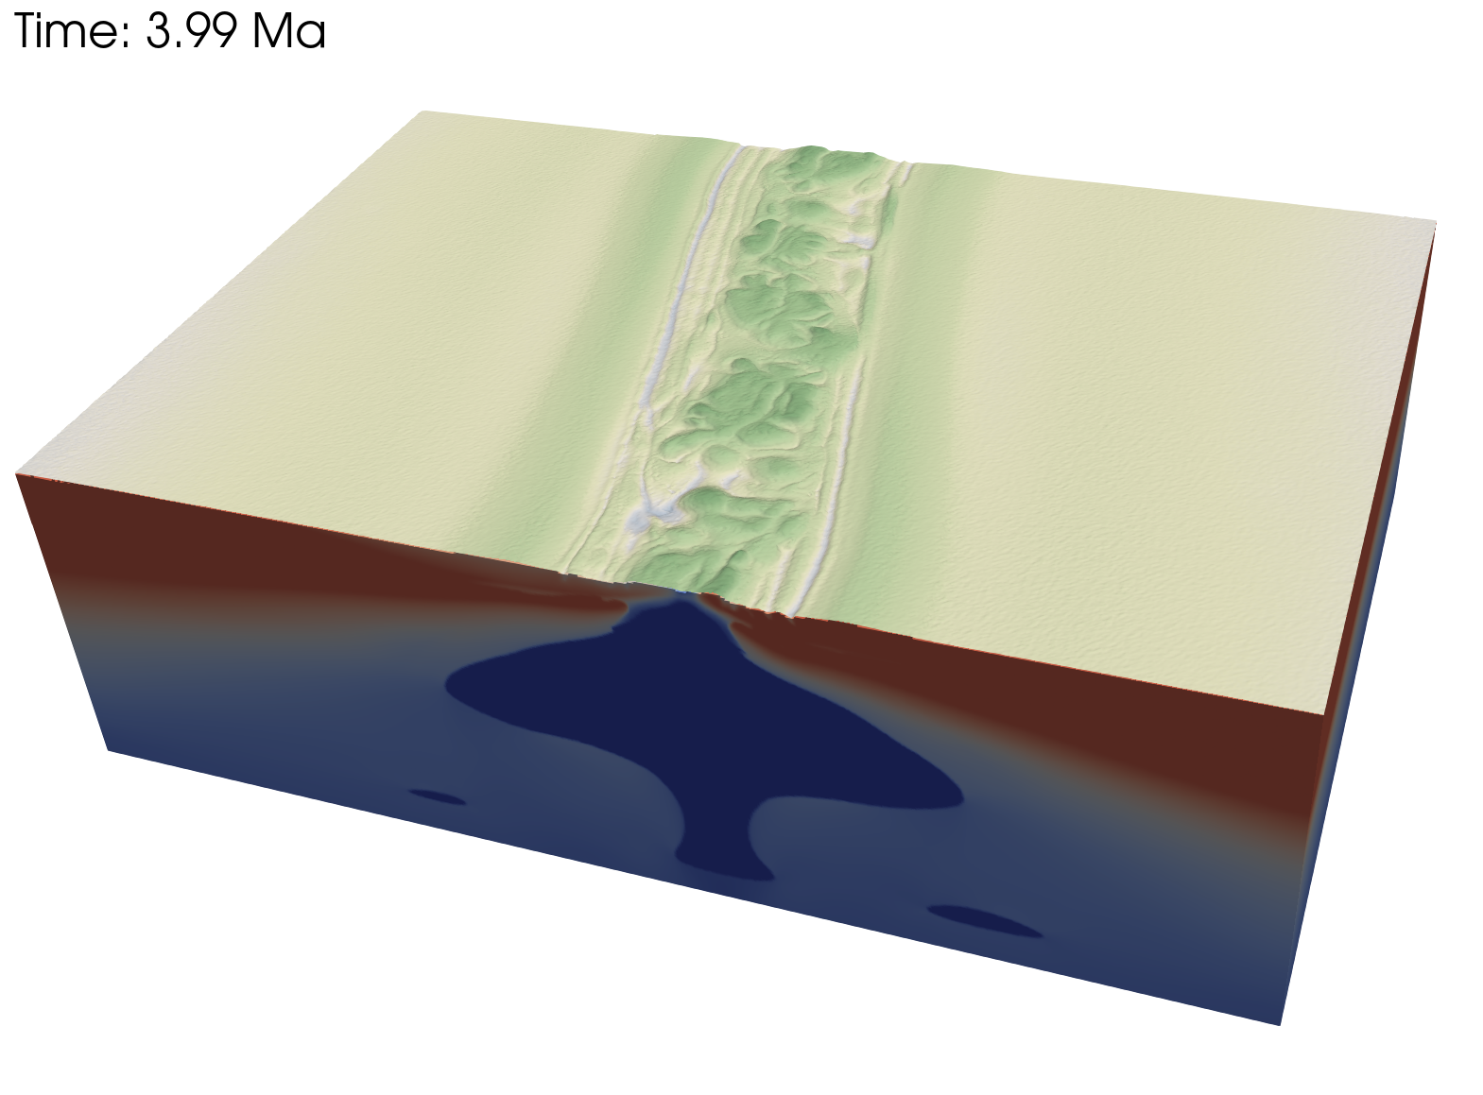
Obliquity 80ᵒ - mantle depletion – 0.0
Go Back

Slide 17
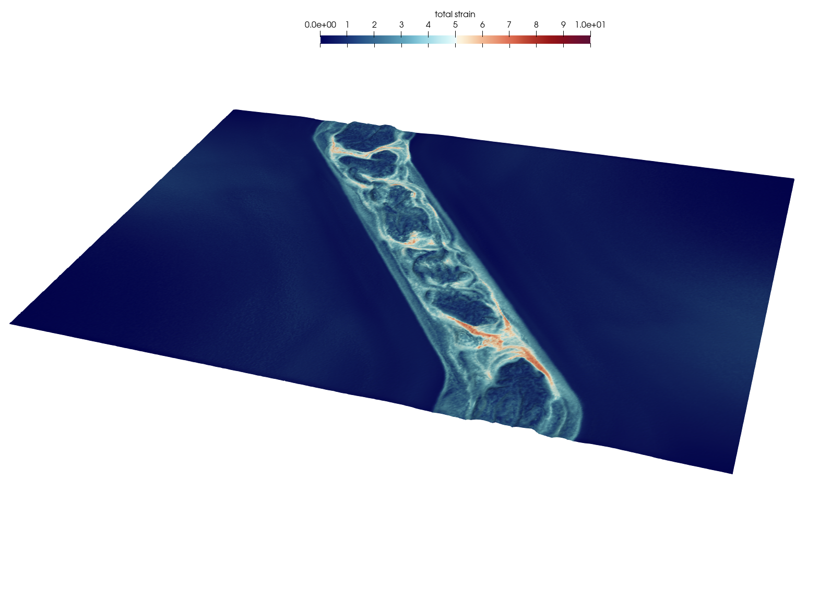
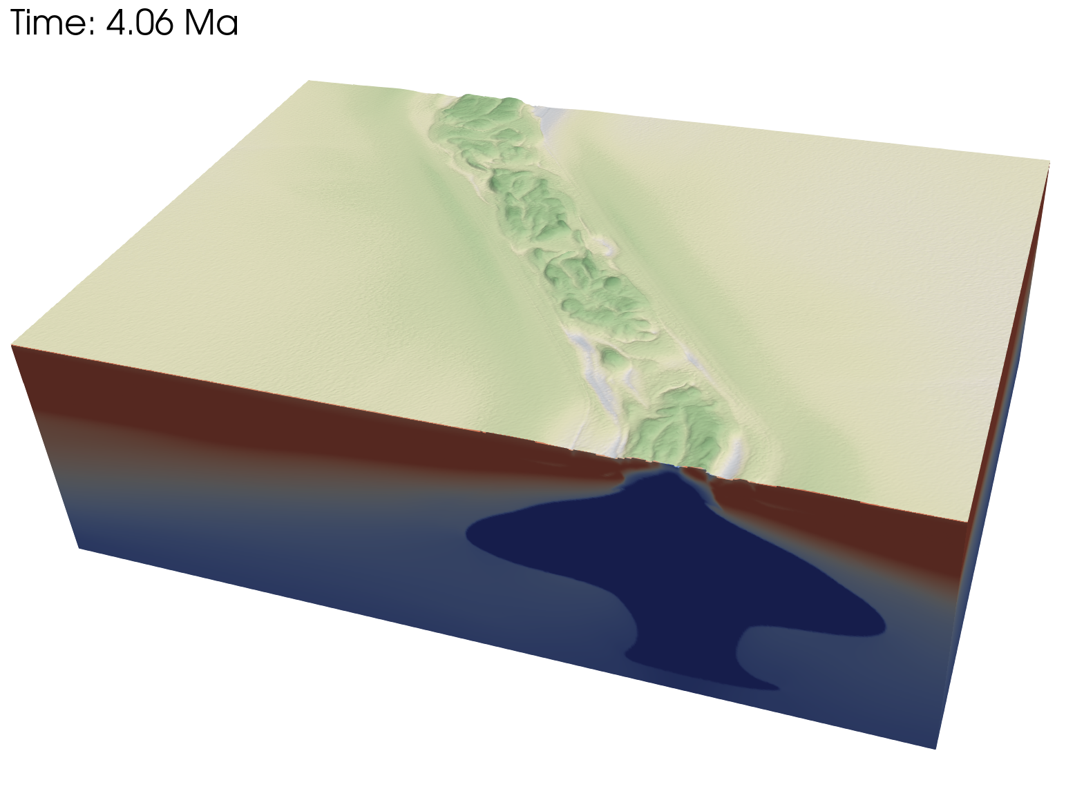
Obliquity 50ᵒ - mantle depletion – 0.0
Go Back

Slide 18
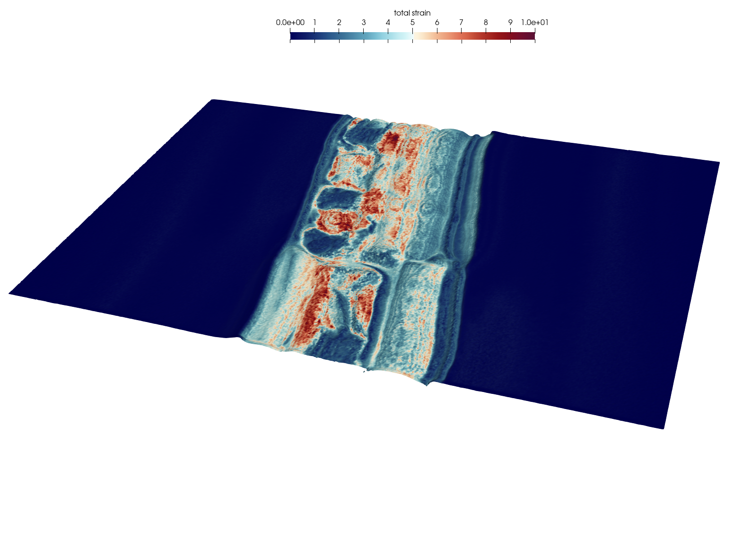
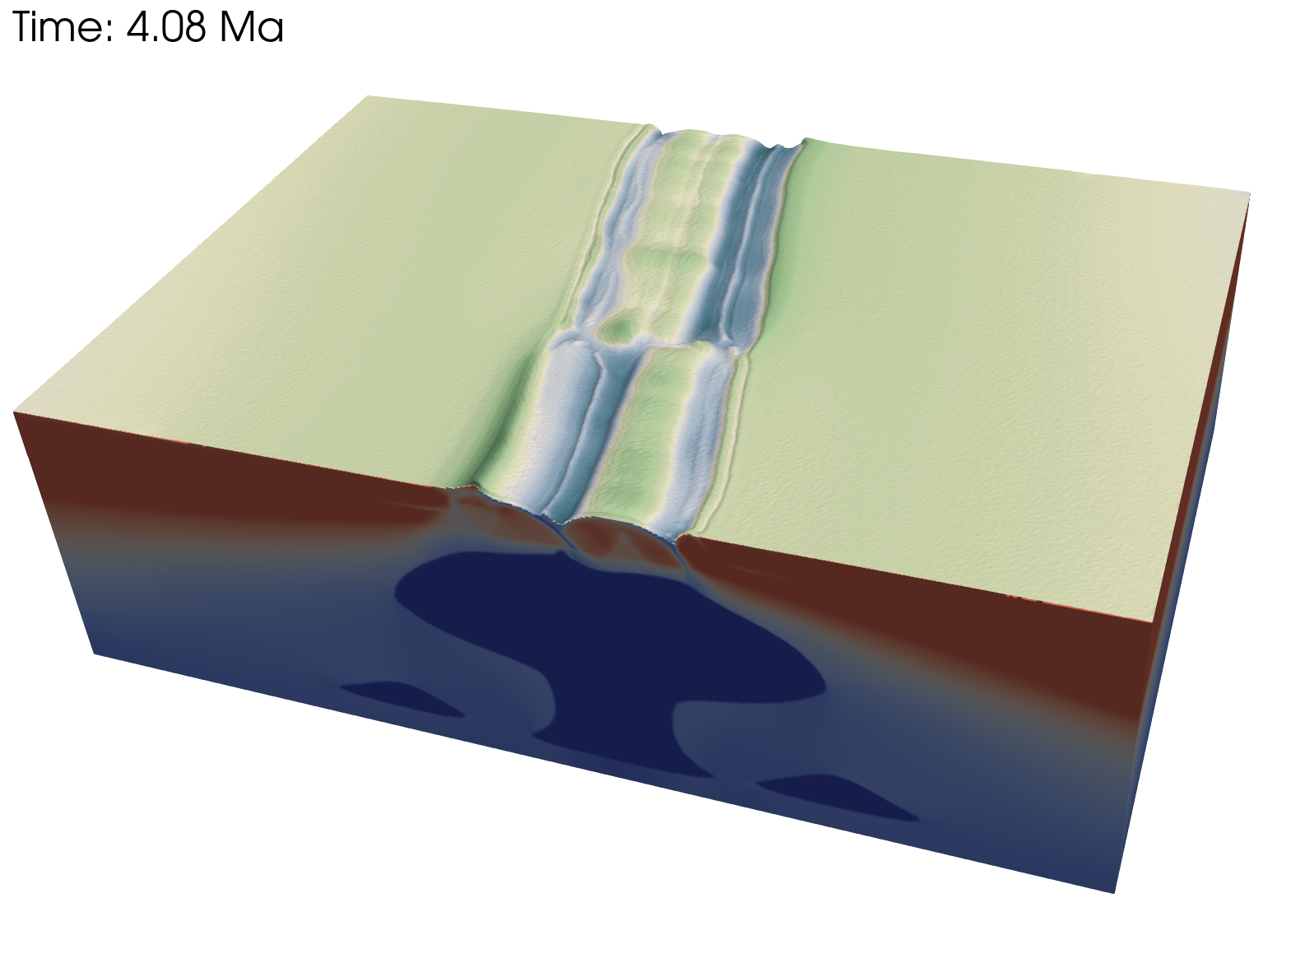
Obliquity 80ᵒ - mantle depletion – 0.2
Go Back

Slide 19
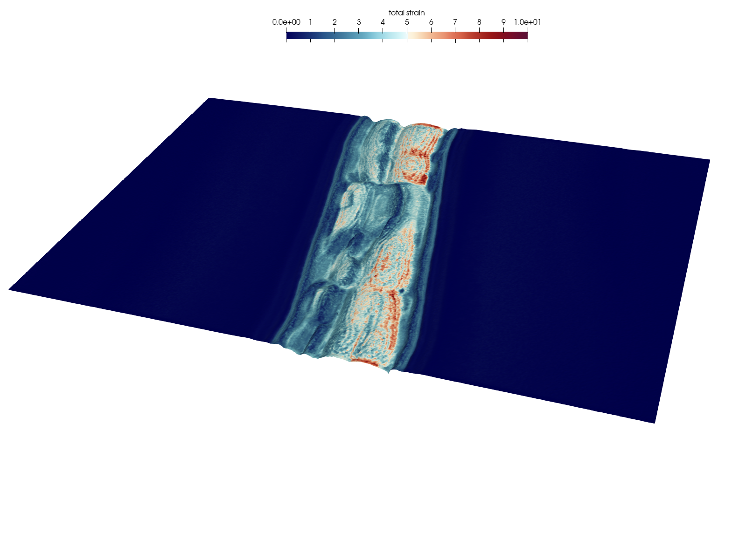
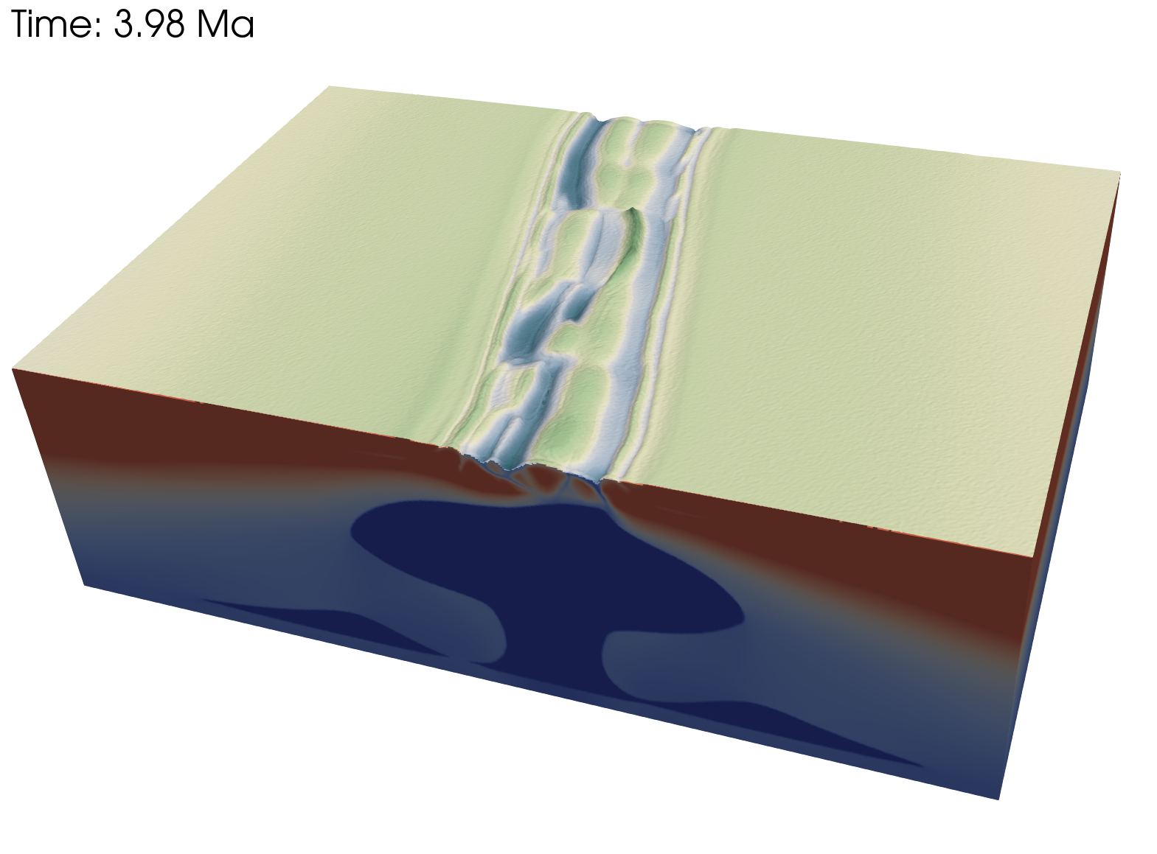
Obliquity 80ᵒ - mantle depletion – 0.6
Go Back

Slide 20
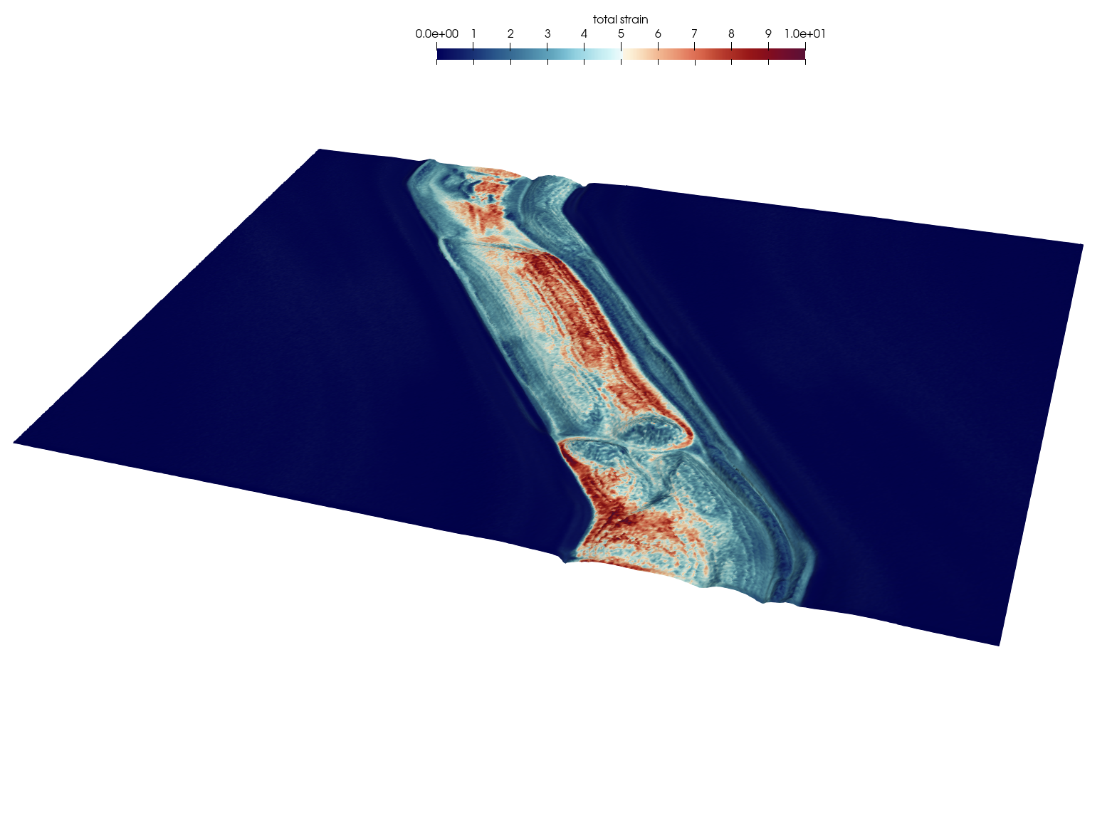
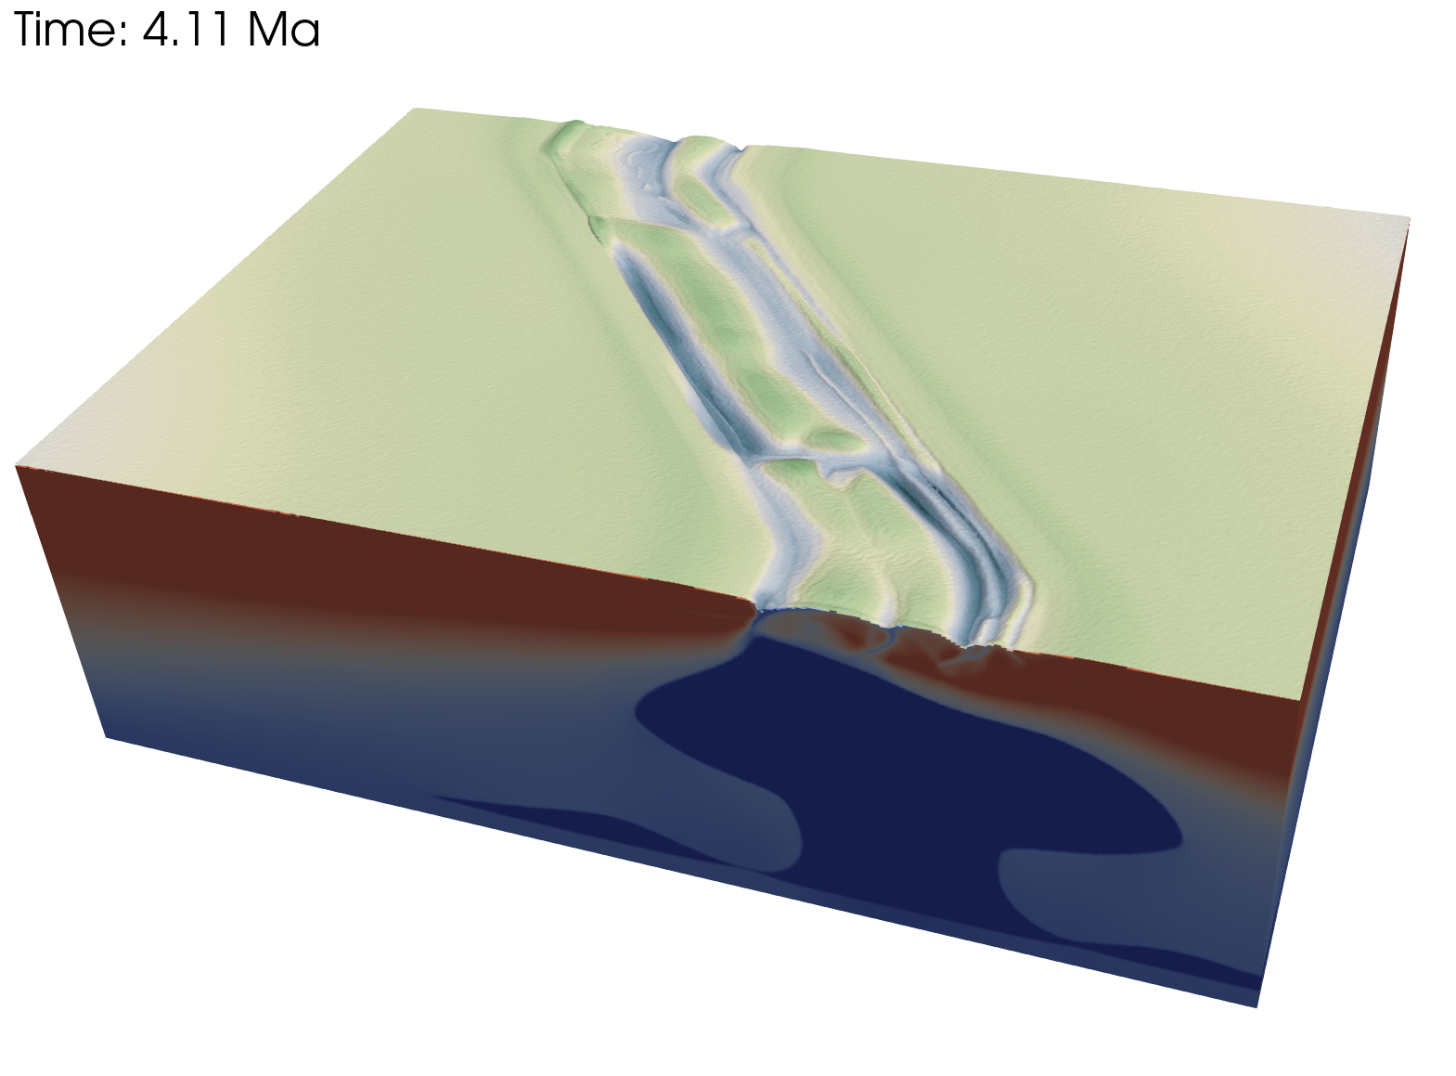
Obliquity 80ᵒ - mantle depletion – 0.6
Go Back

