Slide 1
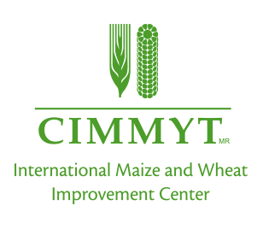
“SOC modelling and cropping system managements in contrasting climatic conditions”
Marco Acutis, Elena Valkama, Gulya Kunypiyaeva, Muratbek Karabayev, Rauan Zhapayev, Erbol Zhusupbekov, Alessia Perego, Calogero Schillaci, Dario Sacco, Barbara Moretti, and Carlo Grignani
SSS9.7/BG3.54
Wed, 06 May, 08:30–10:15 | D2110

Slide 2
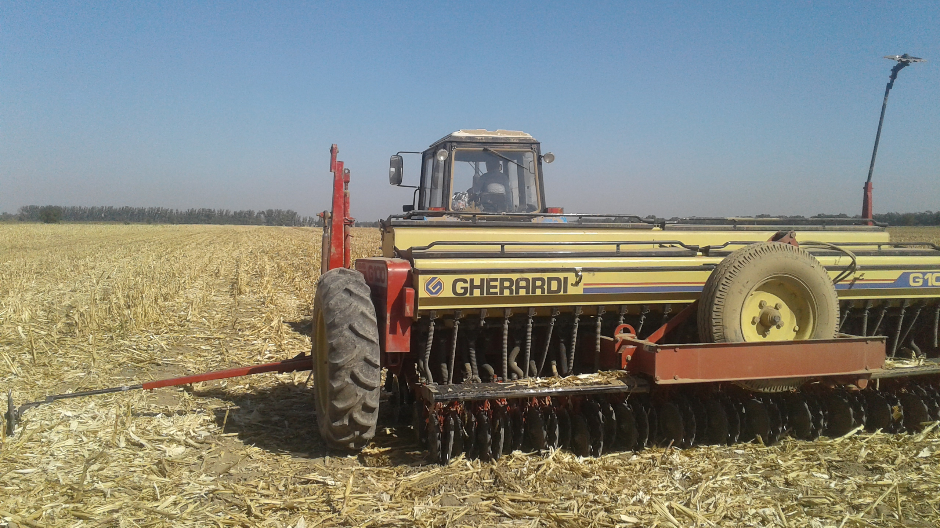
INTRODUCTION
Conservation Agriculture (CA)
Minimum soil disturbance
Permanent soil cover
Crop rotation and intercropping

Slide 3
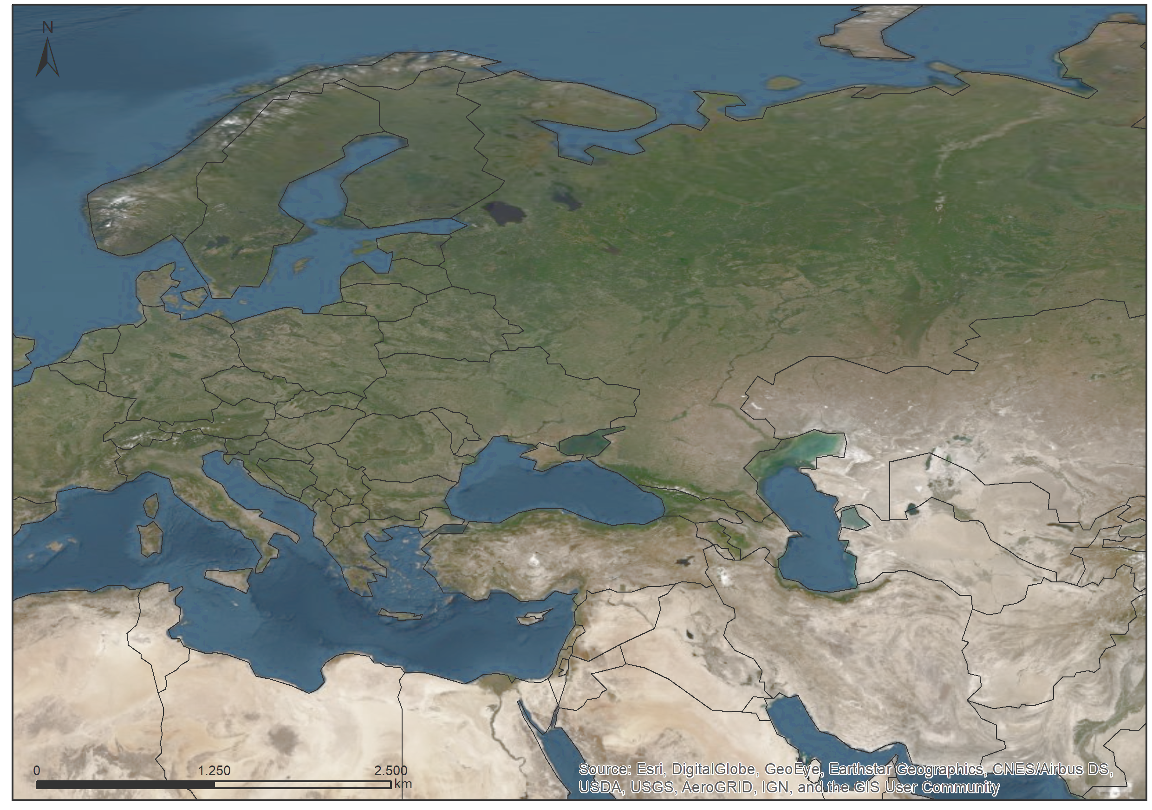
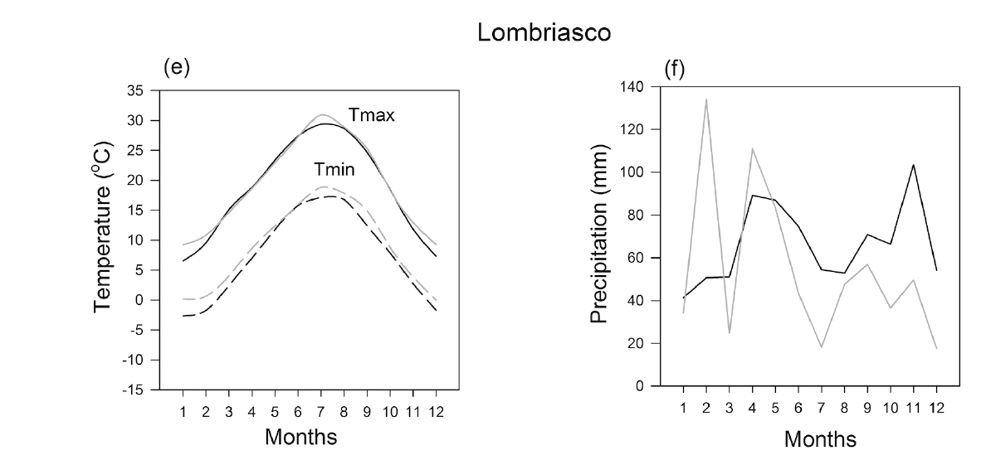
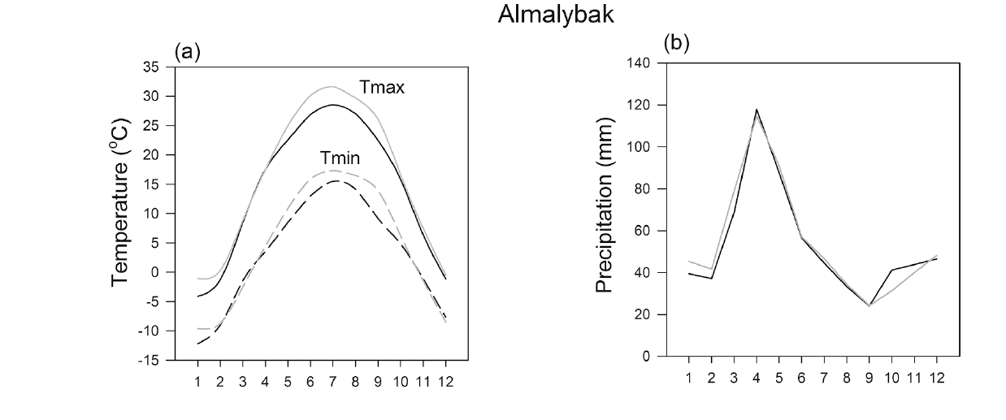
METHOD
SOC modeling-
ARMOSA
IT
KZ

Slide 4
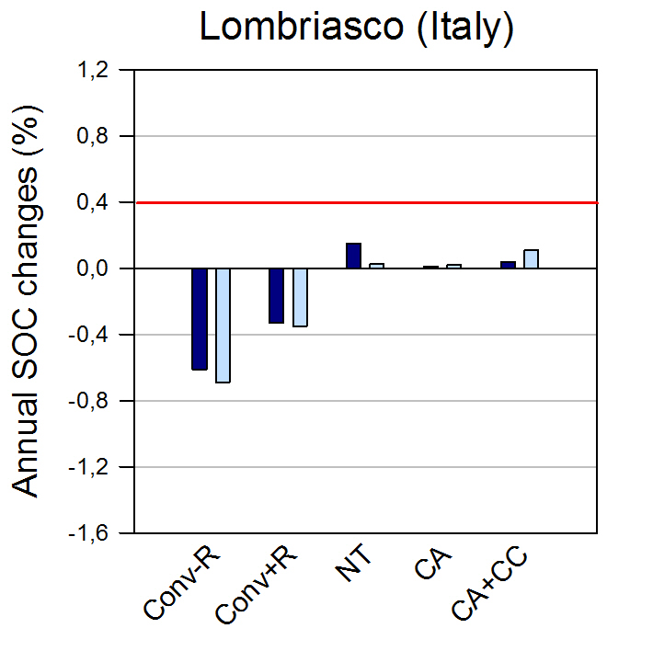
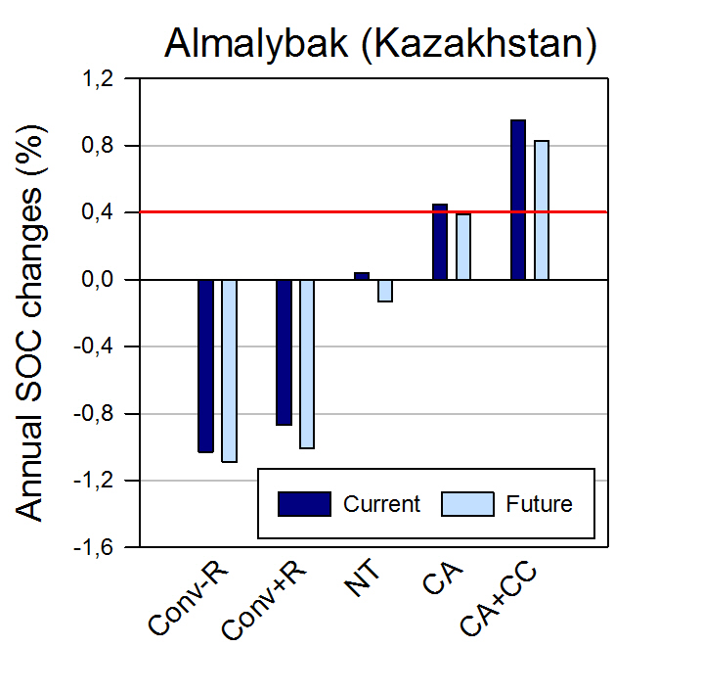
RESULTS
Valkama et al. (2020) Can conservation agriculture increase soil carbon sequestration? A modelling approach. Geoderma: 369 https://doi.org/10.1016/j.geoderma.2020.114298
Conv-R/Conv+R – Conventional (residues removed/retained);
NT-no-tillage;
CA- Conservation Agriculture
CA+CC - Conservation Agriculture + Cover Crops
In Italy CONV and NT was a maize monoculture;
CA and CA+CC was a rotation of Winter wheat, soybean and maize
In Kazakhstan CONV and NT was a spring barley monoculture;
CA and CA+CC was a rotation of Winter wheat, spring barley and chickpea.

Slide 5
CONCLUSIONS
In Italy
it is impossible to reach the 4 per 1000 objective
CA can avoid soil carbon losses in actual and future climate.
In Kazakhstan
it is possible to store carbon in the soil adopting CA and to reach the 4 per 1000 objective
The cover crops play a very important role allowing to double the C storage.

Slide 6
THANK YOU!

