Slide 1
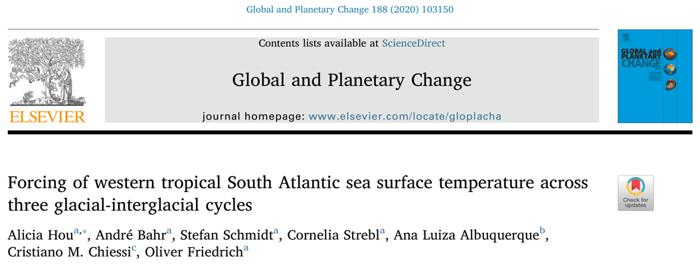
Forcing of western tropical South Atlantic SST across three glacial-interglacial cycles
Alicia Hou¹, André Bahr¹, Stefan Schmidt¹, Cornelia Strebl¹, Ana Luiza Albuquerque², Cristiano M. Chiessi³, Oliver Friedrich¹
¹Institute of Earth Sciences, Heidelberg University, Heidelberg, Germany
²Programa de Geociências (Geoquímica), Universidade Federal Fluminense, Niterói, Brazil
³School of Arts, Sciences and Humanities, University of São Paulo, São Paulo, Brazil

Slide 2
Introduction
We present a high-resolution SST reconstruction of the southern western tropical Atlantic (WTA) using planktic foraminiferal Mg/Ca ratios to investigate the drivers of WTA SST evolution across several glacial-interglacial cycles.
Cores M125 -55-7/8 (yellow star in figure)
R/V METEOR cruise M125
1960.8 m depth
Methods
Mg/Ca analysis of Globigerinoides ruber (pink) after oxidative and reductive cleaning (Martin & Lea, 2002)
¹⁴C dating and tuning of benthic δ¹⁸O to LR04 benthic stack (Lisiecki & Raymo, 2005)
Hou et al. (2020)

Slide 3
Results
M125-55-7 SSTs are representative of the WTA (note similarity to Site 999) and thus suitable for investigating the climatic drivers of long-term WTA SST evolution.
Note the prolonged SST warming during MIS 6 – 5e and the lack of orbital pacing in Site M125-55-7 SSTs.
Hou et al. (2020)

Slide 4
Evaluating driving mechanisms
WTA SST responds more strongly to southeast (SE) trade wind intensity (indicated by the intrahemispheric △SST) than to variations in AMOC strength (indicated by the essentially constant interhemispheric △SST).
Anomalous SST warming during MIS 6 – 5e may be due to exceptionally strong SE trade winds when the intrahemispheric ∆SST is sustained above a threshold temperature.
Hou et al. (2020)

Slide 5
Evaluating driving mechanisms
Zonal SST gradients display high-amplitude glacial-interglacial variability which is likely driven by glacial-interglacial fluctuations in the strength of the SE trade winds.
Hou et al. (2020)

Slide 6
Proposed mechanism: SE trade wind forcing
Hou et al. (2020)
Tropical Atlantic SST and surface-heat distribution are modulated by SE trade wind strength. Note that colored dots show mean MIS 5 and 6 SST at selected sites.

Slide 7
Conclusions
Variations in SE trade wind intensity have a strong influence on WTA SST at glacial-interglacial timescales
Prolonged SST warming during MIS 6 – 5e was exceptional due to strong SE trade winds
Southern WTA SSTs are generally insensitive to orbital forcing
The cross-equatorial SST gradient in the WTA remained low and stable over the past 322 kyr

