Slide 1






Global Stability Properties of the Climate: Melancholia States, Invariant Measures, and Phase Transitions
Valerio Lucarini (1,2,3)
Department of Mathematics and Statistics, Uni. Reading, Reading
Centre for the Mathematics of Planet Earth, Uni. Reading, Reading
CEN, University of Hamburg, Hamburg
Thanks:
T. Bodai, H. Dijkstra, M. Ghil, A. Gritsun, V. Lembo, F. Lunkeit, F. Ragone, A Tantet
B. Eckhardt⁺, G. Gallavotti, M. Ghil, D. Ruelle, J. Yorke

Slide 2

Mathematics of Climate
Emerging area of interdisciplinary research;
MPE2013 global initiative (Newton Inst. Event)
Some Topics:
  Numerical Methods
  (Geophysical) Fluid Dynamics PDEs and SPDEs
  Network Theory
  Big Data
  Data Assimilation
  Parametrization/Coarse Graining Multiscale Systems
  Extreme Value Theory
  Large Deviation Theory
  Dynamical Systems: Instabilities and Bifurcations
  Nonequilibrium Statistical Mechanics

Slide 3

Lots of Dissemination & Training
ICTP
I. Newton Institute
I. H. Poincaré
Banff Research Station
Lorentz Center
Kavli Institute
Volga River
Les Houches, Cargese, Valsavaranche
Oberwolfach
MPI Dresden
Topical Conferences: Climathnet, DAMES, LMS/IMA
Sessions: SIAM, IUTAM, Dynamics Days, EGU, AGU, APS, AIMS, …
I. Poincaré, Paris, 2019

Slide 4
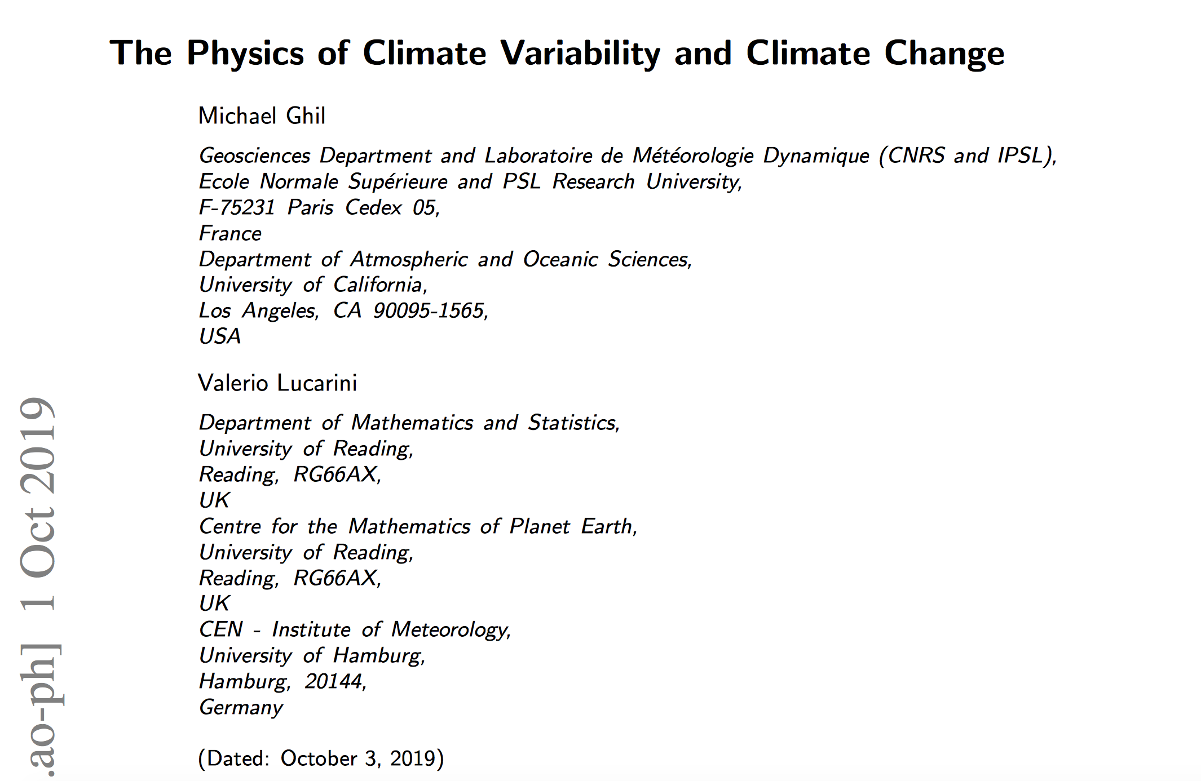
arXiv: 1910.00583
Rev. Mod. Phys, in press (2020)

Slide 5
Motivations: Basics
Understanding how a system responds to perturbations is a central area of research in natural and mathematical sciences
  Robustness of the system?
  Smooth response?
  Critical Transitions?
Groundbreaking work by Kubo (1957)
  Response theory for statistical physical systems
  Only for near-equilibrium (canonical ensemble)
  Mathematically and physically non-rigorous, many criticisms
  Acoustics, Optics, etc. based on Kubo’s results
  Fluctuation-Dissipation Theorem: dictionary between forced and free fluctuations

Slide 6
From Smooth Response …
Ruelle (‘90s): rigorous response theory for smooth observables of Axiom A systems (eq. & noneq.!)
  Usual FDT does not apply for nonequilibrium systems: Critical Transitions as loss of smoothness in response
  Hard to construct response operator!
Liverani, Baladi, Dolgopyat,.. (‘00s)
  Response theory derived using transfer operator approach
  Change in the invariant measure vs change in observables
  Beyond Axiom A systems
Hairer and Maida (2010): Response for stochastic systems

Slide 7
… to Critical Transitions
Catastrophe theory (’60s, Thom, Arnold): comprehensive view of bifurcations in “relatively simple systems’
Multistability in complex systems & hysteresis
Defining the boundaries between the basins
Ashwin et al. 2012: Parameter-, rate-, and noise-induced tipping
Freidlin-Wentzell theory (’70s) based on Large Deviations Theory (‘60s): general laws for noise-induced escape from basins of attraction

Slide 8
Why Climate is relevant
The climate is a nonequilibrium system whose evolution is driven by inhomogeneous absorption of solar radiation
The climate features variability of a vast range of spatial and temporal scales
Understanding the climate response to perturbation is great scientific challenge
  Anthropogenic climate change
  Paleoclimate  Life
  Planetary Science  Habitability
Smooth vs. nonsmooth response
  Climate change, climate surprises, climate tipping points

Slide 9
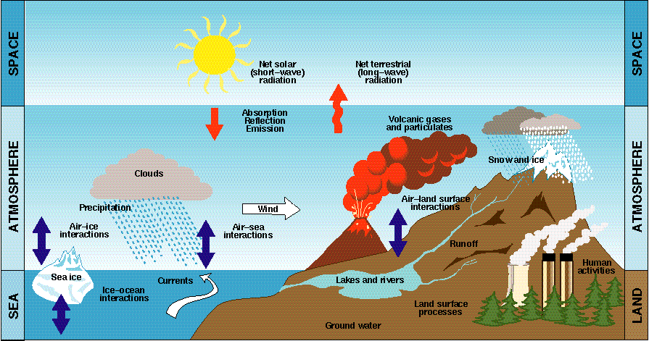
The Climate System
Components in nonlinear interaction
Atmosphere
Land
Cryosphere
Hydrosphere
Biosphere
IPCC

Slide 10
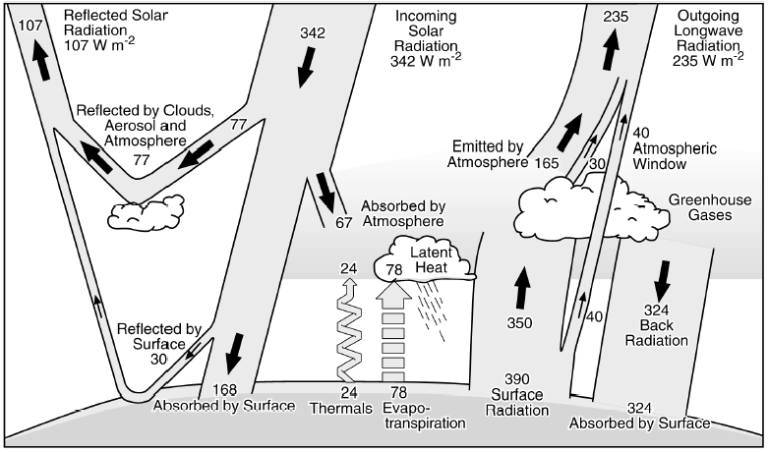
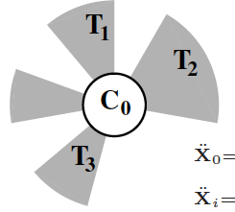
Nonequilibrium
Vertical
Horizontal
IPCC
Gallavotti 2014
Nonequilibrium

Slide 11
An extremely non-ideal engine
dissipation
Qin
W
Qout
Q1 Q2
Irreversible heat
transport
T1 T2
Energy transformation
Entropy Production

Slide 12
Multiple Scales of Motion: Different models for different scales

Slide 13


Slide 14
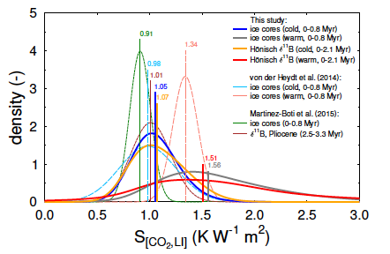
Climate Sensitivity (1)
What is the long-term T response to a radiative forcing? (e.g. Köhler et al. 2015)
BTW – long with respect to what?

Slide 15
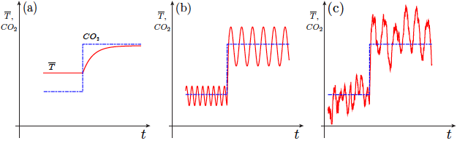
Climate Sensitivity (2)
clim_sens_ghil.pdf
Ghil 2015
What kind of mathematical model we have in mind?
Does Climate sensitivity tell us the whole story?

Slide 16
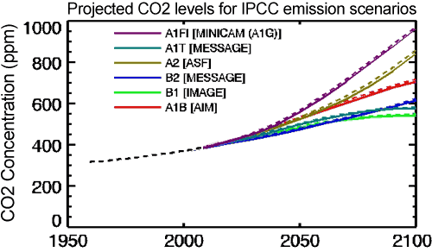
Climate Forcing …
IPCC scenarios

Slide 17
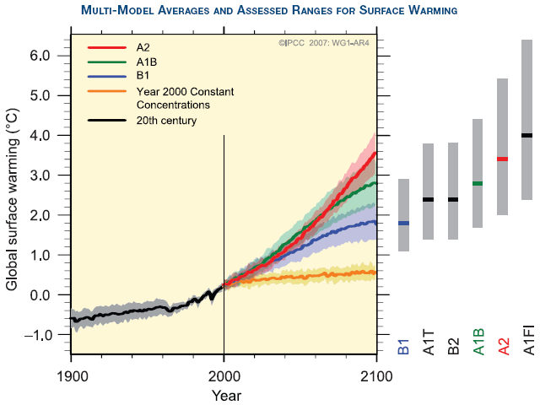
…. Models’ Response
Shaded area includes results of > 20 GCMs

Slide 18
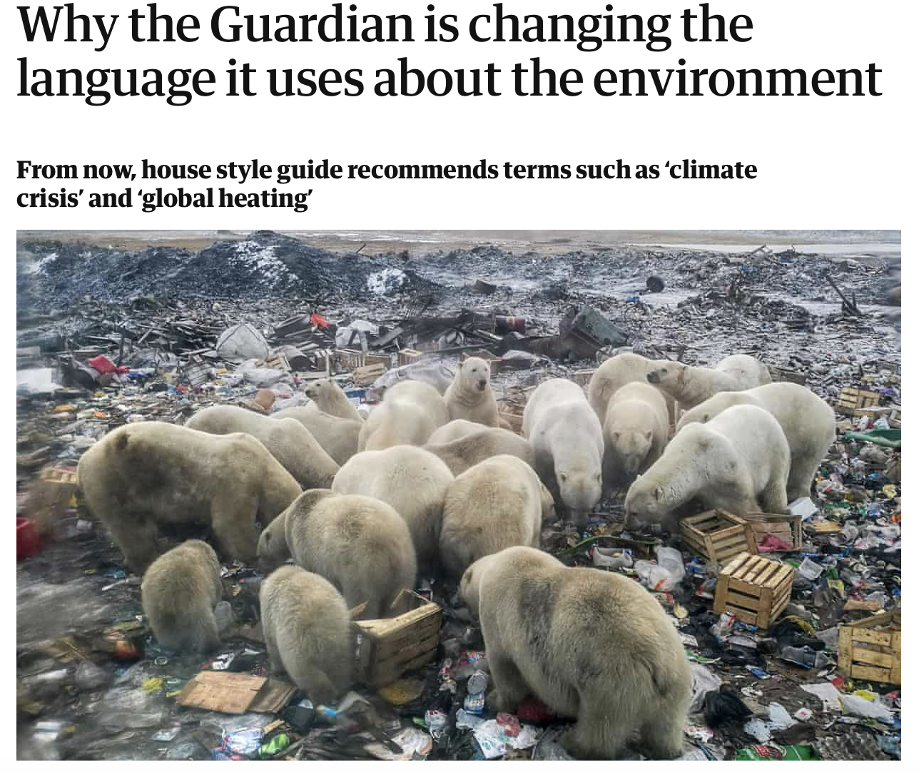
Climate Narrative is Changing
Climate Change ➔Climate Crisis

Slide 19
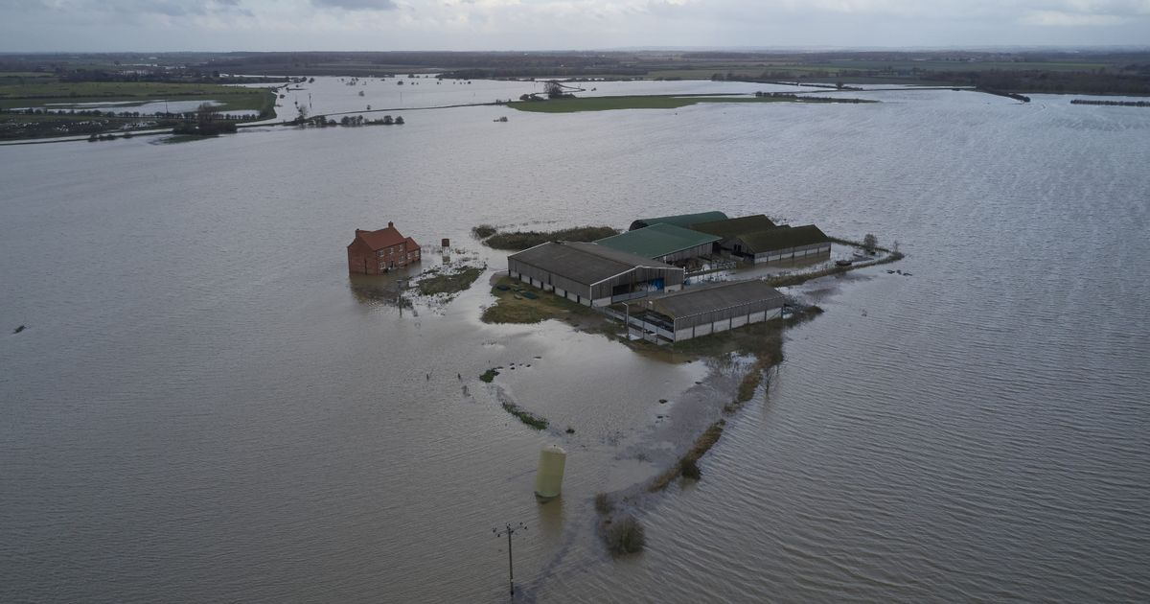
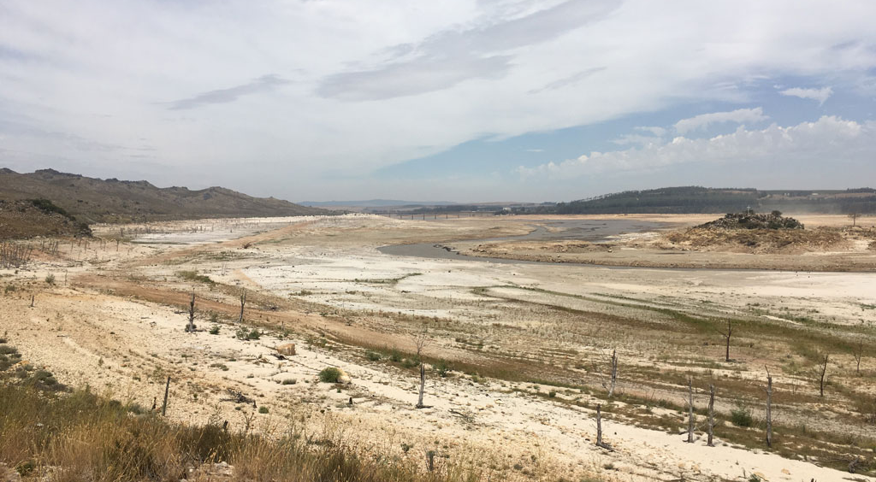
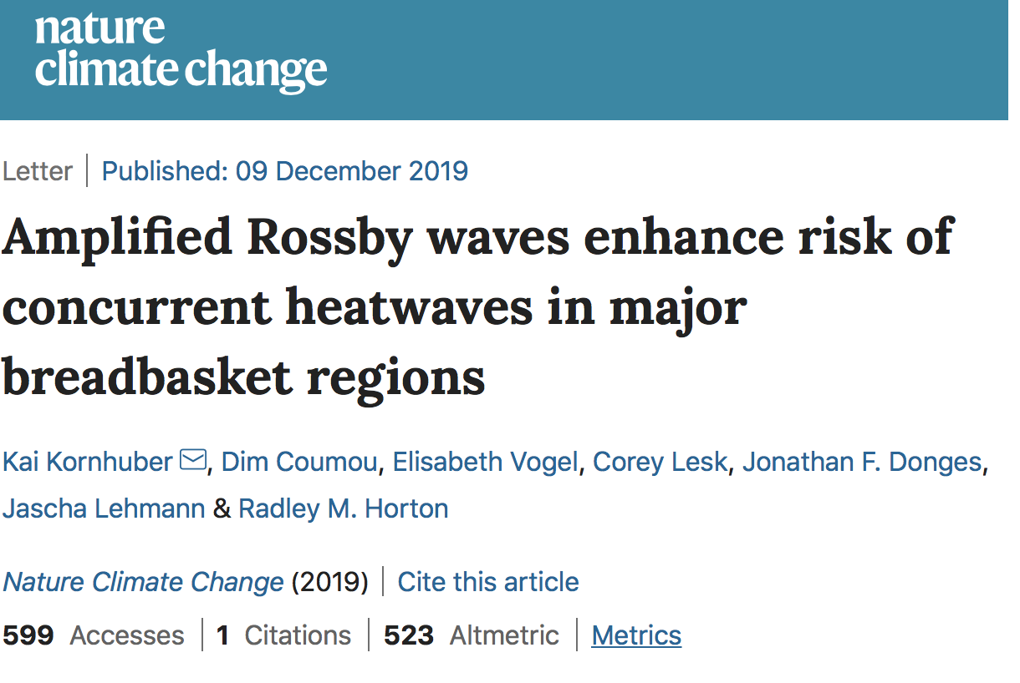
Extremes
UK 2018
Dramatic and hard-to-predict
change in extremes
Regions of the globe becoming
uninhabitable (Gulf, N India)
Capetown 2018

Slide 20
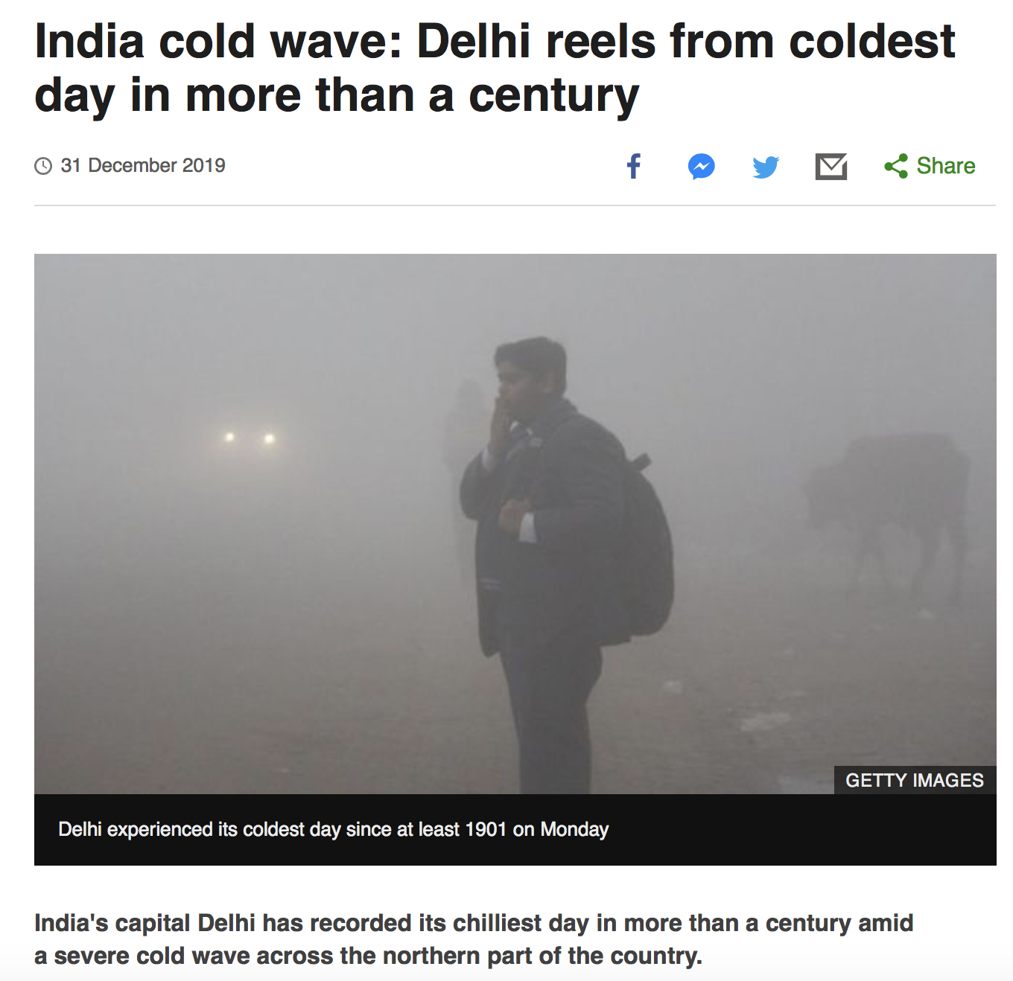

Apparent contradiction…
Climate Change is a complex matter!

Slide 21

Tipping elements
Aiming at a comprehensive framework
From Smooth Response to Critical Transitions

Slide 22
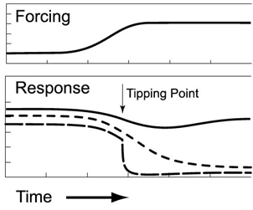
Irreversible Effects
Once the Amazon forest is lost, it is lost

Slide 23
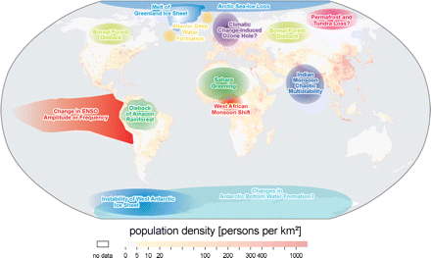
Tipping elements
Lenton et al. 2008
Horizon2020
Project
2019-2023
“Highly sensitive” regions to climate change
“irreversible” response to forcings
Maybe the concept of climate sensitivity should be revised
  If we like to think in terms of “climatic crisis:, maybe we should…
There is nothing but tipping points… (mathematically speaking)

Slide 24
Autonomous, Forced, and Dissipative, Dynamical Systems
We consider
We have
Phase space contracts
Measure evolves:
Working hypothesis: The system is Axiom A-equivalent, and its measure is SRB-equivalent
  Chaotic Hypothesis
  (Practically) problematic if multiscale – de facto partially hyperbolic (Vannitsem & L. 2016)
Strange attractor, SRB measure, Lyap exponents, CLVs, …
Climate variability, instabilities, extremes, etc.

Slide 25
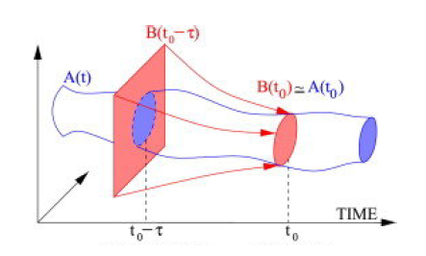
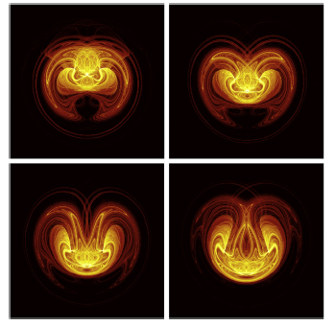
Time dependent case:
Pullback Attractor (Flandoli, Tel, Ghil, …)
Chekroun et al.
2011
Random forcing
Sevellac and Fedorov 2015
Need many ensemble members to capture this
Can we still use properties of autonomous systems?

Slide 26
Mathematics of Climate:
Response Regimes
Smooth response
  Ruelle Response Theory (Ruelle 1998, 2009)
  Defining the sensitivity of the climate to perturbations; constructing the time-dependent measure of the pullback attractor.
High sensitivity
Ruelle-Pollicott Resonances (Ruelle 1986; Pollicott 1985)
  Radius of expansion controlled by spectral gap; rough dependence of statistics on parameters when gap shrinks (Chekroun et al. 2014)
Critical Transitions
Freidlin & Wentzell (1984) meet Grebogi, Ott & York (1983)
  Noise-induced transitions; Boundary crisis of the high-dimensional attractor (Ott 2002)

Slide 27
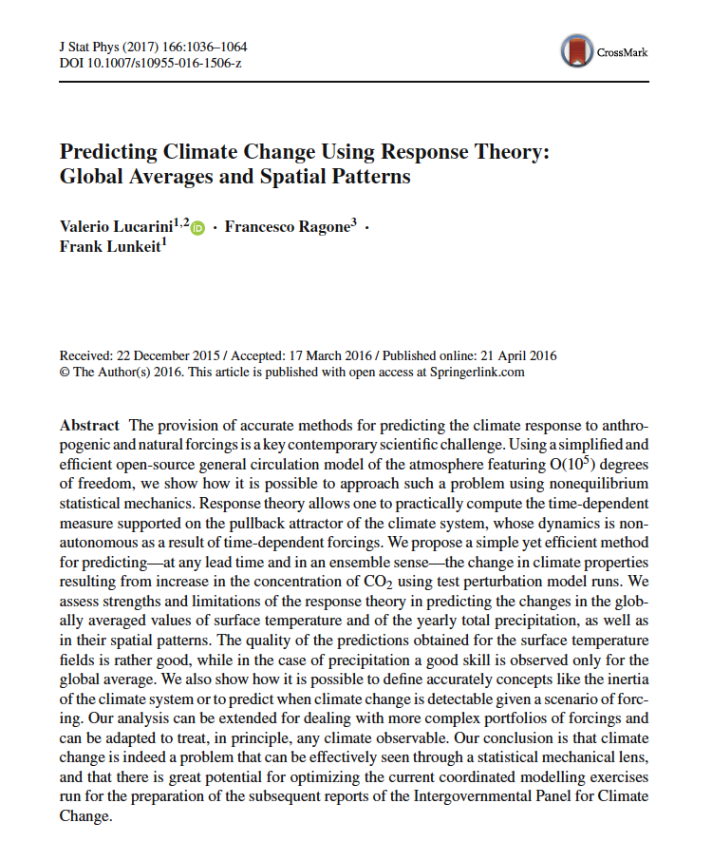
A
Lucarini et al. J Stat. Phys (2017)

Slide 28
Constructing the time-dependent measure via Ruelle Response Theory
Perturbation :
Change in expectation value of a smooth Φ:
Linear term:
Linear Green:
Linear suscept:
obeys KK relations
Pullback attractor

Slide 29
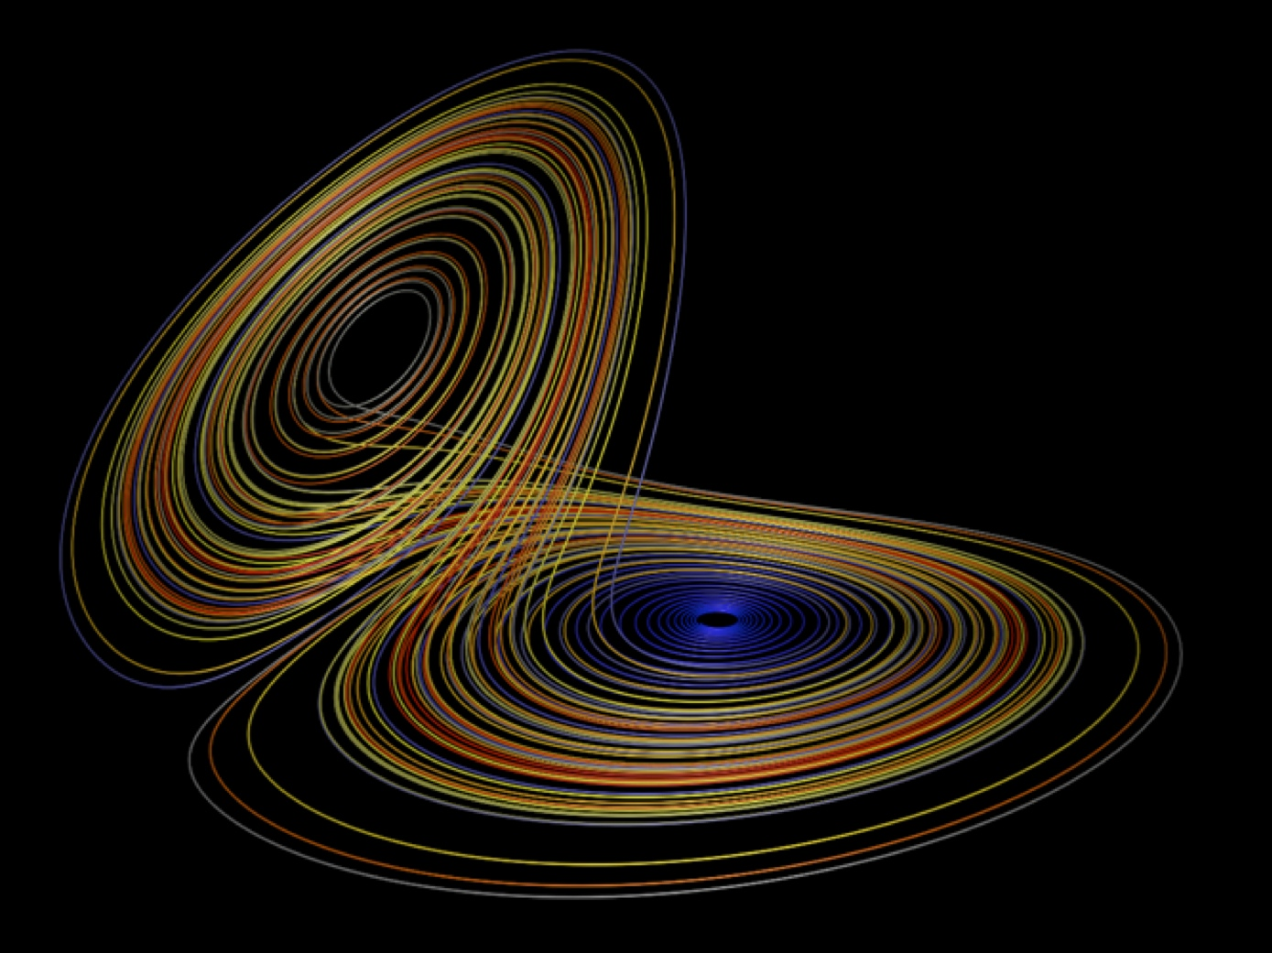
FDT (if…) and Entropy Production
σ(x) is the excess of Entropy production
Higher order terms also interesting
Colangeli and L 2014

Slide 30
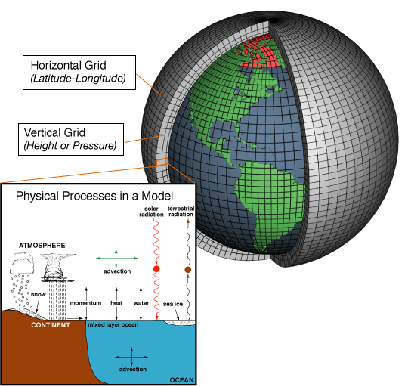
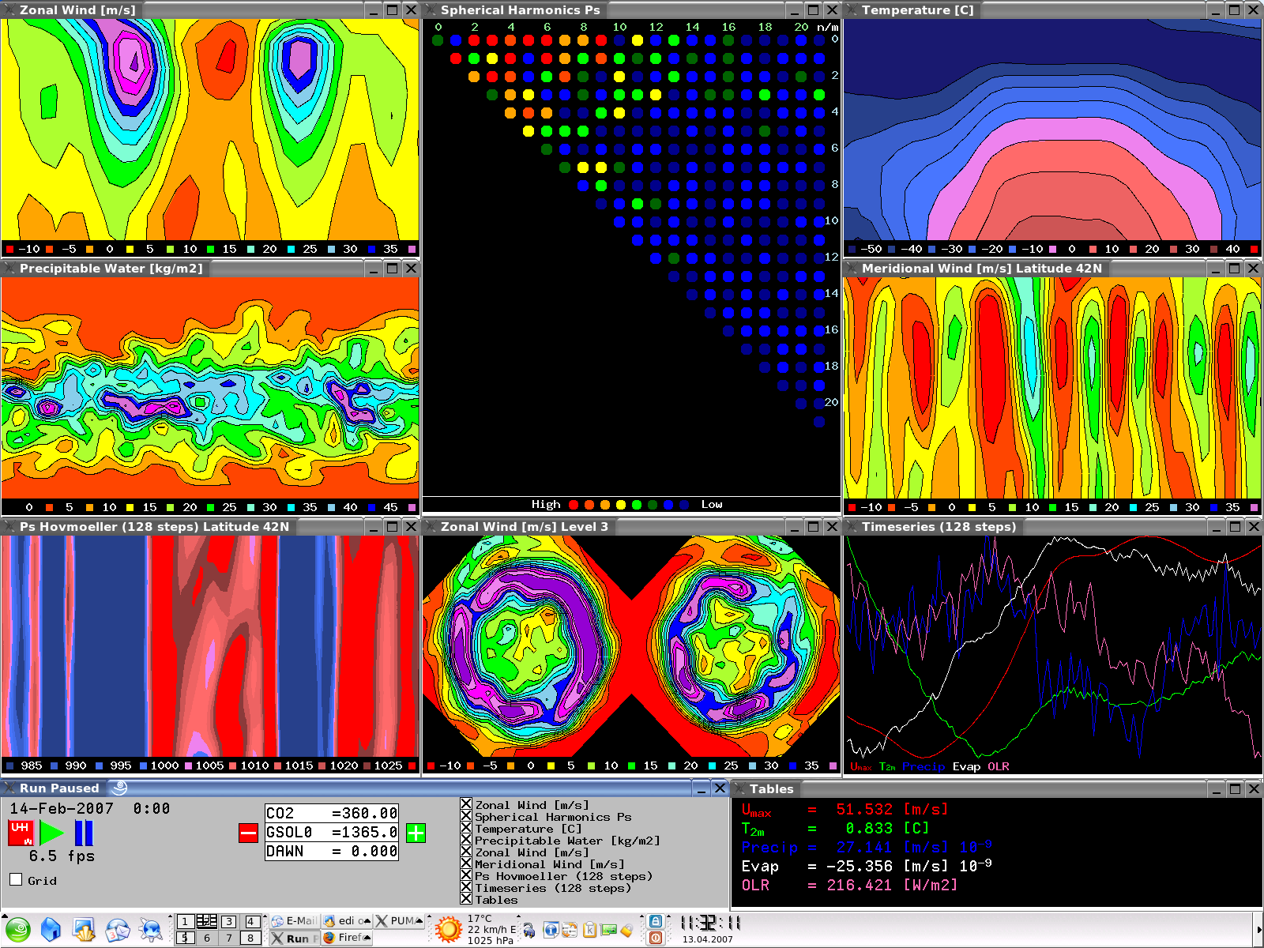
PLASIM: An efficient Climate Model
Key features
portable; fast
open source; parallel
modular; easy to use
documented; compatible
Spectral Atmosphere
moist primitive equations
on σ levels
Sea-Ice
thermodynamic
Vegetations
(Simba, V-code,
Koeppen)
Oceans:
LSG, mixed layer,
or climatol. SST
Terrestrial Surface:
five layer soil
plus snow
O(10⁵) d.o.f.

Slide 31
Step 1
Observable: globally averaged T_{S}
Forcing: increase of CO₂ concentration
Linear response:
We perform ensemble experiments
  Concentration at t=0
Fantastic, we estimate
…and we predict:

Slide 32
Step 1: [CO₂] Doubling
360 ppm ➔ 720 ppm

Slide 33
Step 2
We increase the [CO₂]
  360 ppm  720 ppm at 1% per year
  [CO₂] is doubled after τ≈ 70 years
  We keep [CO₂] constant after that
Rad. forcing is ≈ log[CO₂]
We look at response of T_{S}
We average over the N ensemble members
We predict using

Slide 34
Climate Change Prediction - T_{S}
Prediction

Slide 35
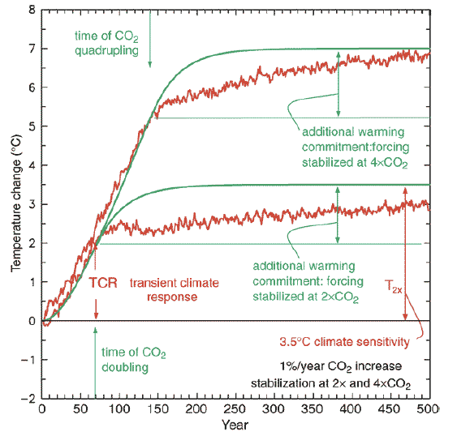
Equilibrium Climate Sensitivity vs Transient Climate Response
ECS
TCR

Slide 36
Equilibrium Climate Sensitivity vs Transient Climate Response
ΔT at the end of the ramp (τ=70 ys)
Smaller than ECS (4.1 K vs 4.8 K)
Want to define inertia at all values of τ
  Instantaneous vs quasi static
“EQUILIBRIUM”
“TRANSIENT”

Slide 37
20 y
Projection
Bias
60 y

Slide 38
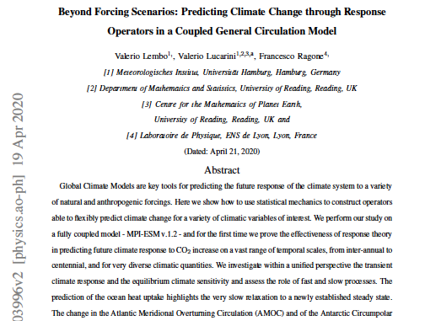
Lembo, Lucarini, Ragone
Sci. Rep. 2020, in press

Slide 39
Multiscale Prediction – Coupled GCM
Same protocol using MPI-ESM v1.2 low resolution
Not IPCC-class but ..
Full atmo-ocean dynamics
Centennial time scales well resolved
20 Ensemble members for constructing Green function – 2000 y simulations each

Slide 40
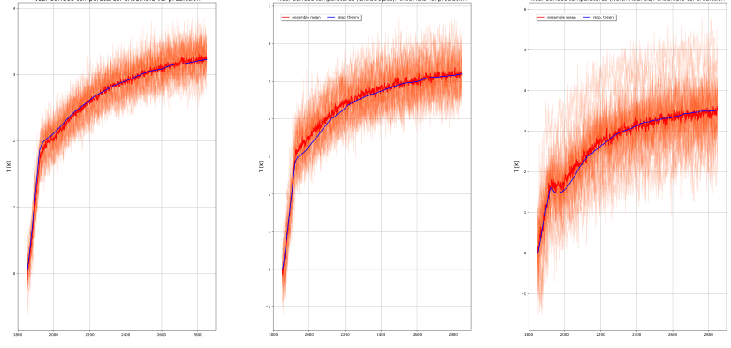
Prediction - Atmospheric Variables
Experiments performed with
Global average near
Surface Temperature
Global average
Precipitation
Temperature in the
N. Atlantic

Slide 41
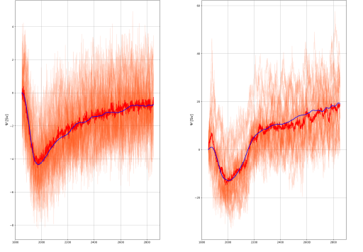
Prediction - Oceanic Variables
Meridional Overturning
Circulation
Antarctic Circumpolar
Current

Slide 42
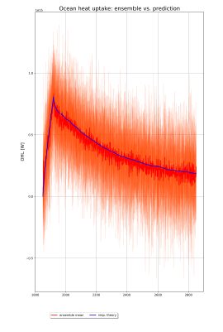
Prediction –
Coupling Atmosphere-Ocean
Ocean Heat Uptake

Slide 43
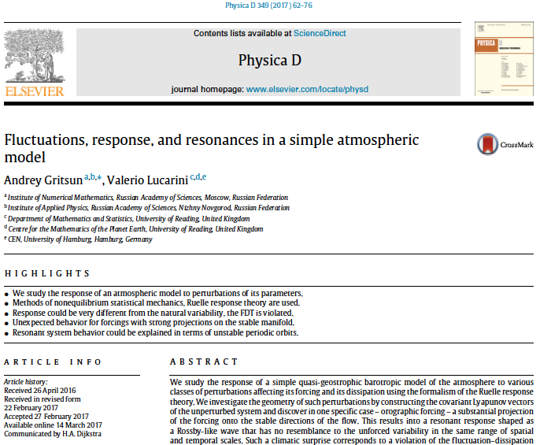

A
Gritsun and Lucarini, Physica D (2017)

Slide 44

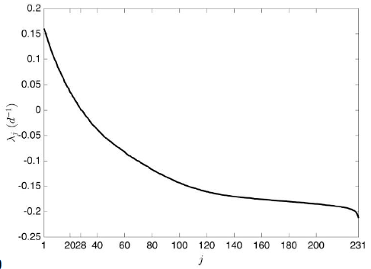
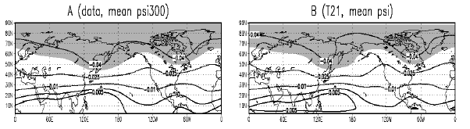
Simple model of the mid-latitudes
Ψ is streamfunction, ΔΨ vorticity
Rotation, Orographic forcing, diffusion, friction
External driving
Made to look like winter atmosphere
Very chaotic (#(λ_{j},>0)=28, 231 dof)

Slide 45
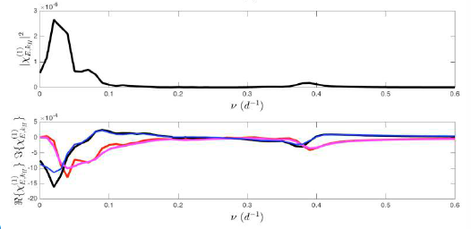
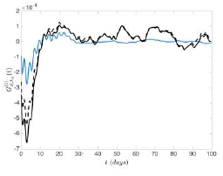
Response to Forcings
Response orographic forcing vs natural variability
Resonance inexplicable with FDT
Resonance comes from a group of UPOs
UPOs rarely visited by system but resonant
Possible paradigm for climatic surprises

Slide 46
Mathematics of Climate:
Response Regimes
Smooth response
  Ruelle Response Theory (Ruelle 1998, 2009)
  Defining the sensitivity of the climate to perturbations; constructing the time-dependent measure of the pullback attractor.
High sensitivity
Ruelle-Pollicott Resonances (Ruelle 1986; Pollicott 1985)
  Radius of expansion controlled by spectral gap; rough dependence of statistics on parameters when gap shrinks (Chekroun et al. 2014)
Critical Transitions
Freidlin & Wentzell (1984) meet Grebogi, Ott & York (1983)
  Noise-induced transitions; Boundary crisis of the high-dimensional attractor (Ott 2002)

Slide 47

B
Tantet et al.,Nonlinearity (2018)

Slide 48
What happens
Near Critical Transition two possible processes:
Critical Slowing down: the decay of correlations becomes slower and slower
  Property of the attractor
  The system has longer memory
  The response to perturbation diverges
  Radius of expansion of Ruelle’s theory
Convergence of ensembles: the attractor attracts less efficiently nearby trajectories
  Property of neighborhood of the attractor
  Cannot be flagged by dynamics on the attractor
Transfer operator in different functional spaces…

Slide 49
Mathematics of Climate:
Response Regimes
Smooth response
  Ruelle Response Theory (Ruelle 1998, 2009)
  Defining the sensitivity of the climate to perturbations; constructing the time-dependent measure of the pullback attractor.
High sensitivity
Ruelle-Pollicott Resonances (Ruelle 1986; Pollicott 1985)
  Radius of expansion controlled by spectral gap; rough dependence of statistics on parameters when gap shrinks (Chekroun et al. 2014)
Critical Transitions
Freidlin & Wentzell (1984) meet Grebogi, Ott & York (1983)
  Noise-induced transitions; Boundary crisis of the high-dimensional attractor (Ott 2002)

Slide 50
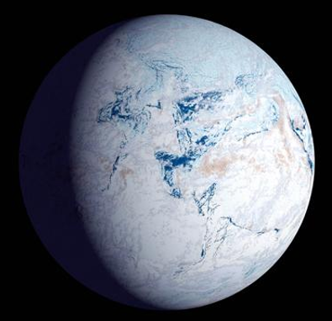
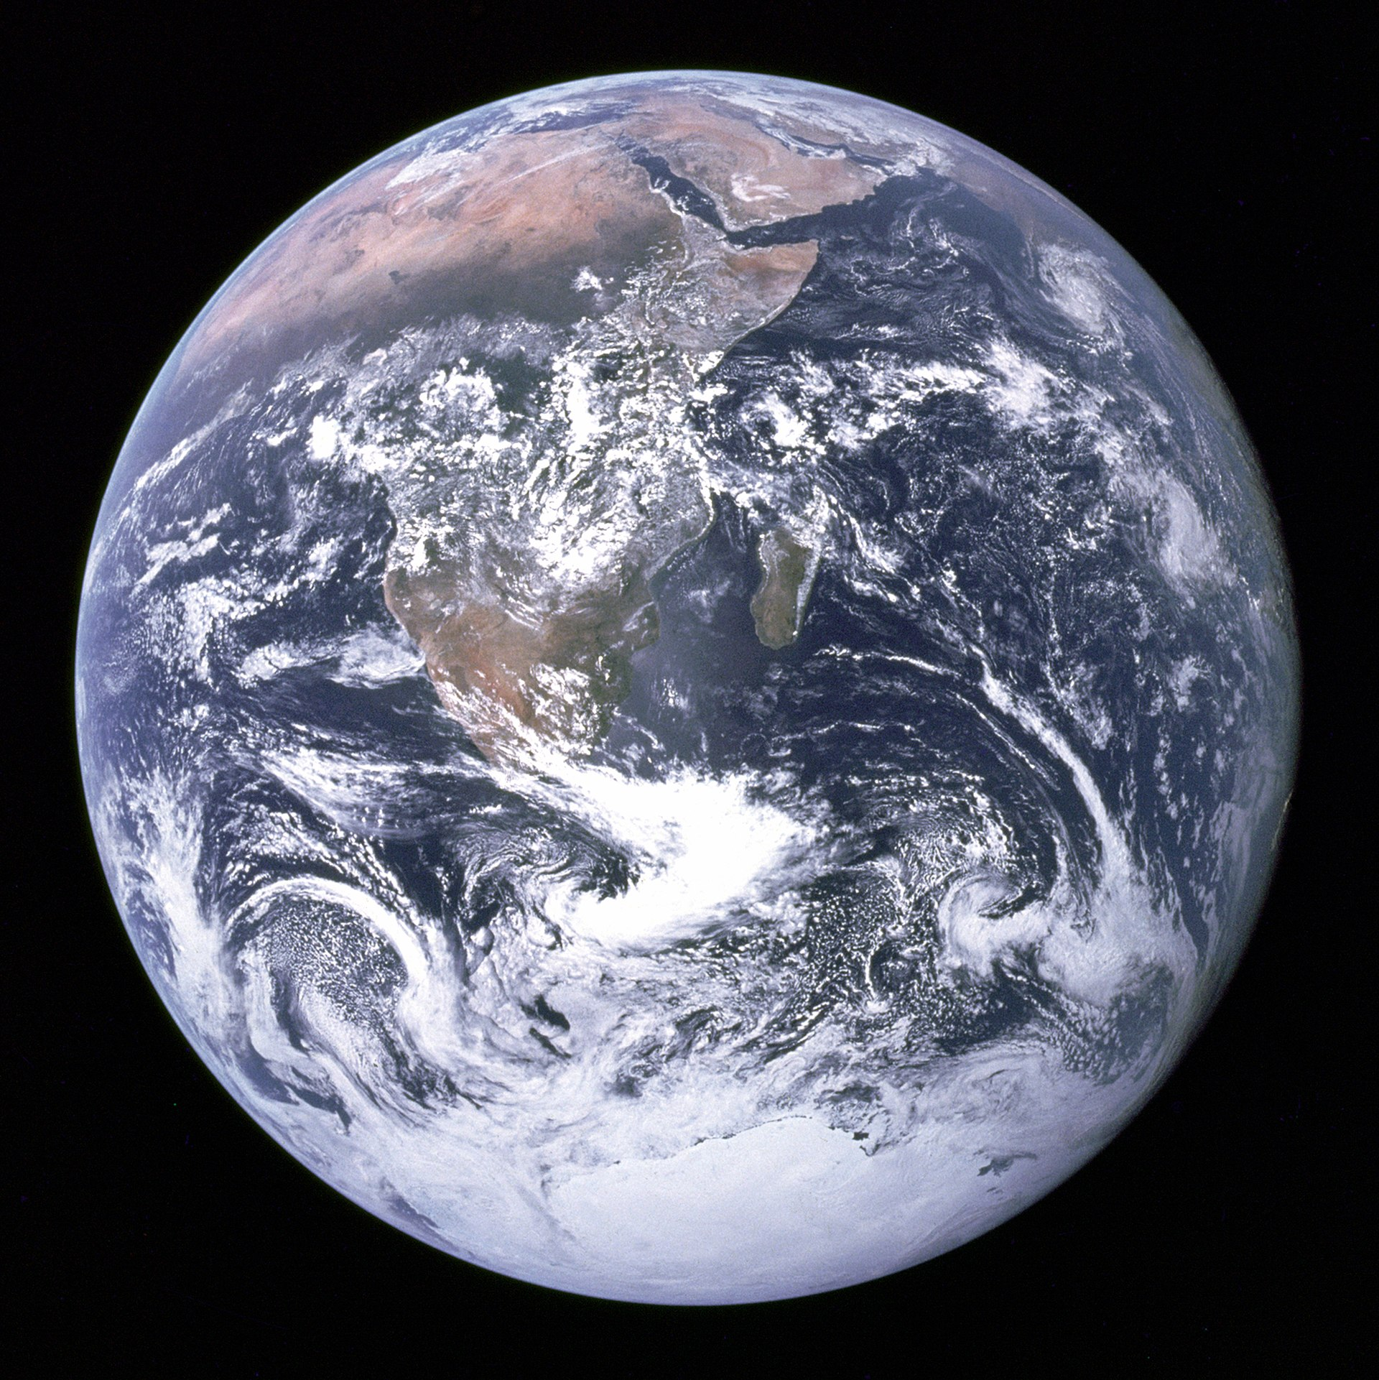
Snowball vs Warm
A
B
Now in B, but we have been in A (650 Mya)
Life development in A? Habitability for Exoplanets?

Slide 51
Historical Note
The bistability of the Earth system was discovered when studying the possible effects of the nuclear winter
Budyko, Sellers in the late ‘60 realized that a prolonged nuclear winter might lead to a global glaciation
Ghil (1976) extended the analysis
People laughed at this possibility… but in early ’90s paleo evidences emerged!
  Beware critical transitions!

Slide 52
0-D Energy balance
Ice/Albedo Feedback
Energy balance :
With:
I 0

Slide 53
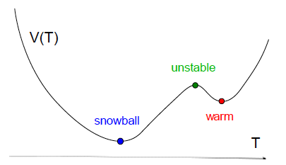
Stationary Solutions
Snowball
Unstable
Unstable
Warm
Potential

Slide 54
Bifurcations
STABLE
TIPPING
POINT
UNSTABLE
TIPPING
POINT
STABLE
Bistability

Slide 55
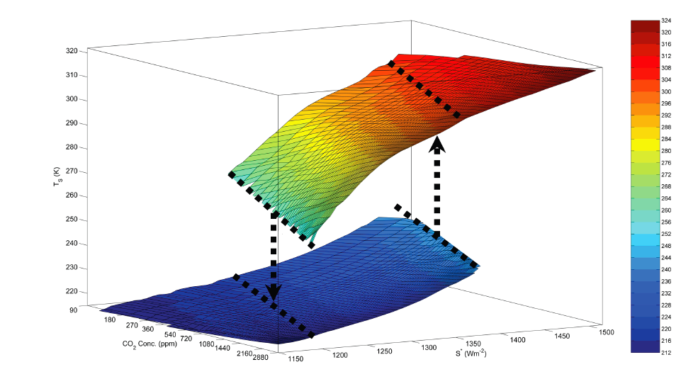
Climate Response: Regimes
Boschi et al. 2013
A. Differentiable
B. Rough
Dependence
MELANCHOLIA
C. Critical Transition
CO2
S*

Slide 56


Melancholia States
Dissipative system, co-existing attractors Ω₁, Ω_{2;} basins B₁, B₂; Inv. measure ergodic comp. ν₁, ν₂|ν=αν₁+(1-α)ν₂
M State Π₁ attracts orbits initialised on basin boundary δΒ between basins B₁ and B₂
δΒ
Grebogi, Ott,
Yorke 1983
B₂
B₁
Π₁
Ω₂
Ω₁
δΒ

Slide 57
Melancholia States
Let’s put some colours!
If near M state, uncertainty on final W or SB state
  Loss of Predictability of the second kind á la Lorenz
M
W
SB

Slide 58

C
Nonlinearity 30, R32-R66 (2017)

Slide 59


PUMA-GS
Simplified Climate Model
Primitive Equations Atmosphere
Simple Diffusive Ghil ‘76 Ocean
Slow and fast climate variability
Positive/negative feedbacks
Spectral Atmosphere
moist primitive equations
on σ levels
Sea-Ice
thermodynamic
Vegetations
(Simba, V-code,
Koeppen)
Ghil-Sellers Diffusive
Ocean Model
with Albedo
Terrestrial Surface:
five layer soil
plus snow
O(10⁵) d.o.f.

Slide 60
Tracking the M State: Step 1
After GOY 1983: Eckhardt et al., multistable fluids
  Pipe flow, Plane Couette Flow with fixed point vs (transient) turbulent regime for suitable Re
Dynamics on the basin boundary
W
M
SB

Slide 61
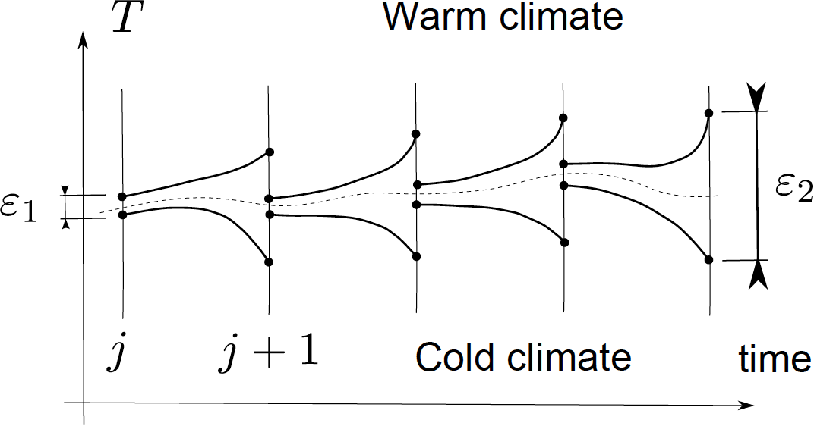
Tracking the M State: Step 2
Dynamics of an orbit near the the basin boundary
  First, it relaxes VERY rapidly towards the M state;
  Second, it decides towards which attractor it should head to;
  Third, it reaches the final destination.

Slide 62
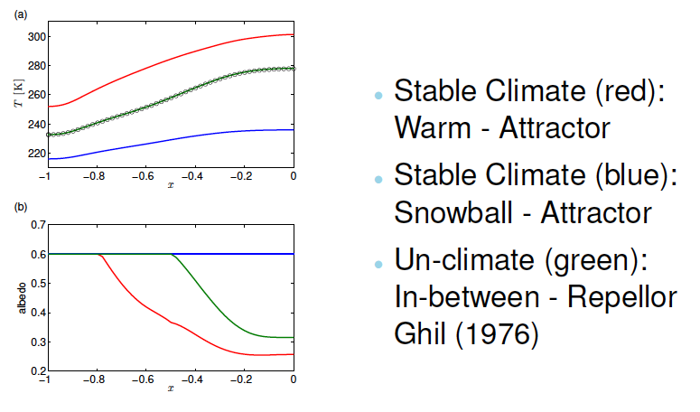
Temperature Profiles
M State

Slide 63
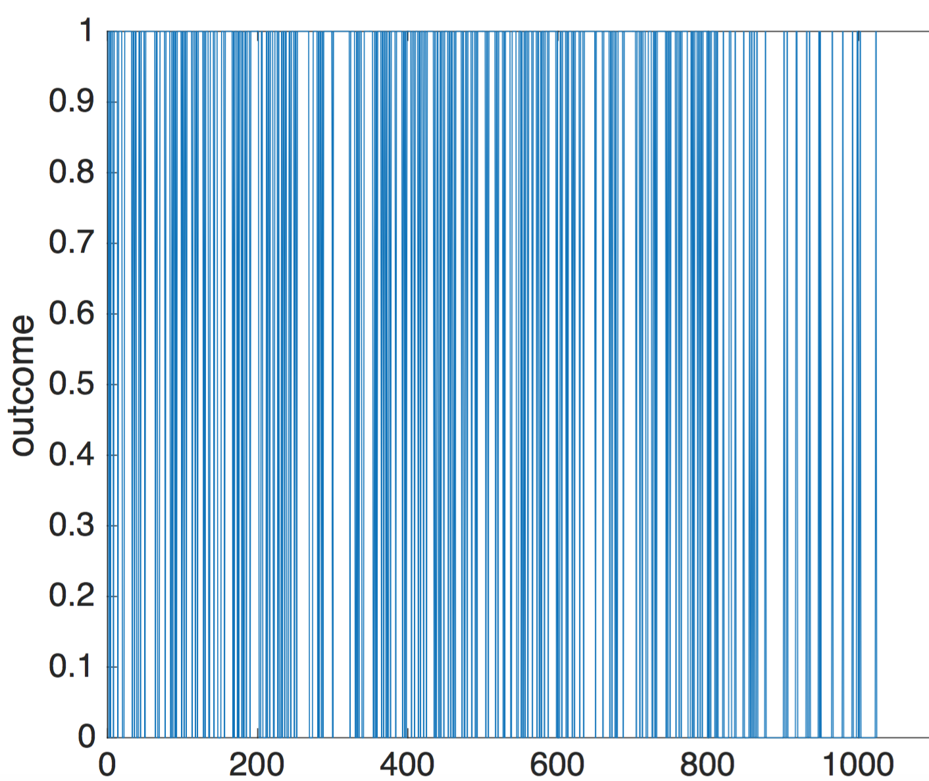
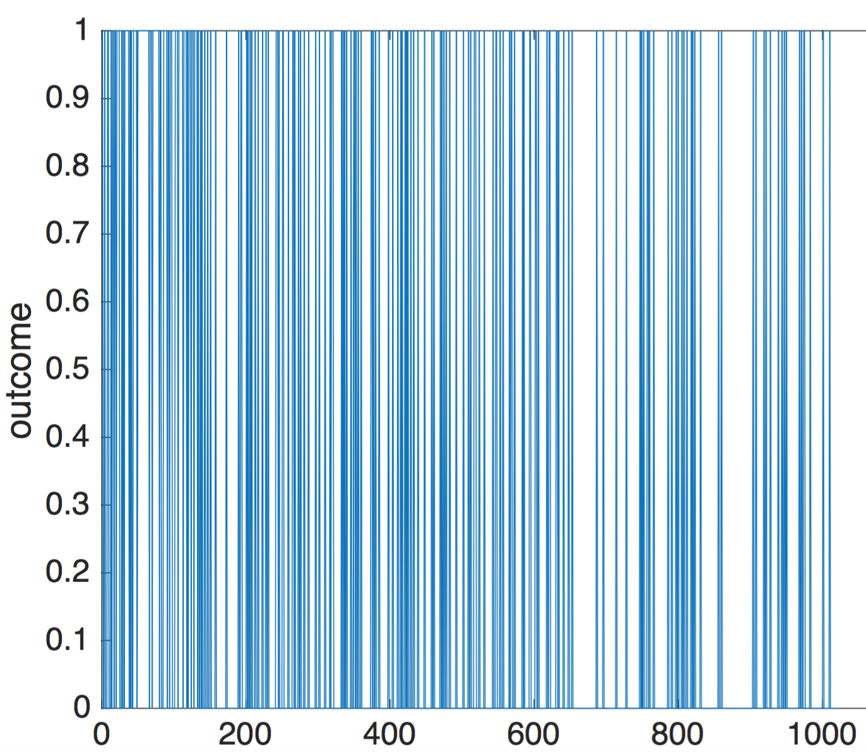
A closer look at the boundary
Pikovsky: “is the basin boundary smooth?”
  It is folded, indeed fractal.
  Result of 1024 integrations between two trajectories near the boundary, 0.5 K difference in T_{surf}
  Result of different time scales of instability on the Melancholia states vs across it

Slide 64
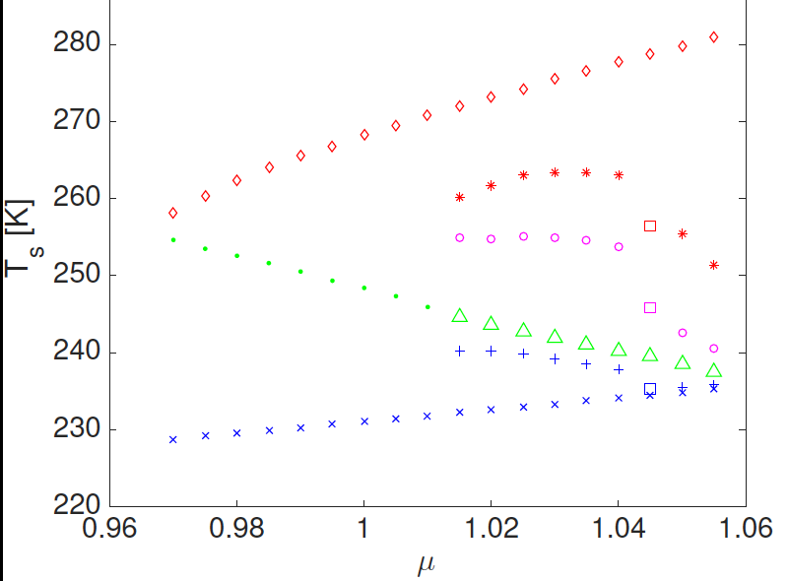
Multiple Steady States
3 STABLE STATES
CHAOTIC WARM CLIMATE STATE
SYMM.
BREAK
SYMMETRY
BREAK
CHAOTIC MELANCHOLIA STATE
CHAOTIC TRANSIENT STATE
STATIONARY COLD CLIMATE STATE
3 CLIMATES

Slide 65
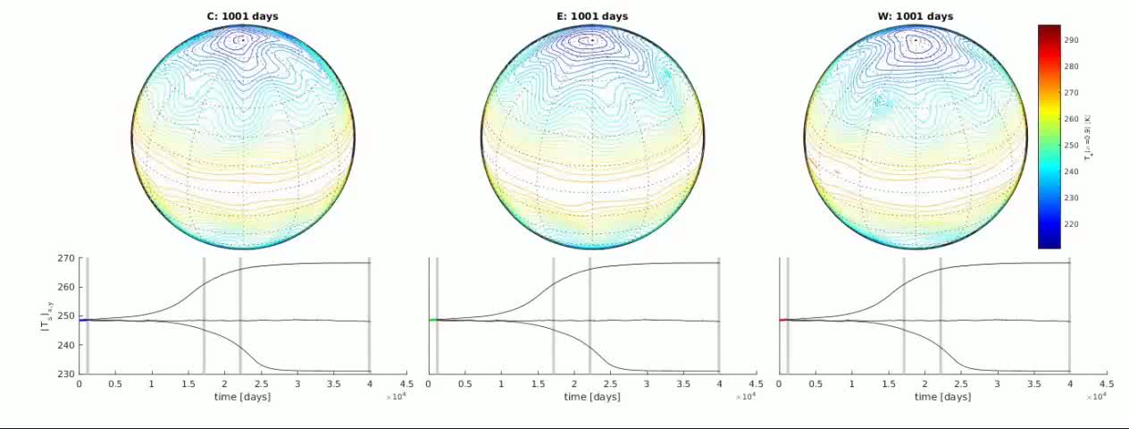
Multistability
Cold State
Melancholia State
Warm State

Slide 66
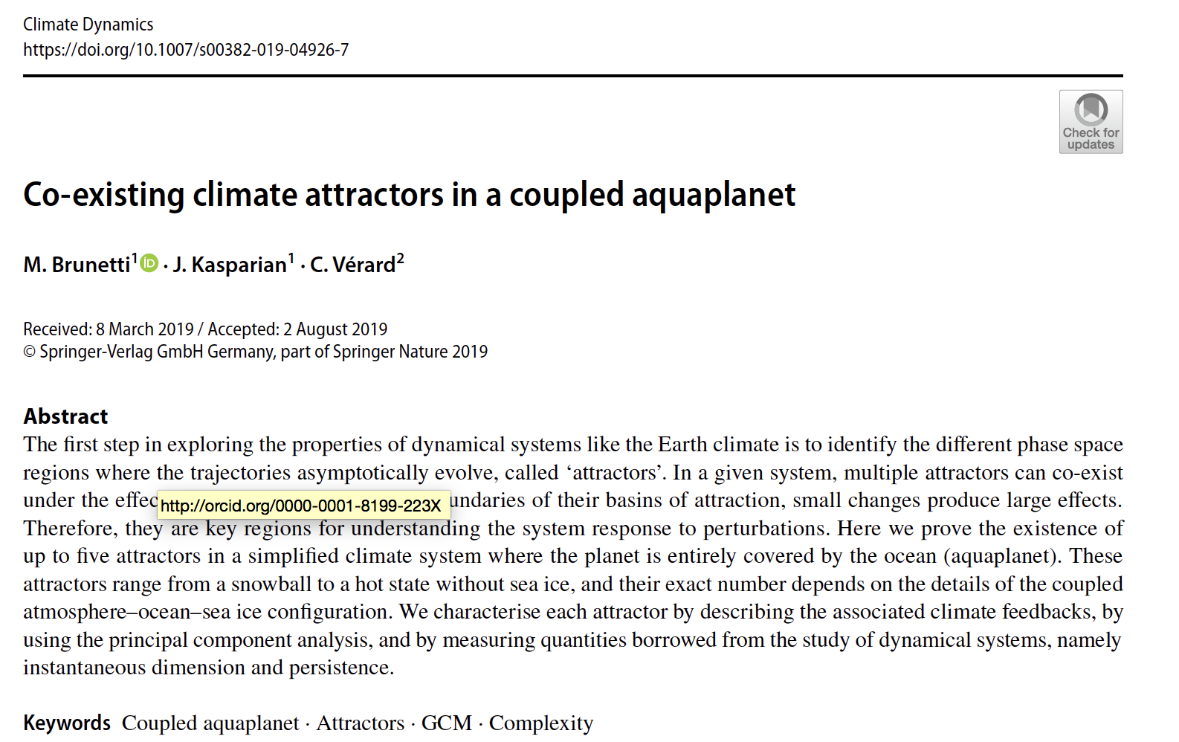
A complex dynamical landscape
How many competing attractors?
Maybe explains ultralong climate variability
Exciting perspective for planetary research

Slide 67
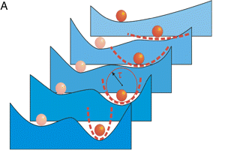
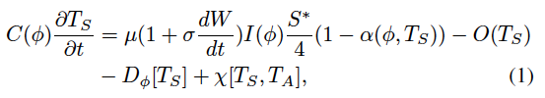
Can we retain something of this?
ΔV
ΔV
Multiplicative Noise: Solar radiation fluctuates

Slide 68
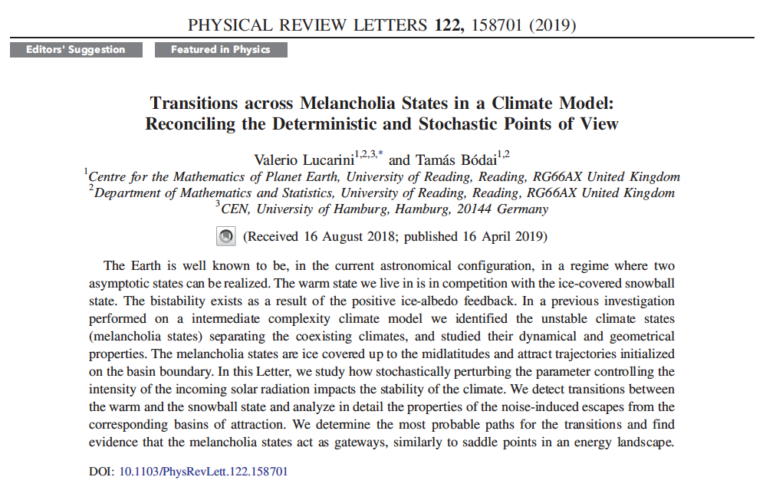
C
Lucarini and Bodai
Phys. Rev. Lett. 2019

Slide 69
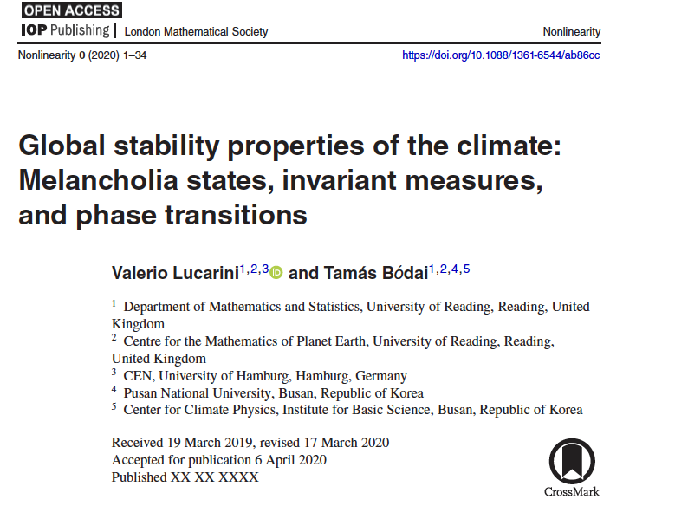
C
Lucarini and Bodai, Nonlinearity, in press, 2020

Slide 70


Freidlin-Wentzell theory
- with updates by Graham, Hamm, Tel … -
SDE:
Hypoelliptic diffusion:
  noise propagates everywhere thanks to interaction with drift term (Hörmander condition for (Stratonovich, modified) drift F* and volatility s
If multiplicative noise, weak x-dependence of correlation matrix
Invariant Measure:
  is the Pseudo-potential; depends on drift F and volatility s
It is the potential in gradient flows plus trivial additive noise
OK in our case: fluctuations in solar energy input impact all d.o.f. of the system by energy cascade processes; “weakly” multiplicative

Slide 71
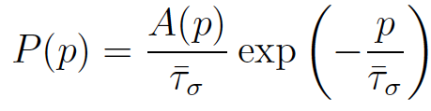
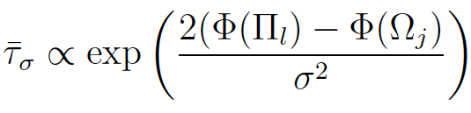
Noise-induced escapes
In the weak-noise limit, escapes from attractors take place through the M state
Paths: instantons (minimizers of F&W action; weights departure from deterministic trajectory)
Since the edge state/attractors are nontrivial sets, instantons are not unique
Distribution of escape times:
τ is controlled by pseudopotential differences
is constant on attractors and edge states

Slide 72
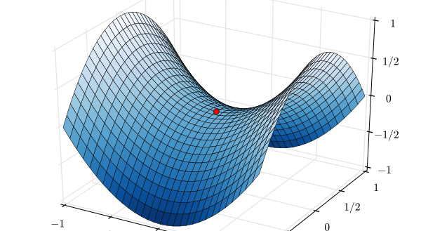
Instantons
Cheapest Transition Path – Action Minimiser

Slide 73
Noise-induced Transitions
CHAOTIC WARM CLIMATE TATE
CHAOTIC MELANCHOLIA STATE
STATIONARY COLD CLIMATE STATE

Slide 74
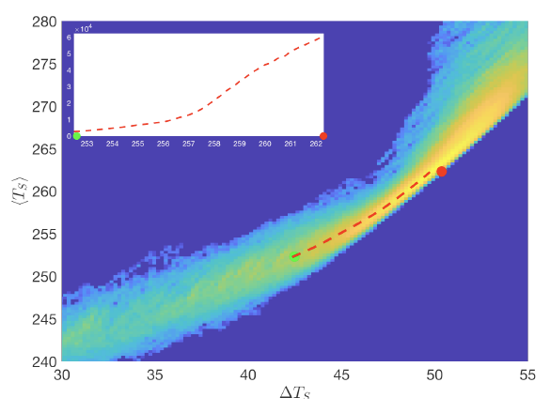
Escape from the warm attractor
μ=0.98
Instantons constructed by averaging the stochastic trajectories
Instantons follow crests of pdf ✓
Instantons go from attractor to M state ✓

Slide 75

Escape Rate W➔C, μ=0.98
α
atan(α)=2ΔΦ

Slide 76

Constructing the invariant measure, μ=1.0
We have here the W➔C and the C➔W instantons
The distributions peak at/near the attractors W and C
M State M is a saddle, instantons cross it

Slide 77

Impact of noise on ΔT_{S}

Slide 78
Limit Measure?
Invariant Measure
For weak noise the measure will concentrate on the attractor corresponding to the minimum of the pseudo-potential
  Which attractor corresponds to the minimum of the pseudo-potential as a function of μ?
But: in the weak-noise limit also the competing state will have diverging life-time
  Risk of being trapped in a local minimum
  Metastable stable

Slide 79

<T_{S}> Bifurcation Diagram
new

Slide 80

Measure projected on <T_{S}>
SB dominated
W dominated

Slide 81

Measure projected on <T_{S}>
SB dominated
W dominated

Slide 82

Measure projected on <T_{S}>
SB dominated
W dominated

Slide 83



A New Phase Transition
Decreasing noise
Decreasing noise
1st Order Phase Transition at μ=μ_{crit}≈1.005
Change of sign for

Slide 84

Fresh experiments
With F. Lunkeit, Uni Hamburg, G. Margazoglou, Uni. Reading
PLASIM, closer to a real GCM
Transition is very similar

Slide 85
Conclusions
Climate as nonequilibrium statistical mechanical system
Beyond invariant measure: pullback attractor
Response theory for smooth response
  Predict climate change,
High sensitivity and mixing rate
  Transfer operator approach
Multistability and Tipping points
  Melancholia State, gate for the transitions
We can construct the Melancholia state, which separates the warm from the snowball climate state, also in real GCMs
The edge state is the gate allowing for noise-induced transitions between the two basins of attraction
A new phase transition for climate

Slide 86
Bibliography
Ghil M., Lucarini, The Physics of Climate Variability and Climate Change, Rev. Mod. Phys, in press (2020)
Gritsun A., V. Lucarini, Fluctuations, Response, and Resonances in a Simple Atmospheric Model, Physica D 349, 62 (2017)
Lembo,. V., V. Lucarini, F. Ragone, Beyond Forcing Scenarios: Predicting Climate Change through Response Operators in a Coupled General Circulation Model, Sci. Reports, in press (2020)
Lucarini V., F. Lunkeit, F. Ragone, Predicting Climate Change Using Response Theory: Global Averages and Spatial Patterns, J. Stat. Phys. 166, 1036 (2017)
Lucarini V., T. Bodai, Edge States in the Climate System: Exploring Global Instabilities and Critical Transitions, Nonlinearity 30, R32-R66 (2017)
Lucarini V., T. Bodai, Transitions across Melancholia States in a Climate Model: Reconciling the Deterministic and Stochastic Points of view. Phys. Rev. Lett. 122, 158701 (2019)
Lucarini V., T. Bodai, Global Stability Properties of the Climate: Melancholia States, Invariant Measures, and Phase Transitions, Nonlinearity, in press. (2020)
Tantet A., V. Lucarini, F. Lunkeit, H. Dijkstra, Crisis of the Chaotic Attractor of a Climate Model: A Transfer Operator Approach, Nonlinearity 31, 2221 (2018)

Slide 87

Beware Critical Transitions!

