Slide 1
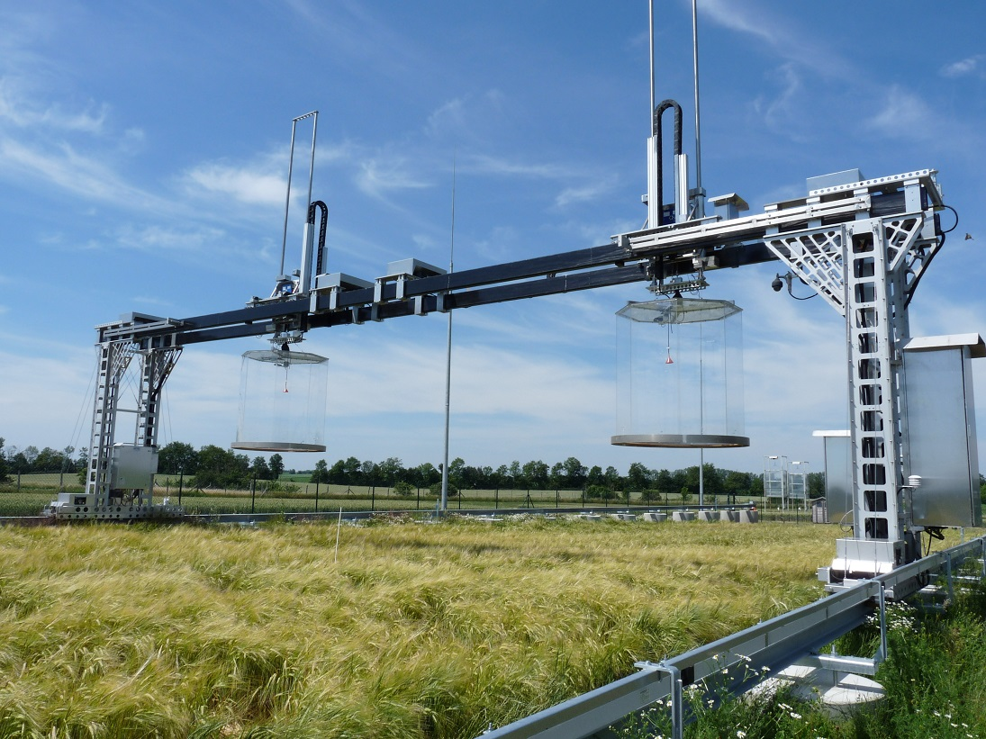
Novel robotic chamber system for the accurate and precise determination of spatio-temporal CO₂ flux dynamics on heterogeneous cropland
Vaidya S, Schmidt M, Rakowski P, Verch G, Augustin J, Sommer M, Hoffmann M
May 8, 2019

Slide 2
Introduction:
Measurement of CO₂ gas exchange is crucial for the accurate assessment of terrestrial carbon (C) sink.
However, uncertainties occur by ignoring the dynamics of CO₂ fluxes caused by land use management or small scale soil heterogeneity resulted due to soil erosion.
Current approaches to measure CO₂ gas exchanges have limitations accounting for small scale spatial heterogeneity (eddy covariance and automatic chambers) or short-term temporal variability (manual chambers) Influences the CO₂ flux estimations while determining sink and source function.
To face these challenges, we developed a novel robotic chamber system with a high temporal and spatial resolution.
The purpose is to apply in manipulation experiment for testing the land use management practices which aims to sequester additional C and bind more N in a range of soil types.

Slide 3
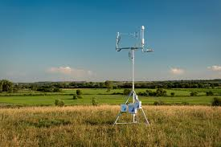
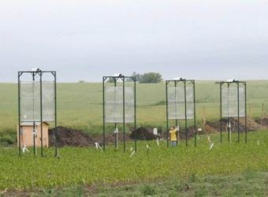
Why is this work important and timely?
Manual chambers
High temporal resolution
but low spatial resolution
High temporal and high
spatial resolution
Temporal resolution
Spatial resolution limited to measurement
plots /also influencing the biomass
development
High spatial resolution
but low temporal resolution
Eddy covariance
Spatial resolution
Automatic chambers
Robotic chamber system
Hypothesis:
new robotic chamber system is capable to detect:
short term temporal dynamics
Small scale spatial heterogeneity
of measured net ecosystem exchange (NEE) and derived flux components

Slide 4
Advantages of robotic chamber system:
Act as a mobile platform and can move in 3 dimensions; x-axis (along the track), y-axis (perpendicular to track) and z-axis (moving chambers up and down)
High temporal and spatial resolution to demonstrate the effect of weather conditions, plant phenology, land use management and different soil properties on CO₂ fluxes
y-axis
y-axis
Offers the possibility to carry out supplementary measurements exactly on the plots where the gas exchange measurements are made without disturbing the plant development
z-axis
x-axis
Additional CH₄, N₂O and H₂O gas analyzers can be added along with CO₂ gas analyzer for concurrent measurements

Slide 5
Study site and robotic chamber system
CaboZALF-D area near village of Dedelow, Uckermark region, NE Germany (53°23N, 13°47E showing 36 plots) at an area of 110×16×5 m.
(b) Three distinct soil types (RG-ca: extremely eroded, LV-ng: strongly eroded and LV-cc: non eroded)
(c) Robotic chamber system comprised of a gantry crane mounted on two tracks (110 m) transporting multiple sensors and two transparent closed chambers.

Slide 6
CO₂ concentration and auxillary measurements
CO₂ concentration was measured during two months (08 July-09 September) for spring barley
The measurement frequency was 4 sec over a 7 min deployment time using two transparent chambers connected via 5 m tubes to two infrared gas analyzer
For data collection and controlling the system, a CR6 data logger and additional CDM-A116 analog multiplexer were used
Leaf area index were measured weekly till harvest and other environmental variables such as PAR, air temperatures were recorded inside and outside the chambers
Moreover, air humidity, air pressure, precipitation, wind speed and wind direction were recorded using WXT520 weather transmitter

Slide 7
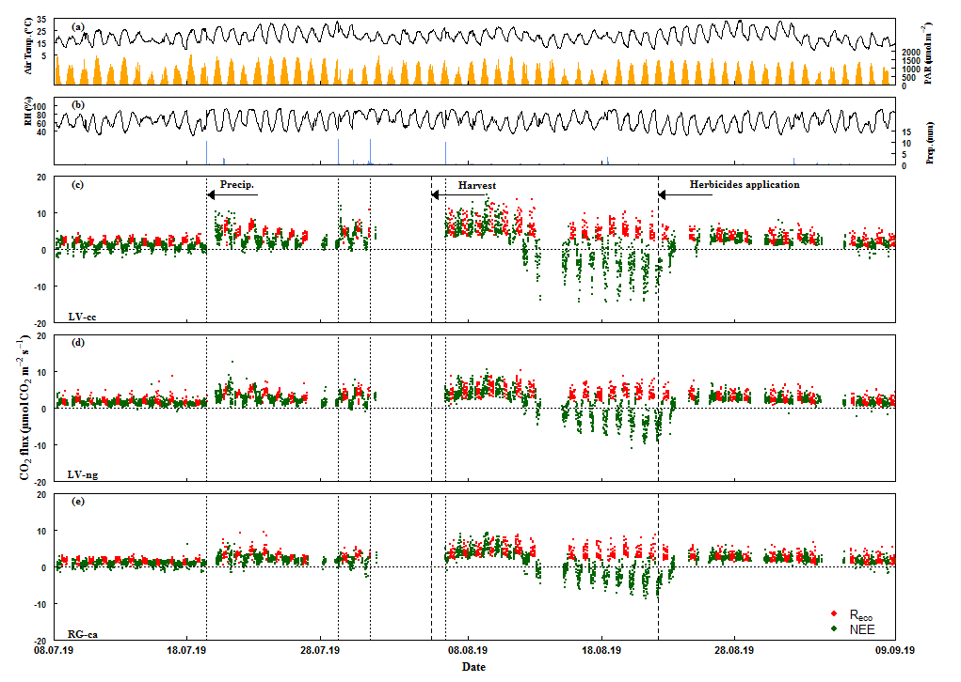
Results : Temporal Resolution
Regermination
Mineralization
peak
Crop senescence
Die off regerminated plants

Slide 8
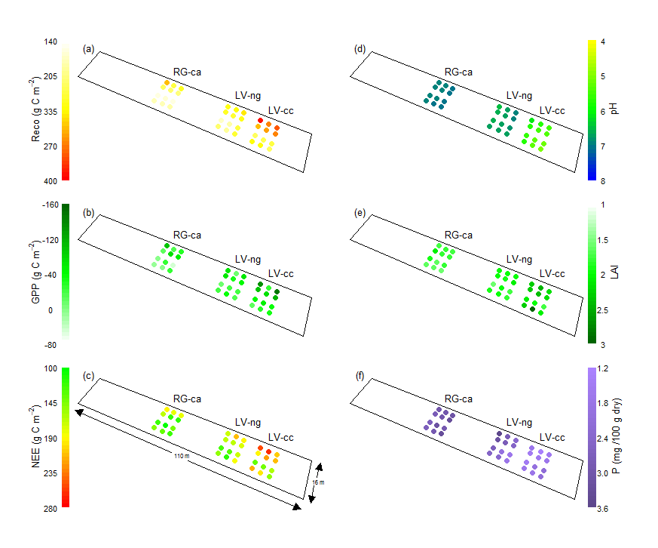
Results : Spatial Resolution
RG-ca: extremely eroded, LV-ng: strongly eroded and LV-cc: non eroded
pH range
Non-eroded soil – 4.6 - 6.3
Extremely eroded soil – 7.4 - 7.6
High cumulated Reco fluxes in non eroded
soil as compared to srongly and extremely
eroded soil
LAI range
Non-eroded soil – 1.3-2.8
Extremely eroded soil – 1.1-1.7
High cumulated GPP fluxes in non eroded
soil as compared to srongly and extremely
eroded soil
Phosphorous range
Non-eroded soil – 1.3-2.2
Extremely eroded soil – 2.7-3.3
High cumulated NEE fluxes in non eroded
soil as compared to srongly and extremely
eroded soil

Slide 9
Conclusion:
The CO₂ fluxes were low (only ~34% of usual seasonal amplitude), due to measuring in conditions when plants were in 1) senescence and 2) soil was dry for a long time
Despite that, we were able to demonstrate the effect of
weather conditions,
crop phenology,
landuse management and
soil properties
on the temporal and spatial dynamics of the CO₂ fluxes
The results demonstrate that the novel robotic chamber system can well represent the short term temporal differences and small scale spatial heterogeneity contributing to accurate and precise determination of CO₂ flux dynamics on heterogeneous cropland

Slide 10
Acknowledgements:
The study is supported by the German Federal Ministry of Food and Agriculture (FNR Grant: 22404117) within the project “Krumensenke”
The authors would like to thank all the team members of Pfannenstiel Pro project GmbH for designing the structure of robotic chamber system, ATTEC Automation Gmbh for developing the scripts to operate the system and Nobert Bonk who ensured the continuous operation of the robotic chamber system

Slide 11
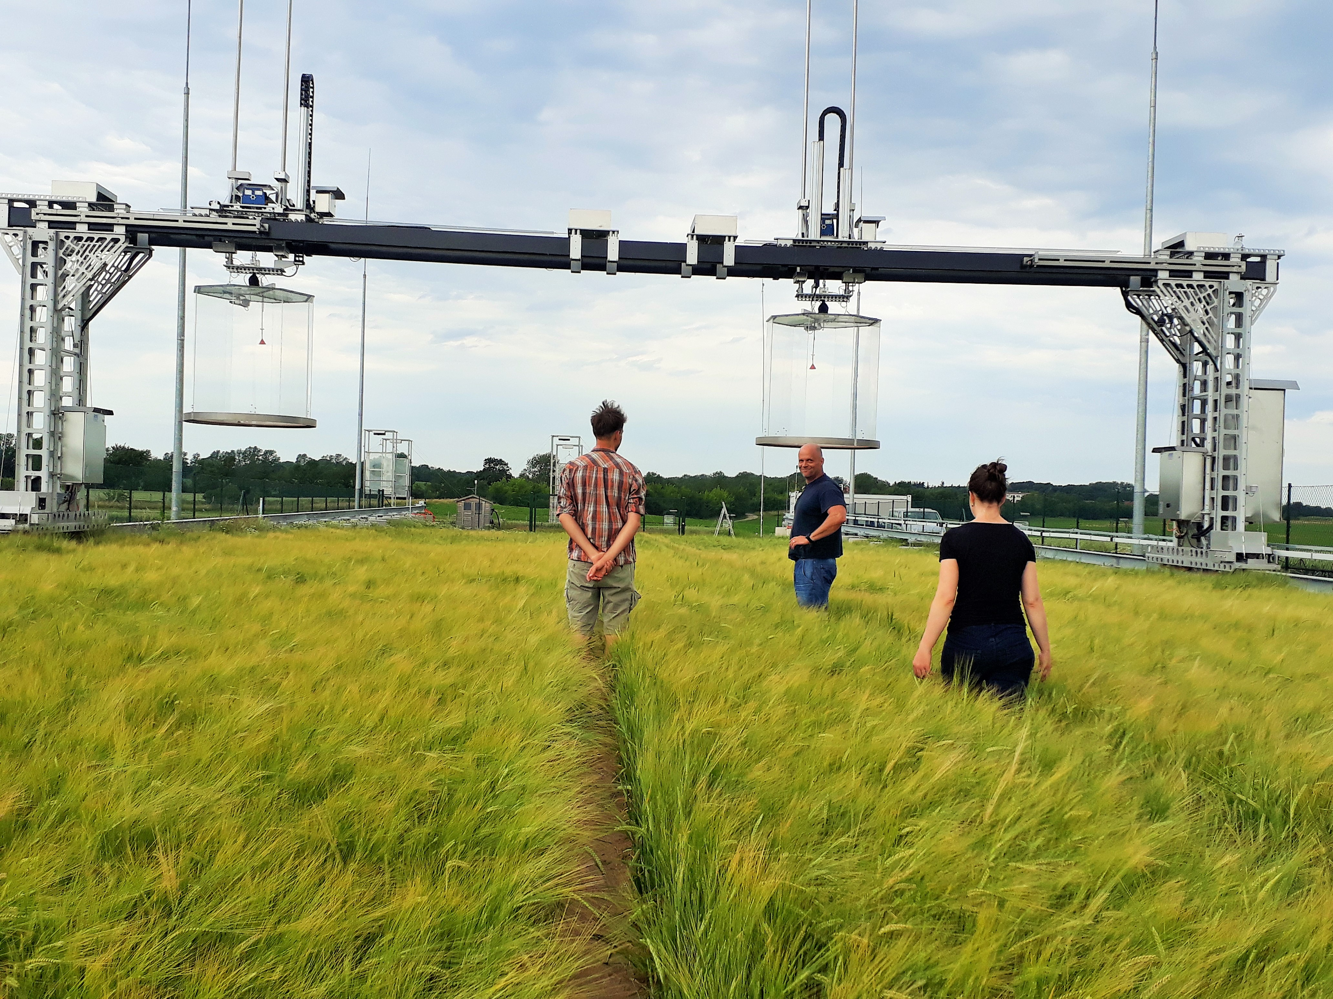
THANK YOU !
March 2, 2019

