Slide 1
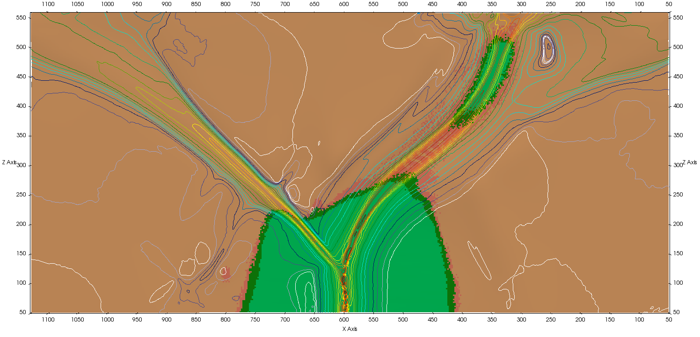
Obliquity favours propagation pulses during continental break-up
Anthony Jourdon, Laëtitia Le Pourhiet, Frédéric Mouthereau, Dave A. May

Slide 2
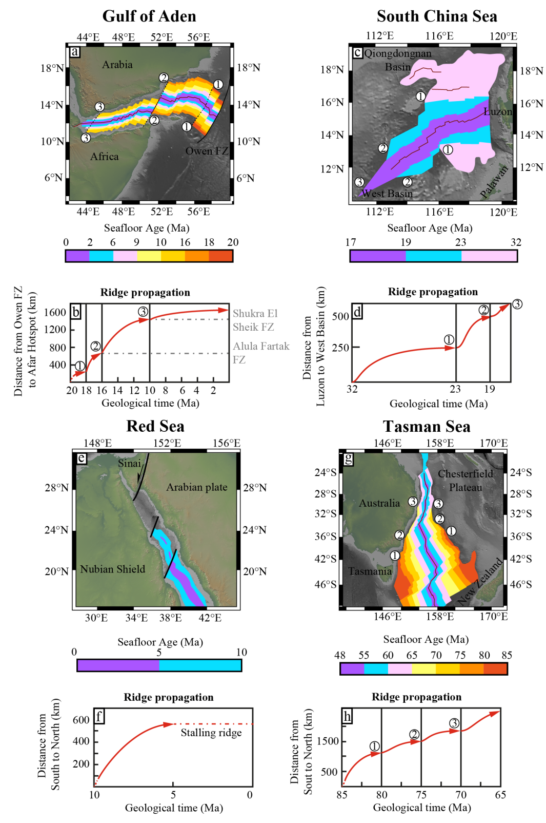
Introduction
Many oceanic basins display V-shaped propagators of several sizes and ages
Oceanic ridge propagation highlighted by the absence of oldest oceanic crust along the ridge strike
Ages and angles of magnetic anomalies along strike provide information about the propagation dynamics of the ocean (alternation of stalling and propagation phases)

Slide 3
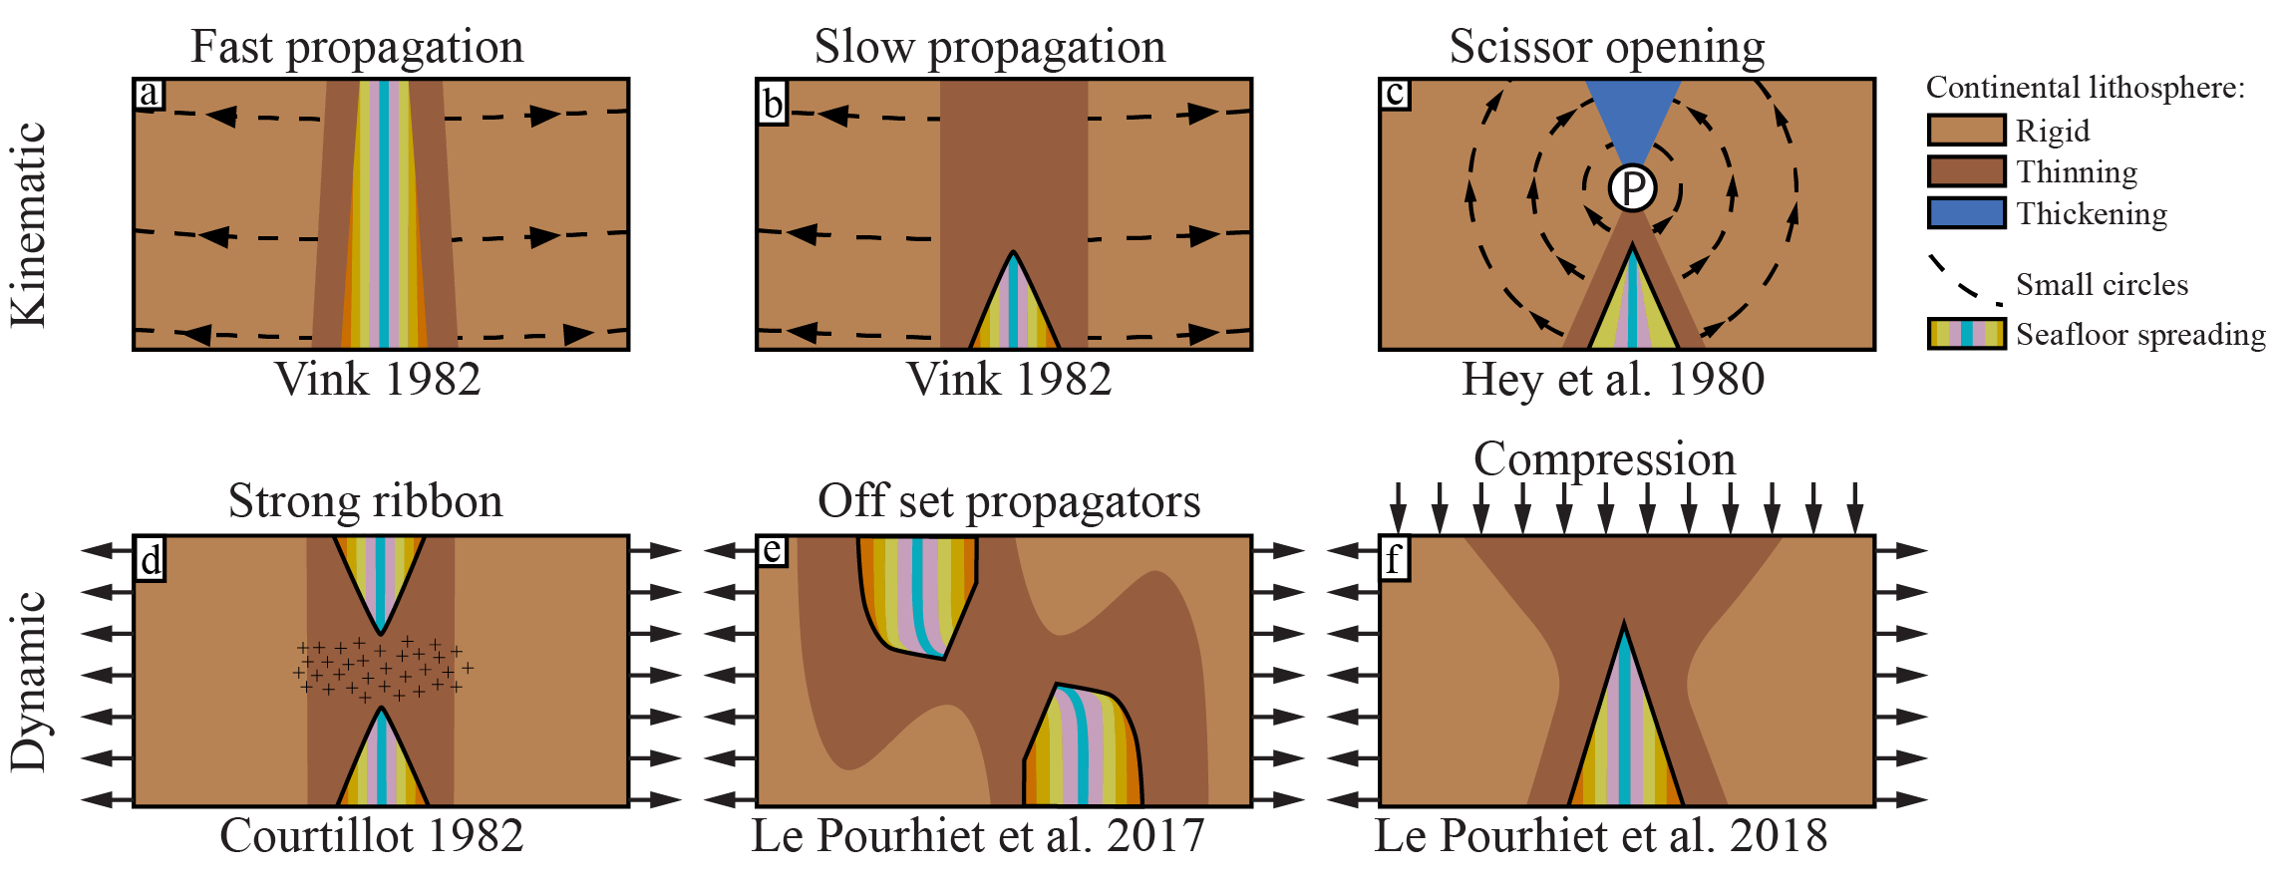
Introduction
Models about oceanic ridge propagation
Several concept were proposed to explain V-shaped propagators:
Vink 1982 ➔ Shape depends on propagation velocity in an orthogonal extension context
Hey et al. 1980 ➔ Opening near the plate rotation pole (varying velocity along strike)
Courtillot 1982 ➔ Stronger material slowing down the propagation
Le Pourhiet et al. 2017 ➔ Linkage of off set segments delay the propagation
Le Pourhiet et al. 2018 ➔ Small shortening velocity (perpendicular to extension direction) slows the propagation and forms a V-shaped oceanic basin

Slide 4
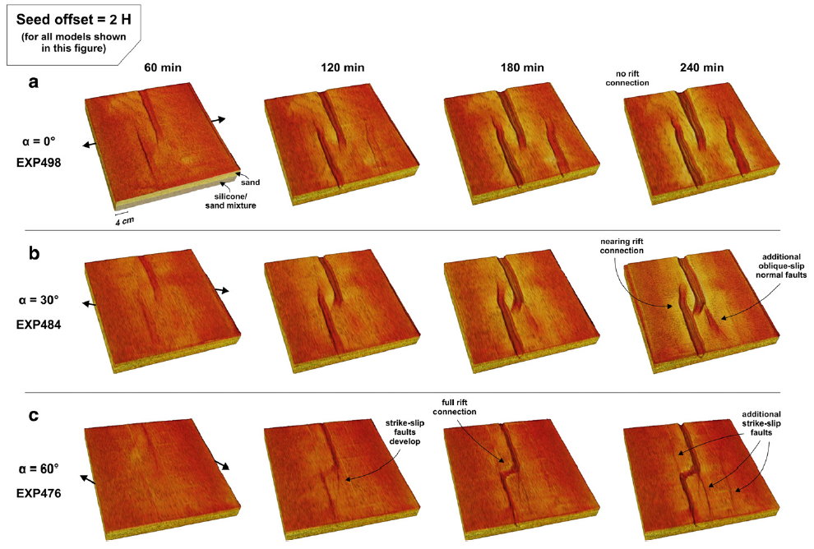
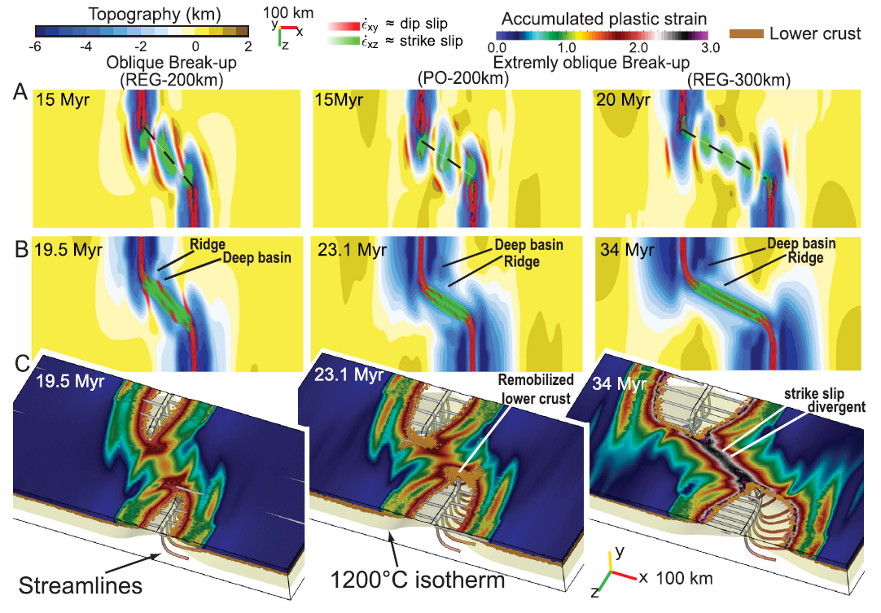
Introduction
Analogue modelling
Numerical modelling
Zwaan et al. 2016
Off set propagators show propagation stalling during linkage
Stalling phase is associated with strike-slip deformation during linkage
V-shaped oceanic basins
Le Pourhiet et al. 2017

Slide 5
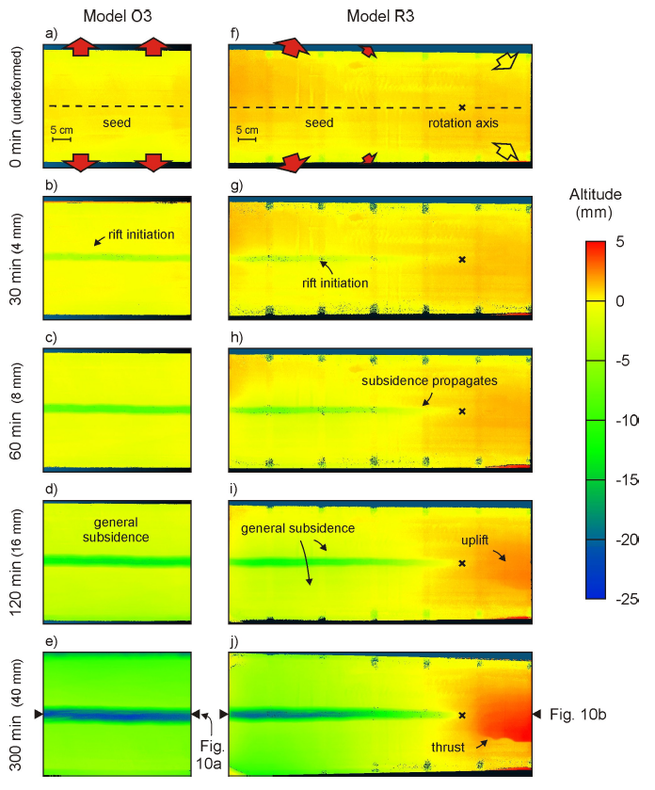
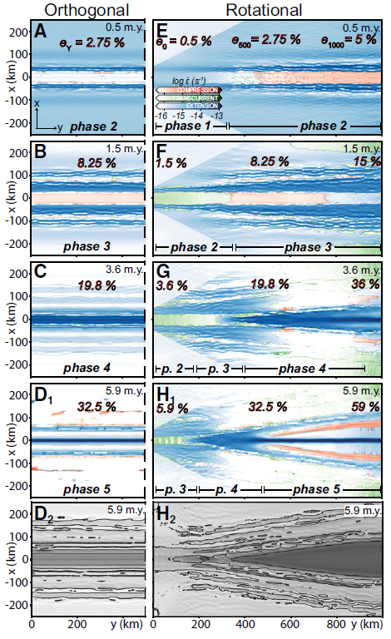
Introduction
Analogue modelling
Numerical modelling
Shortening
Zwaan et al. 2020
Mondy et al. 2018

Slide 6
Introduction
Shortening velocity slows the propagation
Produces synchronous oceanic opening and intracontinental rifting in front of the propagator
Wider rift is produced in front of the propagator
Seafloor ages stripes stop at the margin with an angle varying with the propagation velocity
Le Pourhiet et al. 2018

Slide 7
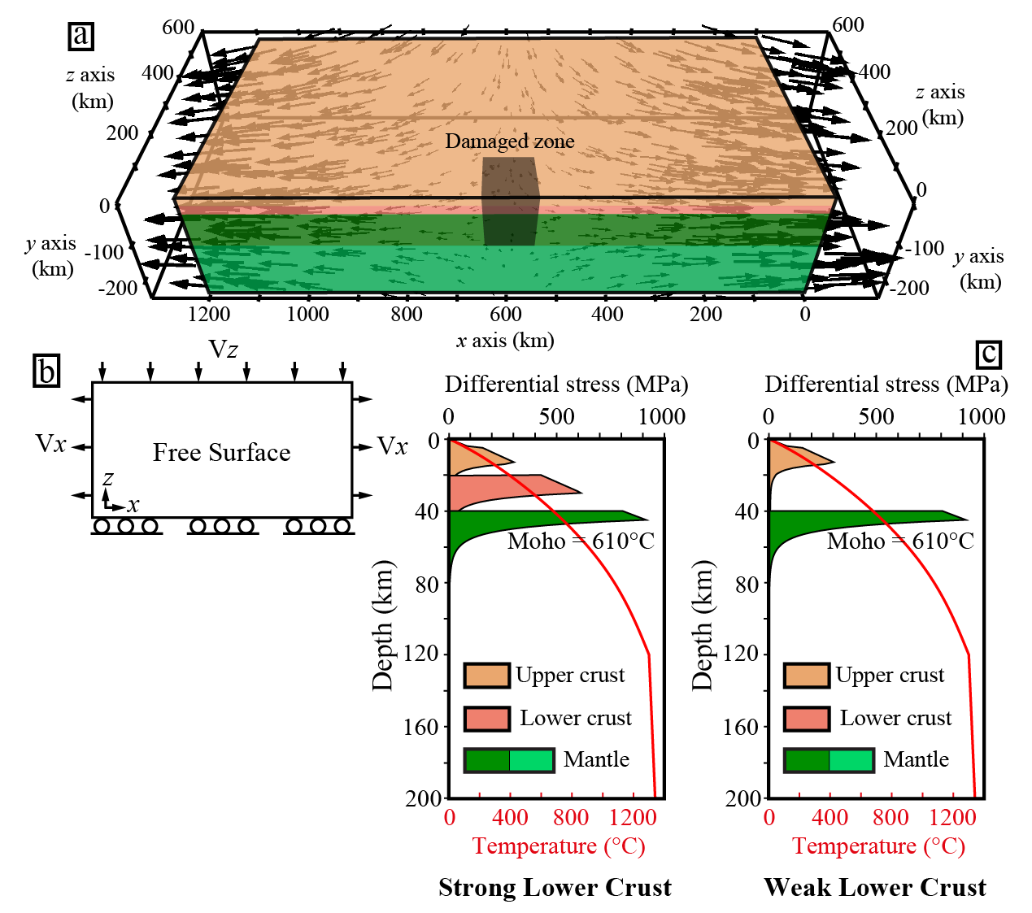
Setup
Re-use of Le Pourhiet et al. 2018 setup
Code: pTatin3D (May et al. 2014; 2015)
Solving Stokes flow for an incompressible fluid coupled with Energy conservation
Investigated parameters:
Rheology of the crust (Coupled and decoupled lower crust)
Shortening velocity along z axis (Vz)
Stretching along x direction
Shortening along z direction on the back face
Constant stretching velocity (Vx = 0.5 cm/an, total: 1cm/a)
Vz = 1.2 to 2.0 mm/a
Freeslip in x direction on the front face
Resolution 2 km x 2 km x 2 km

Slide 8
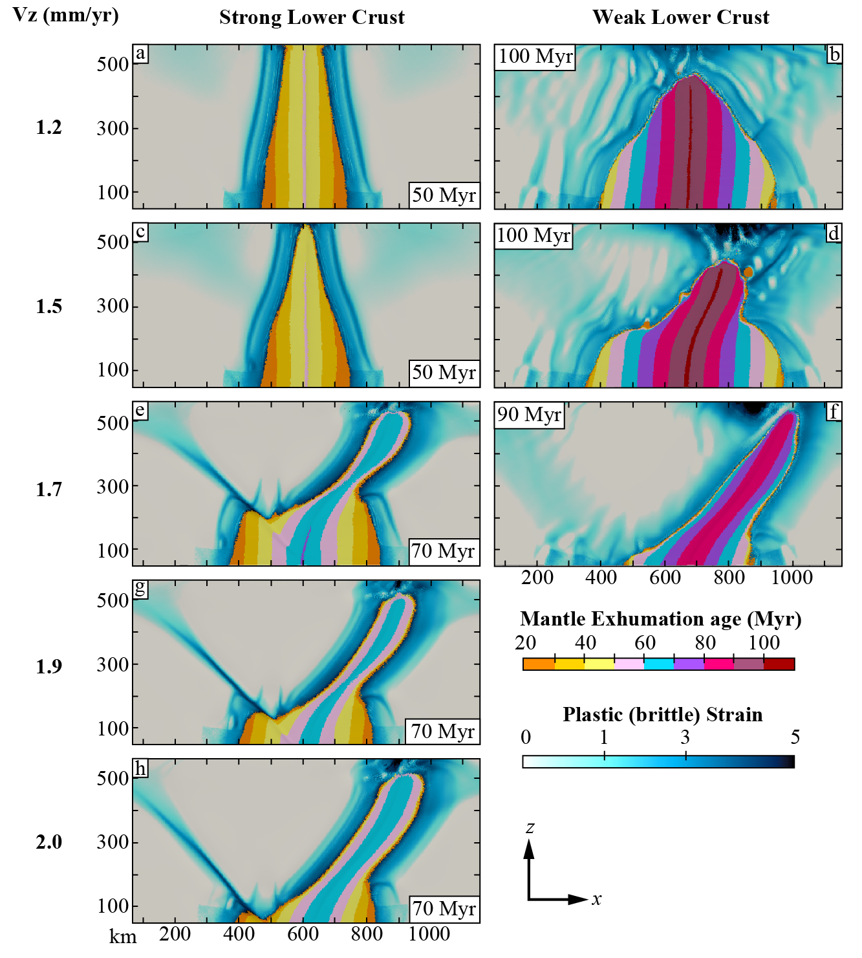
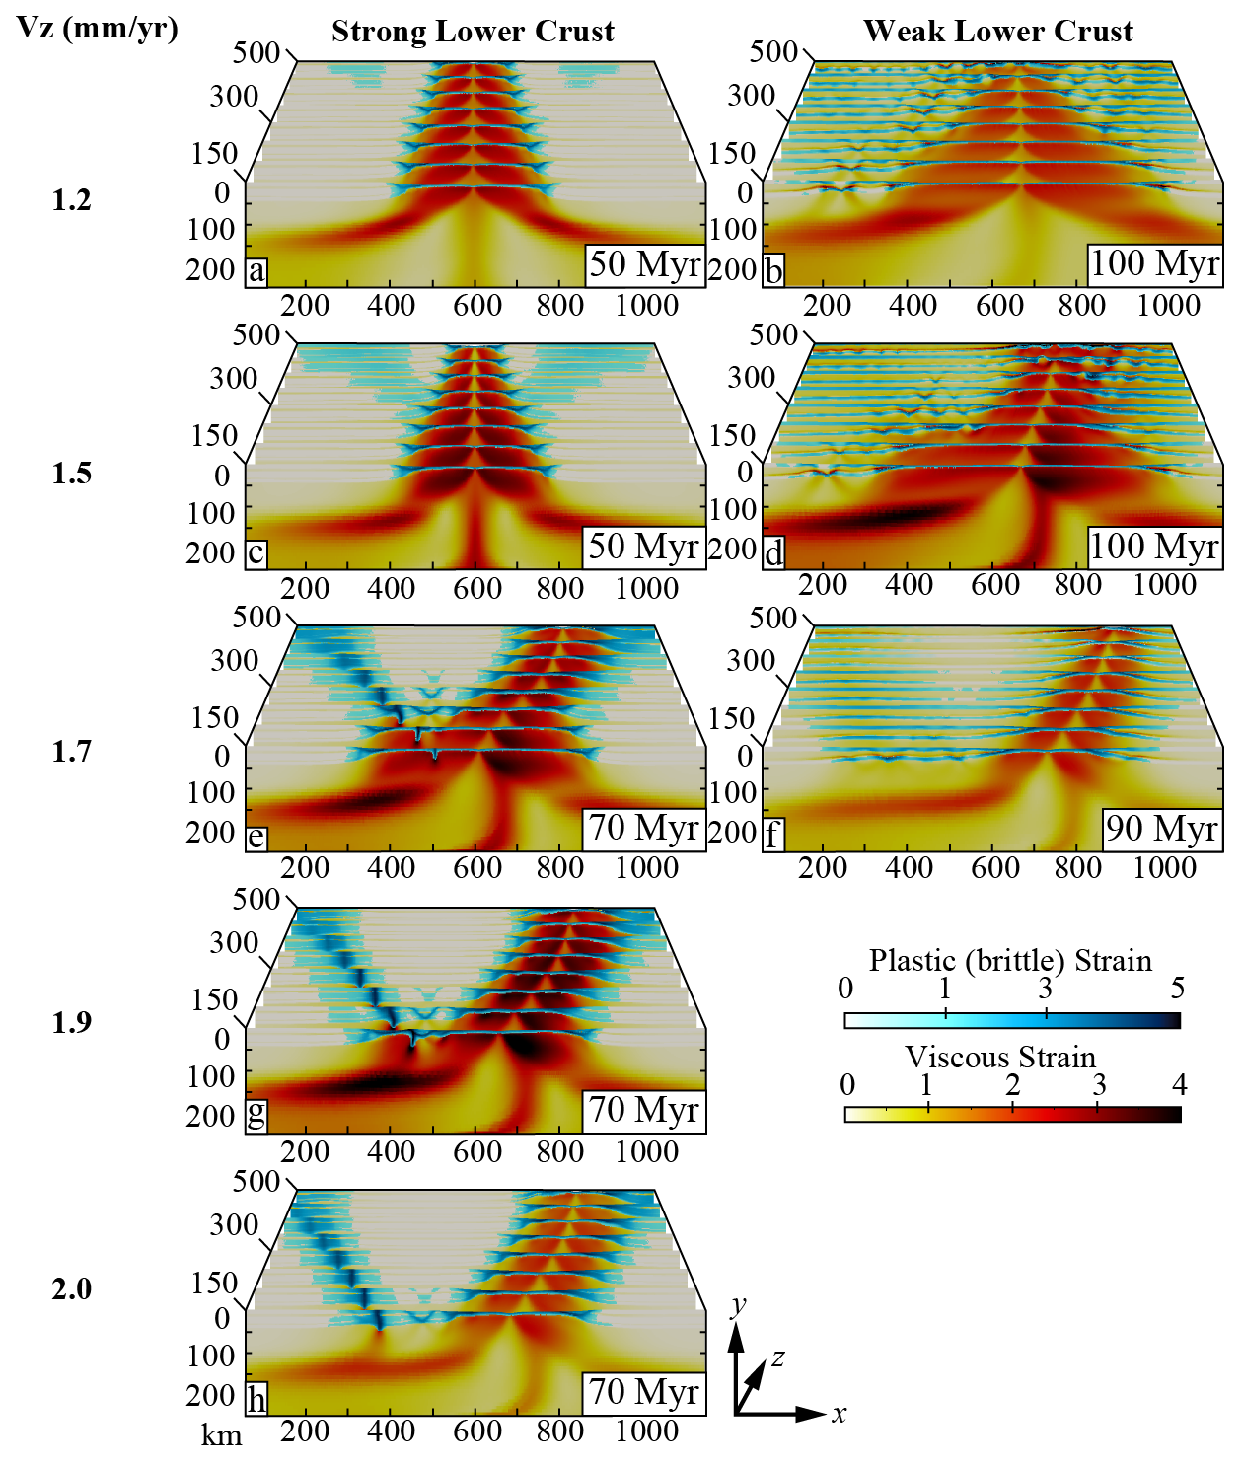
Results
Map view
Serial cross-sections view
Increasing Vz shortening velocity ➔ Increases obliquity and modifies the ridge propagation dynamics

Slide 9
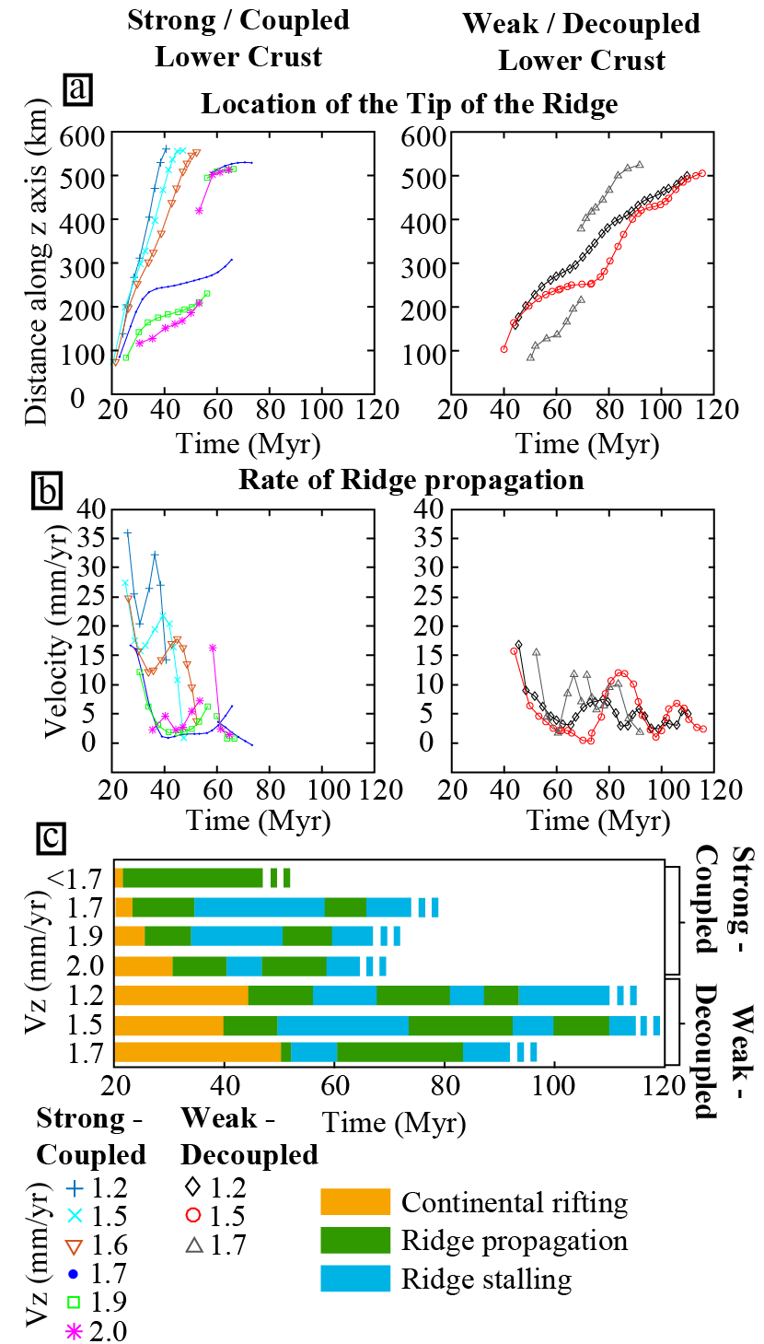
Results
Jump
Models show 3 ridge propagation modes:
Fast and straight
Alternation of stalling and propagation
Ridge jump

Slide 10
Decoupled Lower Crust, Vz = 1.5 mm/a
40 Myr ➔ Ridge initiation
Wide rift in continental crust in front of the ridge
Deformation regime dominated by dip-slip extensional shear zones

Slide 11
Decoupled Lower Crust, Vz = 1.5 mm/a
Structures and margins rotation
Stalling phase
Active deformation in the continental crust in front of the propagator reorients
Deformation regime change into strike-slip dominated (in the continent)
Mantle exhumation age stripes NOT parallel to the margins near the propagator tip

Slide 12
Decoupled Lower Crust, Vz = 1.5 mm/a
Lower crust exhumation as domes aligned along strike-slip faults
Strike-slip faults
Ridge propagated with a new orientation (boundary conditions did NOT change)
During propagation phase deformation regime switches back to dip-slip dominated

Slide 13
Coupled Lower Crust, Vz = 1.7 mm/a
End of first propagation phase
Mantle exhumed domain forms a V-shaped propagator and ridge propagation starts to slow down
Active deformation propagates into two branches ➔ Left: Strike-slip fault, Right: oblique rift

Slide 14
Coupled Lower Crust, Vz = 1.7 mm/a
Structures and margin rotation due to strike-slip deformation
Stalling phase
Active deformation in the continental crust switches from dip-slip dominated to strike-slip dominated (green and purple colours)
Formation of a Ridge-Rift-Fault triple junction

Slide 15
Coupled Lower Crust, Vz = 1.7 mm/a
Propagation phase
Active deformation in the continental crust switches again from strike-slip dominated to dip-slip dominated in the oblique rift
The ridge propagates by jumping to a new spreading centre in the oblique rift
At lithosphere scale 3 plates are formed and strain is partitioned between a pure strike-slip fault, an oblique ridge and an orthogonal ridge

Slide 16
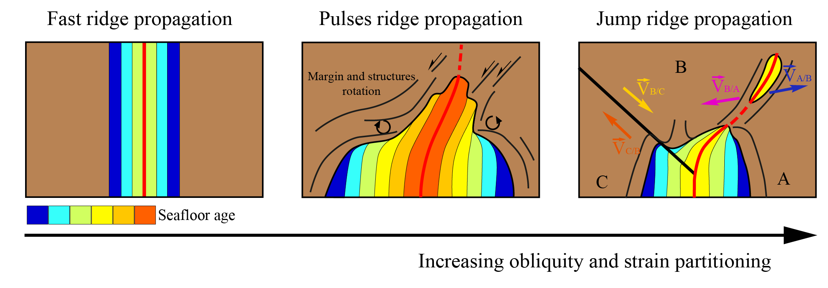
Conclusion
During stalling phases the continental margins and tectonic structures rotate
Deformation regime changes from dip-slip dominated to strike-slip dominated while boundary kinematic conditions are kept constant.
At least three propagation modes can exist. A fast propagation resulting in a straight oceanic basin, an alternation of propagation and stalling phases and propagation with a “jump” of the spreading centre

Slide 17
References
Courtillot, V. (1982). Propagating rifts and continental breakup. Tectonics, 1(3), 239–250
Hey, R., Duennebier, F. K., & Morgan, W. J. (1980). Propagating rifts on midocean ridges. Journal of Geophysical Research, 85(B7), 3647–3658
May, D. A., Brown, J., & Le Pourhiet, L. (2014). pTatin3D : High-Performance Methods for Long-Term Lithospheric Dynamics. Proceeding SC′14 Proceedings of the International Conference for High Performance Computing, Networking, Storage and Analysis:, 274–284.
May, D. A., Brown, J., & Le Pourhiet, L. (2015). A scalable , matrix-free multigrid preconditioner for finite element discretizations of heterogeneous Stokes flow. Computer Methods in Applied Mechanics and Engineering, 290, 496–523. https://doi.org/10.1016/j.cma.2015.03.014
Mondy, L. S., Rey, P. F., Duclaux, G., & Moresi, L. (2018). The role of asthenospheric flow during rift propagation and breakup. Geology, 46(2), 103–106
Le Pourhiet, L., May, D. A., Huille, L., Watremez, L., & Leroy, S. (2017). A genetic link between transform and hyper-extended margins. Earth and Planetary Science Letters, 465, 184–192. https://doi.org/10.1016/j.epsl.2017.02.043
Le Pourhiet, L., Chamot-Rooke, N., Delescluse, M., May, D. A., Watremez, L., & Pubellier, M. (2018). Continental break-up of the South China Sea stalled by far-field compression. Nature Geoscience. https://doi.org/10.1038/s41561-018-0178-5
Vink, G. E. (1982). Continental rifting and the implications for plate tectonic reconstructions. Journal of Geophysical Research, 87(B13), 10677–10688
Zwaan, F., Schreurs, G., Naliboff, J., & Buiter, S. J. H. (2016). Insights into the effects of oblique extension on continental rift interaction from 3D analogue and numerical models. Tectonophysics, 693, 239–260. https://doi.org/10.1016/j.tecto.2016.02.036
Zwaan, F., Schreurs, G., & Rosenau, M. (2019). Rift propagation in rotational versus orthogonal extension: Insights from 4D analogue models. Journal of Structural Geology. https://doi.org/10.1016/j.jsg.2019.103946
Jourdon A., Le Pourhiet L., Mouthereau F., May D.A. Oblique extension favours propagation pulses during continental break-up. Submitted.

