Slide 1
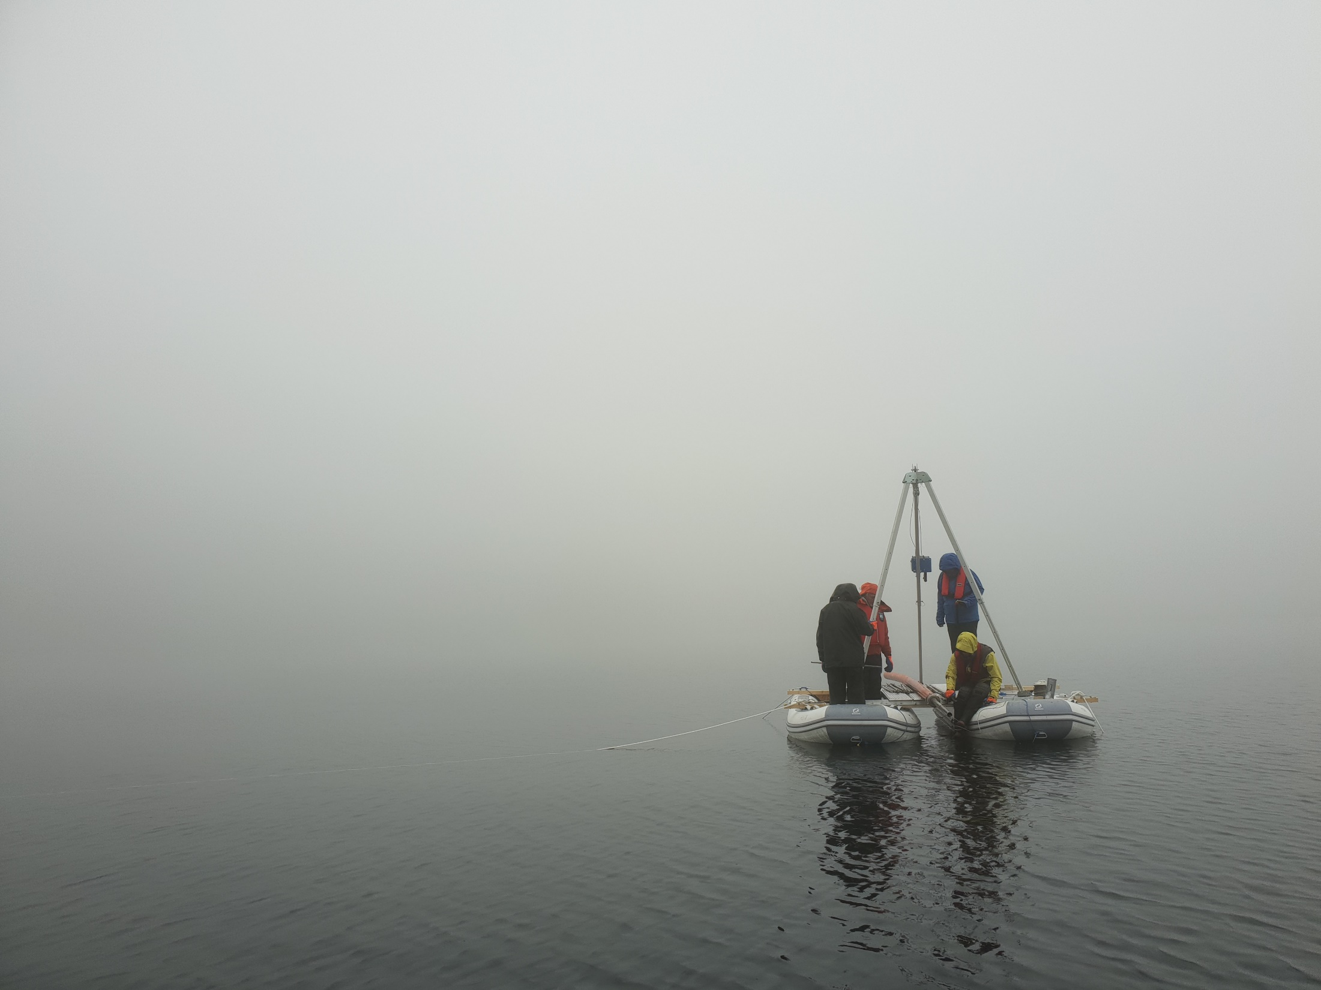


Ancient sedimentary DNA reveals long-term impact of climate change on northern flora
Inger Greve Alsos, Peter D. Heintzman, Dilli Prasad Rijal, Tony Gavin Brown, Charlotte Clarke, Anne E. Bjune, Kelsey Lorberau, Youri Lammers, Sandra Garces Pastor, Scarlett Zetter, Nigel Giles Yoccoz, Mary E. Edwards, Kari Anne Bråthen, Anastasia Poliakova, Marie K.F. Merkel, Iva Pitelkova, Ludovic Gielly, Aage Paus, Paul Hughes, Haflidi Haflidason, Jan Mangerud, John-Inge Svendsen, Anders Schomacker, Tomasz Goslar
Inger G. Alsos
EGU 2020

Slide 2
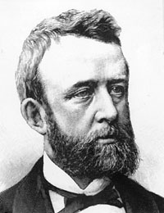
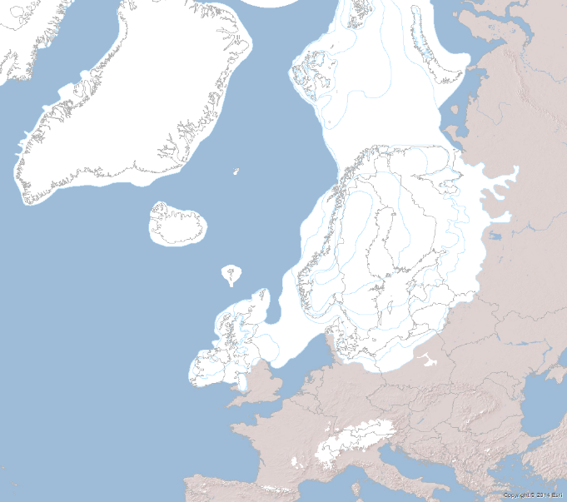

150 year debate
Tabula rasa
High dispersal
Low survival
Glacial survival
Short dispersal
High survival
AG Blytt 1876
K Fægri 1960
Alsos et al. 2007 Science
Modern DNA
Parducci et al. 2012 Science
Ancient DNA

Slide 3
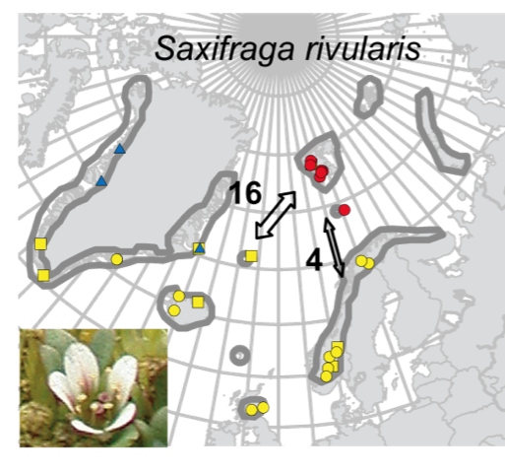
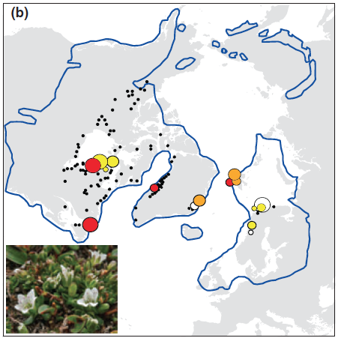
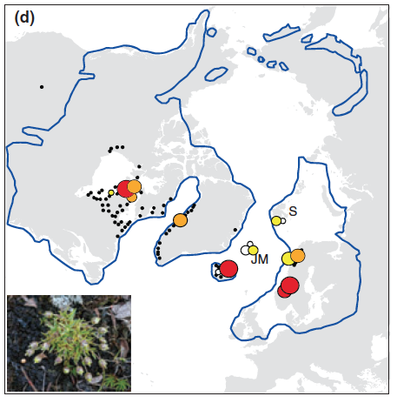
Modern DNA: Indirect evidence of glacial survival
Saxifraga rivularis
Arenaria humifusa
Sagina cespitosa
Westergaard et al. 2010. J. Biogeogr. 37: 1262-1276
Westergaard et al. 2011. Mol. Ecol. 20: 376-393

Slide 4
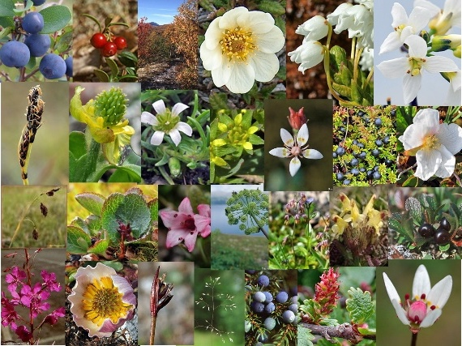
Modern DNA: 92% Tabula rasa
Limitations modern DNA
Relative dating
Genetic swamping
Infer dispersal ≠ true dispersal?
Alsos et al. 2015. AoB Plant

Slide 5
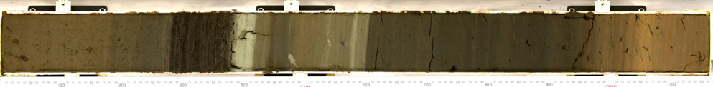
New contribution from sedaDNA
1 000 BP
8 000 BP
10 000 BP
12 000 BP
Parducci et al. 2017 Transley Review. New Phytologist 214: 924-942

Slide 6
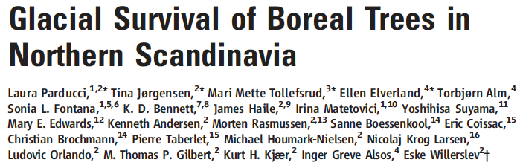

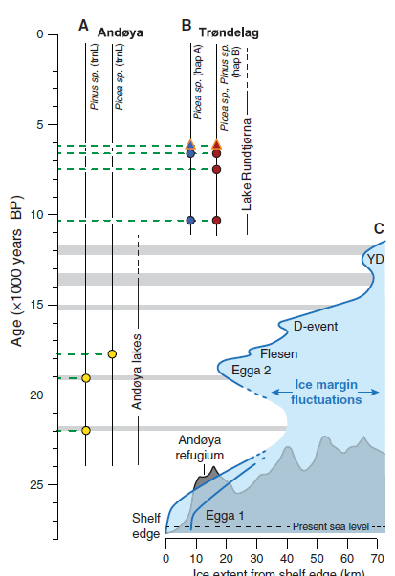
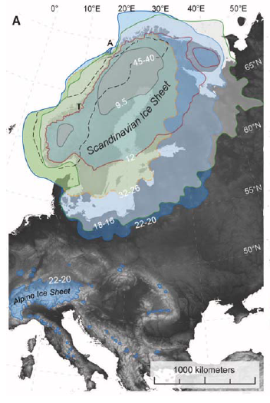

Science 2012

Slide 7
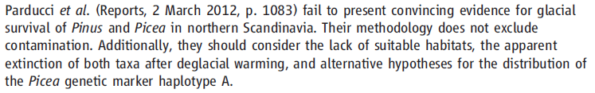
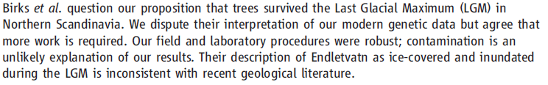
Birks, Giesecke, Hewitt, Tzadakis, Bakke & Birks (2012) Science 388: 742
Parducci et al. (2012): 742

Slide 8
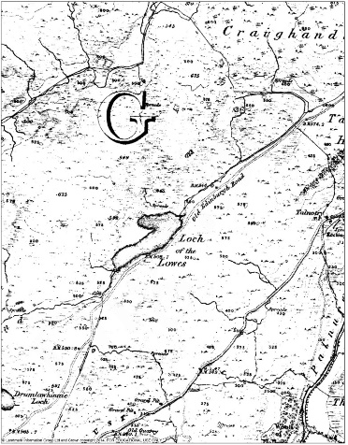
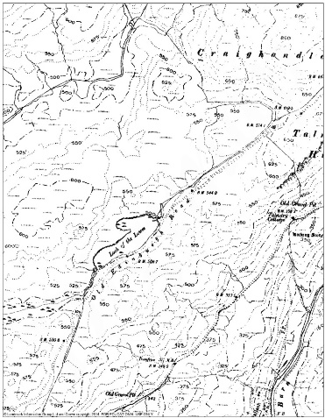
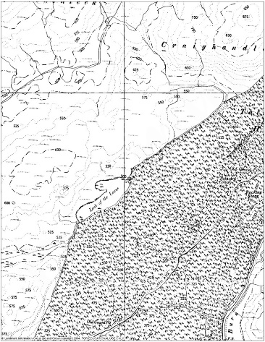
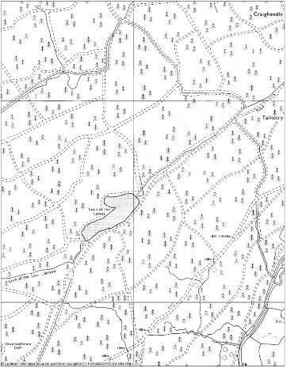
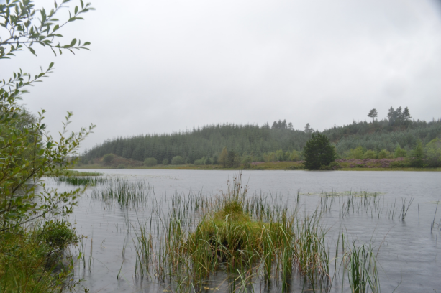
2017
DNA leaching?
DNA from pollen?
No
No
1850s
1910s
Historical maps
1950s
1970s

Slide 9
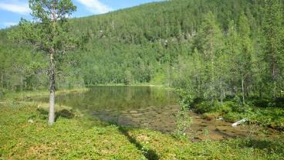
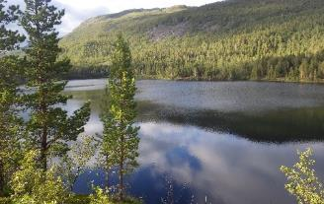
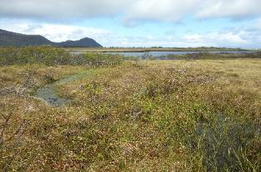
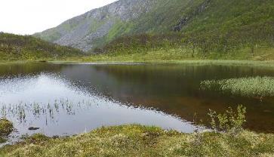
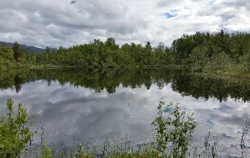
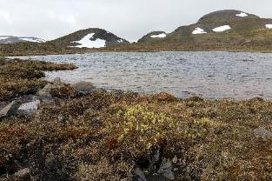
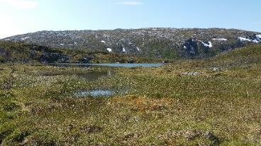
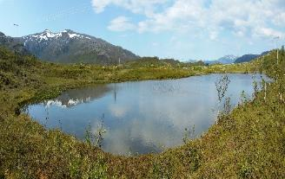
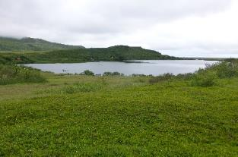
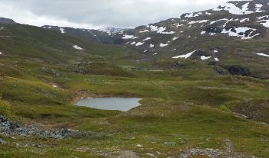
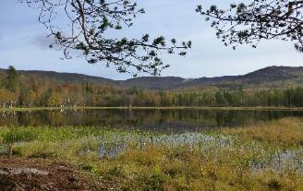
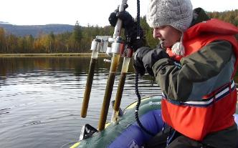
Local origin
Detection depends on:
  abundance
  family
  distance
  site
Aquatic especially well detected

Slide 10
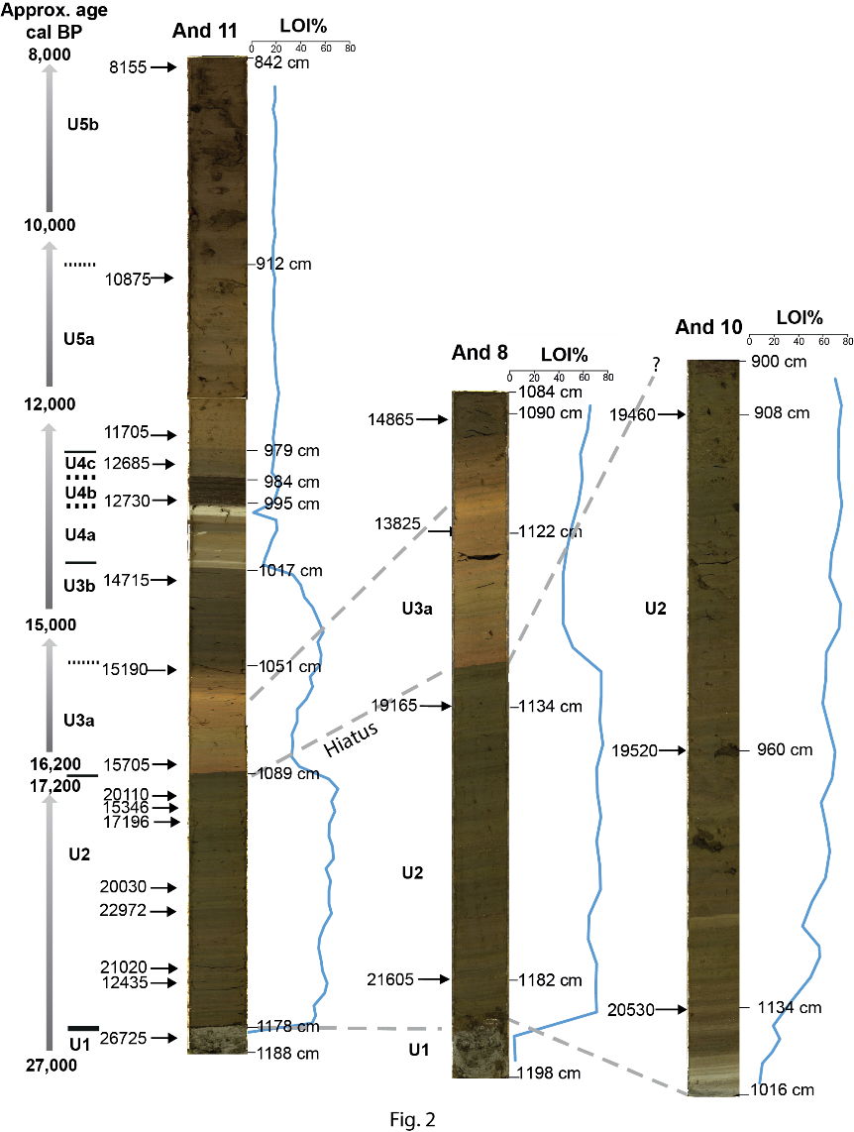
Three new cores from Andøya
Alsos et al. Submitted QSR

Slide 11
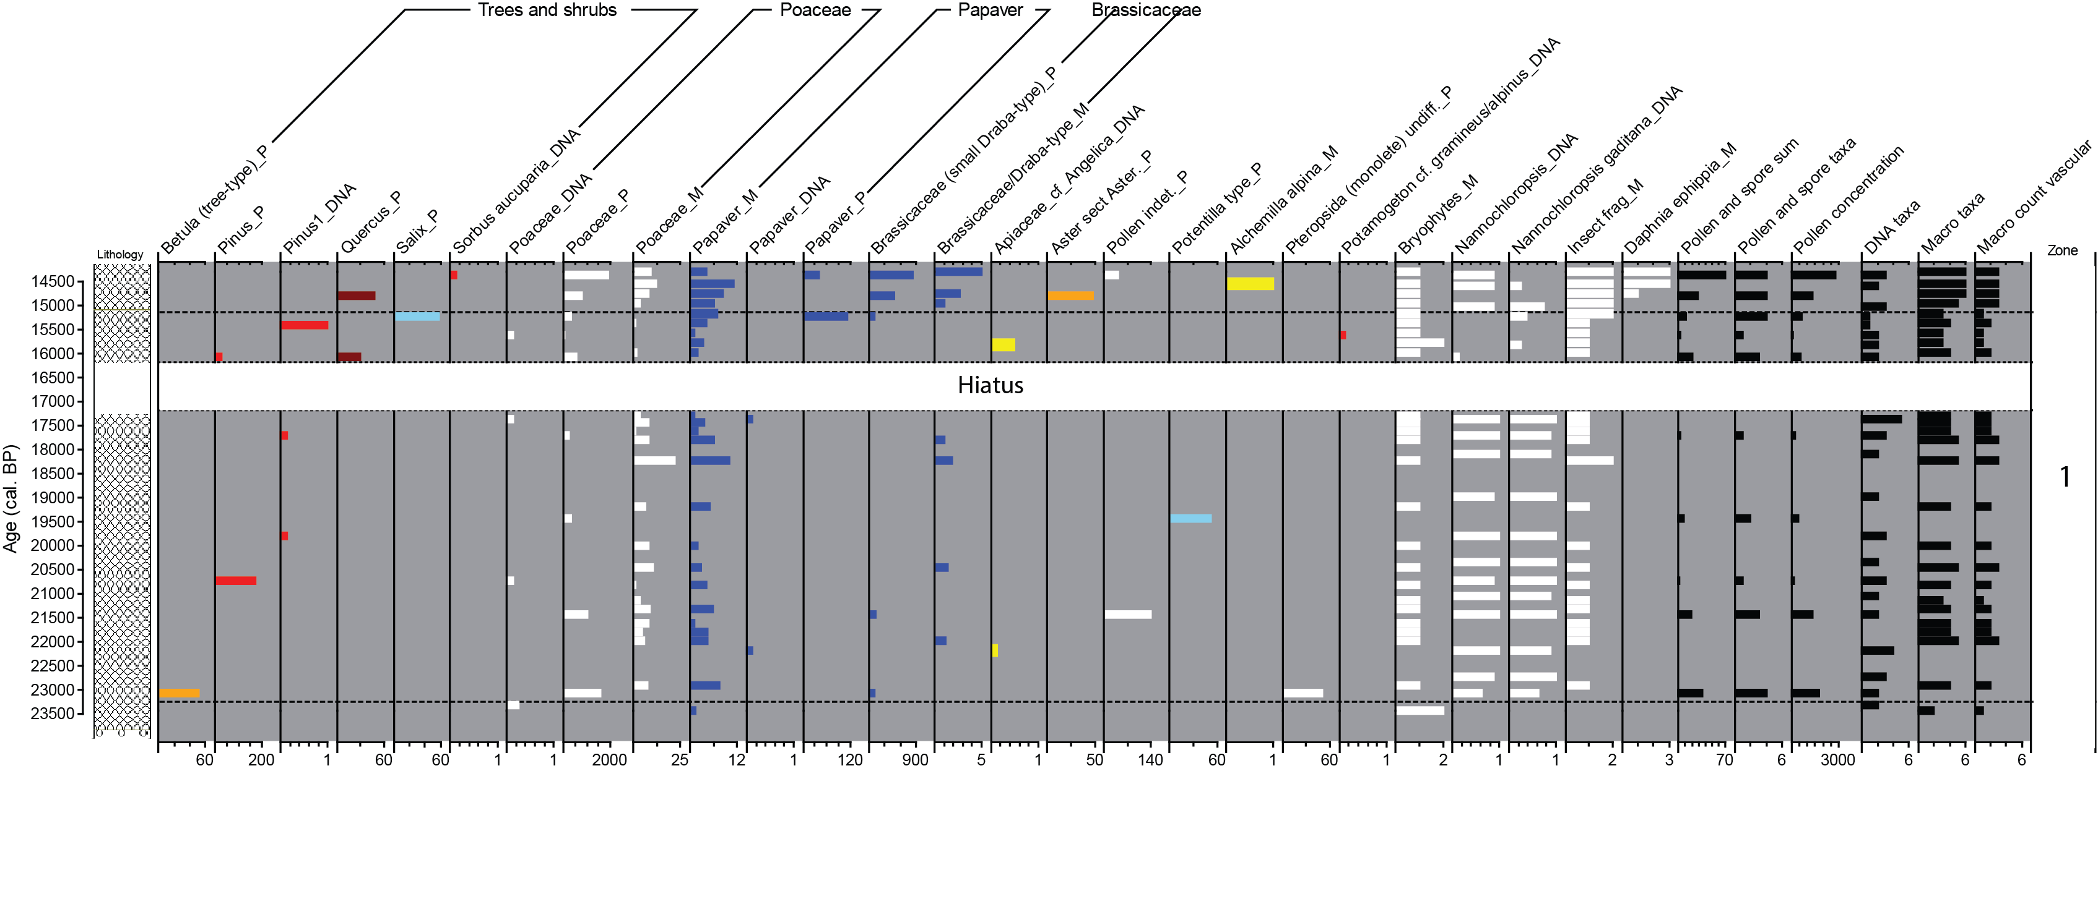
Scattered pine and spruce
Sequence | Samples | Negative controls | Evaluation
Picea | 0.031 | 0.038 | Likely contamination – not shown in figure
Pinus 1 | 0.033 | 0.013 | ?
Pinus 2 | 0.010 | 0.000 | ?
New DNA results does not allow conclusion about local growth of trees on Andøya
Alsos et al. Submitted QSR
Notes:
We found pine and spruce DNA in all three cores but also in some negative control samples. When we compared the frequency of pine and spruce DNA with that in negative controls - and here we used all negative controls run in the our DNA lab in the same period so about 700 of them - there were only marginally differences in frequency. We suspect that small amount of pine and spruce DNA may occure in reagents and this could explain why different DNA labs sometimes detect these taxa. With such low frequences, and only marginally differences to negative controls, we canot make any conclusion based on the DNA.

Slide 12
Last Glacial Maximum environmental conditions at Andøya, northern Norway; evidence for a northern ice-edge ecological “hotspot”
Isotopes and bones indicate birds roosted near the ice edge
Review of all Andøya LGM studies reveals presence of boreal and arctic taxa
High trophic level
U1
U2, U3b
U4
U3a
U5, U6
Alsos, Sjögren, Brown, Gielly, Merkel, Paus , Lammers, Edwards, Alm, Leng, Goslar, Langdon, Bakke, van der Bilt. Submitted QSR

Slide 13

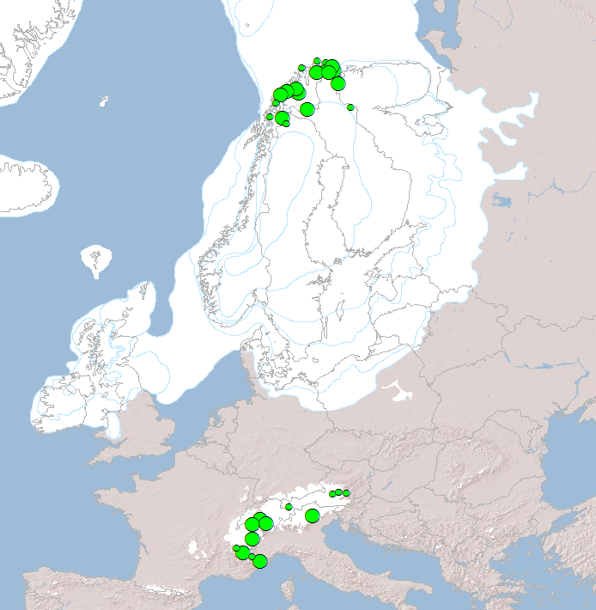

ECOGENE - Ecosystem change and species persistence over time: a genome-based approach
Effect of:
climate
biota
human
On:
species persistence
tipping points
Dilli P Rijal et al. BG2.2 16:41-16:44
Low human impact
Sandra G Pastor et al. BG2.2 16:54-16:57
Scarlett Zetter et al. BG2.2 16:57-17:00
High human impact
ECOGEN.no

Slide 14
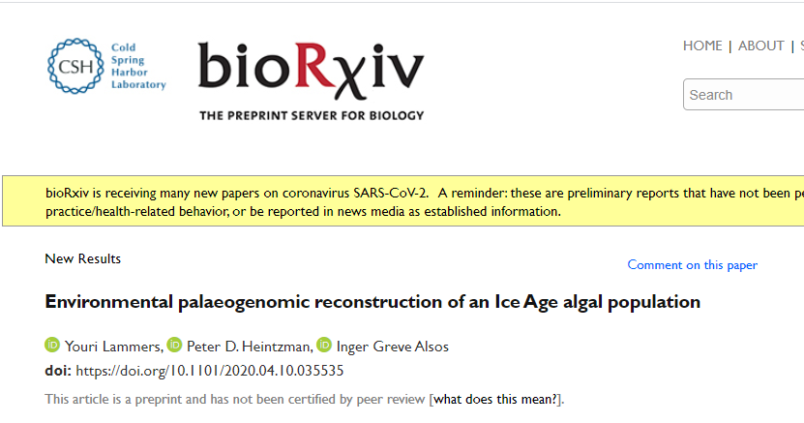
Finding variation within species is possible
Genetic variation within Nannochloropsis limnetica in LGM sediments from Andøya

Slide 15
We have the reference libary needed for further developing sedaDNA studies

Slide 16

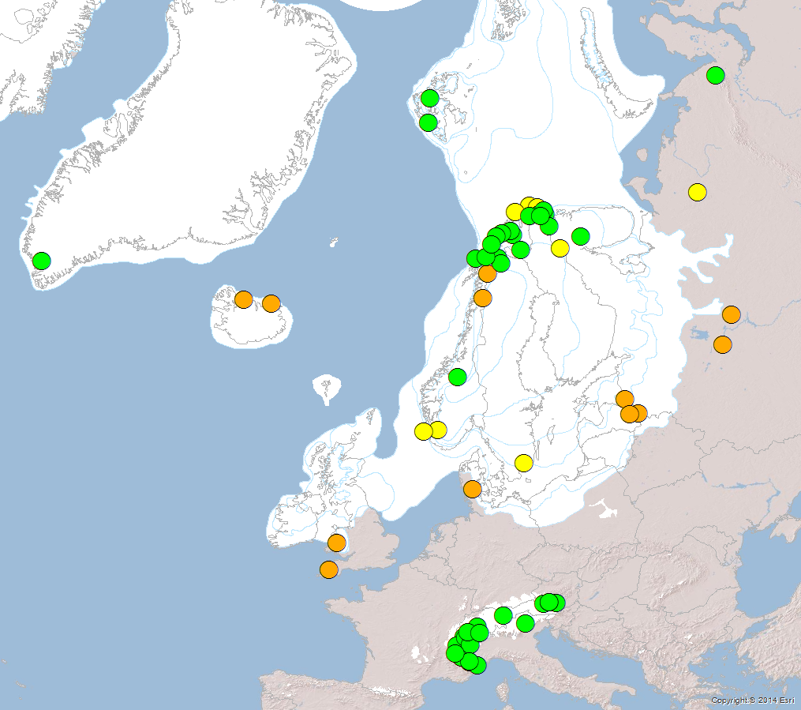

Ice Age Genomic Tracking of
Refugia and Postglacial Dispersal
aDNA (almost) complete
Sediment cores taken
New coring sites
>50 locations
Covers previously glaciated
areas and ice age refugia
Alsos et al. 2016 Holocene, Clarke et al. 2018 Boreas
Voldstad et al. QSR in press, Alsos et al. QSR submitted
Rijal et al. in prep, Garces Pastor et al in prep.

Slide 17

Ice Age Genomic Tracking of
Refugia and Postglacial Dispersal
aDNA (almost) complete
Sediment cores taken
New coring sites
>50 locations
Covers previously glaciated
areas and ice age refugia
Cores
wanted!!!!
Corona prohibits coring – we need cores covering LGM!!!

Slide 18
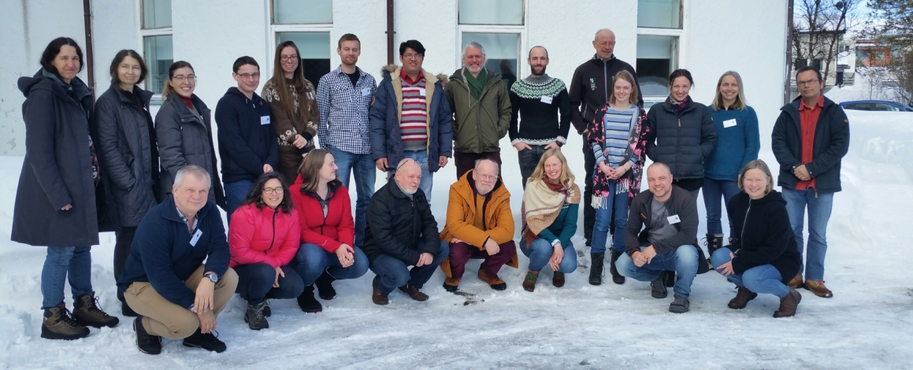


Thanks to my co-workers
Thank you for your attention!
inger.g.alsos@uit.no
http://en.uit.no/ansatte/inger.g.alsos
http://svalbardflora.no

