Slide 1


Core-mantle boundary flows obtained purely from Swarm secular variation gradient information
Kathy Whaler
University of Edinburgh
Magnus Hammer, Chris Finlay, Nils Olsen
DTU Space

Slide 2
Outline
Previous work
Data
Flow inversion
Pacific jerk
Conclusions

Slide 3
Virtual Observatories
Virtual observatories (VOs) are a way of reducing large quantities of satellite data to estimates of magnetic field quantities at a set of target points as a function of time, mimicking the time series obtained from ground observatories
Data within a vertical cylinder whose axis passes through the target point are used
Data are reduced to values at the target point using a potential representation

Slide 4
Previously …
DTU group have made several key improvements to VO methodology
This includes producing spatial gradients of the field in addition to the magnetic field, and its time derivatives
At Swarm DQW 2018
  demonstrated that SV gradient as well as SV VO estimates themselves can be used to infer core surface flow
  showed residuals are less biased, indicating less contamination of the data by external fields
  showed that resolution is better for gradient data

Slide 5
Virtual Observatory (VO) estimates
Derived from sums and differences of the observations along- and across-track
Cubic potential description to reduce to central point
4-monthly values so each VO volume is well-sampled
Annual differences provide secular variation
Uncertainties derived for each component at each VO
300 equally spaced VOs (but we don’t use gradients from polar VOs for flow modelling)
VO search range (cylinder radius) is 700 km
Corrections:
CHAOS-6 crustal (SH degrees 14 to 120) field estimate removed
CHAOS-6 external (plus induced) field estimate removed
CM4 ionospheric (plus induced) field estimate removed

Slide 6
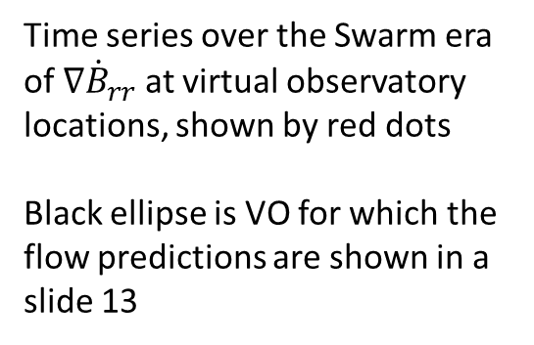
Example of VO SV gradient time series
Time series over the Swarm era of $∇{\dot{B}}_{rr}$ at virtual observatory locations, shown by red dots
Black ellipse is VO for which the flow predictions are shown in a slide 13

Slide 7
Data
Both SV gradient (previous slide) and SV (below, also seen in VOs) estimates show a jerk in the Pacific region around 2017

Slide 8
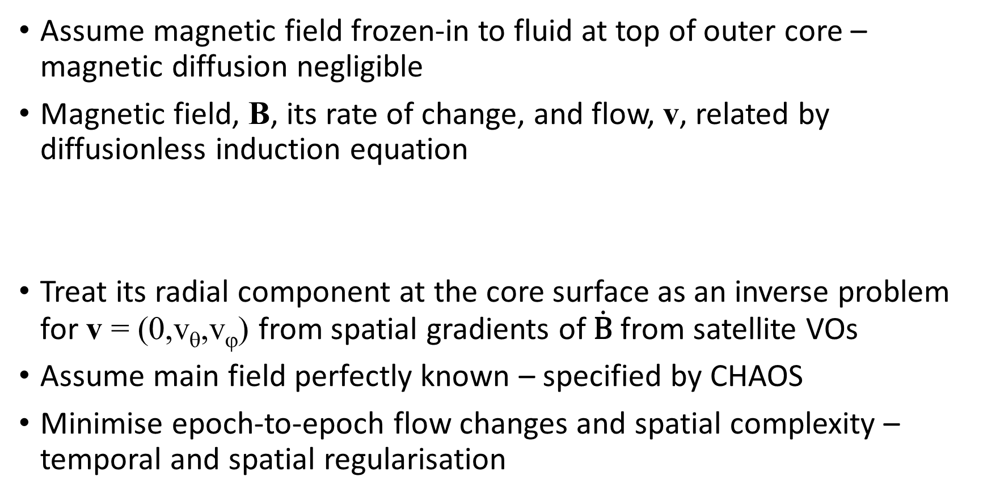
Flow inversion method
Assume magnetic field frozen-in to fluid at top of outer core – magnetic diffusion negligible
Magnetic field, B, its rate of change, and flow, v, related by diffusionless induction equation
Treat its radial component at the core surface as an inverse problem for v = (0,v_{θ},v_{ϕ}) from spatial gradients of $\dot{\text{B}}$from satellite VOs
Assume main field perfectly known – specified by CHAOS
Minimise epoch-to-epoch flow changes and spatial complexity – temporal and spatial regularisation

Slide 9
Results
Minimum normalised misfit 1.2 (flows presented here have that value)
Flows show usual features such as band of westward flow beneath the Atlantic Ocean, slower flow beneath the Pacific Ocean, the eccentric planetary gyre
Viewed globally, very little flow change is required (e.g. movie on next slide)
Find features responsible for Pacific jerk in 2017
  localised increase in flow speed, particularly in the western part
Regularised flows under-predict the amplitude of the signal
  relaxing the regularisation does not help

Slide 10
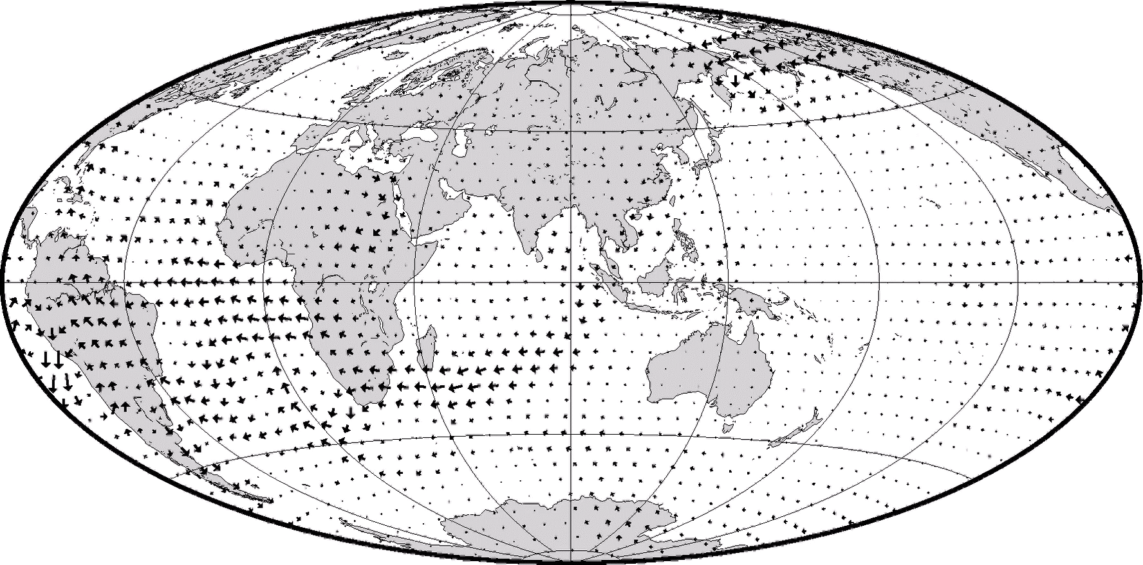
Video of toroidal flow component over 2014-9
20 km/year

Slide 11
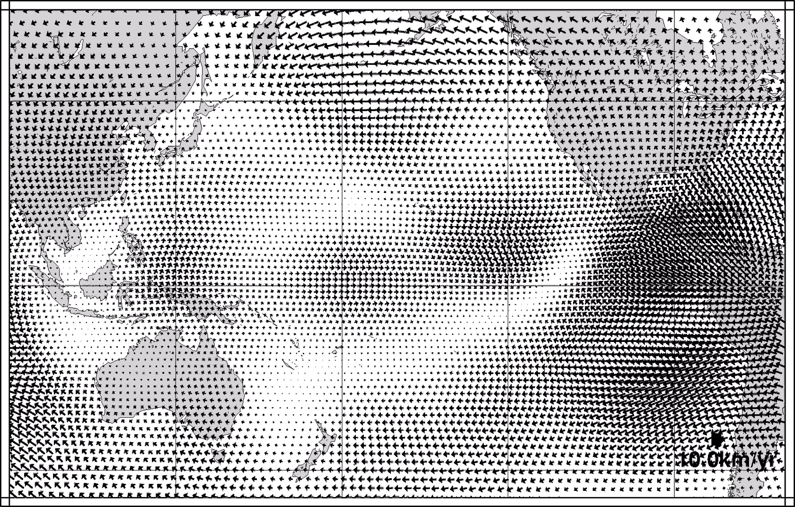
Pacific region changes

Slide 12
Next slide
6 independent gradient components at VO located at (6°N,161°W) in the Pacific between 2014 and 2019 and their predictions by two flows
Units are pT km⁻¹ year⁻¹
Vertical scales vary from plot to plot
Predictions of strongly and weakly spatially regularised solutions fit equally well globally (rms misfit 1.2), and differ little at the VO location

Slide 13






Time series and their predictions by flows
$$∇{\dot{B}}_{φφ}$$
$$∇{\dot{B}}_{φr}$$
$$∇{\dot{B}}_{rr}$$
$$∇{\dot{B}}_{θφ}$$
$$∇{\dot{B}}_{θr}$$
$$∇{\dot{B}}_{θθ}$$

Slide 14
Summary
Satisfactory flow models derived only from satellite VO SV gradients obtained from ~5 years of Swarm data
Very little flow change required
2017 jerk involves a flow acceleration
Temporally and spatially regularised flows under-predict the jerk amplitude

