Slide 1
Time-series experiments of pyroxene crystal nucleation and growth in basaltic magmas and implications for magma rheology
Margherita Polacci
F. Arzilli, G. La Spina, N. Le Gall, R. Torres-Orozco, M. E. Hartley, D. Di Genova, R. C. Atwood, E. W. Llewellin, R. Brooker, H. M. Mader, P. D. Lee and M. R. Burton

Slide 2
Abstract
Basaltic volcanism is strongly influenced by magmatic viscosity, which, in turn, is controlled by magma composition, crystallisation, oxygen fugacity and vesiculation. We developed an environmental cell to replicate the pressure and temperature during magma ascent from crustal storage to the surface, while capturing crystallisation using in-situ 4D X-ray computed microtomography. Crystallisation experiments were performed at Diamond Light Source, using monochromatic 53 keV X-rays, a pixel size of 3.2 μm, a sample to detector distance of 2000 mm, 1440 projections per 180 deg, an acquisition time of 0.04 s, and a rotation velocity of 3.125 deg.s-1. The redox conditions were controlled using an oxidised nickel disk for each experiment. Our starting materials were samples made of crystal-free glass cylinders (Ø 3 mm) from the 2001 Etna eruption with 0.9 and 0.8 wt. % water content. In the experiments, samples and crucibles were sealed initially by applying ~10 N loads. All samples were then heated up above glass transition (between 800 °C and 900 °C) in order to allow sample homogenisation while preventing volatiles exsolution. We then pressurised each sample by applying uniaxial loads (between 80 and 380 N), using high-degree alumina pistons, in order to generate enough internal pressure to maintain bubble-free samples when the desired high temperature was reached. Once at the initial high temperature, we began experiments via dropping the temperature to different target isothermal (from 1210 to 1130 °C or 1180 to 1110 °C) and isobaric conditions (8 and 10 MPa, respectively). For the whole duration of the experiments, we were able to observe directly and record pyroxene crystal nucleation and growth. Specifically, we were able to observe pyroxene nucleation on bubbles at small undercooling (∆T) and epitaxial growth of pyroxene at large ∆T. An increase of ∆T (up to 50 °C) can be associated with a decompression of a magma chamber or a decompression during magma ascent in the conduit. As ∆T = 30 - 50 °C can be reached in most of the basaltic volcanic systems on Earth, our results provide a feasible explanation of which mechanisms control nucleation and growth of pyroxene crystals in hydrous basaltic magmas. In addition, epitaxial growth promotes a faster increase of the crystal volume. As a larger crystal content translates into a higher viscosity, our results have important implications for magma rheology, and are extremely important to improve our understanding of magma ascent dynamics during volcanic eruptions, and our capacity to predict eruptions and mitigate volcanic hazards.

Slide 3
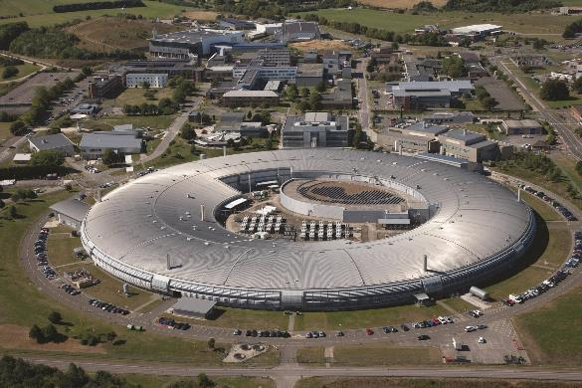
In situ High Temperature High Pressure X-ray microtomography experiments
Diamond Light Source
The aim of these experiments is to constrain the timescales of crystallization in real time. The experiments were performed at Diamond Light Source (beamline I12), Harwell, UK. For these experiments we used small cylindrical chips of Etna 2001 hydrous basaltic glass (with 0.9 wt.% of H₂O), which were heated in-situ in the Alice furnace and pressurized with the P2R compression rig in order to reach 10 Mpa. The combination of P2R and Alice furrnace allowed us to perform experiments at 10 Mpa and magmatic temperatures under water-saturated conditions.

Slide 4
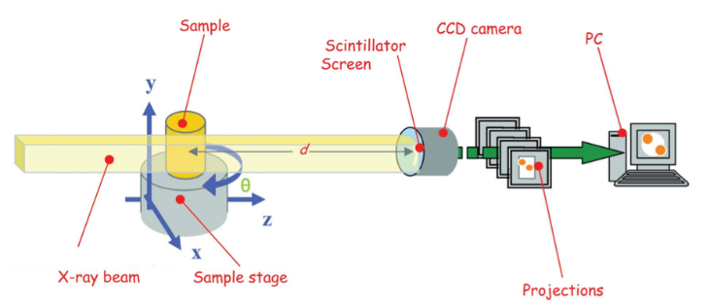
Schematic illustration of X-ray µ-CT acquisition
and reconstruction processes
Polacci et al. (2009)

Slide 5
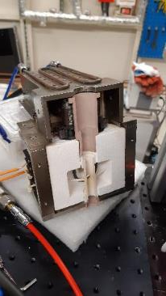
Alice furnace
Schematic of one half of environmental cell with heating and sample module and (b) schematic of the environmental cell setup at the I12 beamline of Diamond Light Source [10]. Scale bar = 32.5 mm.

Slide 6
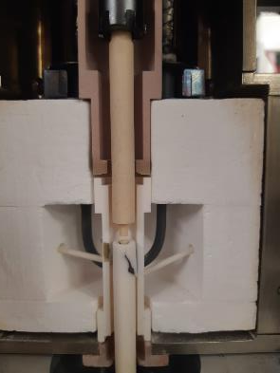
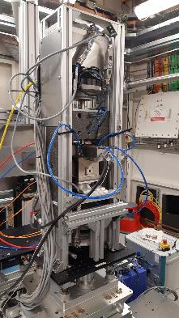
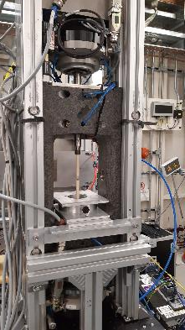
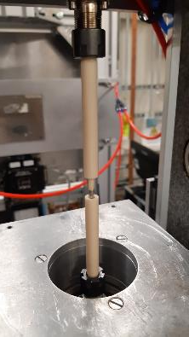
Picture of P2R compression rig at the I12 beamline + Alice furnace The combination of P2R and Alice allowed us to perform experiments at 10 Mpa and magmatic temperatures
P2R
piston
P2R
piston
P2R
+
Alice
P2R
Alice
crucible
crucible

Slide 7
Experimental approach In situ 4D crystallisation experiments
Schematic representation of the thermal paths used in this study.
After the initial annealing period at 1180 °C, crystallisation was induced by decreasing temperature isobarically to 1160, 1140 and 1110 °C.

Slide 8
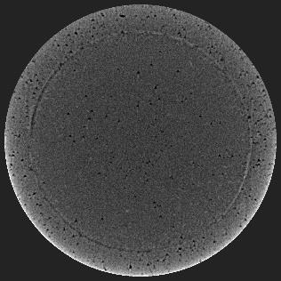
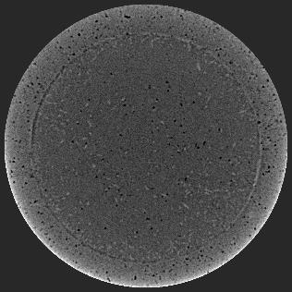
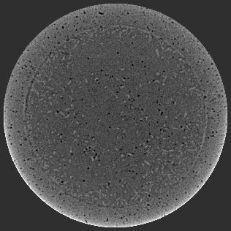
Crystallization through time
T = 1140 °C
P = 10 MPa
H₂O = 0.9 wt.% (water-saturated conditions at 10 Mpa)
crucible
crucible
crucible
Cpx
Cpx
10 min
30 min
50 min

