Slide 1
PSMSL (Permanent Service for Mean Sea Level) An International Data Centre for GNSS Interferometric Reflectometry Data for Observing Sea Level Change Andy Matthews, Simon Williams, Liz Bradshaw, Kathy Gordon, Angela Hibbert, Sveta Jevrejeva, Lesley Rickards, Phil Woodworth National Oceanography Centre, United Kingdom

Slide 2
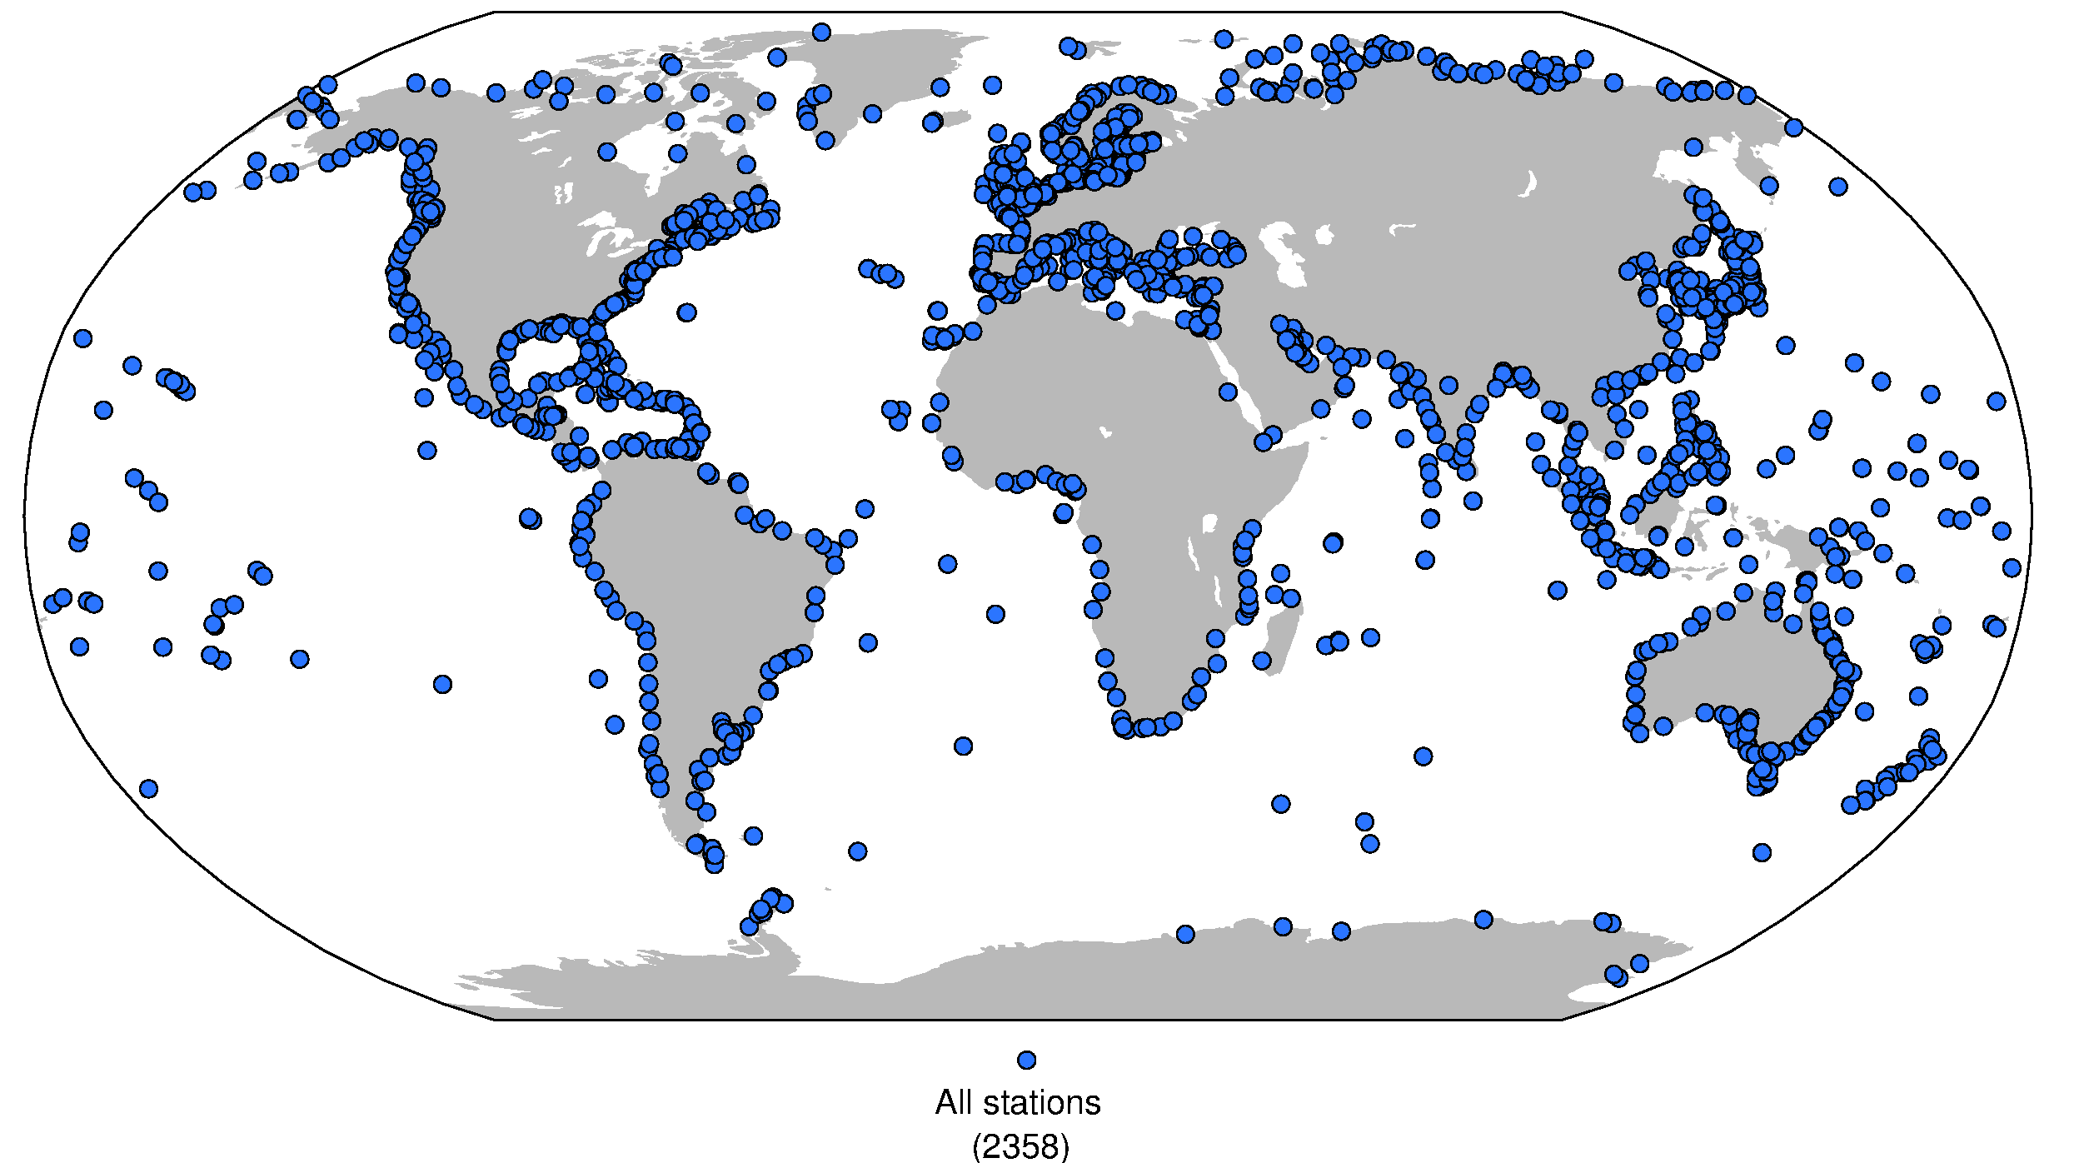
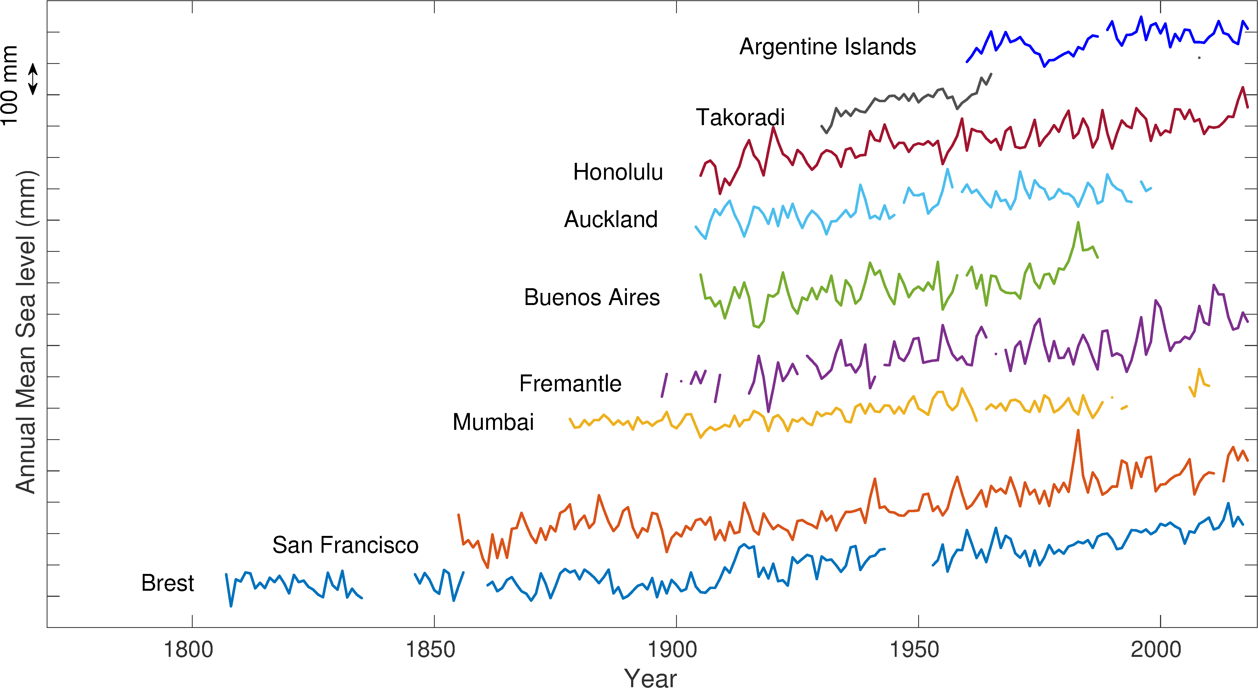
The global tide gauge network at psmsl.org
The PSMSL is a global databank for mean sea level data measured at tide gauges, and also provide advice on collection, distribution of sea level data.
PSMSL data forms the core of our understanding of sea level rise over the past couple of centuries, but is also used to study ocean currents vertical and land movement.
The global tide gauge network continues to improve, but gaps still exist, particularly in the Southern Hemisphere. Furthermore, funding issues mean that the quality of data from long running records is under threat.
Notes:
Very brief intro on who the PSMSL are.
Data is key component of IPCC chapters on sea level rise - PSMSL data inform the IPCC report and we have been lead authors on sea level chapters in the second, third and fifth assessment reports, and have contributed to the first and fourth assessment reports.
Answer questions from scientists, governments, industry, media & general public about sea level and tide gauges.

Slide 3
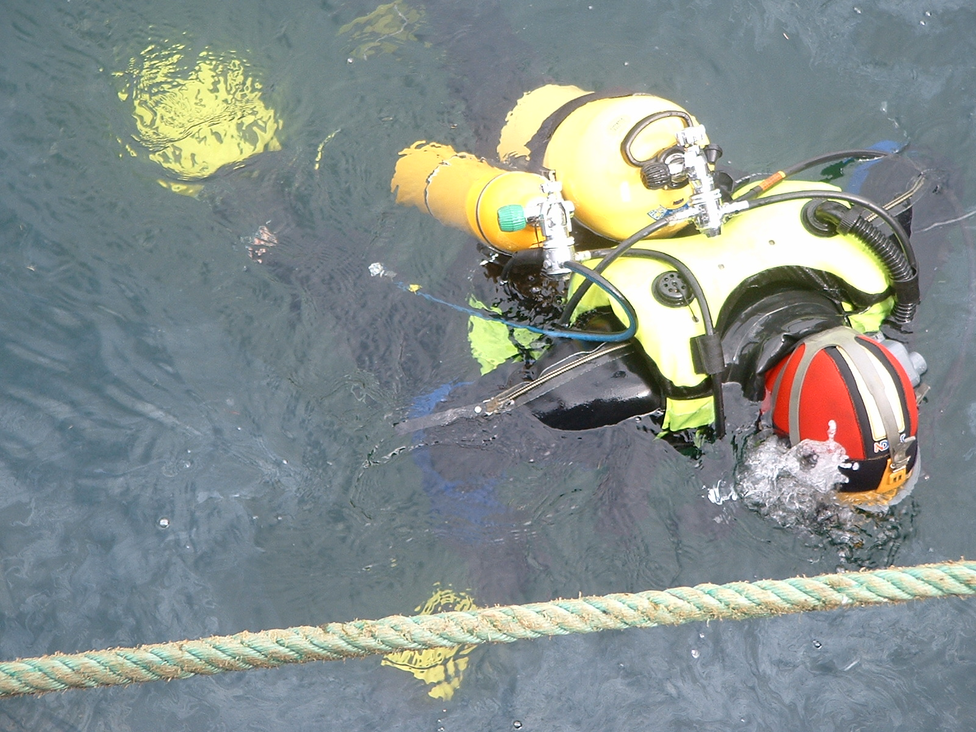
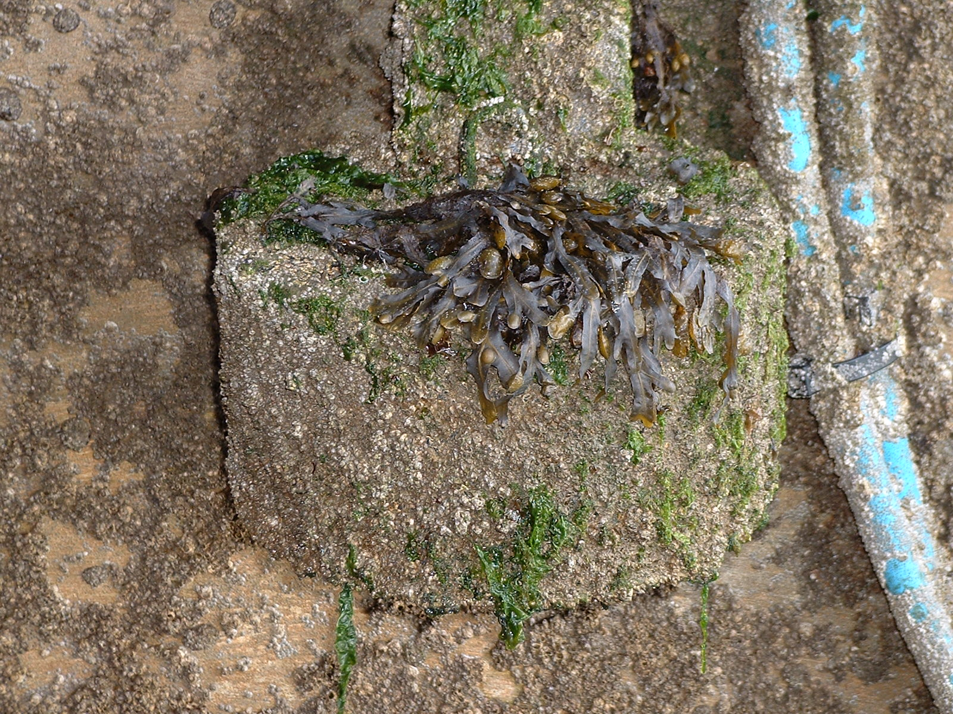
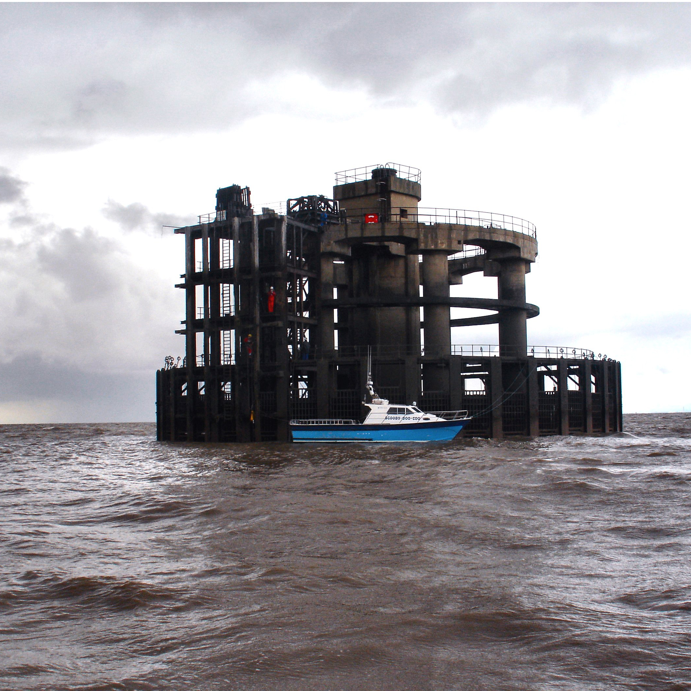
Why aren’t there more tide gauges records?
While tide gauge sensors themselves are not very expensive, there are considerable costs involved in operating them over a long period of time, particularly when budgets are tight:
Water based sensors (e.g. pressure transducers) suffer from biofouling, and can require divers to perform maintenance.
Land based sensors (e.g. radar or acoustic) are exposed to damage from storms, vandalism, or general accident in often busy port environments.
Gauges can be located in remote, hard to access areas

Slide 4
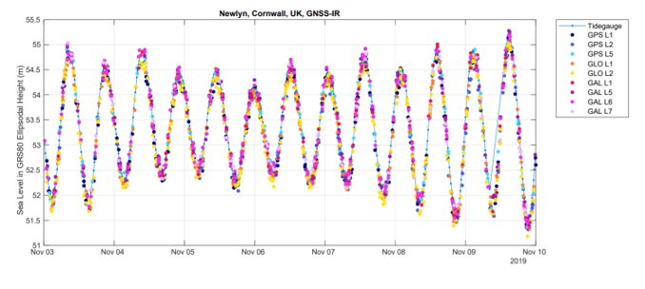
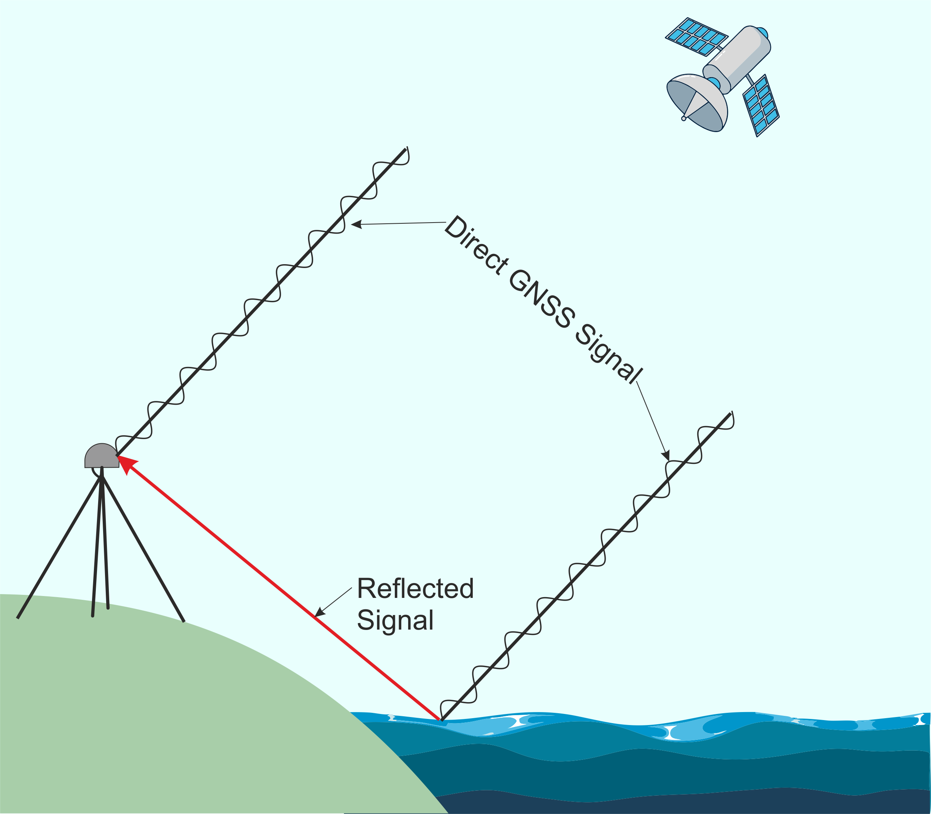
GNSS Interferometric Reflectometry (GNSS-IR)
The emerging technology of GNSS-IR gives us the opportunity to measure sea levels without getting out feet wet
This technique allows sea level to be measured using only a GNSS receiver.
As well as a receiving a direct signal from a GNSS satellite, the GNSS receiver detects a reflected signal off the surface of the water. The phase delay between the direct and reflected signal will vary as the height of the water changes.

Slide 5
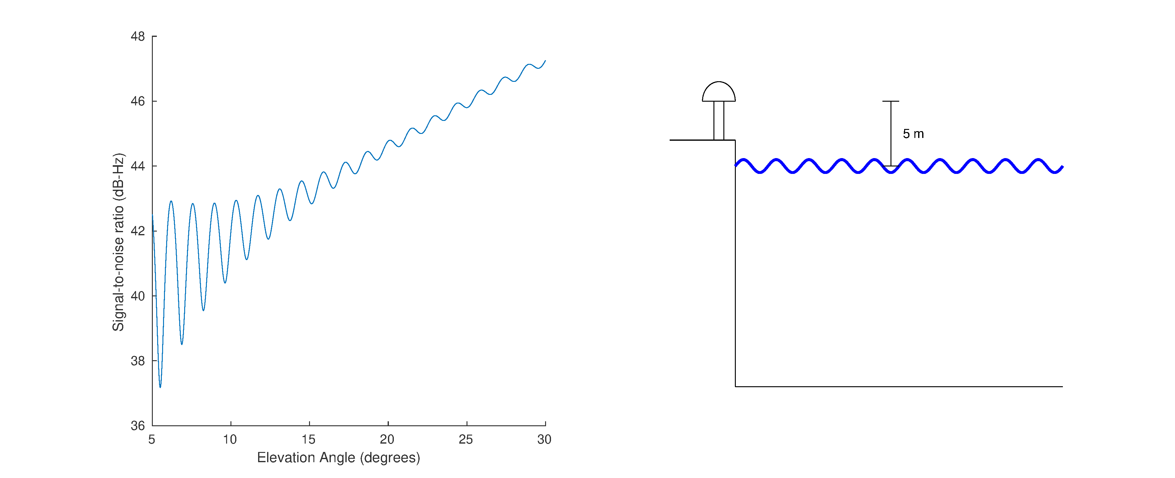
How GNSS-IR works (note: animation plays in slide show mode)
The plot of the signal-to-noise ratio as the GNSS satellite passes overhead changes as the height of the water changes. Lower water levels means the reflected signal has to travel further, resulting in greater frequency modulation. The water level can be extracted from this (see Larson et al., 2013)

Slide 6
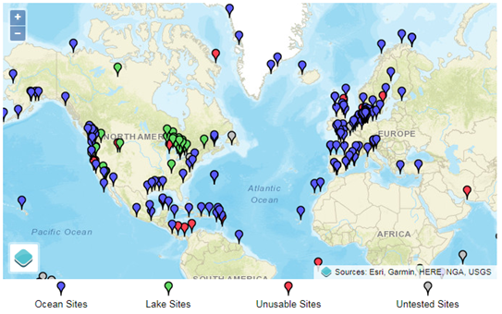
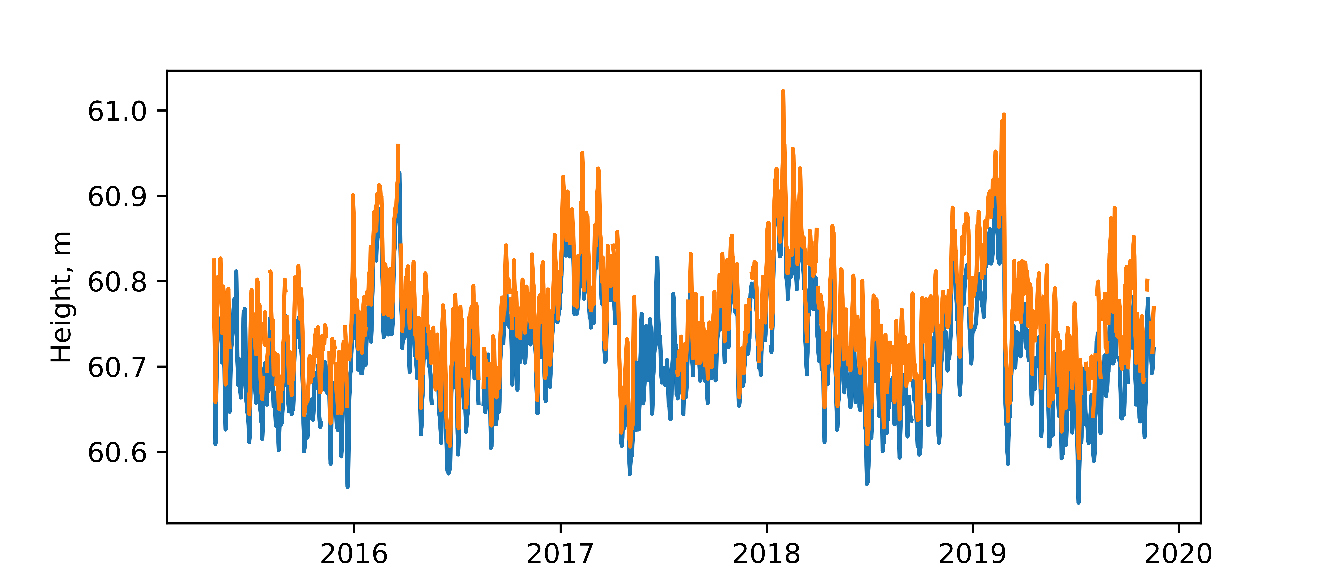
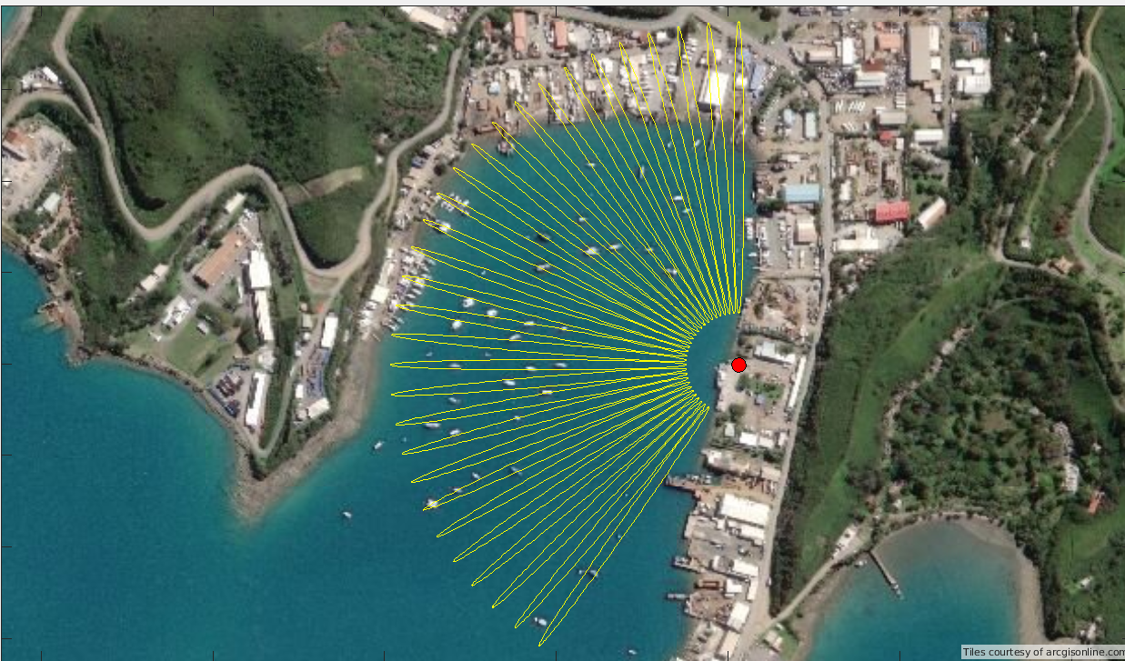
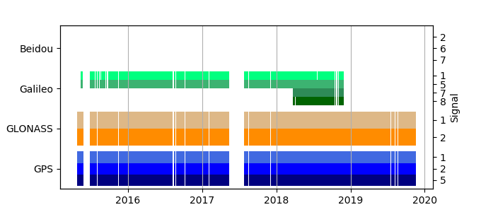
In development: a GNSS data portal
We have already extracted sea level data from over 250 GNSS receivers worldwide. As part of the EuroSea project, PSMSL will be making this data available through a portal.
At each site we will provide a file of calculated sea levels, along with information about which satellite, constellation, and frequency was used to calculate that value, along with metadata from the site.

Slide 7
Thank You Please give us your feedback psmsl@noc.ac.uk https://psmsl.org

