Slide 1
Exploring nitrogen losses from urine patches between upland and lowland grazing systems
Danielle Hunt, David Jones, Laura Cardenas, and David Chadwick
Negative Environmental Consequences:
Potent green house gas emissions
Ozone depleting compounds
Formation of particulate matter (PM10 and PM 2.5)
Eutrophication
N₂O emissions vary in response to climate, soil conditions and management practices.
Much of the current literature on urine patch N cycling has focused on typical lowland agricultural systems. Very little work has explored other grazing systems, such as upland farming which is conducted across much of Wales. We have investigated this by using a catena sequence crossing both upland and lowland agricultural grazing systems.
Nitrogen
NH₃
N₂O
Soil was collected from two upland sites and two lowland sites along the same altitudinal gradient.
Laboratory incubation was conducted 70% WFPS.
Sheep urine applied to half the treatments (150 kg N ha⁻¹).
N₂O emissions, NH₄⁺ and NO₃⁻ were measured for 100 days.
Soil type | Land classification
Histosol | Upland- Moreland/heathland
Podzol | Upland- Semi improved grassland
Cambisol | Lowland- Improved grassland
Coastal Cambisol | Lowland- Improved grassland
Plant Uptake
Microbial Uptake
NO₃⁻ Leaching

Slide 2
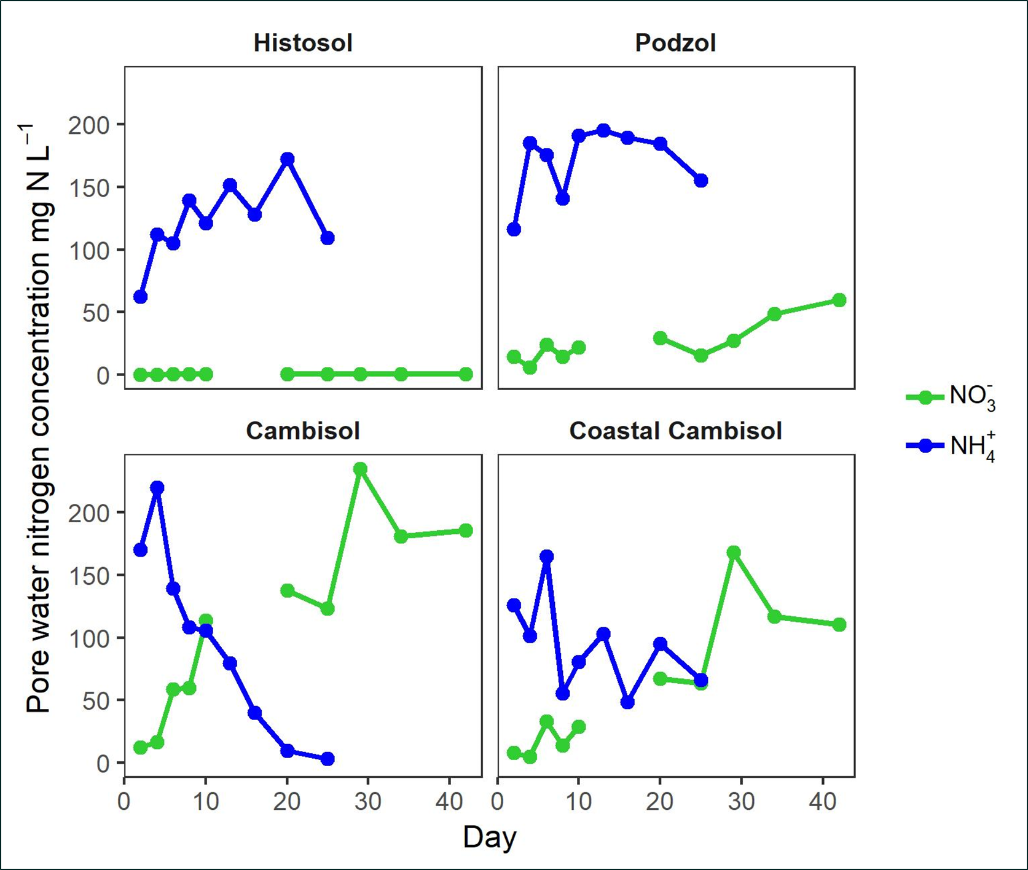
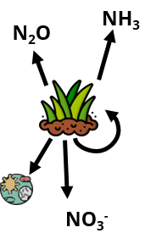
Exploring nitrogen losses from urine patches between upland and lowland grazing systems
Danielle Hunt, David Jones, Laura Cardenas, and David Chadwick
N₂O
Histosol N₂O emissions/EF was very low suggesting inhibition of N cycling processes (nitrification) in these soils which is supported by low NO₃⁻ concentrations through the experiment.
Future research: Investigate how other N losses differ on these soils.
Inorganic N concentrations (mg N L⁻¹) up to day 42 of incubation.
N₂O emissions are influenced by the soil type on which urine is deposited.
Podzol N₂O emissions/EF were significantly higher than other soil types. Also far higher than measured in previous field study at site ³.
Urine was applied to bare soil. Reduced vegetation cover can increase urine patch N₂O emissions ⁴. Vegetation may play an important role in N cycling at this site.
Soil Types | N₂O Emission Factors
Histosol | 0.2± 0.1%
Podzol | 4.85± 0.69%
Cambisol | 0.62± 0.34%
Coastal Cambisol | 1.09± 0.96%
Podzol field study ³ | 0.02-0.08%
Estimates of mean cumulative N₂O emissions for different soil types with 95% confidence intervals. Soil type has an overall significant effect p<0.001. Pairwise differences indicated on figure.
Notes:
Intergovernmental panel on climate change, 2006. guidelines for national greenhouse gas inventories agriculture, forestry and other land use. Intergovernmental Panel on Climate Change. Chapter 11: N₂O Emissions from Managed Soil and CO₂ Emissions from Lime and Urea Application (2006).
Chadwick, D.R., Cardenas, L.M., Dhanoa, M.S., Donovan, N., Misselbrook, T., Williams, J.R., Thorman, R.E., McGeough, K.L., Watson, C.J., Bell, M. and Anthony, S.G., 2018. The contribution of cattle urine and dung to nitrous oxide emissions: Quantification of country specific emission factors and implications for national inventories. Science of the Total Environment, 635, pp.607-617.
Marsden, K.A., Holmberg, J.A., Jones, D.L. and Chadwick, D.R., 2018. Sheep urine patch N 2 O emissions are lower from extensively-managed than intensively-managed grasslands. Agriculture, ecosystems & environment, 265, pp.264-274
Chirinda, N., Loaiza, S., Arenas, L., Ruiz, V., Faverín, C., Alvarez, C., Savian, J.V., Belfon, R., Zuniga, K., Morales-Rincon, L.A. and Trujillo, C., 2019. Adequate vegetative cover decreases nitrous oxide emissions from cattle urine deposited in grazed pastures under rainy season conditions. Scientific reports, 9.

