Slide 1
How hillslopes and channels impact the water age in catchments
EGU2020-9871
Antonio Zarlenga and Aldo Fiori
Engineering Department
antonio.zarlenga@uniroma3.it
© Authors. All rights reserved

Slide 2
Aims
The water age is a lumped descriptor of the complex dynamics taking place in hillslope and catchments.
In a given cross section of a river, the water age results from
the time the water spends through the hillslope
the time the water spends through the channel network
In this study, we present a general physically based framework for the description of the water age and its variability in catchments subject to transient flow
© Authors. All rights reserved
BACK
NEXT

Slide 3
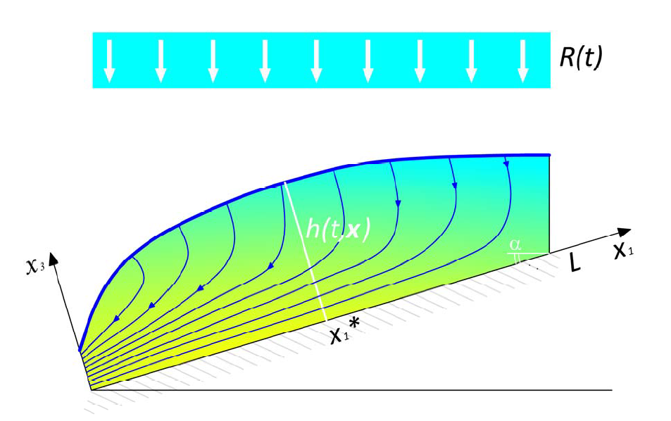
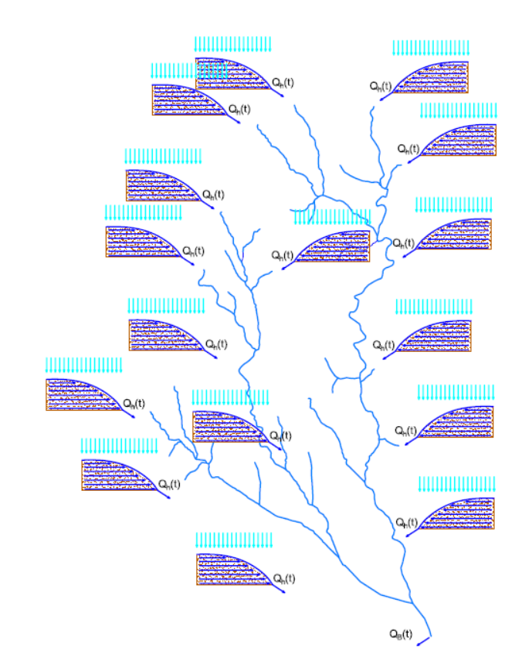
Flow Models
The water entered in the hillslope as recharge is conveyed up to the stream and then transported trough the channel network.
The hillslope flows concentrations due to the channel network is performed through a IUH model
Stream
$$q_{b}=∫q_{h}\left(t−τ\right)p\left(τ\right)dτ$$
The linearized Boussinesq model is adopted to describe the water flow through the hillslope.
$$n\frac{∂h}{∂t}=T\frac{∂^{2}h}{∂x^{2}}+R(t)$$
The rain considered here as a tracer is a 5 year long synthetic timeseries.
$$q_{h}=−T\frac{∂h}{∂x}$$
© Authors. All rights reserved
BACK
NEXT

Slide 4
The hillslope ageing dynamics: the Age Equation
Moving from the work Delhez et al (1999) of we developed a framework for the derivation of the water age and the related moments in hillslope (Zarlenga and Fiori 2020). The age equation represents the continuity equation in a 5 dimensional space $(t,x_{1},x_{2},x_{3},τ)$, where the age $τ$ is coupled with the time and the 3 physical dimensions.
Defining $c(t,x,τ)$ as the concentration of water with age $τ$at time $t$ in the position $x$ the age equation is:
$$n\frac{∂c\left(t,x,τ\right)}{∂t}=−q_{i}\frac{∂c\left(t,x,τ\right)}{∂x_{i}}−n\frac{∂c\left(t,x,τ\right)}{∂τ}+R(t,x,τ)$$
Storage
Flow
Ageing
Source/Sink
The assessment of the water age requires the solution of 3 linked differential equations for the 3 moments of the age:
$$\left\{ \begin{aligned}n\frac{∂hC}{∂t}=−\frac{∂q_{h}C}{∂x}+R(t) \\ \\ n\frac{∂hA}{∂t}=−\frac{∂q_{h}A}{∂x}+Ch \\ \\ n\frac{∂hW}{∂t}=\frac{∂q_{h}W}{∂x}+2Ah\end{aligned}\right.$$
$τ^{0}$ : Recharge water concentration
$τ^{1}$ :Age concentration
$τ^{2}$ : 2M concentration
Stream
© Authors. All rights reserved
BACK
NEXT

Slide 5
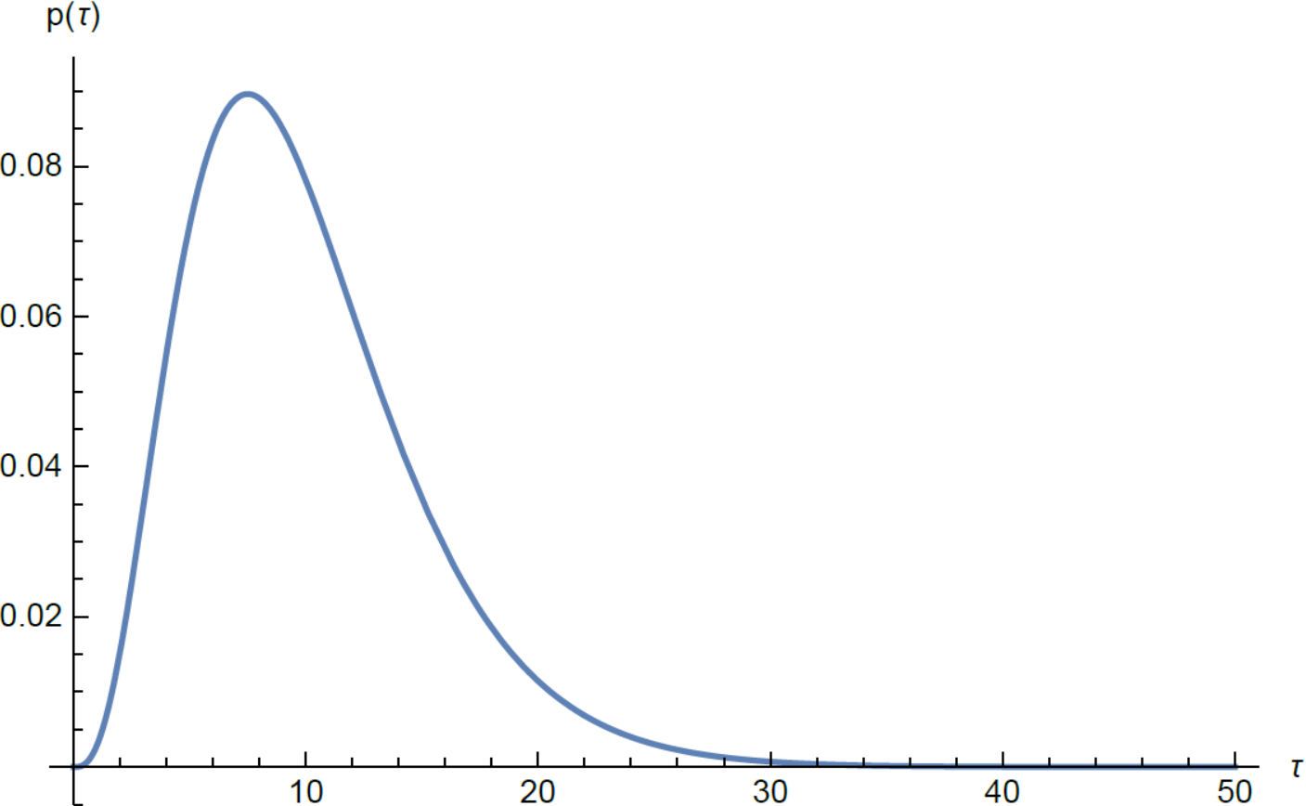
The channel network ageing dynamics
Different ages resulting from different hillslopes are combined as function of the river network topology.
The water ageing continues during the channel network flowing.
Adopting a suitable travel time distribution $p(τ_{b})$the water age moments at the catchment outlet can be obtained by the following convolutions:
$$\begin{matrix}\begin{aligned}A_{b}^{}\left(t\right)=\frac{\int_{0}^{t}{\left(A_{h}\left(t−τ_{b}\right)+τ_{b}\right)q_{h}\left(t−τ_{b}\right)p\left(τ_{b}\right)dτ_{b}}}{Q_{b}(t)} \\ \end{aligned} \\ W_{b}^{2}\left(t\right)=\frac{\int_{0}^{t}{{\left(A_{h}\left(t−τ_{b}\right)+τ_{b}\right)}^{2}{ q}_{h}\left(t−τ_{b}\right)p\left(τ_{b}\right)dτ_{b}}}{Q_{b}(t)}\end{matrix}$$
The gamma distribution is adopted for the channel network travel time distribution $p(τ_{b})$.
© Authors. All rights reserved
BACK
NEXT

Slide 6
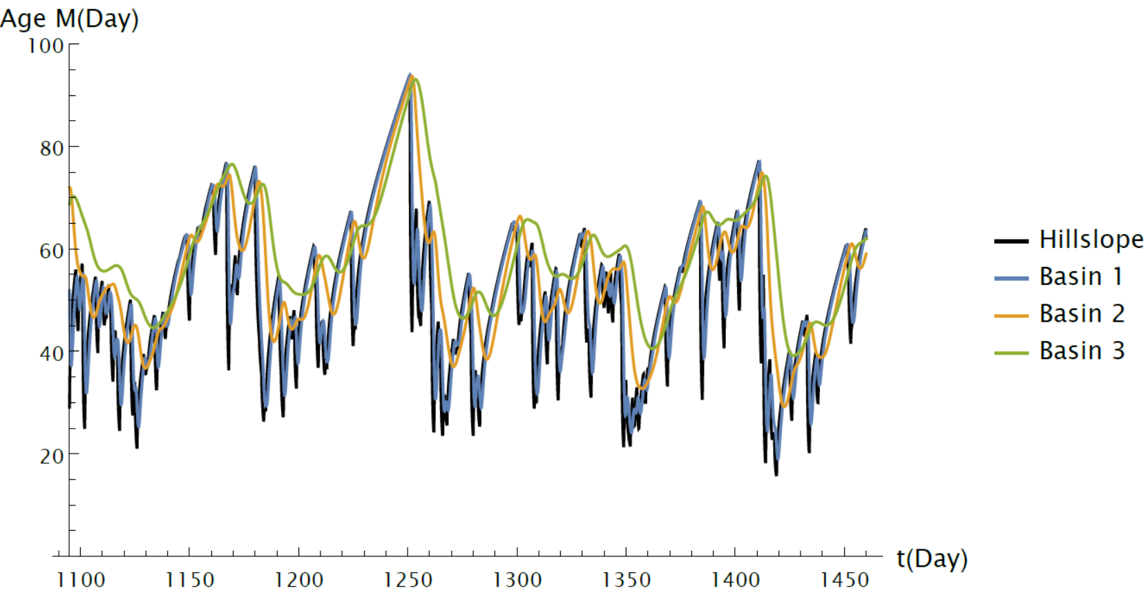
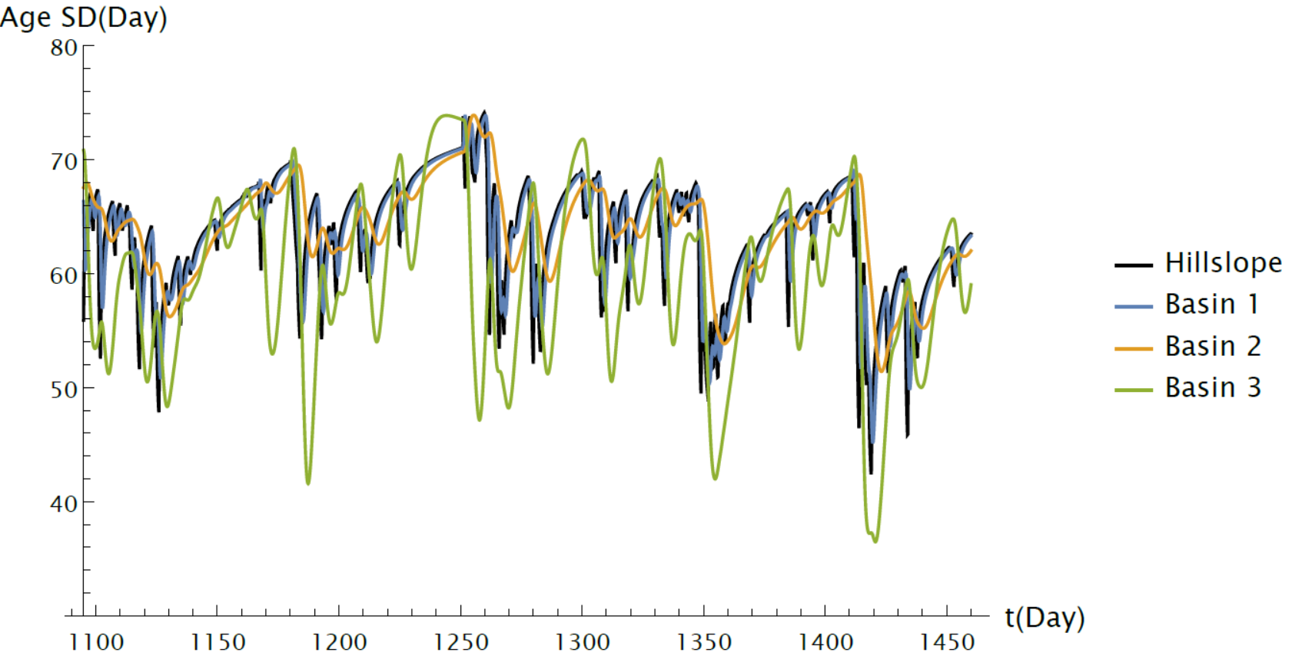
Results: Application example 1
For a given hillslope (dimensions and hydraulic characteristics) the average age magnitude at the catchment outlet ($Age M$) depends on the channel network dimensions. Generally $Age M$ increases with the basin dimensions.
Catchment dimensions
The age variability, quantified through the standard deviation ($Age SD={(W}_{b}^{2}−Age{M^{2})}^{1/2}$) has a complex behavior.
The $Age SD$at the catchment outlet decreases with the basin dimension as a consequence of the increase of $Age M$.
Catchment dimensions
© Authors. All rights reserved
BACK
NEXT

Slide 7
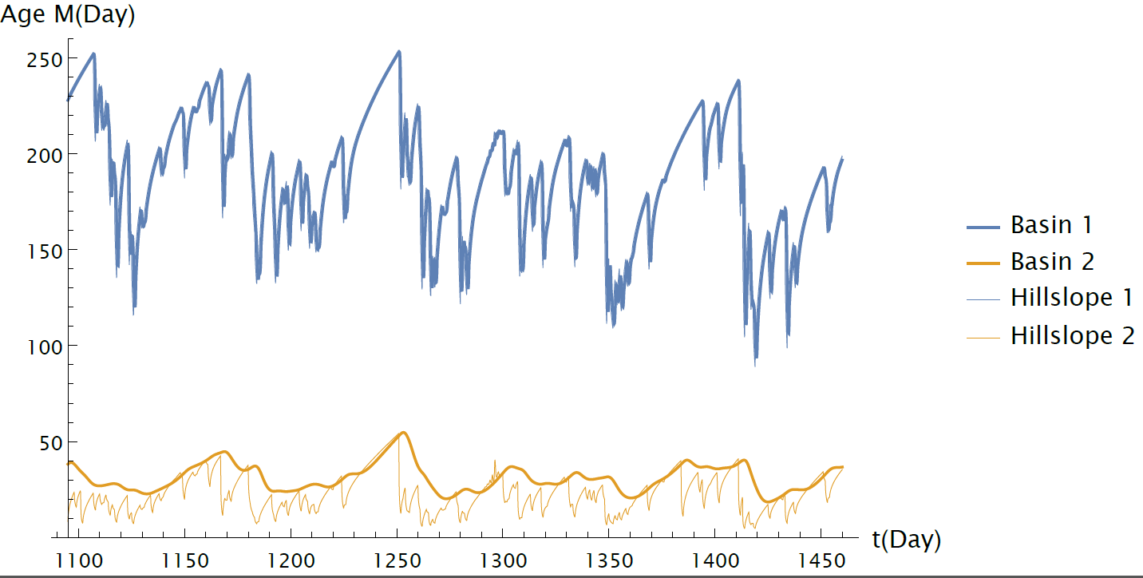
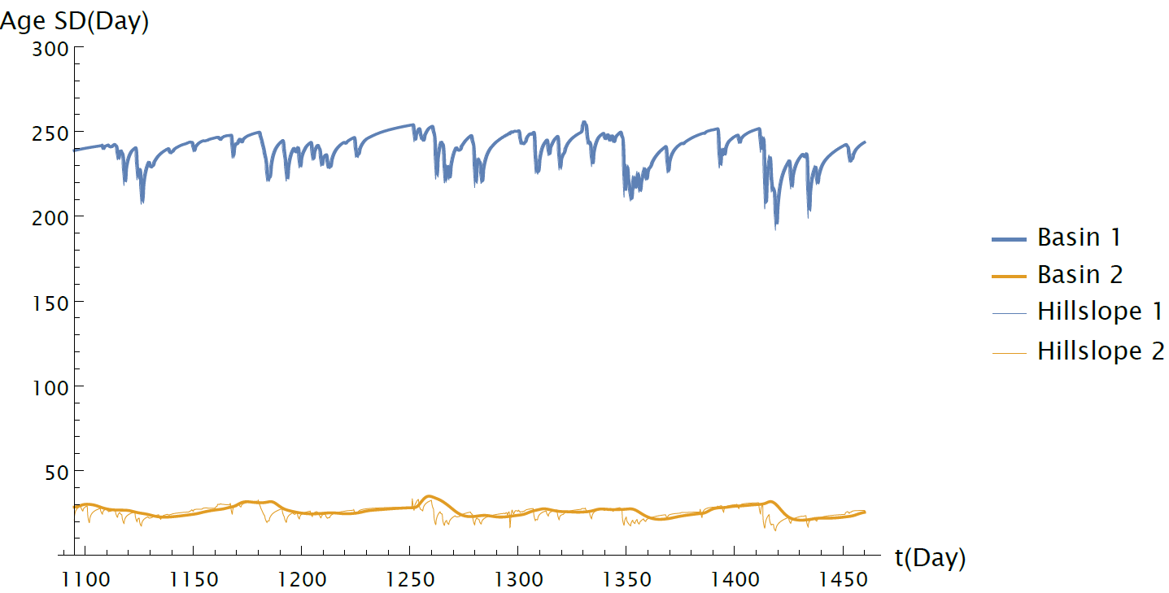
Results: Application example 1
In the case of low hillslope transmissivity and short channel traveltime both $Age M$ and $Age SD$strictly depends on the hillslope dynamics while the channel effects are negligible.
In the case of high hillslope transmissivity and long channel traveltime the channel effects are significant.
The complex interplay between the hillslope and the channel dynamics cannot be explained through a simple general way: for instance the water age at the hillslope outlet can be very high and the hillslope effects could be crucial also for large basins.
Slow Hillslopes
Fast Channels
Fast Hillslopes
Slow Channels
Slow Hillslopes
Fast Channels
Fast Hillslopes
Slow Channels
© Authors. All rights reserved
BACK
NEXT

Slide 8
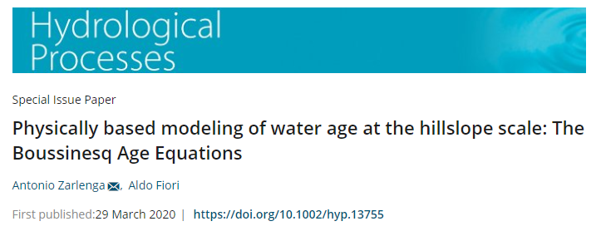
Conclusions and future developments
We developed a general physically based framework for the description of the water age and its variability in catchments subject to transient flow.
The preliminary results obtained indicates that:
The average age at the catchment outlet depends on the hillslope dynamics; the ageing due to the water transport through the channel network is proportional to the channel network dimensions.
The age variability which strongly depends on the hillslope characteristics generally decreases during the channel network transport.
The complex interplay between the hillslope and channel dynamics does not allow a simple and general interpretation of the results.
Thanks!
Water has memory
antonio.zarlenga@uniroma3.it
© Authors. All rights reserved

