Slide 1
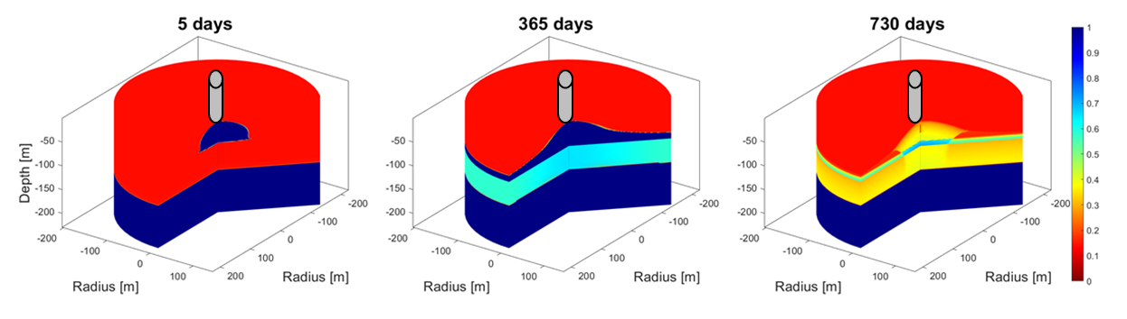
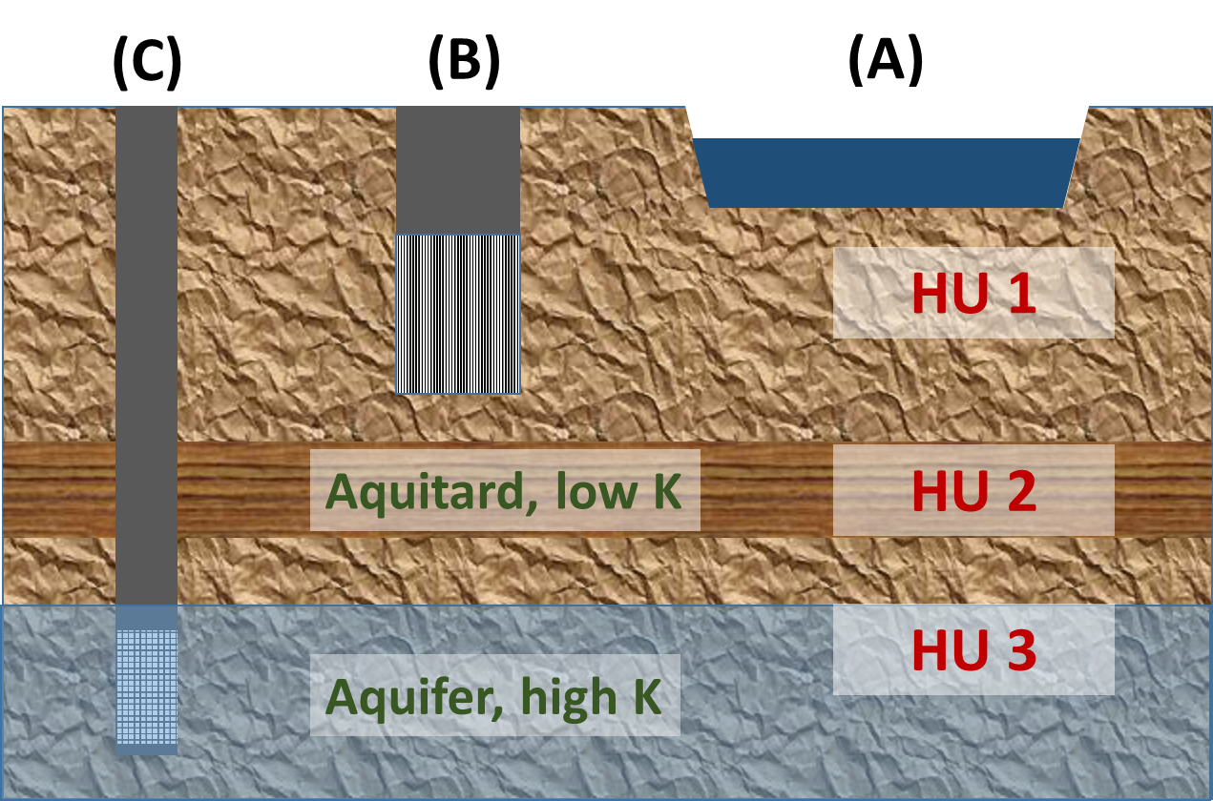
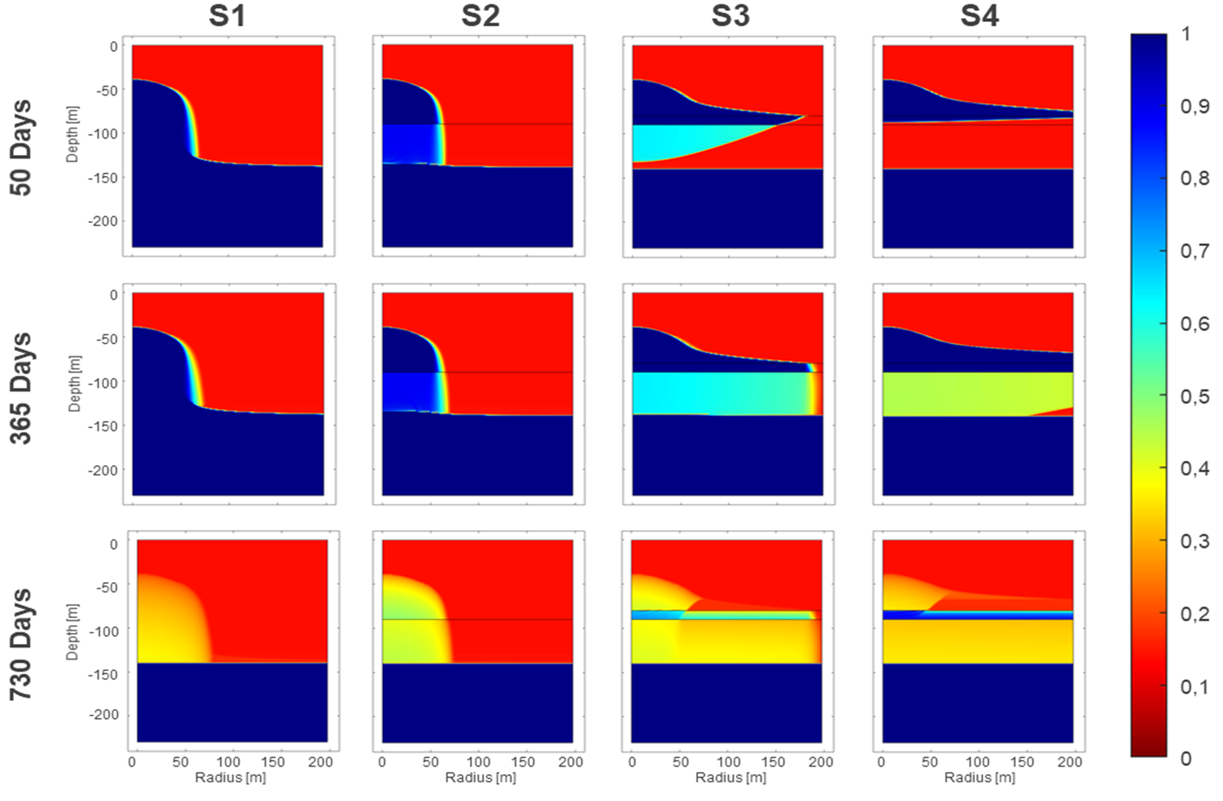
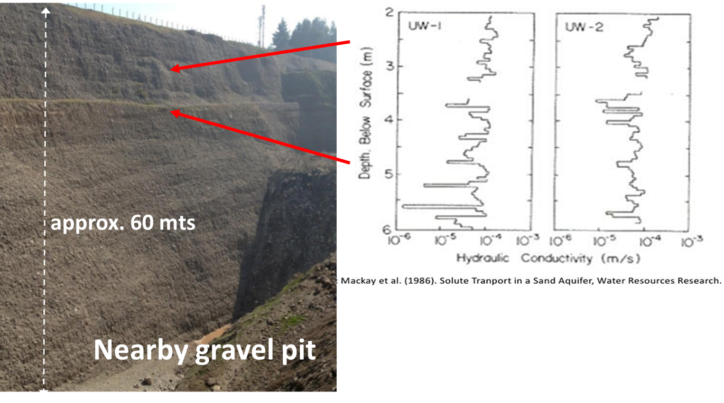
Assessment of an artificial recharge system through numerical simulations, Y. Olivares & P. Herrera
2D axisymmetric detailed numerical simulations of shallow well (B)
Aquifer Storage and Recovery (ASR):
1. Infiltrate water 2. Recover water
Arizona, USA
Design & operation:
low cost (A, B)
easy to build (A, B)
easy to operate (A, B)
natural filtration (A, B)
recover water (?)
Question: what would be the impact of different hydro-stratigraphic units?
FACT: Subsurface is heterogeneous

Slide 2


Assessment of an artificial recharge system through numerical simulations
Yerko Olivares¹ and Paulo Herrera^{1,2}
Department of Civil Engineering, U. Técnica Federico Santa María, Chile
Deparment of Environmental Geosciences, U. Vienna, Austria

Slide 3


Artificial Recharge (AR)
Managed Aquifer Recharge (MAR)
Aquifer Storage & Recovery (ASR)
Aquifers as reservoirs to store water
1. Infiltrate water
2. Recover water
(C)
(B)
(A)
Design & operation:
low cost (A, B)
easy to build (A, B)
easy to operate (A, B)
natural filtration (A, B)
recover water (?)
Fact:
subsurface is heterogenous
Question:
what could be the impact of
different hydrostratigraphic
units?
HU 1
Aquitard, low K
HU 2
HU 3
Aquifer, high K

Slide 4
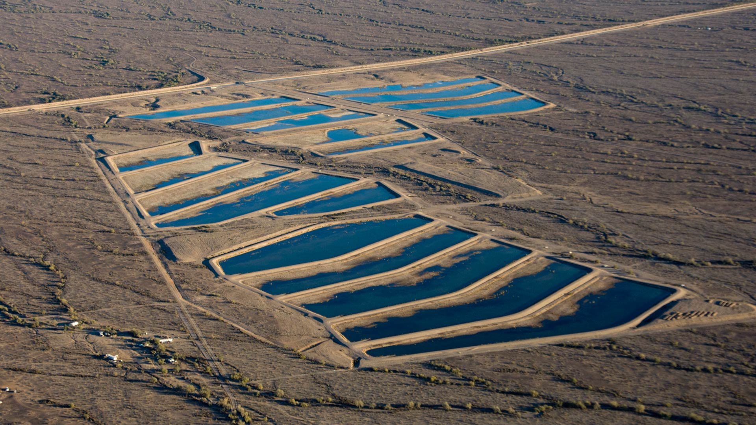
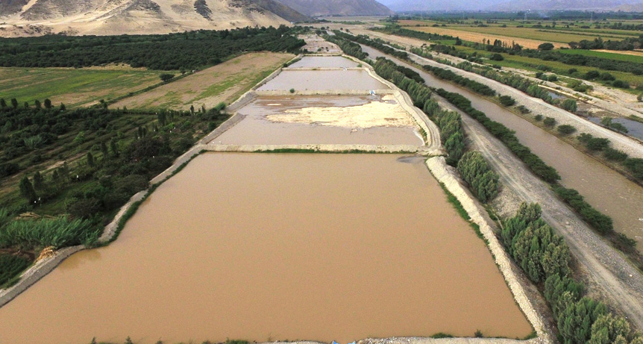
Arizona, USA
Applied since centuries in different places around the world
Modern projects have been built in recent decades to stop the decline of water levels in aquifers and/or dispose treated wastewater in different arid regions, e. g. western USA, South America, Middle East and Southeast Asia. Most of them are based on large (~1-10 km² size) infiltration ponds.
https://news.azpm.org/p/lastdrop/2018/8/20/135331-arizona-has-been-banking-cap-water-but-doesnt-have-a-clear-plan-to-withdraw-it/
Peru
https://agronoticias.pe/noticias/recarga-artificial-de-acuiferos-en-la-costa/

Slide 5
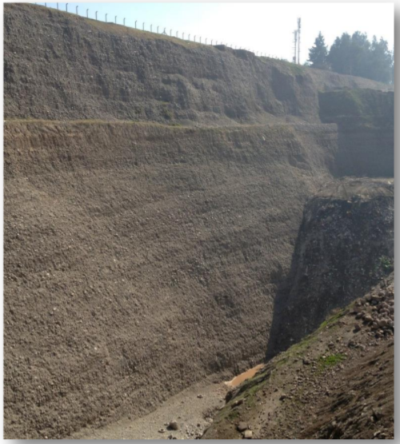
MOTIVATION:
Potential site in Santiago, Chile: heterogeneous fluvial-alluvial sediments.
Water table below 100 m depth.
Visual inspection and granulometric analyses indicate presence of quasi-horizontal hydrostratigraphic units with different characteristics.
~ 60 mts
Peru
gravel pit
https://agronoticias.p/noticias/recarga-artificial-de-acuiferos-en-la-costa/

Slide 6
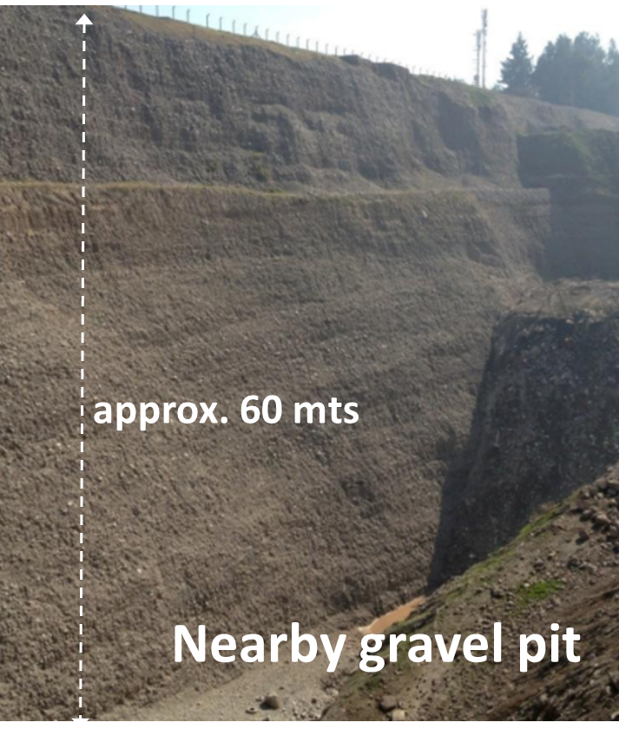
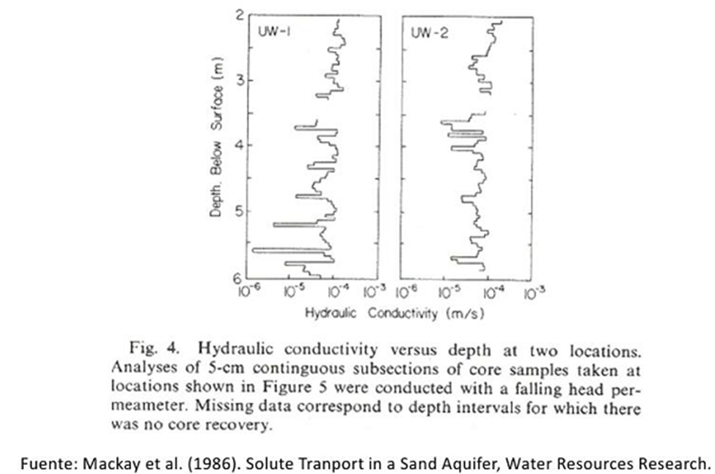
KNOWN:
K can vary by up 2-3 orders of magnitude even for homogenous sandy aquifers

Slide 7
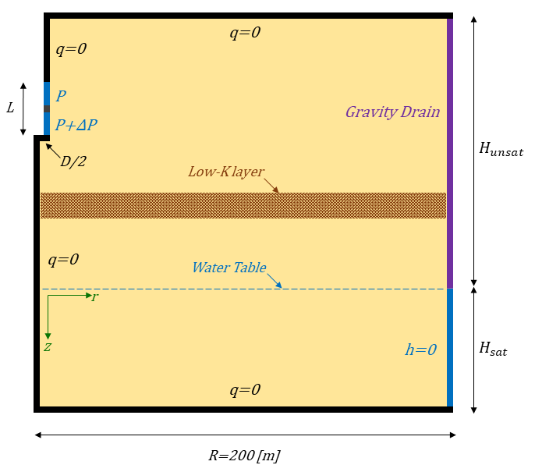

We performed detailed 2D (axisymmetric geometry) numerical simulations of unsaturated flow to assess the performance of an artificial recharge system composed of a single shallow well.
We consider 4 different scenarios according to the vertical sequence of 3 hydrostratigraphic units: two permeable units separated by a low permeability unit that act as a barrier (aquitard).

Slide 8
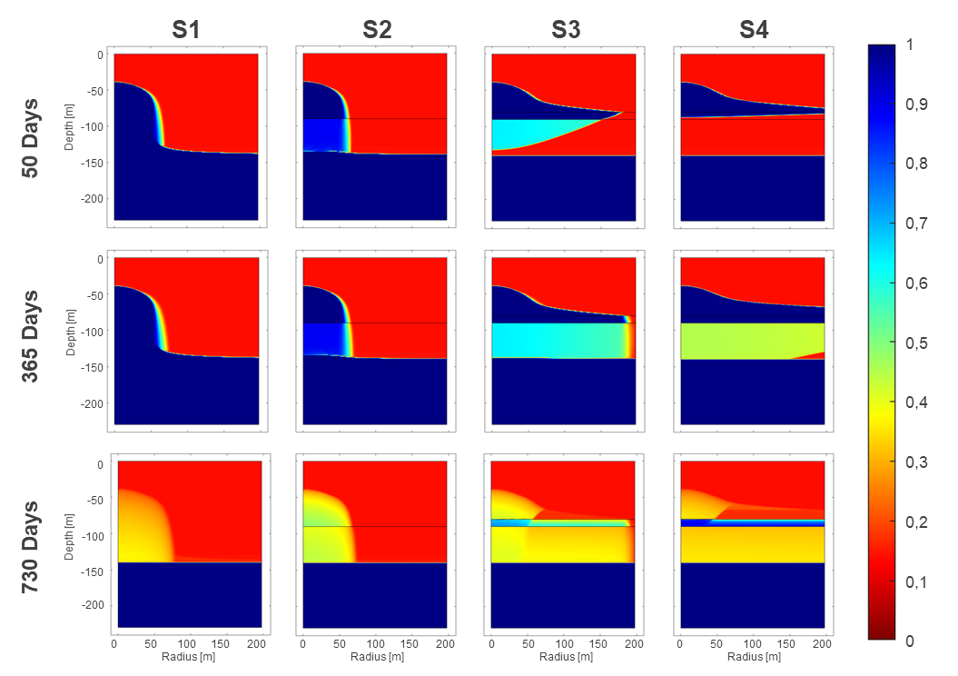
Perched
aquifer
Injection
stops after
365 days

Slide 9
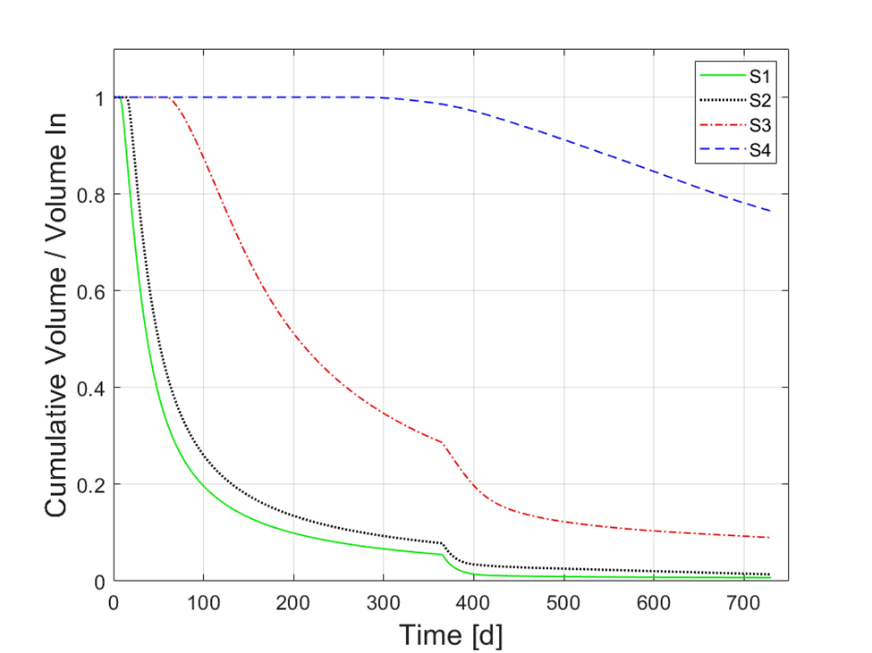

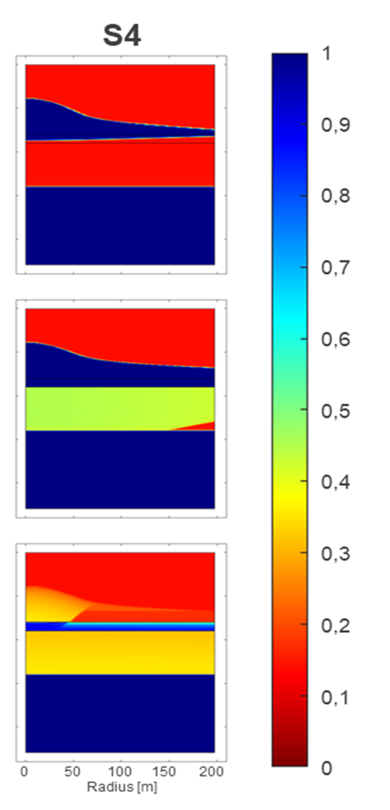
After 1 year since injection stops, a large percentage of the injected water remains in the model domain, mainly within the initially unsaturated volume.

Slide 10
Conclusion:
Real subsurface may be more difficult to deal with than we would like to imagine for the design of recharge systems!

