Slide 1
Cereal yield forecasting in Morocco using the CARAIB dynamic vegetation model driven by HadGEM2-AO projections
I. Loudiyi ¹, I. Jacquemin ², B. Tychon ², L. Francois ², M. Lahlou ³, J. Wellens ², and R. Balaghi ⁴
¹Institute of Astrophysics and Geophysics, University of Liège, Belgium
²Research Unit : SPHERES, University of Liège, Belgium
³The Agronomic and Veterinary Institute Hassan 2, Morocco
⁴National Institute of Agronomic Research, Morocco
Iliass.loudiyi@uliege.be

Slide 2
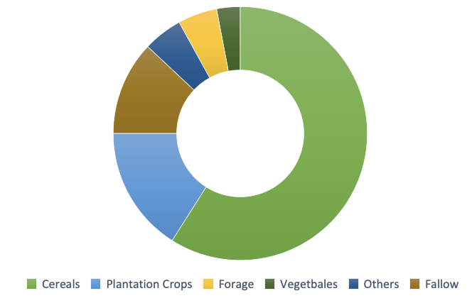
Overview :
Morocco, by its geographical position and its climate, is strongly affected by climate change and presents an ever-increasing vulnerability. Moreover, food security, in Morocco as in many parts of the world, depends heavily on cereal production which fluctuates relying on weather conditions. In fact, Morocco has a production system for cereals which is dominated by rainfed. It is therefore necessary to further develop knowledge about climate change and strengthen forecasting systems for predicting the impacts of climate change.
Cereal production:
Cereal crops are the most dominant agricultural activities in Morocco, particularly in rainfed regions, since it occupies more than half of the area. The three main cereal crops in Morocco include soft wheat, durum wheat and barley. They are grown in all provinces and all agro-ecological zones.
Distribution of agricultural areas in Morocco

Slide 3
Dynamic Vegetation Model CARAIB (CARbon Assimilation In the Biosphere) :
CARAIB (CARbon Assimilation In the Biosphere) is a dynamic vegetation model developed to study the role of vegetation in the global carbon cycle and to study vegetation distribution in the past, in the present and in the future. The model is composed of several modules dealing with soil hydrology, photosynthesis and stomatal regulation, carbon allocation and biomass growth, soil and litter carbon dynamics, vegetation dynamics, seed dispersal and natural vegetation fires. CARAIB was recently improved by the addition of the crop module.
Main Inputs | Main Outputs
Climate data Soil data Elevation Morpho-physiological parameter Phenological phases Basic crops management (sowing, harvest, rotation) | Soil hydrology Surface energy budget Yield, gross and net primary productivity Cover fraction for simulated species Biome distribution Soil heterotrophic respiration Carbon sequestration

Slide 4
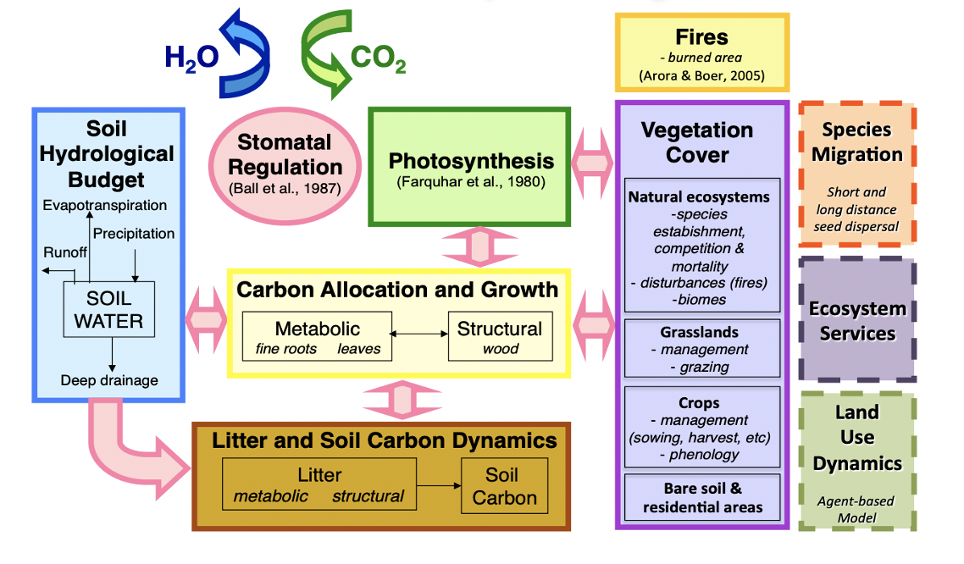
Dynamic Vegetation Model CARAIB (CARbon Assimilation In the Biosphere) :

Slide 5
Simulation protocol :
The simulations are performed across all Morocco, by using different input data. We are using two sets of data: the first one is monthly interpolated and bias-corrected fields from the climate model HadGEM2-AO for the historical period (1990-2005), in addition to three different Representative Concentration Pathway scenarios (RCP2.6, RCP4.5 and RCP8.5) from 2005 to 2100. The second one is interpolated daily climate data for the period from 1997 to 2017, downloaded from the NASA POWER database at a spatial resolution of 1° latitude by 1° longitude
HadGEM2-AO
NASA POWER database
RCP2.6, RCP4.5 and RCP8.5
1970
1997
2005
2017
2100

Slide 6
Input
Climate data
Soil data
Land cover
Morpho-physiological parameter
Basic crops management (sowing, harvest, rotation)
NASA POWER database from 1997 to 2017
HadGEM2-AO from 1970 to 2100
ISRIC data hub soil grids at 250m resolution
Copernicus Global Land Service at 100m resolution
literature
INRA guide
Simulation protocol :

Slide 7
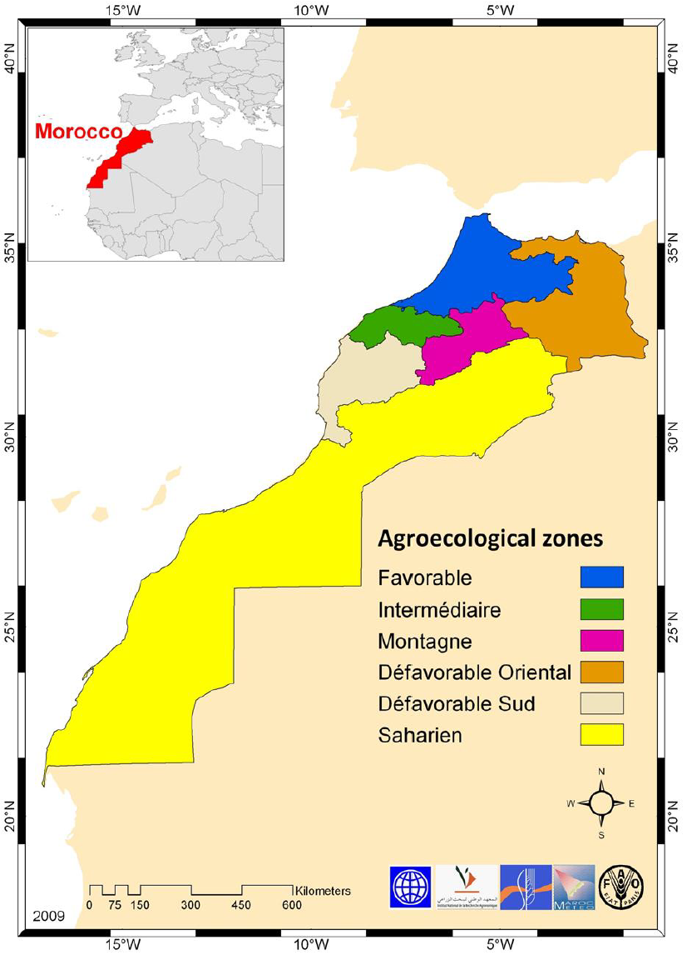
Preliminary results : Past period from 1997 to 2017 using climate data from NASA power database
To analyze yield variation, we adopted the agro-ecological regions of Morocco

Slide 8
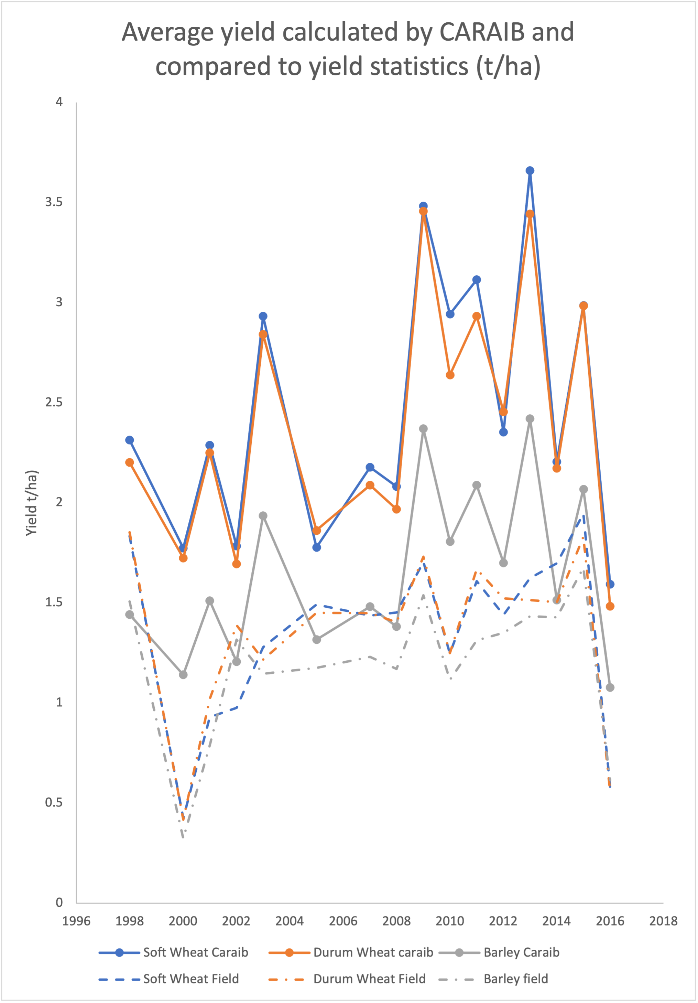
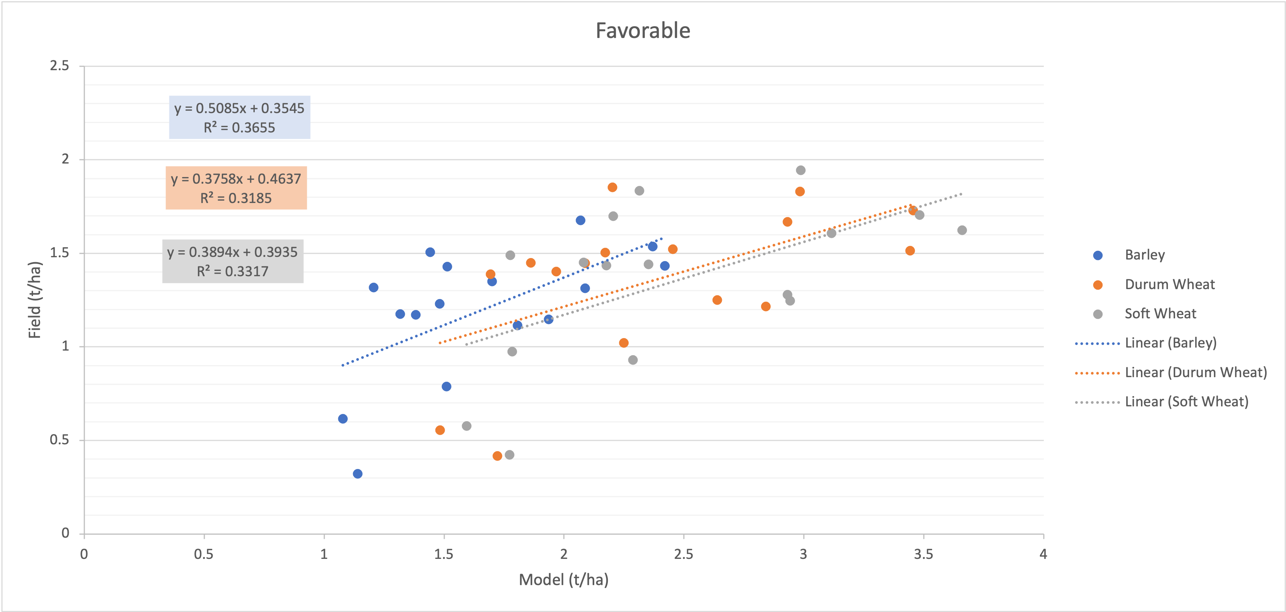
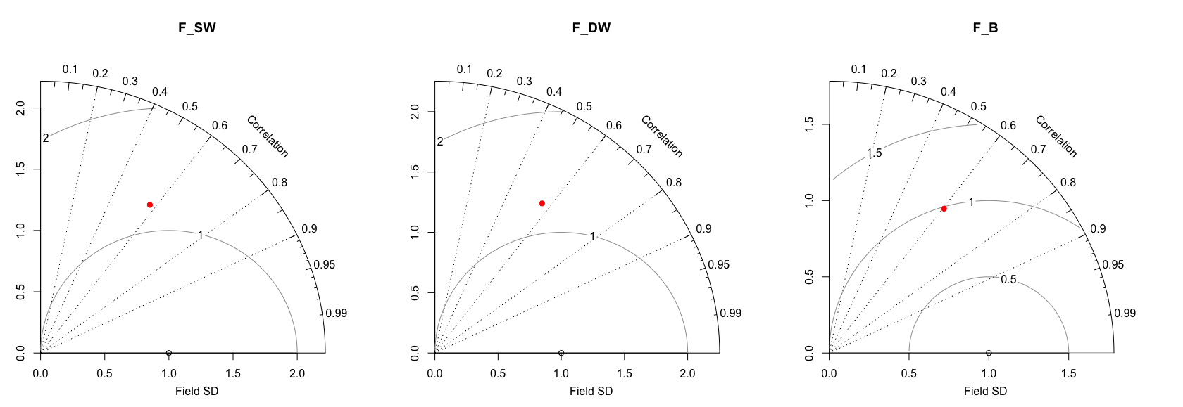
Preliminary results : Past period from 1997 to 2017 Region: Favorable
Relationship between observed yield (field) and forecasted yield (caraib) of soft wheat, durum wheat and barley, based on linear regression model
Taylor diagram displaying a statistical comparison between average yield calculated by CARAIB and yield statistics of soft wheat (SW), durum wheat (DW) and barley (B)

Slide 9
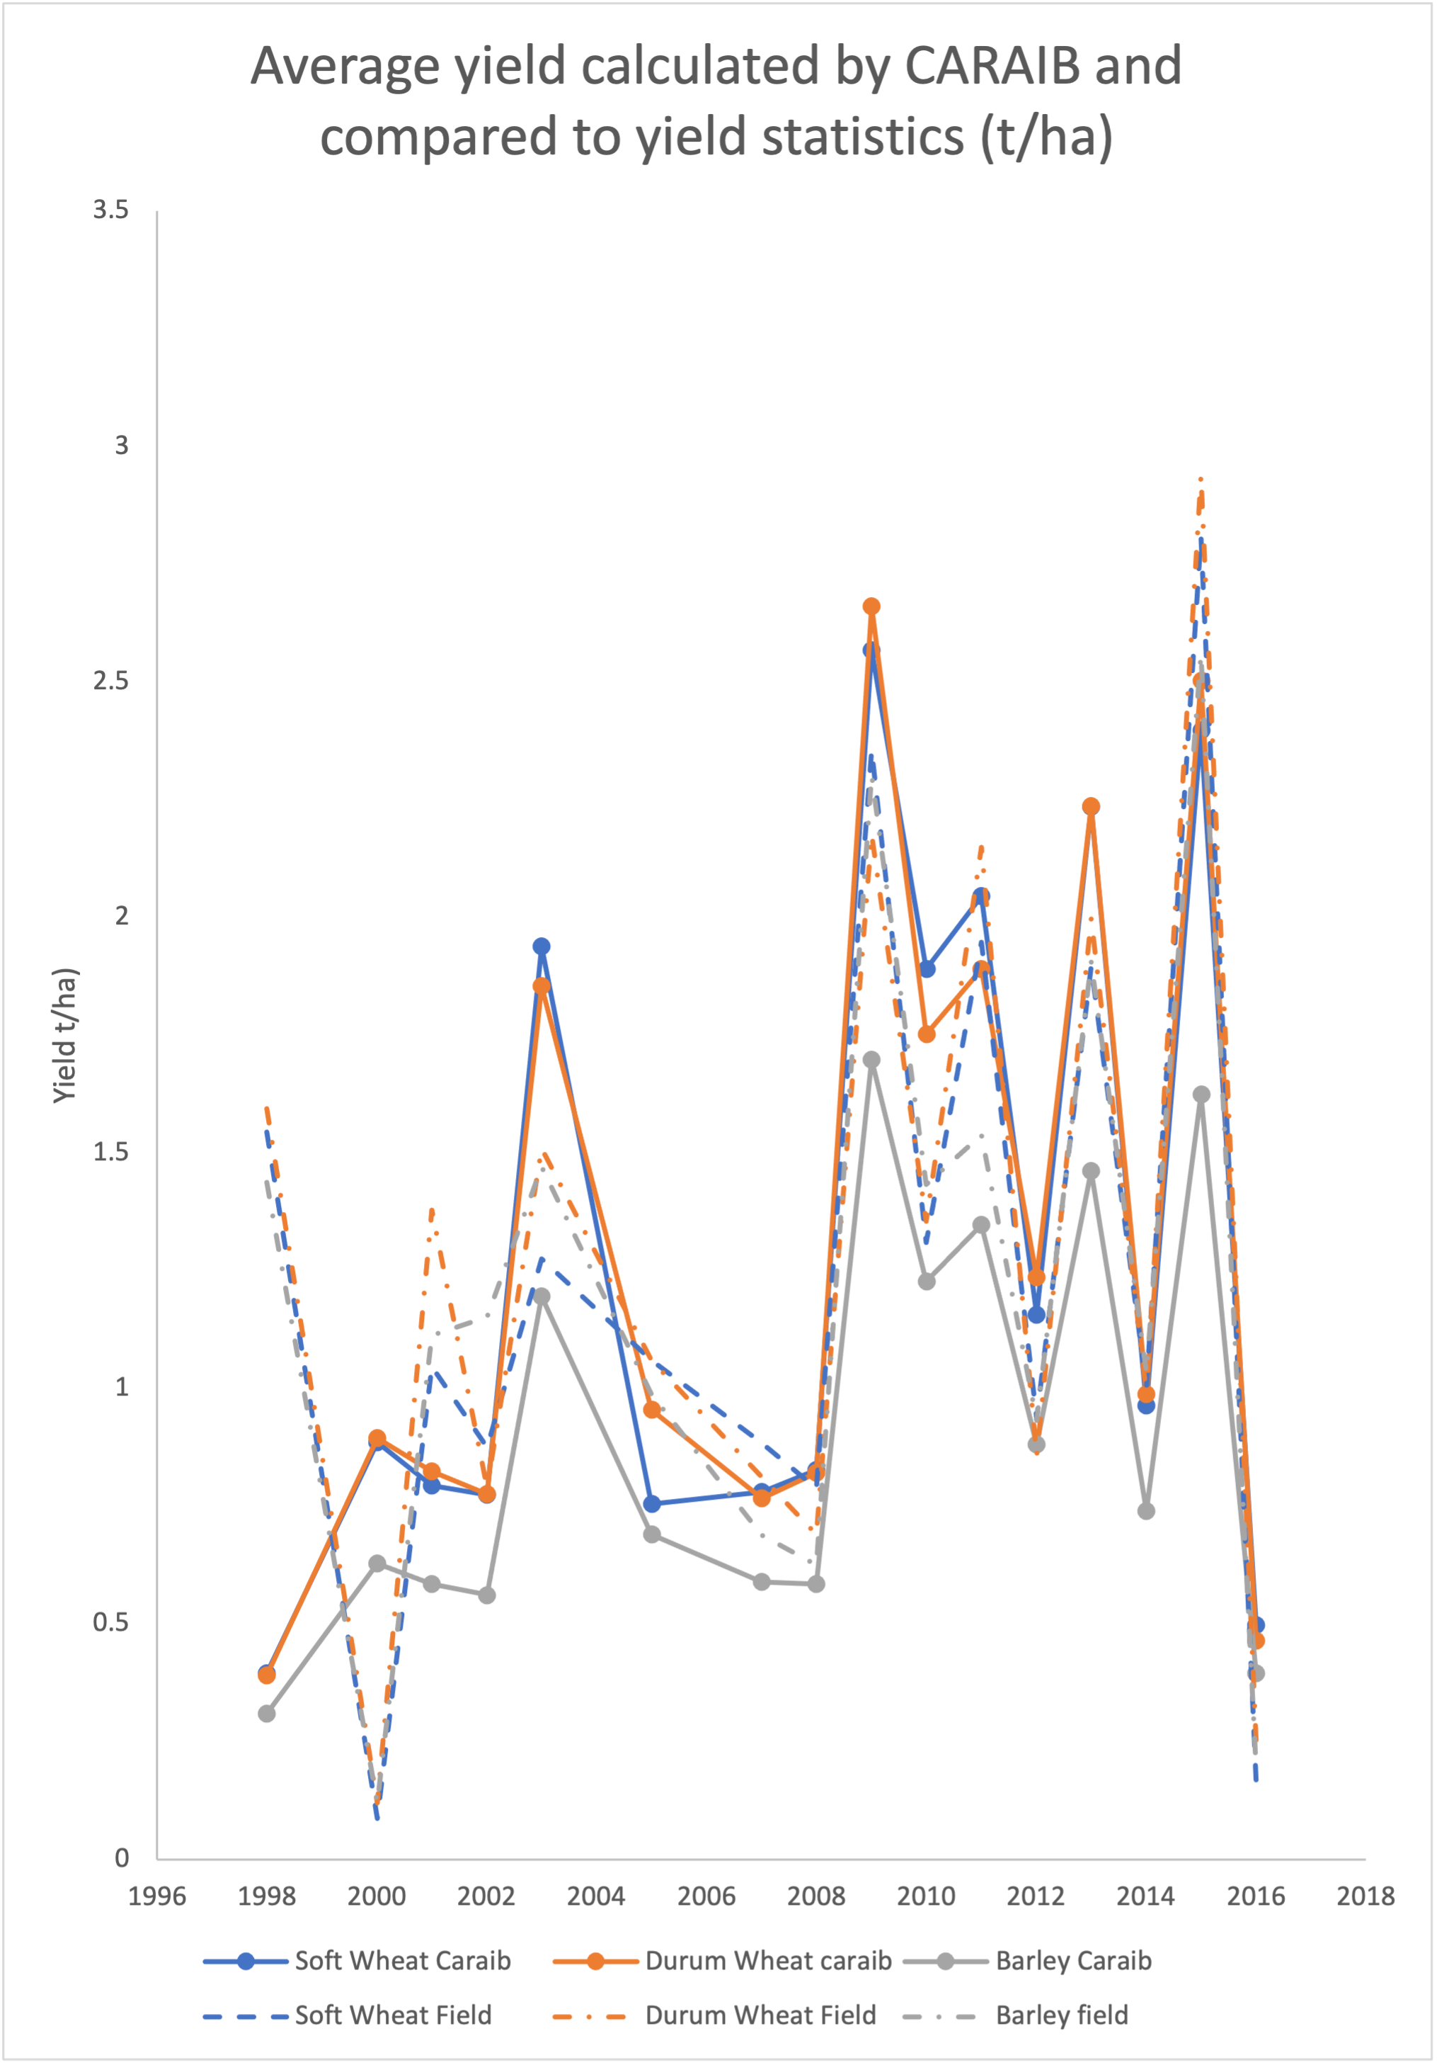
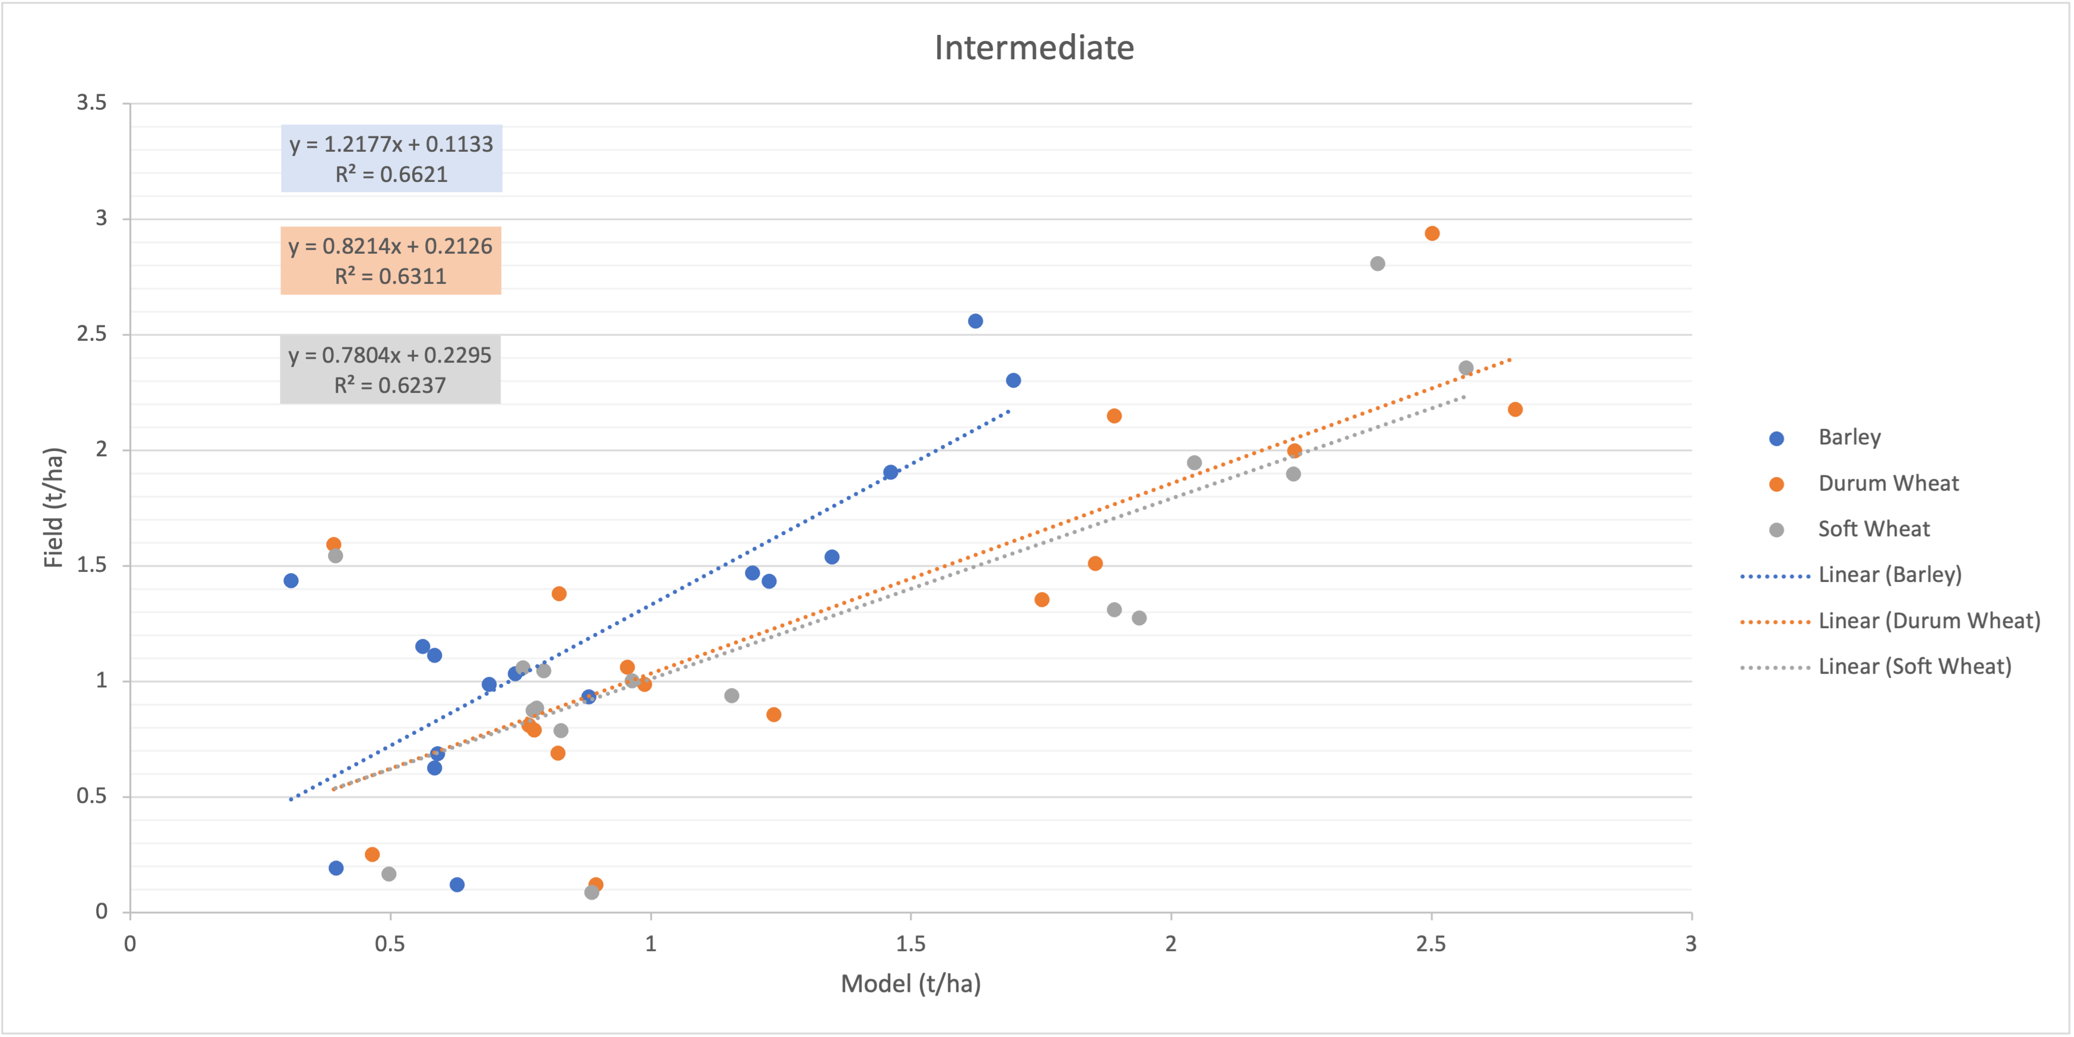
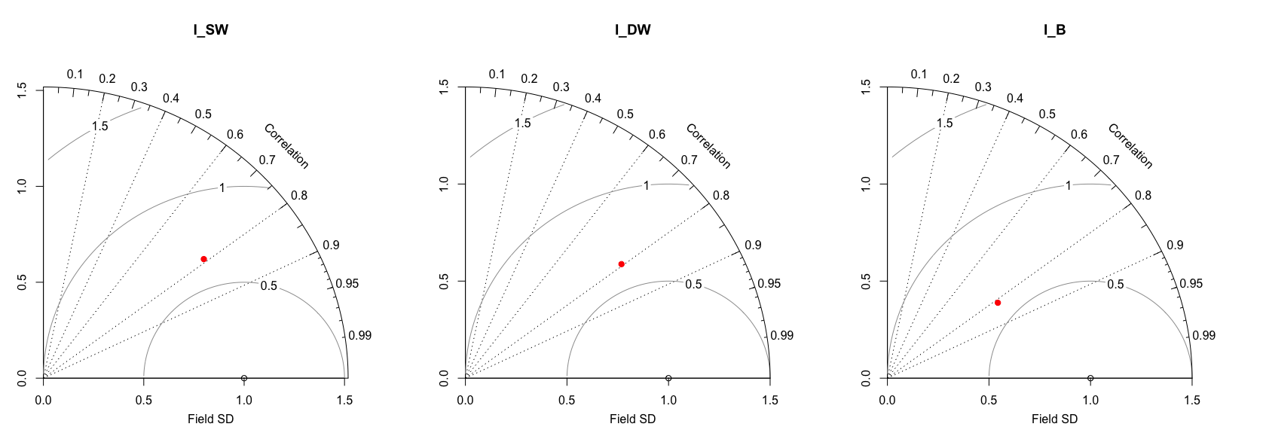
Preliminary results : Past period from 1997 to 2017 Region: Intermediate
Relationship between observed yield (field) and forecasted yield (caraib) of soft wheat, durum wheat and barley, based on linear regression model
Taylor diagram displaying a statistical comparison between average yield calculated by CARAIB and yield statistics of soft wheat (SW), durum wheat (DW) and barley (B)

Slide 10
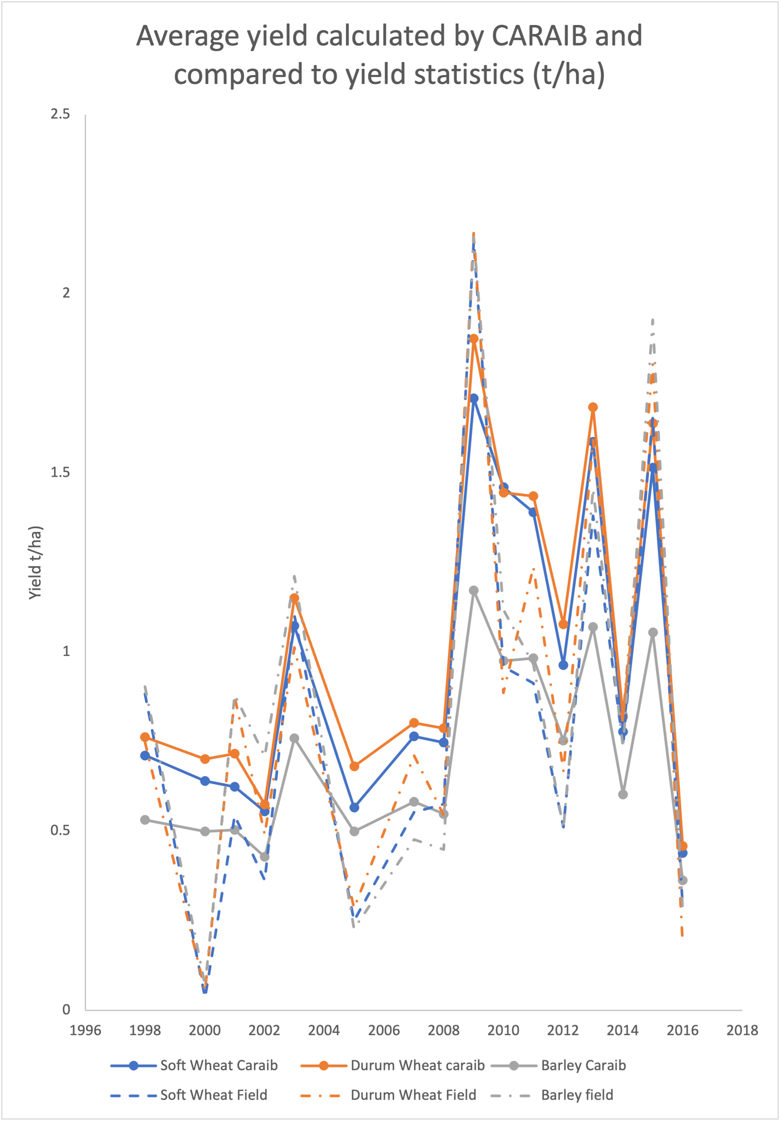
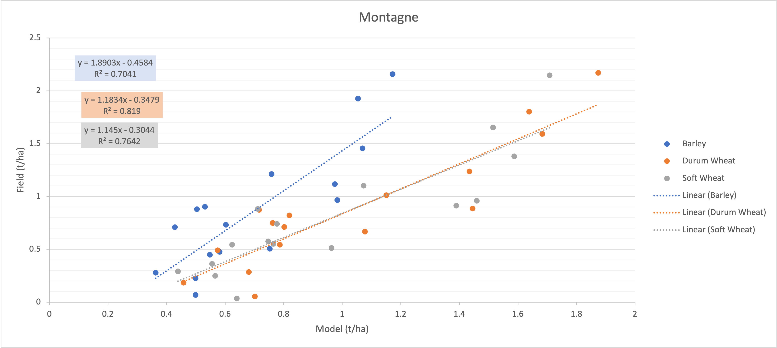
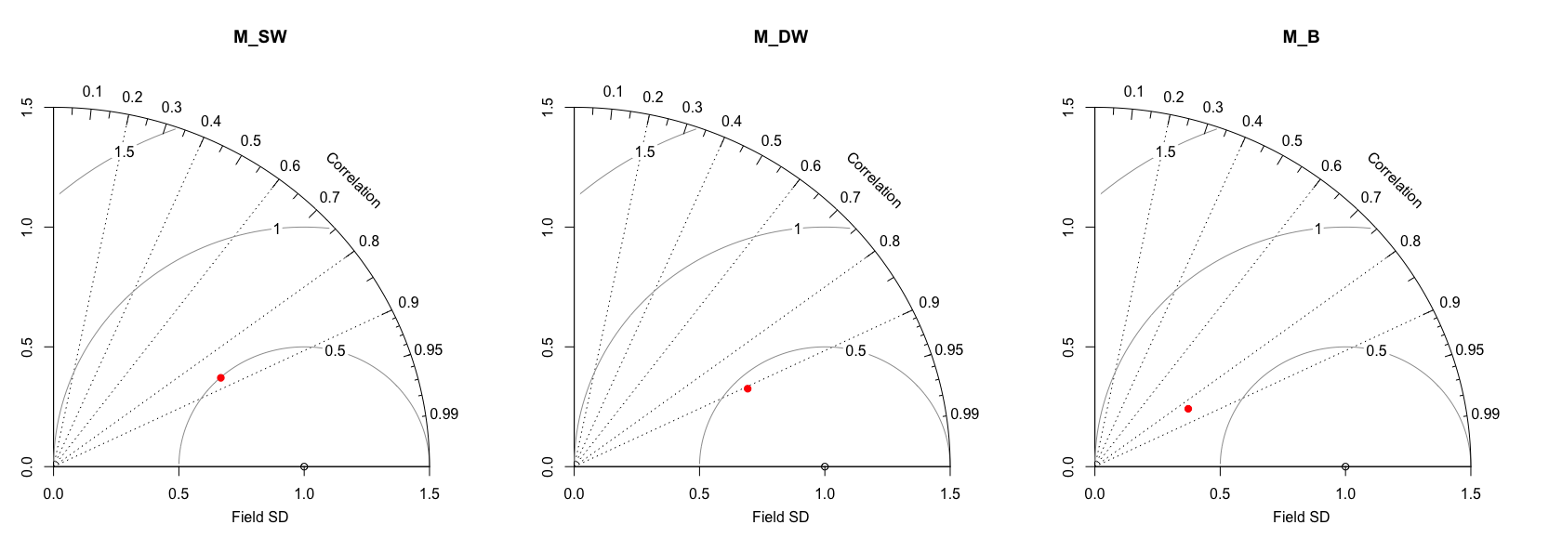
Preliminary results : Past period from 1997 to 2017 Region: Mountain
Relationship between observed yield (field) and forecasted yield (caraib) of soft wheat, durum wheat and barley, based on linear regression model
Taylor diagram displaying a statistical comparison between average yield calculated by CARAIB and yield statistics of soft wheat (SW), durum wheat (DW) and barley (B)

Slide 11
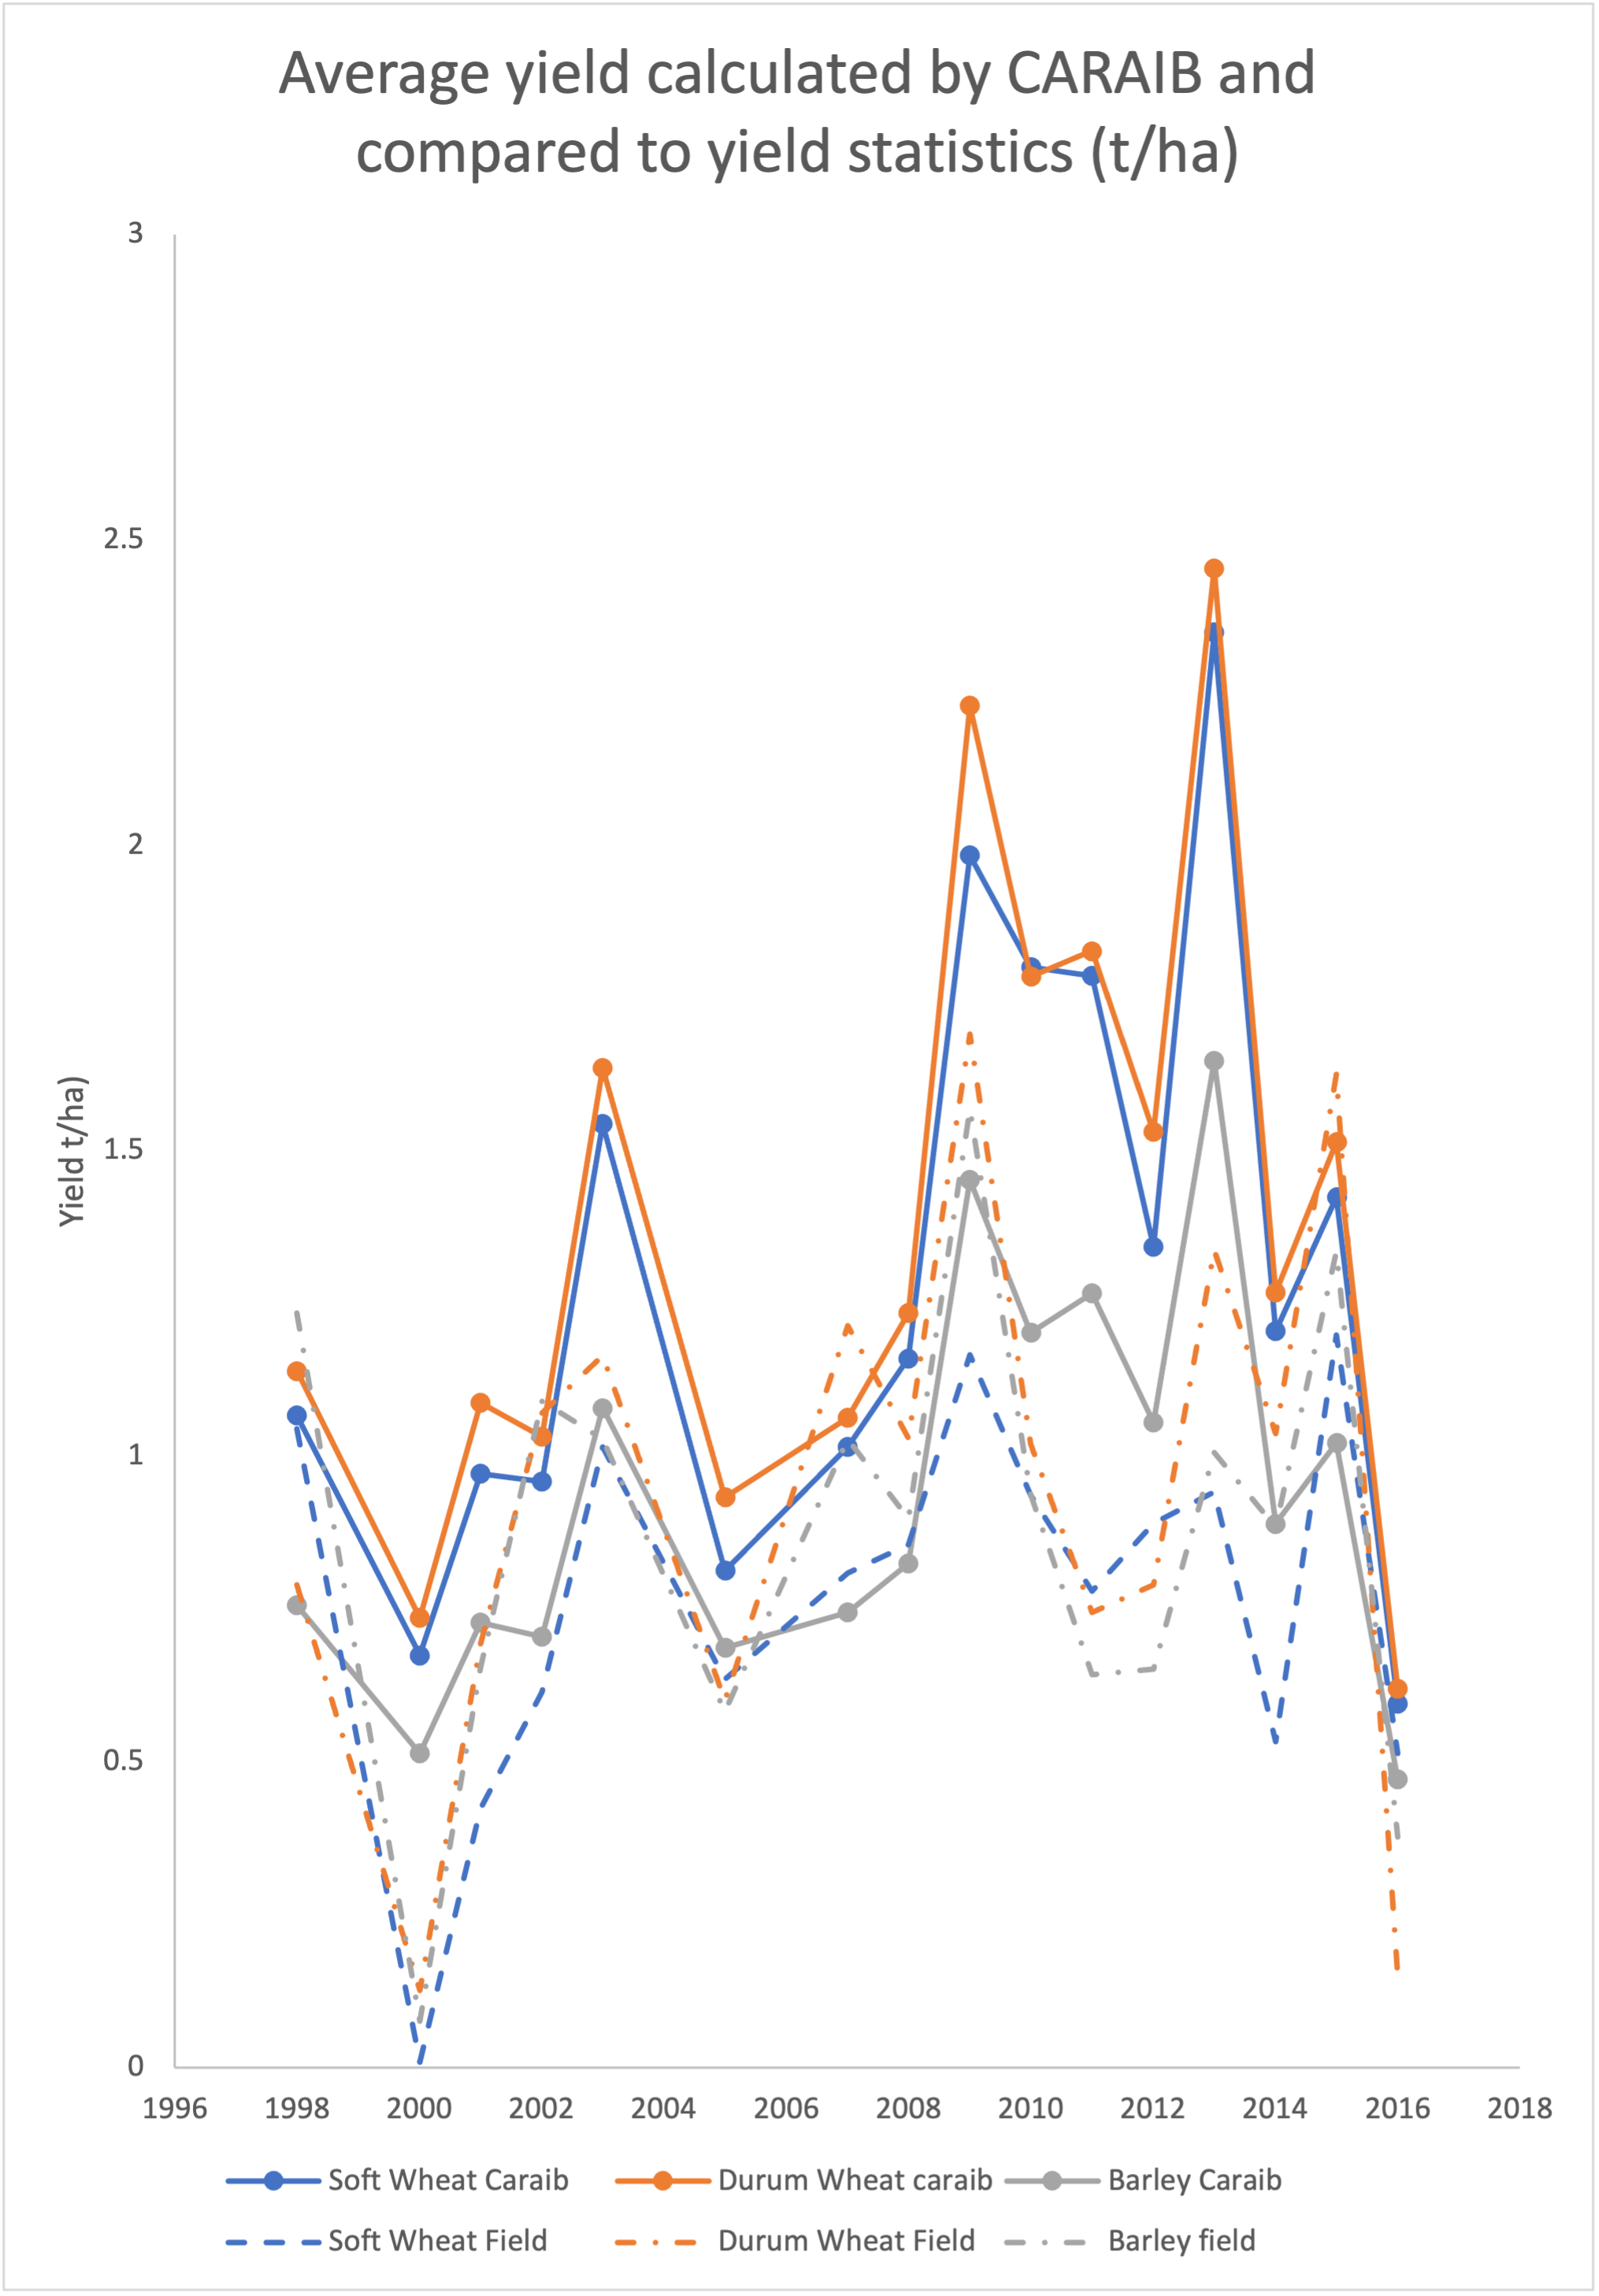
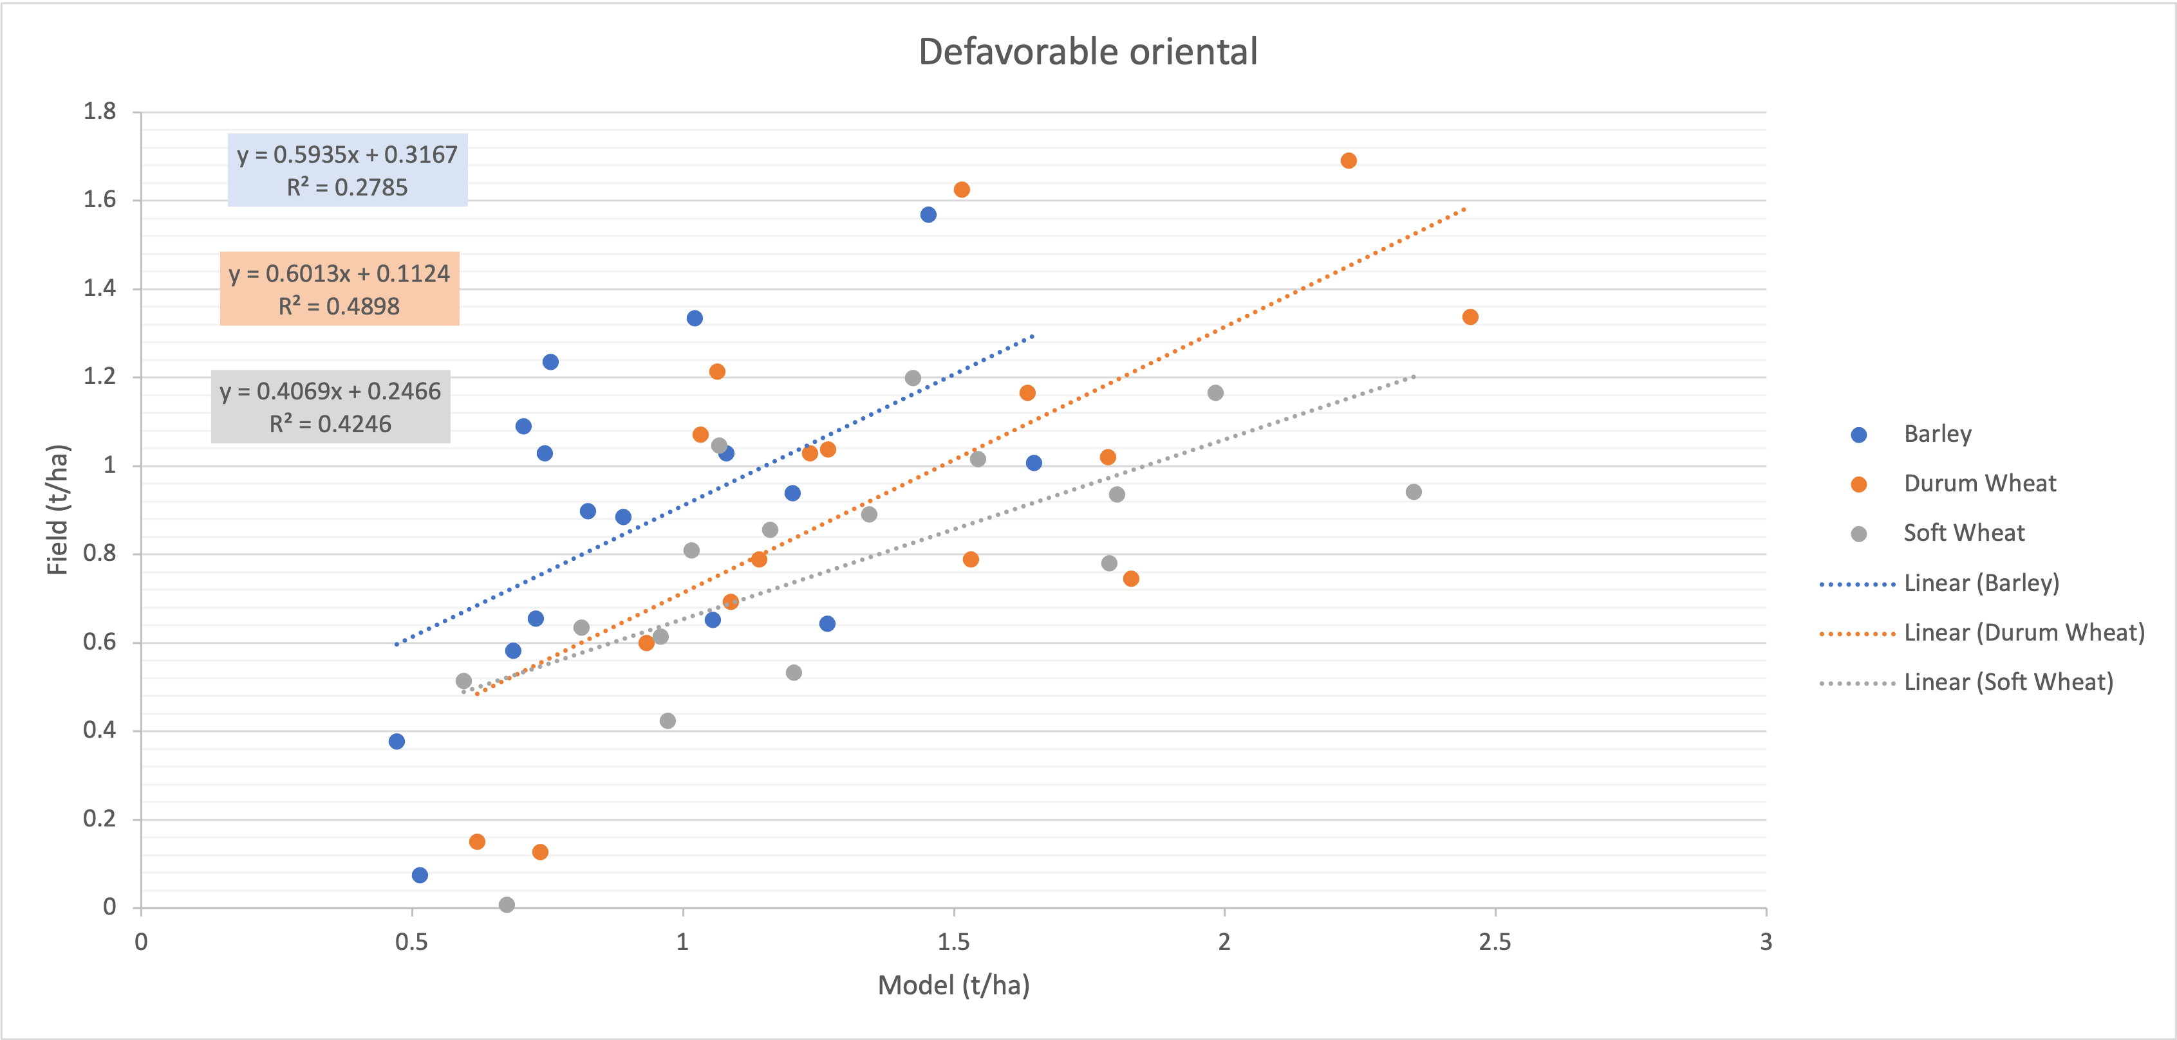
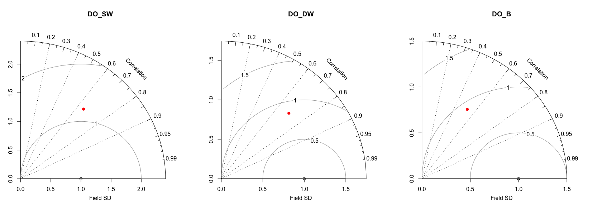
Preliminary results : Past period from 1997 to 2017 Region: East
Relationship between observed yield (field) and forecasted yield (caraib) of soft wheat, durum wheat and barley, based on linear regression model
Taylor diagram displaying a statistical comparison between average yield calculated by CARAIB and yield statistics of soft wheat (SW), durum wheat (DW) and barley (B)

Slide 12
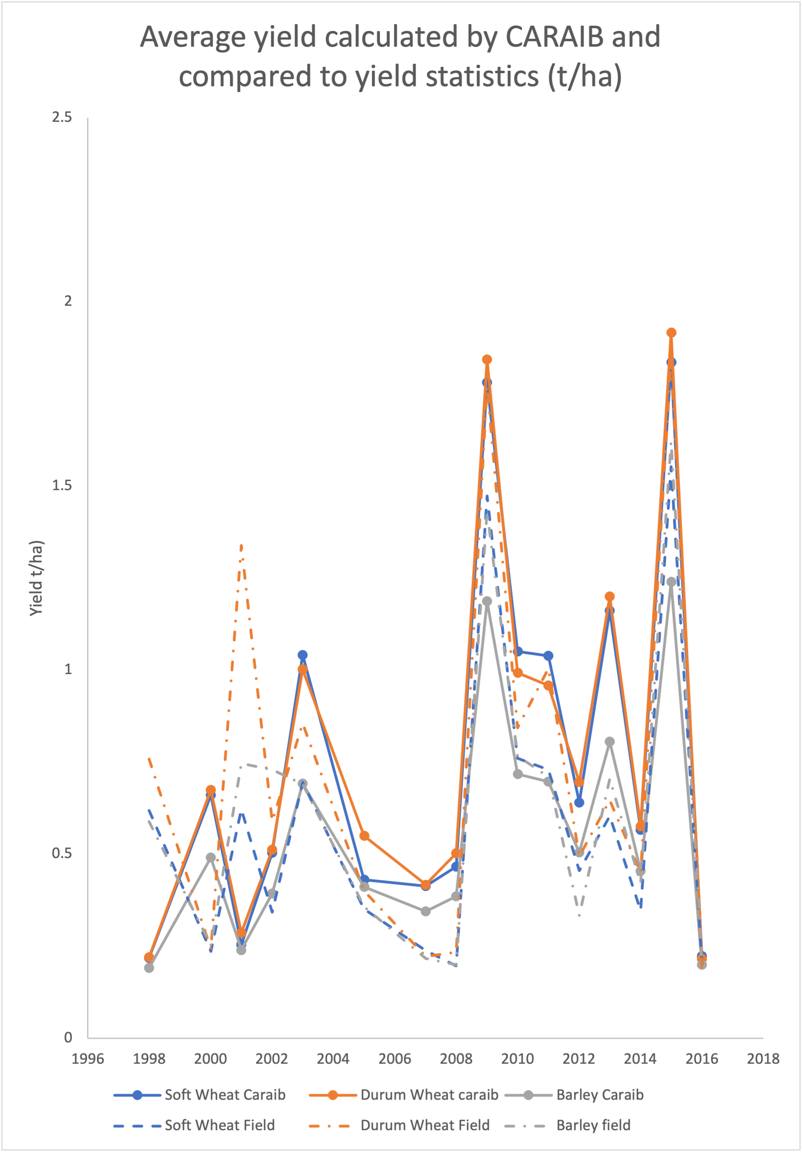
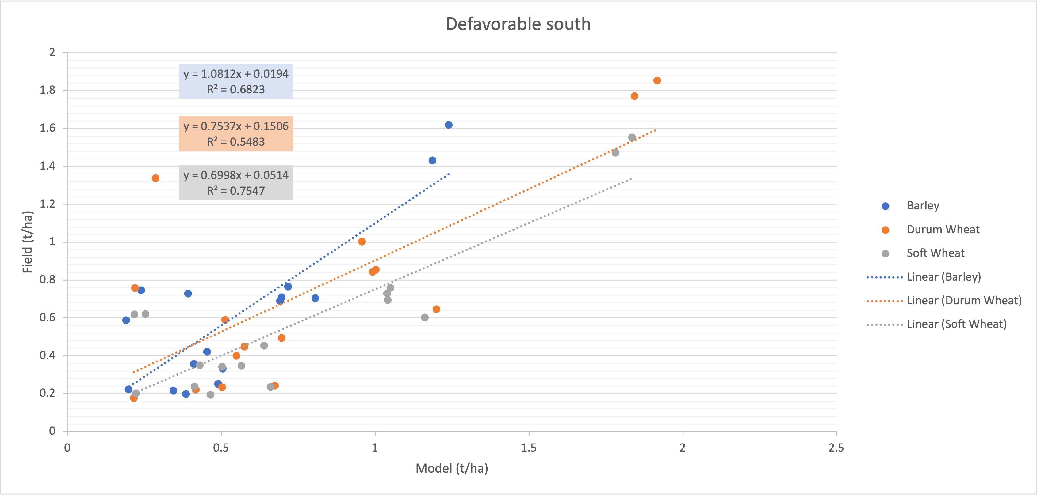
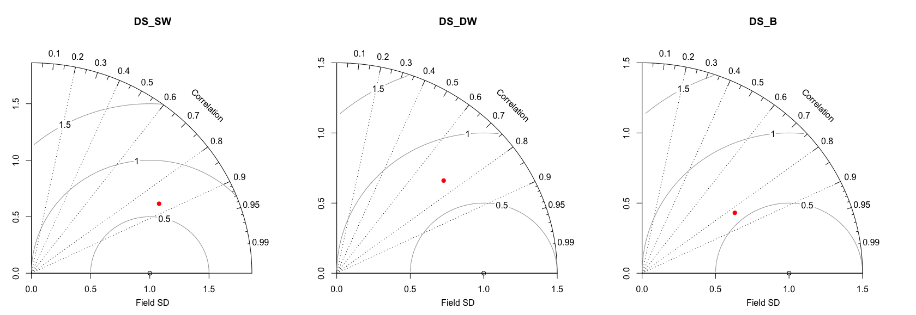
Preliminary results : Past period from 1997 to 2017 Region: South
Relationship between observed yield (field) and forecasted yield (caraib) of soft wheat, durum wheat and barley, based on linear regression model
Taylor diagram displaying a statistical comparison between average yield calculated by CARAIB and yield statistics of soft wheat (SW), durum wheat (DW) and barley (B)

Slide 13
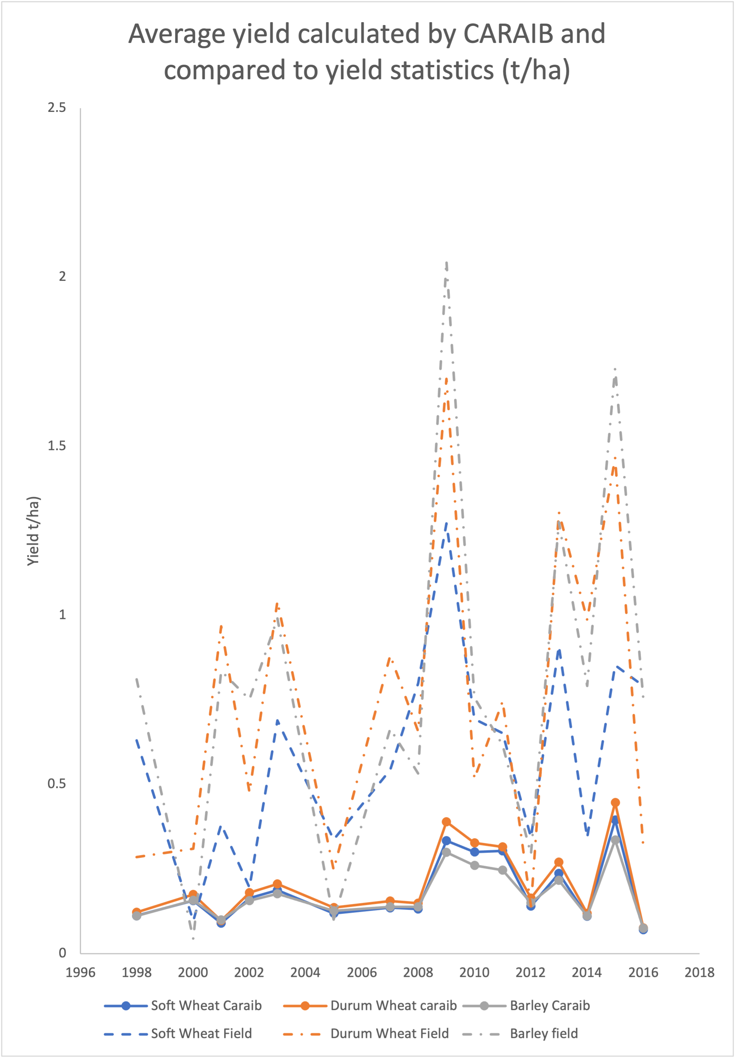
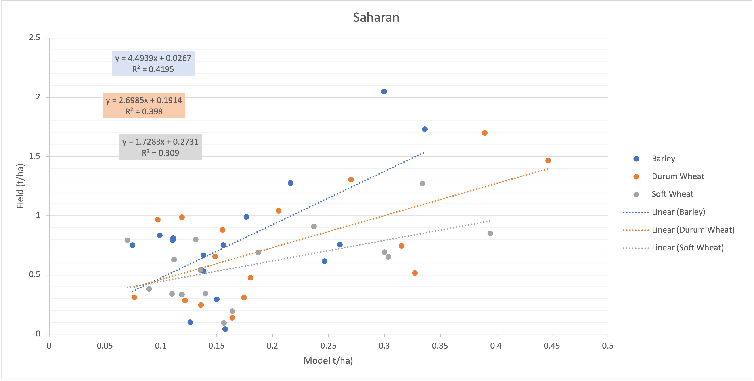
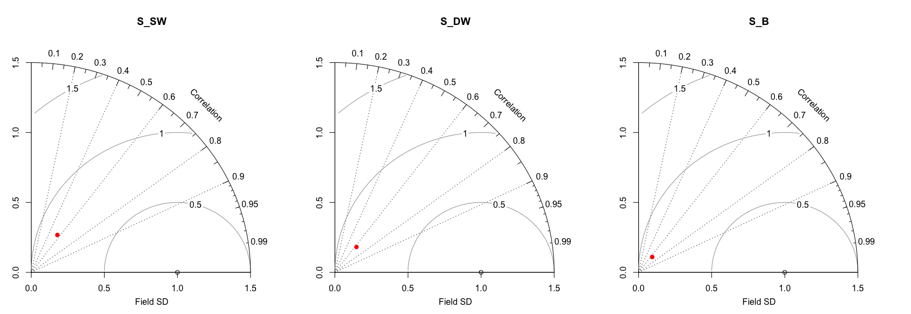
Preliminary results : Past period from 1997 to 2017 Region: Sahara
Relationship between observed yield (field) and forecasted yield (caraib) of soft wheat, durum wheat and barley, based on linear regression model
Taylor diagram displaying a statistical comparison between average yield calculated by CARAIB and yield statistics of soft wheat (SW), durum wheat (DW) and barley (B)

Slide 14
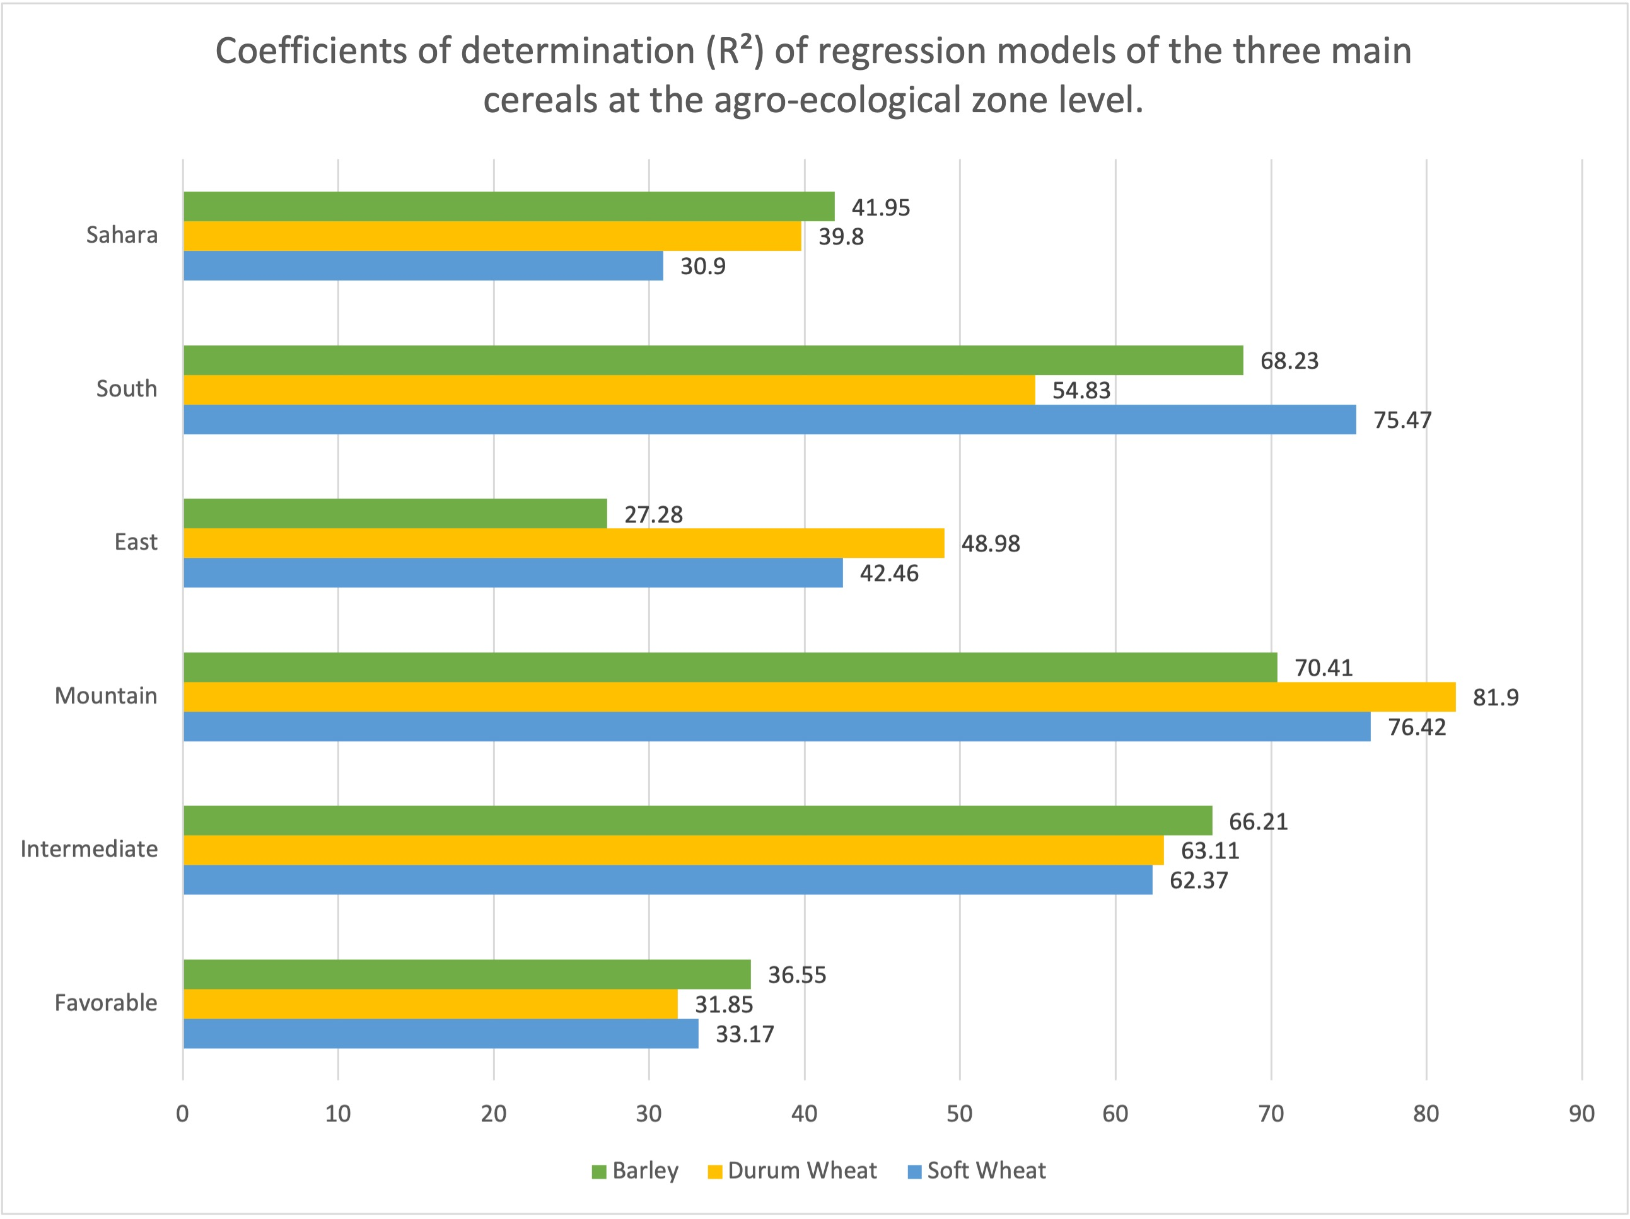
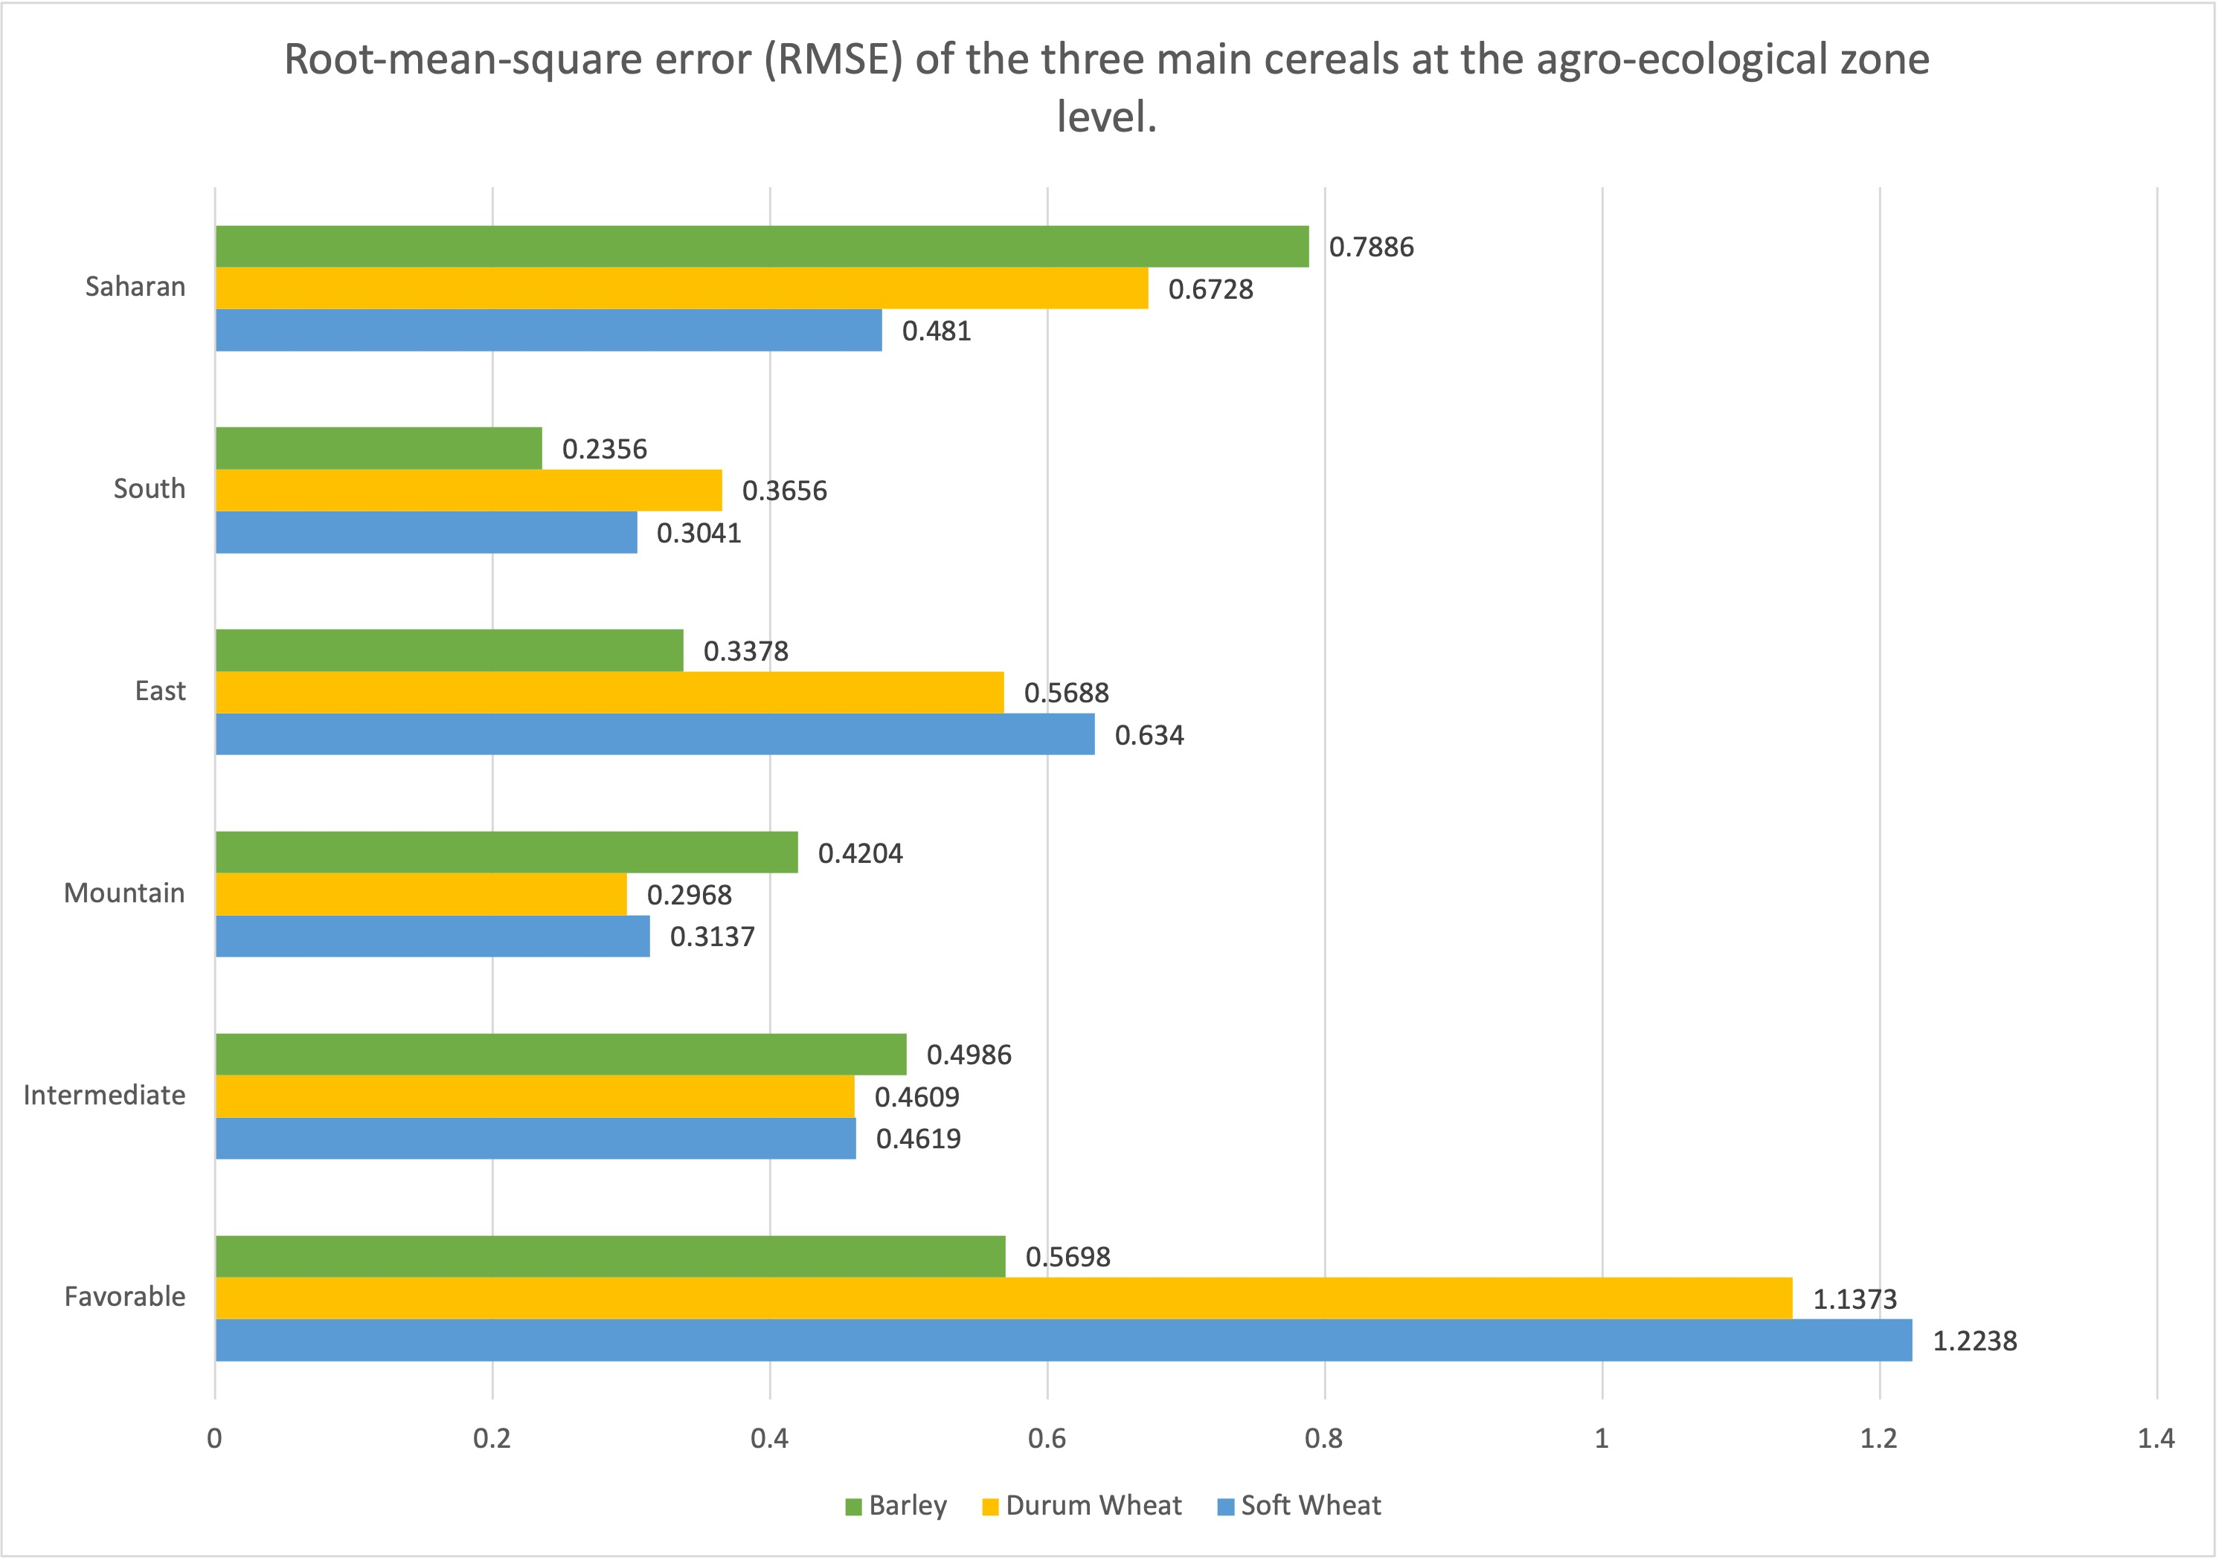
Summary of results: Past period from 1997 to 2017
We compared CARAIB results with the statistics on crop yields. Globally, the determination coefficients and RMSE values are good for the three crops in the intermediate, mountain and south regions (R² > 50%, RMSE < 0.49). For the three other regions: favorable, east and Sahara, the coefficient is relatively good ( 28% < R² <49%), but we can notice a much worse RMSE values, especially for soft wheat. We also notice that CARAIB tends to globally overestimate the yields of all the crops in the favorable and east regions, but for Sahara region, CARAIB underestimate the yields and the gap between the observed yields and the forecasted yields is important.

Slide 15
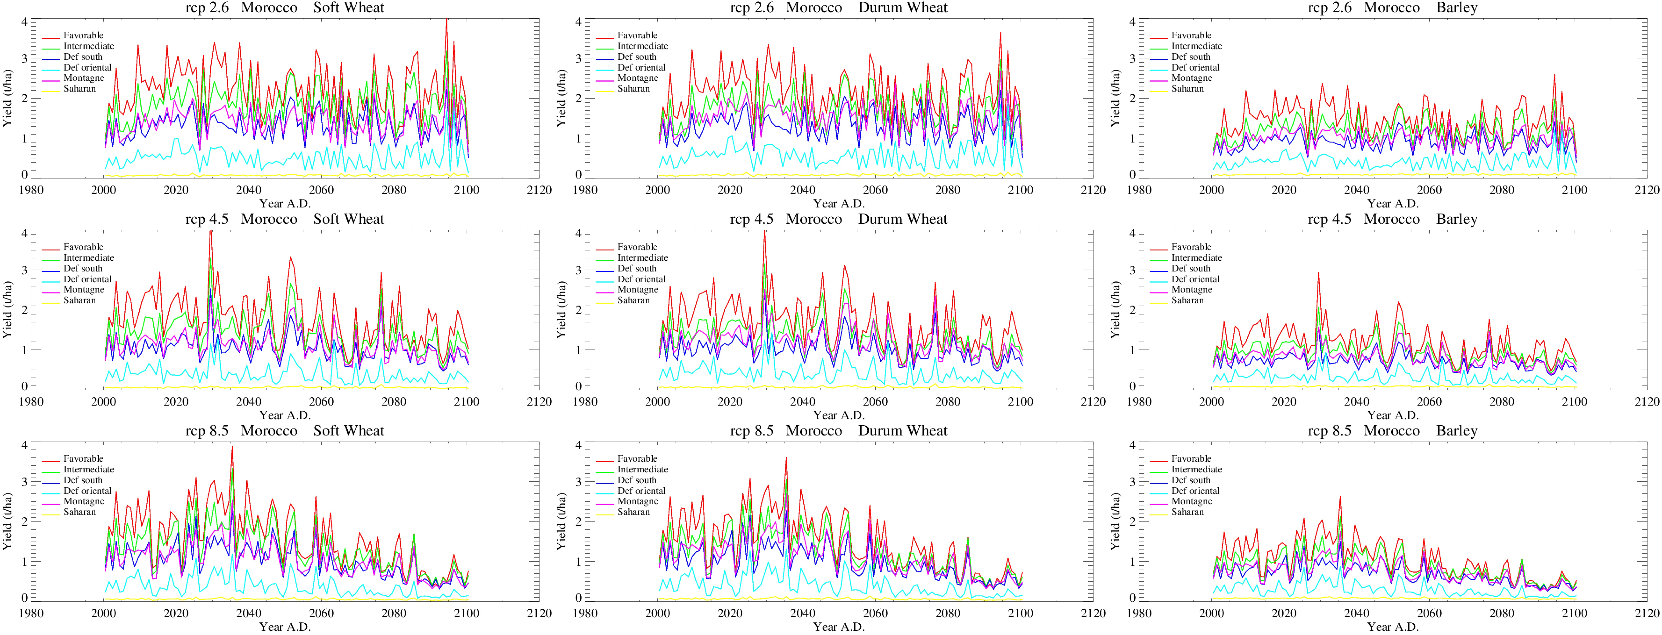
Future results (HadGEM2-AO) : Future period from 2000 to 2100
For these future simulations, CARAIB was forced with the three climate scenarios: RCP 2.6, RCP 4.5 and RCP 8.5, in order to analyse the impact on crop yields. We can notice an important inter-annual variability for the three simulations, in addition to the important amplitude difference between wheat and barley. In fact, yields are positively impacted by climate change and the rising atmospheric CO₂. For RCP 2.6, the yields will reach the maximum value at the turn of the century. Contrarily, the yields in RCP 8.5 will start decreasing gradually after 2035. Regarding RCP 4.5, we notice a lower inter-annual variability and relative yields decreasing after 2030.

Slide 16
Future results (HadGEM2-AO) : Future period from 2000 to 2100
Results: Spatial yield Variation ‘Barley’
Results: Spatial yield Variation ‘Winter wheat’
Mean Yield 2000-2020
Mean Yield 2080-2100
Mean Yield 2000-2020
Mean Yield 2080-2100
RCP 2.6
RCP 4.5
RCP 8.5
The pattern of spatial variation of all the crops is the same: the highest yields values are concentrated in the north and the west of the country. Under RCP 2.6, there is no major yield variation between the beginning and the turn of the century. However for the other RCPs, we can notice an important decreasing trend.

Slide 17
Conclusion :
These preliminary results appear to be encouraging. In order to improve the predictions and the response of model yields to the future climate, we are going to study the adaptation of functional traits (Specific leaf area – SLA, C/N ratio and δ13C) to climate and CO₂ in a mechanistic model.
For that purpose, we will parameterise and validate CARAIB for the different species as well as their varieties from the measurements and evaluate the role of measured functional traits in yield simulation.

