Slide 1
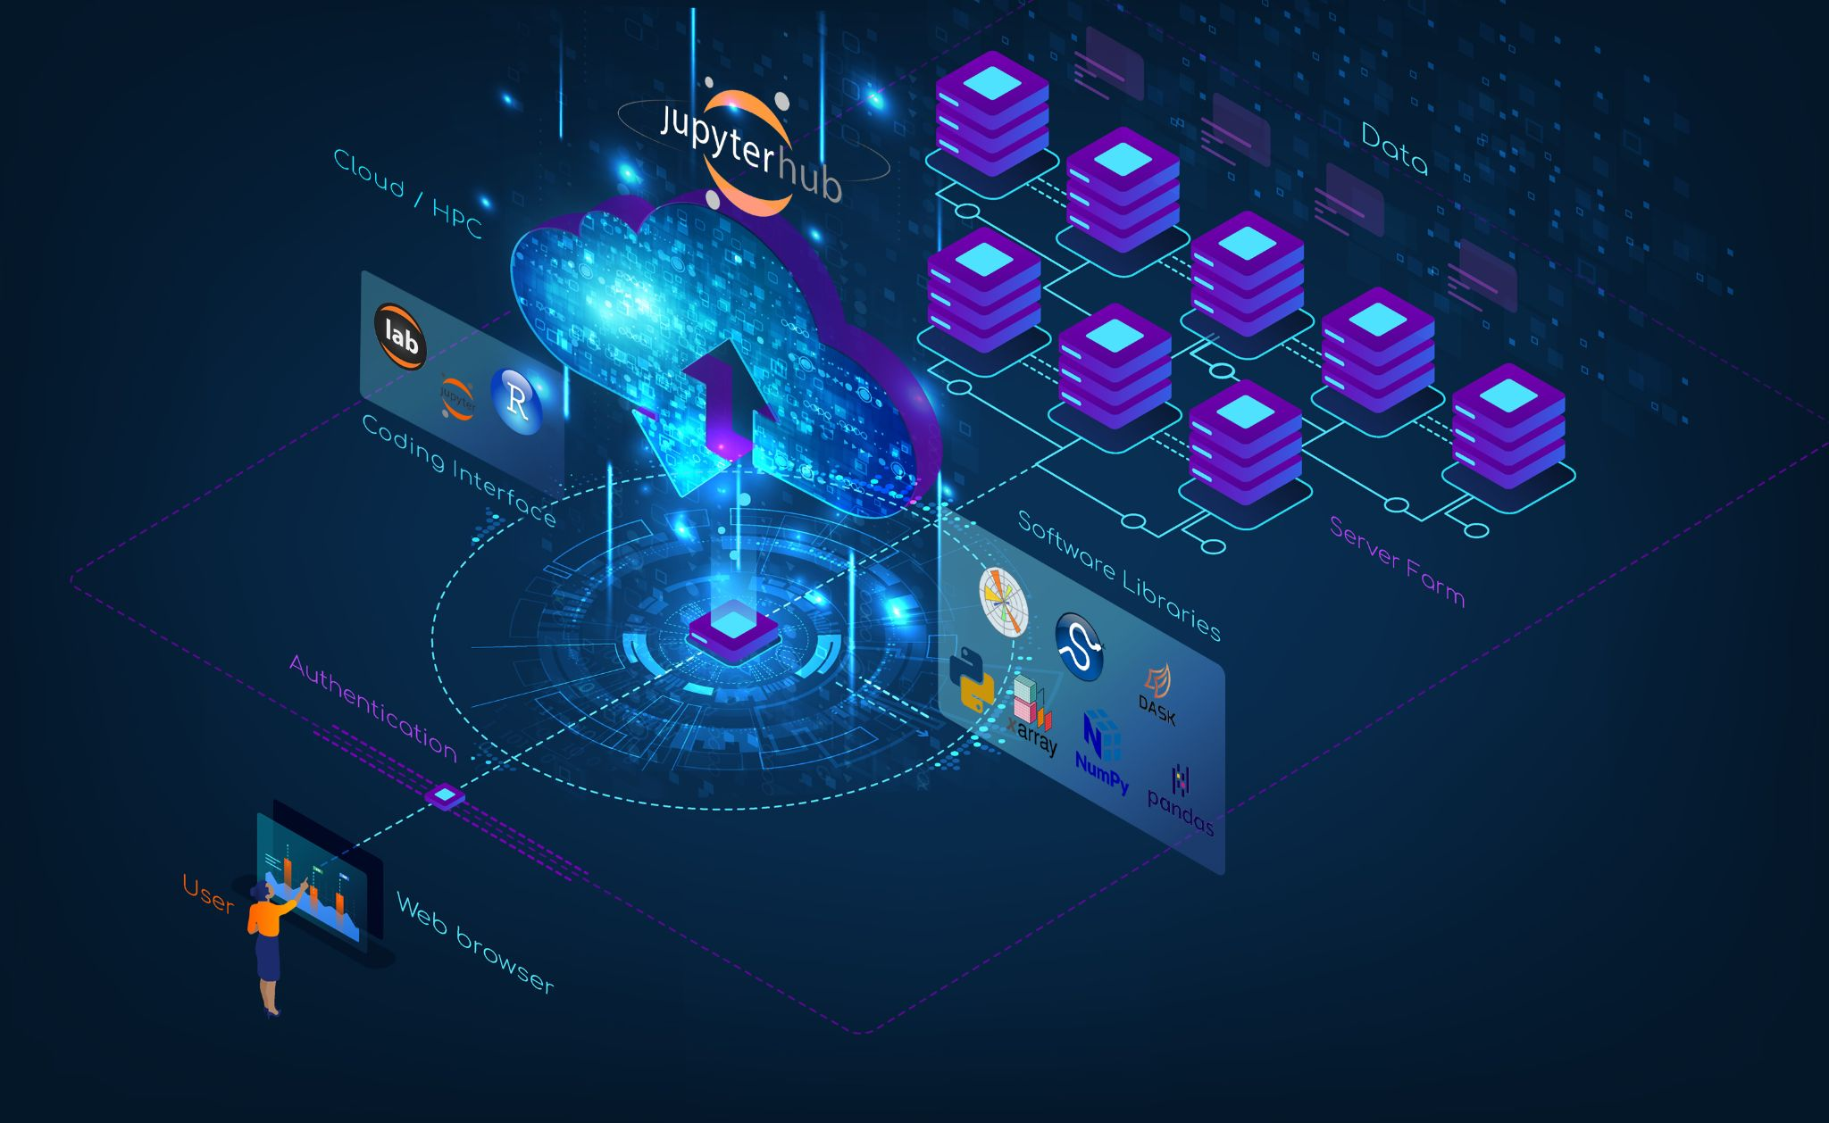



Science Storms the Cloud
C. Gentemann
C. Holdgraf
R. Abernathey
D. Crichton
J. Colliander
E. J. Kearns
Y. Panda
R. P. Signell
Notes:
Science stands at the cusp of a new, open science, cloud-enabled era
Advances in data, software, and computing are enabling transformational, interdisciplinary science, changing the realm of possible questions
Deliberately designed open science communities can advance science and inclusivity simultaneously

Slide 2
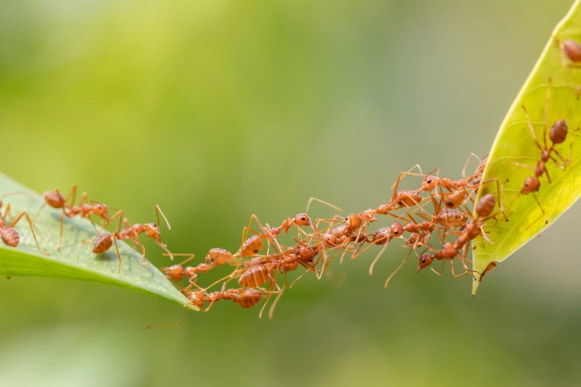
Technology is increasing our ability to easily collaborate
https://www.uu.nl/en/research/open-science

Slide 3

Collaborations are accelerating the speed of science and amplifying impacts
https://www.uu.nl/en/research/open-science

Slide 4

Data
Old: bring data to you:
Can take months to download!!
New version? Download again!!
Storage and maintenance costs
Discourages external collaborations
Reinforces institutional advantages
New: open cloud-based data
Increases ability to collaborate
Increases reproducibility
Access not bandwidth-limited
Enables interdisciplinary research
https://www.dataquest.io/blog/design-tips-for-data-viz/

Slide 5
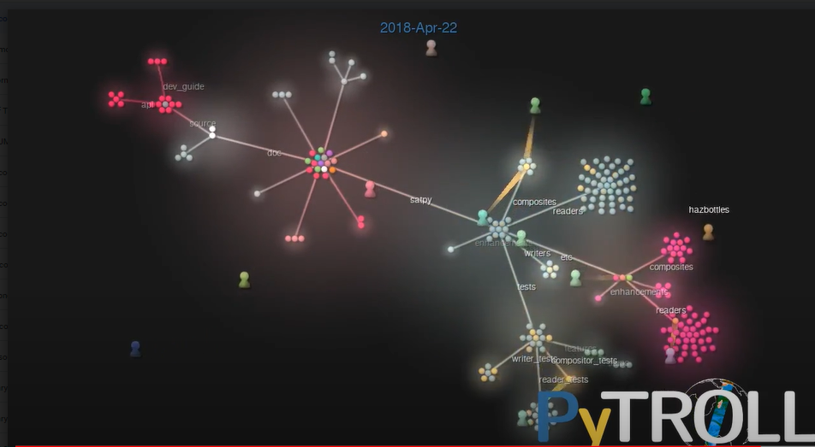
Open Software
dev_guide
api
source
docs
satpy
composites
readers
Permissively licensed software public on GitHub
Collaboratively built tools
Available to anyone
More robust code
Explosion in use of AI/ML and advanced analysis techniques
Speeds up science
enchancements
etc
composites
tests
writers
enhancements
readers
writer_test
features
compositor_tests
reader_test
Notes:
Open source software is building powerful tools for scientists. Xarray, Dask, PyTroll, Scipy, Scikit-learn, Tensorflow.
These tools are increasing access to science by abstracting data access and providing easy to use toolkits for science vizualization and analysis.

Slide 6
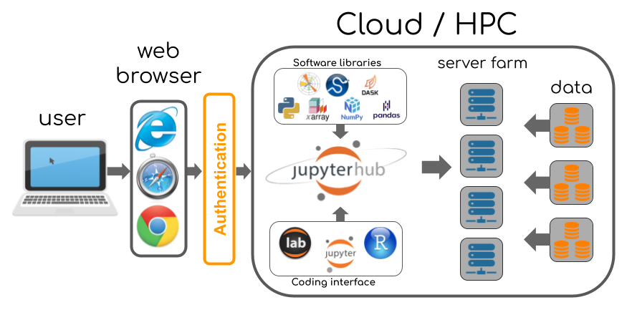
Open Cyberinfrastructure -
Science Data Platforms
Support platform agnostic, open source infrastructure solutions
Challenge use of proprietary/platform specific software
Image credit: https://2i2c.org/
Notes:
We can bring this all together on cloud/hpc based infrastructure. Science Data platforms are advancing rapidly, there seems to be a new one coming out every month or so, but virtually all of them are based on JupyterHubs as the primary mode of interface to give users a common framework no matter where they work. This gives you...

Slide 7
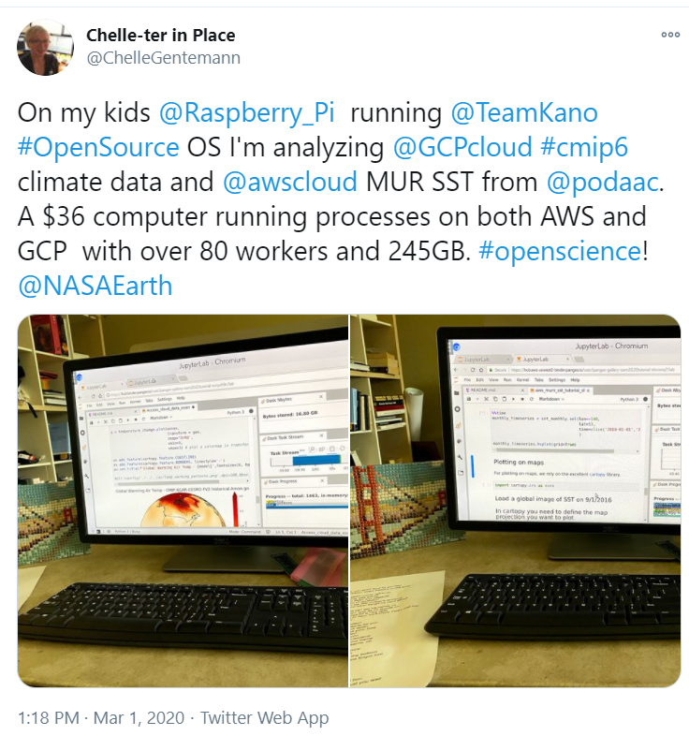
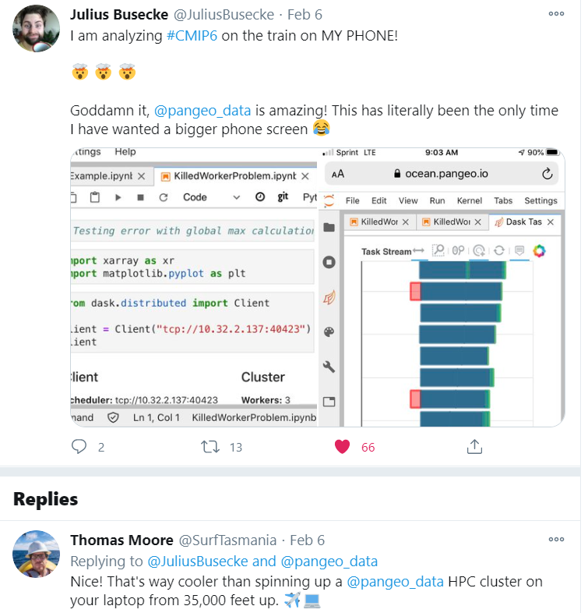
A super computer behind every device
Notes:
A super computer behind every device breaks the institutional advantage and opens access to science for more people to participate.

Slide 8

Open by Design
(1) Build an inclusive community of scientists advancing open science
(2) Incentivize openness
(3) Highlight early adopter activities to motivate broader community
(4) Coordinate -- move forward together

Slide 9


Open to accelerate science
“Give sufficient credit for whatever one would like to see shared, and scientists will indeed start sharing it” Bright & Heesen
http://sootyempiric.blogspot.com/2020/11/the-head-and-heart-incentives-and-norms.html
Notes:
Global warming is accelerating. Our world is changing and our science must adapt and accelerate if we are to thrive. Open science combined with cloud computing can be fast and better. The Pangeo community has created a gallery of executable notebooks to get you started, has a forum for questions, and a bi-weekly meeting open to everyone interested in doing cloud-enabled open science.

Slide 10
BACKUP SLIDES

Slide 11
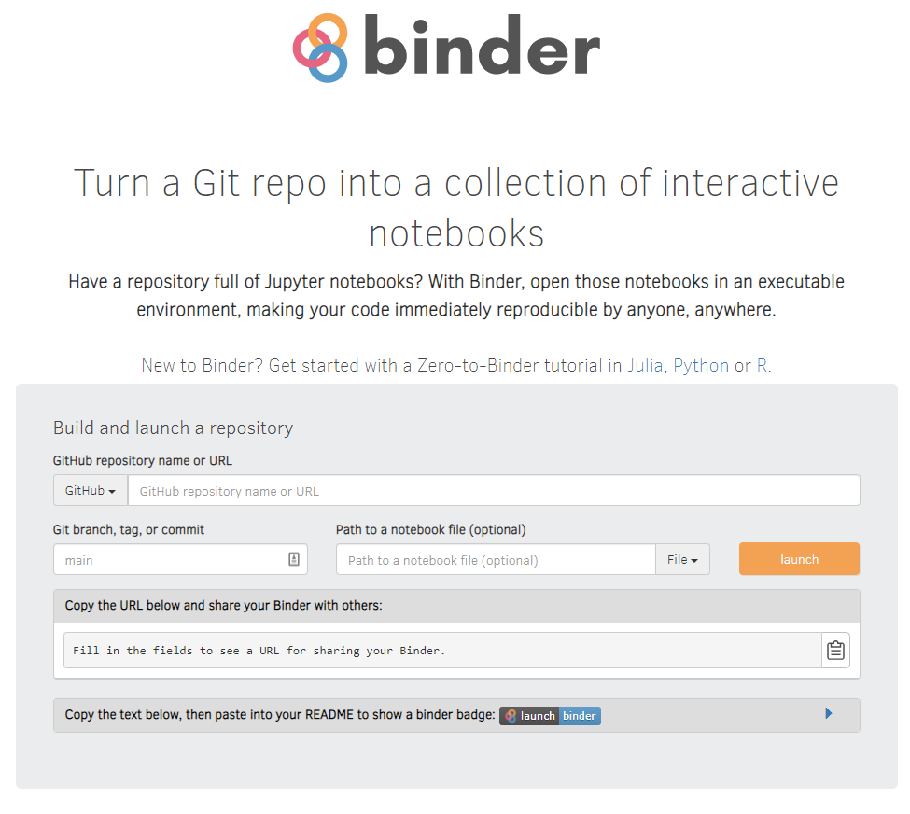
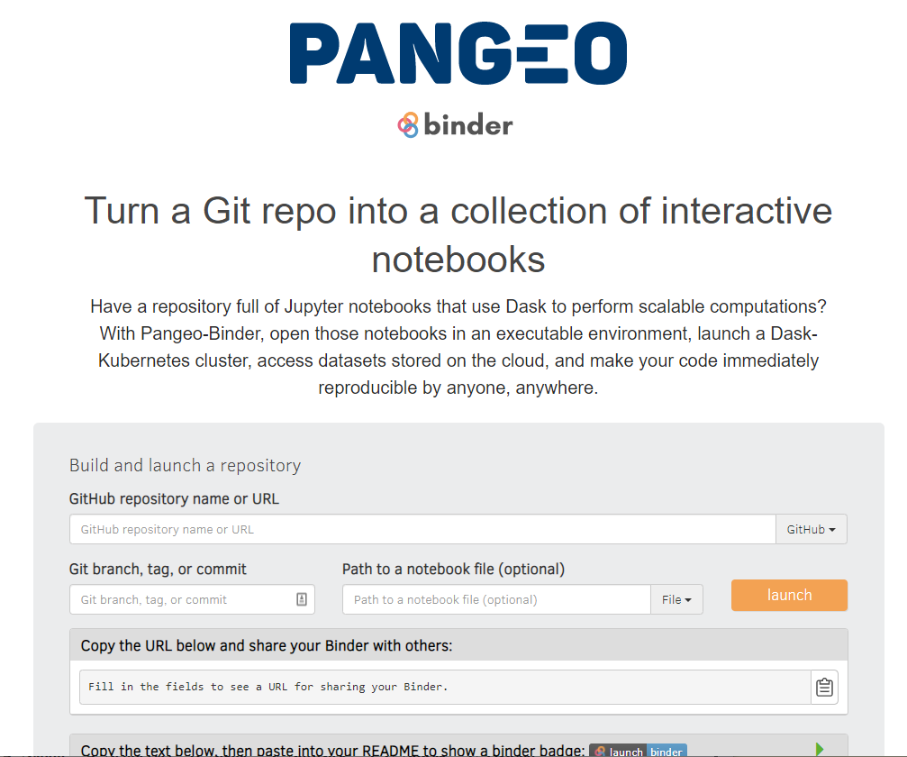
https://mybinder.org/
https://binder.pangeo.io/
https://blog.jupyter.org/mybinder-org-serves-two-million-launches-7543ae498a2a

