Slide 1

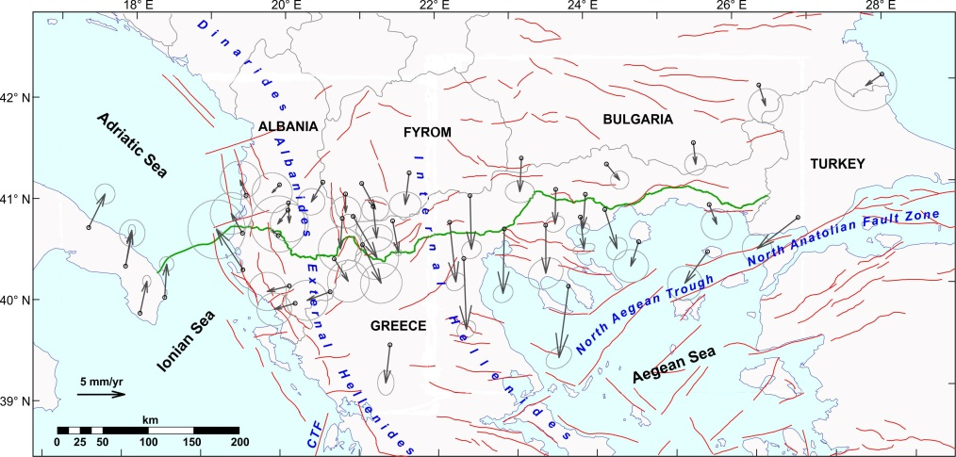


EGU21-10111: Analysis of GNSS data along the Southern Gas Corridor and estimate of the expected slowly-cumulating tectonic displacements
Giuliana Rossi¹, Riccardo Caputo^{2,3}, David Zuliani¹, Paolo Fabris¹, Massimiliano Maggini^{2,3}, Panagiotis Karvelis⁴
1) National Institute of Oceanography and Applied Geophysics–OGS, Italy ; 2) Dept. Physics & Earth Sciences, University of Ferrara, Italy ; 3) Centro Interuniversitario per la Sismotettonica Tridimensionale, CRUST-UR Ferrara, Italy; 4) Korros-e, Greece
3. The OGS TAP Project
2. The Trans Adriatic Pipeline -TAP
4. The data used
1. The reasons for a geodetic study
5. The method and results
6. Conclusions
The ‘Home’ Button takes you back to this slide
Clicking on the arrow , you move to the next slide
To go into details, click, , to go back from where you started, click
Istituto Nazionale di Oceanografia e di Geofisica Sperimentale –OGS
National Institute of Oceanography and Applied Geophysics -OGS
EGU21-10111

Slide 2
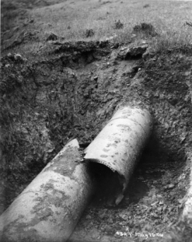
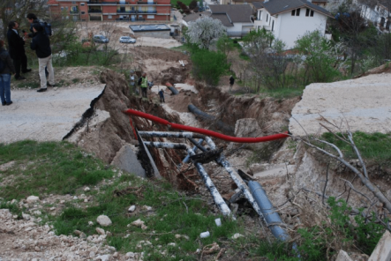

1. The reasons for a geodetic study
Earthquakes, inducing shear, compression, or tension in the ground associated with travelling waves, as well as large permanent soil deformations produced by fault displacements, landslides, liquefaction of sandy soils, can strongly affect buried infrastructures, like pipelines, depending on the relative orientation of the pipeline and the fault (O’Rourke and Liu, 1999; Ballantyne, 2008).
San Francisco, USA; 18th April, 1906, M=8.3
L’Aquila, Italy: 6th April, 2009, Mw=6.3
Effects of the fault rupture on water pipelines
Istituto Nazionale di Oceanografia e di Geofisica Sperimentale –OGS
National Institute of Oceanography and Applied Geophysics -OGS
EGU21-10111

Slide 3
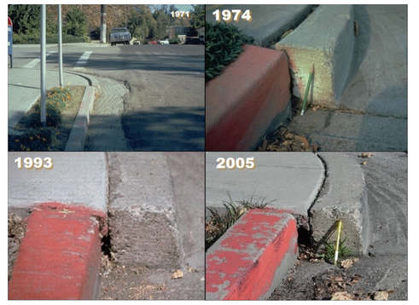
1. The reasons for a geodetic study
The differential motions of faulted blocks, due to the interseismic strain-accumulation within the upper crust, lead to permanent ground deformations.
In the case of a pipeline, such motions can distress the pipe and cause operation interruptions, while the anchor points can result in local stress concentrations.
Hayward fault (USA): differential movements across years
Hence, quantifying the entity of the displacement due to tectonic movements, can indicate pipeline sectors under stress, also in absence of very strong earthquakes
Istituto Nazionale di Oceanografia e di Geofisica Sperimentale –OGS
National Institute of Oceanography and Applied Geophysics -OGS
EGU21-10111

Slide 4
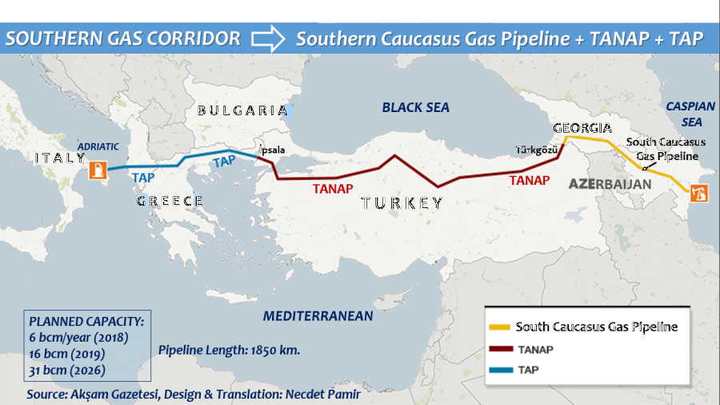
TAP, together with TANAP (Trans Anatolian Pipeline) and SCPX (South Caucasus Gas Pipeline), is one of the transport infrastructures of the so-called Southern Gas Corridor, which allows access to the European market for natural gas reserves in the Caspian Sea area.
2. The Trans Adriatic Pipeline -TAP
Istituto Nazionale di Oceanografia e di Geofisica Sperimentale –OGS
National Institute of Oceanography and Applied Geophysics -OGS
EGU21-10111

Slide 5
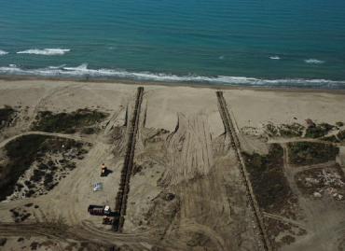
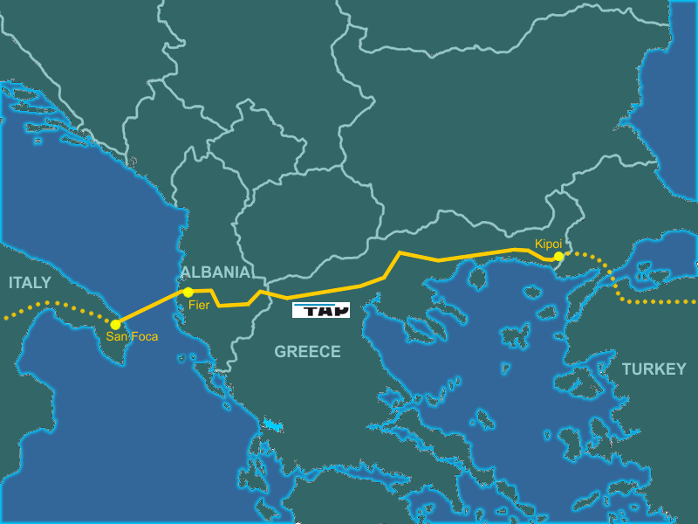
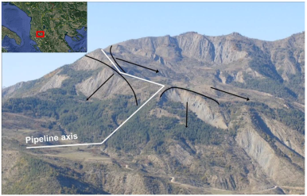
2. The Trans Adriatic Pipeline -TAP
In particular, TAP is the pipeline for the transport of natural gas from Azerbaijan to the Greek-Turkish border, through Greece and Albania, to Italy.
Fier, Albania
Landslides, Albania
Istituto Nazionale di Oceanografia e di Geofisica Sperimentale –OGS
National Institute of Oceanography and Applied Geophysics -OGS
EGU21-10111

Slide 6

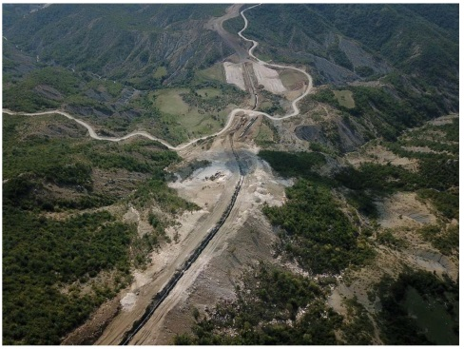
2. The Trans Adriatic Pipeline -TAP
Total length of the pipeline: 878 km
Greece: 550 km
Albania: 215 km
Offshore Adriatic Sea: 105 km
Italy: 8 km
Maximum elevation: 2100 m a.s.l. in Albania
Maximum water depth: 810 m b.s.l.
Four compression stations along the route (2 for the initial phase)
Pipe diameter: Pipe diameter: onshore 48’ with a pressure of 95 bar; offshore 35’ with a pressure of 145 bar (©Trans Adriatic Pipeline AG, all rights reserved, https://www.tap-ag.com).
A view of the TAP’s path
Istituto Nazionale di Oceanografia e di Geofisica Sperimentale –OGS
National Institute of Oceanography and Applied Geophysics -OGS
EGU21-10111

Slide 7
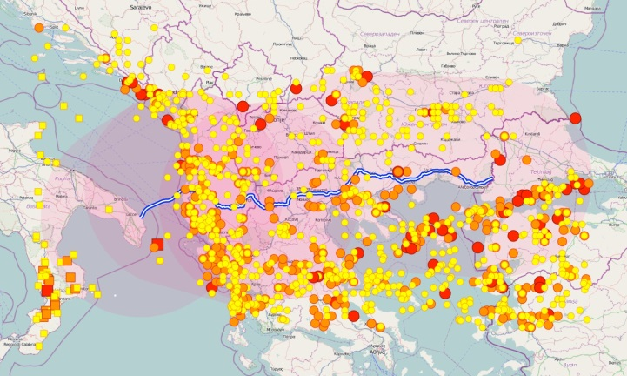
3. The OGS TAP Project
“Trans Adriatic Pipeline Seismological Investigation”
funded by E.ON New Build & Technology GmbH, Geisenkirchen, Germany.
The project, aimed to study the seismological hazards along the path, was led by OGS, and involved three OGS divisions, and the Universities of Ferrara (I), Tirana (AL), and Thessaloniki (GR).
Istituto Nazionale di Oceanografia e di Geofisica Sperimentale –OGS
National Institute of Oceanography and Applied Geophysics -OGS
EGU21-10111

Slide 8
3. The OGS TAP Project: scientists involved
National Institute of Oceanography and Applied Geophysics –OGS (Italy)
- Seismology: Slejko D., Re bez A., Santulin M., Garcia-Pelaez J., Sandron D., Tamaro A., Moratto L., Saraò A., Vuan A., Rossi G., Fabris P., Zuliani D.
- Geophysics: Civile D., Volpi V., Ceramicola S., Geletti R., Zecchin M.
- Infrastructure: Zgur F.
University of Ferrara (Italy)
Caputo R., Rapti D.
University of Thessaloniki (Greece)
Chatzipetros A., Papazachos C., Pavlides S., Sboras S.
University of Tirana (Albania)
Daja S.
Korros-E Athens (Greece)
Karvelis P.
Istituto Nazionale di Oceanografia e di Geofisica Sperimentale –OGS
National Institute of Oceanography and Applied Geophysics -OGS
EGU21-10111

Slide 9
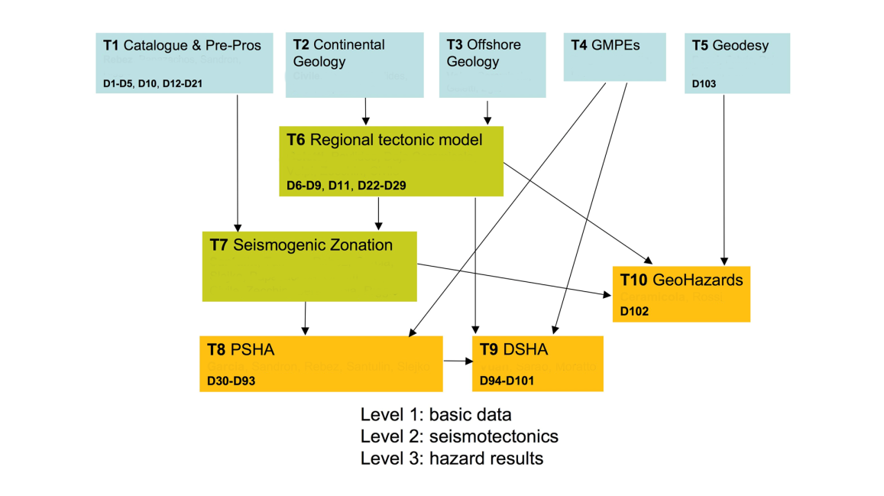
3. The OGS TAP Project: the flow chart
Istituto Nazionale di Oceanografia e di Geofisica Sperimentale –OGS
National Institute of Oceanography and Applied Geophysics -OGS
EGU21-10111

Slide 10
3. The OGS TAP Project: the flow chart
Our study
Istituto Nazionale di Oceanografia e di Geofisica Sperimentale –OGS
National Institute of Oceanography and Applied Geophysics -OGS
EGU21-10111

Slide 11
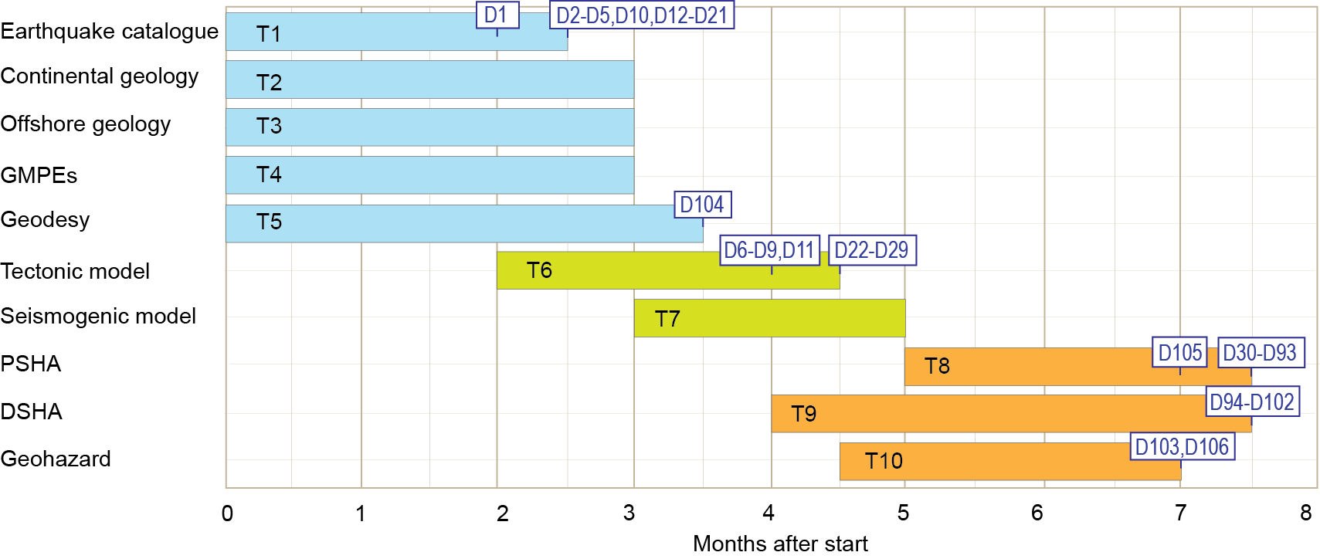
3. The OGS TAP Project: the deliverables
D1 = earthquake catalogue
D2-D11 = reports
D12-D21 = general maps
D22-D29 = specific geological maps
D30-D93 = PSHA specific maps
D94-D102 = specific DSHA maps
D103-D104 = geohazard maps
D105 = final report
Our study
Istituto Nazionale di Oceanografia e di Geofisica Sperimentale –OGS
National Institute of Oceanography and Applied Geophysics -OGS
EGU21-10111

Slide 12
4. The data used: the tectonic data base
Data on the faults in an area about 200 km from the pipeline path (white-blue line), mainly from the Greek Database of Seismogenic Sources (GreDaSS; Caputo and Pavlides, 2013; http://gredass.unife.it)
Istituto Nazionale di Oceanografia e di Geofisica Sperimentale –OGS
National Institute of Oceanography and Applied Geophysics -OGS
EGU21-10111

Slide 13
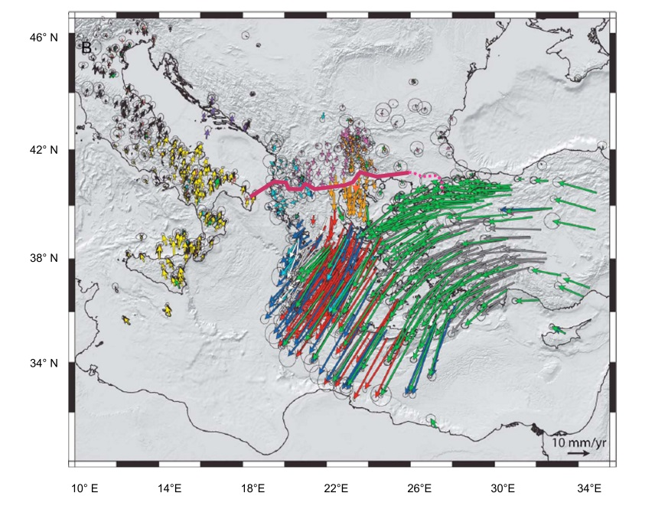
4. The data used: GNSS velocities
Velocities from permanent and temporary GNSS stations, from different data-sets (colours) (From Pérouse et al. 2012, modified, and references therein).
Istituto Nazionale di Oceanografia e di Geofisica Sperimentale –OGS
National Institute of Oceanography and Applied Geophysics -OGS
EGU21-10111

Slide 14
4. The data used: a summary of GNSS velocities pattern
Istituto Nazionale di Oceanografia e di Geofisica Sperimentale –OGS
National Institute of Oceanography and Applied Geophysics -OGS
EGU21-10111

Slide 15

4. The data used: Our data selection from Pérouse et al. 2012
Zoom 1
Zoom 2
more details on data used
Velocities (gray arrows) from GNSS sites within a distance of ca. 120 km form the path, and/or with the smallest error ellipses (major axis smaller than 6.8 mm).
Istituto Nazionale di Oceanografia e di Geofisica Sperimentale –OGS
National Institute of Oceanography and Applied Geophysics -OGS
EGU21-10111

Slide 16
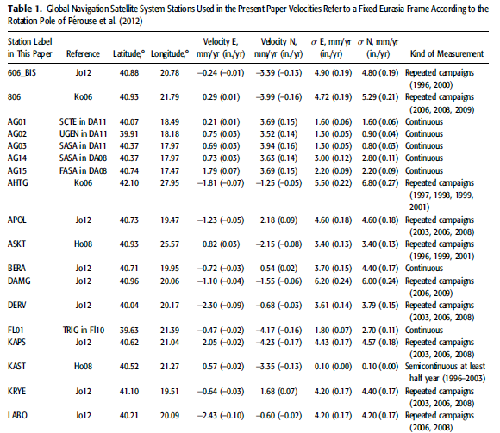
4. The data used
GNSS stations used in the present work. Velocities refer to a fixed Eurasia frame according to the rotation pole of Pérouse et al. (2012). Velocities and errors (σ) are both in mm/yr and in/yr. References: DA08 = D'Agostino et al. (2008); DA11 = D'Agostino et al. (2011); Fl10 = Floyd (2010); Ho08 = Hollenstein et al. (2008); Jo12 = Jouanne et al. (2012); Ko06 = Kotzev et al. (2006); Ma11 = Matev (2011); Re06 = Reilinger et al. (2006). The last column indicates for each station, the kind of measurement available (continuous, or due to repeated campaigns).
Istituto Nazionale di Oceanografia e di Geofisica Sperimentale –OGS
National Institute of Oceanography and Applied Geophysics -OGS
EGU21-10111

Slide 17
4. The data used: zooming on two important sectors of the path
Zoom 1
Zoom 2
The black arrows indicate the strain rates, the purple ones refer to some relevant tectonic lineament
Istituto Nazionale di Oceanografia e di Geofisica Sperimentale –OGS
National Institute of Oceanography and Applied Geophysics -OGS
EGU21-10111

Slide 18
5. The method and results
The problem:
Our input is a number of scattered data defined by:
- locations, (x,y) or (longitude, latitude)
- velocity in E-W and N-S directions
errors in E-W and N-S directions
We need to have continuous information along the pipeline path.
The black arrows indicate the strain rates, the purple ones refer to some relevant tectonic lineament
Istituto Nazionale di Oceanografia e di Geofisica Sperimentale –OGS
National Institute of Oceanography and Applied Geophysics -OGS
EGU21-10111

Slide 19
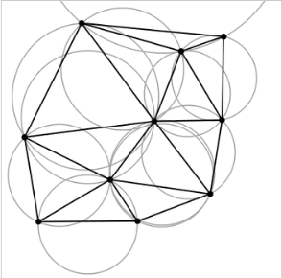
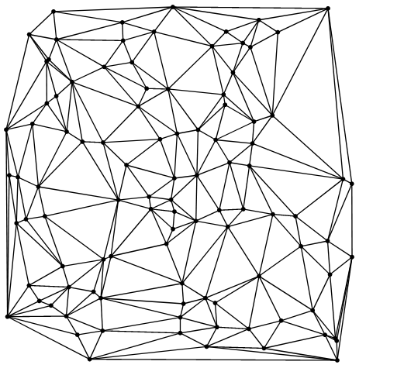
5. The method and results
Input: the d_{i} values (velocity and errors in E-W and N-S directions) in the locations, (x,y)
Method: Delaunay triangulation of (x,y) yelding the surface F(x,y)=d.
F is the interpolating function used to asses unknown values of d_{i} at whatever location (x_{i},y_{i}) (De Berg et al., 2008; http://mathworld.wolfram.com/DelaunayTriangulation.html, 2010).
With Delaunay triangulation, no point of the data set is inside the circumcircle of any resulting triangle.
Istituto Nazionale di Oceanografia e di Geofisica Sperimentale –OGS
National Institute of Oceanography and Applied Geophysics -OGS
EGU21-10111

Slide 20
5. The method and results
We interpolated the data on 49 points, spaced 20 km (minimum possible, due to the data spacing) following two approaches:
A. First approach:
the medium is a continuum and data are continuously interpolated
B. Second approach:
The medium is considered consisting of blocks, with:
Homogeneous velocity or
Characteristic tectonic style, different from adjacent blocks
The data are interpolated continuously within each block,
but independently from the data of the adjacent blocks
more details on the continuum approach
more details on the blocky approach
Istituto Nazionale di Oceanografia e di Geofisica Sperimentale –OGS
National Institute of Oceanography and Applied Geophysics -OGS
EGU21-10111

Slide 21
5. The method and results
A. Interpolation on the whole path: continuum assumption
The gray arrows indicate the observed strain rates, the blue ones the calculated strain rates
Istituto Nazionale di Oceanografia e di Geofisica Sperimentale –OGS
National Institute of Oceanography and Applied Geophysics -OGS
EGU21-10111

Slide 22
5. The method and results
A. Interpolation on the whole path: continuum assumption
The gray arrows indicate the observed strain rates, the blue ones the calculated strain rates
A smooth velocity field
Istituto Nazionale di Oceanografia e di Geofisica Sperimentale –OGS
National Institute of Oceanography and Applied Geophysics -OGS
EGU21-10111

Slide 23
5. The method and results
B. Block-based interpolation of the whole path, based on strain velocity and tectonics
The gray arrows indicate the observed strain rates
Istituto Nazionale di Oceanografia e di Geofisica Sperimentale –OGS
National Institute of Oceanography and Applied Geophysics -OGS
EGU21-10111

Slide 24
5. The method and results
B. Block-based interpolation of the whole path, based on strain velocity and tectonics
The gray arrows indicate the observed strain rates, the coloured ones
the calculated strain rates within the blocks
Istituto Nazionale di Oceanografia e di Geofisica Sperimentale –OGS
National Institute of Oceanography and Applied Geophysics -OGS
EGU21-10111

Slide 25
5. The method and results
B. Block-based interpolation of the whole path, based on strain velocity and tectonics
The gray arrows indicate the observed strain rates, the coloured ones
the calculated strain rates within the blocks
Good data fit
Istituto Nazionale di Oceanografia e di Geofisica Sperimentale –OGS
National Institute of Oceanography and Applied Geophysics -OGS
EGU21-10111

Slide 26
5. The method and results
Differences between the two approaches?
Continuum approach:
A smoother field, that could not perfectly fit abrupt direction changes
Istituto Nazionale di Oceanografia e di Geofisica Sperimentale –OGS
National Institute of Oceanography and Applied Geophysics -OGS
EGU21-10111

Slide 27
5. The method and results
Differences between the two approaches?
Blocky approach:
A better fit of the data but critical choice of the block boundaries
Istituto Nazionale di Oceanografia e di Geofisica Sperimentale –OGS
National Institute of Oceanography and Applied Geophysics -OGS
EGU21-10111

Slide 28
5. The method and results
Maximum displacements in 50 years of pipeline lifetime
Continuum approach
Blocky approach
Maximum displacement with both approaches: 355±55 mm in 50 years
Where: near the city of Chalkidona, 15–30 km northwest of Thessaloniki
Istituto Nazionale di Oceanografia e di Geofisica Sperimentale –OGS
National Institute of Oceanography and Applied Geophysics -OGS
EGU21-10111

Slide 29
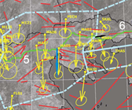
5. The method and results
Maximum differential displacements in 50 years of pipeline lifetime
Blocky approach
181±78 mm in 50 years
122±70 mm in 50 years
184±59 mm in 50 years
Istituto Nazionale di Oceanografia e di Geofisica Sperimentale –OGS
National Institute of Oceanography and Applied Geophysics -OGS
EGU21-10111

Slide 30
6. Conclusions
The block-based interpolation, based on tectonic information and interpretation of the strain style, allows to evidence the discontinuities, where differential displacements can be expected.
Blocky approach
Istituto Nazionale di Oceanografia e di Geofisica Sperimentale –OGS
National Institute of Oceanography and Applied Geophysics -OGS
EGU21-10111

Slide 31
6. Conclusions
In a 50 years lifespan of the pipeline, displacements as great as 355 mm can be expected near Chalchidona (Greece).
In the same interval the maximum differential displacement (184 mm/yr) can be expected near Berat (Albania).
Blocky approach
Blocky approach
Istituto Nazionale di Oceanografia e di Geofisica Sperimentale –OGS
National Institute of Oceanography and Applied Geophysics -OGS
EGU21-10111

Slide 32
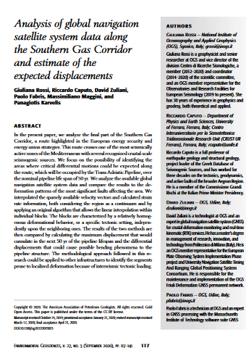
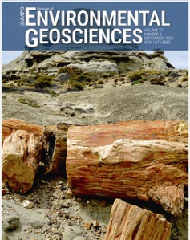
6. Conclusions
Where you can find this work:
Environmental Geosciences, 2020, 27 (3): 117–141, https://doi.org/10.1306/eg.01222019023
Istituto Nazionale di Oceanografia e di Geofisica Sperimentale –OGS
National Institute of Oceanography and Applied Geophysics -OGS
EGU21-10111

Slide 33
6. Conclusions
Would you like to deepen other aspects?
Other works in preparation:
Slejko D. et al., Seismic hazard for the Trans Adriatic Pipeline (TAP). Part 1: probabilistic seismic hazard analysis along the pipeline
Bulletin of Earthquake Engineering (BEEE), accepted.
Moratto L. et al, Trans Adriatic Pipeline (TAP) Seismic Hazard Assessment for the Trans Adriatic Pipeline (TAP) (Part2): Broadband Scenarios at Fier Compressor Station (Albania)
Bulletin of Earthquake Engineering (BEEE), under revision
Istituto Nazionale di Oceanografia e di Geofisica Sperimentale –OGS
National Institute of Oceanography and Applied Geophysics -OGS
EGU21-10111

Slide 34
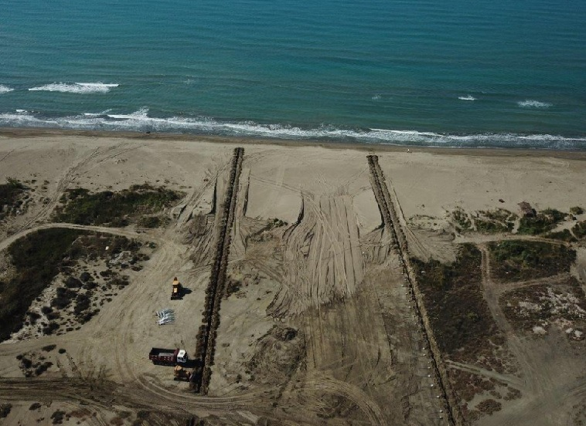
6. Conclusions
THANKS
to the whole TAP group for the discussions and help,
and to you for the patience!
Post you comments and we shall be happy to answer!
remember, NH9.8 session «Natural hazard impacts on technological systems and infrastructures» Fri, 30 Apr, 13:30–15:00!
Istituto Nazionale di Oceanografia e di Geofisica Sperimentale –OGS
National Institute of Oceanography and Applied Geophysics -OGS
EGU21-10111

