Slide 1
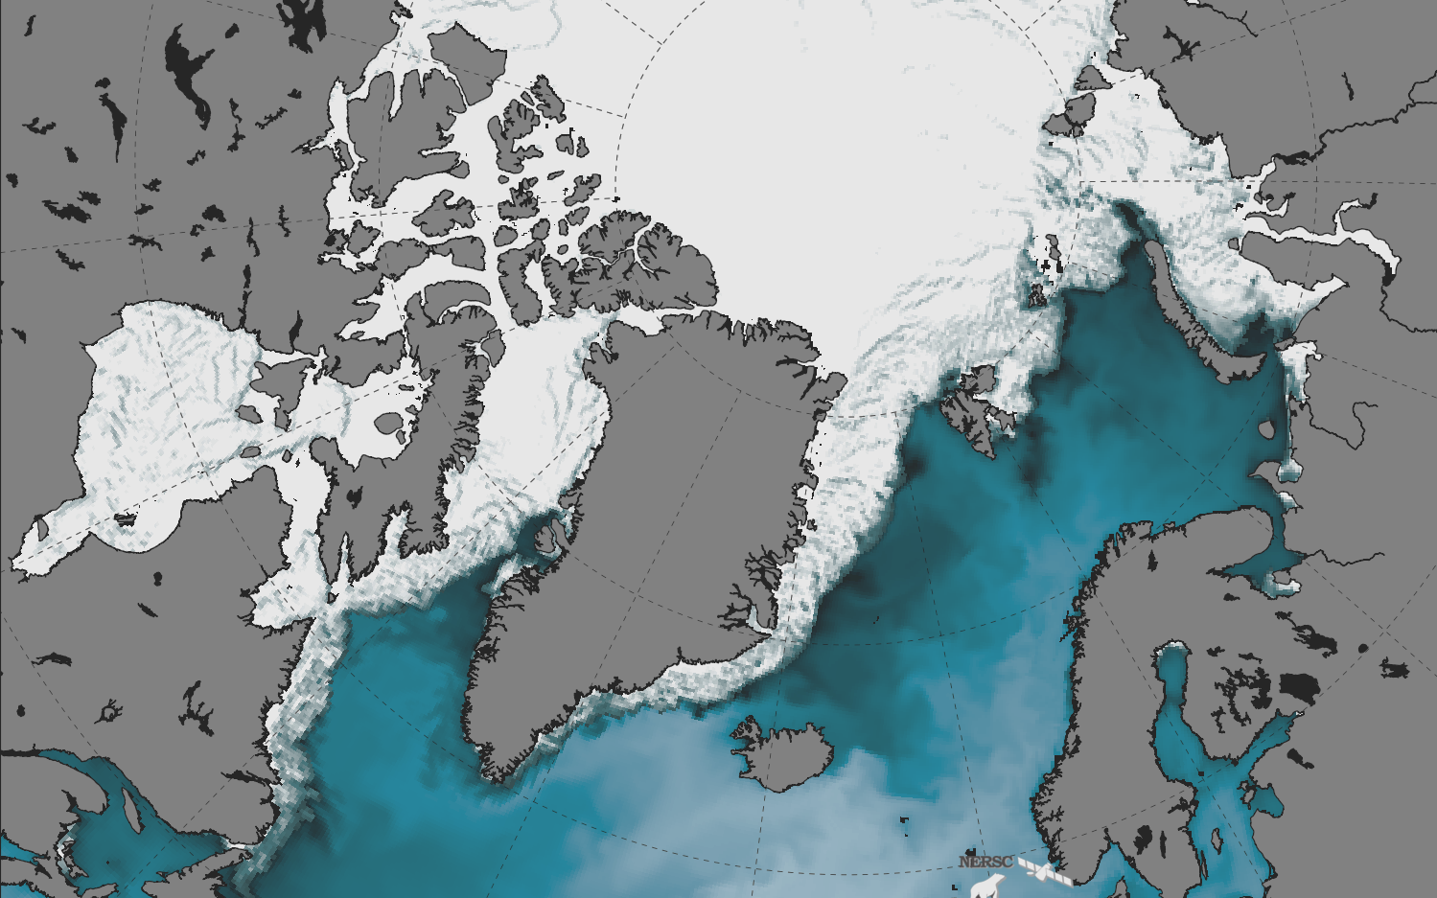
A new coupled model to shed light on sea ice-ocean interactions
EGU 2021
OS 4.4 April 26th
Guillaume Boutin¹, Einar Olason¹, Pierre Rampal², Camille Lique³, Claude Talandier³, Laurent Brodeau⁴
RECORDED PRESENTATION
https://youtu.be/WUTN1XndEqM
1. Nansen Environmental and Remote Sensing Center, Bergen, Norway
2. CNRS, Institut de Géophysique de l'Environnement, Grenoble, France
3. Univ. Brest, CNRS, IRD, Ifremer, Laboratoire d’Océanographie Physique et Spatiale (LOPS), Brest, France
4. OceanNext, Grenoble, France

Slide 2
Overview
I) Introduction
II) The coupled system: how it works
III) Results
IV) Conclusions and perspectives
EGU 2021

Slide 3
Introduction — context and problem
In polar regions, sea ice lives at the interface between the ocean and the atmosphere
Sea ice cover is highly heterogeneous → leads and ridges through which a large part of air-sea exchange takes place → needs to be quantified!
Models struggle to capture the heterogeneity of the sea ice cover, even though it could be key to capture atm-ice-ocean interactions
Breakup event in the Beaufort Sea (Feb. 2013)
EGU 2021

Slide 4
Introduction — context and problem
Snapshot of sea ice deformation
from RGPS dataset (left) and a simulation done with the sea ice model neXtSIM running at 10km resolution with a “classical” VP-based rheology (right).
Sea ice deformation fields of VP-based models (right) look very homogeneous compared to the observation (left)
In particular, Linear Kinematic Features (LKFs) are poorly reproduced if not absent
This low/absence of heterogeneity is likely impacting atm—ice—ocean heat and momentum fluxes
To quantify this impact, we need to reproduce these LKFs realistically in space and time
Total deformation, 1/day
EGU 2021

Slide 5
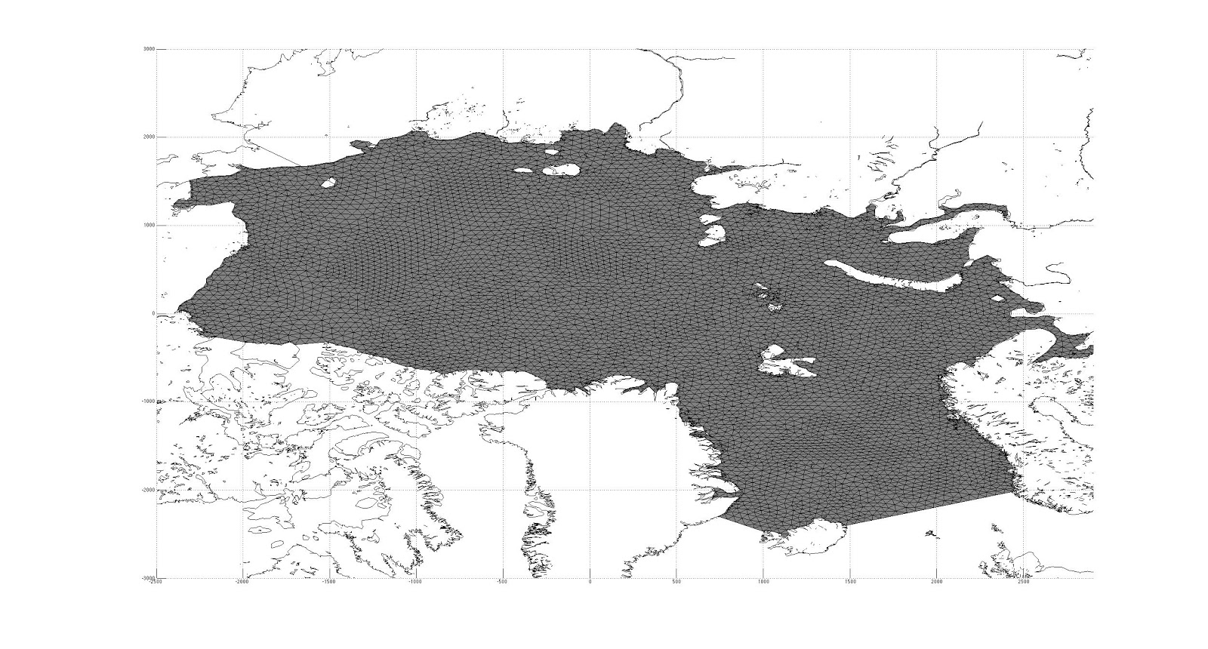
Introduction — context and problem
There are two ways of reproducing the spatial and temporal heterogeneities of sea ice in models:
Increasing spatial resolution to ∼1km to get heterogeneity at 10km scale → very costly
Using a brittle rheology including a “damage propagation” mechanism → very new
We chose the second approach as we:
are excited to try something new
have a sea ice model with “damage propagation” available (it is called neXtSIM)
We want to investigate the impact of sea ice cover heterogenity on the ocean
→ Need coupling to an ocean model
Important note:
neXtSIM uses a Lagrangian moving mesh
Illustration of mesh adaptation during the simulation of a sea ice breakup event near the Kara gate (video)
Adaptive remeshing
Less numerical diffusion
Better localisation
EGU 2021
Credit: P. Rampal

Slide 6
The coupled system
Can we get an ice-ocean coupled model that successfully reproduces sea ice dynamics from the native resolution of the mesh grid to the e.g. Arctic basin scale?
What we started from:
neXtSIM
Main characteristics:
- New brittle rheology (BBM)
- Lagrangian moving mesh
Used to:
Study small-scale sea ice dynamics
Do short term forecasts/yearly runs
Will need to:
Be coupled to an ocean model
Be run over decadal time scales, for a reasonable computation cost
NEMO → CREG025
Main characteristics:
NEMO-OPA v3.6, normally runs with LIM3
Already used many times
Used to:
Study the evolution of ocean properties in the Arctic
Will need to:
Run with neXtSIM
EGU 2021

Slide 7
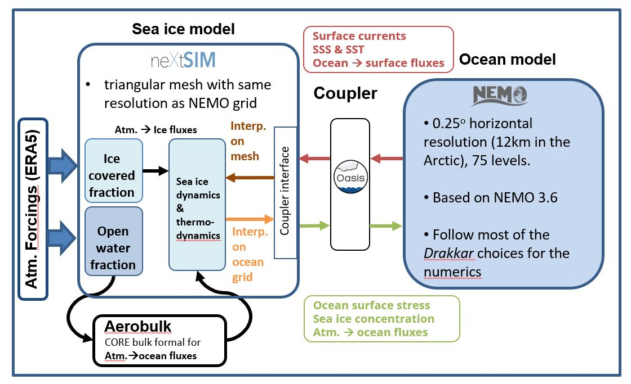
The coupled system
How does it work?
Notes:
All surface boundary conditions are processed by neXtSIM.
Atmosphere→ ocean fluxes over open water are computed using the external library Aerobulk (Brodeau et al., 2016). It contains the same bulk formula parameterizations as NEMO.
Interpolation from mesh to grid (and grid to mesh) is performed every coupling timestep within neXtSIM
OPA
Brodeau, L., B. Barnier, S. Gulev, and C. Woods, 2016: Climatologically significant effects of some approximations in the bulk parameterizations of turbulent air-sea fluxes. J. Phys. Oceanogr., 47 (1), 5–28, 10.1175/JPO-D-16-0169.1.
Schematic of the coupling framework
EGU 2021

Slide 8
Results — Large-scale properties
Note: the simulation starts in 1995 and stop end of 2016
Top: Evolution of sea ice volume in the coupled model, PIOMAS, and CS2-SMOS observations
Bottom: 2011-2016 winter climatology of sea ice volume for the coupled model, PIOMAS and CS2-SMOS observations
Sea ice volume and thickness pattern are all very well reproduced (as well as extent and drift)
Fancy NEMO plotting library: L. Brodeau
https://github.com/brodeau
Evolution of sea ice concentration superimposed on SST (video)
EGU 2021

Slide 9
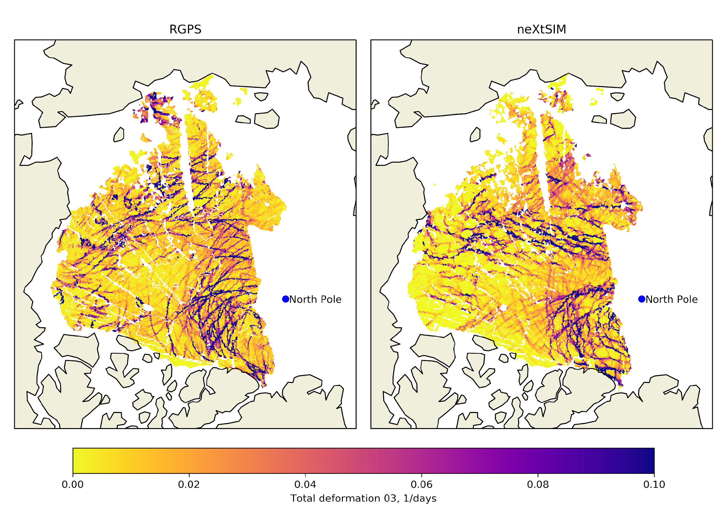
Results — fine-scale dynamics
Snapshot of sea ice deformation from RGPS (left) and MODEL simulation (right) for April 15, 2007
MODEL
Measurable properties of simulated LKFs are very similar to observations
Reminder:
Viscous-Plastic rheologies (as used in LIM3) do not reproduce such features, at least not at these resolutions.
EGU 2021

Slide 10
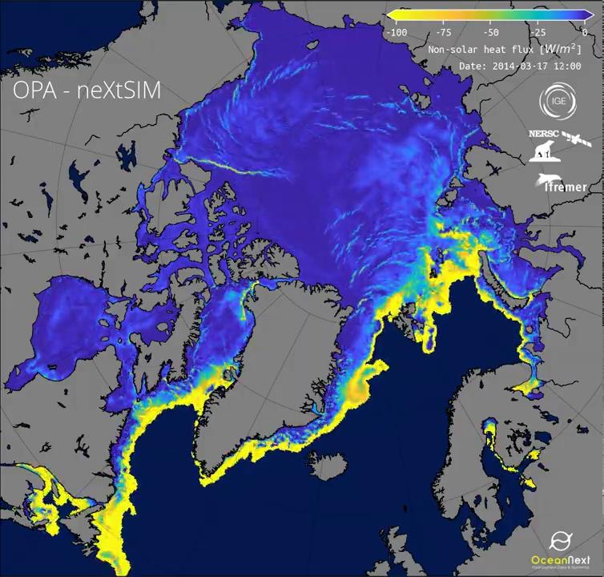
Conclusions and perspectives
We developed a new Lagrangian ice- Eulerian ocean coupled modelling framework
It is shown successful at reproducing large-scale sea ice patterns and fine-scale sea ice dynamics at the same time.
Observed LKFs are well reproduced when running the coupled model at 12km horizontal resolution → no need for 1000s of cores.
Ongoing and future works:
Arctic sea ice mass balance (1995-2016) — How much ice grows in the leads?
Arctic sea ice age evolution (1995-2016) — What is responsible of the multiyear sea ice cover decline?
Evaluate the impact of surface heterogeneity on the ocean (MEDLEY project)→ impact on MLD, heat/salt content…
EGU 2021

