Slide 1
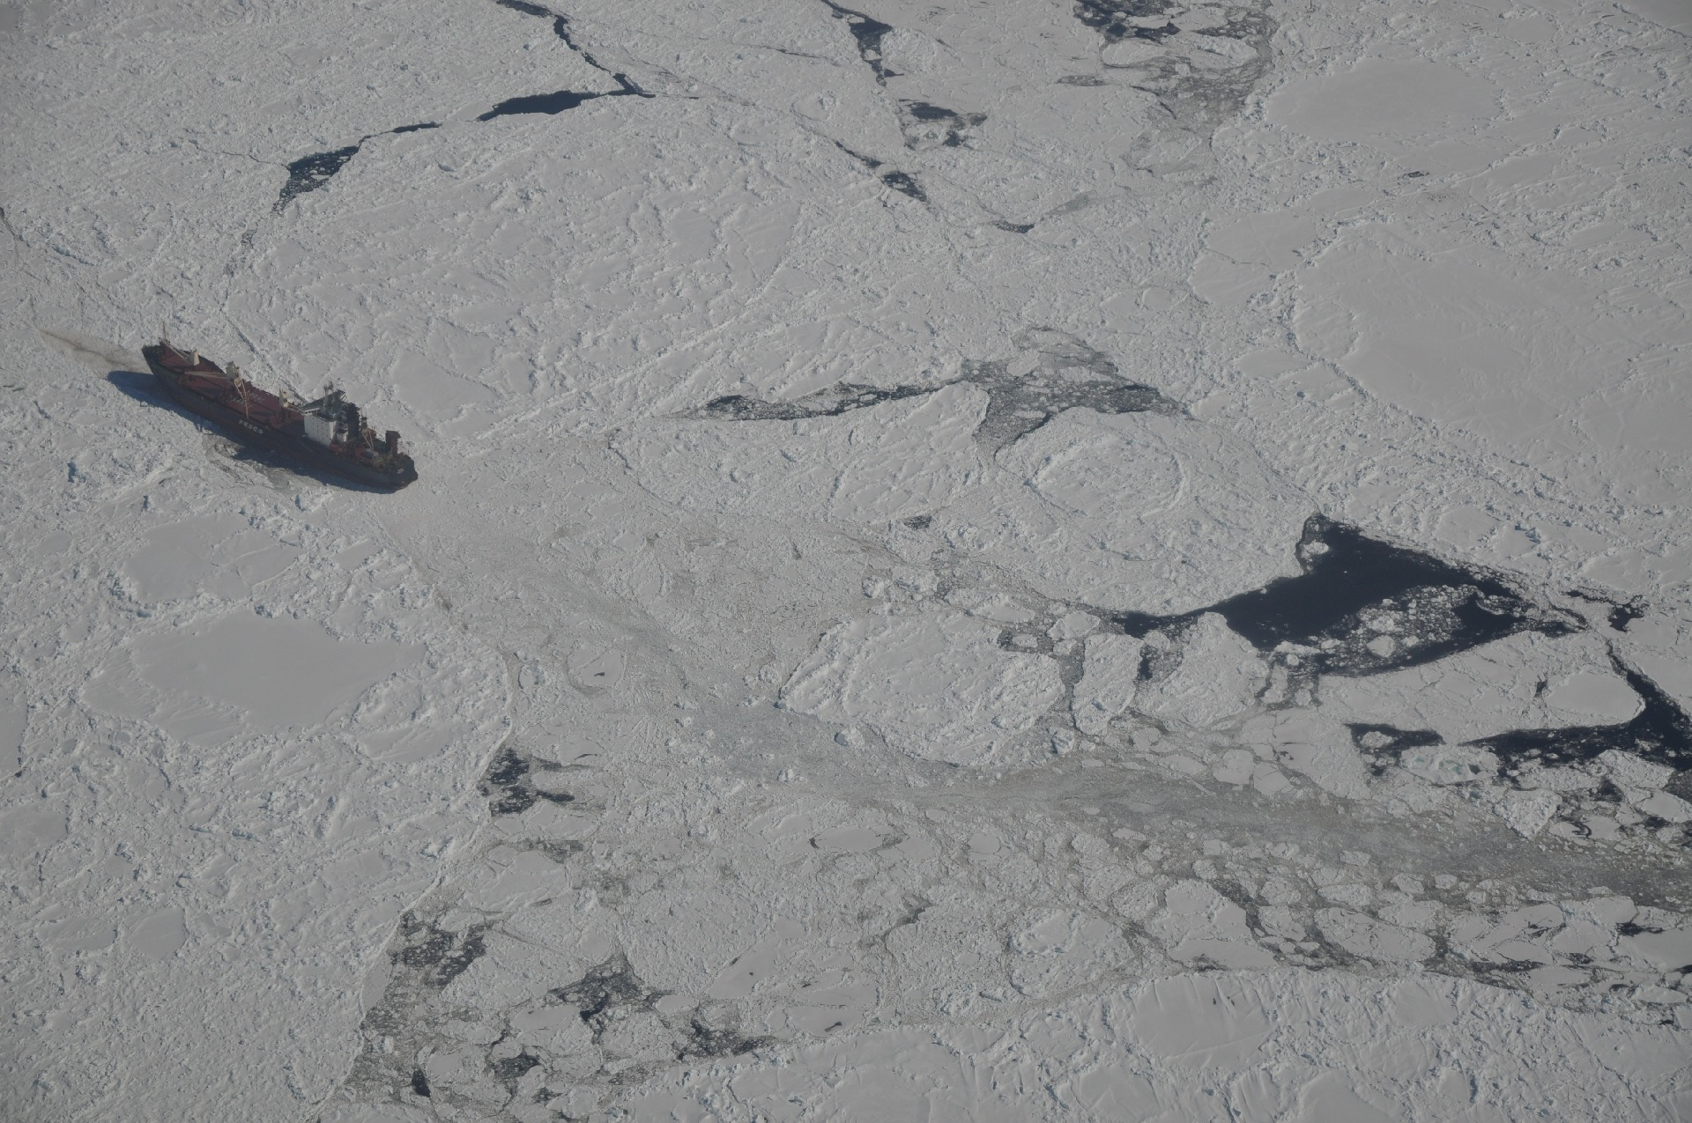


Validation of atmospheric reanalyses over the Weddell Sea, Antarctica,
using observations from drifting buoys
John C. King, Gareth Marshall, Steve Colwell, Clare Allen-Sader and Tony Phillips
British Antarctic Survey,
Cambridge, UK

Slide 2
Introduction
Atmospheric reanalyses are frequently used to drive ocean-ice models
Few data are available to validate analyses over sea ice in the polar regions
We have examined the performance of the ERA-Interim and ERA5 reanalyses from the European Centre for Medium-Range Weather Forecasts (ECMWF) over the Weddell Sea pack ice using meteorological data from three drifting buoys that were deployed in January 2016 as part of the Filchner Ice Shelf System project.

Slide 3
The ECMWF atmospheric reanalyses
 | ERA Interim | ERA5
Year released | 2006 | 2016
Horizontal resolution | ~ 80 km | ~ 30 km
Temporal resolution | 6 hours | 1 hour
Vertical levels | 60 | 137
Model top | 0.1 hPa | 0.01 hPa
Reference | Dee et al., 2011 | Hersbach et al., 2020
ERA5 model has improved dynamics and physics compared to ERA Interim
Both models use the OSTIA product (Donlon et al., 2012) to specify sea ice concentration (updated daily)
Both models assume a uniform sea ice thickness of 1.5 m, with no snow cover

Slide 4
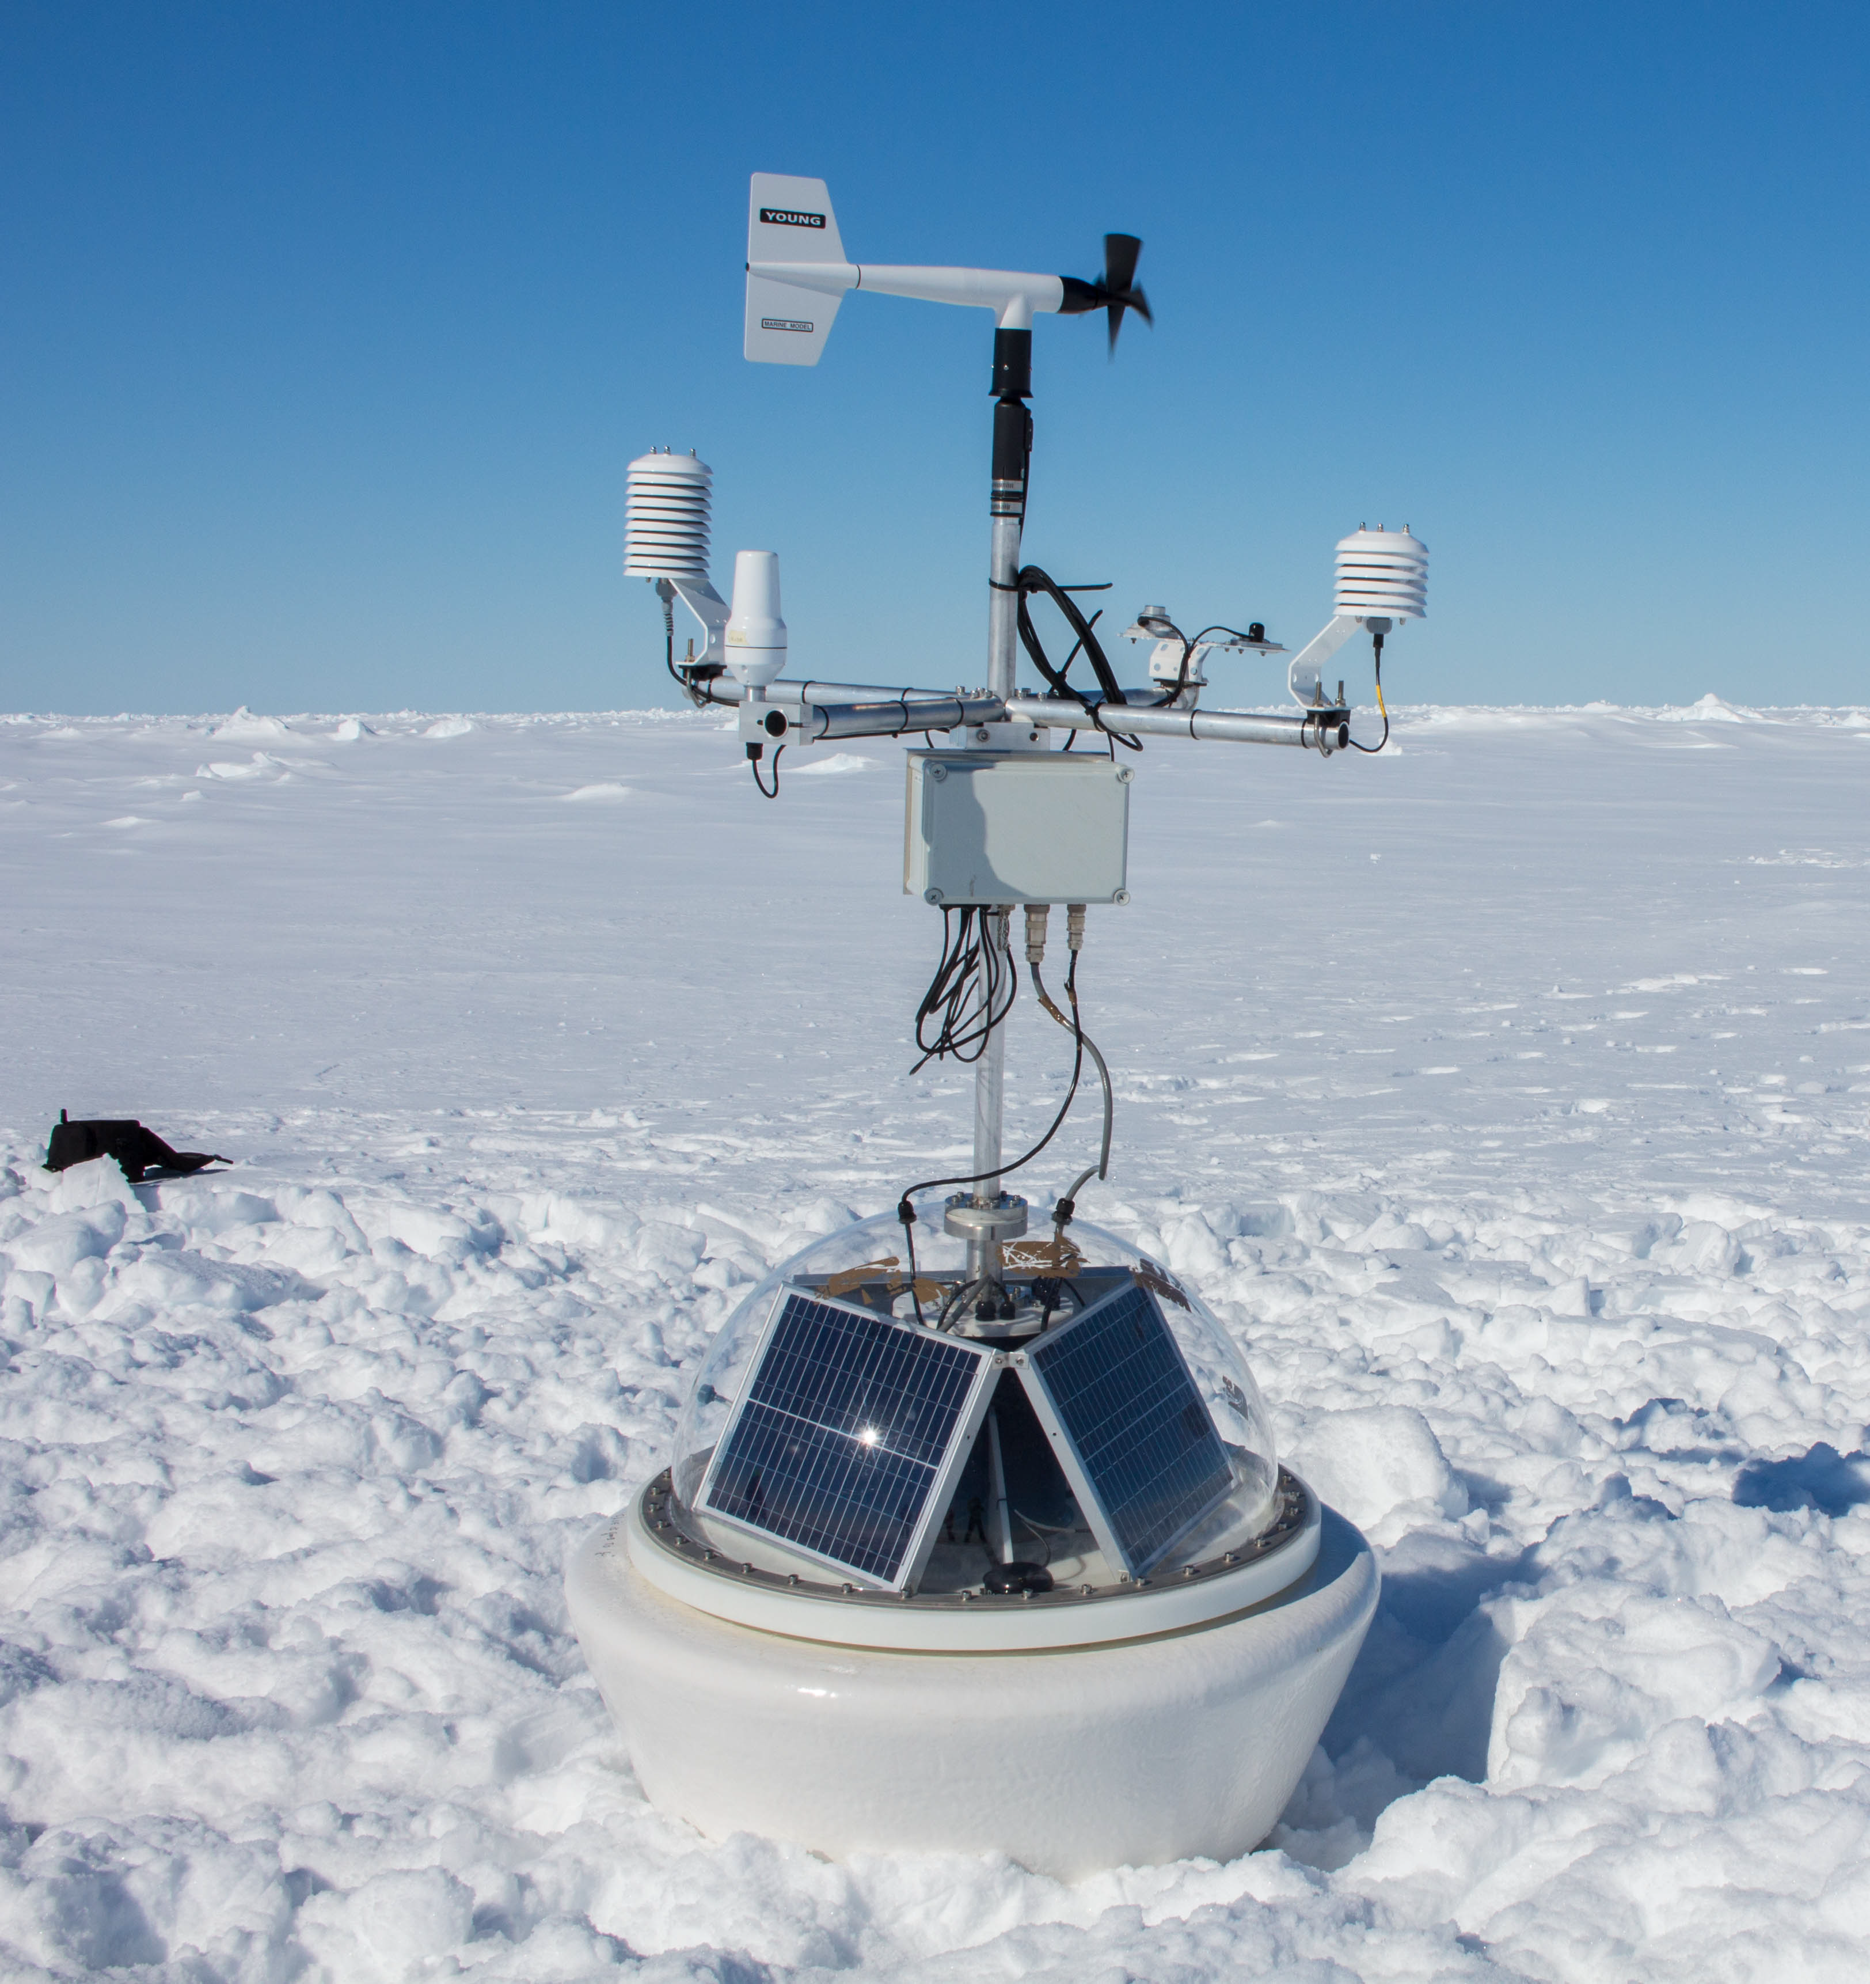
Drifting buoys
Three buoys were deployed in Weddell Sea ice by the Alfred Wegener Institute, January 2016
Buoys measured atmospheric pressure, air temperature, relative humidity, downwelling short- and longwave radiation, wind speed, relative wind direction and buoy orientation.
Measurements made at 1-hour intervals, transmitted via Iridium
Buoy location was determined by GPS
Buoy data were NOT made available on the GTS and are thus an independent source of data for validating reanalyses
Data available from www.meereisportal.de

Slide 5
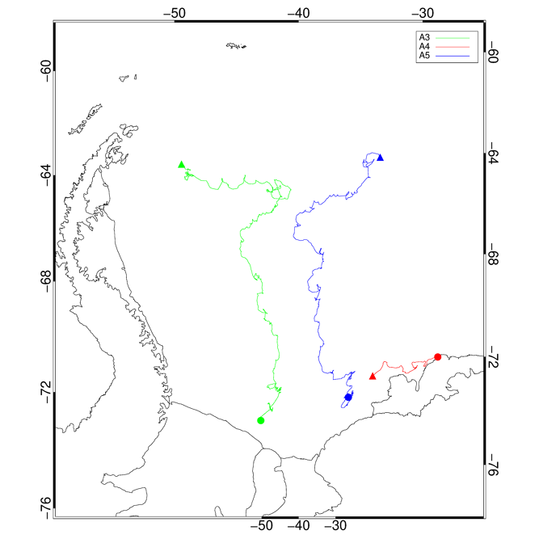
Drifting buoys
 | Buoy number
 | A3 | A4 | A5
Start date | 15 January 2016 | 27 January 2016 | 25 January 2016
End date | 1 March 2017 | 1 February 2017 | 2 November 2016
Start location ( ) | 76.53 °S, 47.04 °W | 72.80 °S, 19.34 °W | 75.47 °S, 31.39 °W
End location ( ) | 65.17 °S, 51.74 °W | 74.42 °S, 28.12 °W | 65.16 °S, 31.80 °W
Ice type at deployment | Multi-year ice | Fast ice | First-year ice
Ice thickness at deployment (m) | 2.32 | 3.3 | 1.44
Snow thickness at deployment (m) | 0.25 | 0.32 | 0.39

Slide 6
Data processing and quality control
Periods when no GPS signals were received were removed from the data
Wind data were removed if the measured wind speed dropped to zero for an extended period of time (indicative of anemometer icing)
Relative wind direction was converted to true wind direction using the buoy heading (measured by magnetic compass, corrected for magnetic variation using the International Geomagnetic Reference Field, www.ngdc.noaa.gov/IAGA/vmod/igrf.html)
Measured relative humidity was corrected according to Anderson (1994) before being converted to mixing ratio for comparison with the reanalyses.
Wind speed (measured at ~ 2m) was corrected to 10 m for comparison with the reanalyses, assuming neutral stratification and a roughness length of 10 mm.

Slide 7
Validation of reanalyses
6-hourly data were extracted from both reanalyses and were interpolated to the corresponding buoy locations.
Variables validated:
  Surface pressure
  2 m air temperature
  2 m mixing ratio (ERA-Interim only)
  10 m wind speed
  10 m u and v wind components (not for A3 – compass not working)

Slide 8
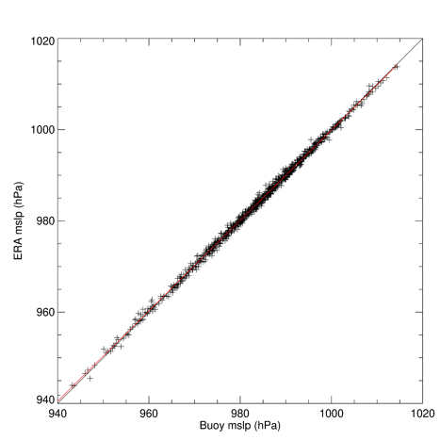
Validation – surface pressure
Buoy A5
1:1
Regression
 | ERA-Interim | ERA5
Mean (hPa) | 983.95 | 984.22
Bias (hPa) | 0.08 | 0.36
Correlation coefficient | 0.999 | 0.999
Very high correlation
Very small bias
Little difference between ERA-Interim/ERA5
Similar results for all three buoys

Slide 9
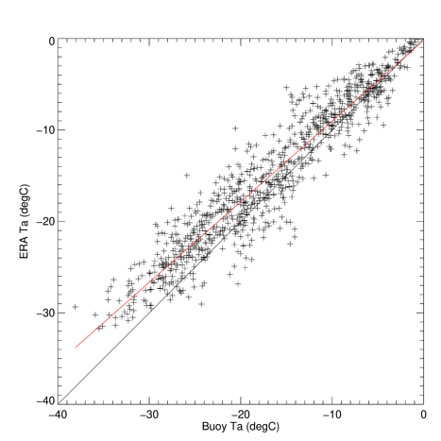
Validation – 2m air temperature
Buoy A5
1:1
Regression
 | ERA-Interim | ERA5
Mean (°C) | -14.73 | -15.20
Bias (°C) | 1.73 | 1.26
Correlation coefficient | 0.952 | 0.954
High correlation
Warm bias in both reanalyses (ERA5 slightly better)
Bias increases with falling temperature
Similar results for all three buoys

Slide 10
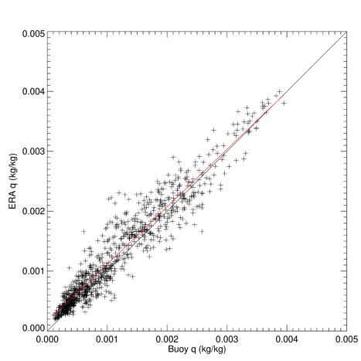
Validation – 2m mixing ratio
Buoy A5
1:1
Regression
 | ERA-Interim | ERA5
Mean (g/kg) | 1.26 | -
Bias (g/kg) | 0.11 | -
Correlation coefficient | 0.957 | -
High correlation
Low bias
Similar results for all three buoys

Slide 11
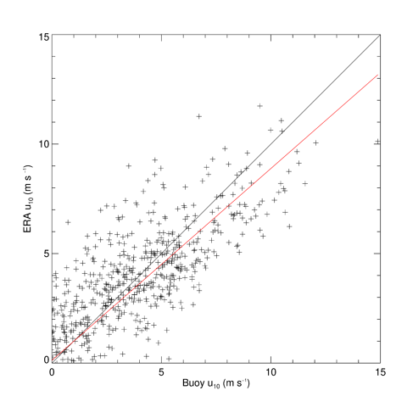
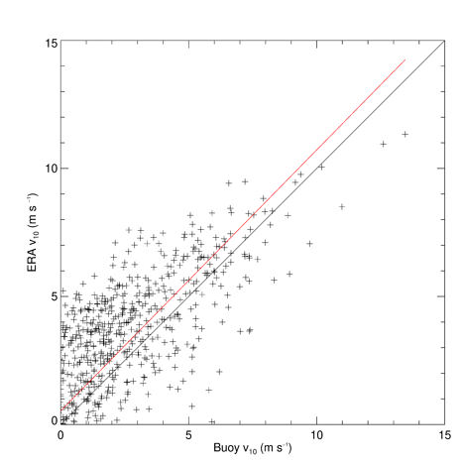
Validation – 10m wind components
Buoy A5
1:1
Regression
U₁₀ | ERA-Interim | ERA5
Mean (m s⁻¹) | 1.32 | 1.30
Bias (m s⁻¹) | -0.05 | -0.07
Correlation coefficient | 0.903 | 0.928
u
V₁₀ | ERA-Interim | ERA5
Mean (m s⁻¹) | 1.44 | 1.44
Bias (m s⁻¹) | 0.55 | 0.55
Correlation coefficient | 0.872 | 0.871
Larger scatter than for other variables
Reanalyses slightly better for u than for v
Similar results for both reanalyses
Similar results for all three buoys
v

Slide 12
Validation – Summary
Very little difference between the performance of ERA-Interim and ERA5, despite the improved resolution of the latter
Pressure: Very low bias, very high correlation
Temperature: Reanalyses have a warm bias, ranging from around 0 °C at 0 °C to around +3 °C at -30 °C Similar biases were found over the Weddell Sea by Jonassen et al (2019), and over Arctic sea ice ( Batrak and Müller 2019, Wang et al., 2019)
Mixing ratio: Low bias, High correlation
10m wind components: Small bias, but rather scattered. Reanalyses are slightly better at simulating the u-component
Overall, the reanalyses are doing a pretty good job of reproducing the observed conditions, but the significant temperature biases are a concern, and these have not improved from ERA-Interim to ERA5

Slide 13
Why are the reanalyses biased warm?
Sea level
Reanalyses lack the insulating snow layer
Central Weddell Sea ice is often thicker than the 1.5 m uniform thickness used in the reanalyses
OSTIA sea ice product may not always represent ice concentration realistically in this region
Possible deficiencies in model physics (clouds, turbulent mixing) BUT a similar bias is found in both ERA-interim and ERA5, which use different physics schemes.
1 m
A3
A4
A5
ERA
Snow
Ice

Slide 14
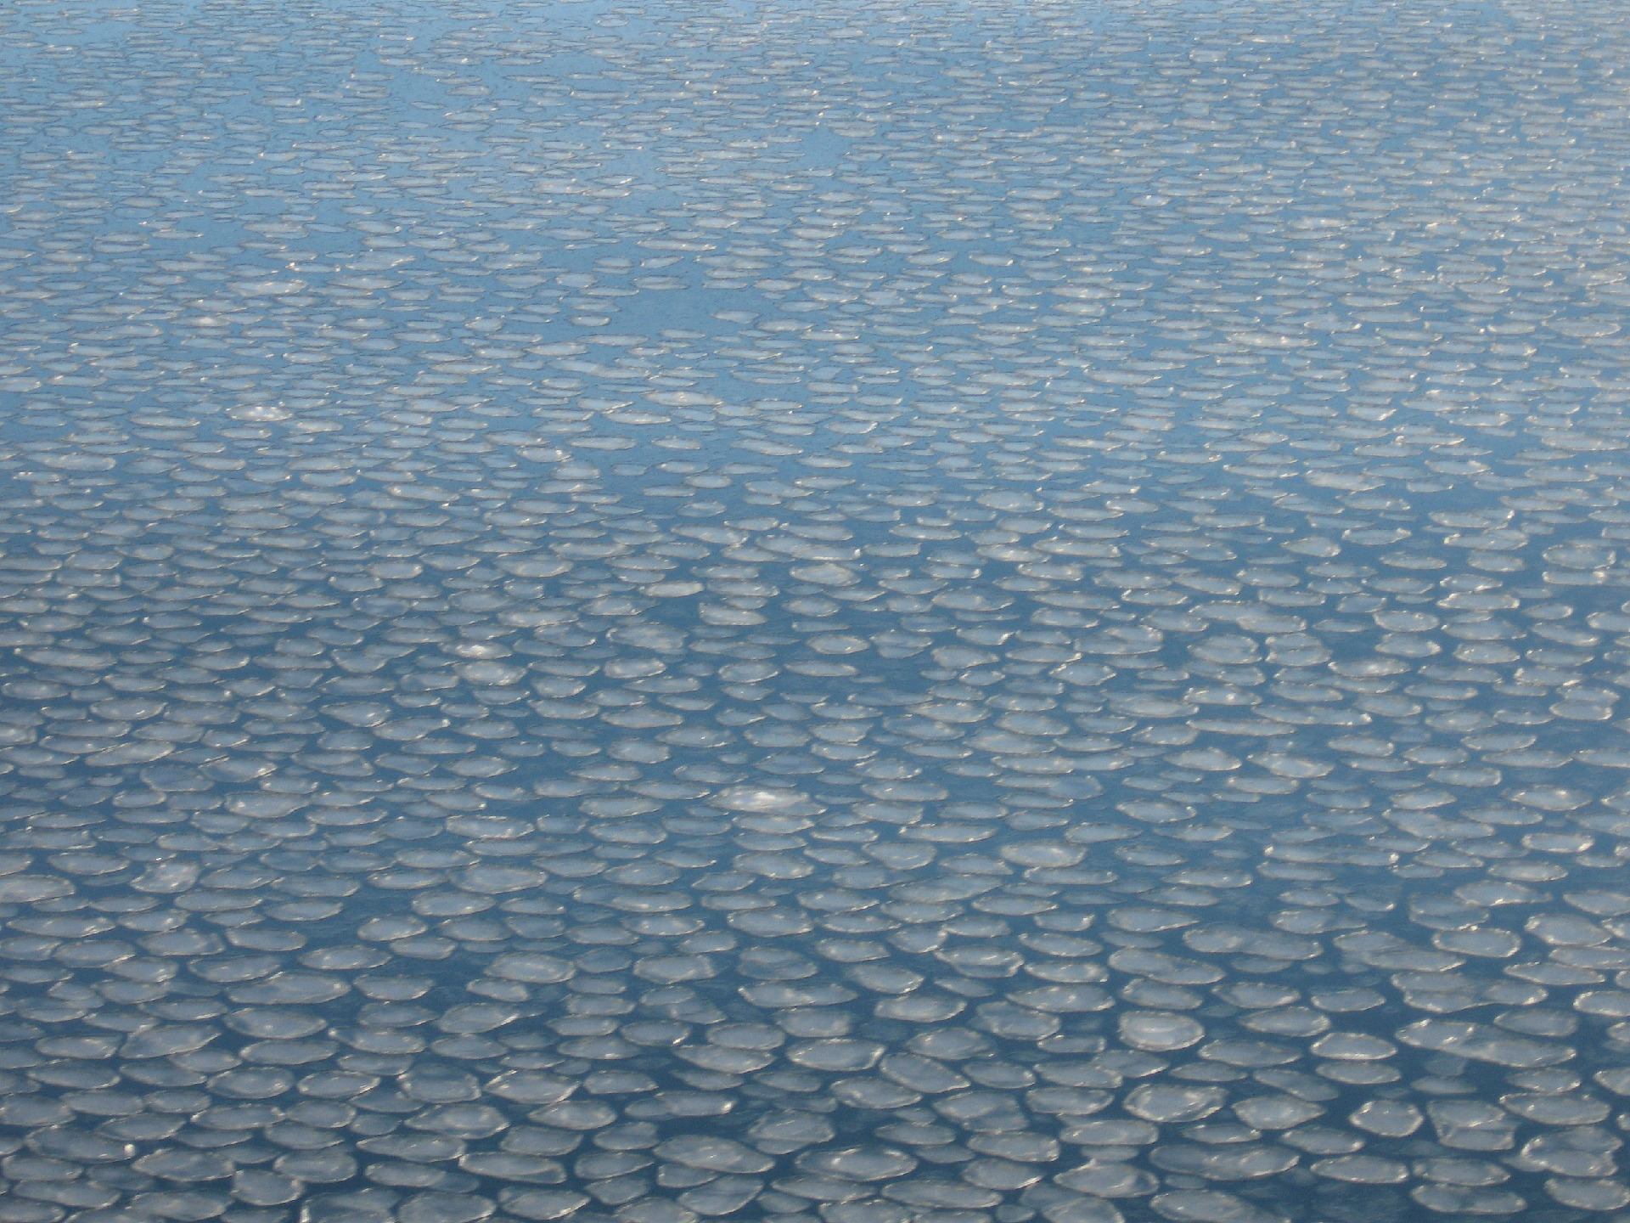

Conclusions and recommendations
ERA-Interim and ERA5 both provide a reasonably good representation of near-surface meteorology over the Weddell Sea
Both models exhibit similar warm biases in near-surface air temperature. These biases probably result from the simplified representation of sea ice in the models.
The impact of these biases needs to be considered when using the reanalyses to drive ice-ocean models
A more sophisticated representation of sea ice (and of its snow cover) should be used in future reanalyses
Any questions?
John King
jcki@bas.ac.uk

Slide 15
References
Anderson, P. S. (1994). "A method for rescaling humidity sensors at temperatures well below freezing." Journal of Atmospheric and Oceanic Technology 11: 1388-1391.
Batrak, Y. and M. Müller (2019). "On the warm bias in atmospheric reanalyses induced by the missing snow over Arctic sea-ice." Nature Communications 10(1): 4170.
Dee, D. P., et al. (2011). "The ERA-Interim reanalysis: configuration and performance of the data assimilation system." Quarterly Journal of the Royal Meteorological Society 137(656): 553-597.
Donlon, C. J., et al. (2012). "The Operational Sea Surface Temperature and Sea Ice Analysis (OSTIA) system." Remote Sensing of Environment 116: 140-158.
Hersbach, H., et al. (2020). "The ERA5 global reanalysis." Quarterly Journal of the Royal Meteorological Society 146(730): 1999-2049.
Jonassen, M. O., et al. (2019). "Assessment of Atmospheric Reanalyses With Independent Observations in the Weddell Sea, the Antarctic." Journal of Geophysical Research - Atmospheres 124(23): 12468-12484.
Wang, C., et al. (2019). "Comparison of ERA5 and ERA-Interim near-surface air temperature, snowfall and precipitation over Arctic sea ice: effects on sea ice thermodynamics and evolution." The Cryosphere 13(6): 1661-1679.
Back to last slide viewed

