Slide 1

EGU21-10132 vPICO presentations
Increased wildfire frequency initiated by marine organic carbon burial at the Frasnian–Famennian boundary
Man Lu¹*, Takehito Ikejiri¹, Yongge Sun², Richard Carroll³, Yuehan Lu¹
* mlu8@crimson.ua.edu
¹ Molecular Eco-Geochemistry Laboratory, Department of Geological Sciences, University of Alabama, USA
² Environmental and Biogeochemical Institute , School of Earth Science, Zhejiang University, China
³ Energy Investigation Program, Geological Survey of Alabama, USA

Slide 2
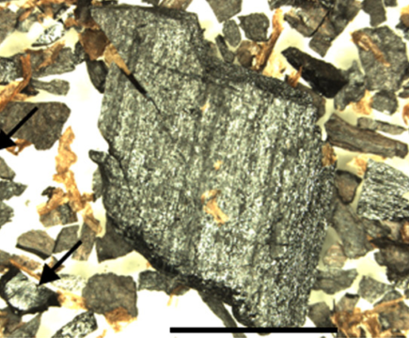


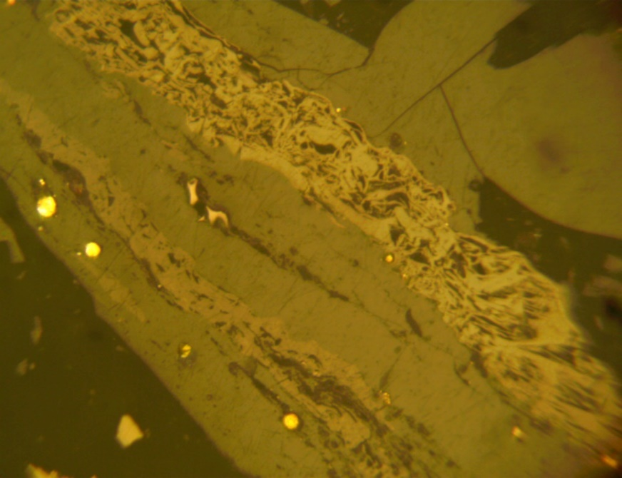
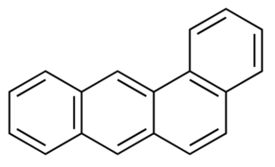
Wildfire indicators
Charcoals and inertinite
Polycyclic aromatic hydrocarbons (PAHs)
Modern
(Scott, 2010)
Pyrene
Pennsylvanian
Vitrinite
Inertinite
Coronene
Benz(a)anthracene
(Lu et al in prep)

Slide 3
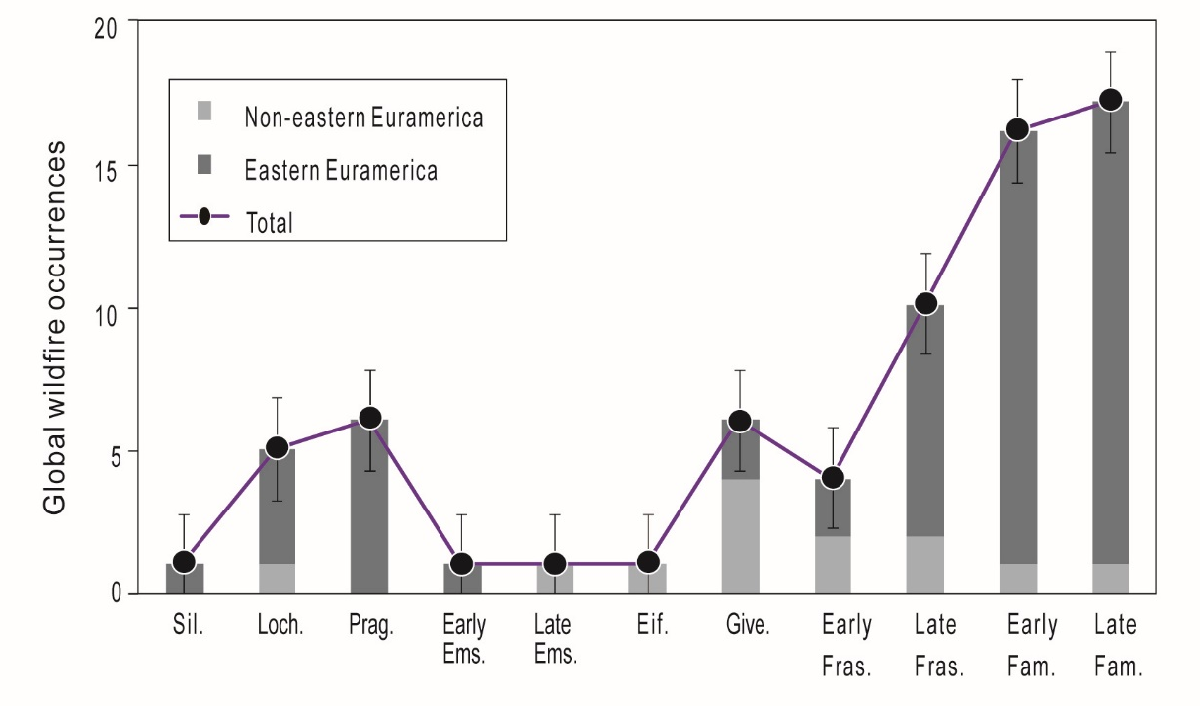
Wildfire record
Frasnian–Famennian (F–F)
(Lu et al., 2021-Palaeo-3)

Slide 4
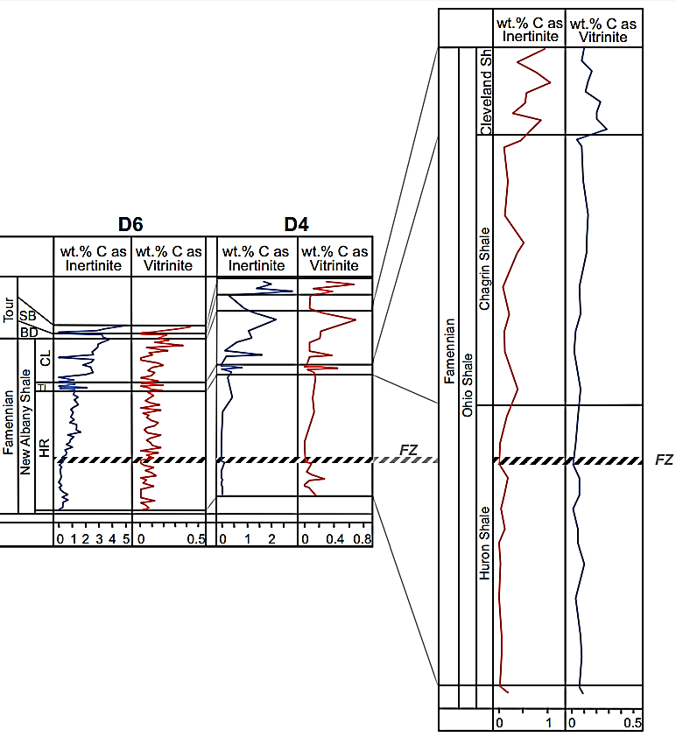
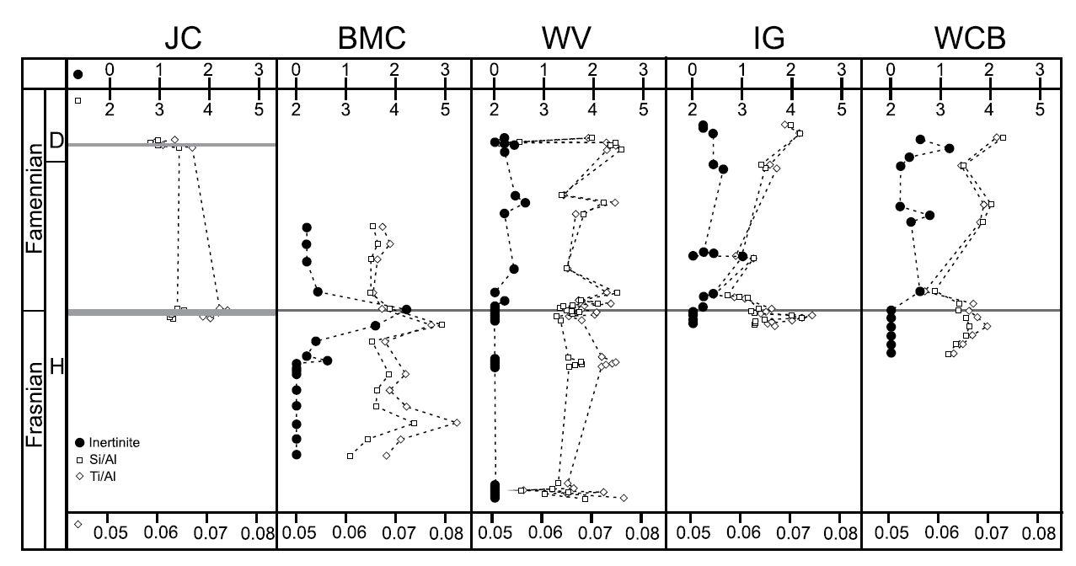
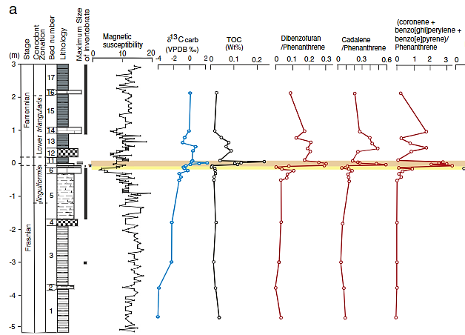
Previous studies
Rimmer et al., 2015
Kaiho et al., 2013
Liu et al., 2020
Ohio
New York
Sinsin section, Belgium:
Kentucky
Organic rich black shales and/or limestones were deposited in shallow marine environment.
The occurrences of fossil charcoals and/or PAHs in marine rocks can provide a continuous record of wildfire.
A continuous high-solution temporal change of wildfire frequency across the F‒F boundary needs to be investigated.

Slide 5
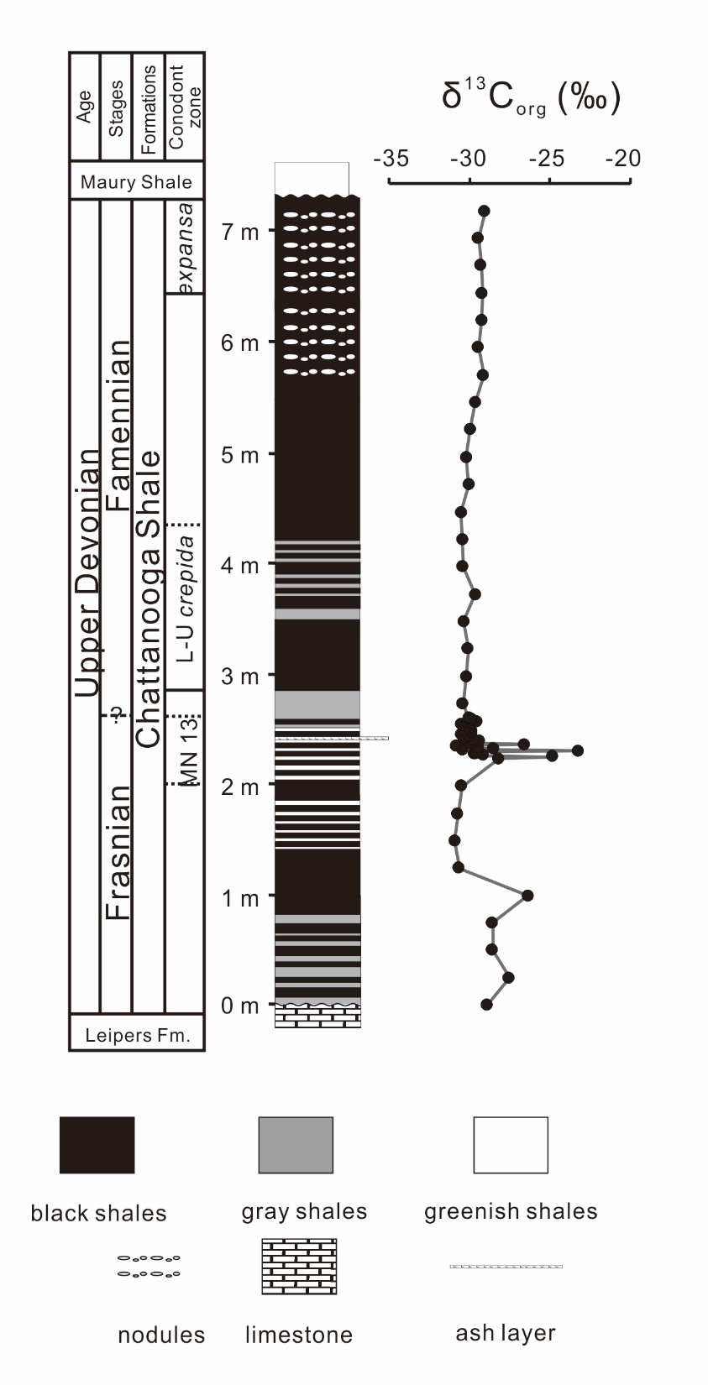
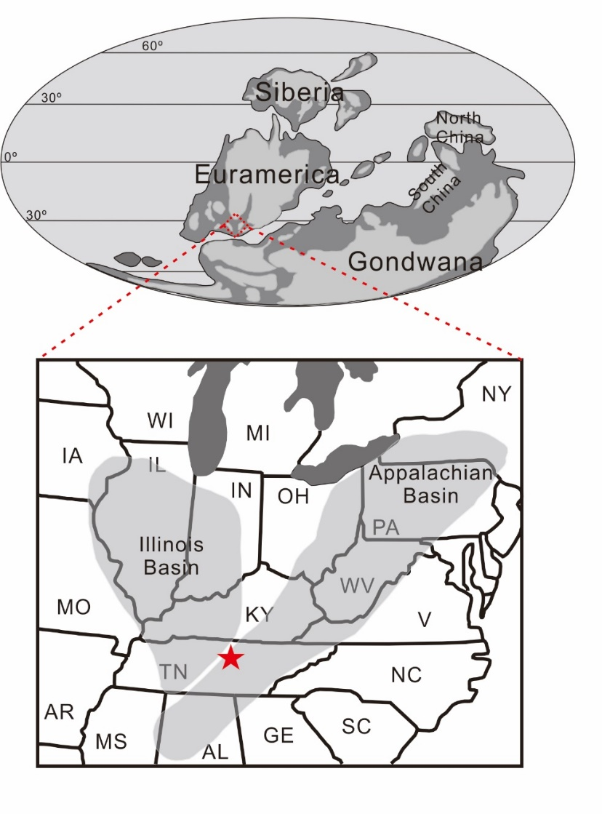
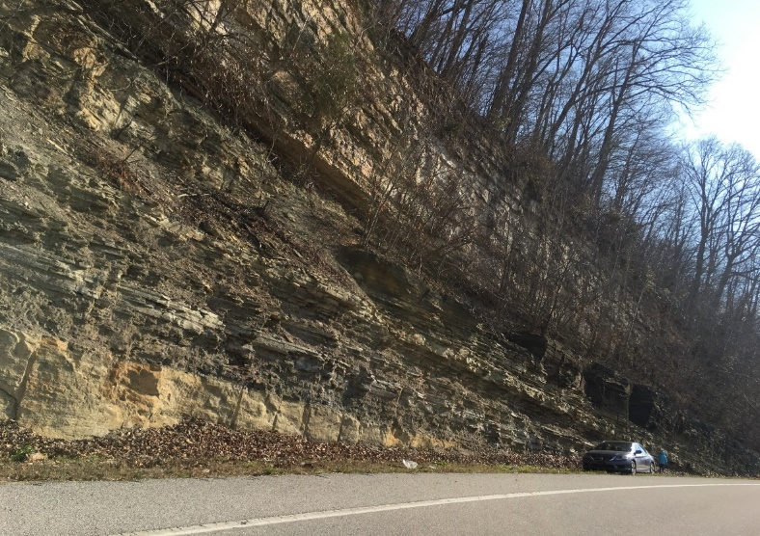
Study site
Upper Devonian Chattanooga Shale from Tennessee
F-F
(Lu et al. in prep; modified from Golonka, 2020)
(modified from Lu et al. 2021-EPSL)

Slide 6
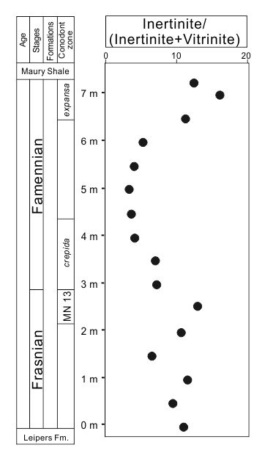
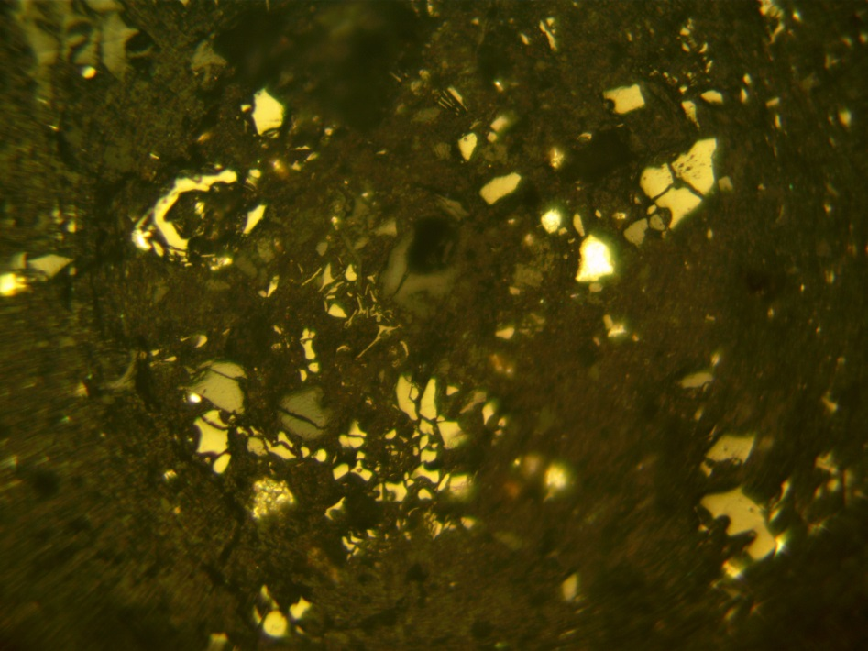
Results: fossil charcoals
Vitrinite
Inertinite
Inertinite abundances show increased fire frequency after the F–F boundary.

Slide 7
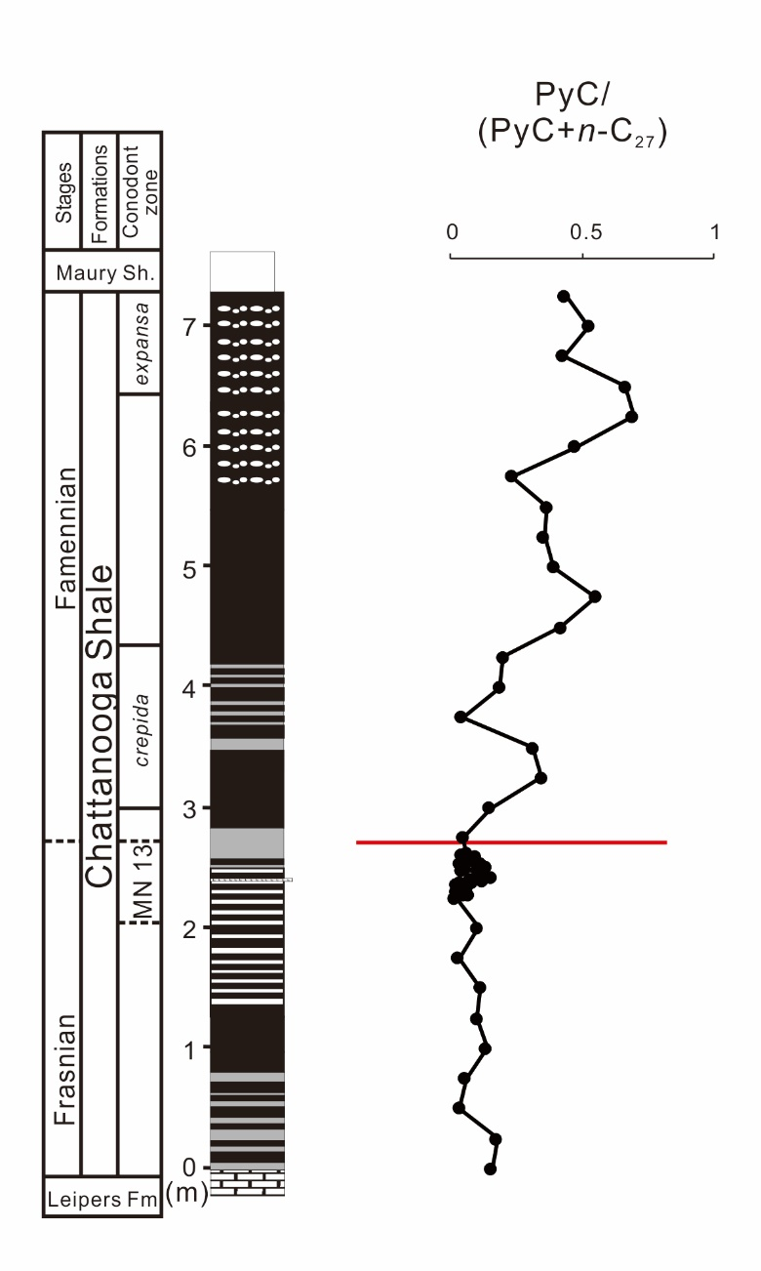
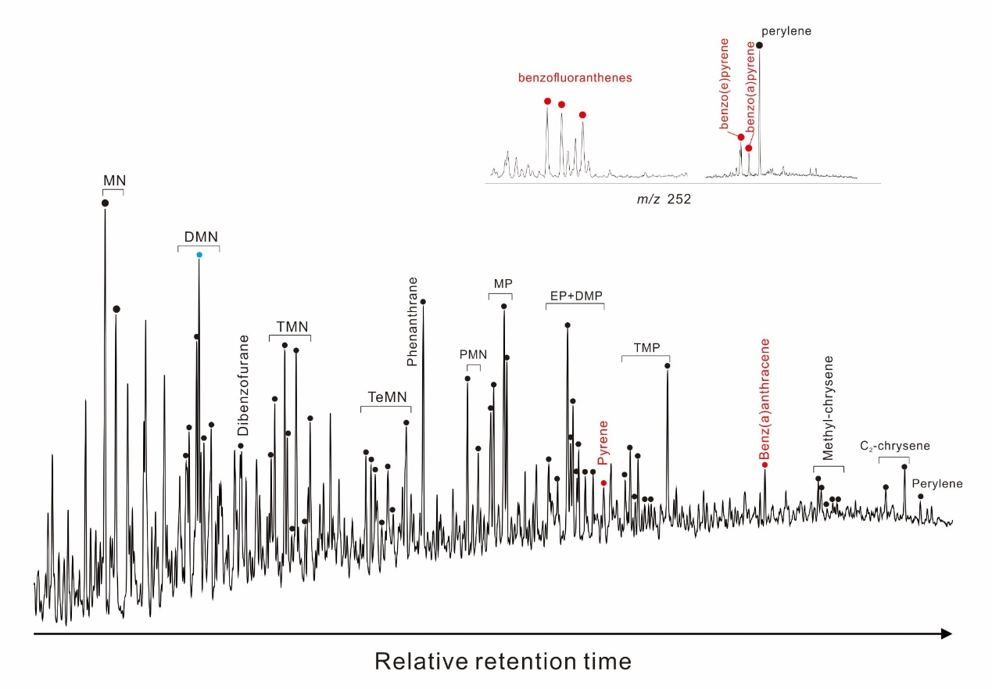
Results: PAHs
Pyrogenic PAHs (PyC) concentrations show increased fire frequency after the F–F boundary.
PyC: pyrogenic PAHs
n-C₂₇: C₂₇ normal alkane

Slide 8

Organic carbon burial: carbon isotope model
Kump and Arthur, 1999:
Unknown
$$\frac{dδc}{dt}=(Fi\left(δi−δc\right)+Fo△D)/M$$
Synthesizing δc of Late Devonian rocks: Chen et al., 2005; Buggisch and Joachimski, 2006; Kaiser et al., 2008; Xu et al., 2012; George et al., 2014; Girard et al., 2017 Buggisch and Joachimski, 2006; Zhang et al., 2019
Assigning age to each carbon isotope data point: absolute ages are calculated by using the biostratigraphic zonation given by the authors and by the absolute ages given for the biozone boundaries (Becker et al., 2016)
Fi: input carbon flux delivered from continental weathering and volcanic emission
δi: carbon isotope composition of Fi
Fc: incoming flux of carbon into sedimentary carbonate reservoir
Fo: incoming flux of carbon into the sedimentary organic matter reservoir
δc: carbon isotope composition of Fc
δo: carbon isotope composition of Fo
Fi: 60*10¹⁹ gC/Myr
δi=-5 ‰
Mo: 45.6*10¹⁸ gC
△D: 30 ‰

Slide 9
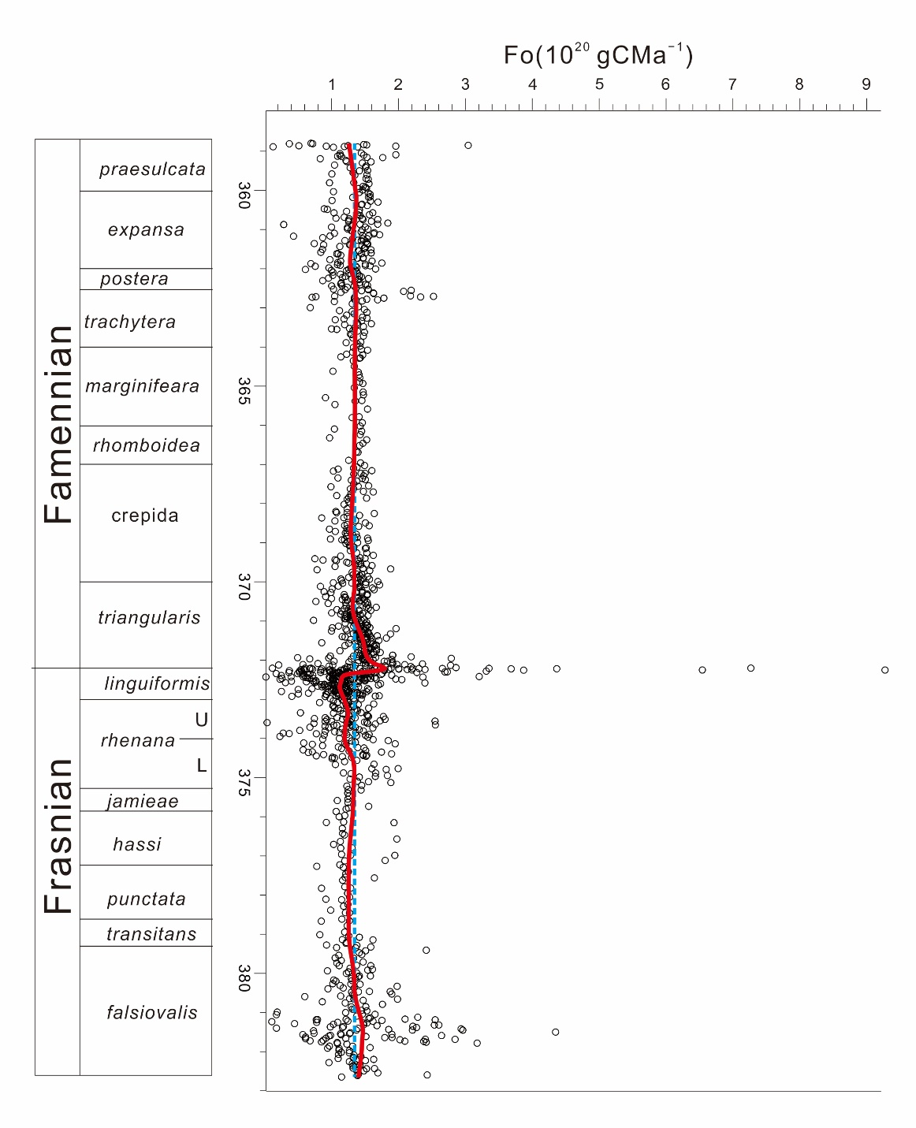
Results: organic carbon burial
Enhanced organic carbon burial at the F‒F boundary may initiate the rise of the wildfire frequency during the Famennian.
F-F

Slide 10
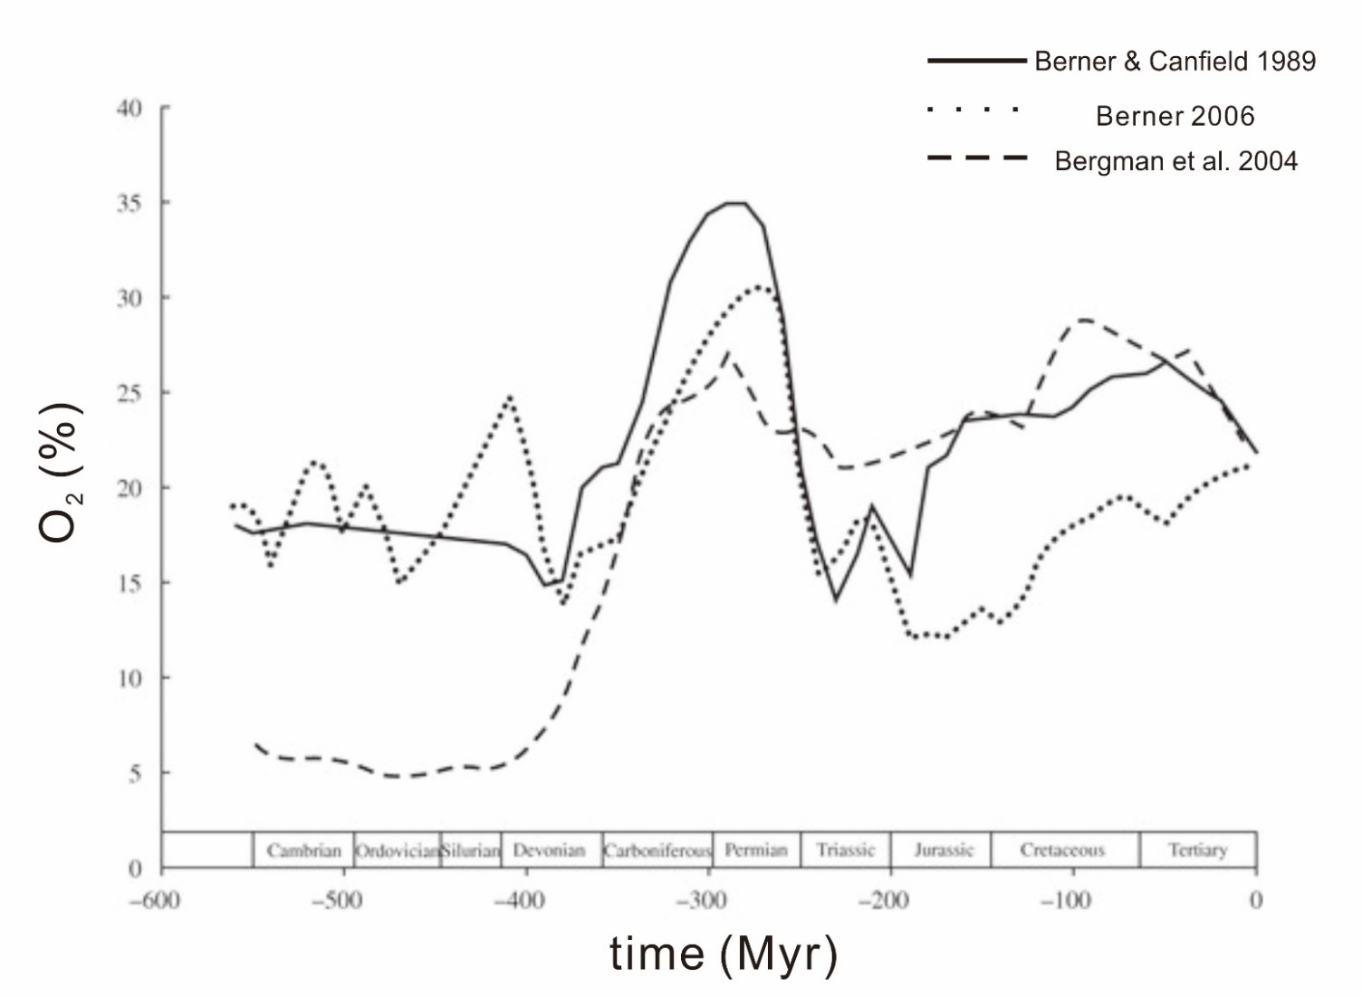
Discussions: atmospheric O2
Organic carbon burial
O₂ removed during respiration and decay of organic carbon
O₂ in atmosphere
wildfire

Slide 11
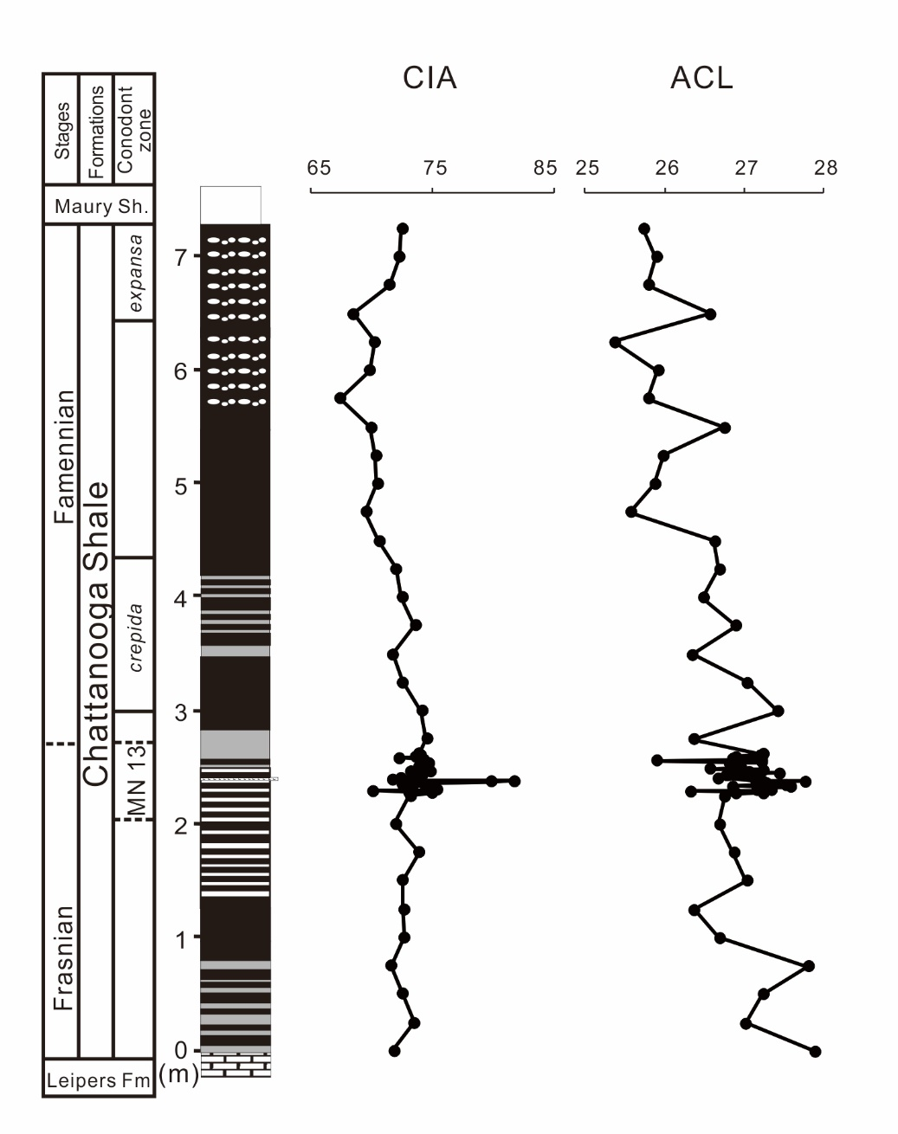
Discussions: drying climate
Enhanced organic carbon burial
Decreased CO₂ in the atmosphere, lower temperature
Less water vapor in the atmosphere
Increased
aridity
F-F
Drying climate
Increased frequency of wildfire
CIA: chemical index of alteration
ACL: average chain length of plant waxes

Slide 12
Conclusions
Wildfire frequency increased after the F–F boundary.
The increased wildfire frequency is linked to the organic carbon burial at the F–F boundary.
Rising organic carbon burial can lead to higher atmospheric O₂ and a drier climate during the Famennian, both of which may have intensified wildfire.

Slide 13
Acknowledgements
American Chemical Society Petroleum Research Fund PRF#61366-ND2
NSF EAR 1255724
GCGAS Student Grant
Hook’s Research Fund
Johnson Travelling Fund
Graduate School Research and Travel Fund
Newton/Winefordner Scholarship

